Slide 1

VIA BUS SEP, ICT ENGINEERING
Krystof Spiller, Cristian Cuibaru,
Denis Durovic, Ovidiu Muresan
Notes:
Hi. Within the following 20 minutes we, as a group, would like to present you our project, mainly the process of creating it.

Slide 2
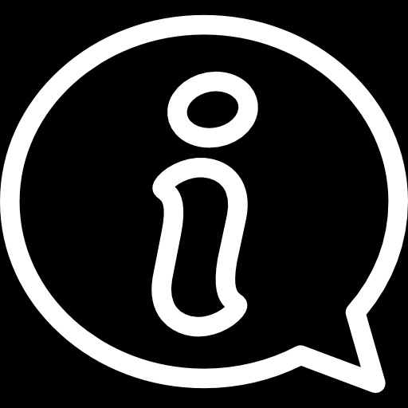
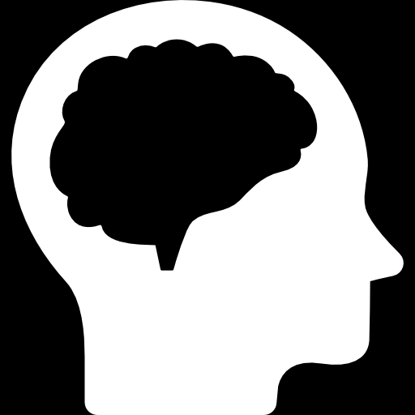
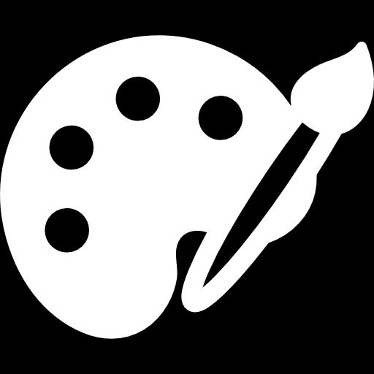
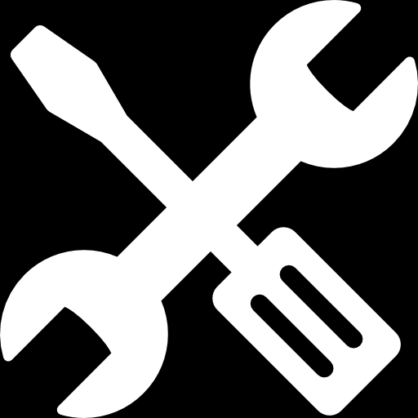
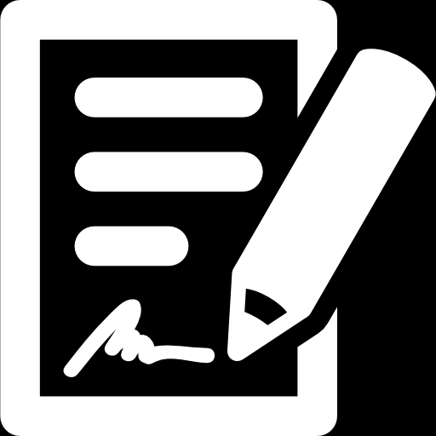
Introduction
Analysis
Design
Implementation
Documentation
Notes:
First we will start with a short introduction, Ovidiu is going to talk about Analysis, Cristian about Design, me about Implementation and finally Denis about Documentation.

Slide 3

The project focus is to make a program that allows employee to manage company’s data.
Introduction
Notes:
Customer of a project is a VIA Bus company located in Horsens, Denmark with a Trip Driver as a manager. Company offers one-day trips, travels to predefined destinations and bus-and-chauffeur service where the customer can rent a bus with a chauffeur and chooses destination of their travel.
Company needs a system to keep track of chauffeurs, buses, tours, customers and reservations. Based on the interview we gathered the requirements on which we based the program where only the employee is able to enter data which the program stores and processes.
Both the model and the GUI of the program was developed in Java. The diagrams were made in program called Astah where Use Case Diagram, Use Case Descriptions, Activity Diagrams, Class Diagram and Sequence Diagram were created in this order.

Slide 4
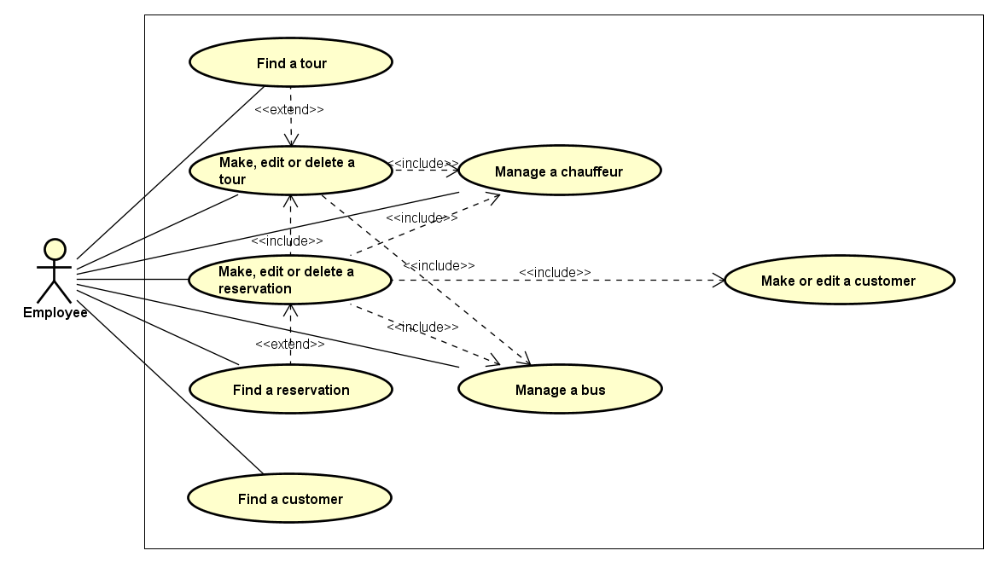
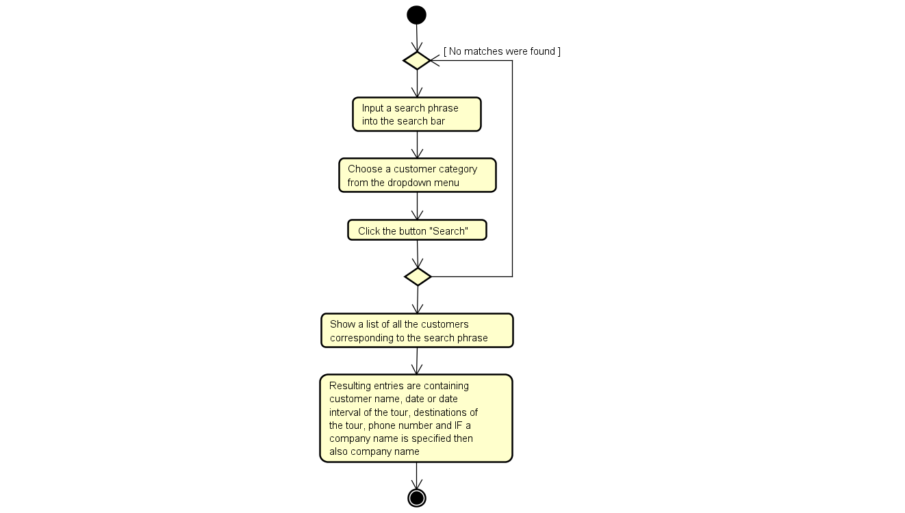

Requirements
Use Case Diagram
Use Case Descriptions
Activity Diagrams
Analysis
Notes:
Then we moved into the creation of Use Case Diagram, where we made a lot of versions before we figured out our own way. We quickly found out that we had to make a compromise between the readability of the diagram and simplicity of the individual use cases. See, both sides, customer and developer, have different wishes here. Customer would like to have a simple and readable diagram, which means smaller amount of the individual use cases. The developer, on the other hand, would like to have a simple use cases, which means more of the individual use cases.

Slide 5

Class Diagram
Mockups
GUI
Design
Notes:
1. The first step in develop the design of our program was using the class diagram, using the classes and their methods we were able to work on mockups in a way that it can be user friendly and finally having the mockups ready we started working on GUI.

Slide 6
Notes:
2. As i said before, the first step in develop the GUI was using the class diagram. This is the simplified version of class diagram. Based on each method in each class the GUI ellements and atributes of interface were created

Slide 7
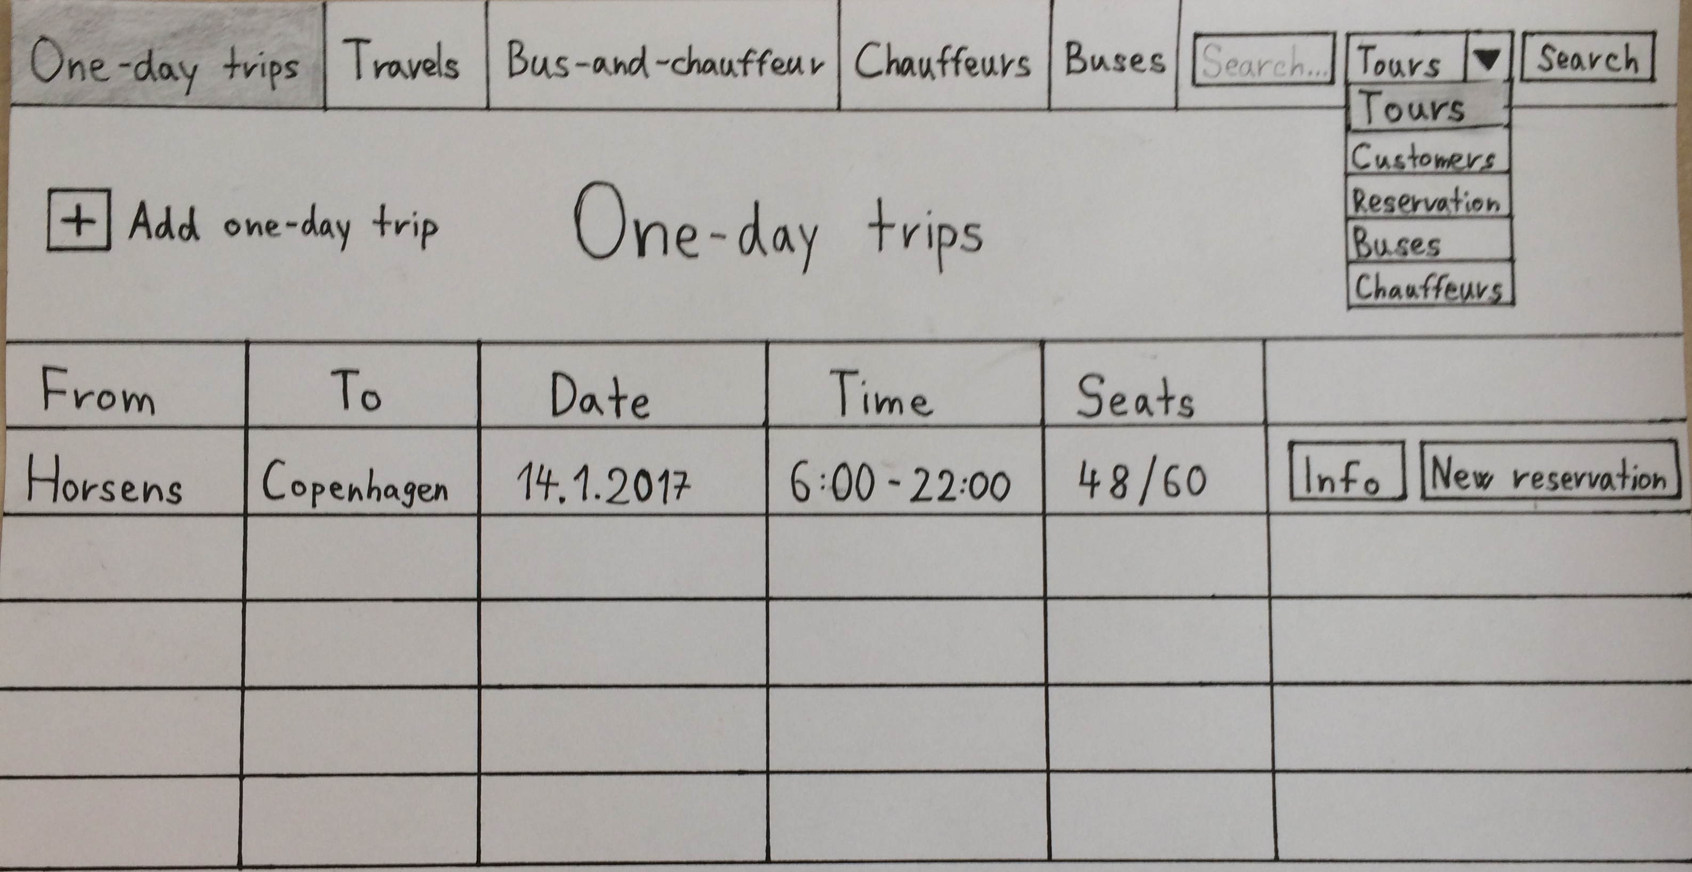
Notes:
3. This mockup represents the main window of our program, where the user have five different tabs, each of them is responsible for different actions, the list of available tours also the search bar with text-field and dropdown menu

Slide 8
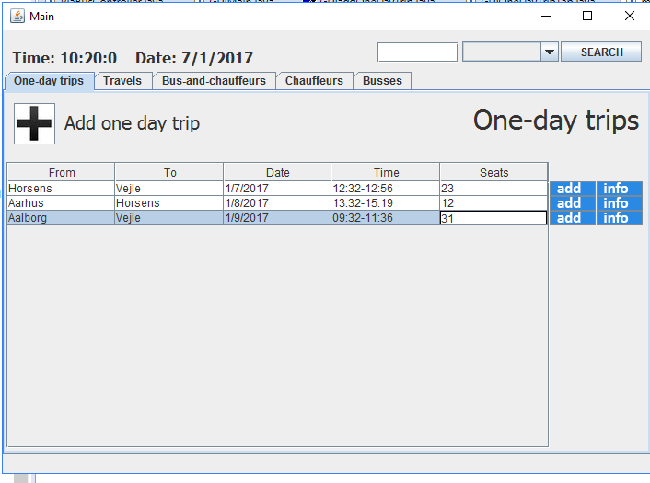
Notes:
4, This is the GUI the version of the mockup. In order to create one more tour, the employee should press the "Add one day trip" and input required information. Such as Start and end destination, and if needed stops between them. Time and date of departure and arrival, also choosing an available bus and chaffeur.

Slide 9
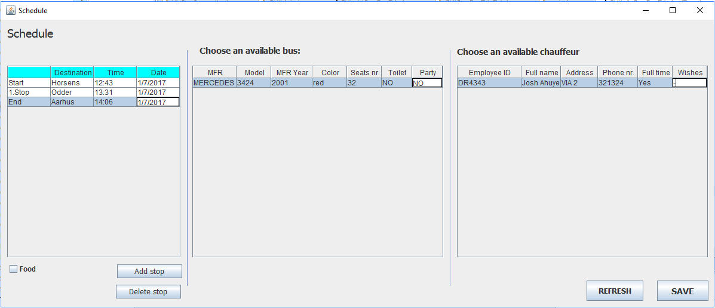
Notes:
5. In order to create a new reservation the employee should select a tour and press the blue buttom "add".

Slide 11
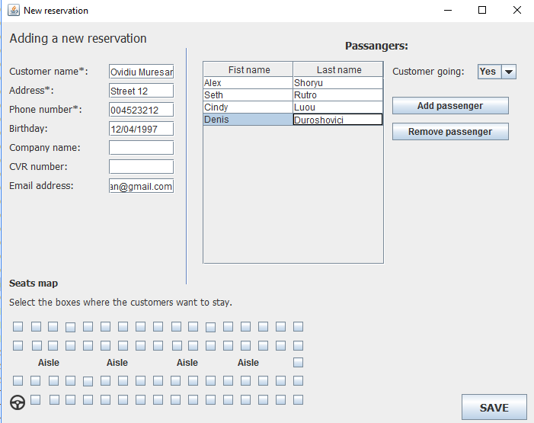
Notes:
6. Here he needs to input the info, either it is a regular customer or a company. Input the name of the passangers witch is mandatory for One day trip and Travel and also select disereble seats.

Slide 12
Notes:
7. Next we have "info" buttom witch is for showing the information about the tour.

Slide 13
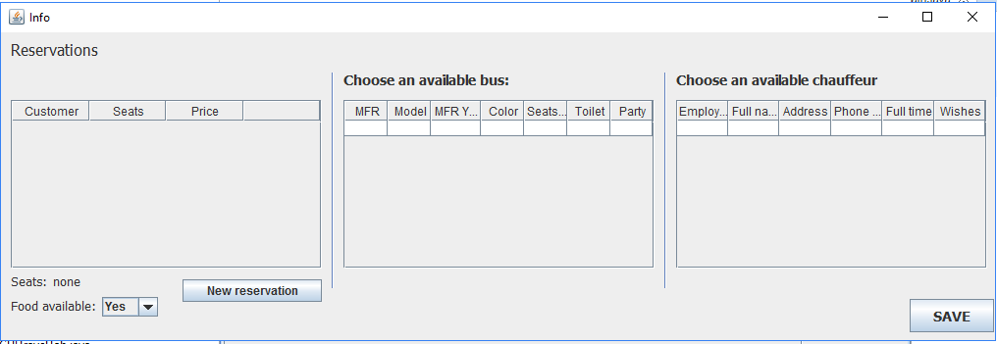
Notes:
8.Here we have all information about reservations, assigned busses and chaffeurs, and also the employee is able to create a reservation using this window.

Slide 14

Coding
Testing
Weaknesses
Implementation
Notes:
Coded based on the Class Diagram
90% of the model done following the Class Diagram
Skill regular expressions
Remaining 10%
Biggest problem - stack overflow
Two specific occasions where it occurred
Weakness – unfinished controller
Two culprits – intensive work only week before the deadline and poor group communication.
Tasks separated, come week before the deadline and finalize.
Believe it is good system
Wasted time
Better communication

Slide 15

Process Report
Project Report
Javadoc
Documentation

Slide 16
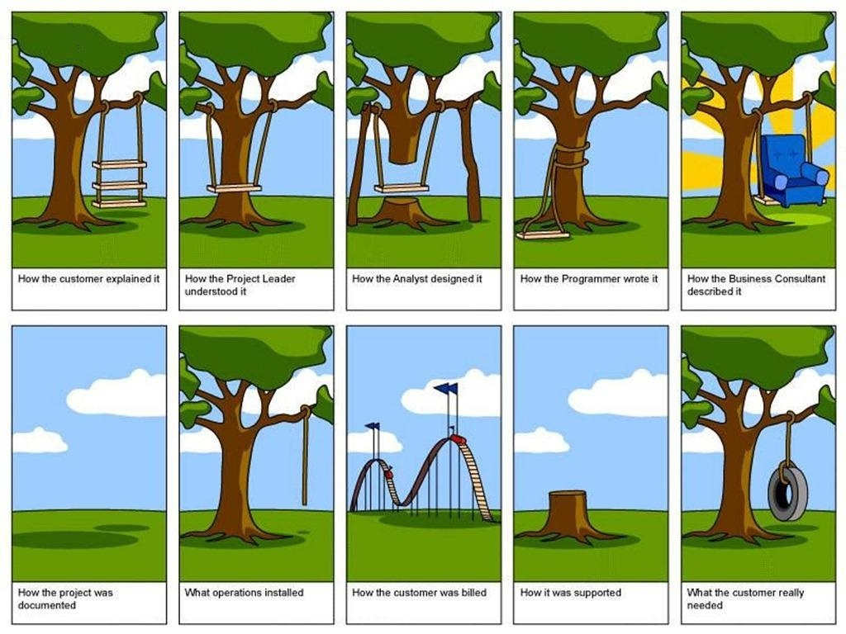

Slide 17

Thanks For Attention .

