Slide 1
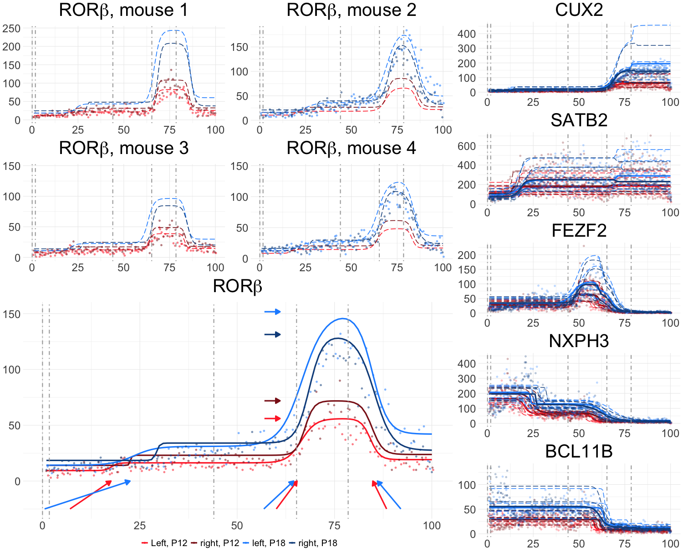
A
B
F
G
C
D
H
E
L6b
L6a
L5
L4
L2/3
β_{right,P18}
I
B1
β_{P18}
β_{right}
J
β_{P18}
β_{P18}
B2
B3
B4

