Slide 1
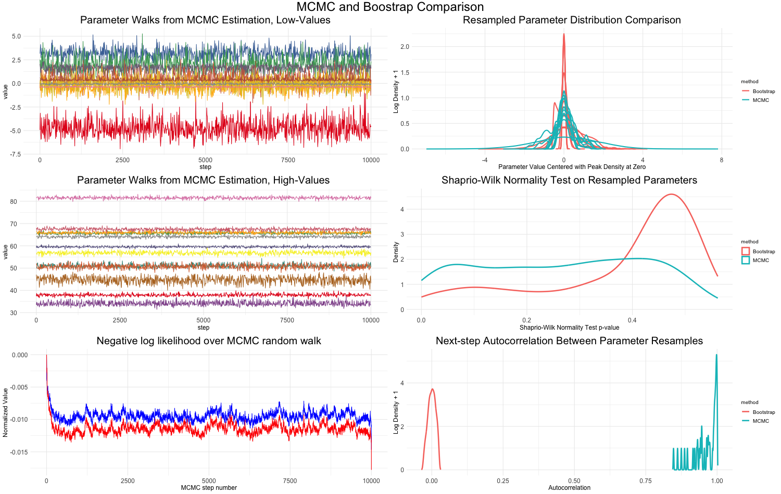
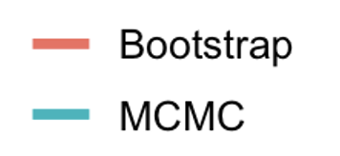
A
D
Bootstrap
MCMC
B
E
C
F
Negative Log Likelihood
with penalty

