Slide 1
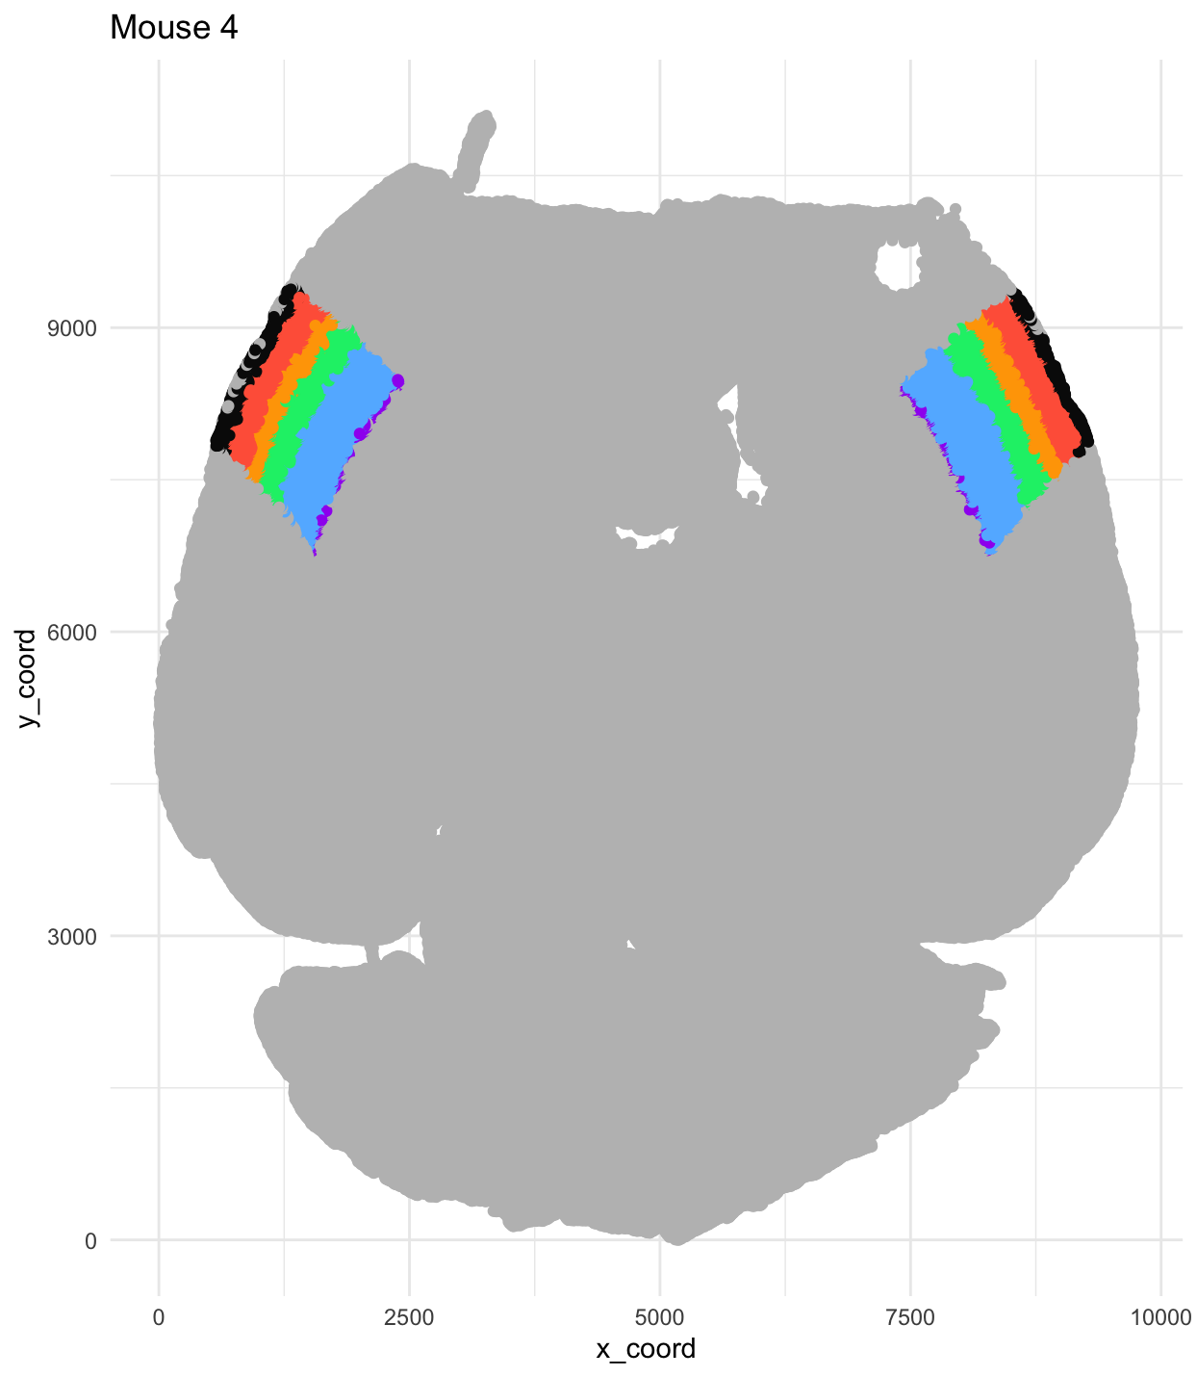
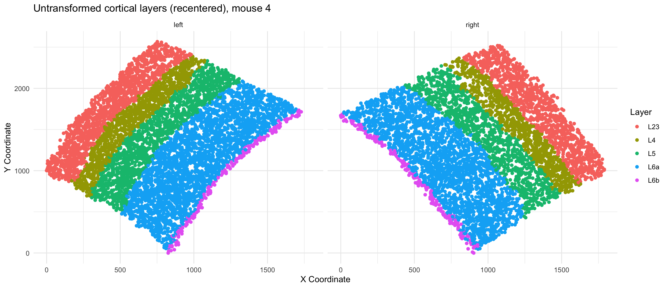
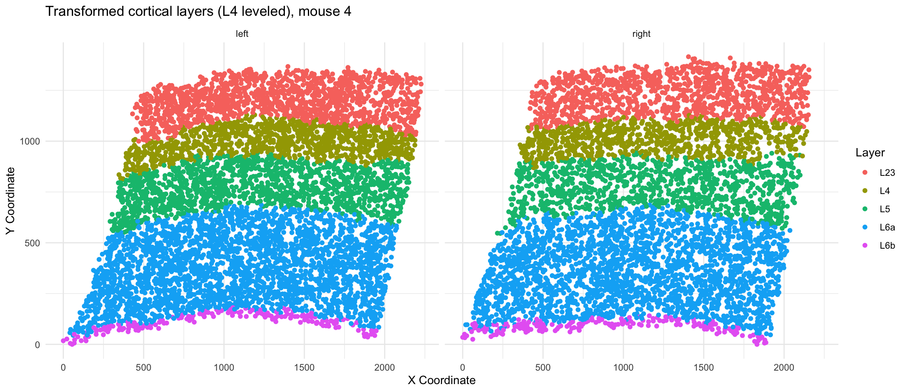
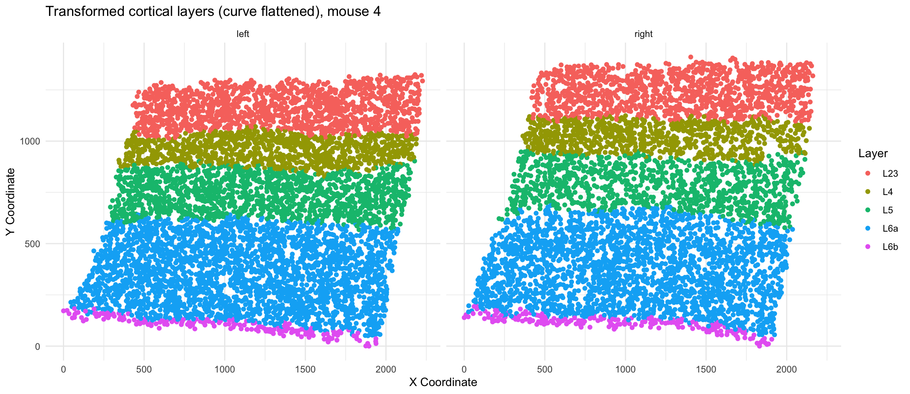
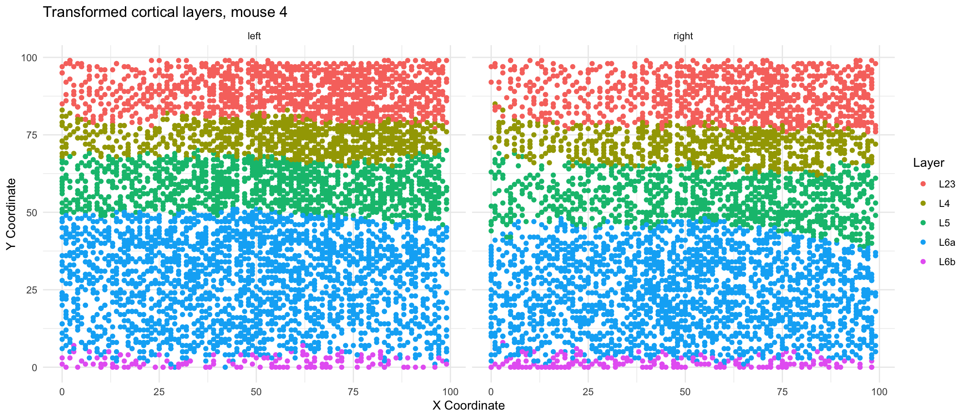
Transformation into Laminar and Columnar Coordinates
Coordinates from CCFv3
Step 1: Translate to origin
Step 2: Level L4 and rotate to put L2/3 on top
Left
Right
Left
Right
Step 3: Fit quadratic to L4 and flatten
Step 4: Bin coordinates and rescale to edges
Left
Right
Left
Right
Pos
Ant
Pos
Ant

