Slide 1


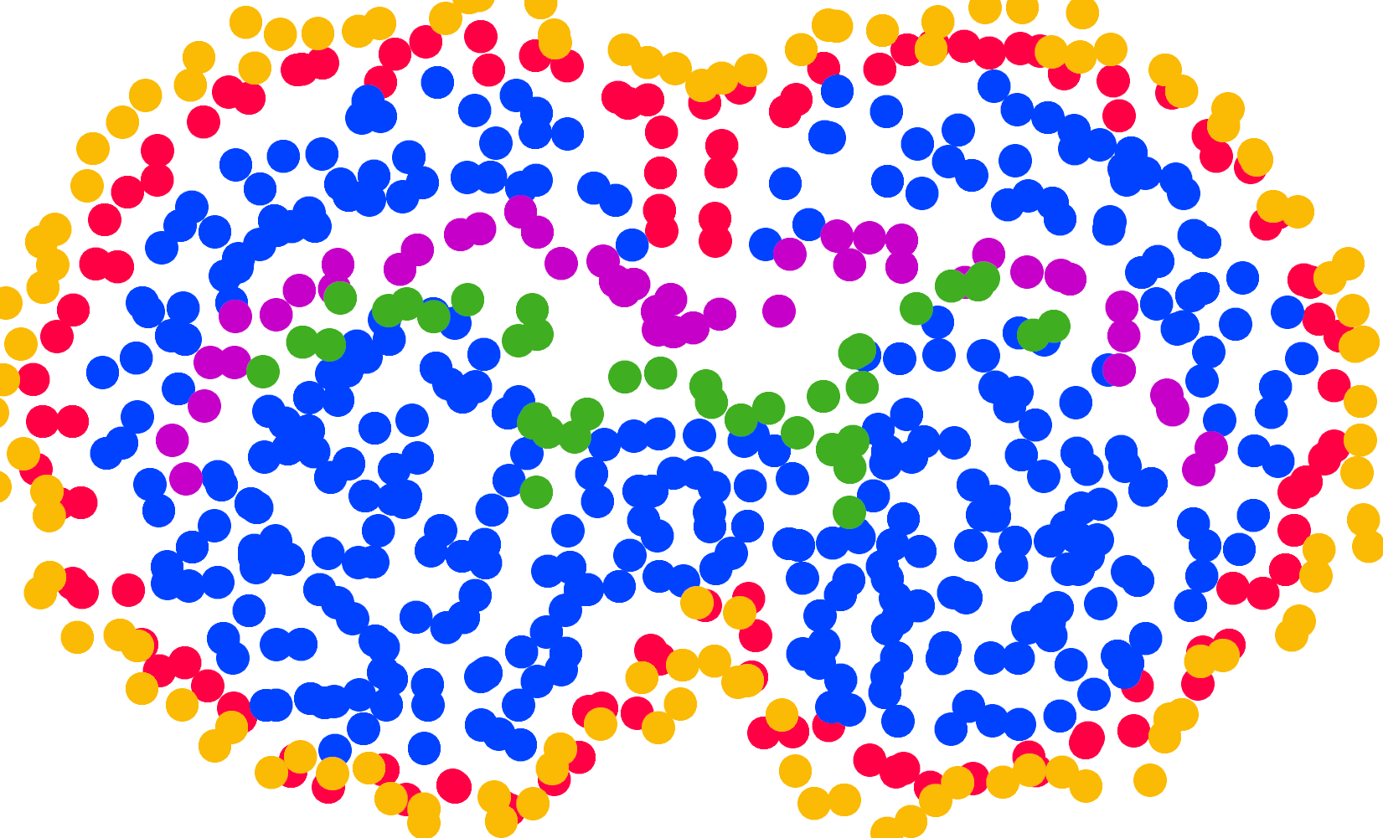
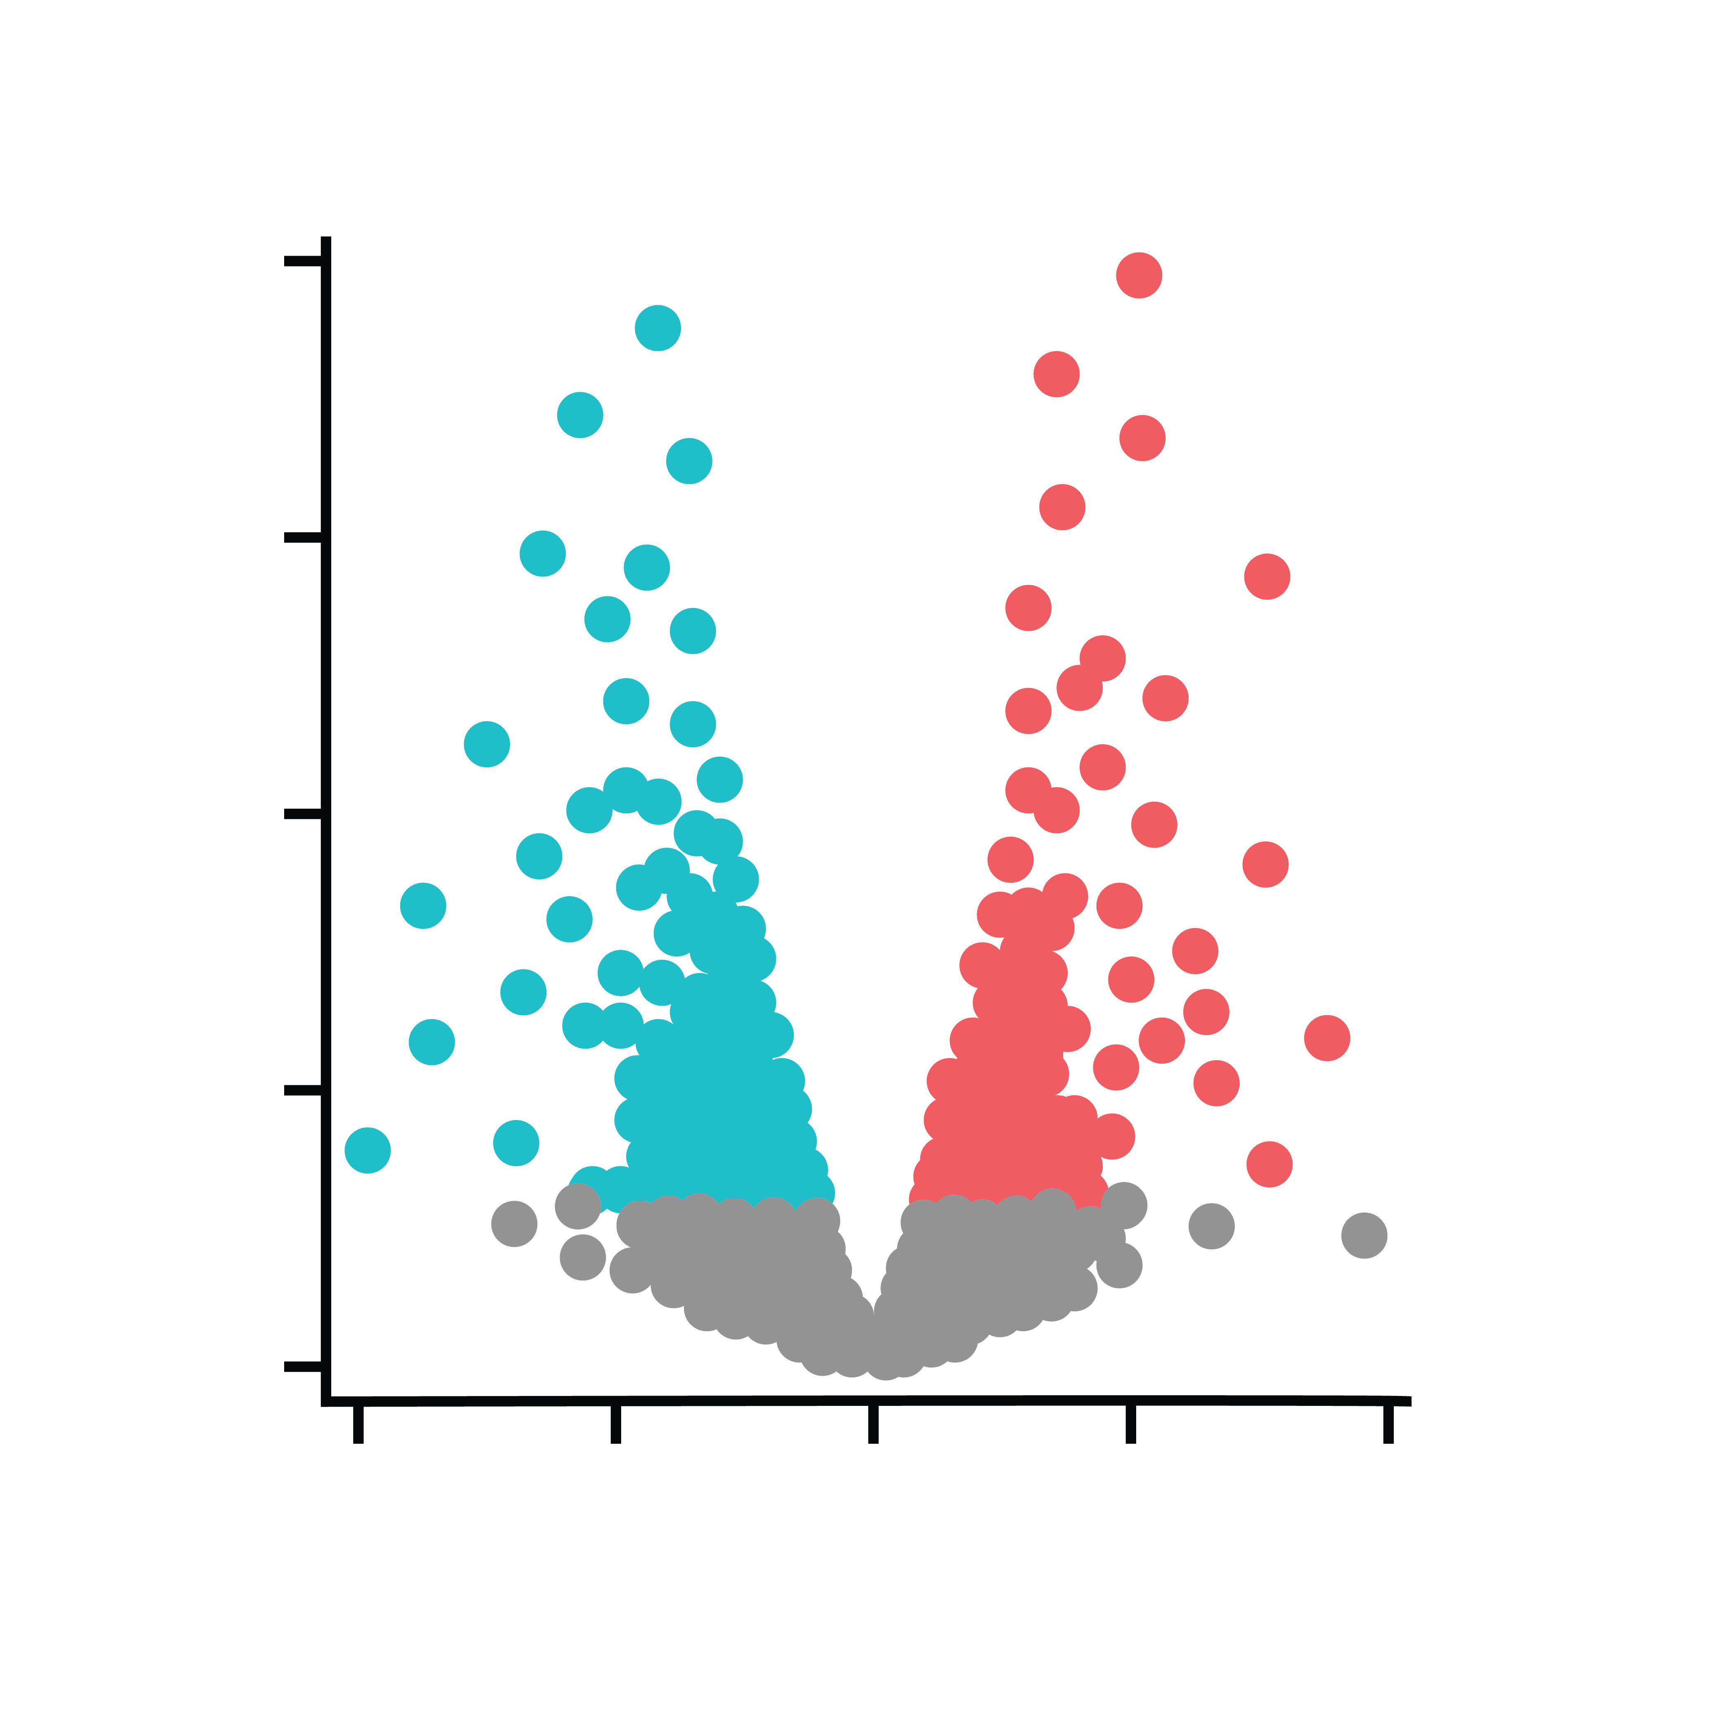
Differential Expression
Spatial Variability
Functional Spatial Effects
left/right
left/right
left/right
Spatial Information?
NO
YES
YES
Between-Group Comparison?
YES
NO
YES

