Slide 1
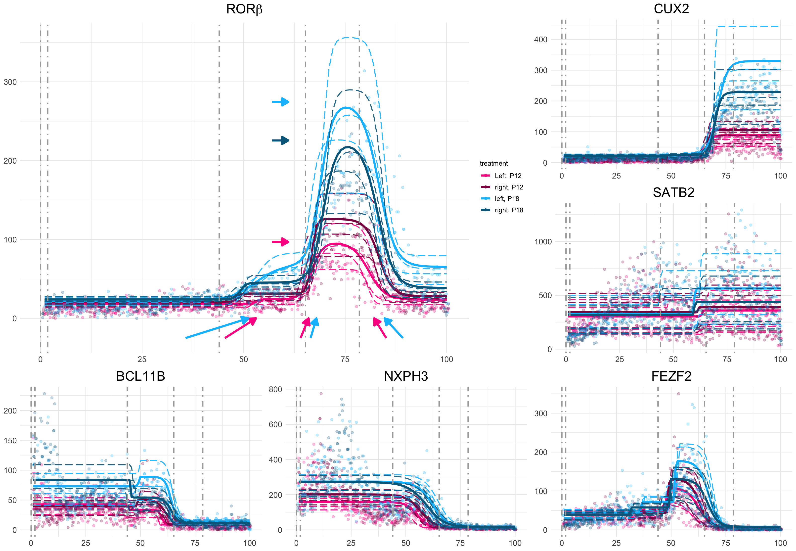
Box A
β_{right,P18}
β_{P18}
Box B
Box C
β_{P18}
Notes:
Ratio: 1.445

