Slide 1
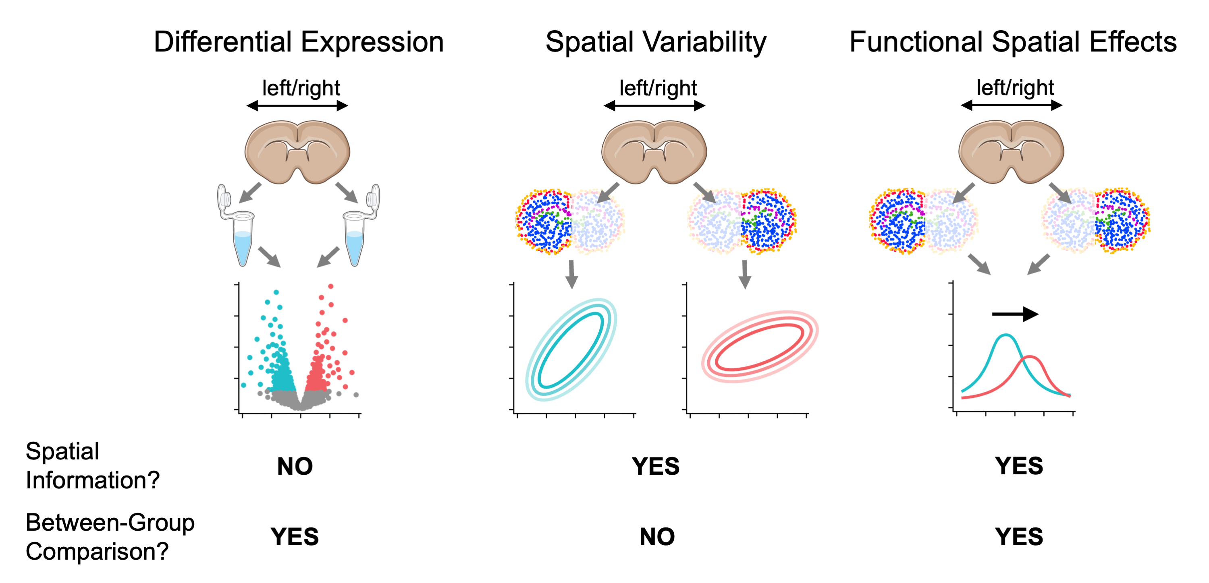

(wisp)
A
B

