Slide 1

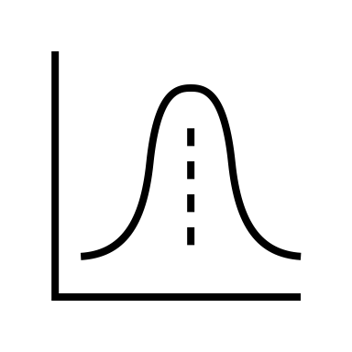
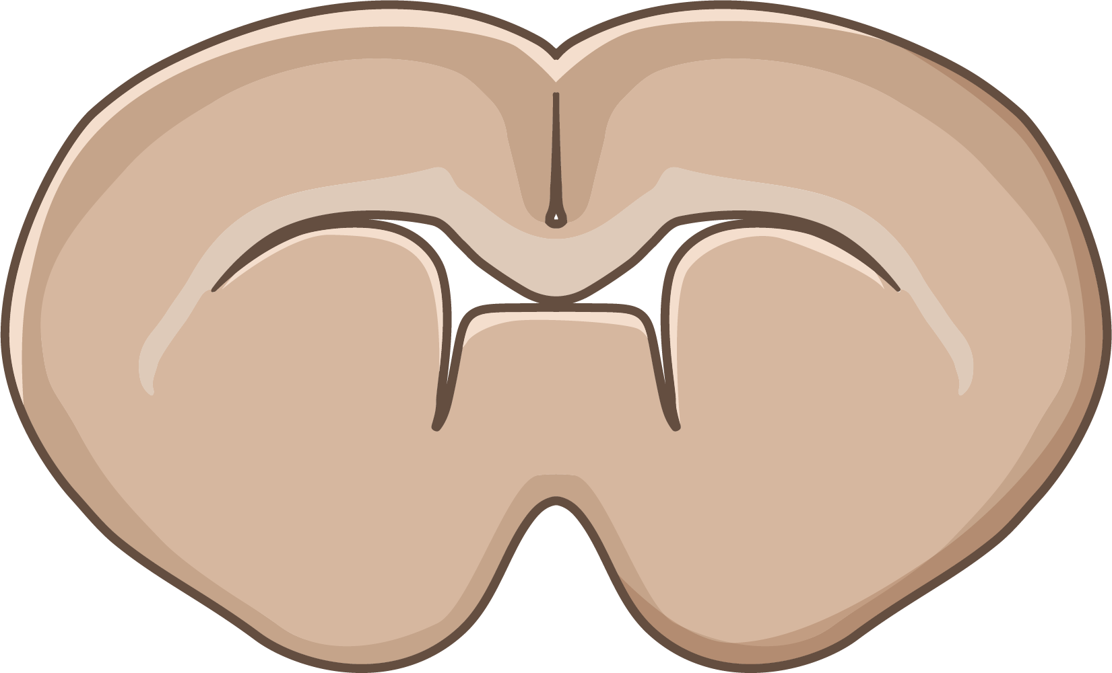
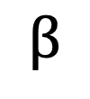
Factor of Interest
Spatial Distribution of Gene Transcripts
left/right
Reference Level
left
$$β$$
Treatment Level
right

