Slide 1
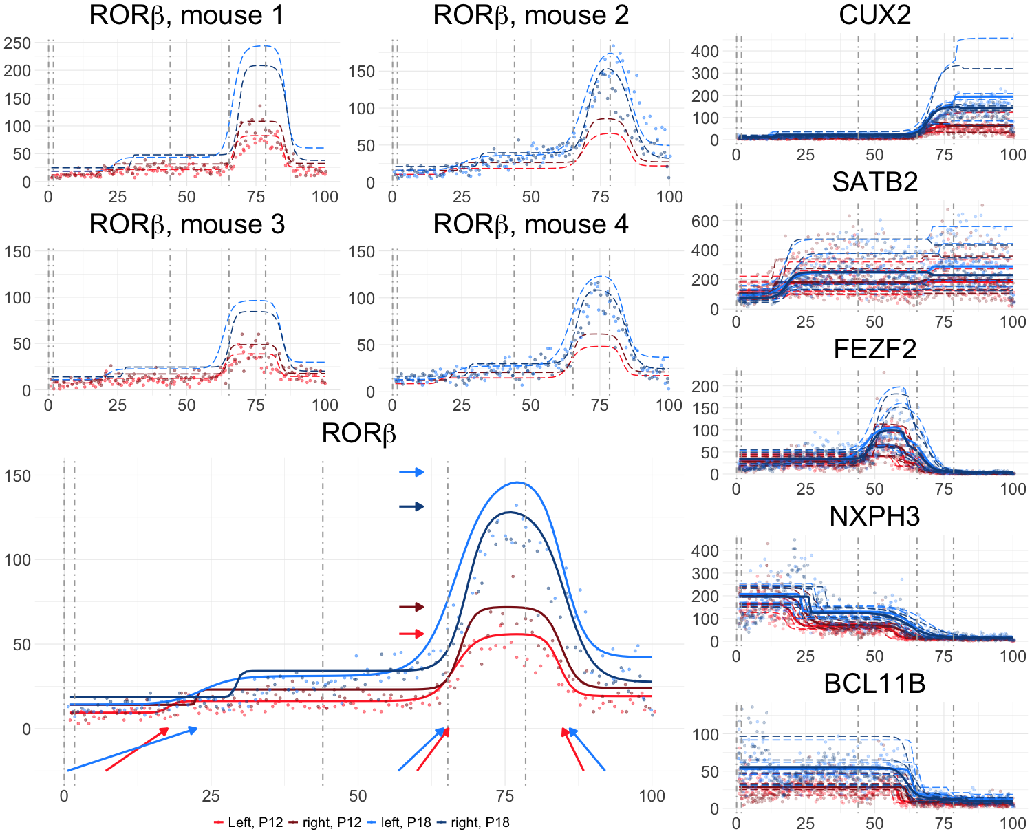
A
B
F
G
C
D
H
E
L6b
Effect of switching from left to right at P12
Effect of switching from P12 to P18 on left
Effect of switching from P12 to P18 on right
L6a
L5
L4
L2/3
I
B1
β_{P18} + β_{right,P18}
β_{P18}
β_{right}
J
β_{P18}
β_{P18}
B2
B3
B4

