Slide 1
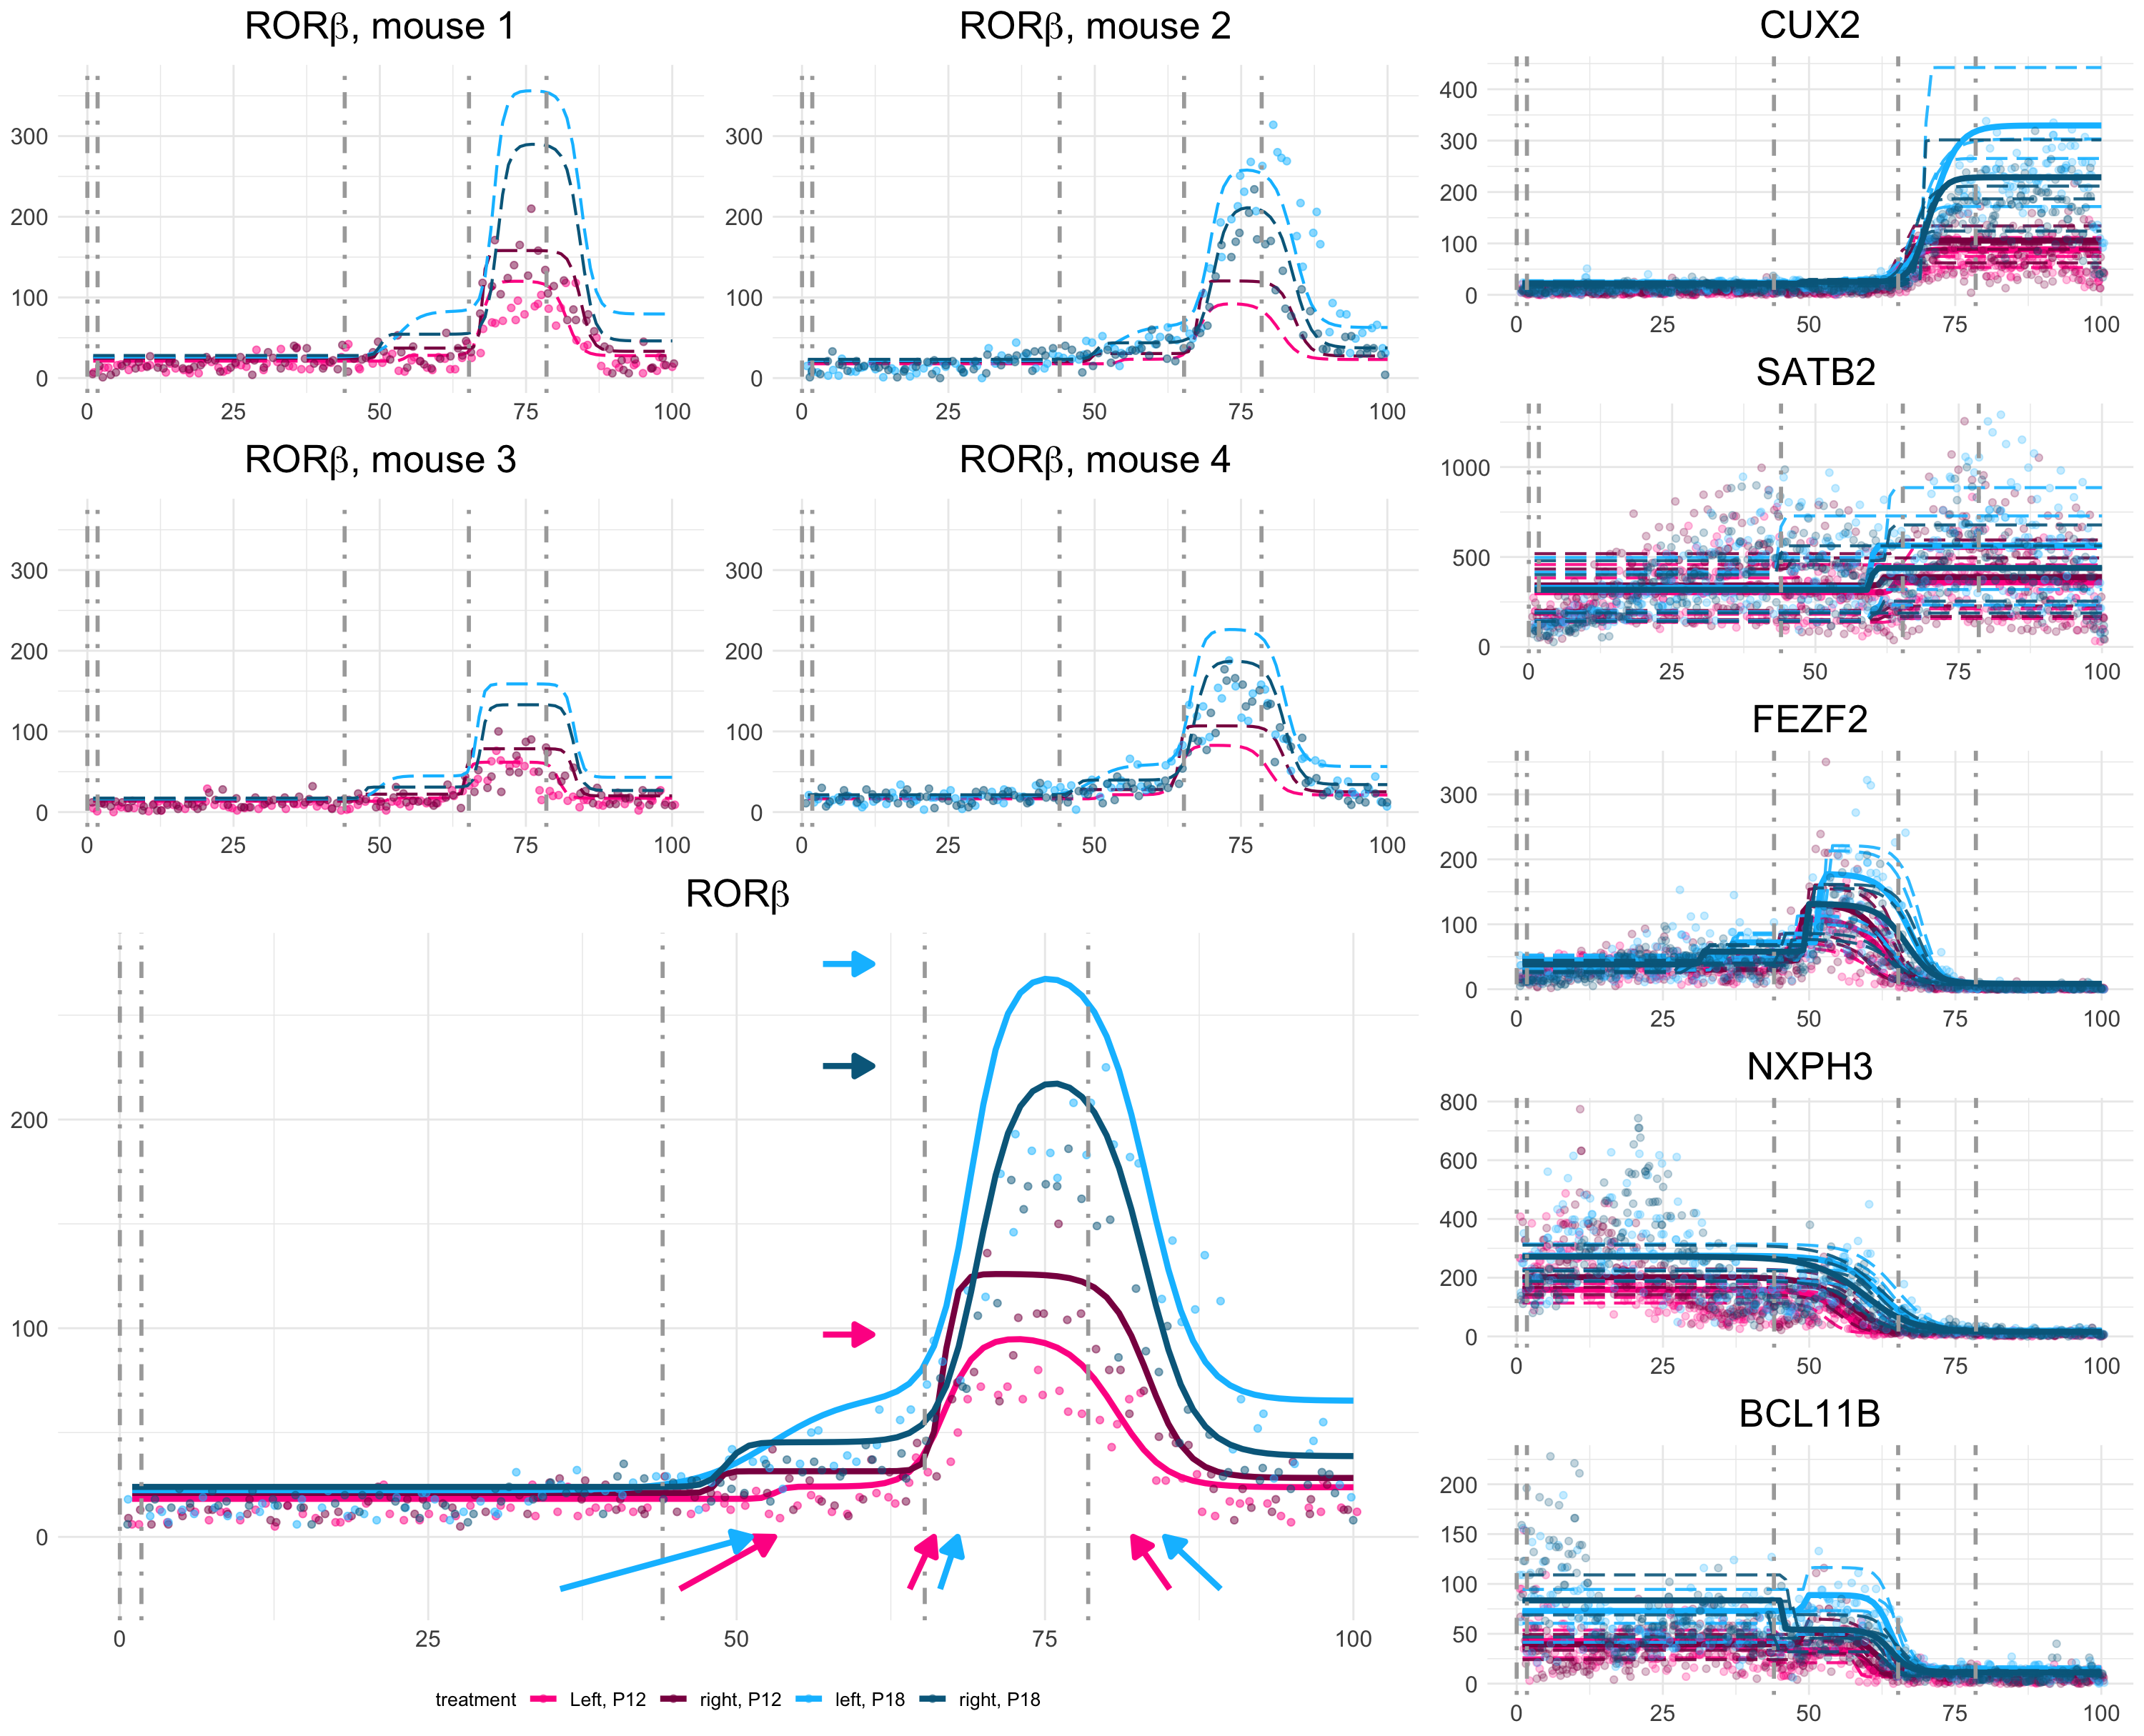

L6b
Box A
L6a
L5
L4
L2/3
β_{right,P18}
β_{P18}
Box B
β_{P18}
Box C

