Slide 1

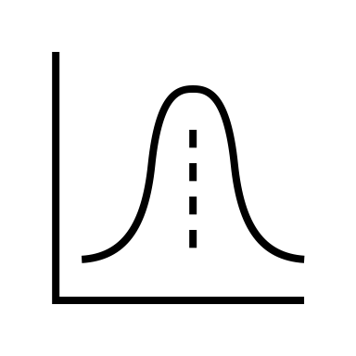
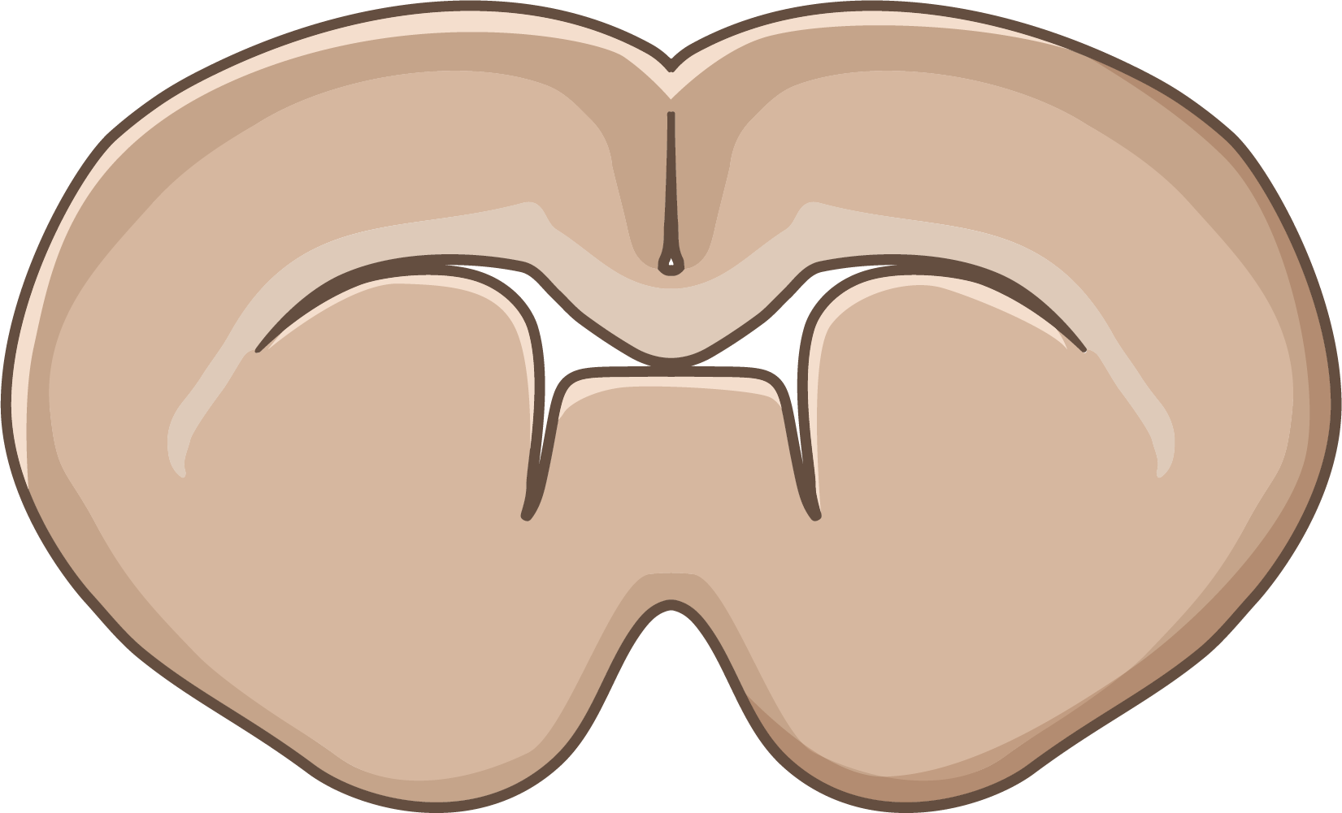
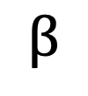
Factor of Interest
Spatial Distribution of Gene Transcripts
Biological or Cognitive Functioning
left/right
Reference Level
left
$$β$$
right
Treatment Level

