Slide 1
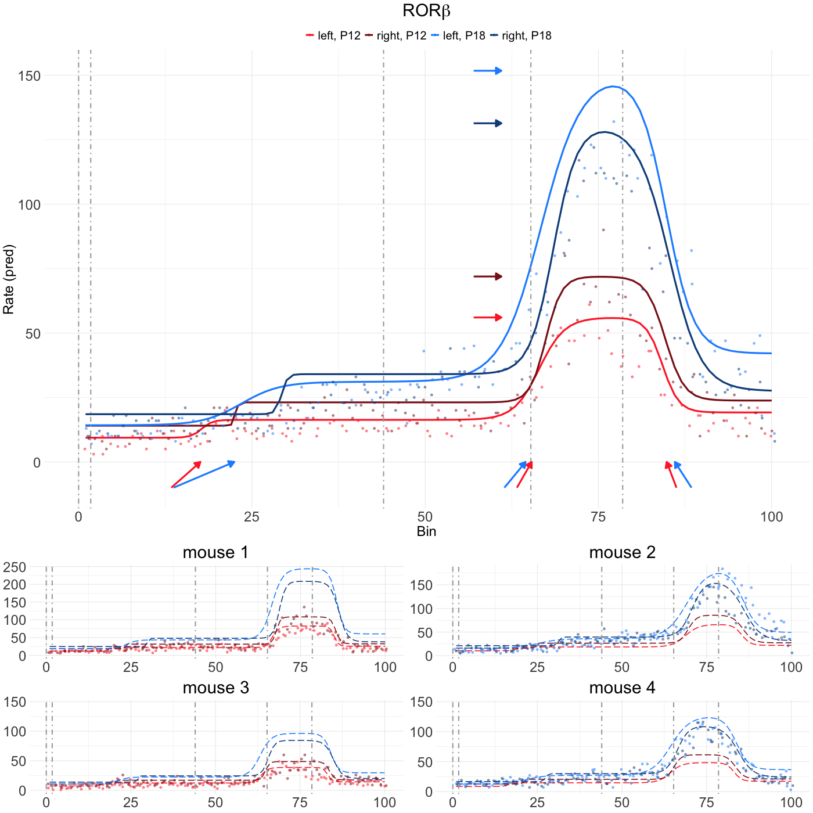





A
L6b
L6a
L5
L4
L2/3
B

