Slide 1
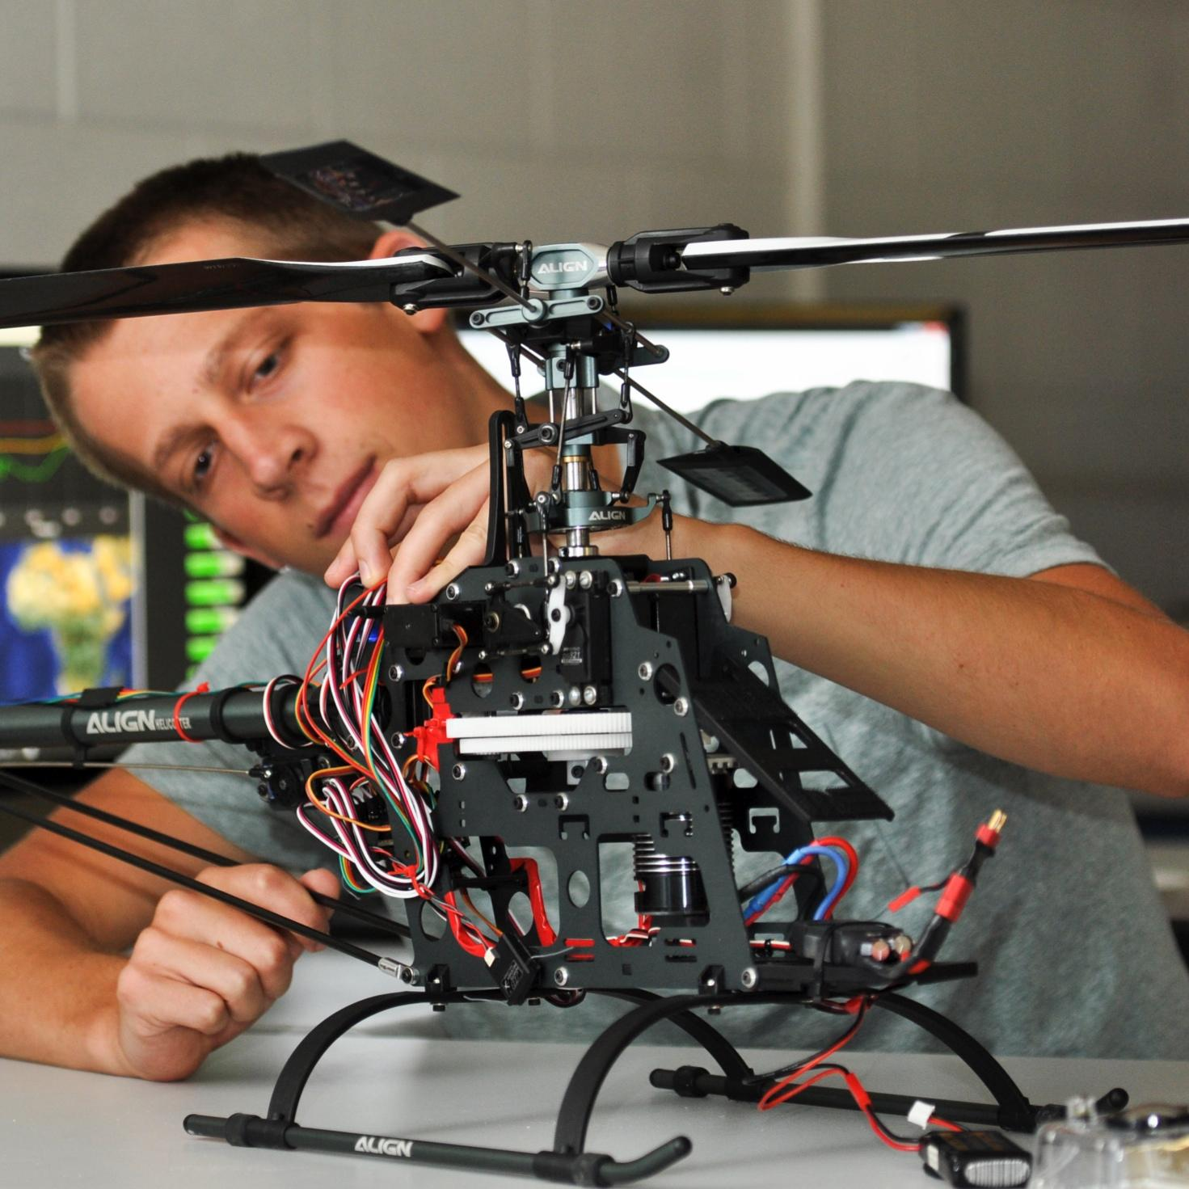

TMEIC DI-Water Cooling Skid
Bi-Weekly Update 1
Ethan Henderson
Robert Parker
Noah Ovikian
Sponsor: TMEIC
TA: Jerry Xu
Notes:
Michelle

Slide 2
Project Summary
Problem statement
TMEIC’s high-power VFDs rely on deionized-water cooling to protect inverter IGBTs from damaging heat. Using a full-scale cooling system for customer training is costly, cumbersome, and impractical, yet trainees still need realistic operating and troubleshooting scenarios.

Slide 3
Project Summary
Problem statement
TMEIC’s high-power VFDs rely on deionized-water cooling to protect inverter IGBTs from damaging heat. Using a full-scale cooling system for customer training is costly, cumbersome, and impractical, yet trainees still need realistic operating and troubleshooting scenarios.
Our Solution
We are designing and building a compact, temperature-controlled DI water cooling skid for TMEIC’s training facility. It will reproduce the behavior of the full-scale system, enabling accurate hands-on testing, diagnostics, and troubleshooting at a fraction of the scale, cost, and complexity.

Slide 4
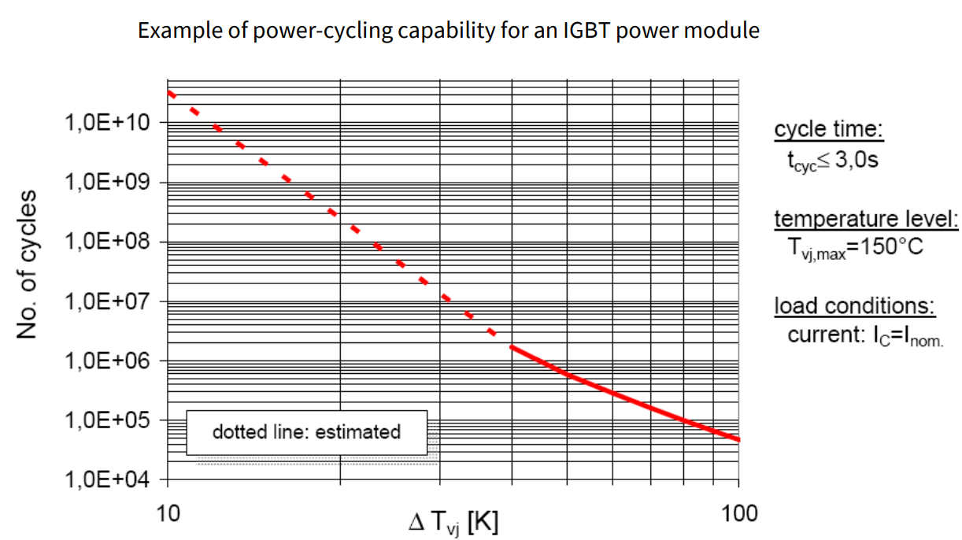
Project Summary
Credit: Infineon AN2019-05

Slide 5
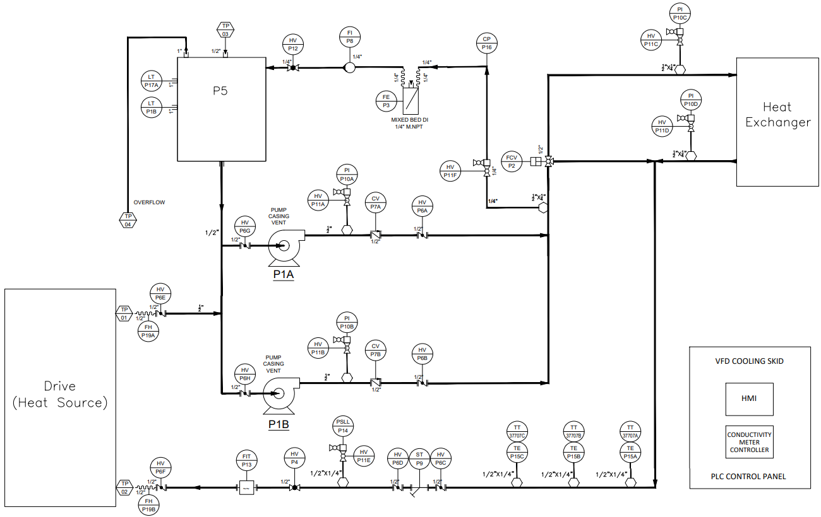
Project Summary

Slide 6
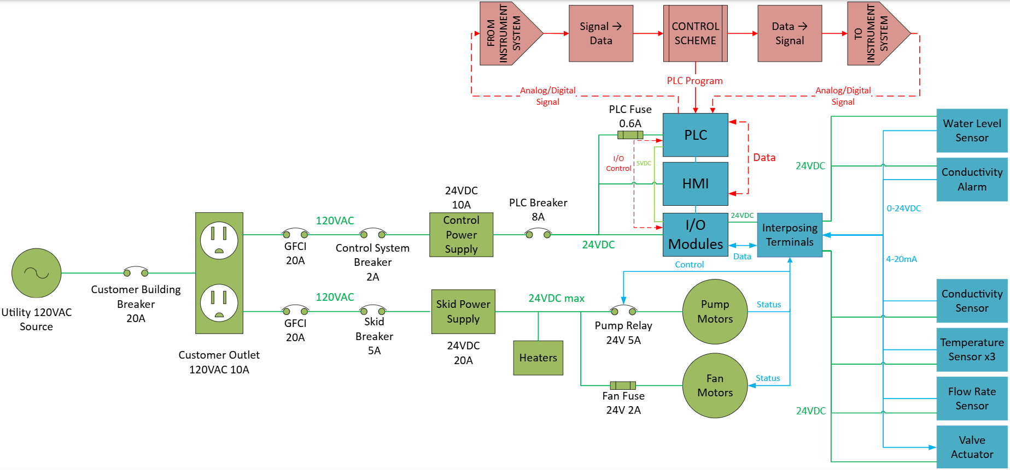
System Overview
Ethan Henderson
Robert Parker
Noah Ovikian

Slide 7
Major Project Changes for 404
MEEN Integration

Slide 8
Project Timeline
AUG 29
Design Baseline Complete
Controls architecture & materials baseline set
AUG 31 – SEP 12
Procure & Install Remainder
- Instrumentation & Skid Power
- Target less than 2 weeks
DEC 1
Project Completion
Fully integrated skid ready
SEP 7
NOV 15
AUG 29
No Later Than SEP 7
Testing Phases Begin
MEEN Team begins component-level testing
SEP 12
DEC 1
SEP 7 – NOV 15
Electrical Integration
Integrate each phase build
Complete
In Progress
Behind Schedule
Not Started
*Contains AI generated content*

Slide 9
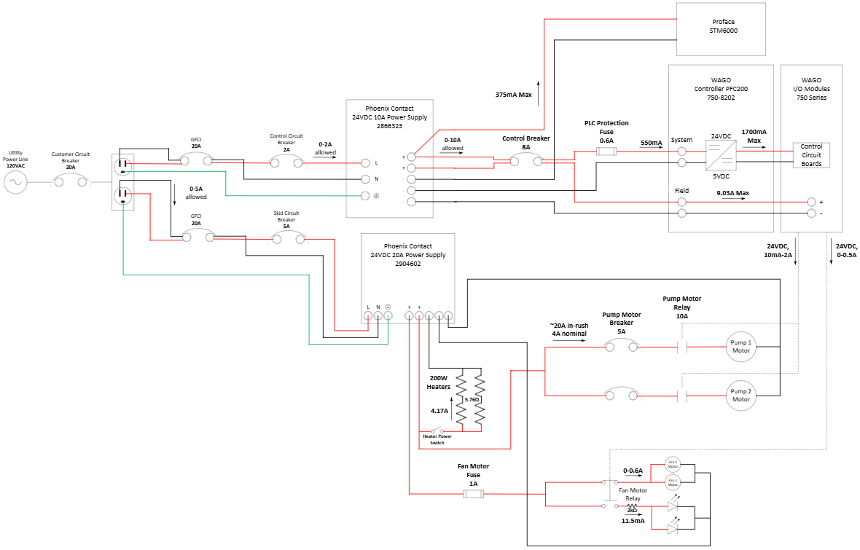
Power System

Slide 10
Power System
Existing, Tested, and Validated
Everything else is awaiting sponsor approval for procurement

Slide 11
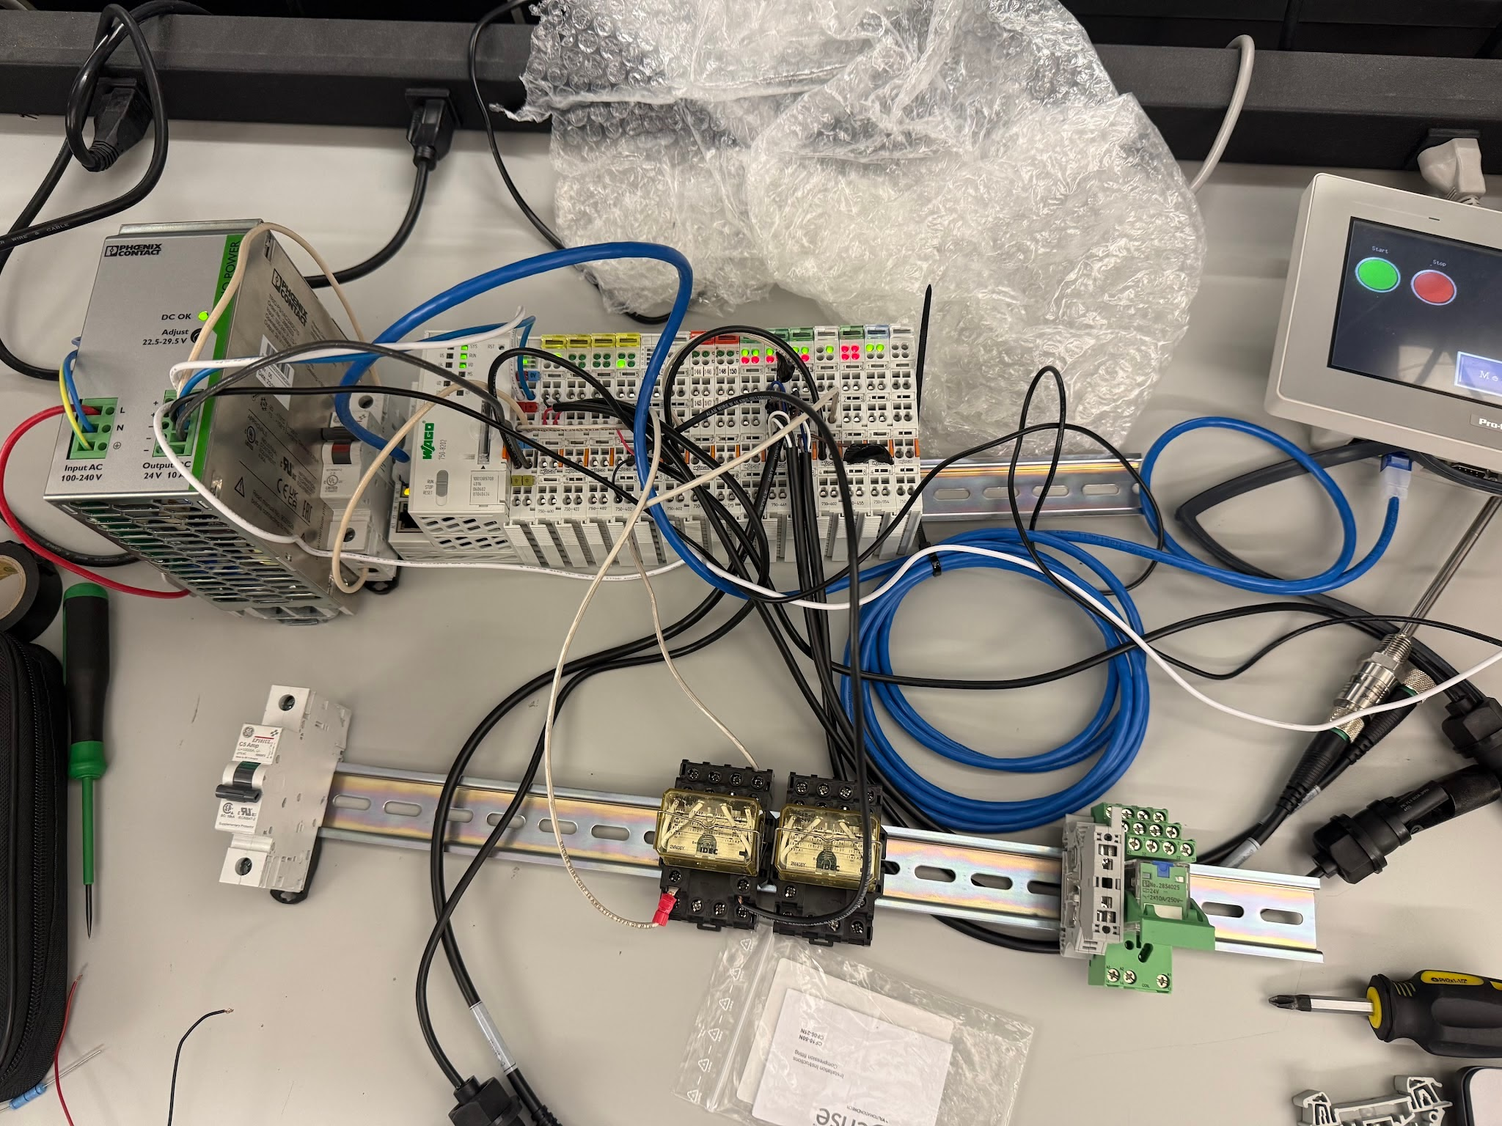
Power System

Slide 12
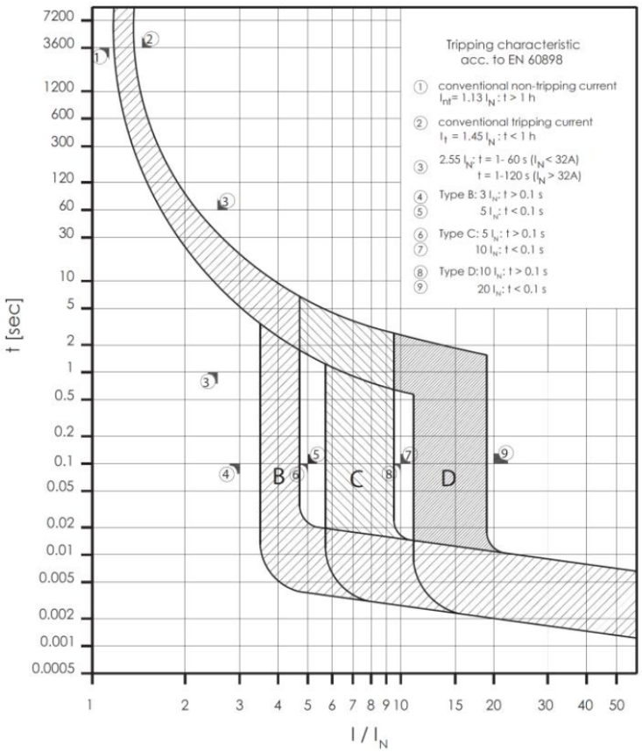
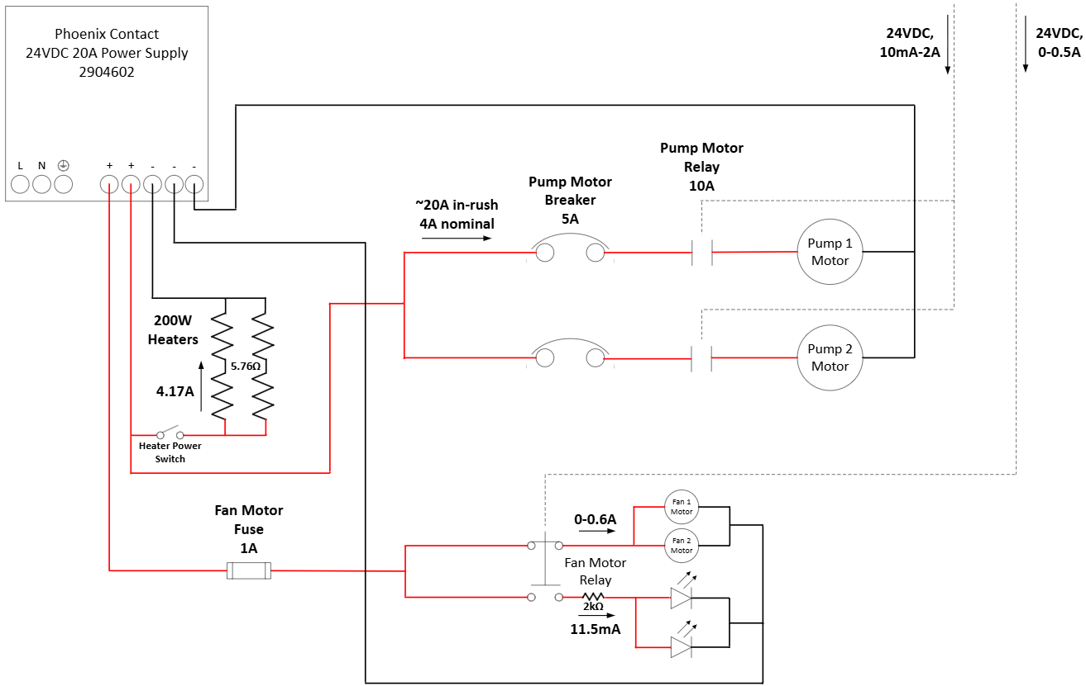
Power System

Slide 13
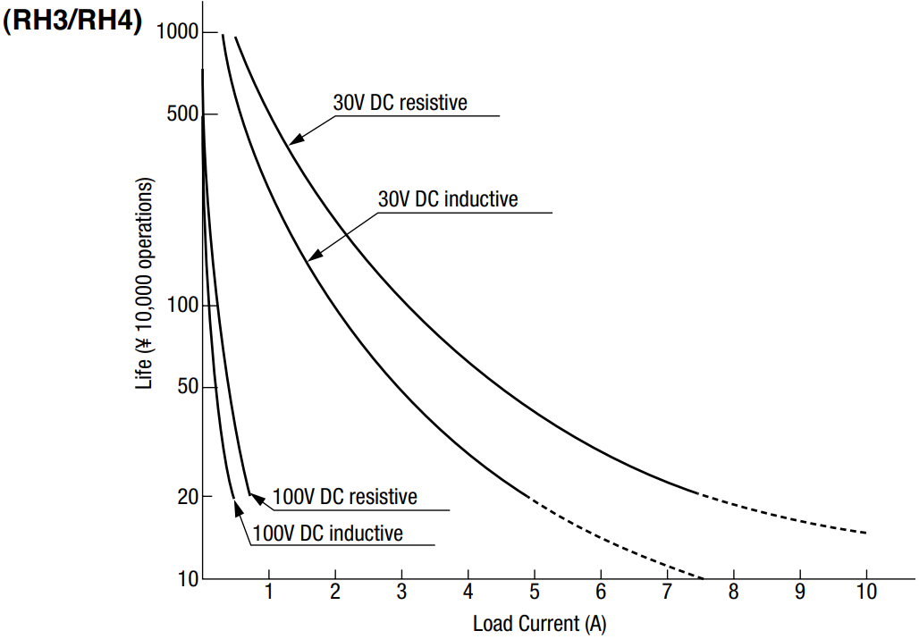
Power System

Slide 14
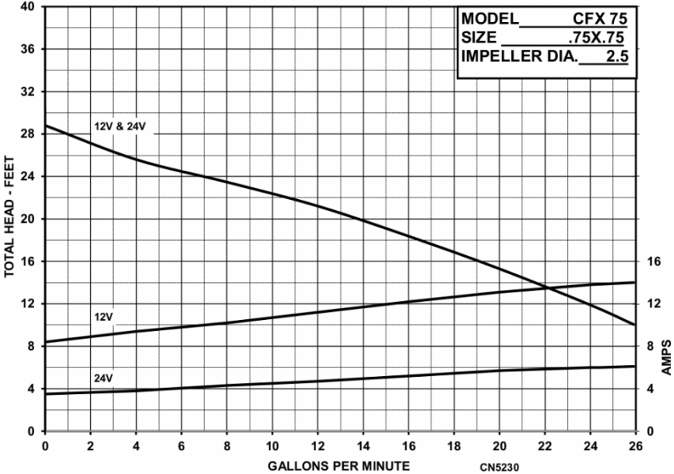
Power System

Slide 15
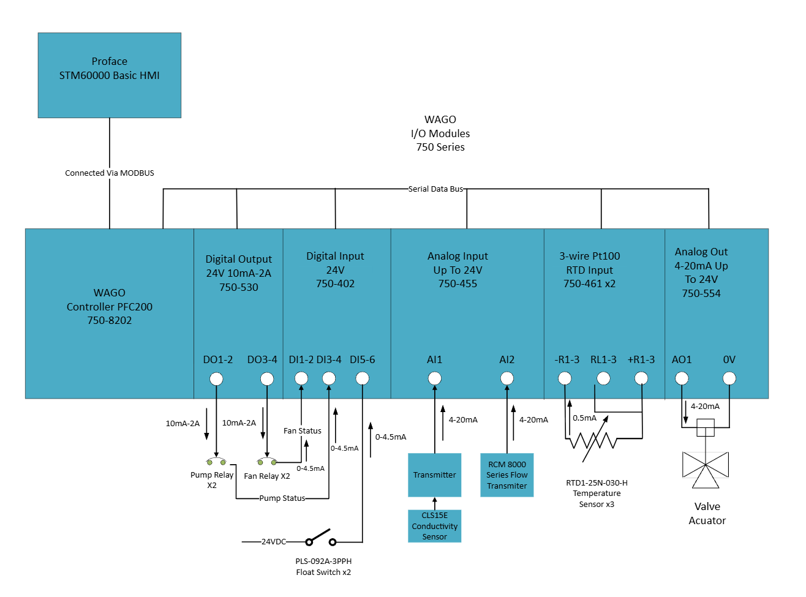
Control Hardware

Slide 16
Hardware Selection
Control Hardware
Component | Part number | Procurement Status
PLC and I/O Modules | Wago 750-8202 | Acquired
HMI | Pro-face STM-6400WA | Acquired
Float Switch | PLS-092A-3PPH | Acquired
Resistance Temperature Detector | RTD1-25N-050-H | Acquired
Flow Transmitter | RCM 3/4"-83-R-10-W2 | To Be Provided By Sponsor
Pressure Switch | MPS25-1C-D30A | To Be Provided By Sponsor
Conductivity Meter | CM442R-AAM1A2F21+SA# | To Be Provided By Sponsor
Power Meter | TBD

Slide 17
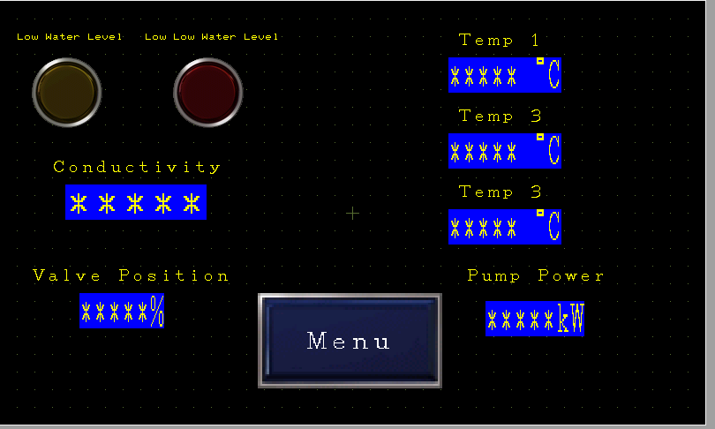
HMI Screen
Control Hardware
HMI displays the system status
Provides interface for configuration
Accesses Data Via MODBUS TCP
example HMI screen

Slide 18
Next Steps
Control Hardware
Instruments
  Procure and Unit Test Remaining Parts
HMI
  Integrate With Full Software
  Add Alarm Function
MEEN Integration
  Mount Instruments to Final Build
  Test Instruments on Real Skid

Slide 19
Control Software
Primary Control Features
Temperature Control
  Observation of Inlet Coolant Temp.
  PI Control of Temp. via Flow
  Excess Time @ Critical Temp → Fault
Coolant Conductivity Control
  Observation of Coolant Conductivity
  High & Critical Cond. Level Interlocks
  Excess Conductivity → Fault.
Hydraulic Controls
  Observation of System Hydraulics
  Automatic Redundant Pump Turnover
  Total Hydraulic Failure → Fault
Figure: P&ID of Cooling Skid. Primary Control Components Highlighted in Red, Green, Blue, representing conductivity, temperature, and hydraulics, respectively

Slide 20
Control Software
Supporting Features
Signal Processing
  Affine Transformation, Hysteresis/Debouncing, Last Read Values Stored
Temperature C&E (Cause & Effect) Logic
  Triplex Median-Value Redundancy, Duplex Mean-Value Redundancy, Fault Interlock @ +2 RTD Fails
Hydraulic C&E Logic
Triplex Hydraulic Redundancy (2 of 3 Voting Between Power, Pressure, & Flow)
Vessel C&E Logic & Control
  Observability of coolant level in vessel at low and critical (fault) levels. Instrument Verification Sequence
Conductivity Redundancy
  Verification of digital conductivity interlocks via analog measurement of conductivity
Fan Control
  Automatic Fan Actuation w/ ability for user to override
System-User Interlocks
  User-Only Release of Fault & Simplex Pump Conditions

Slide 21
Control Software
Subsystem Adjustments
Philosophy Redirection
  Shifting focus to ensure ease-of-use and headache free maintenance for “field” engineers
  Complete Elimination of Object-Oriented Coding (Controls First Approach)
Reduction of Abstraction
  Removed “God Blocks” within Ladder Logic
  Replaced structures with arrays for easier data mapping
  Consolidated variables, data, and fault flags
Refined Startup, Temperature Control and Pump Control
  Removed Unnecessary delays in system startup procedure
  Reduced Permissives in Pump Controls
  Updated controller gain, Kp, and Ki values to reflect linear control valve operating point

Slide 22
Control Software
Ongoing & Integration
Subsystem Touch Up
  Commenting Code
  Perform Final Functional Checks
Digital Twin
  Reboot MATLAB fluid and thermodynamic simulation
Electrical System Interfacing
  Interface with Instrumentation (RTDs, Actuator, etc) and Power (Fan/Pump Relays)
  Validate Instrumentation/Power-Software Interaction through expected-actual value comparison
  Formalize functionality through control narrative, interlock diagrams, and C&E diagrams
Mechanical/Process Interface
  Piecewise Integration & Testing of Mechanical Apparatus w/ Control Logic
  Validate Integration by observing system behavior and contrasting to sponsor requirements & expectations

Slide 23
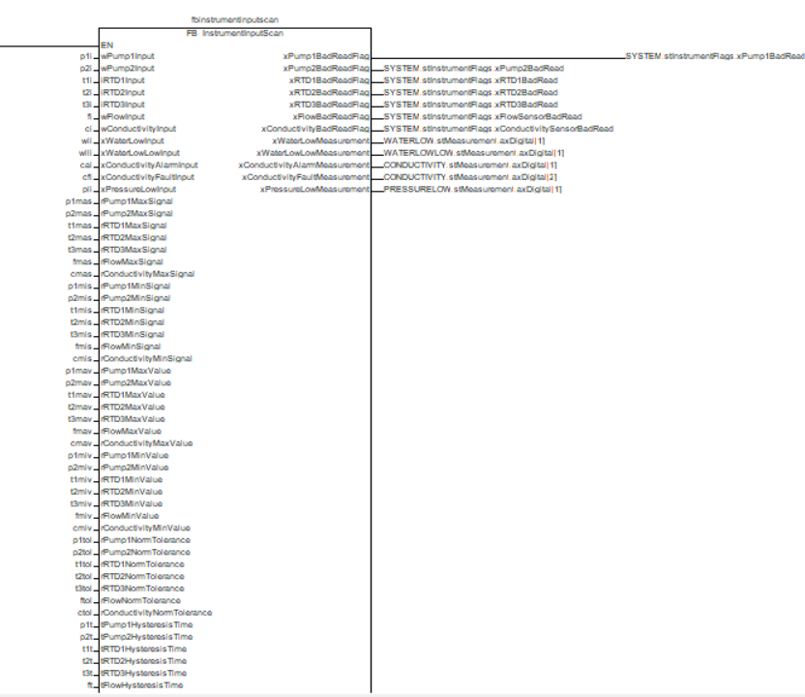
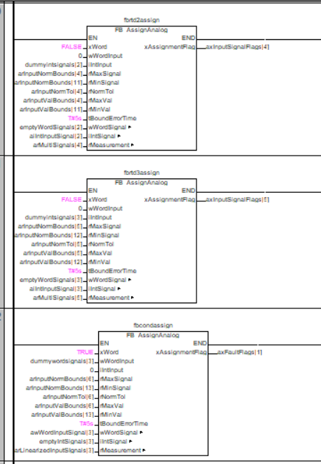
Control Software
God Block
Not God Block
Figure: Comparison of data-bloated functional block (i.e. “God Glock”) to current function block configuration in master ladder logic program

Slide 24
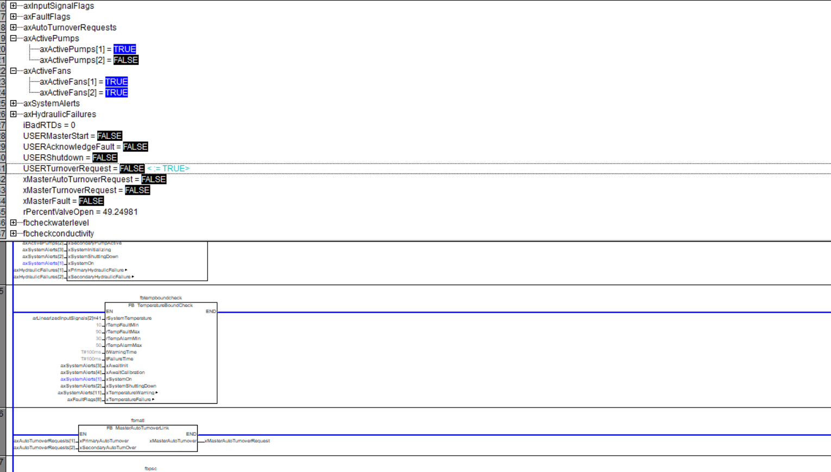
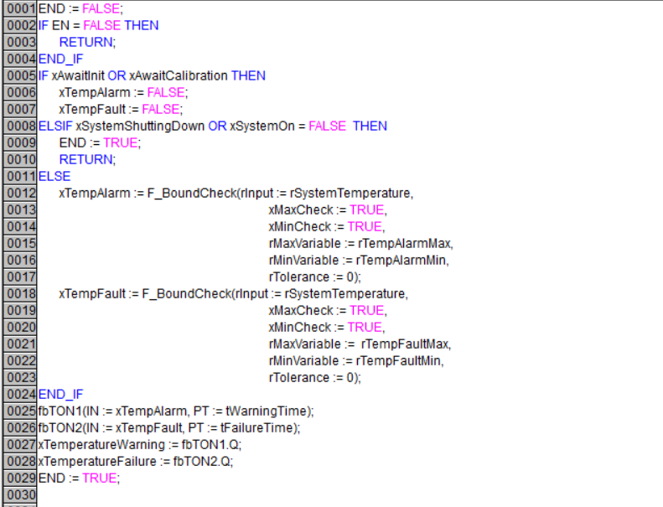
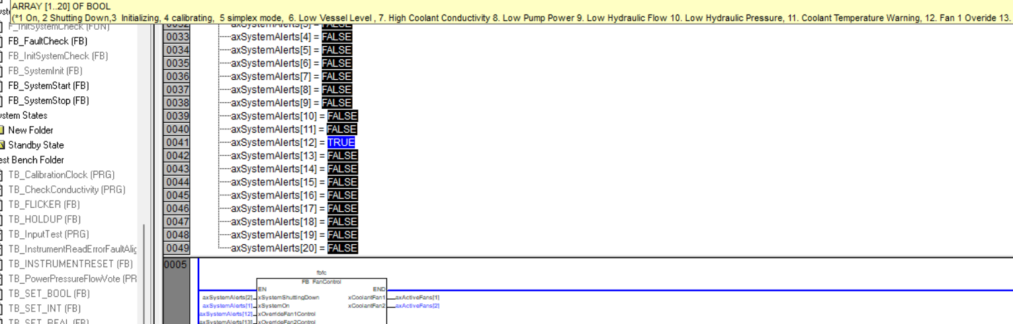
Control Software
Figure: Snippet of Code Containing Cause & Effect Temperature Logic
Figure: (Top Image) Functional Test of Manual Pump Turnover. (Bottom Image) Functional Test of Fan Override

Slide 25
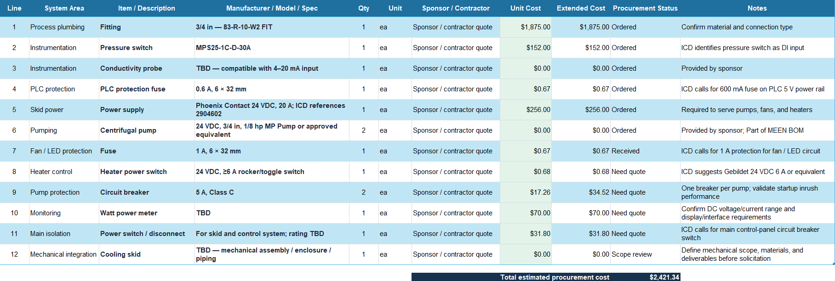
Parts Ordering Status
*Contains AI generated content*

Slide 26
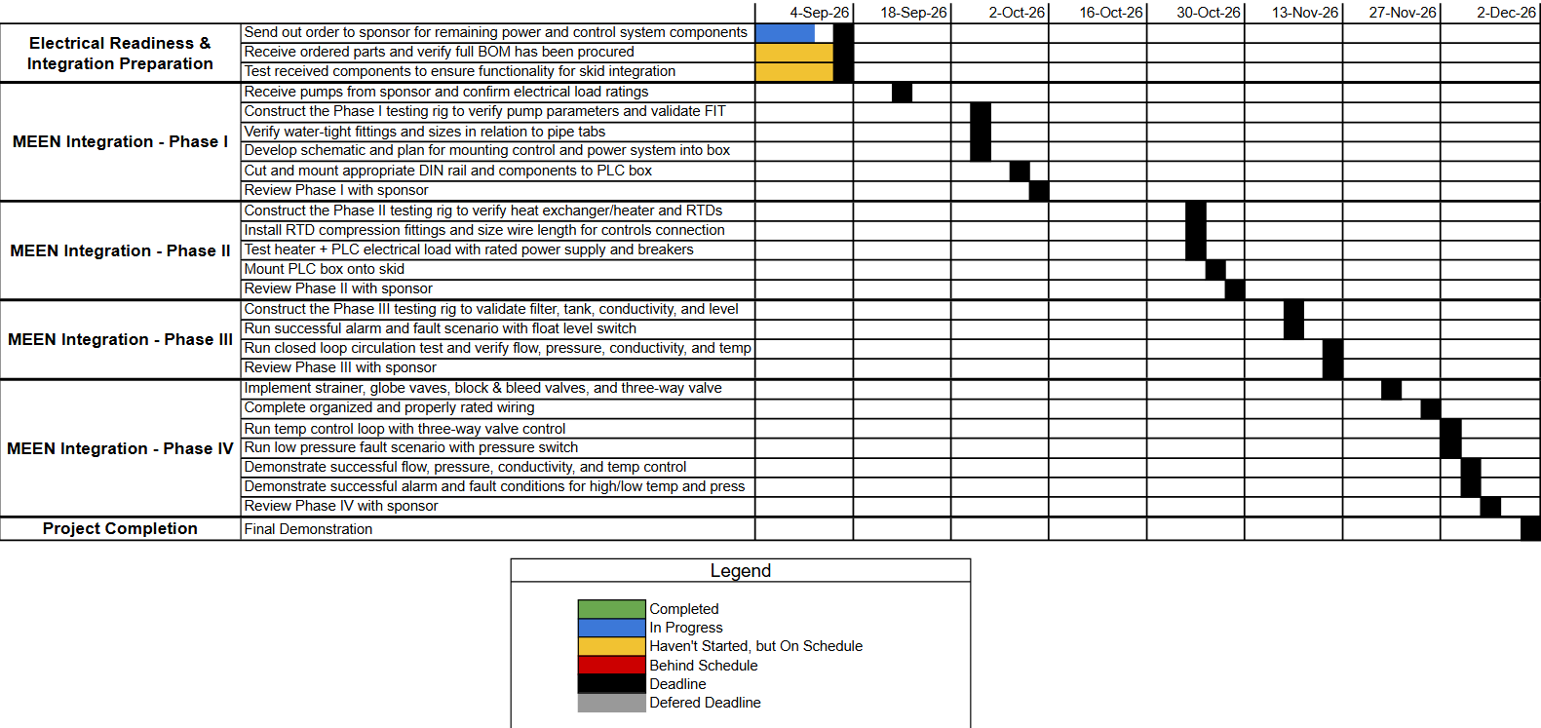
Execution Plan

Slide 27
Thank You

