Slide 1

Product Recommender System and NLP
Machine Learning
review -2
Submitted by: Group 4 – CSE D
Adheena B – CB.EN.U4CSE19301
Oviya B – CB.EN.U4CSE19341
Swathi P – CB.EN.U4CSE19353
Nivedya Sheej – CB.EN.U4CSE19364

Slide 2
Agenda / Topics
Problem Statement
Project Methodology
Research drilldown
Conclusion

Slide 3
Problem Statement
Objective
Cold Start Cases
COLD USER
COLD PRODUCT
"Develop a product recommendation system that alleviates the effect of cold start problem by incorporating user-written reviews "

Slide 4
Procedure / Methodology
Preprocessing
Classification of Reviews
Under sampling to deal imbalance
Comparison of Classifiers:
User Item Prediction
Item-Item Prediction

Slide 5
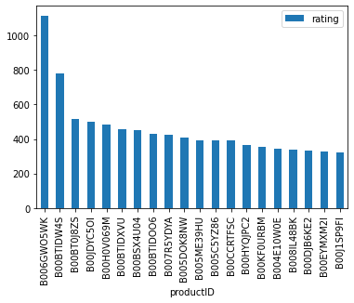
Pre-Processing Works
Link:
Data Set Used: Amazon Kindle Store.
Removed Unnecessary Columns and removal of Null Values
Visualization of Popular books
Categories made into Correct categories

Slide 6
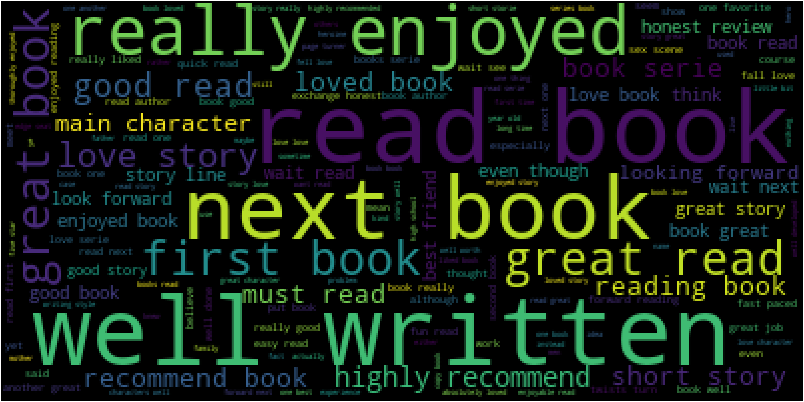
Classification of Reviews:
Link:
Techniques Used:
Tokenization
Cleaning Text using Regular Expression
Stop Words
Stemming
Classifying the reviews as Positive or negative (Word Cloud for most used words).

Slide 7
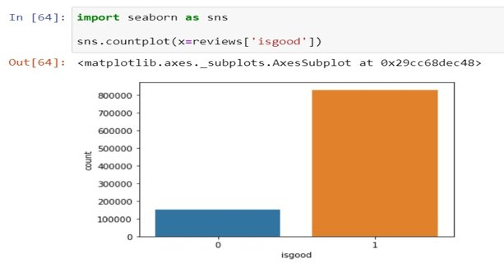
Under sampling to deal imbalance:
Link:
Visualizing the imbalance in the dataset
Comparison of positive and negative values
Converting 982619 rows × 7 columns into 306684 rows × 7 columns

Slide 8
NLP and Comparison of Classifiers:
Link:
Classifiers Used: | Percentage of Accuracy
LogisticRegression | 83.86210606974583%
DecisionTreeClassifier | 73.1483443924548%
LinearSVC | 81.80543554461418%
RandomForestClassifier | 77.06686013336159%
Conclusion Arrived:
Logistic Regression

Slide 9
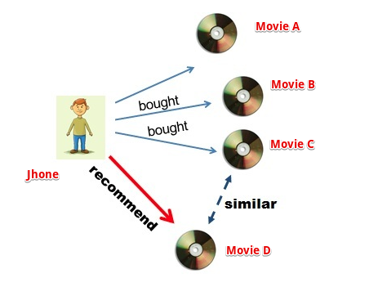
Item-Item Prediction Working Model:

Slide 10
Item-Item Prediction:
Link:
1. Acquires data with positive sentiments only.
2. Creates a rating_matrix (user x Product) where we get the overall rating given to a product by the user.
3. SVD applied on ratings_matrix and a correlation matrix is created with the decomposed matrix. Hence we get the correlation between different products.
4. We can now find the similar products to a particular item with this correlation matrix.

Slide 11
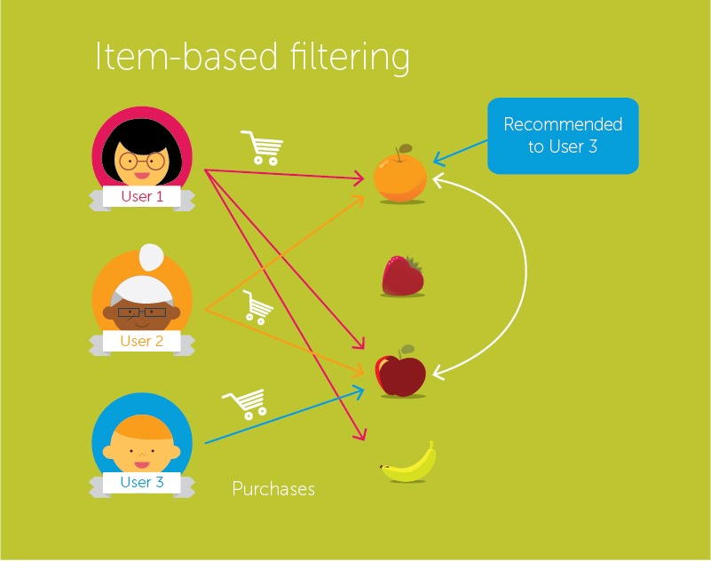
User-Item Prediction Working Model:

Slide 12
User Item Prediction:
Colab Link
User Input
Review
Usefulness of Reviews
Recommend Similar item using Collaborative Filtering
Ratings
Develop Model to Analyse the user Ratings
​

Slide 13
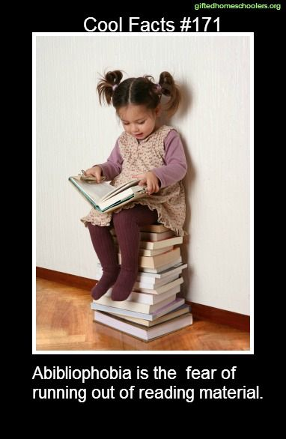
Conclusion:
Classification –Positive/Negative
Classifiers – Logistic Regression
Cold Start Problem Solved using:
Popular products with high positive sentiment association
Item-Item Prediction
User –Item Prediction
Link to Google drive folder containing all ipynb files:
https://drive.google.com/drive/folders/1YKkIHVor-QUNDynIaqVttdZNo-WsHF8o?usp=sharing

