Slide 1

Exploratory Data Analysis and Proposed Modeling Technique
Healthcare – Persistency of a drug
12/11/2022

Slide 2
Group FTR
Name | Email | Country | College/Company | Specialization
Fabian Umeh | Fabianumeh335@gmail.com | UK | Teesside University | Data Science
Rukevwe Ovuowo | rukevwe10@gmail.com | Nigeria | GBG Data science Academy | Data Science
Olutayo Oladeinbo | oladeinboolutayo@yahoo.com | UK | Teesside University | Data Science

Slide 3

Agenda
Executive Summary
Problem Statement
Objectives
Approach
EDA
EDA Summary
Proposed modeling technique

Slide 4
Executive Summary
Problem statement
One of the challenge for all Pharmaceutical companies is to understand the persistency of drugs as per the physician prescription. To solve this problem ABC pharma company would like the process Automated.
Objectives
The overall aim of the analysis part of the project is to provide insights into factors that impact the persistency of drugs, which afterwards will lay the foundation on building a suitable classification model and also propose some modelling technique to be used.
Approach
Understanding the dataset
Identifying the most impactful factors
Making recommendations.
Proposed modeling technique

Slide 5
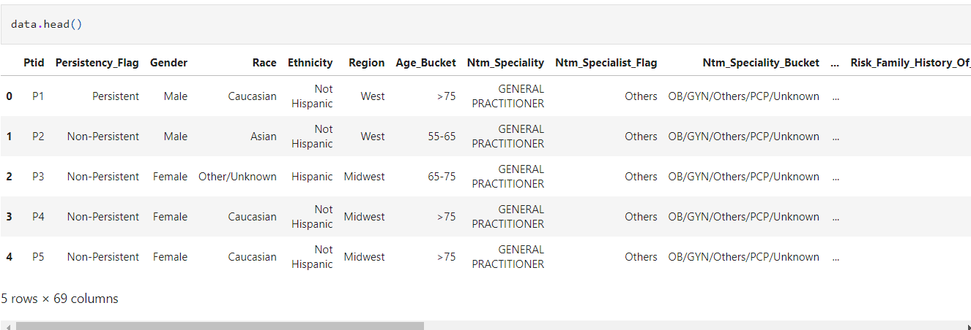
Data Understanding
Bucket | Variable | Variable Description
Unique Row Id | Patient ID | Unique ID of each patient
Target Variable | Persistency_Flag | Flag indicating if a patient was persistent or not
Demographics | Age | Age of the patient during their therapy
 | Race | Race of the patient from the patient table
 | Region | Region of the patient from the patient table
 | Ethnicity | Ethnicity of the patient from the patient table
 | Gender | Gender of the patient from the patient table
 | IDN Indicator | Flag indicating patients mapped to IDN
Provider Attributes | NTM - Physician Specialty | Specialty of the HCP that prescribed the NTM Rx
Clinical Factors | NTM - T-Score | T Score of the patient at the time of the NTM Rx (within 2 years prior from rxdate)
 | Change in T Score | Change in Tscore before starting with any therapy and after receiving therapy (Worsened, Remained Same, Improved, Unknown)
 | NTM - Risk Segment | Risk Segment of the patient at the time of the NTM Rx (within 2 years days prior from rxdate)
 | Change in Risk Segment | Change in Risk Segment before starting with any therapy and after receiving therapy (Worsened, Remained Same, Improved, Unknown)
 | NTM - Multiple Risk Factors | Flag indicating if patient falls under multiple risk category (having more than 1 risk) at the time of the NTM Rx (within 365 days prior from rxdate)
 | NTM - Dexa Scan Frequency | Number of DEXA scans taken prior to the first NTM Rx date (within 365 days prior from rxdate)
 | NTM - Dexa Scan Recency | Flag indicating the presence of Dexa Scan before the NTM Rx (within 2 years prior from rxdate or between their first Rx and Switched Rx; whichever is smaller and applicable)
 | Dexa During Therapy | Flag indicating if the patient had a Dexa Scan during their first continuous therapy
 | NTM - Fragility Fracture Recency | Flag indicating if the patient had a recent fragility fracture (within 365 days prior from rxdate)
 | Fragility Fracture During Therapy | Flag indicating if the patient had fragility fracture during their first continuous therapy
 | NTM - Glucocorticoid Recency | Flag indicating usage of Glucocorticoids (>=7.5mg strength) in the one year look-back from the first NTM Rx
 | Glucocorticoid Usage During Therapy | Flag indicating if the patient had a Glucocorticoid usage during the first continuous therapy
Disease/Treatment Factor | NTM - Injectable Experience | Flag indicating any injectable drug usage in the recent 12 months before the NTM OP Rx
 | NTM - Risk Factors | Risk Factors that the patient is falling into. For chronic Risk Factors complete lookback to be applied and for non-chronic Risk Factors, one year lookback from the date of first OP Rx
 | NTM - Comorbidity | Comorbidities are divided into two main categories - Acute and chronic, based on the ICD codes. For chronic disease we are taking complete look back from the first Rx date of NTM therapy and for acute diseases, time period before the NTM OP Rx with one year lookback has been applied
 | NTM - Concomitancy | Concomitant drugs recorded prior to starting with a therapy(within 365 days prior from first rxdate)
 | Adherence | Adherence for the therapies
The dataset contains 3424 rows and 69 columns.

Slide 6
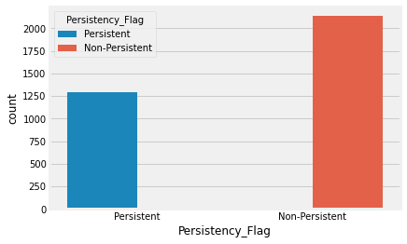
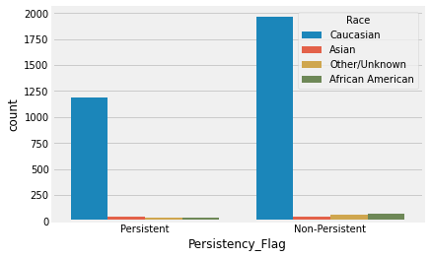
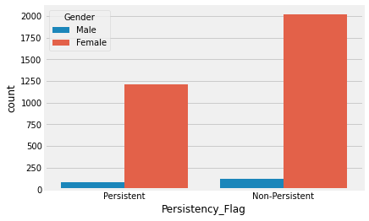
Exploratory data analysis
The number of cases where the drugs proved to be non-persistent were higher compared to number od persistency cases.
The dataset reveal that more females partook in this analysis than male.
People of Caucasian race when compered to other races were the most common in the study.

Slide 7
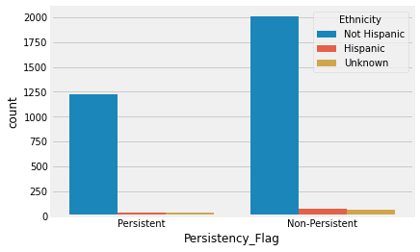
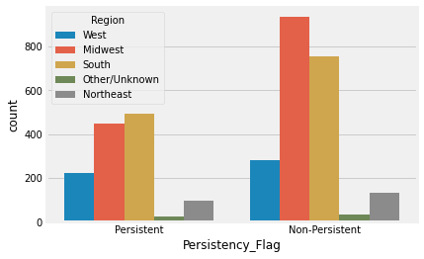
Exploratory data analysis
The non-Hispanic ethnic group were the most common in the study.
There were more people from the Midwest and South region compared to other regions.

Slide 8
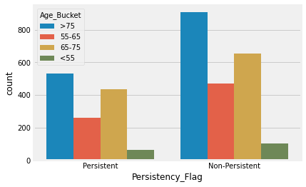
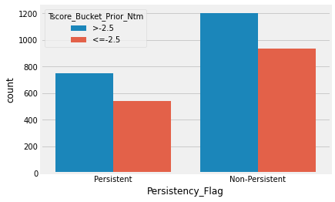
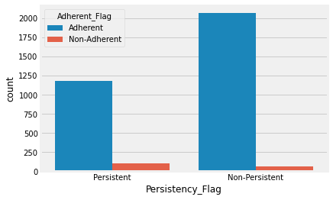
Exploratory data analysis
For this study, the majority of people selected are greater than 75 years of age.
People with a Tscore of >-2.5 have a higher chance of drug being non-persistent.

Slide 9
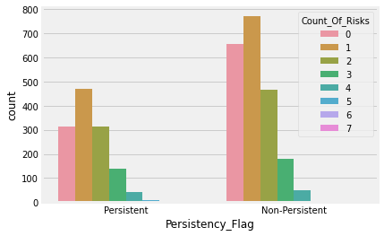
Exploratory data analysis
The chart reveals people with a lower count of risk have a higher chance of drug being non-persistent.

Slide 10
Summary and recommendation
EDA SUMMARY
The dataset contains 3424 rows and 69 columns.
The number of cases where the drugs proved to be non-persistent were higher compared to number od persistency cases.
The dataset reveal that more females partook in this analysis than male.
People of Caucasian race when compered to other races were the most common in the study.
The non-Hispanic ethnic group were the most common in the study.
There were more people from the Midwest and South region compared to other regions.
For this study, most people selected are greater than 75 years of age.
People with a Tscore of >-2.5 have a higher chance of drug being non-persistent.

Slide 11
Proposed modeling technique
The project is aimed at using certain factors relative to a patient in classifying successfully whether a drug is persistent or not. From the machine learning aspect of things, the task is a classification task and a binary classification task to be specific. For this project, we will focus on state-of-the-art machine learning classification models to build our drug persistency classifier. They include:
Logistic regression model
Support vector machines (SVM)
K-nearest neighbours (KNN)
Gradient Boost model

Slide 12
Repository details
Github Repo link: Ovuowo-Rukevwe/-Healthcare-Persistency-of-a-Drug (github.com)

Slide 13
Thank You

