Slide 1
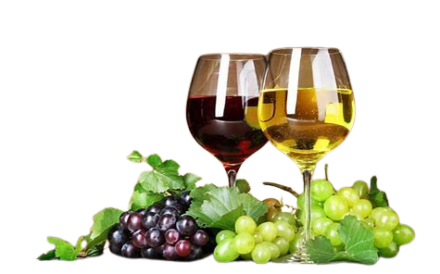
Wine Quality Report

Slide 2
CONTRIBUTORS
Name | Email | Country | College/Company | Specialization
Fabian Umeh | Fabianumeh335@gmail.com | UK | Teesside University | Data Science
Rukevwe Ovuowo | rukevwe10@gmail.com | Nigeria | GBG Data science Academy | Data Science
Olutayo Oladeinbo | oladeinboolutayo@yahoo.com | UK | Teesside University | Data Science

Slide 3
Problem statement
The Purpose of this data analysis is to predict the quality of a wine based on certain key physiochemical characteristics
Residual sugars
Alcohol content
Surfur dioxide
Volatile acididty
Citric acid
Fixed acididty
Chloride

Slide 4
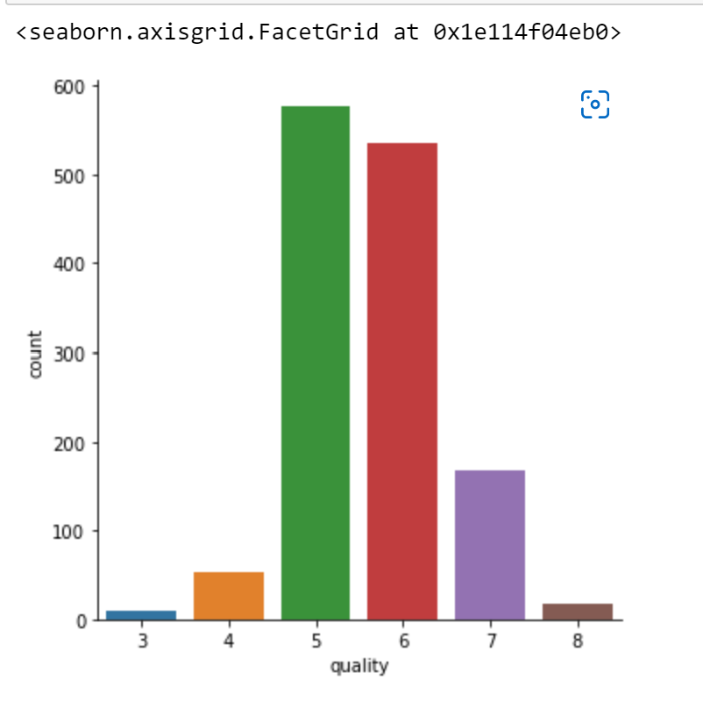
What makes a wine Quality?
Many factors determine the quality of a wine. The types of grapes used, the condition of the environment, as well as growing methods can all affect a wine’s quality.
There are official formulas that wine tasters use to determine the quality of taste:
Sweet Taste = sugar +alcohols
Acid Taste = acids + Bitter Taste(phenols).
There are many factors that contribute to a wine’s quality.

Slide 5
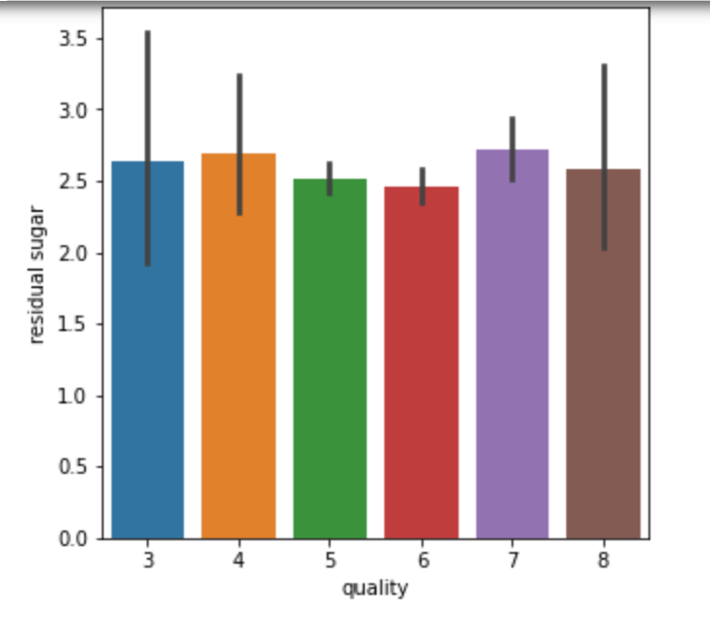
Residual Sugar
Residual Sugar is one of many factors that contribute to the sweetness of a wine .
It is the natural sugar from the grapes that is leftover after the fermentation process is completed.
If the residual sugar is high the wine as a good quality else the wine as a bad quality.
As the residual sugar increases, the quality of the wine increases

Slide 6
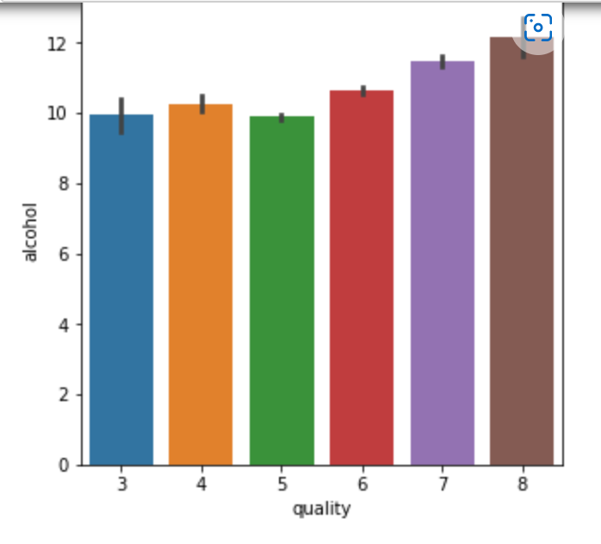
Alcohol
Alcohol is the result of yeast converting sugar during fermentation. Too much alcohol leads to hot wine. Higher alcohol content is acceptable for fortified or dessert wines.
The alcohol content is measured in alcohol by volume. Wines contain between 9% to 16% alcohol.
The wine quality increases when the volume of alcohol also increases, other wise it losses it quality.

Slide 7
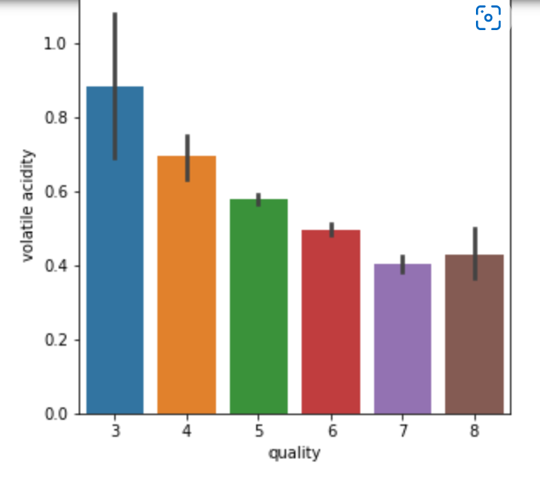
Volatile Acidity
Volatile acidity refers to the steam distillable acids present in wine.
Primarily acetic acid, but also lactic, formic, butyric and propionic acids may be used. These acids must be distilled from the wine before completion. If not monitor, too much acid will lead to the wine spoiling.
From the analysis, we can see that little volume of volatile acidity leads to good quality wine.

Slide 8
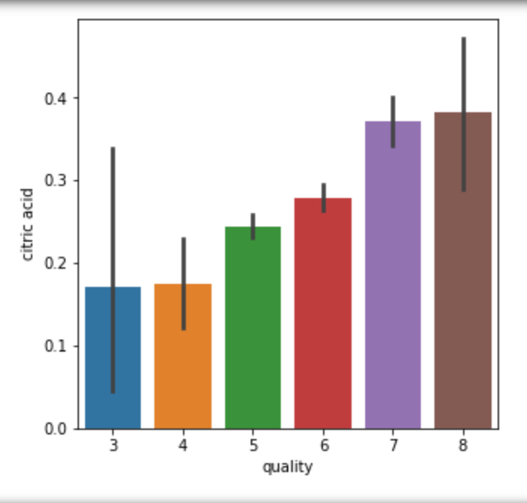
Citric Acid
Citric acid is measured separately from the rest of the fixed acids, and most of it is consumed during fermentation.
However, wine makers will often add it to a wine that is too basic.
Citric acid gives wine its freshness.
From the diagram, we can see that as the citric acid increases, the quality of the wine increases.

Slide 9
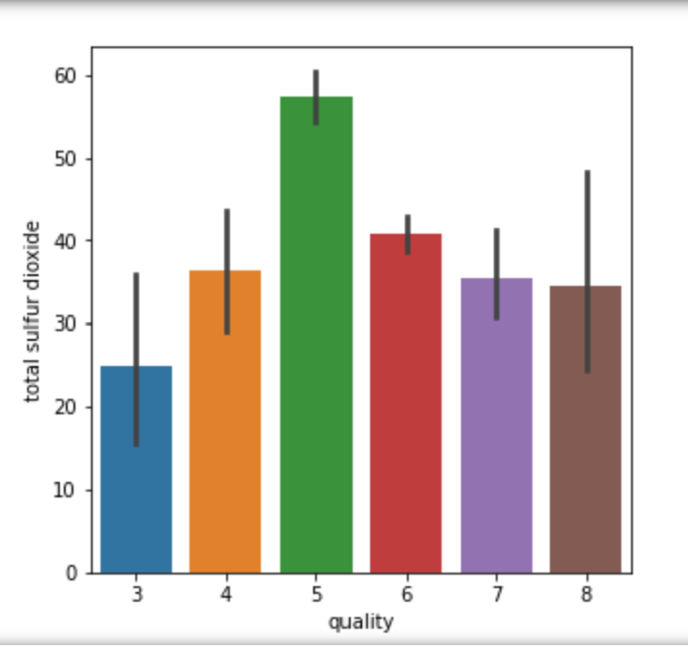
Sulfur dioxide
Sulfur dioxide contains the following:
1. Source of antioxidants. It helps to preserve quality and freshness
2. Sulfur dioxide is added to a wine to combat the growth of harmful bacteria.
3. Excess Sulfur dioxide can kill good yeast and a pungent odor is a sign of excess.
Can’t make a wine containing no sulfur dioxide

Slide 10
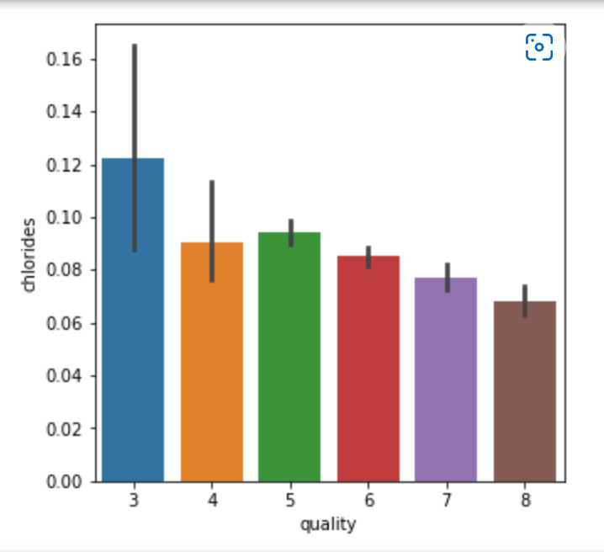
Chlorides
chloride in wine (which is then expressed as the concentration of sodium chloride [NaCl]). The Australian Food Standards Code specifies, “A wine must not contain more than 1000mg/L soluble chlorides expressed as sodium chloride”. This equates to 606mg/L of chloride ions.
If the chlorides reduces the quality of the wine increases

Slide 11
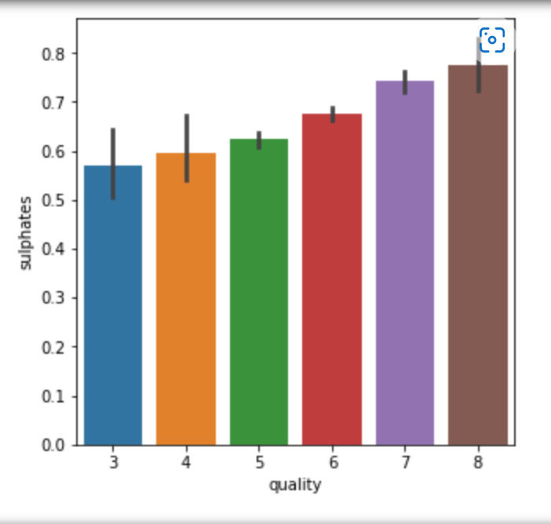
Sulphates
A wine additive which can contribute to sulfur dioxide gas (S02) levels, which acts as an antimicrobial. Sulfites are a chemical compound used to improve the appearance, taste, and shelf life of wine and other products. A well made dry red wine typically has about 50 mg/l sulfites. Wines with lower acidity need more sulfites than higher acidity wines.
The more the sulphates acid, the more the wine increases in quality.

Slide 12
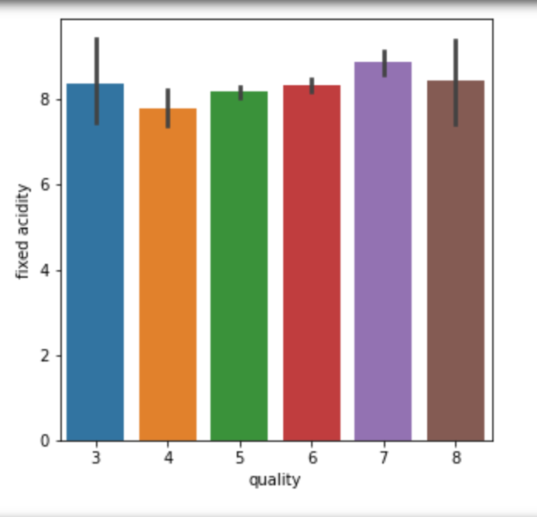
Fixed Acidity
Is a measurement of the total concentration of titratable acids and free hydrogen ions present in your wine. Total acidity and titratable acidity are not the same thing and the terms should not be used interchangeable.
The predominant fixed acids found in wines are tartaric, malic, citric, and succinic. Their respective levels found in wine can vary greatly but in general one would expect to see 1,000 to 4,000 mg/L tartaric acid

Slide 13
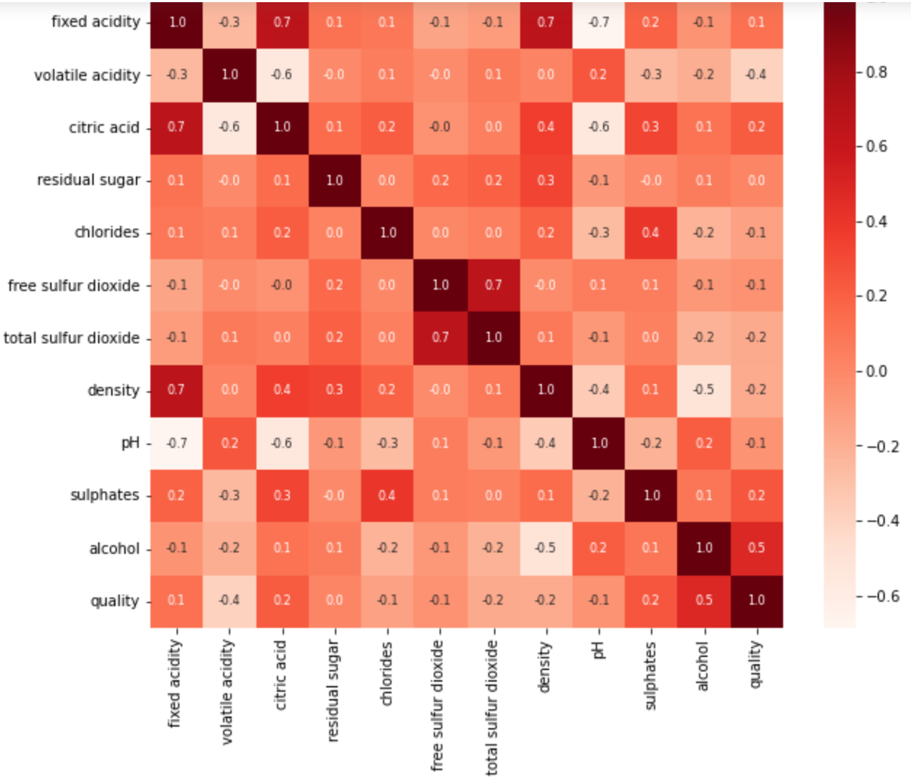
Correlation Between data
From the correlation map, we can see that the wine has a good quality in terms of alcohol, citric acid, sulphates, fixed acidity. If the volume of these factors increases, the quality of the wine increases, other wise the wine loss it quality.

Slide 14
Model Used
Random Forest Classifier
K Nearest Neighbours Classifier

Slide 15

Thank You

