Slide 1
Ovyo Healing Library
AI‑Powered Self‑Healing Selenium Framework

Slide 2
Why Self‑Healing Automation?
UI changes break tests
High maintenance effort
Flaky CI pipelines
Slow release cycles

Slide 3
Ollama Working
Ollama is a tool that lets you run large language models (LLMs) locally on your own machine—no cloud calls, no API keys, no data leaving your laptop. Think of it as Docker for AI models, but way simpler.
What problem does Ollama solve?
Most AI apps depend on cloud LLMs (OpenAI, Anthropic, etc.), which means:
💸 Usage costs
🌐 Internet dependency
🔐 Data/privacy concerns
⚠️ Latency and rate limits
Ollama flips this by letting you:
Run models offline
Keep all data local
Use open-source models
Integrate with your apps via a local HTTP API

Slide 4
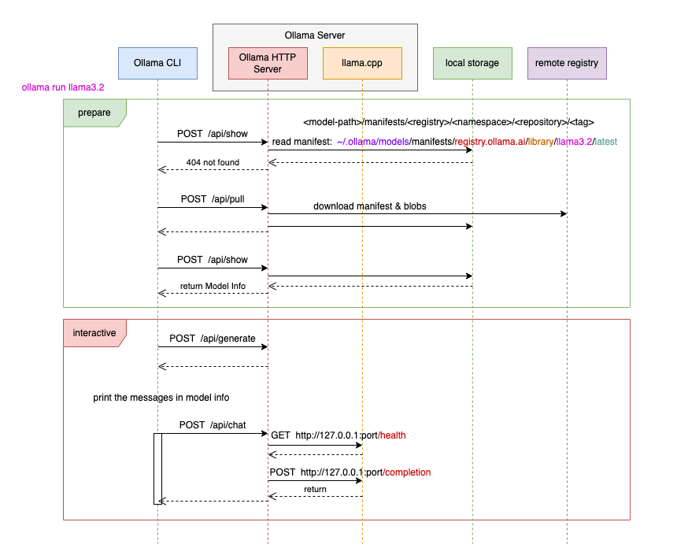

Slide 5
Solution Overview
Automatic locator recovery
Local + AI healing
Persistent learning
Minimal test changes

Slide 6
Robot Framework & PyTest Usage
Built as a wrapper over Selenium Library
Currently optimized for Robot Framework
Uses all existing Selenium keywords
NO changes required to existing test cases
How it works:
• Replace SeleniumLibrary import with Healing library
• Existing keywords continue to work
• Healing happens transparently in background
Future:
• PyTest support via custom driver fixture

Slide 7
End‑to‑End Healing Flow
Test Step
Find Element
Locator Failure?
Local Healing
AI Healing (Ollama)
Validate & Persist

Slide 8
Healing Metrics & ROI
✔ Healing Success Rate: 85–95%
⏱ Avg Recovery Time: <200 ms
🔁 Failure Reduction: ~70%
💰 Maintenance Cost Savings: ~60%
🚀 CI Stability Improved

Slide 9
AI Prompt & Confidence Scoring
Broken Locator + DOM Snapshot
Prompt Template
(Intent + Rules)
Ollama LLM
Generated Locator Candidates
Confidence Scoring
(tag, attr, position)
Best Locator Stored

Slide 10
Future enhancements
1. Multi-Programming language/framework support.
2. Duplicate content(Element) detection.
3. Jira integration for QA workflows. - Test case status(Pass/Fail) update on Jira, with Build ID. Feature branch and release branch.
4. “Last updated” indicator. 5. Version history for documents.
6. Email report, Grafana(Build ID, Test case Status, TC-id, Documentation), Power BI/Tableau.
6. Adidtya- Can take up the scope of OTT integration with self healing.

