Slide 1
Demographics
File created on: 16-09-2024 21:22:44

Slide 2
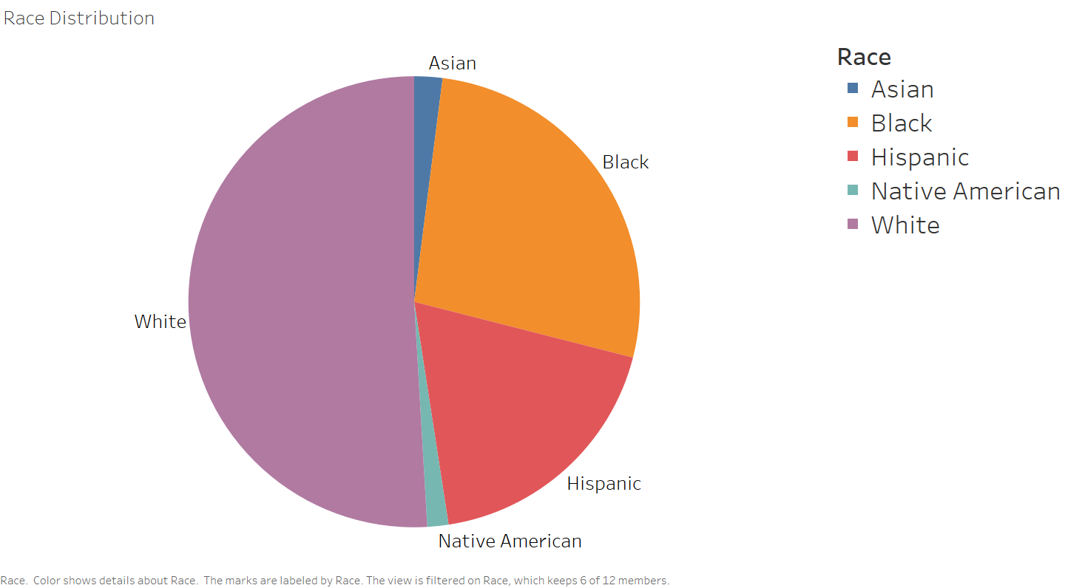

Slide 3
Distribution of Police Shooting Cases by Race
To represent the distribution of police shooting cases by race, we chose a pie chart to provide a visual comparison of the proportion of cases involving different races. The pie chart can effectively communicate the relative proportions of each category at a glance
The largest segment represents the most common race, while smaller slices indicate less frequent cases.
Mark: Pie
Channel: Color(to represent races) and size of slices(to represent proportions)

Slide 4
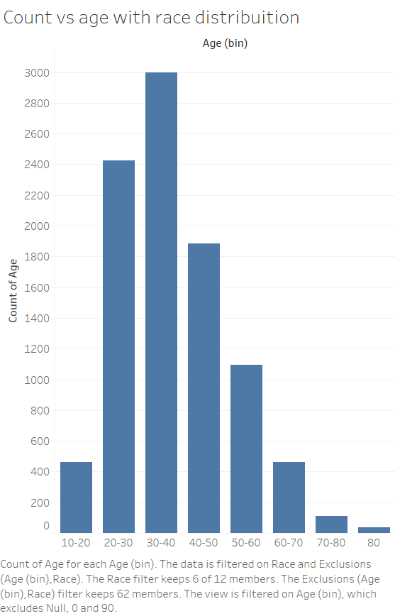

Slide 5
Distribution of Police Shooting Cases by Age
To represent the age distribution of police shooting cases, we chose a bar chart with age ranges on the x-axis and the count of cases for each on the y-axis.
This method is optimal for comparing the frequency of police shootings across different age groups, as the bar lengths make it easy to identify which age groups are most affected. The spacing between bars ensures clarity and easy interpretation.
Mark: Bar
Channel: X-axis(Age Range), Y-axis(Count of Police Shootings), and length of bars(represent count)

Slide 6
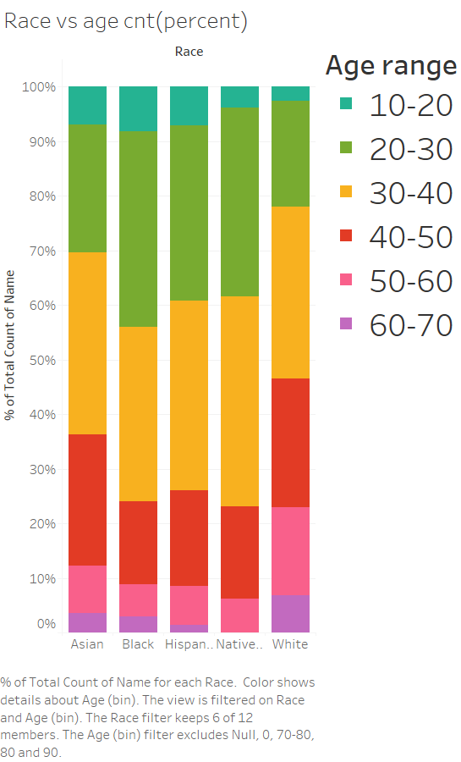

Slide 7
Distribution of age groups within different races
This stacked bar chart represents the concentration of different age ranges across various races involved in police shootings.
The chart uses the percentage of the total count on the y-axis to provide a normalized comparison of age groups within each race.
Each race is represented as a separate bar graph, with different color segments indicating specific age ranges. This method helps visualize how age groups are distributed within each race and offers a clear way to compare trends across racial categories.
Mark: Bar
Channel: X-axis(Race), Y-axis(percent of total count) and color(representing different age groups).

Slide 8
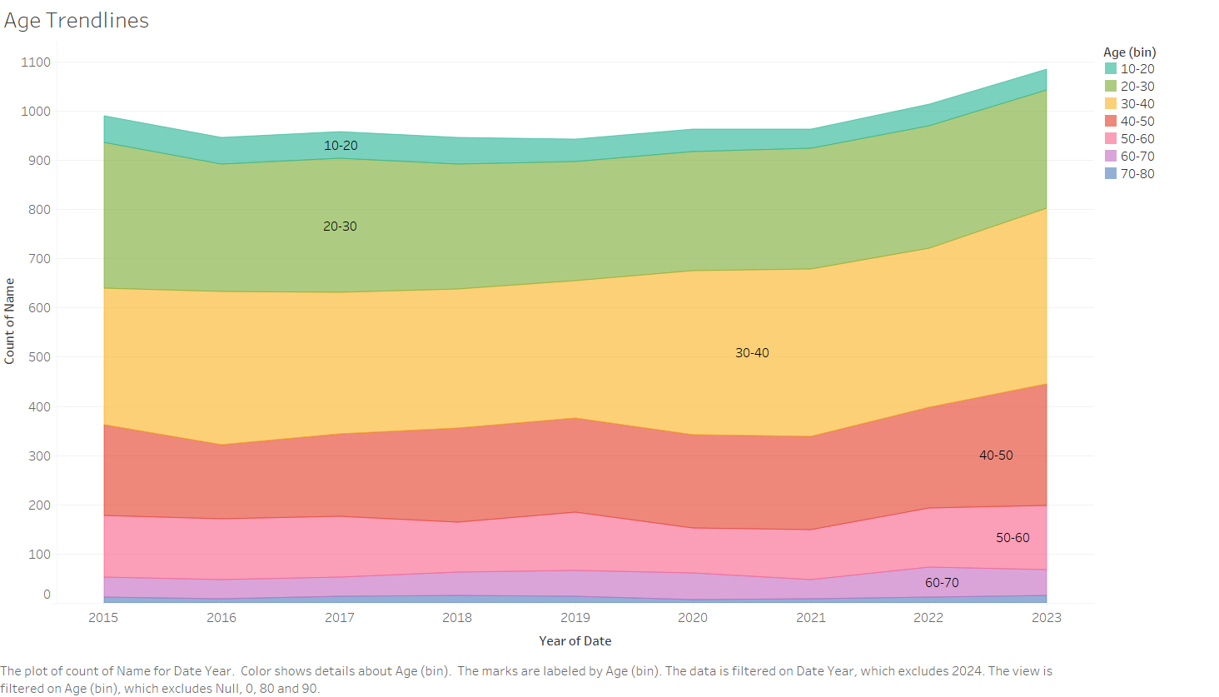

Slide 9
Age Distribution Trends in Police Shootings Over Time
This visualization shows age trends over the years using an area chart. Each colored band represents a different age group, showing how the counts of individuals in each age group have changed over time, from 2015 to 2023.
The area chart provides an effective way to show both the volume and proportion of different age groups over time.
Mark: Area(Stacked Area Chart)
Channel: X-axis(year of date(temporal)), Y-axis(count of names(quantitative)), color(Age Range(Ordinal))

Slide 10
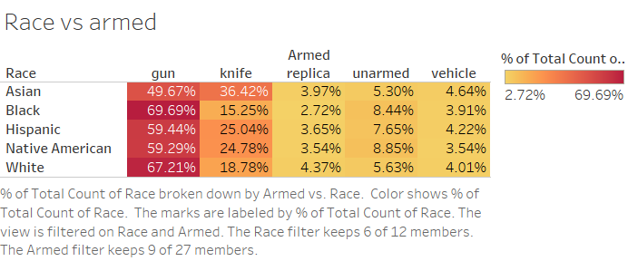

Slide 11
Heat map between Race and Armed used
This heat map visualizes the relationship between race and the type of weapon or object the individual was armed with, representing the percentage of weapon usage by race.
The intensity of the color represents the proportion of armed usage within each race.
The heat map is effective for identifying patterns or trends in armed usage across races, where varying intensities of color allow for quick comparisons across different race and weapon combinations.
Mark: Rectangular cells(heat map)
Channel: X-axis(Race), Y-axis(Armed used), color intensity(percentage of armed used by race)

Slide 12
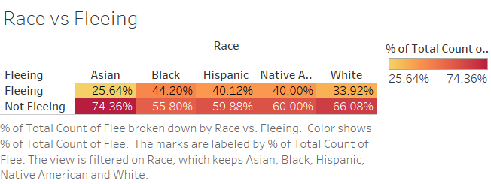

Slide 13
Heat map between Race and Fleeing
This heat map visualizes the relationship between race and Fleeing, representing the percentage of Flee by race.
The intensity of the color represents the proportion of Flee within the race.
The heat map is effective for identifying patterns or trends in Flee across races, where varying intensities of color allow for quick comparisons across Flee or not Flee.
Mark: Rectangular cells(heat map)
Channel: X-axis(Race), Y-axis(Flee or not Flee), color intensity(percentage of flee by race)

Slide 14
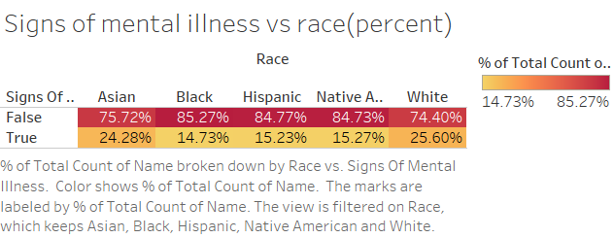

Slide 15
Heat map between Race and Illness
This heat map visualizes the relationship between race and illness, representing the percentage of mental illness by race.
The intensity of the color represents the proportion of mental illness within the race.
The heat map is effective for identifying patterns or trends in mental illness across races, where varying intensities of color allow for quick comparisons across Flee or not Flee.
Mark: Rectangular cells(heat map)
Channel: X-axis(Race), Y-axis(Mental illness or no illness), color intensity(percentage of mental illness by race)

Slide 16
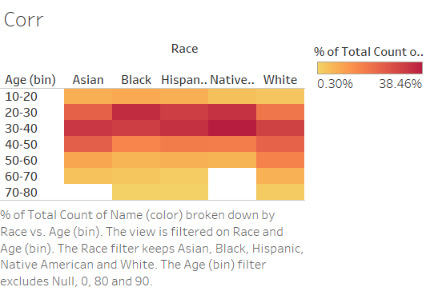

Slide 17
Correlation between age groups and race
This heat map allows for quick identification of patterns between race and age groups.
It provides an effective way to observe how different age demographics vary across racial lines, with the color intensity making it easy to spot trends at a glance.
Marks: Rectangular cells (Heat Map)
Channels: X-axis(Race), Y-axis(age ranges), color intensity(percentage of count)

Slide 18
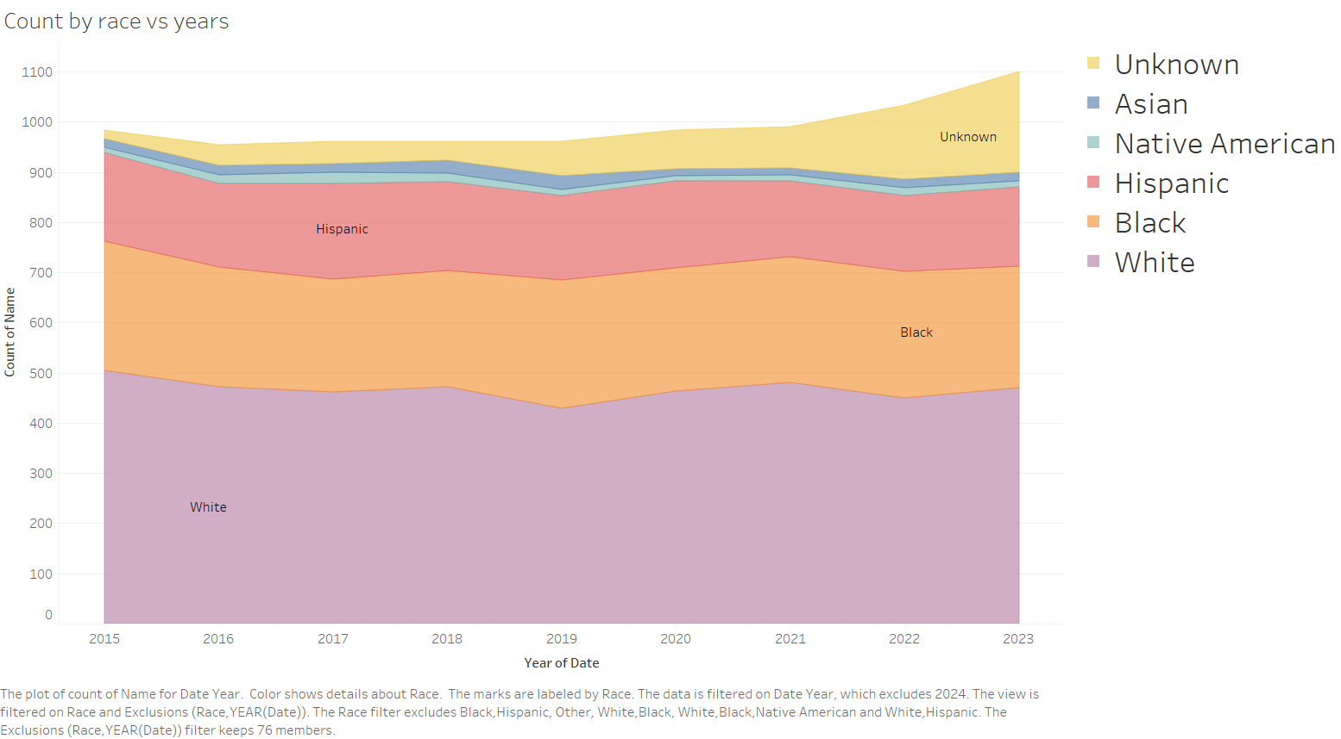

Slide 19
Race Distribution Trends in Police Shootings Over Time
This visualization shows race trends over the years using an area chart. Each colored band represents a different race group, showing how the counts of individuals in each age group have changed over time, from 2015 to 2023.
The area chart provides an effective way to show both the volume and proportion of different age groups over time.
Mark: Area(Stacked Area Chart)
Channel: X-axis(year of date(temporal)), Y-axis(count of names(quantitative)), color(race(Ordinal))

Slide 20
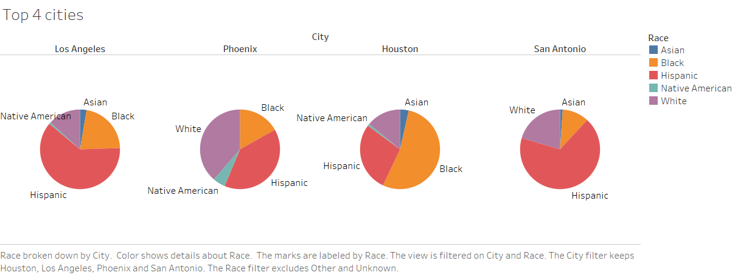

Slide 21
Pie charts of race distributions in 4 cities with highest number of cases
This set of pie charts visualizes the race distribution in the four U.S. cities with the highest number of fatal police shooting cases. Each pie chart represents a city, and the slices show the proportion of individuals of different races involved in these cases.
This visualization helps in observing racial disparities and distribution patterns in fatal police shooting cases across these high-incident cities.
Mark: Pie Chart
Channels; Color(different races) and angle(size of each slice corresponds to the proportions)

Slide 22
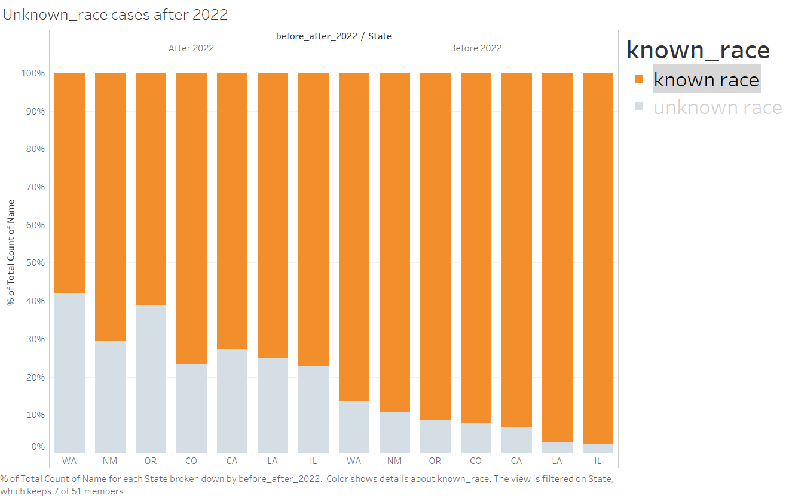

Slide 23
Distribution of incomplete data in major cities before 2022 and after 2022
This stacked bar graph displays the distribution of incomplete data in major cities, comparing two time periods: before 2022 and after 2022. Each bar is divided into segments representing the proportion of incomplete data for each city, providing insights into the changes over time.
This visualization is useful for making comparisons between time periods, understanding reporting issues, and identifying cities with persistent data gaps.
Mark: Stacked Bar
Channels: X-axis(2 different time periods and different cities), Y-axis(count of incomplete data entries), color(corresponds to ratio of incomplete to complete), stacked bars(Proportion of incomplete data for each city within the two timeframes).

Slide 24
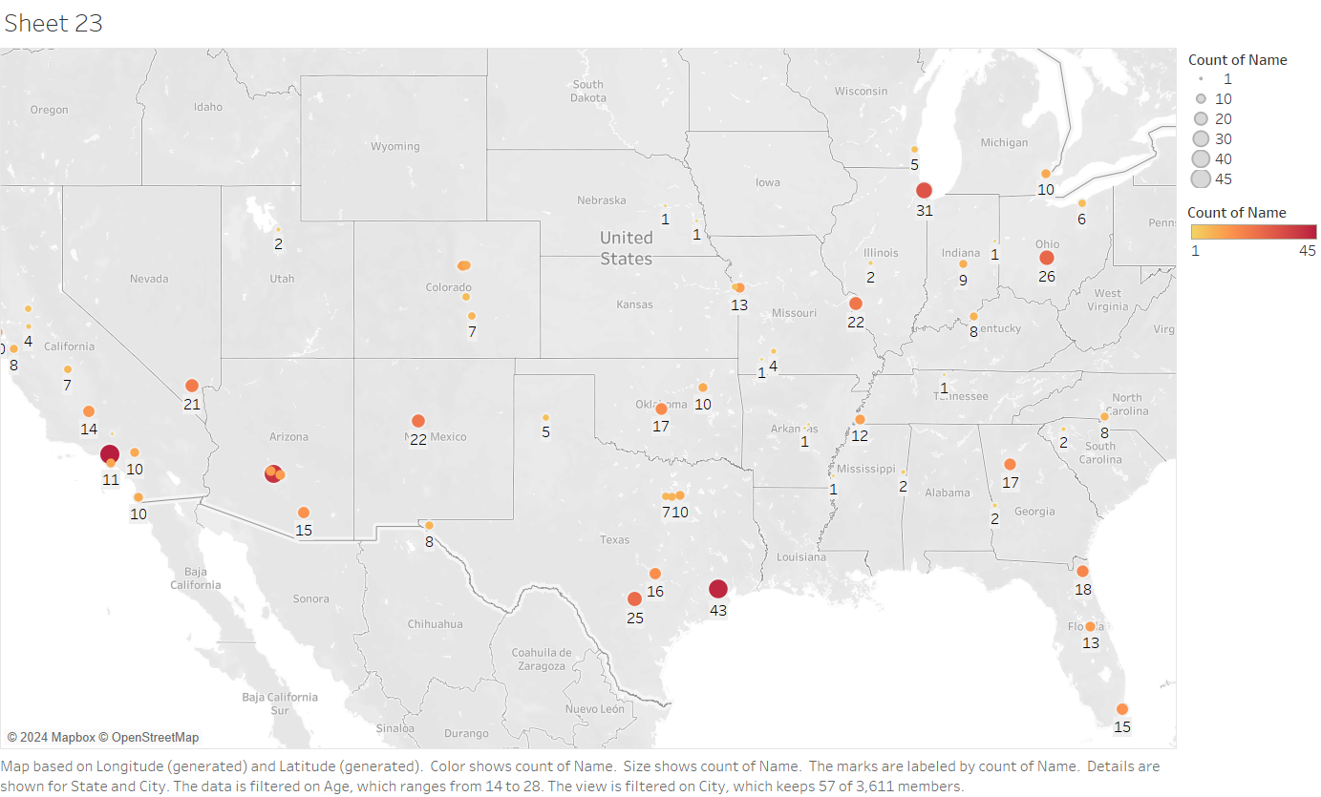

Slide 25
Geographical heatmap of number of cases of youth-related police shooting recorded by cities
This geographical heatmap presents the distribution of youth-related police shooting cases recorded by various cities. The cities are represented on a map, with both color and size of the data points indicating the number of cases.
This heatmap enables a clear visual comparison of youth-related police shootings across cities, helping identify areas with higher or lower incident rates.
Mark: Geographical points plotted on a map
Channels: geographical coordinates(location of cities), color and size (show number of cases)

Slide 26
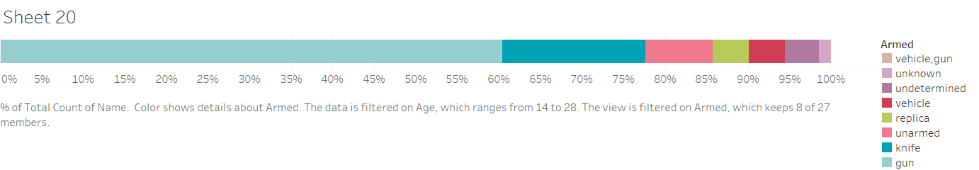

Slide 27
Distribution of arms used by youths(14-28yrs)
This horizontal stacked bar chart illustrates the distribution of arms used by youths (14-28 years). Each segments within the bar colored according to the proportion of each type of weapon used.
The lengths of the segments in each bar indicate the percentage of total weapons used by youth.
This visualization makes it easy to compare the types of weapons used by youths and spot trends or patterns in weapon distribution.
Mark: Horizontal stacked bars
Channels: X-axis(percentage of arms used) and color(different weapon used), stacked bars(proportion representation of weapon usage in each city)

Slide 28
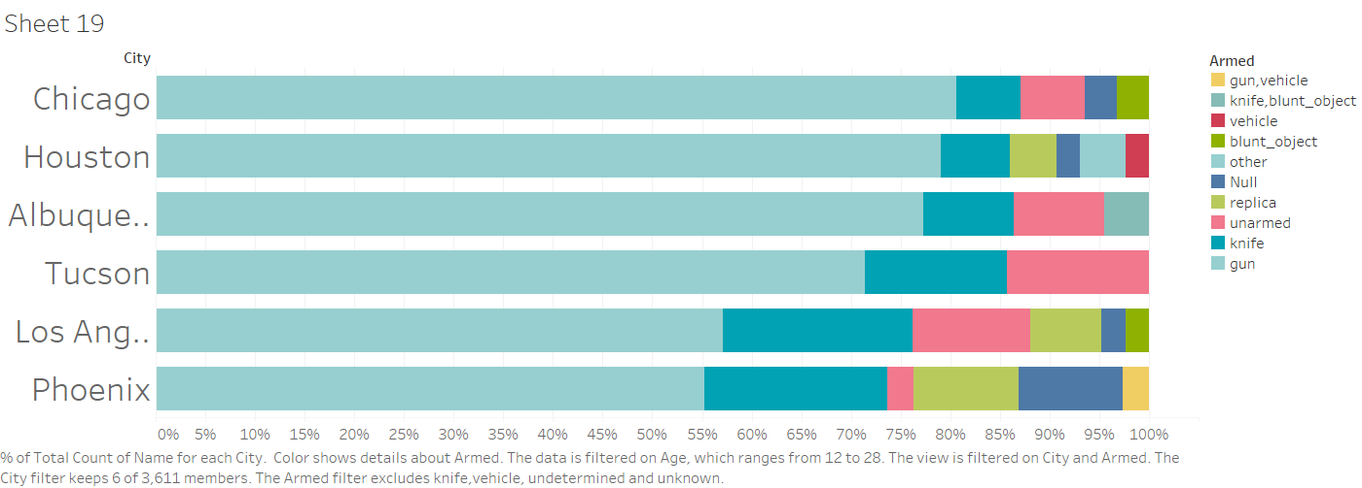

Slide 29
Distribution of arms used by youths(14-28yrs) in 6 cities recording high number of police shooting cases involving youths
This horizontal stacked bar chart illustrates the distribution of arms used by youths (14-28 years) across 6 cities with the highest number of youth-related cases. Each bar represents one of the six cities, with segments within the bar colored according to the proportion of each type of weapon used.
The lengths of the segments in each bar indicate the percentage of total weapons used by youths in that city.
This visualization makes it easy to compare the types of weapons used by youths across different cities and spot trends or patterns in weapon distribution among cities with high youth case rates.
Mark: Horizontal stacked bars
Channels: X-axis(percentage of arms used), Y-axis(names of 6 cities) and color(different weapon used), stacked bars(proportion representation of weapon usage in each city)

