Slide 1
Task 2 – Geopolitical Analysis
IMT2022055 Harsh Modani

Slide 2
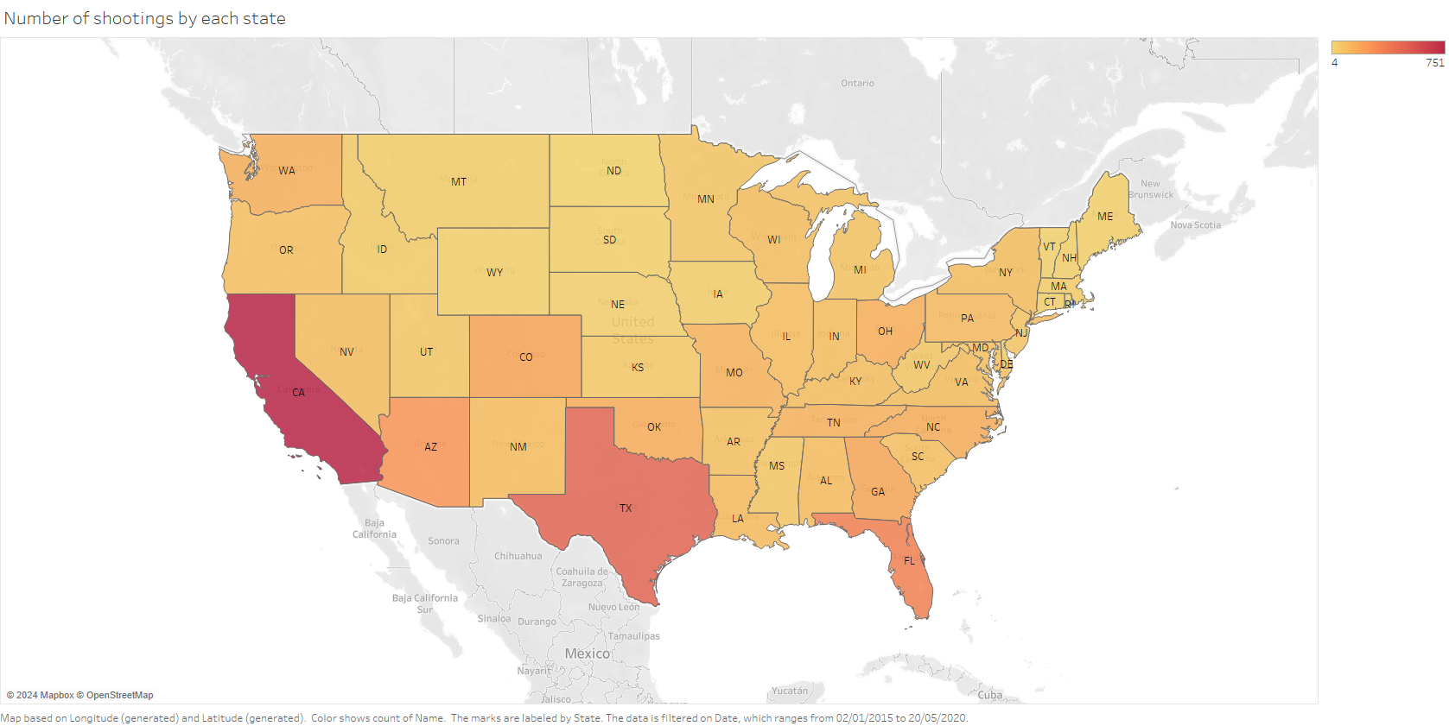

Slide 3
Figure T2.1
This visualization displays the number of shootings by each state in the U.S., represented using a cartograph. States are color-coded based on the frequency of shootings, with darker shades indicating higher numbers. The data ranges from a minimum of 4 shootings to a maximum of 751 shootings, as shown by means of a color gradient used as a channel. The red colors signify higher intensity (i.e. more cases) whereas the more subtle gold signifies lower intensity.
The map allows for a geographic comparison of police shootings across states. California (CA) and Texas (TX) are among the darkest regions, indicating the highest number of incidents, while states like Maine (ME) and Vermont (VT) show lighter shades, reflecting lower counts.

Slide 4
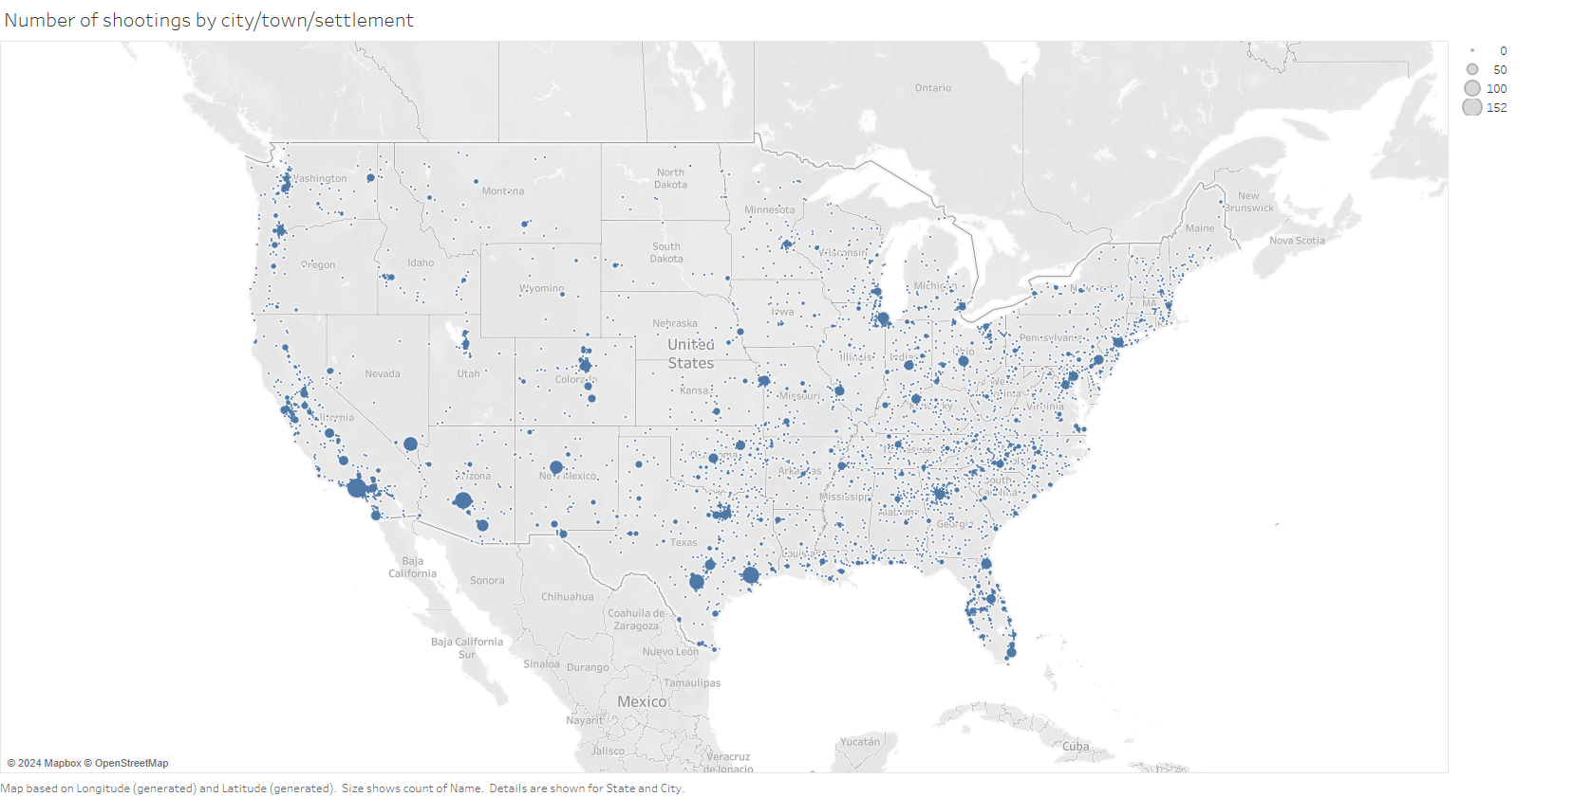

Slide 5
Figure T2.2
A similar visualization is created in figure T2.2, where the mark of the visualization is the dots that convey shootings occurring in that particular geographic region. The corresponding channel used is the radius of the dot, that signifies the count of cases occurring in the same region.
This graph is mainly used to highlight the aggregation of cases of police shootings around major urban areas in the U.S., such as the Bay Area, New York City etc., where population density in the U.S. is at its maximum. Another trend that the visualization uncovers is the tendency of higher case counts to occur in cities that are within California and Texas, the two most populated states in the U.S. as well.

Slide 6
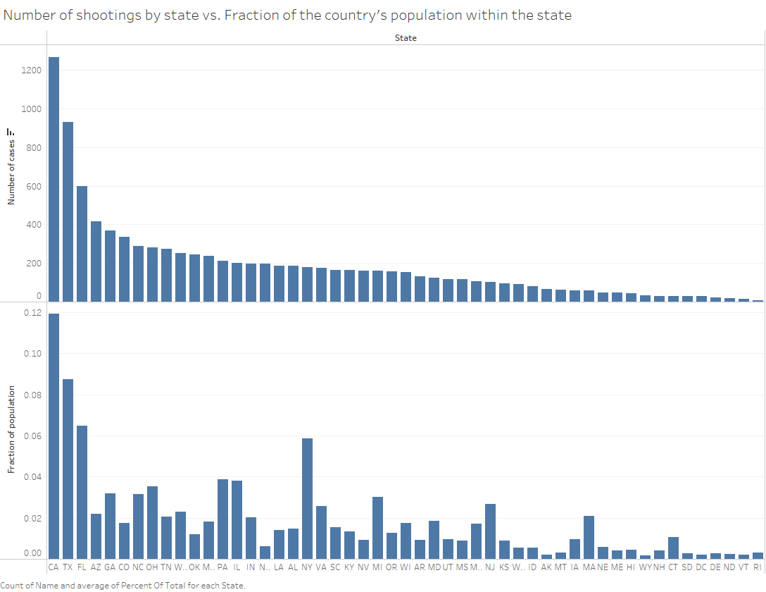

Slide 7
Figure T2.3
Figure T2.1 has problems in the sense that although it does indicate the concentration of cases well, it does not do well to establish a comparative between the number of cases in the state against the population of the state itself (which can be used to identify which states have disproportionately higher cases).
To solve this issue, a simple visualization containing two bar charts, where the column is the state and the channel is
The number of cases in the first bar chart; and
The fraction of population of the U.S. residing in the same state in the second bar chart
This bar chart provides a simple understanding of the relation between state population and number of cases in the state, but it also highlights some outliers from the given trend, which will be analyzed in further visualizations.

Slide 8
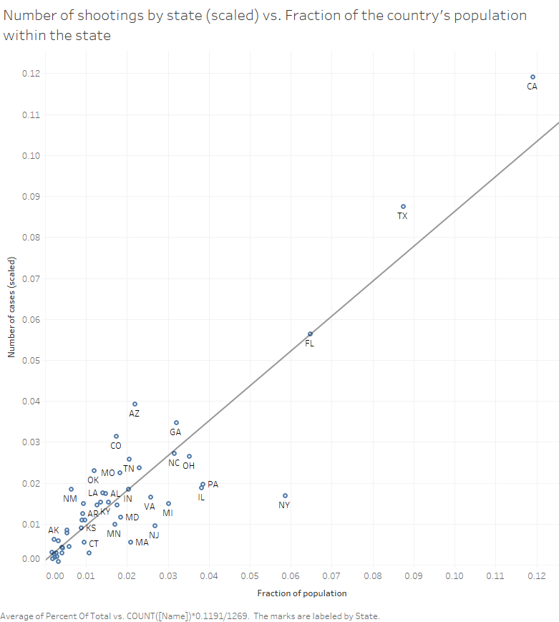

Slide 9
Figure T2.4
The primary purpose of figure T2.4 is to elucidate the correlation between the state population and the number of cases in the state, as well as highlight outliers from the same correlation.
To do so, an obvious method is the scatter plot as used above, where the marks are points on the graph indicating each state and the channels are its position on the X- and Y-axes, namely, their number of cases and the fraction of the population of the U.S. that reside in them, respectively.
From the chart, we see a clear linear trend, but also a few outliers on either side. We pick out the states (AZ, CO, NM, OK) as outliers on the “high case density” side and (CT, MA, NJ, MY) as outliers on the “low case density” sides.
Also, this graph highlights that both CA and TX – the two biggest states in the U.S. – lie far ahead of the others in terms of both population and cases.
Further analysis is performed on both sets of states.

Slide 10
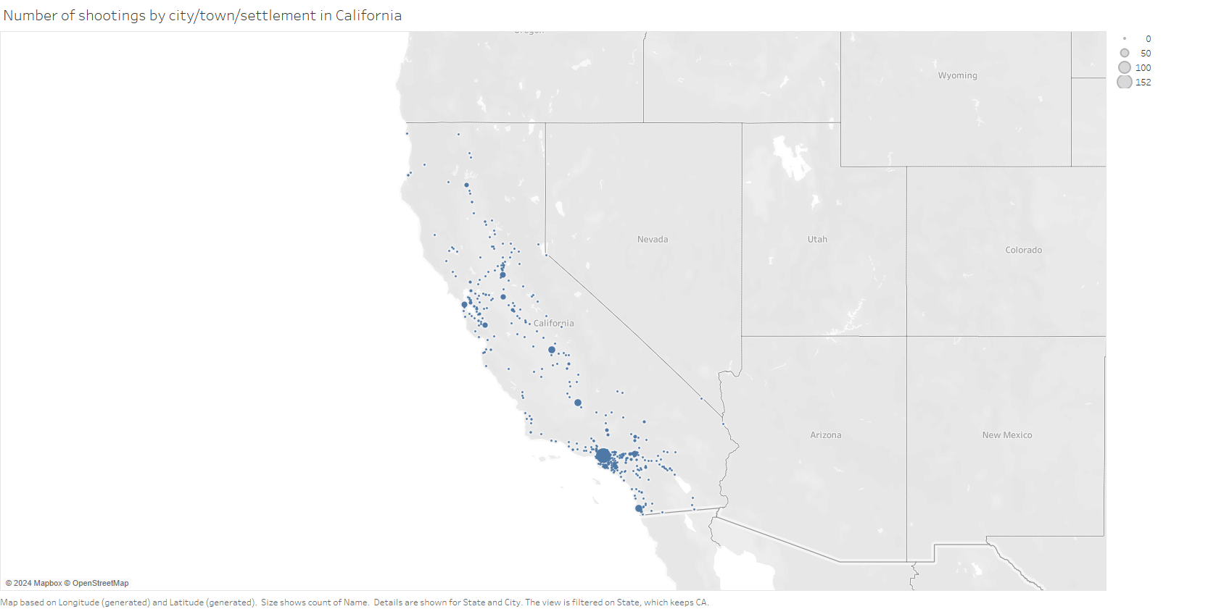

Slide 11
Figure T2.5
This visualization is a map showing the number of shootings by city, town, or settlement within California. Each point on the map represents a location where a shooting occurred, with larger dots indicating a higher number of shootings. The significance of the blue color used for the points is nothing but our portrayal of California as a politically “blue” (i.e. democrat) state.
The distribution of shootings is concentrated around major metropolitan areas, as is predictable. However, an interesting factor is that cases are even more concentrated towards the south of California, namely in the Los Angeles and San Diego areas.

Slide 12
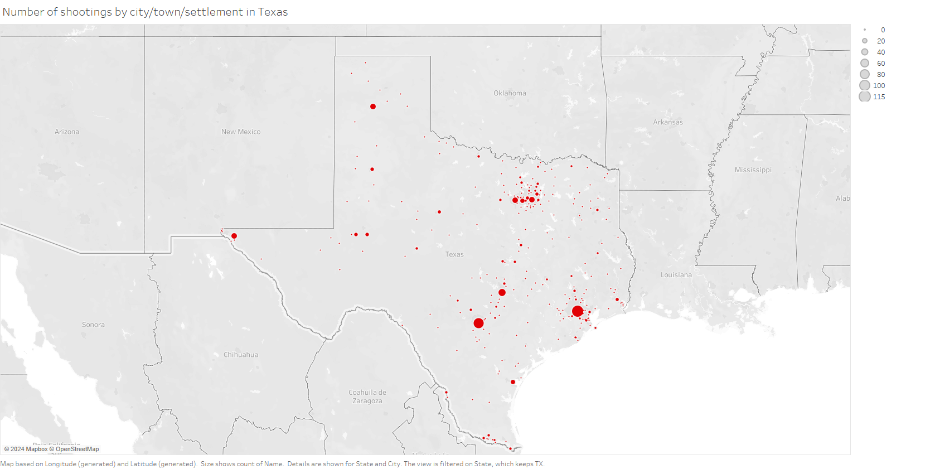

Slide 13
Figure T2.6
This visualization is a map showing the number of shootings by city, town, or settlement within Texas. Each point on the map represents a location where a shooting occurred, with larger dots indicating a higher number of shootings. Like in the previous visualization, the significance of the red color used for the points is nothing but our portrayal of Texas as a politically “red” (i.e. republican) state.
This map is not as informative, and relatively mundane, compared to the previous visualization. It only shows the concentration of shooting cases occurring in the four major cities – Houston, Dallas, San Antonio and Austin.

Slide 14
Figures T2.7, T2.10, T2.13
These visualizations are an analysis of the distribution of police shooting cases by race of the suspect. The graph used is a stacked bar chart, where the marks are the bars themselves and the channels used are the length of the bar, to denote the count of the cases; and the color, which is used to categorize the bar into a particular race.
From figure T2.7, we make the observation that there is a disproportionately high count of cases in CA where the suspect was of Hispanic origin, and the same could be said for Black cases in TX.
In figure T2.10, the distribution of cases by race largely models the population distribution of the same state; thus, we cannot draw significant conclusions from the same.
In figure T2.13, we see a higher proportion of Black shootings in the states of NY and NJ, which may indicate racial profiling in these two states.

Slide 15
Figures T2.8, T2.11, T2.14
These visualizations are an analysis of the distribution of police shooting cases by arms borne by the suspect. The graph used is a stacked bar chart, where the marks are the bars themselves and the channels used are the length of the bar, to denote the count of the cases; and the color, which is used to categorize the bar by the arms borne by the suspect.
From figures T2.8 (specifically Texas) and T2.11, we make the observation that a lot of suspects involved in police shootings were armed with guns, which is a reflection of the more lax gun laws in the corresponding states.
In figure T2.14, the proportion of suspects bearing guns is relatively less. Also, barring Connecticut, the number of unarmed people shot is less.

Slide 16
Figures T2.9, T2.12, T2.15
These visualizations are an analysis of the distribution of police shooting cases by whether the suspects attempted to flee, and the mode of fleeing. The graph used is a stacked bar chart, where the marks are the bars themselves and the channels used are the length of the bar, to denote the count of the cases; and the color, which is used to categorize the bar into cases where the suspect is not fleeing, fleeing by foot, fleeing by car etc.
From figure T2.9, we see no significant difference in the modes of fleeing used by suspects in California and Texas.
From figures T2.12 and T2.15, we can see that a larger proportion of people in the states of low case density are not fleeing when shot.

Slide 17
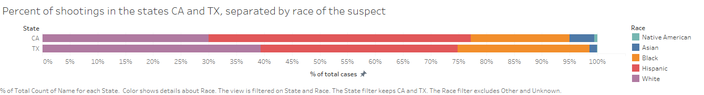

Slide 18
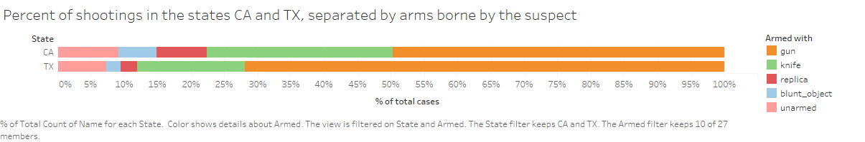

Slide 19
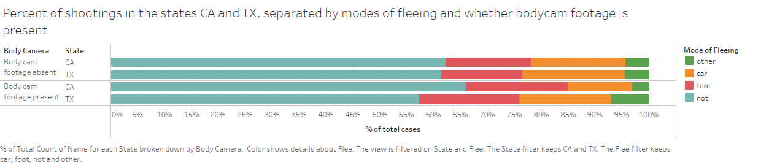

Slide 20
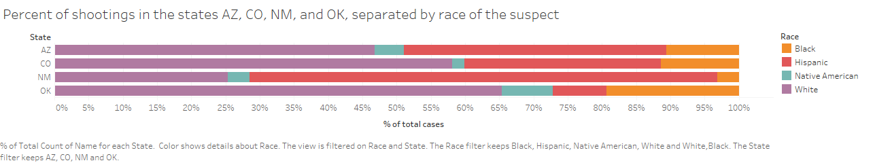

Slide 21
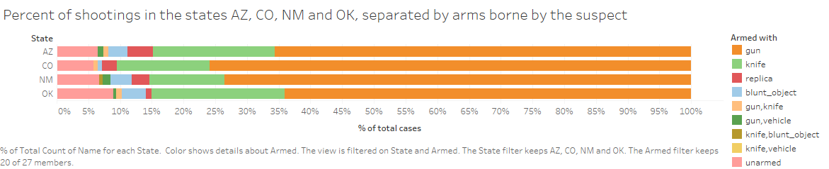

Slide 22
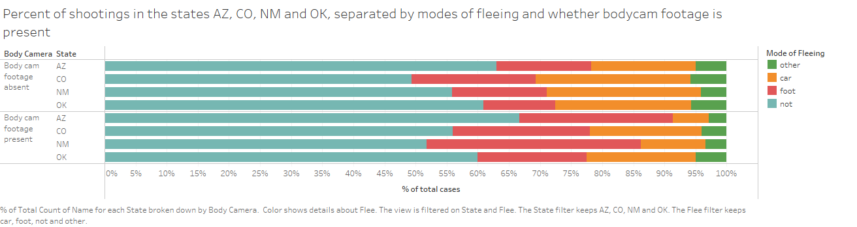

Slide 23
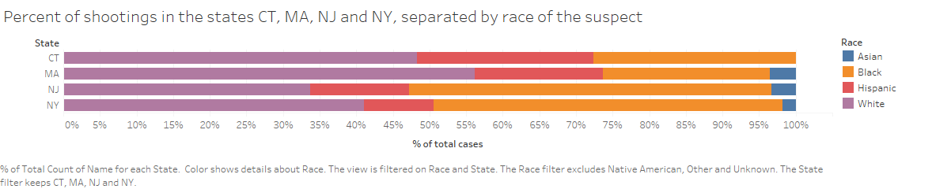

Slide 24
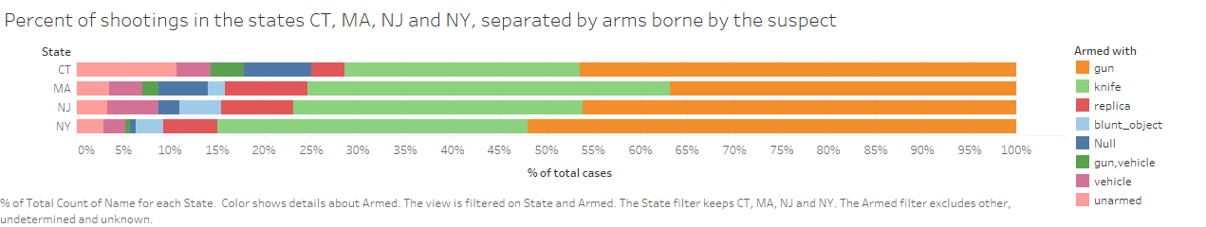

Slide 25
