Slide 1
T3
Descriptions of Visualizations

Slide 2
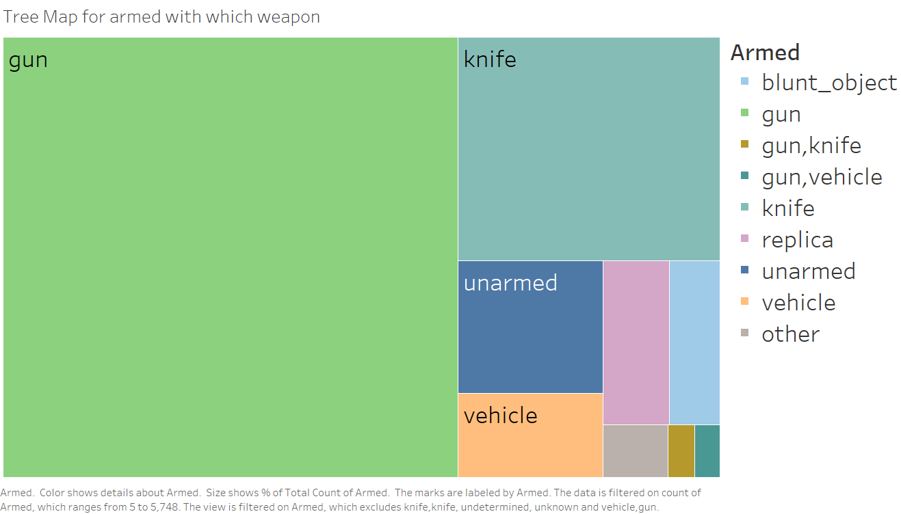

Slide 3
Tree map for armed with which weapon
There are multiple possible values for the armed field, and to represent which fractions of suspects in the dataset use which weapons, we initially chose bar graphs, and then pie chart, as we wanted to show comparison between which weapons were more common.
Count of max value is gun – 5748, and count of multiple min values is 1 each
Using a bar chart makes it very difficult to compare ratio, as there are weapons that are very less used, and the graph becomes very large due to scaling, so bar graph is suboptimal.
In pie chart, there are still multiple slices taking very little space, so it is very hard to read smaller values
So, we decided to use treemap, as they cover a larger area, and size is compared by mark as area, which allows us to see colour coded areas for comparison.

Slide 4
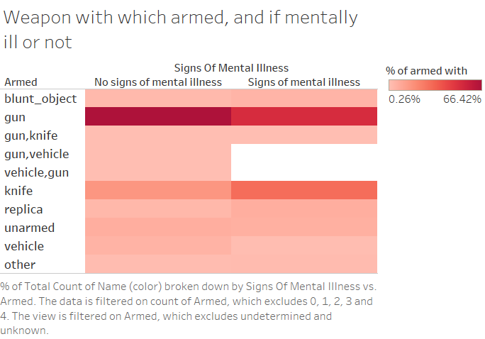

Slide 5
Weapon with which armed and if mentally ill or not
To represent the relationship between the type of weapon used by suspects and whether they showed signs of mental illness, we initially attempted a stacked bar chart. However, the stacked bars became cluttered, making it difficult to compare across categories, especially since some combinations of weapon types and mental illness status had very few occurrences.
In this heatmap, we improved clarity by using color intensity to represent the percentage of suspects armed with each type of weapon, while also indicating the presence or absence of signs of mental illness. This visual effectively uses color to show distribution, making it easier to interpret patterns at a glance.
The color range shows that a majority of cases involve suspects armed with guns (66.42%), with a clear contrast between those showing signs of mental illness and those not. Other categories, such as "blunt object" or "replica," have significantly fewer cases (0.26%), but the heatmap still allows us to see those patterns visually, even if the numbers are small. The gradient of the heatmap simplifies the comparison without overwhelming the viewer, addressing the issues we had with the stacked bar chart.

Slide 6
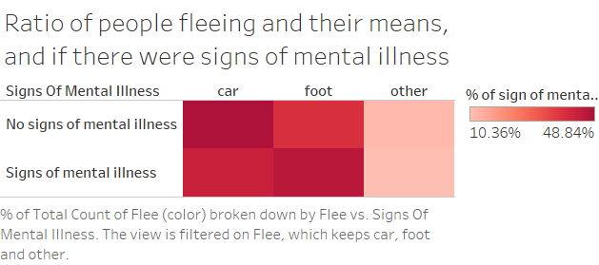

Slide 7
Ratio of people fleeing and their means, and if there were signs of mental illess
We initially used a line chart to show the breakdown of fleeing status versus signs of mental illness, but with only six data points, it didn’t make sense to use lines, as there’s no continuous trend.
We switched to a heatmap, which better visualizes these discrete categories. The color intensity easily highlights the percentage of total occurrences across the fleeing methods (car, foot, other) and mental illness signs, making it clearer and easier to interpret.

Slide 8
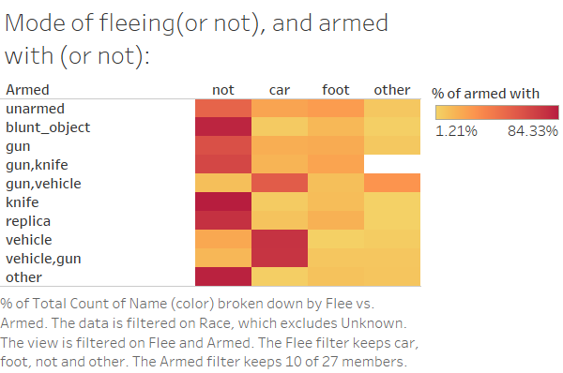

Slide 9
Mode of fleeing(or not), and armed with(or not)
We initially tried a sunburst chart to represent armed status versus fleeing categories, but it was hard to compare across small segments due to the circular layout. The outer layers made it difficult to interpret less frequent categories, and comparing across layers wasn’t intuitive.
We switched to a heatmap, which provided a cleaner, grid-like view. The color intensity clearly shows the percentage of total occurrences, making patterns easier to spot. Filtering the data by race (excluding unknown) and selecting 10 of the 27 armed statuses allowed for more focused comparisons. This approach improved clarity, especially for categories with fewer data points.

Slide 10
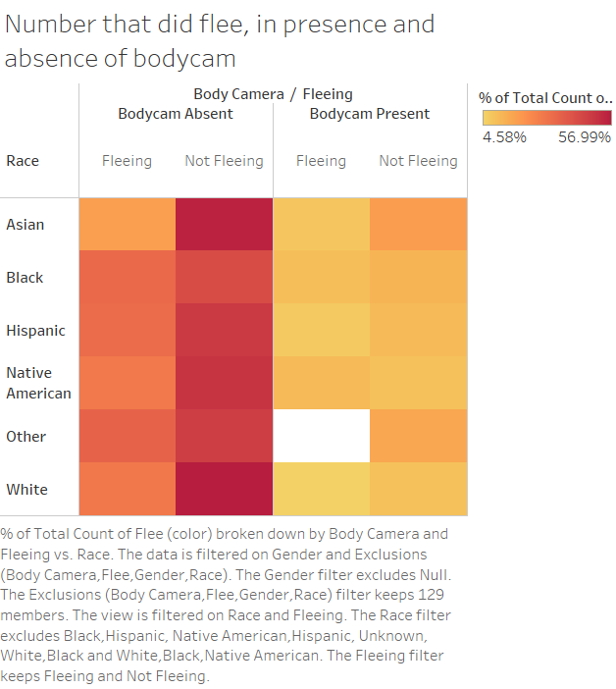

Slide 11
Number that flee, in presence and absence of bodycam
We initially used multiple donut charts by race to show the relationship between fleeing status, body camera presence, and race. However, the donut charts made it difficult to compare across categories and races due to the fragmented view, and smaller values were hard to distinguish.
We switched to a heatmap, which allows for a clearer side-by-side comparison of these discrete variables. The color intensity shows the percentage of total occurrences, making it easy to compare how often suspects fled or didn’t flee in the presence or absence of a body camera, across different races.

Slide 12
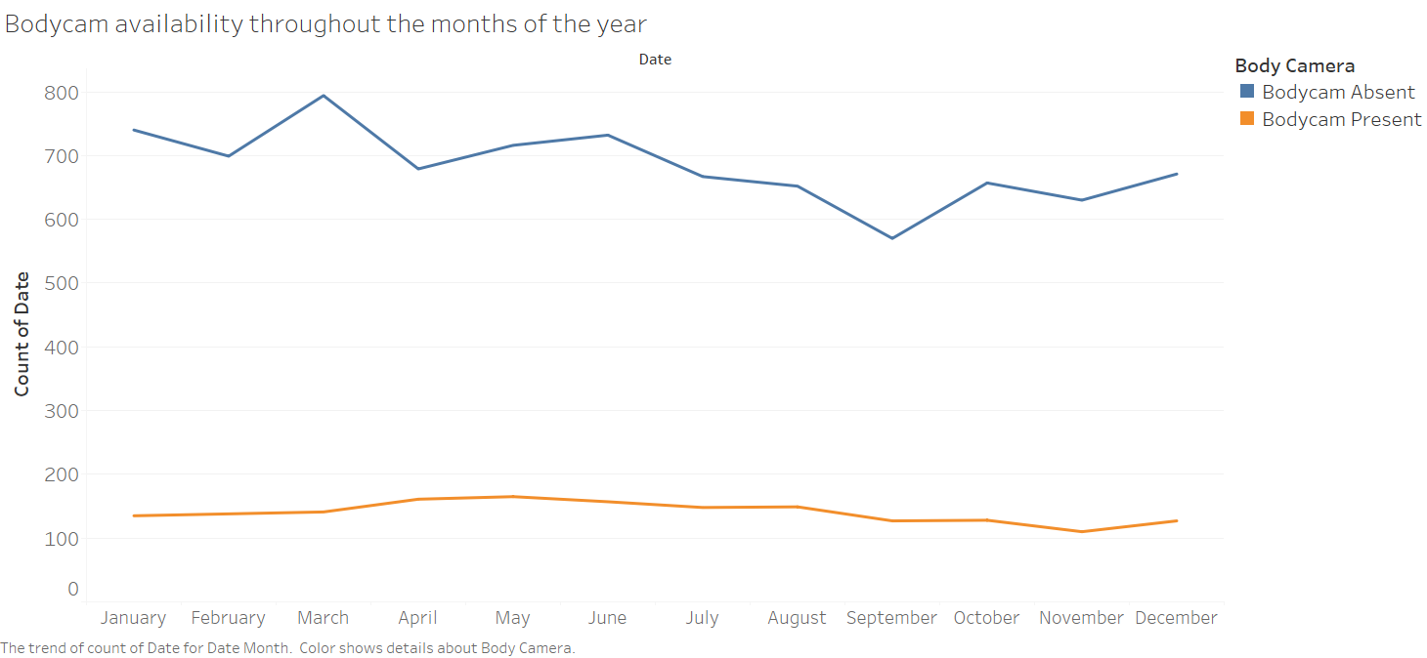

Slide 13
Bodycam availability throughout the year
A simple visualization to compare the number of cases where bodycam was present or in different months across the year
The first visualization we chose was line graph, and stuck with it as the data is continuous, and line graph is good at showing changes across the months, and also colour is used to differentiate between bodycam present or absent

Slide 14
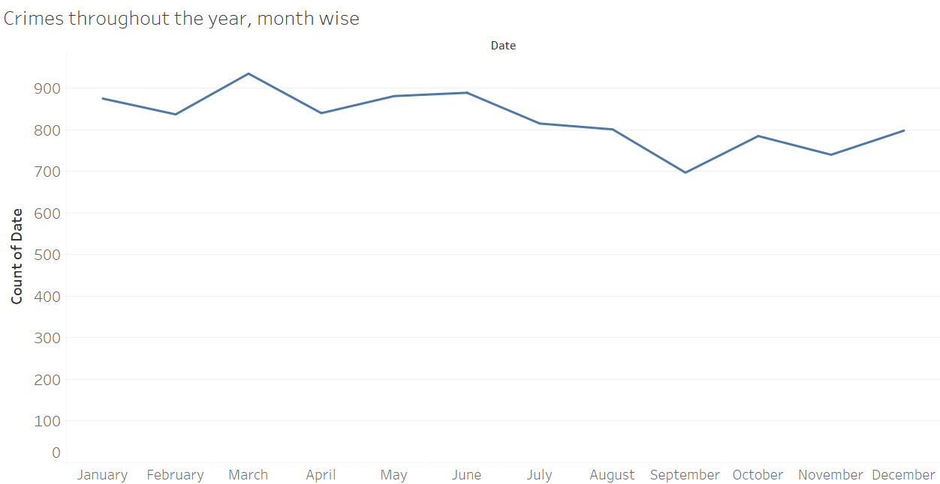

Slide 15
Crimes throughout the year
The simplest visualization in the entire task.
Since this visualization was made to confirm and validate an inference from a hypothesis, we use the same graph as the one in bodycam availability throughout the year
To make comparison with the previous visualization, the marks and channels need to be same to be able to compare the trend.

Slide 16
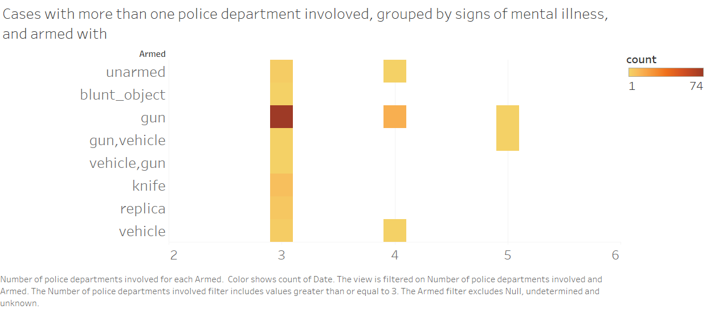

Slide 17
Cases with more than one police department involoved, grouped by signs of mental illness, and armed with
To visualize cases involving multiple police departments, grouped by armed status and signs of mental illness, we initially tried both a line graph and a stacked bar chart. However, the line graph struggled to represent categorical data like "armed status," which doesn’t follow a continuous trend. The stacked bar chart, while better, became cluttered and difficult to read due to the overlap of categories, especially for cases involving 3 or more police departments.
We then moved to a heatmap, which was much more effective for this dataset. The heatmap uses color intensity to show the count of incidents (by date) for each combination of armed status and signs of mental illness. Filtering the data to include only cases with 3 or more police departments involved helped focus on the relevant data, while excluding null and unknown armed statuses improved clarity.
This method provided a clear, comparative view of how often multiple departments are involved in cases where suspects are armed, making it far easier to identify trends that were previously obscured in the other chart types.

