Slide 1
TIME/DAY | MONDAY | TUESDAY | WEDNESDAY | THURSDAY | FRIDAY | SATURDAY | SUNDAY
06:00 – 08:00 | Salah + Ready | Salah + Ready | Salah + Ready | Salah + Ready | Salah + Ready | Salah + Ready | Salah + Ready
08:00 – 10:00 | App Work | JOB DEUTSCH | JOB AFEM LAB | AFEM LAB | PhD Position | App Work | Ice Skating/ OLK
10:00 – 13:00 | Code Integration |  |  |  | App Development
13:00 – 15:00 | Salah+ Lunch+ Family |  |  | Salah+ Lunch+ Family | Salah+ Lunch+ Family | Salah+ Lunch+ Family | Salah+ Lunch+ Family
15:00 – 19:00 | Literature + Document + Salah |  |  | App Integration | Research in IGA MATLAB | Write Thesis | German Assignment
19:00 – 20:30 | Salah + Dinner/ Cooking | Salah + Dinner/ Cooking | Salah + Dinner/ Cooking | Salah + Dinner/ Cooking | Salah + Dinner/ Cooking | Salah + Dinner/ Cooking | Salah + Dinner/ Cooking
21:00 – 23:00 | Salah + Ta’leem+ Book | Salah + Ta’leem + Laundry/ Cleaning | Salah + Ta’leem + Movie | Salah + Ta’leem + Write Thesis | Salah + Ta’leem + Book | Salah + Ta’leem + Book | Salah + Ta’leem + Book

Slide 2
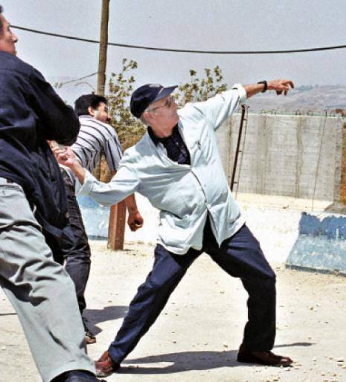
Dr. Edward Said on Lebanese-Palestine Border throwing stone at Israeli Occupiers

Slide 3
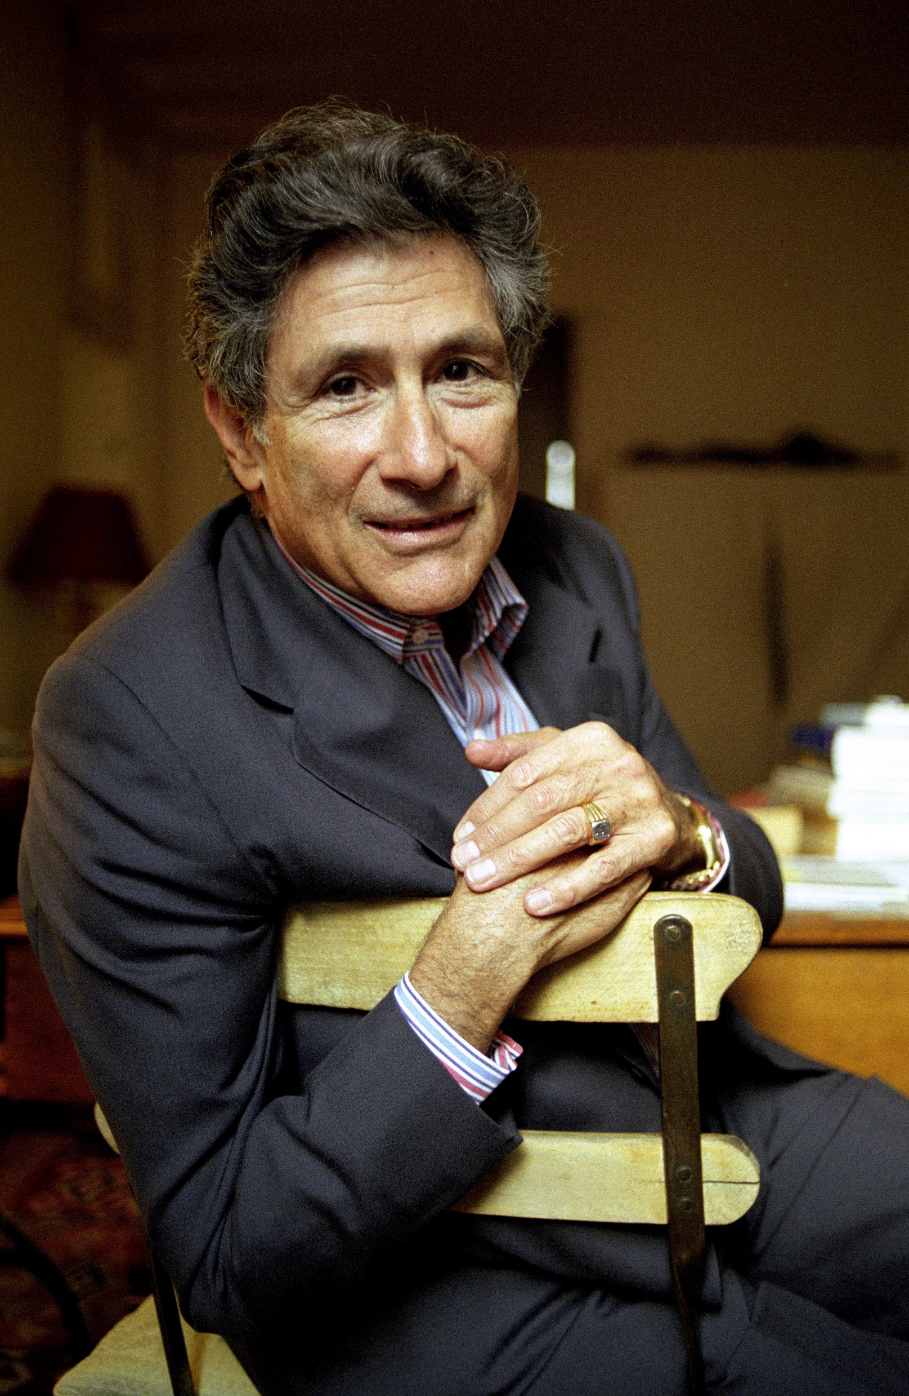
Since the time of Homer every European, in what he could say about the Orient, was a racist, an imperialist, and almost totally ethnocentric.
Edward Said

Slide 4
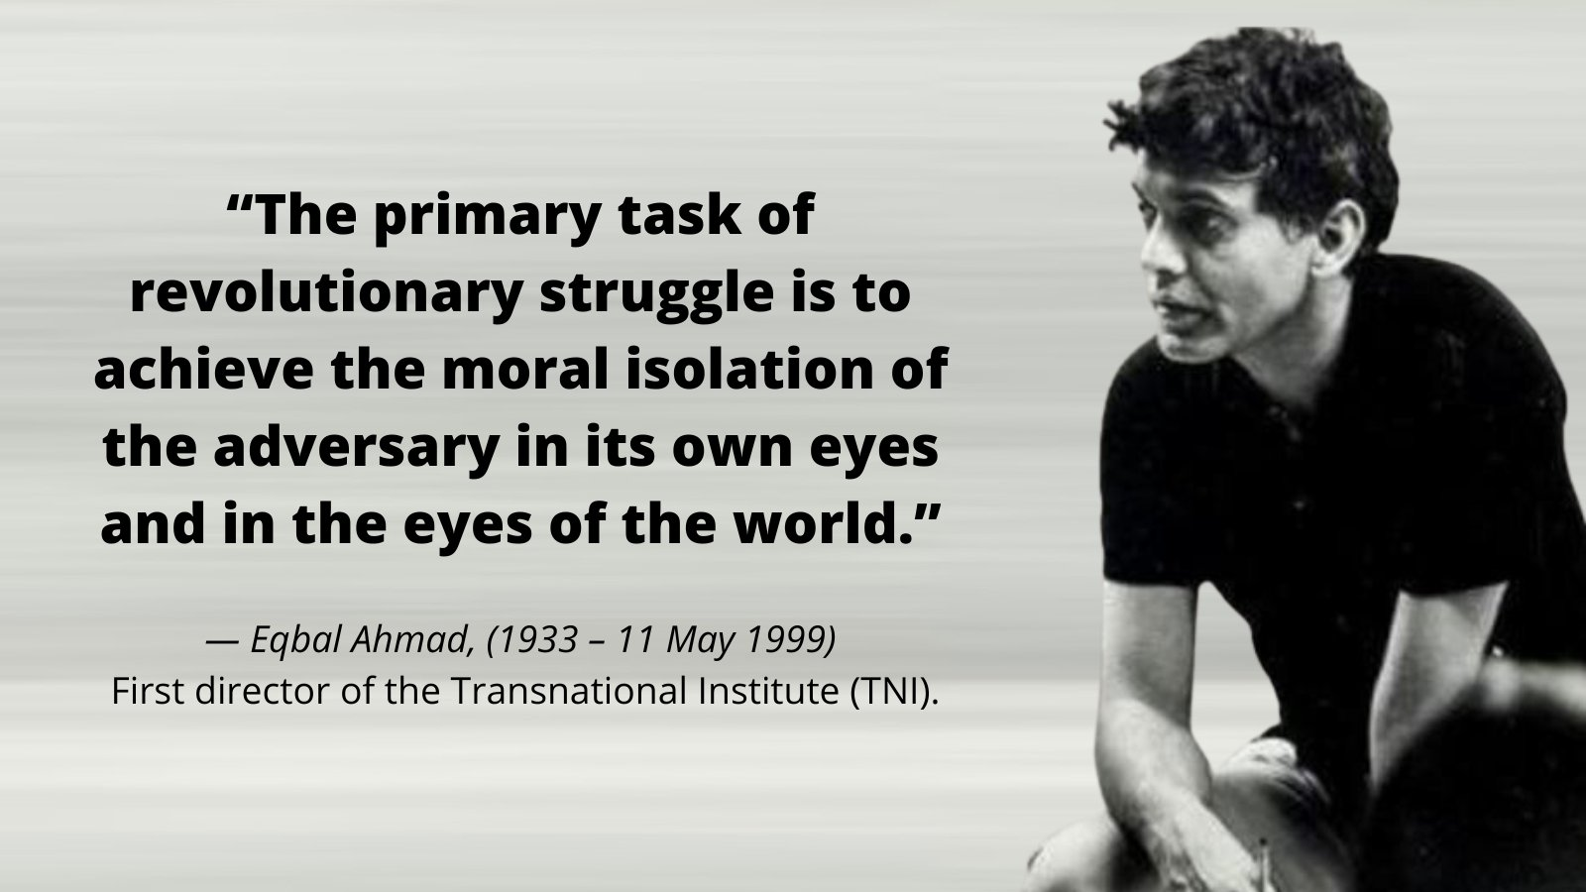

Slide 5
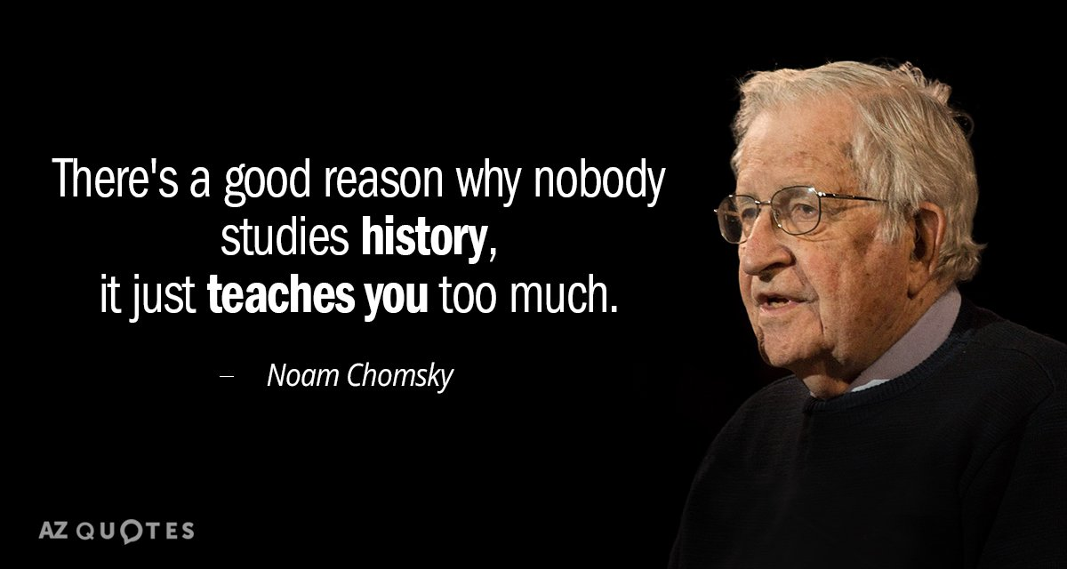

Slide 6
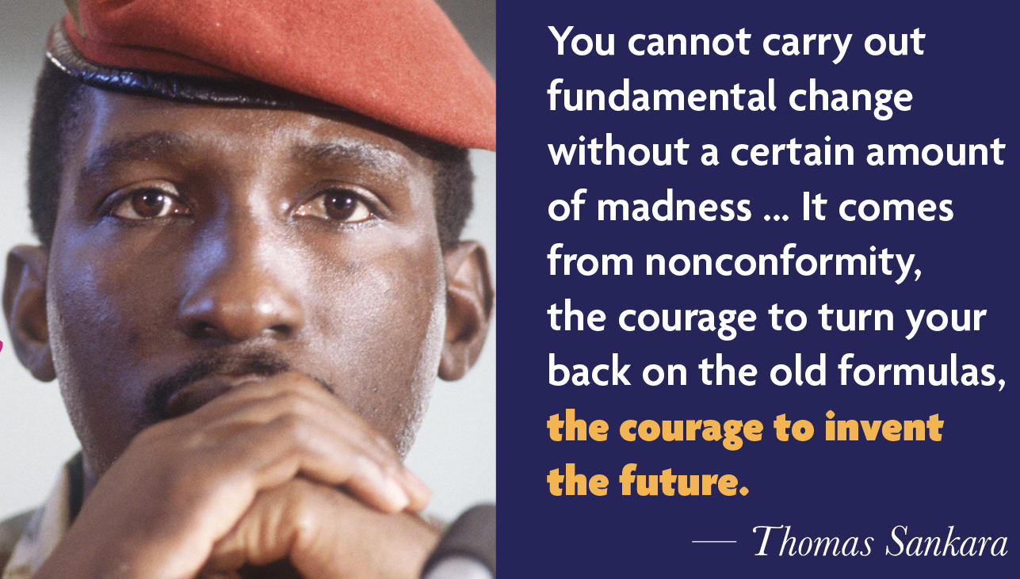

Slide 7
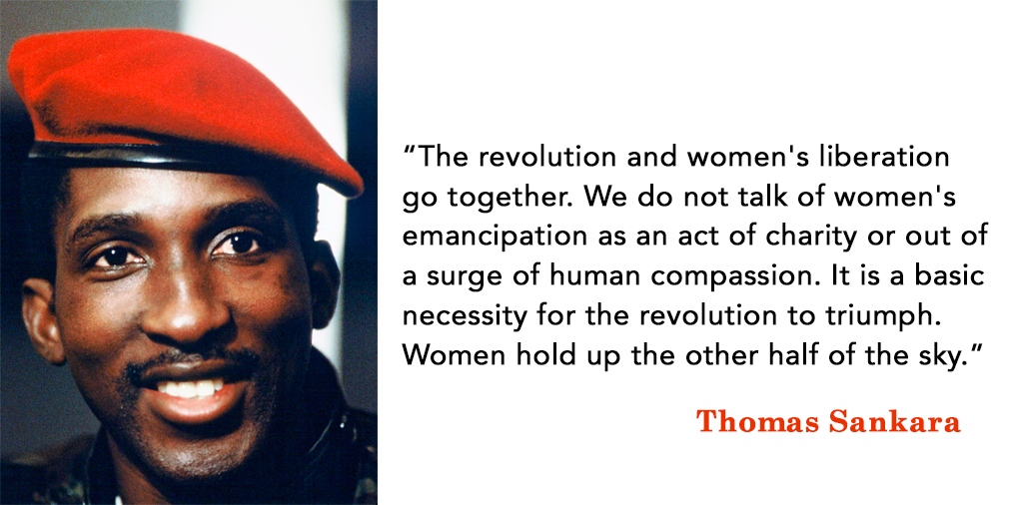

Slide 8
