Slide 1
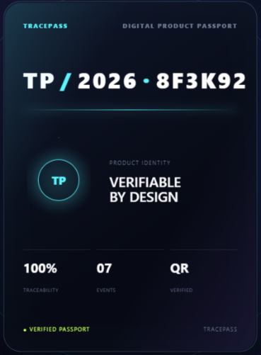
Introductory Notes Assignment Project
TracePass
Muhammad Owais Meethani Abu Atif Asif Raza Wasil Jahanzaib
Muhammad Aneeq
Mubeen Attari
Rafay

Slide 2
The Problem
Digital Product Passports internationally, especially in the European Union, are becoming a regulatory requirement for specific product categories.
As per EU regulation (EU) 2024/1781 declares that a Digital Product Passport Framework must be established before February 2027 for many industries to EU.
Why It is important for Pakistan?
EU is the largest importer region of Pakistani goods ($9.82 billion in 2025-2026). More than 30% exports send to EU members.
Pakistan exports Textile, Cotton, Fabric, Leather goods, Sports goods, IT, Agri-food and Sea-food to EU.
There is only one Pakistani website https://www.pharmatrax.net/digital-product-passport-dpp/ that facilitates Pharma, Food, Beverages and Cosmetics Industries for DPP

Slide 3
TRACEPASS
TracePass is a general Digital Product Passport and supply-chain compliance platform.
A manufacturer builds a product passport with materials, evidence and supply-chain events.
B2B procurement between manufacturers and suppliers added so they make sure authentic raw materials.
An auditor reviews compliance.
Once published, anyone can scan a QR code and see a public, verified passport.

Slide 4
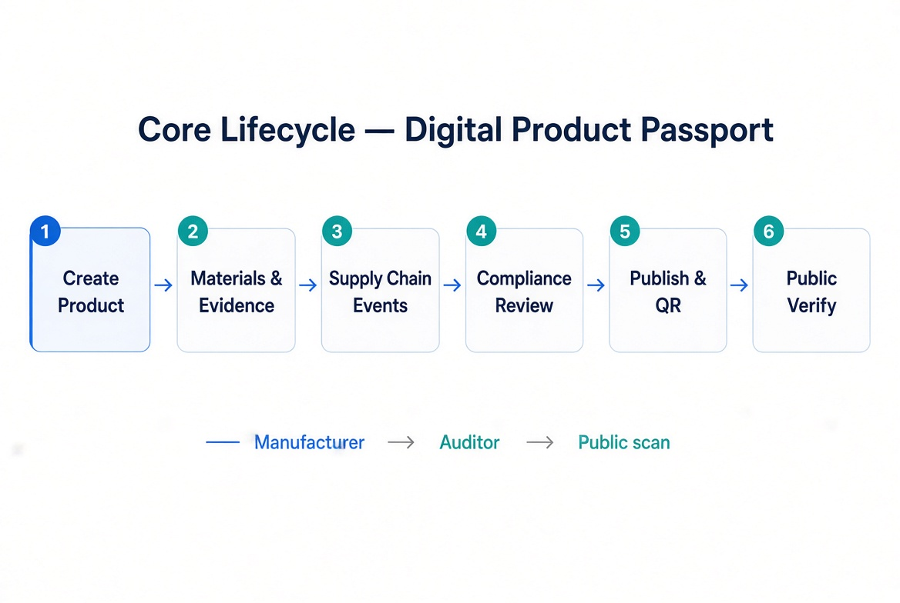
LIFECYCLE

Slide 5
Tech List
HTML, Jinja2, CSS, JavaScript for Frontend
Flask for Authentication, Authorization and Workflow
SQLAlchemy for Data Access
SQLite during development and PostgreSQL at production for Database.
Flask Migrate/Alembic for Migration
Dashboard, KPIs, Notifications, Audit logs and export as CSV and PDF for Reporting
Rest API for Integration
Environment Configuration with Docker

Slide 6
Main Modules
Authentication
Administration
Product Passport
Supply Chain
Compliance
Lifecycle & Sustainability
Reporting & Controls
Public Verifications
Rest API

Slide 7
Responsibilities
Admin: configuration of the platform and control other users data.
Manufacturer: create product passports and record product, materials, batches, evidence and compliance.
Supplier: Provide materials and supplier offerings and participate in procurement.
Distributor: Participate in downstream supply-chain operations.
Retailer: Participate in downstream receipt/retail flow.
Auditor: Review evidence/ compliance and access reporting controls.
Customer: for public verification identity.

Slide 8
Demonstration

