Slide 1

Developer Jockeys (DJs): James Ellis Mario Essig Owais Islam Ida Krause

Slide 2
Agenda
Objective
Concept
Process
Demo
Directions for Future Development
Links

Slide 3
Elevator Pitch / Objective
As music lovers, we wanted a clean and accurate way to search for our favorite songs to play while also displaying the lyrics. The interface of our application is intuitive - simply type in the name of the artist and song you would like to listen to. You will then have to option listen to the song on YouTube, read the lyrics or search for concert tickets.

Slide 4
Concept
In order to develop a concept, we need to gather a User Story:
“As a < type of user >, I want < goal > so that < reason >.”
Type of User - Consumer who likes music
Goal - To be able to search for music easily
Reason - Listen to music, view the lyrics and look for concert and event tickets
Our motivation for creating Flash Beats our interest in music.

Slide 5
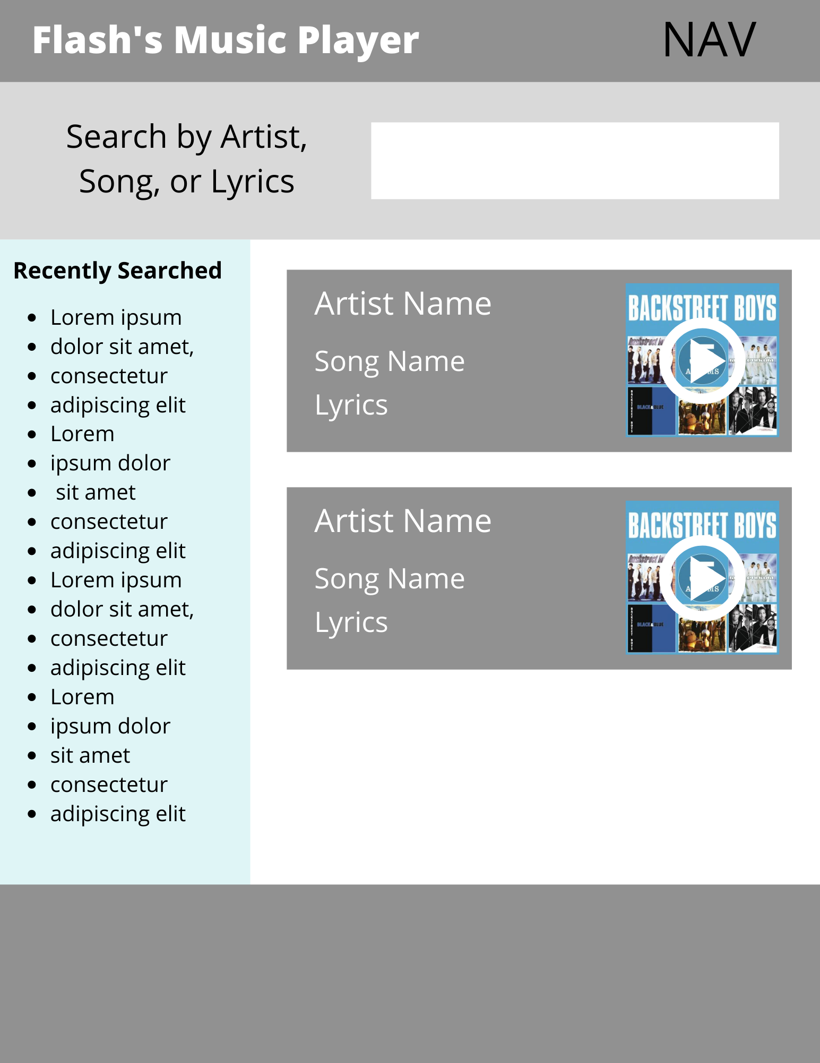
Concept
Wireframe Mockup
The design and layout was a collaborative effort. This is our wireframe mockup of the concept to formulate the Minimal Viable Product (MVP) to set our path as we begin to develop. We wanted a search field at the top, previously searched results on the left and the search results on the right.

Slide 6









Process
Technologies used
Breakdown of tasks and roles
James: Added interactive Javascript
Owais: Set-up HTML wireframe, added CSS and Javascript
Ida: Set-up GitHub repository, designed wireframe, CSS styling, debugged Javascript
Mario: Managed the team project, added title animation and CSS styling
Notes:
HTML
JS
CSS
Visual Studio
Pure CSS
Foundation CSS, mainly because both are similar to Bootstrap
FontAwesome
jQuery
musixmatch API

Slide 7
Process
Challenges
Handling pulls and pushes between team members
Miscommunication on features wanted
Schedules and timing - we have full-time jobs so we had to squeeze in project time
Successes
Definitive roles among our team made it easier to divide up the work on the project
We were able to solve a couple of coding issues as a group which was fun and a great learning experience
Our team is very supportive and helpful with one another
Learned the importance of branch management
Given the time constraint and some merging issues,
we were able to pull together and get our project complete
Notes:
skipped some features in order to put out a minimum viable product

Slide 8
Demo

Slide 9
Directions for Future Development
User stories, enhancements, feature requests, bug fixes are a part of the development cycle. You will encounter these on a daily basis and handle ever so growing backlog. Best to put that Agile Methodology approach in good practice until you become a master at it. Use GitHub issues to your benefit!
Enhancements
Add more visual media to the app
Show top YouTube videos after search (using iFrame)
Feature Requests
Play music directly from the app
Bug Fixes
Link in footer is broken

Slide 10
Links
Deployed GitHub Page
GitHub Repository

