Slide 1
Psychological factors affecting performance
Sports Psychology
Individual Differences - Personality

Slide 2
Learning Objectives
Learning Objective:
Define Personality and understand the theories relating to it
Learning Outcomes:
All: Define, and Describe the theories of personality
Most: Explain the different theories views on personality
Some: Evaluate the different theories on personality

Slide 3
Key Terms
Personality
Trait
Extrovert
Introvert
Stable
Unstable
Type A
Type B
Social Learning Theory
Interactionist Theory

Slide 4
Key Terms
Personality - The characterisation of individual differences.
Trait - a distinguishing quality or characteristic, typically one belonging to a person
Extrovert - an outgoing, socially confident person.
Introvert - a shy, reticent person.
Stable - sane and sensible; not easily upset or disturbed. Unstable - prone to psychiatric problems or sudden changes of mood
Type A - a personality type characterized by ambition, impatience, and competitiveness, and thought to be susceptible to stress and heart disease.
Type B - a personality type characterized as easy-going and thought to have low susceptibility to stress.
Trait Theory - an approach to the study of human personality. Trait theorists are primarily interested in the measurement of traits, which can be defined as habitual patterns of behavior, thought, and emotion.
Social Learning Theory - Bandura's Social Learning Theory posits that people learn from one another, via observation, imitation, and modeling. It encompasses attention, memory, and motivation
Interactionist Theory - behaviour is a combination of both inherent (built-in) personality traits and environmental factors. B = F (P.E) Behaviour is the Function of Personality and Environment. Personality traits can be used to predict behaviour in some situations, but this is not exclusive.

Slide 5
Personality – a definition
“The sum total of an individuals characteristics which make him unique” (Hollander).
“Personality is the more or less stable and enduring organisation of a persons character, temperament, intellect and physique which determines the unique adjustment to the environment” (Eysenck).
the combination of characteristics or qualities that form an individual's distinctive character. (Oxford dictionary)
The characterisation of individual differences. (ocr)
individual differences in characteristic patterns of thinking, feeling and behaving (American Psychological association)
The sum of an individuals characteristics which make them unique (teachPE)
The pattern of psychological characteristics that make each person unique (teachPE)
the set of habitual behaviours, cognitions and emotional patterns that evolve from biological and environmental factors (Wikipedia)

Slide 6
Trait Theory
Trait Theory
“People are born with established personality characteristics”
Inherited at birth.
Stable
Enduring
consistent in all situations.
BEHAVIOUR = FUNCTION OF PERSONALITY
+ve = Can be easily measured through questionnaires
-ve = Does not take into account environmental influences. It is not a true indicator of behaviour.
CATTELL (1965) identified 16 personality traits
INTROVERT & EXTROVERT

Slide 7
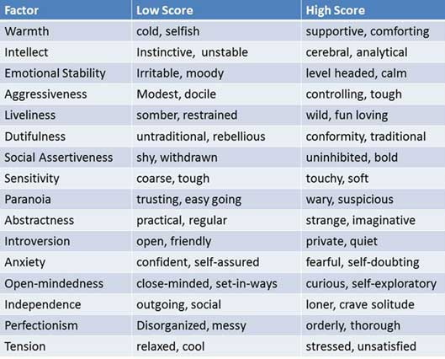
Cattell’s personality Traits

Slide 8
Personality Theories
Concentric Ring Theory (Hollander 1967)
Role Related Behaviour – Surface of personality
- determined by our perception of the environment at any given time, different situations may require you to play different roles, which may be influenced by many things.
Typical Response – Your usual response in most situations
The Psychological Core – The ‘real you’ - your attitudes, values, interests, motives & beliefs about yourself
The boundary line of each layer gets wider as you get closer to the centre of the model which shows that each layer is harder to enter. As you move closer to the centre, your ‘real’ personality begins to surface

Slide 9
Personality Theories
Psychodynamic Theory (Freud, 1933)
ID
Basic Instinct
(no conscious
control)
EGO
Conscious
link with reality
ID, EGO & SUPER EGO interact to produce individual patterns of behaviour in sport.
SUPER EGO
Moral Arm
(social conscience)
Personality is formed from the conflict of SEEKING, RELEASING and INHIBITING behaviour.
****THINK OF AGGRESSION AS AN EXAMPLE!****

Slide 10
Trait Theory - Narrow Band Approach GIRDANO, 1990
TYPE ‘A’
Highly competitive,
Strong desire to succeed,
Works fast, likes to control,
Prone to suffer stress
TYPE ‘B’
Non-competitive,
Unambitious,
Works more slowly,
Does not enjoy control
Less prone to stress

Slide 11
Trait Theory - Eysenck
Eysenck’s Personality Types
Personality traits run across 2 continuums:
INTROVERT: unsociable, shy & nervous
EXTROVERT: sociable, outgoing & lively
STABLE: calm, even-tempered, controlled 7 logical
UNSTABLE: anxious, moody, unpredictable & illogical
NEUROTIC
(UNSTABLE)
INTROVERT
EXTROVERT
STABLE

Slide 12
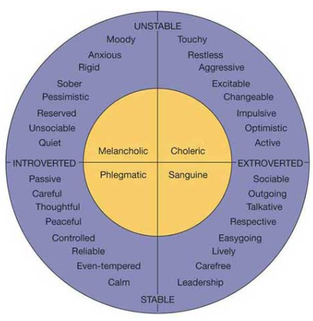
Trait Theory - Eysenck

Slide 13
Social Learning Theory - Bandura
Behaviour = Function of Environment
B = F (E)
Learning takes place in 2 ways
- We imitate others’ behaviour through observation
- New behaviours are acquired when they are endorsed through social reinforcement
ATTENTION RETENTION REPRODUCTION MOTIVATION
Reading - https://www.simplypsychology.org/bandura.html

Slide 14
Interactionist Theory - Lewin
Behaviour = Function of Personality * Environment
B = F (P) * E
A combination of the trait and social learning theory – a person has natural ‘traits’ that are modified by the environment they’re in.

Slide 15
Exam Questions
June 2016 – 3d – Using practical examples of sports performance and healthy lifestyle, explain and critically evaluate the theories of personality (20)
June 2015 – 3a – Describe the social learning and interactionist theories of personality (4)

