Slide 1
Psychoanalysis Traits
Muhammad Anas
Owais Ali Khan
Uzair Shehzad
Hussain Malik
Hamza Iqbal

Slide 2
Agenda
Introduction
Level Of Awareness
Id
Ego
Super Ego

Slide 3
Introduction
At Contoso, we empower organizations to foster collaborative thinking to further drive workplace innovation. By closing the loop and leveraging agile frameworks, we help business grow organically and foster a consumer first mindset.

Slide 5
Main Concepts

Slide 6
Levels Of Awareness
Consciousness | Preconsciousness | Unconsciousness

Slide 7
Levels Of Awareness
The conscious mind involves thoughts that someone is aware of at any given moment.
The preconscious mind involves things that can be brought into consciousness at any time.
The unconscious mind includes the thoughts and feelings that exist outside of one's conscious awareness.

Slide 8
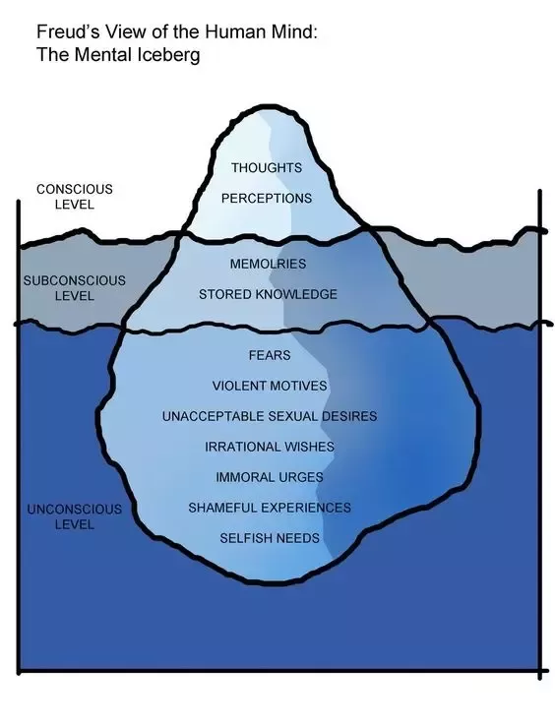
This is the aspect of our mental processing that we can think and talk about rationally.
Consists of anything that could potentially be brought into the conscious mind.
Contains contents that are unacceptable or unpleasant

Slide 9
ID

Slide 10
ID

Slide 11
Pic ke liye/real life application

Slide 12
EGO

Slide 13
EGO

Slide 14
Pic ke liye/real life application

Slide 15
SUPER EGO

Slide 16
SUPER EGO

Slide 17
Pic ke liye/real life application

Slide 18
Thank you

