Slide 1
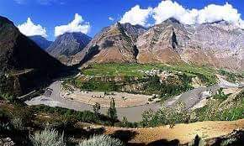

Slide 2
Kashmir issuE ,problems and solutions

Slide 3
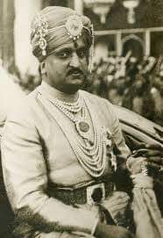
KASHMIR RULER (HARI SINGH )

Slide 4
INTRODUCING KASHMIR UNJUST ACCESSION INTERNATIONAL TREATIES ARMED CONFLICTS

Slide 5
STRUGGLE FOR FREEDOM CURRENT EVENTS REMOVAL OF ARTICLE 370

Slide 6
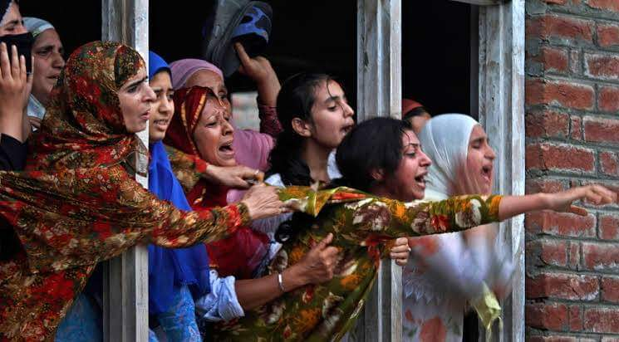
CURRENT SITUATION IN KASHMIR

Slide 7
