Slide 2

Clickstream Analysis Case Study Submission
Presenter: Owais Khan
IMP

Slide 3
Agenda
To demonstrate Proof Of Concept explored for Clickstream Analysis :
Clickstream Architecture
Data Generation
Data Loading into HDFS
Data Loading into Hive
Analysis
Report Generation

Slide 4
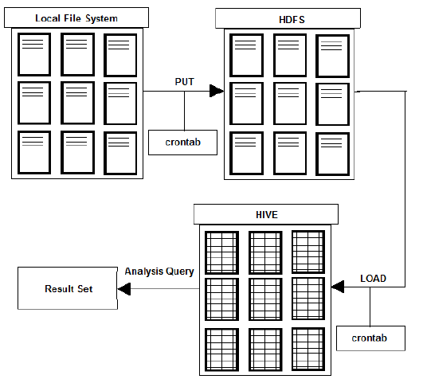
Clickstream High Level Architecture

Slide 5
ClickStream Data Generator
Data Generator Application has been written in Java 8. Using the Freemarker templates to generate sample data in json format as text file.
User Input : Input Date for which records are to be generated
No of Records to Generate
Batch Size
Output Dir
Batch Size should be chosen as maximum as possible and should be in accordance with the allocated java heap memory size in order to avoid out of memory error.
There is no limit to data generation as long as we don’t run out of memory space.
Data is generated based on date and represents clickstream records of entire day.
The Cron Scheduler schedules the job everyday at midnight to generate specified number of records and store them at the designated output directory.

Slide 6
Sample Data
{"userId":"330","url":"/cart/removefromcart","action":"removefromcart","location":"indore","logDate":"12-10-1989", "logTime":"10:57:24","paymentMethod":"null"}
{"userId":"65","url":"/cart/addtocart","action":"addtocart","location":"ahemadabad","logDate":"12-10-1989", "logTime":"18:29:54","paymentMethod":"null"}
{"userId":"220","url":"/products/view","action":"view","location":"delhi","logDate":"12-10-1989", "logTime":"05:22:31","paymentMethod":"null"}
{"userId":"439","url":"/cart/addtocart","action":"addtocart","location":"ahemadabad","logDate":"12-10-1989", "logTime":"20:59:06","paymentMethod":"null"}
{"userId":"650","url":"/cart/removefromcart","action":"removefromcart","location":"mumbai","logDate":"12-10-1989", "logTime":"06:59:33","paymentMethod":"null"}
{"userId":"780","url":"/cart/addtocart","action":"addtocart","location":"mumbai","logDate":"12-10-1989", "logTime":"04:18:07","paymentMethod":"null"}
{"userId":"132","url":"/cart/checkout","action":“checkout","location":"mumbai","logDate":"12-10-1989", "logTime":"02:14:19","paymentMethod":“creditcard"}

Slide 7
HDFS Loading
Once the data is generated and stored in the local file system. It is ready to be loaded into HDFS.
We have used PUT command to load data into HDFS.
Data is loaded into the configured directory : /data
Once the data is loaded into HDFS , it is moved from /clickstream/input directory to /clickstream/processed directory in local file system.
Once the data is further loaded into Hive tables , it is deleted from hdfs data directory.

Slide 8
Hive Schema
CREATE TABLE IF NOT EXISTS activity (userId String,url String,action String,logTime String,paymentMethod String,logDate String,location String)
ROW FORMAT SERDE 'org.apache.hive.hcatalog.data.JsonSerDe’
STORED AS textfile;
CREATE TABLE IF NOT EXISTS activity_partitioned (userId String,url String,action String,logTime String,paymentMethod String)
PARTITIONED BY (logDate String,location String)
ROW FORMAT serde 'org.apache.hive.hcatalog.data.JsonSerDe’
STORED AS textfile;

Slide 9
Hive Loading
Data Loading in hive is achieved using load command to load data from HDFS to activity table.
hive -e "load data inpath '"$HDFS_FILE_PATH"/"$FILE_NAME"' into table clickstream.activity"
Further the data is loaded from activity table to activity_partitioned table.
hive -e "INSERT OVERWRITE TABLE clickstream.activity_partitioned
partition (logDate,location)
SELECT * from clickstream.activity"
Top Level Hierarchy for Partitioning is Date , while the subsequent hierarchy for data loading is location.
Data is loaded on a daily basis using scheduled cron job which executes right after data generation and its loading into hdfs.

Slide 10
Analysis Query
Query 1 : Find out Location Wise Analysis of the Traffic Generated by each location for current date
SELECT location , COUNT(*) AS occurence FROM activity_partitioned WHERE logdate='$CURRENT_DATE' GROUP BY location order by occurence DESC
Query 2 : Find out the Page Hit Analysis across the locations for current date
SELECT url,COUNT(*) AS page_hits FROM clickstream.activity_partitioned WHERE logdate='$CURRENT_DATE' GROUP BY url ORDER BY page_hits DESC
Query 3 : Find out the Page Hit Analysis of users from bangalore location for current date
SELECT url,COUNT(*) AS page_hits FROM clickstream.activity_partitioned WHERE logdate='$CURRENT_DATE' AND location='bangalore' GROUP BY url ORDER BY page_hits DESC
Query 4 : Find out the analysis of shopping from diffrent locations today
SELECT location,COUNT(*) AS occurence FROM clickstream.activity_partitioned WHERE logdate='$CURRENT_DATE' AND action='checkout' GROUP BY location order by occurence DESC

Slide 11
Sample Report
Generating Report . . .
-> Following are the Location Wise Analysis of the Traffic Generated by each location for current date
hyderabad 2376
delhi 2316
mumbai 2285
indore 2270
bangalore 2270
chennai 2253
ahemadabad 2230

Slide 12
Sample Report
-> Following are the Page Hit Analysis across the locations for current date
/cart/removefromcart 4014
/products/view 4007
/cart/addtocart 3954
/checkout/paypal 1090
/checkout/creditcard 1014
/checkout/netbanking 970
/checkout/debitcard 951

Slide 13
Sample Report
-> Following are the Page Hit Analysis of users from bangalore location for current date
/products/view 565
/cart/addtocart 565
/cart/removefromcart 558
/checkout/paypal 162
/checkout/creditcard 155
/checkout/netbanking 135
/checkout/debitcard 130

Slide 14
Sample Report
-> Following are the analysis of shopping from diffrent locations today
hyderabad 610
indore 603
mumbai 585
bangalore 582
delhi 575
chennai 547
ahemadabad 523

Slide 15
Thank You.

