Slide 1
Bootstrap 5

Slide 2
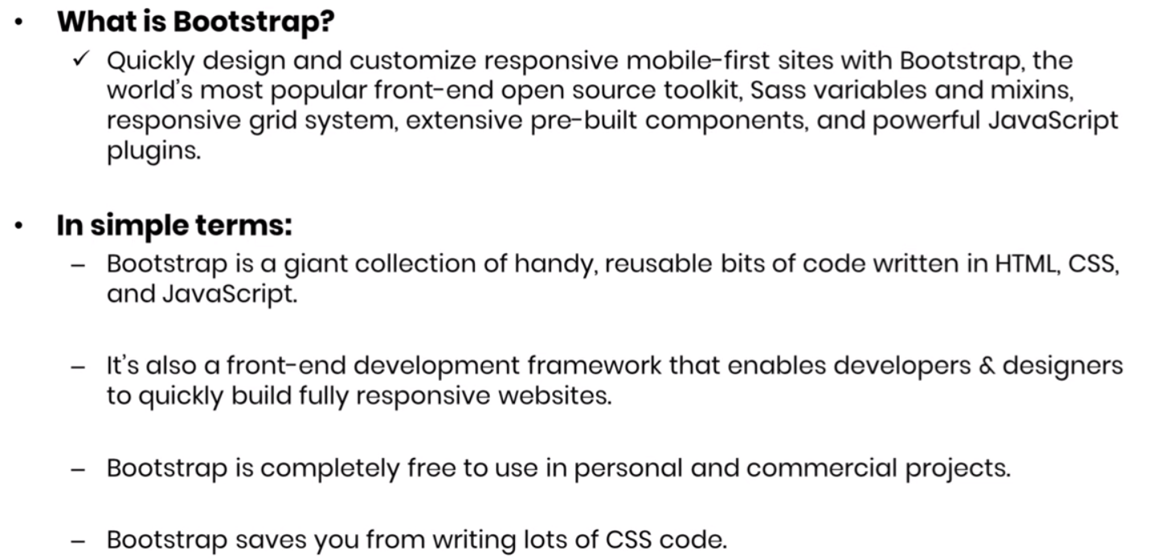
Bootstrap 5 Overview

Slide 3
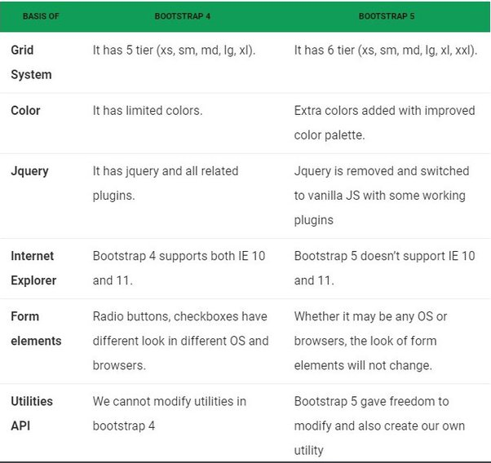
Difference Between Bootstrap 4 and 5

Slide 4
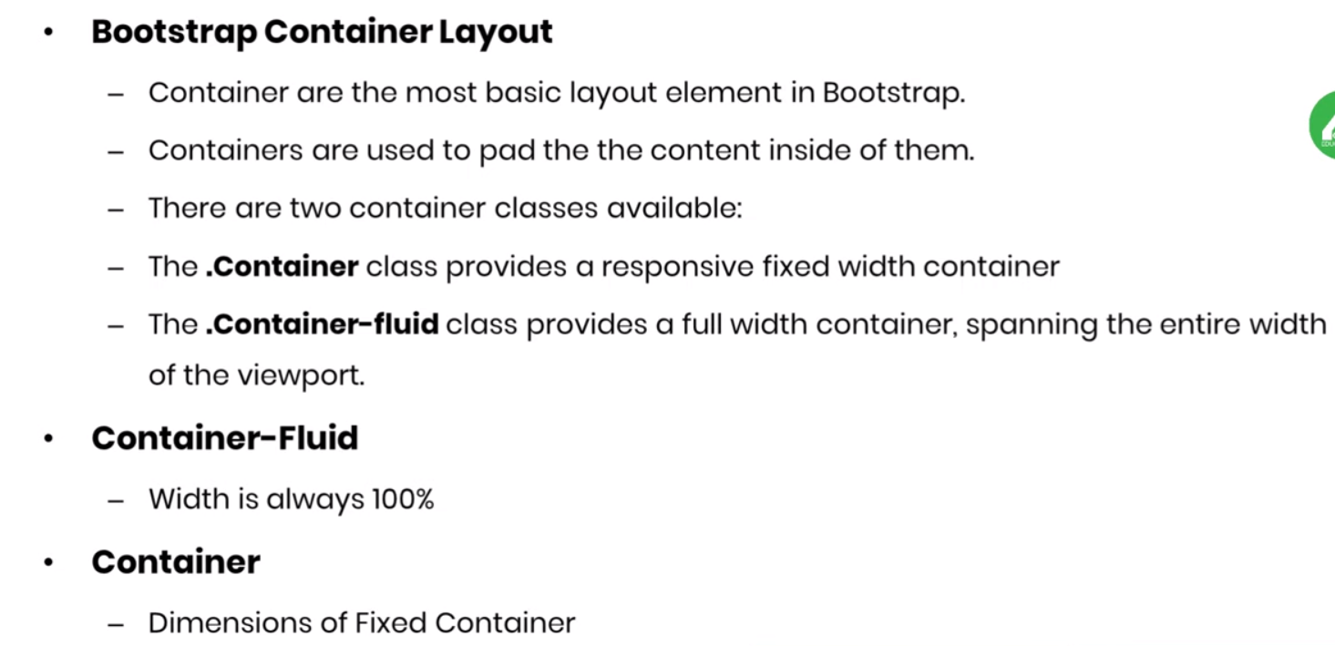
Container Layout

Slide 5
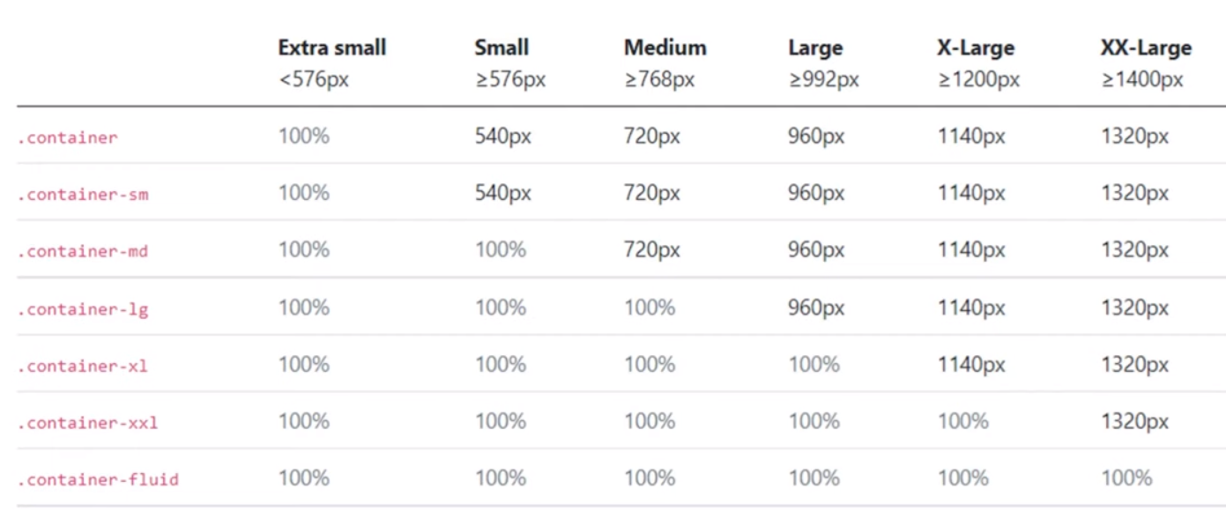
Container Layout

Slide 6
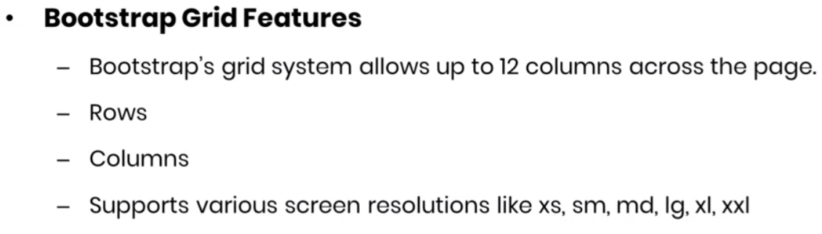
Grid Classes

Slide 7
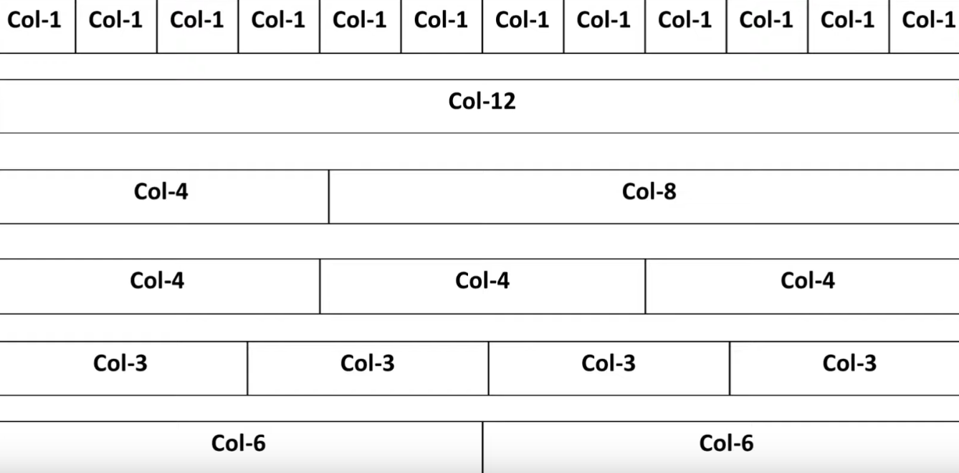
Bootstrap Grid

Slide 8
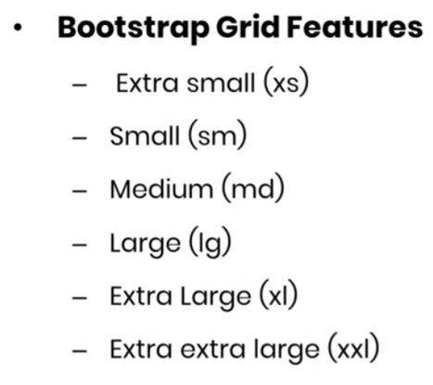
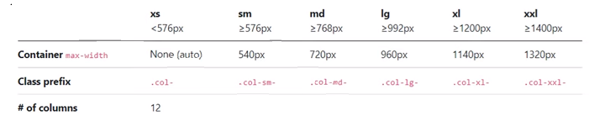
Grid Options

Slide 9
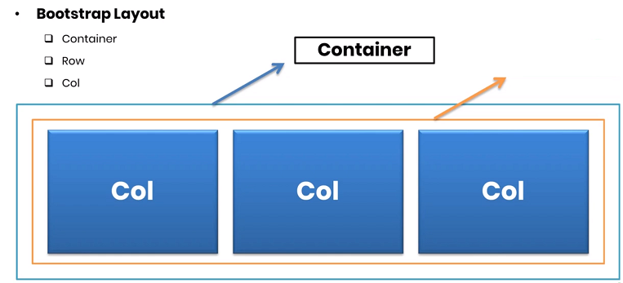

Bootstrap Structure

Slide 10
Typography

Slide 11
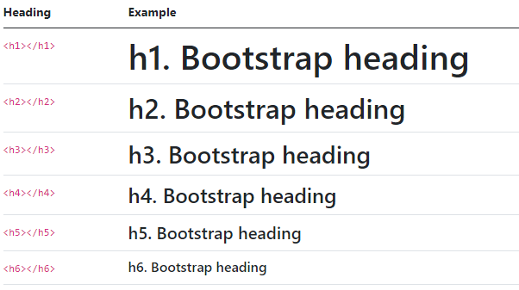
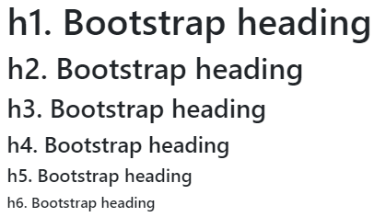
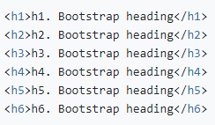
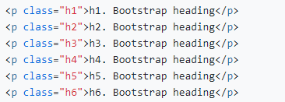
Headings

Slide 12

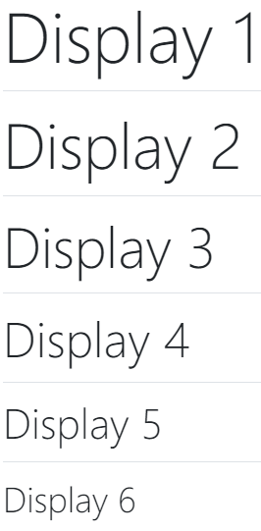
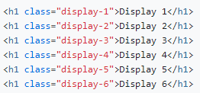
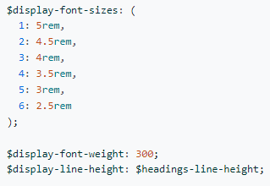
Customizing headings
Display headings

Slide 13

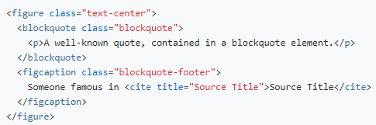
Blockquotes

Slide 14
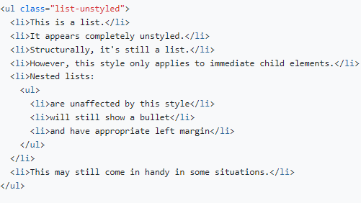
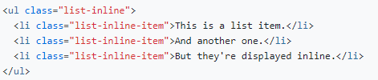
Lists
Un styled
Inline

Slide 15
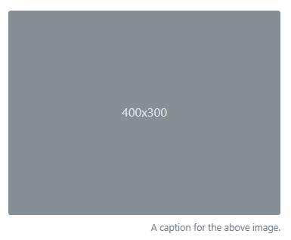



Images and Figure
Responsive images
img-rounded
img-circle
img-thumbnail
Image thumbnails
Aligning images

Slide 16

Button Classes
Button | Outline buttons | Sizes | Block buttons
btn (head) |  | btn-lg
btn-primary | btn-outline-primary
btn-secondary | btn-outline-secondary
btn-success | btn-outline-success
btn-danger | btn-outline-danger
btn-warning | btn-outline-warning
btn-info | btn-outline-info
btn-light | btn-outline-light
btn-dark | btn-outline-dark
btn-link

Slide 17
Table Classes
Table style | On tables | On rows | On cells (`td` or `th`)
table | table-primary | table-primary | table-primary
table- stripped | table-secondary | table-secondary | table-secondary
table-bordered | table-success | table-success | table-success
table-borderless | table-warning | table-warning | table-warning
table-hover | table-info | table-info | table-info
 | table-light | table-light | table-light
 | table-dark | table-dark | table-dark

Slide 18
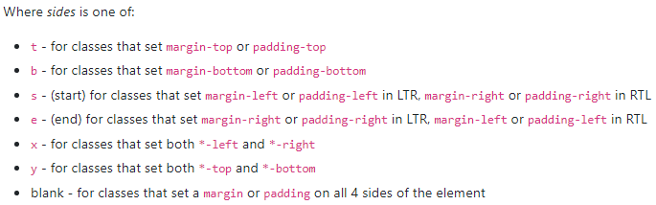
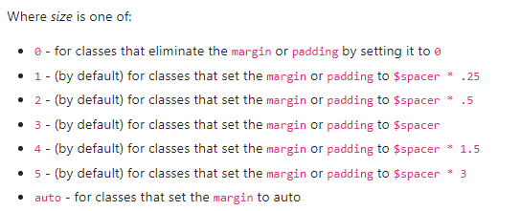
Margin and padding
Assign responsive-friendly margin or padding values to an element or a subset of its sides with shorthand classes.
Where property is one of:
m - for classes that set margin
p - for classes that set padding

Slide 19
Forms

Slide 20
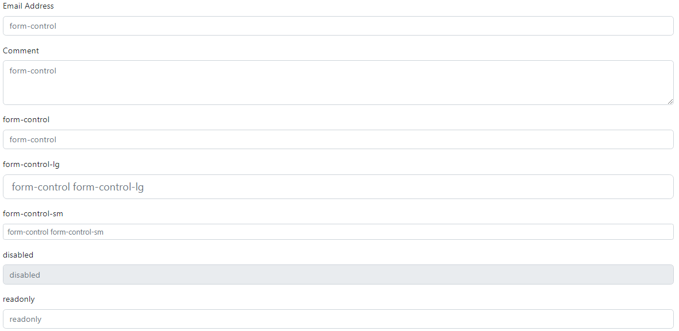
Form controls

Slide 21
Select
form-select
form-select-lg
form-select-sm
the multiple attribute is also supported.
The size attribute.
The disabled attribute.

Slide 22
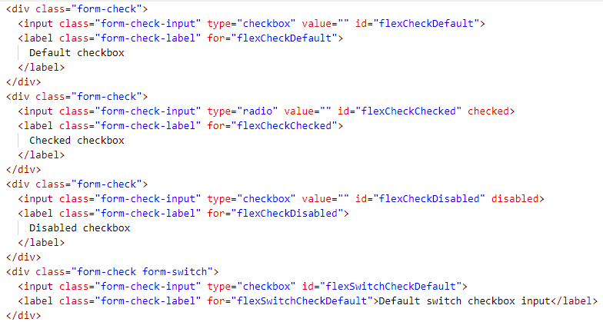
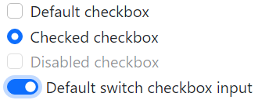
Checks and radios

Slide 23
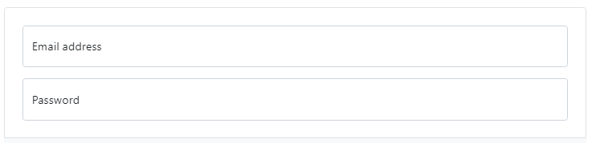
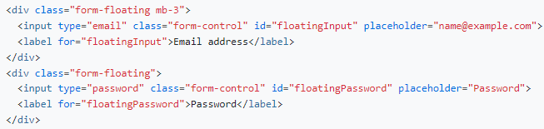
Floating labels

Slide 24
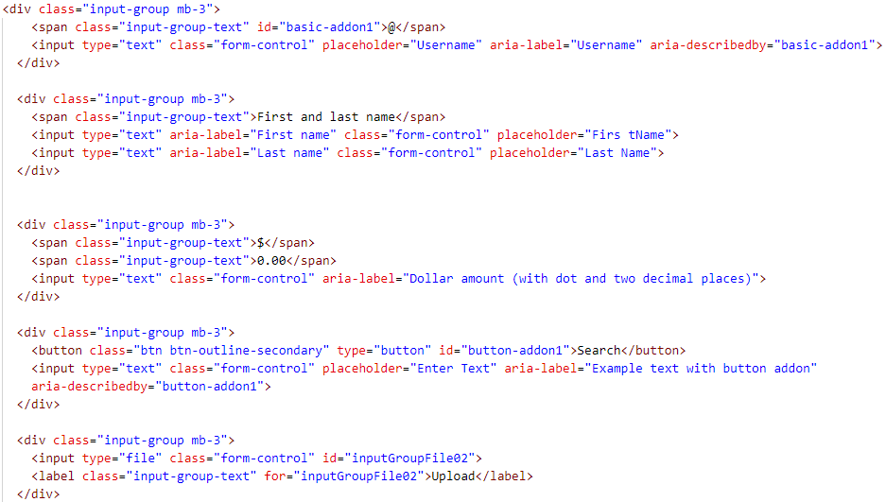
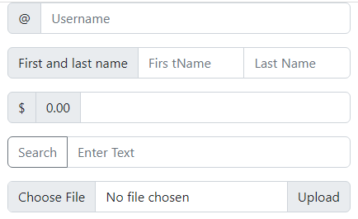
Input group

Slide 25
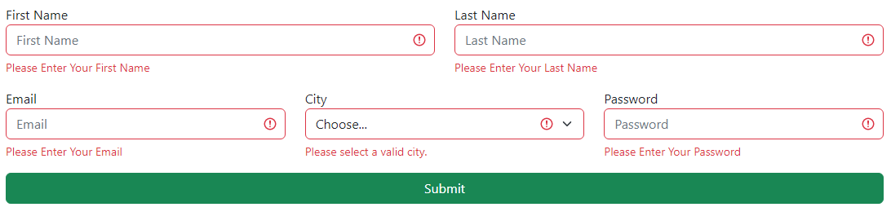
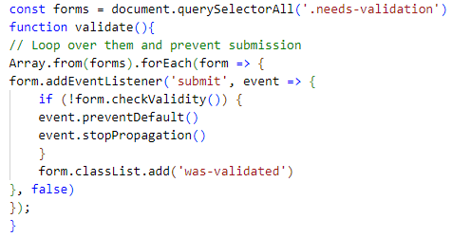
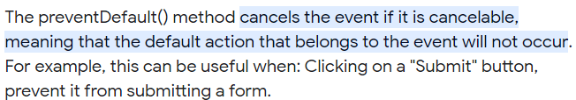

Bootstrap 5 Validation

Slide 26


Jumbotron

Slide 27
Card

Slide 28
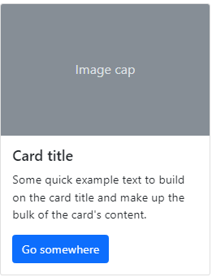
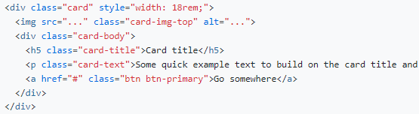
A Card is a flexible and extensible content container. It includes options for headers and footers, a wide variety of content, contextual background colors, and powerful display options.

Slide 29
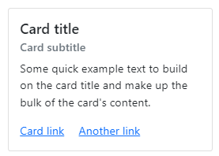
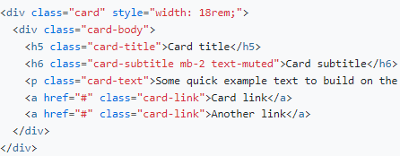
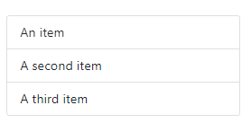
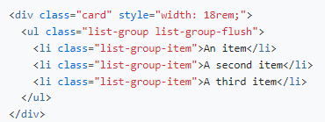
Titles, text, and links
List Groups

Slide 30
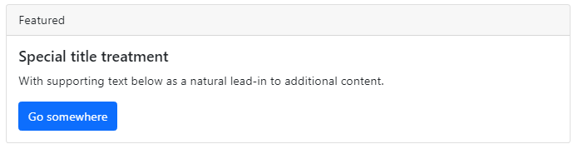
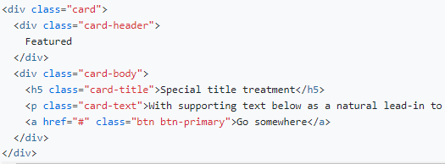
Header and footer

Slide 31
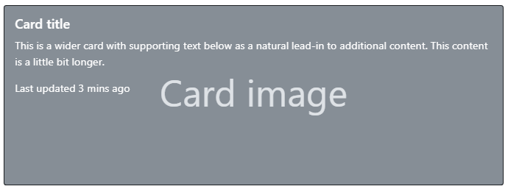
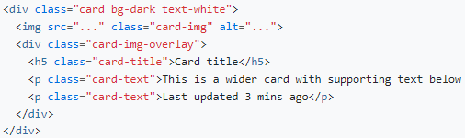
Image overlays

Slide 32
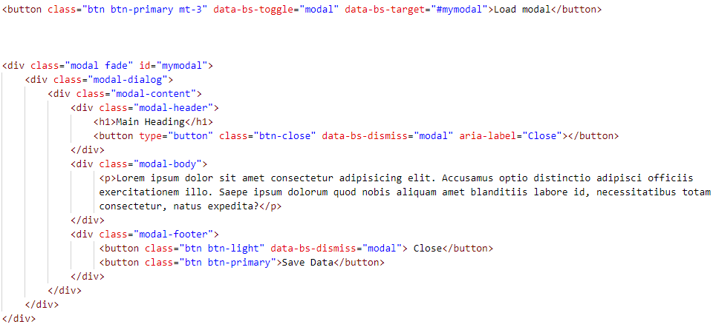
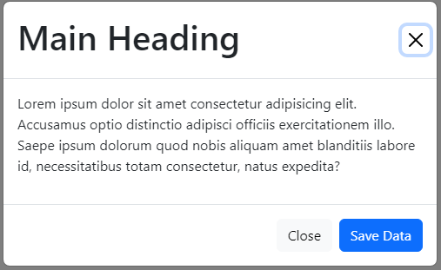
Modal

Slide 33
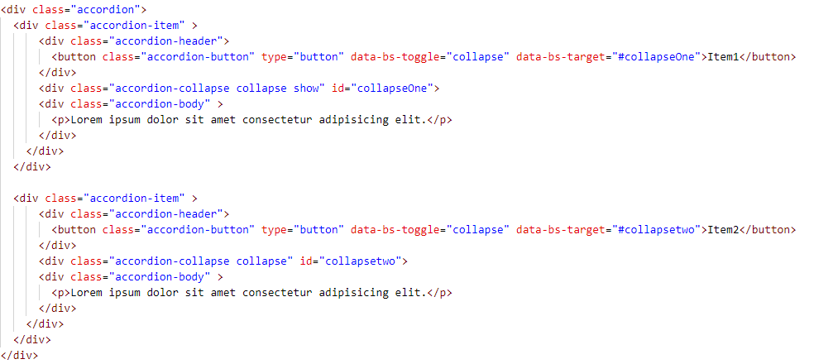
Accordion

Slide 34
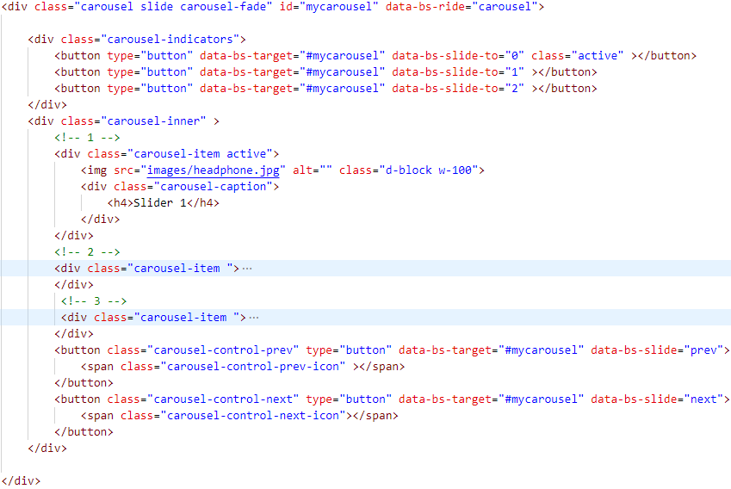
Carousel
Cheat Sheet

Slide 35
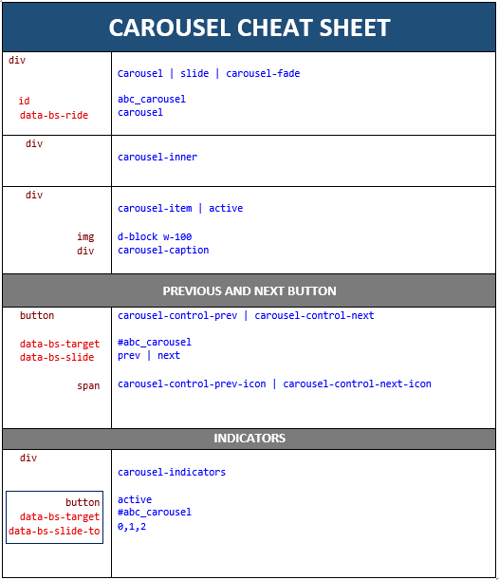

Slide 36
Navs and Tabs

Slide 37
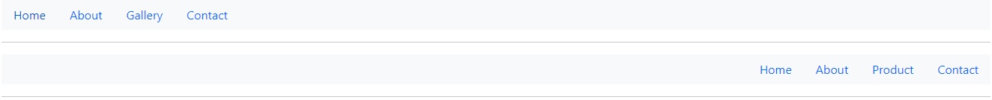
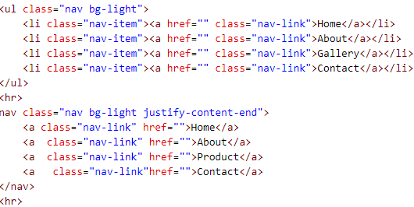
Base nav
Horizontal alignment

Slide 38
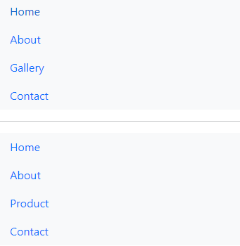

Vertical

Slide 39

Tabs

Slide 40

Pills

Slide 41


Fill and justify

Slide 42


Tabs with dropdowns

Slide 43


