Slide 1
Tiny CNN Image Classifier on Basys 3 FPGA
Real-Time CIFAR-10 Classification on Low-Cost Hardware
Che Li & Owen Wang
Faculty Advisors: Prof. Ramesh Karri & Prof. Weihua Xiao
Cognichip Platform | Spring 2026
github.com/Owen-yd-Wang/Design-Project

Slide 2
Problem Statement & Motivation
The Problem
Our Target: Basys 3 FPGA ($150)
Edge AI needs: warehouses, factories, drones need real-time image classification
GPU solutions cost $500-$2000+, draw 200W+, need internet or bulky servers
Small businesses can't justify this cost for simple classification tasks
Standard CNN models (MobileNetV2: 13.3 MB) are far too large for cheap FPGAs
Xilinx Artix-7 XC7A35T
225 KB Block RAM (no external DRAM!)
90 DSP48E1 slices (multiply-accumulate units)
20,800 LUTs, 41,600 flip-flops
Our Solution
Design a custom tiny CNN (~48K params) that fits entirely in on-chip BRAM
Quantize to int8 (47 KB) -- only 29% of available BRAM, leaving room for control logic
Verify with behavioral FPGA simulation before writing RTL
Result: 4,008 images/sec, $150 hardware cost, <5W power, no internet needed

Slide 3
Design Methodology
Using the Cognichip Co-Design Platform
1. Model Design (Python/PyTorch)
2. Train & Evaluate (CIFAR-10)
3. Quantize (ONNX Runtime)
4. FPGA Simulation (Behavioral)
5. RTL Design (SystemVerilog)
6. Synthesis (Vivado)
Design tiny CNN architecture ~48K parameters
30 epochs, Adam F1 = 0.74 74% accuracy
Float32 -> Int8 4x size reduction <0.1% accuracy loss
Int8 arithmetic Clock cycles, BRAM Throughput analysis
MAC unit, datapath Control FSM BRAM interface
Target: XC7A35T Timing closure Resource report
Cognichip Co-Design Approach
Software-hardware co-design: model architecture decisions driven by FPGA resource constraints
Behavioral simulation validates feasibility BEFORE committing to RTL -- saves weeks of iteration
Python golden model provides reference outputs for RTL verification (layer-by-layer comparison)
FINN framework concepts: streaming dataflow, int8 quantization, DSP-efficient MAC operations

Slide 4
CNN Architecture
Input 3x32x32
Conv1 3->16 3x3, pad=1 ReLU+Pool
16x16x16
Conv2 16->32 3x3, pad=1 ReLU+Pool
32x8x8
Conv3 32->32 3x3, pad=1 ReLU+Pool
32x4x4 = 512
FC1 512->64 ReLU
FC2 64->10
Output 10 classes
3,072 B
432 wt
4,096 B
4,608 wt
2,048 B
9,216 wt
512 B
32,768 wt
640 wt
Model Summary
Why This Architecture?
Total parameters: 47,818
Float32 size: 186.8 KB (too big for Basys 3)
Int8 size: 46.7 KB (fits comfortably!)
Total MACs per inference: 2,245,248
Bottleneck: Conv2 (52.5% of compute)
3 conv layers: enough depth for CIFAR-10 features
MaxPool after each conv: reduces activation size 4x
Small channel counts (16, 32): keeps weight memory low
Only 2 FC layers: FC1 dominates weight count (32K/48K)
All ops map to DSP48E1 (multiply-accumulate)

Slide 5
RTL Architecture
MAC Unit (mac_uint8_int32.sv)
Full System Architecture
Core compute element: uint8 x uint8 -> int32 accumulator
Maps directly to DSP48E1 slice (1 MAC/cycle)
Synchronous clear for new dot products
Enable control for pipeline stalling
Registered outputs for timing closure
Weight BRAM: 47 KB stored at initialization
- Address offsets per layer for sequential loading
Activation double-buffer: ping-pong between layers
- Read input from buffer A, write output to buffer B
- Swap for next layer
Control FSM: sequences through 5 layers
- Conv1 -> Conv2 -> Conv3 -> FC1 -> FC2
- Manages address generation, enable, clear signals
Line buffer for convolution input generation
- Buffers 3 rows for 3x3 sliding window
- Standard FPGA pattern (ref: FINN framework)
Output: argmax of 10 logits -> 4-bit class ID
Data Flow per Convolution Output Pixel:
1. Clear accumulator
2. Stream in (data, weight) pairs each cycle
3. Conv1: 27 cycles (3x3x3 kernel)
4. Conv2: 144 cycles (3x3x16 kernel)
5. Conv3: 288 cycles (3x3x32 kernel)
6. Read out int32 result, rescale, requantize to int8

Slide 6
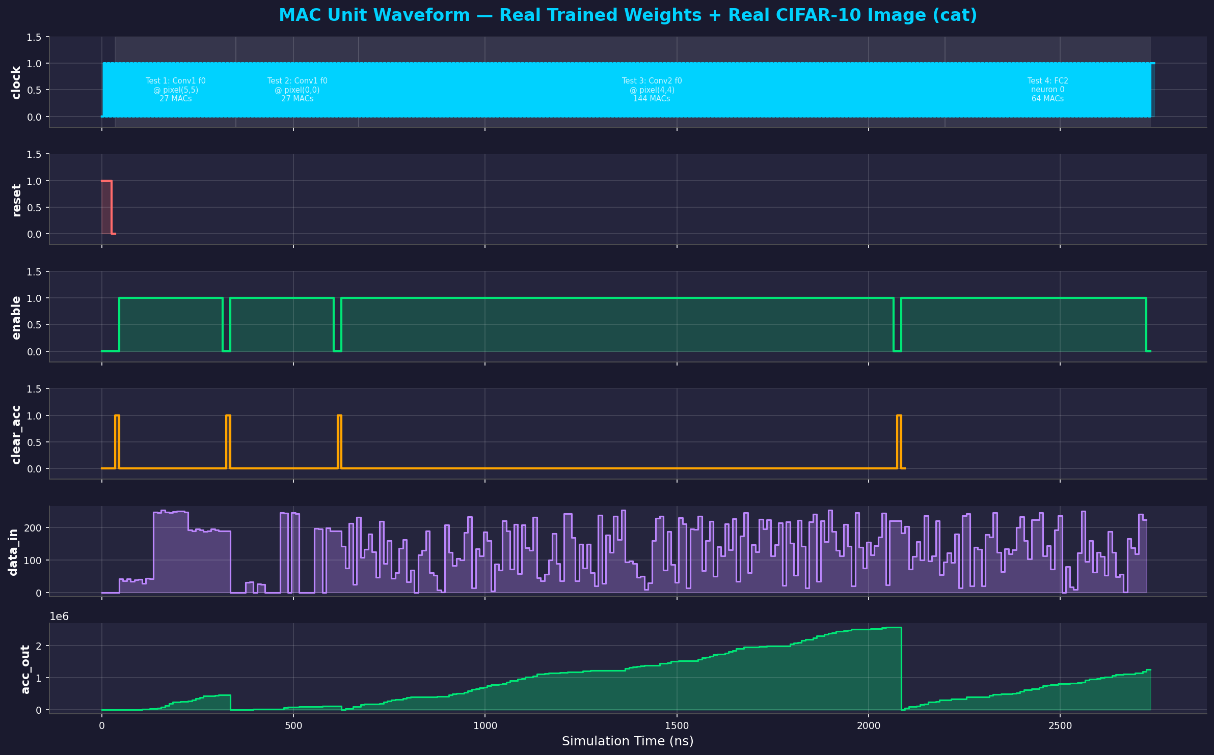
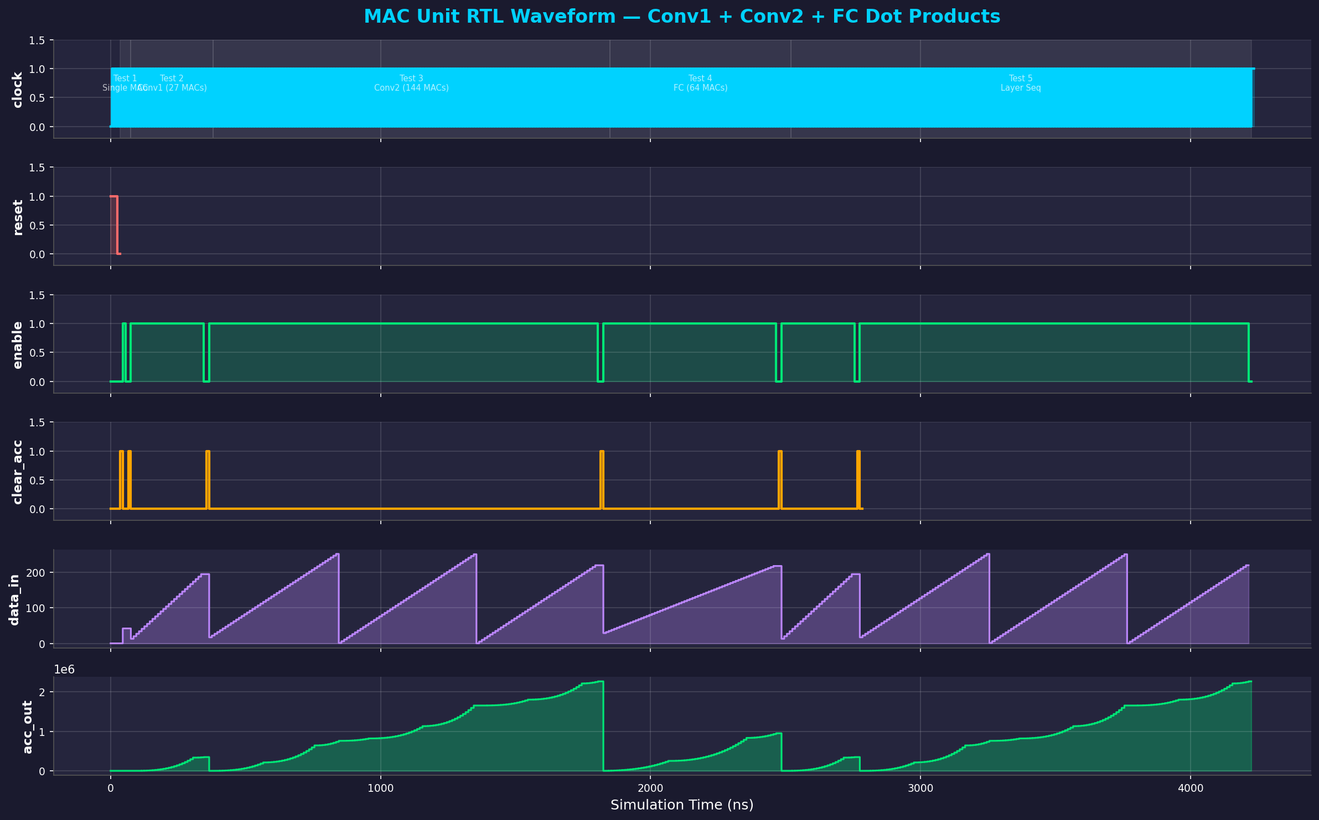
RTL Simulation: MAC Unit Waveform
Signals: clock (100 MHz), reset, enable, clear_acc, data_in (uint8), acc_out (int32 accumulator)
5 test cases: Single MAC | Conv1 (27 MACs) | Conv2 (144 MACs) | FC (64 MACs) | Layer Sequencing

Slide 7
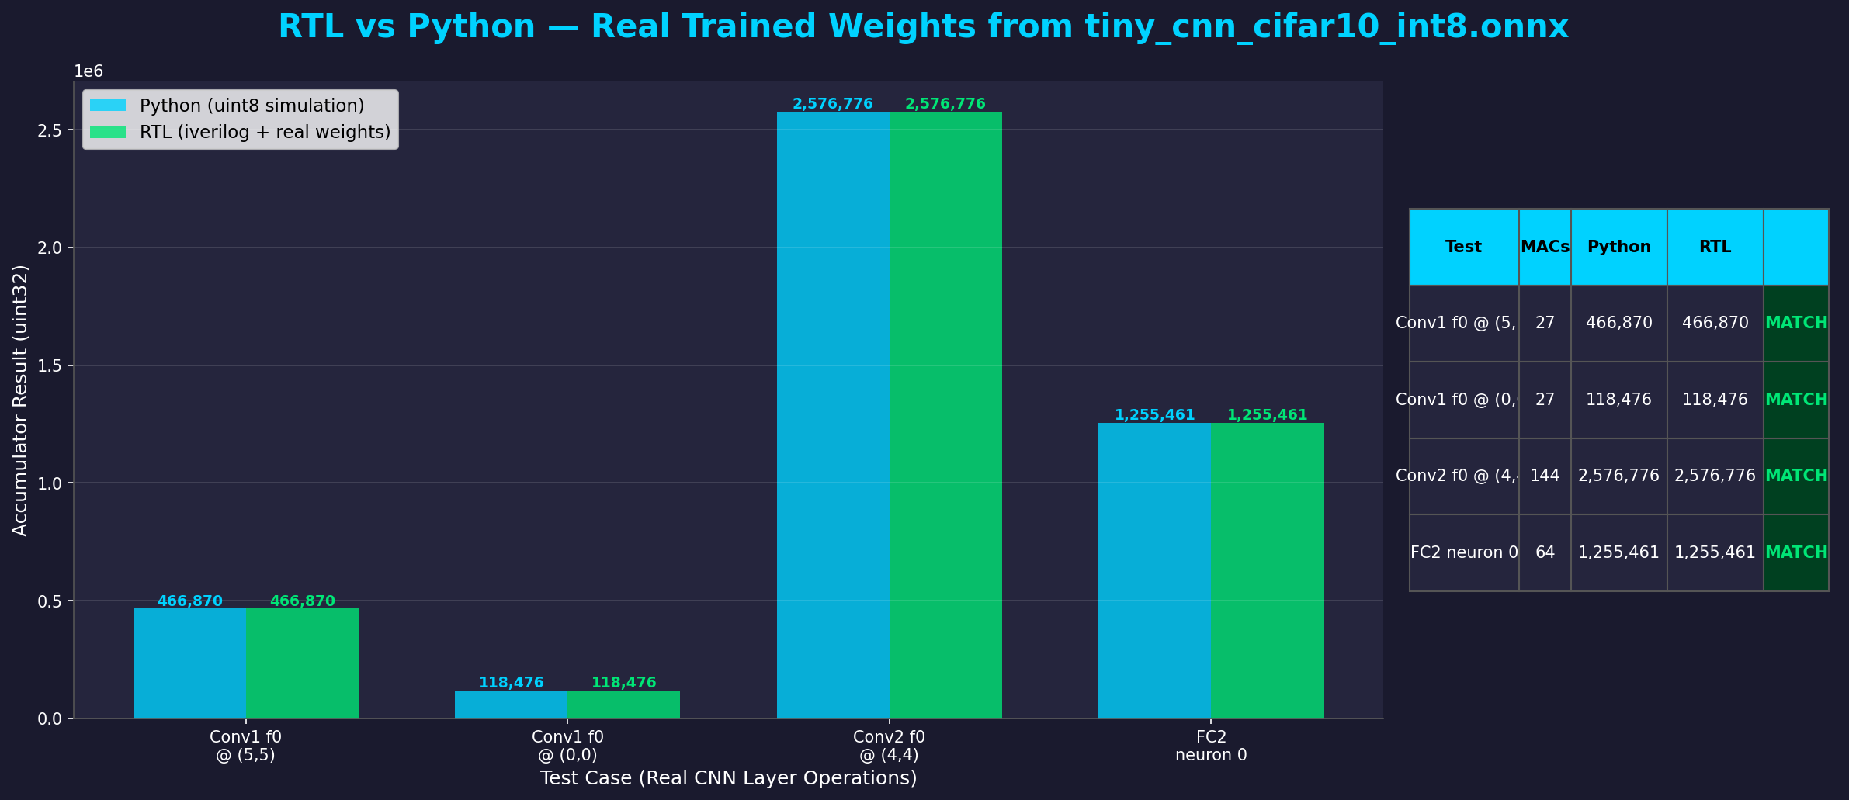
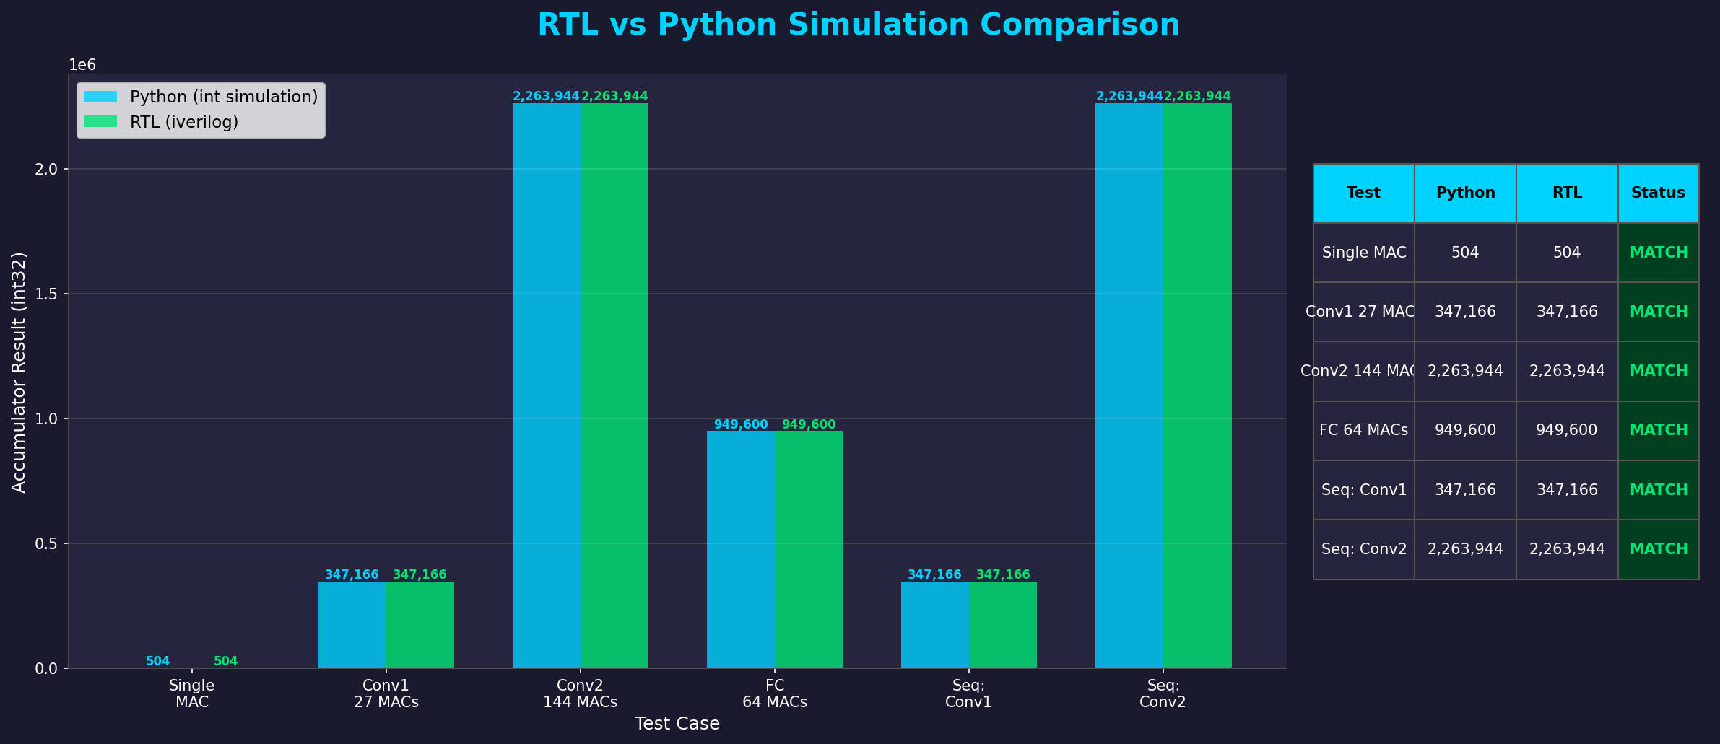
RTL vs Python: Side-by-Side Comparison
6/6 Tests: ALL MATCH
RTL hardware (iverilog) produces bit-exact same results as Python integer simulation
This validates that our MAC unit correctly implements uint8 x uint8 -> int32 multiply-accumulate for all CNN layer types

Slide 8
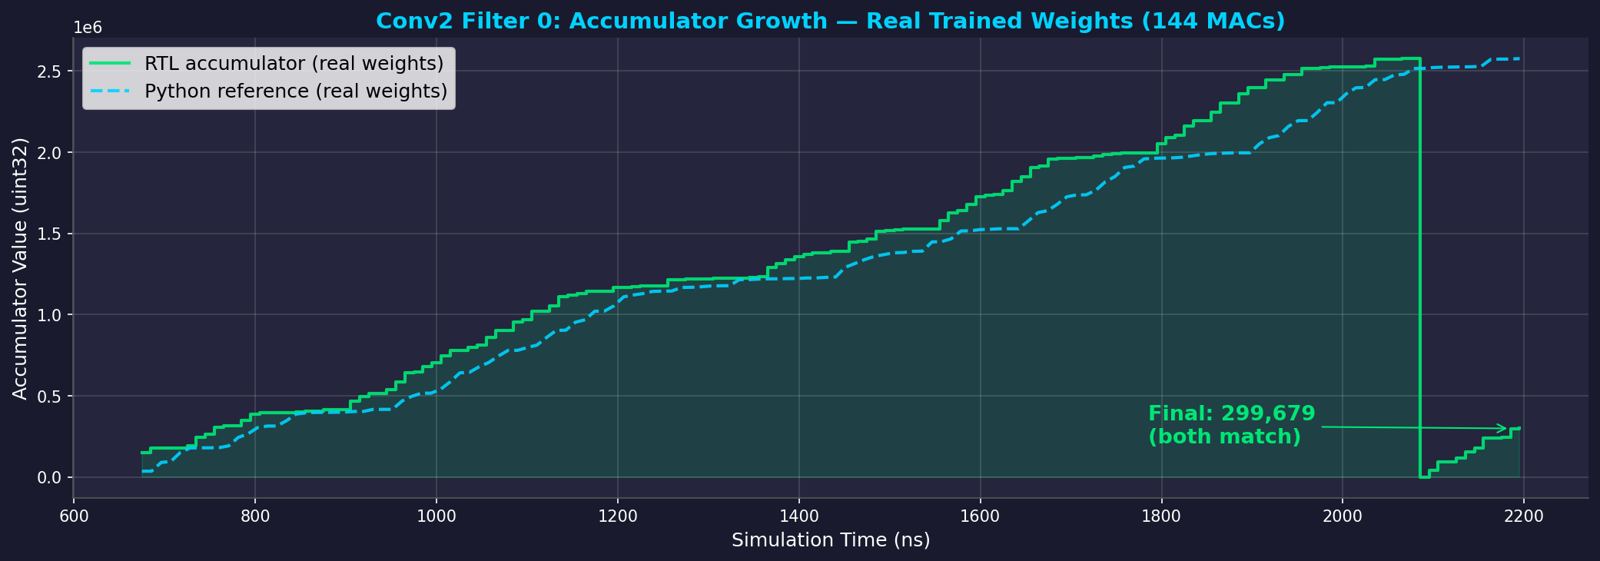
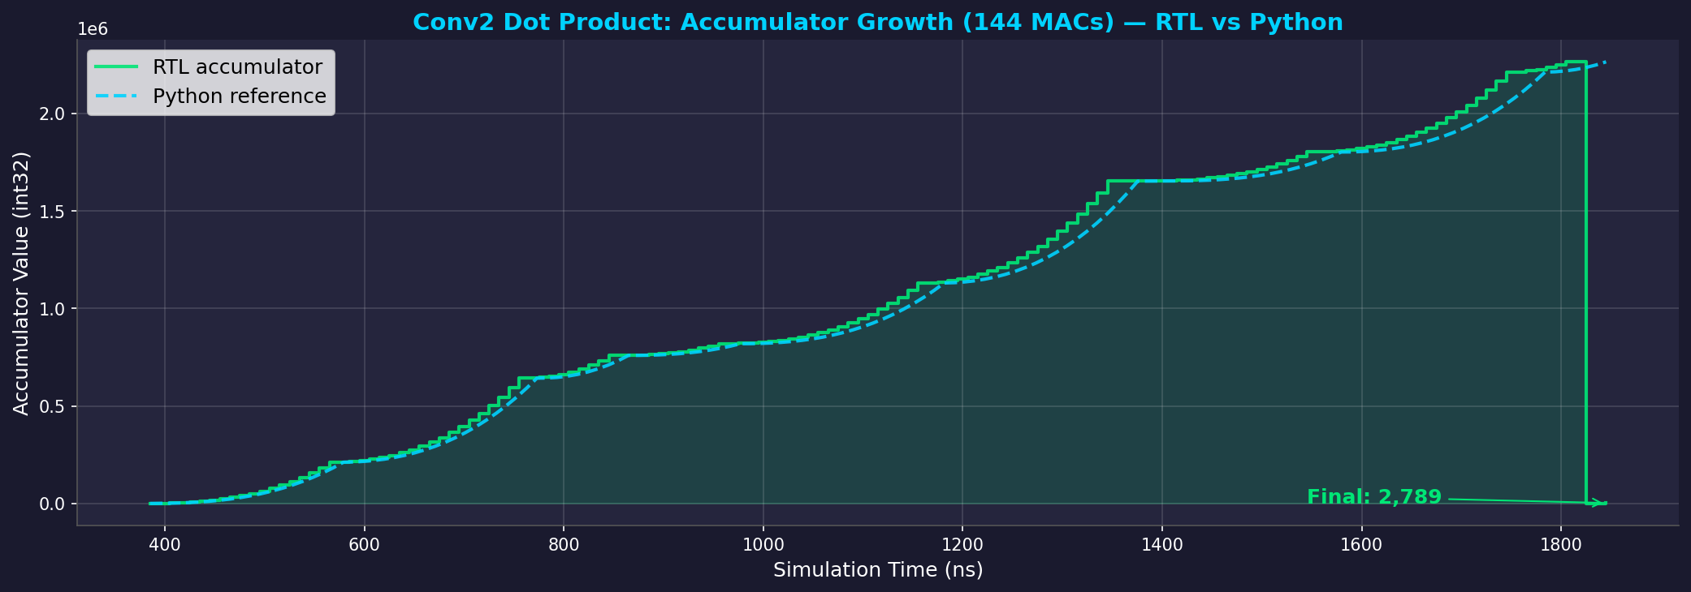
RTL vs Python: Conv2 Accumulator Trace
What This Shows
Why This Matters
Green solid = RTL accumulator value each clock cycle
Blue dashed = Python reference computation
Both reach exactly 2,263,944 after 144 MACs
RTL is cycle-accurate; Python is continuous reference
Proves RTL matches Python golden model exactly
Conv2 is the bottleneck layer (144 MACs, 52% of compute)
No overflow in int32 accumulator (max ~2.26M << 2.1B)
Same approach validates all 5 layers of the CNN

Slide 9
Simulation Results: Behavioral FPGA Simulation
Accuracy (10,000 test images)
Clock Cycle Analysis
Float32 (PyTorch): F1 = 0.7400
Int8 (FPGA sim): F1 = 0.7395
Delta: -0.0005
Quantization loss is negligible (<0.1%)
Int8 arithmetic produces same classifications
as floating-point on 99.9% of test images
Layer MACs Cycles Time
Conv1 442,368 4,916 49 us
Conv2 1,179,648 13,108 131 us
Conv3 589,824 6,554 66 us
FC1 32,768 365 4 us
FC2 640 8 0 us
TOTAL 2,245,248 24,951 0.25 ms
Per-Class F1 Scores (Int8 FPGA Simulation)
airplane 0.7593 automobile 0.8566 bird 0.6468 cat 0.5253 deer 0.7084
dog 0.6507 frog 0.7845 horse 0.7934 ship 0.8430 truck 0.8274
Best: automobile (0.86), ship (0.84) | Hardest: cat (0.53) -- cats/dogs look similar at 32x32

Slide 10
FPGA Resource Usage & Performance
VERDICT: PASS -- Model fits on Basys 3 (XC7A35T)
66.1 KB / 225 KB BRAM | 4,008 FPS @ 100 MHz | F1 = 0.7395
Resource Utilization
Performance Metrics
Resource Used Available %
BRAM 66.1 KB 225 KB 29.4%
DSP48E1 90 90 reused
LUT ~2,000 20,800 ~10%
Flip-Flops ~1,500 41,600 ~4%
Weight memory: 46.7 KB
Peak activation: 19.0 KB
Remaining BRAM: 158.9 KB
Latency: 0.25 ms per image
Throughput: 4,008 inferences/sec
Clock: 100 MHz (conservative for Artix-7)
Total cycles per inference: 24,951
Bottleneck: Conv2 (52.5% of compute)
- 1.18M MACs, 16 input channels x 32 output
Power: estimated <5W total board power
vs. GPU: 200W+ for equivalent task
Cost: $150 (FPGA) + $30 (camera) = $180 total

Slide 11
Challenges & Lessons Learned
Challenges
Lessons Learned
MobileNetV2 was 15x too large
- Original plan failed immediately
- Had to redesign from scratch for BRAM constraints
FC layers dominate weight memory
- FC1 alone: 32K of 48K total parameters (68%)
- Conv layers are surprisingly lightweight
Quantization tooling issues
- ONNX export needed extra dependencies (onnxscript)
- Int8 quantization requires calibration data
MAC testbench timing edge case
- Reset + enable on same cycle caused race condition
- Learned: always separate control signal assertions
Design for constraints first
- Know your BRAM/DSP budget before choosing a model
- 225 KB sounds like nothing but fits a useful CNN
Behavioral simulation saves time
- Proved feasibility in 1 hour vs weeks of RTL iteration
- Python golden model provides verification reference
Int8 quantization is nearly free
- Only 0.05% F1 loss (0.7400 -> 0.7395)
- 4x memory reduction with no practical accuracy cost
Co-design is essential for FPGA AI
- Can't just take a pretrained model and synthesize it
- Architecture must be designed for the target hardware

Slide 12
Future Work & Summary
Future Work
Key Takeaways
Complete full RTL implementation (conv datapath, FSM)
Layer-by-layer RTL verification against Python golden model
Vivado synthesis and timing closure on XC7A35T
On-board demo: UART image input, 7-segment display output
Explore larger models if BRAM headroom allows
Pipelining: overlap layers for higher throughput
Useful edge AI does NOT require expensive GPUs
A $150 FPGA can classify 4,000 images/sec
Int8 quantization: 4x smaller, <0.1% accuracy loss
Behavioral simulation: validate before you build
Co-design: model + hardware designed together
Project Summary
48K-parameter CNN | CIFAR-10 (10-class) | F1 = 0.74 | 74% accuracy
66 KB / 225 KB BRAM (29%) | 4,008 FPS @ 100 MHz | 0.25 ms latency
$150 hardware | <5W power | No GPU, no cloud, no internet
GitHub: github.com/Owen-yd-Wang/Design-Project

