Slide 1
CNN for CIFAR-10 on Basys 3 FPGA
Che Li & Owen Wang | Advisors: Ramesh Karri, Weihua Xiao
GitHub: github.com/Owen-yd-Wang/Design-Project

Slide 2
Problem: GPU-Class Models Don’t Fit on $35 FPGAs
MobileNetV2: 3.5M params, 13.3 MB → needs ~15× more memory than Basys 3
Basys 3 (XC7A35T): 225 KB BRAM, 90 DSP48E1, no external DRAM
Challenge: Design a CNN that fits AND maintains useful accuracy

Slide 3
Methodology: Train → Quantize → Simulate → Verify
Train tiny CNN on CIFAR-10 (10 classes, 32×32 images)
Int8 quantization: 4× size reduction, <0.1% accuracy loss
Behavioral FPGA simulation: model clock cycles, BRAM, DSP usage
RTL verification: bit-exact match between hardware and Python

Slide 4
Architecture: 48K Parameters, 47 KB Int8
Conv1: 3→16, 3×3 → ReLU → MaxPool 2×2 (16×16×16)
Conv2: 16→32, 3×3 → ReLU → MaxPool 2×2 (8×8×32)
Conv3: 32→32, 3×3 → ReLU → MaxPool 2×2 (4×4×32)
FC1: 512→64 → ReLU
FC2: 64→10 (output)
Total: 47,818 params | Int8: ~47 KB | BRAM: 29.4% of Basys 3

Slide 5
RTL Design: MAC Unit (mac_uint8_int32.sv)
Core compute: uint8 × uint8 → uint32 accumulator
Maps to single DSP48E1 slice on Artix-7
Synchronous clear, enable control, registered output
Shared across all layers (conv + FC) via time-multiplexing

Slide 6
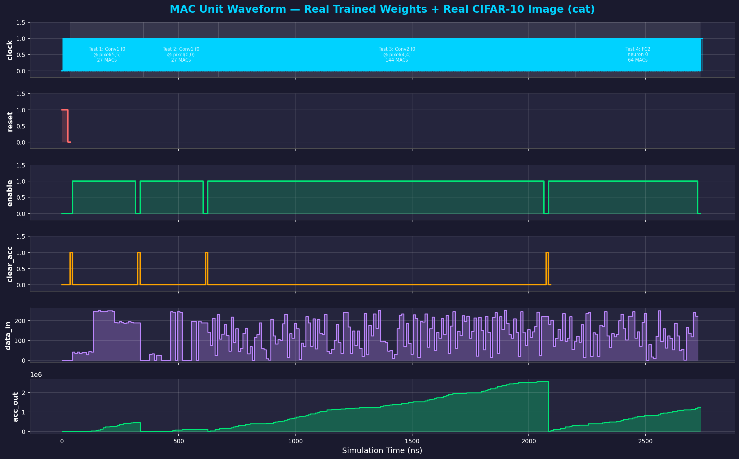
RTL Simulation: MAC Unit Waveform
Real trained weights from tiny_cnn_cifar10_int8.onnx, CIFAR-10 cat image

Slide 7
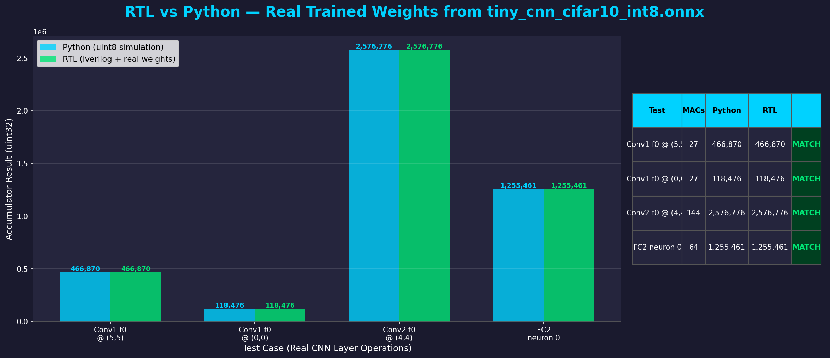
RTL vs Python: Bit-Exact Match (Real Weights)
All 4 tests pass — RTL accumulator matches Python unsigned arithmetic exactly

Slide 8
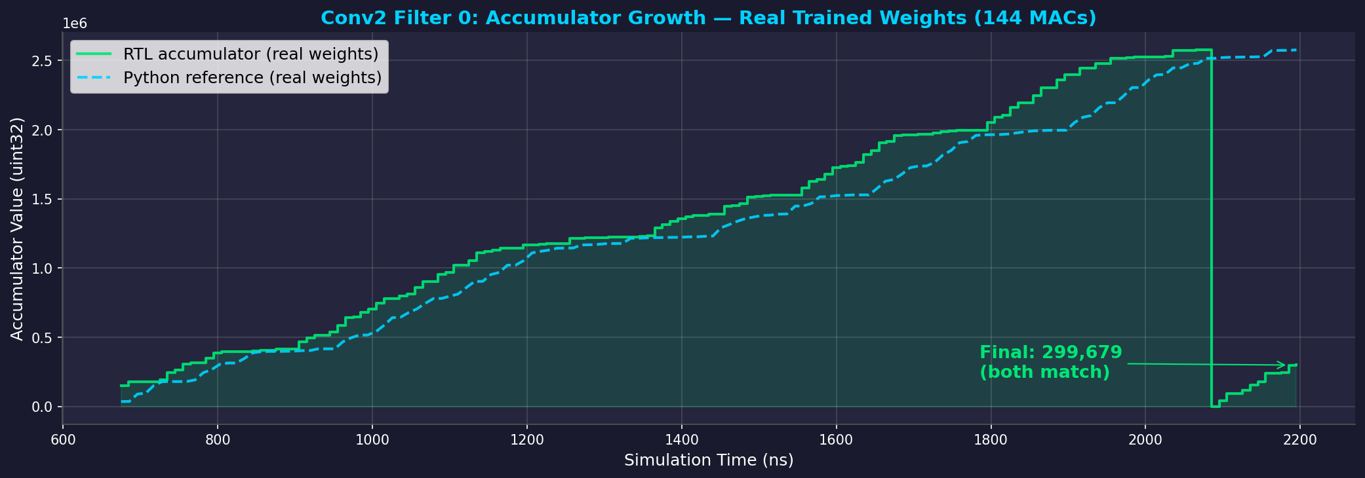
RTL vs Python: Conv2 Accumulator Trace
144 MAC operations using real Conv2 filter 0 weights, final value: 2,576,776

Slide 9
Behavioral FPGA Simulation Results
Float32 accuracy: F1 = 0.7400
Int8 accuracy: F1 = 0.7395 (delta: −0.0005)
Peak BRAM: 66.1 KB / 225 KB (29.4%)
Estimated throughput: 4,008 images/sec @ 100 MHz
Latency: 0.25 ms per image

Slide 10
Performance Breakdown by Layer
Layer | Weights | Size (KB) | MACs | Compute %
Conv1 | 432 | 0.4 | 230K | 12.0%
Conv2 | 4,608 | 4.5 | 1.18M | 52.5% ← bottleneck
Conv3 | 9,216 | 9.0 | 590K | 26.3%
FC1 | 32,768 | 32.0 | 33K | 1.5%
FC2 | 640 | 0.6 | 640 | <0.1%
Bottleneck: Conv2 (52.5% of compute)

Slide 11
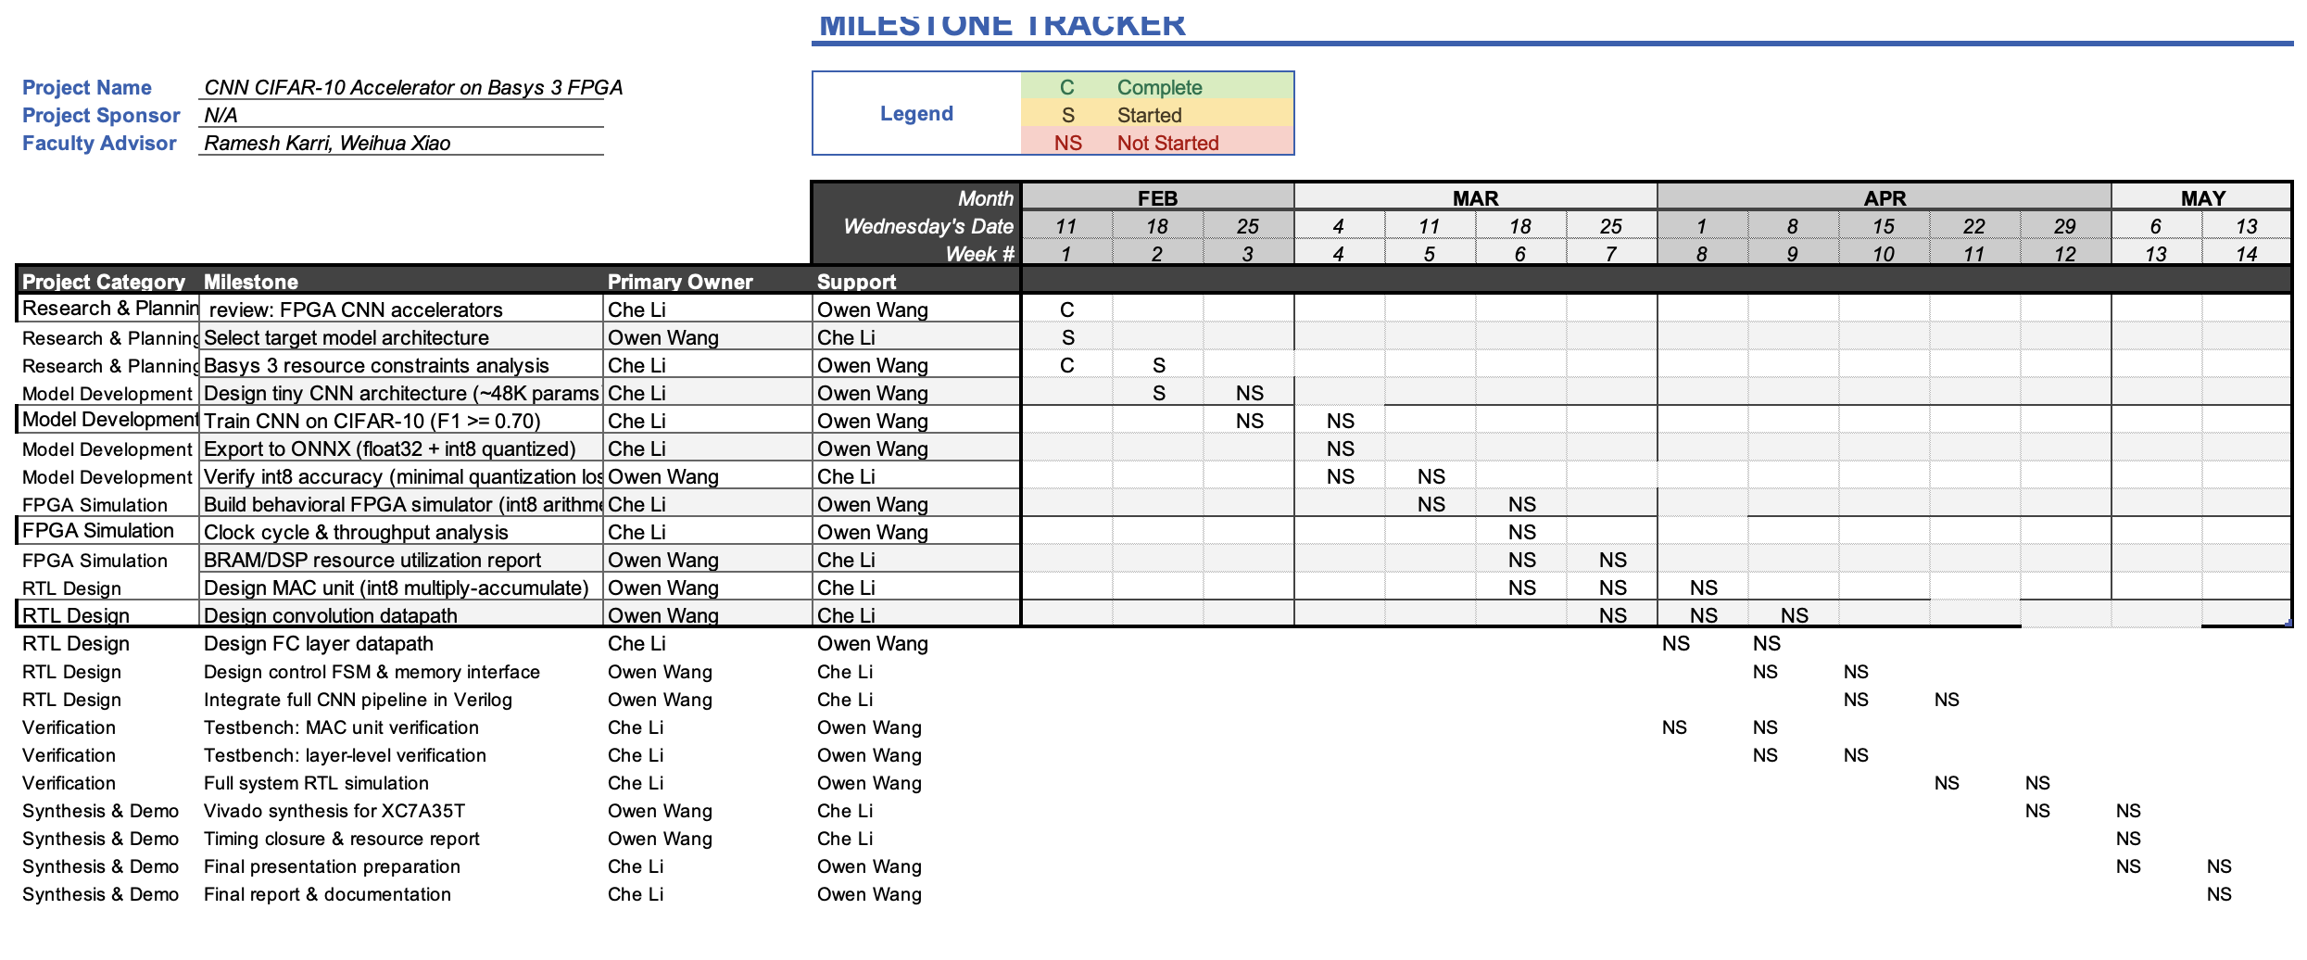
Milestones Tracker

Slide 12
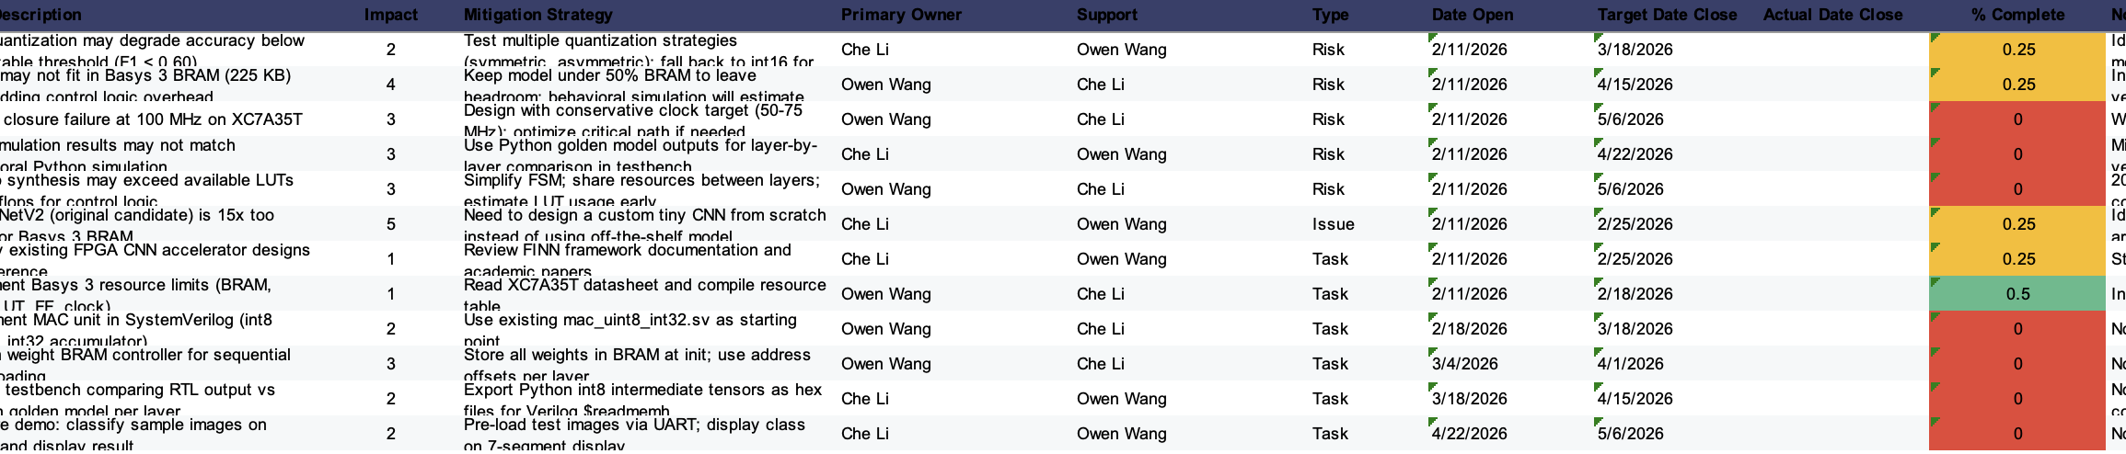
Risks Management

Slide 13
Challenges & Lessons Learned
Signed vs unsigned arithmetic: MAC unit uses uint8, not int8
Quantization: minimal accuracy loss with proper calibration
Resource constraints drive architecture decisions
Behavioral simulation catches issues before synthesis

Slide 14
Next Steps
Synthesize full CNN datapath on Basys 3
UART interface for image input / classification output
Multi-filter parallelism to improve throughput
Compare with FINN-generated accelerator
GitHub: github.com/Owen-yd-Wang/Design-Project

