Slide 1
Predictive Model Level Set Opioid Solutions
June 7, 2018

Slide 2
Topics
Review adaptation of IBM foundational model (Mark/Nicole/Prateek)
Predictive model Outputs
Opioid Epidemic Insights risk-group definitions (Nicole)
Opioid Predictive Model roadmap
Work Ahead in support of the Roadmap

Slide 3
Foundational Model Overview

Slide 4
Foundational Model – Replication to refine definitions for opioid drugs and opioid dependence
The foundational model associates the risk of long-term opioid use 1 year after a person has their first use of an opioid with the drug regimen prescribed in that first use.
The population used for the model replication is Medicaid patients across about 6 states in the Midwest and Southern US (MarketScan data and all non-expansion states)
4 opioid drug regimens were defined: less than 7 days vs. 7+ days crossed with natural opioids vs. semi-synthetic and synthetic opioids
2013-2016 longitudinal data available on 2,392,980 members 12+ years old. 2014 used as the base year, with 2013 look-back and 2015-2016 look-forward
About 1.6 million had drug coverage and 570,000 had an opioid prescription

Slide 5
Foundational Model -
Entry criteria:
Excluded those with (1) a cancer diagnosis or (2) hospice care during the year.
“First use” was defined as all those except with use prior to first use in 2014 of 6 months or less (6 month clean period)
Of 573,165 Members with Opioid Prescriptions in 2014, after exclusions 297,262 were in the “new user” population
Outcome metric:
Continued use was defined as not having a clean period of at least 6 months at 1 year after first use OR receiving drug treatment (buprenorphine or methadone) any time from first use to 18 months thereafter.
Short-term use was defined as having a clean period of at least 180 days 1 year after first use AND no drug treatment from first use to 18 months thereafter

Slide 6
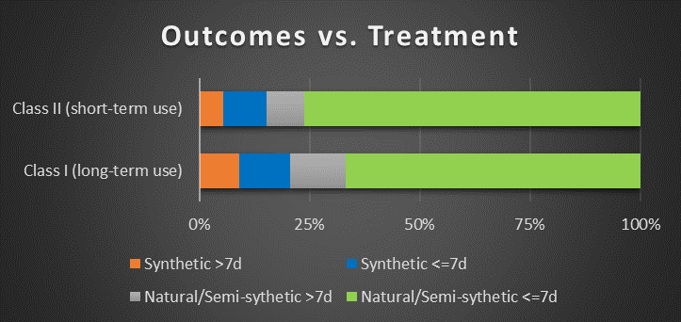
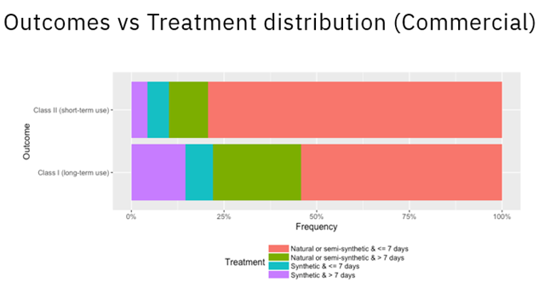
Results comparison of reconstructed model in Medicaid data to Original Model in Commercial MarketScan

Slide 7
Predictive Model on Opioid Dependence Adapted from Foundational Model
Used from foundation
“first use” criteria.
Age, disease, and hospice criteria
Initial treatment regimen as potential driving factor
Modified Outcome Metric to Opioid dependence with prediction time-frame set to 1 year after end of measurement year
Included patient characteristics in the measurement year
age and gender
interim events such as frequency, length, and strength of opioids prescribed
disease conditions.

Slide 8
Modeling Steps Conducted
Assembling Potential Variables
Rebalancing population via SMOTE
Exploring A Variety Predictive Methods
Blending Methods via Voting Classifier
Determining Tunable Thresholds
Model methodology Detail – Prateek Agrawal presenting

Slide 9
A Few Comments on Model Output
For each “new” user:
A prediction for the upcoming year on status as Opioid Dependent (1) or Not (0)
A Score on the probability of being Opioid Dependent for upcoming year
No Predictor contributions to the Risk Score (yet)
Aggregations of Risk Scores to a Prescriber(s) Level (with client data)
Aggregations of Risk Scores to a Pharmacy(s) Level (with client data)

Slide 10
Opioid Epidemic Insights Risk Group identification

Slide 11
High Risk Opioid Cohorts
1. Members has SUD/OUD diagnosis and opioid claim
2. Members with concurrent opioid and bad potentiator pharmacy scripts
3. Members using opioids for chronic pain management - greater than 60 day supply in 90 day period
4. Members with MPR > 125% --- MPR = total days supply/365 days or others day span
5. Members with scripts from 3 or more providers (prescribers)
6. Members with scripts dispensed at 3 or more pharmacies
7. Members with concurrent opioid and benzodiazepine scripts

Slide 12
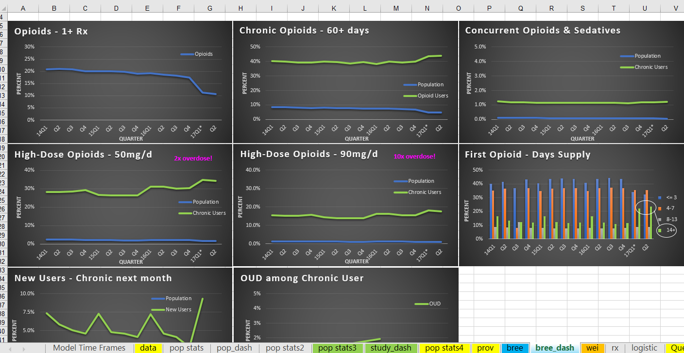
Additional Data Element Definitions
https://ibm.box.com/s/bljnyrco7csun51n17ir9kcj49nxp6fx

Slide 13
Opioid Epidemic Insights Predictive Model Roadmap

Slide 14
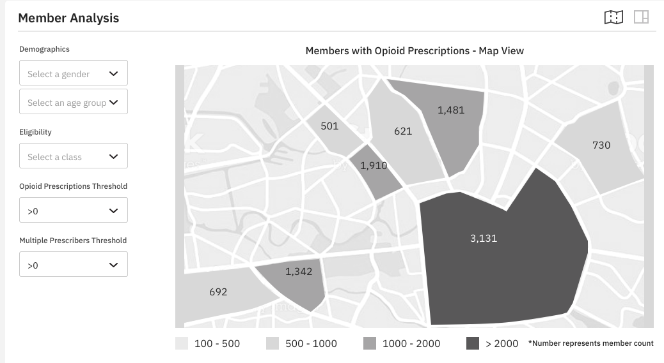
Predictive Models
Predicting OUD or overdose for patients after first opioid prescription…
Phase 1 Variables
Key Value
Future Potential
Opioid prescription
Synthetic vs. non-synthetic opioid
Mental health diagnosis
Short acting vs. long-acting
Good vs. bad opioid potentiators
Continuous enrollment
ER visits
Inpatient stays
Patient demographics (age, sex, race, region, urban/rural)
Days supply
Procedure Groups
History of substance abuse
Geospatial
Overdose
Earlier intervention opportunity
Broader identification of ‘at risk’ cohorts
Reduced ER visits, overdoses, deaths
Additional Data Sources
Death records
Veteran’s data
Homelessness data
Incarceration release
MAT program
State Rx registries (PDMP)
EHR data
Ambulance data
Apply Machine Learning
Additional Models
Identifying bad providers
Predicting acute events
Finding best treatment route
Claims

Slide 15
Future Focus
Social Determinants of Health (usually captured at the census block level and requiring nine-digit zip code localization for a person)
Health Risk Assessment data for the person, (such as levels of tobacco/alcohol use, obesity level, fitness levels, etc
Health history data for the patient (such as patient-supplied surveys)
Incorporate different populations: all members, utilize the discussed risk cohorts, remove certain chronic conditions, etc.

Slide 16
Adding Data Sources to Capture the Full Patient Experience
Data Source
Medicaid and Rx Claims | Capture cost and use statistics for all claims paid for by the Medicaid program.
Prescription Drug Monitoring | Understand provider, member, and pharmacy prescribing patterns in near-real time for all Rx scripts within a state, including Medicaid, private insurance, and out-of-pocket paid scripts.
Vital Records | Birth & death records capturing birth outcomes, parents, and location and cause and manner of death.
Behavioral Health | Information on treatment facilities not captured on claims.
Public Health | Contains information on naloxone distribution monitoring, syringe exchange programs, etc.
Emergency Responders | Captures ambulance and first responder trip data that capture opioid-related events outside of ER.
ER Discharge | Facility admission and discharge data for Medicaid recipients.
Corrections | Manage transition in/out of prison, Drug Courts.
Clinical EMR | Combine clinical outcomes data with administrative data for a more complete view of the experience of the patient.
Case Notes | Capture insights from case notes and unstructured data about the patient experience.

Slide 17
Work Ahead in Support of Predictive Models
Watson Studio Understanding and Use
Re-do the data prep (SAS) in Watson Studio tooling
Connecting to data
Reworking models at needed scale – e.g., revision to PySpark
Model branching, versioning, model management
Deployment
Modeling Discipline and Structure
Implementing DM – CRISP framework
Testing processes, Retesting and Model Enhancement
Data Models for Input, Output, Post-processing, and visualization integration

