Slide 1
Discussion about OptumInsight Data
Jan 30, 2019

Slide 2
1. Procedure codes
The purpose for learning about the procedure codes is to capture the process of procedures during a patient’s visit, both inpatient and outpatient settings.

Slide 3
1. Procedure codes: specific questions
Are there systematic differences between the procedures submitted by a non-facility (Loc_Cd = 2 in medical claims tables), and the procedures submitted by a facility (Loc_Cd = 1 in medical claims tables, or in facility claims tables)?
How does a facility/non-facility choose to submit an ICD procedure code versus a CPT/HCPCS code?

Slide 4
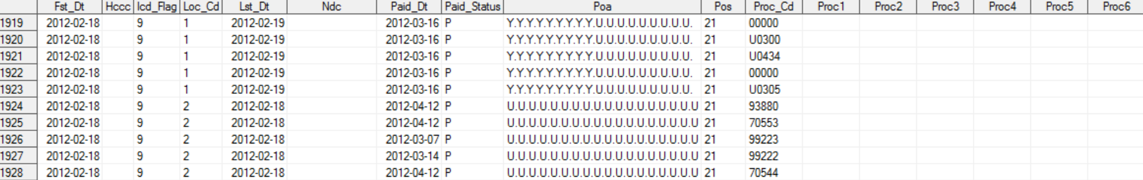
1. Procedure codes: Loc_Cd
Doctors/Professionals (Loc_Cd = 2) generally use CPT/HCPCS to indicate what services are performed on the patients.
Although ICD procedure codes are generally used by facilities to indicate what services the patients received within their facility, most claims with Loc_Cd = 1 have empty Proc1-25 in the medical tables.
Example: Med_dvt_2012

Slide 5
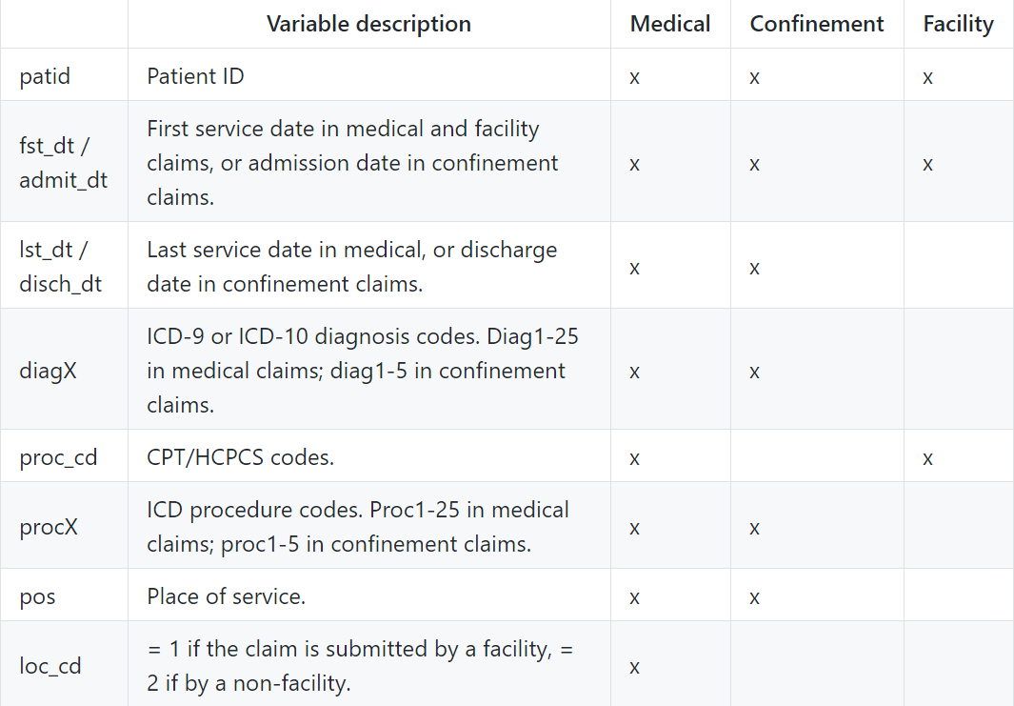
Variables available in different claims tables
Notes:
https://github.com/zhenkewu/OptumInsight/wiki/Variables-in-The-Data-Sets

Slide 6
2. Financial fields
The purpose is to capture hospital utility via financial costs spent in different hospital settings, patient’s diagnoses, and medical procedures.
Financial variables, including charge, copay, coinsurance, and deductible, are available in medical tables and confinement tables.

Slide 7
2. Financial fields: specific questions
How is the charge in confinement tables related to the charge(s) in medical tables?
If we would like to capture detailed charges during a hospitalization, which rows of the medical/confinement tables should we look at?
Patid, fst_dt, lst_dt, conf_id, pos, claim_id…

Slide 8
2. Financial fields: example 1
Is there any way to see breakdown of charges in confinement claims?
The sum of charges in medical claims equals to the confinement claim with matched patient ID, fst_dt (or admit_dt), lst_dt (or disch_dr), and confinement ID?
Counterexample:
1) Confinement claims of patient 802666500107193, between 2015-01-22 and 2015-02-06.
2) The medical claims of this patient between 2015-01-22 and 2015-02-06

Slide 9
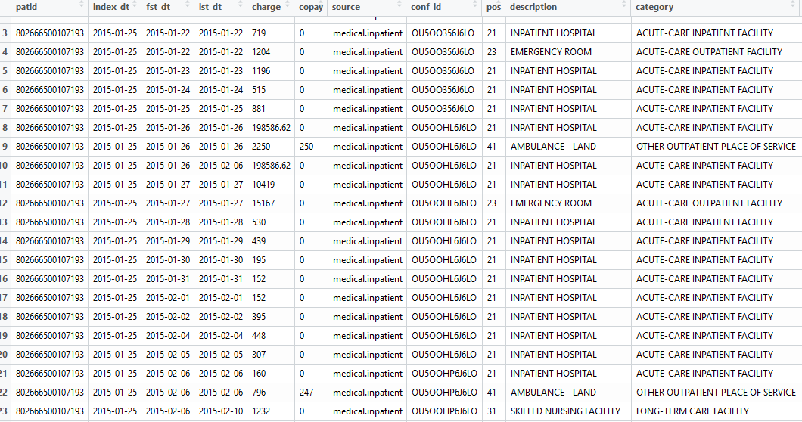
2. Financial fields: example 1
Notes:
For records between 2015-01-22 and 2015-01-26, the medical charges do not sum up to 155071.3, i.e. the confinement charge. In addition, for records between 2015-01-26 and 2015-02-06, the medical charges do not sum up to 394895.24 either. However, charges in rows 8 and 10 of the medical claims sum up to 394895.24 -- why is the confinement charge split into two halves with different lst_dt?

Slide 10
3. Diagnoses
The purpose is to capture the diagnostic process of a patient over the year, and to learn about their health condition and disease progression.
In general, what is the best way to identify diagnostic processes that happened during a hospitalization?

Slide 11
3. Diagnoses: Question 1
It seems that inpatient diagnoses cannot be uniquely identified from confinement claims and medical claims having the same patid, fst_dt, and conf_id.
There is a considerable number of medical claims that are not found in confinement claims, using this matching criterion. How to interpret each component in this partition?
Confinement claims
Medical claims
1
2
3

Slide 12
3. Diagnoses: Question 1
Example: non-empty conf_id, but the place of service is an outpatient setting
Notes:
diagInpatient_long.csv

Slide 13
3. Diagnoses: Question 2
The ICD-9 codes have three levels: 3 digits, 4 digits, and 5 digits. What is the reason why a doctor put ICD-9 codes, at multiple levels, corresponding to the same disease?
Example: 585 and 585.9 appear on the same day at place of service 21. 585 means Chronic kidney disease (ckd).

Slide 14
3. Diagnoses: Question 3
As we are counting the number of occurrences of each ICD-9 code at different levels, we wonder under what circumstances should we consider multiple occurrences as multiple contributions.
Example: 1889 appears three times in the picture. Each row has a different charge amount or place of service.

