Slide 1
Discussion about OptumInsight Data
Jan 30, 2019
Mengbing Li and Zhenke Wu
Department of Biostatistics
Meeting with IHPI Team

Slide 2
Outline of Discussion
Healthcare utilization and cost variables
Procedure codes
Financial variables
Diagnosis codes

Slide 3
1. Procedure codes
Statistical goal: Statistical modeling of the pattern of healthcare utilization
Data: procedures used during a patient’s visit, both inpatient and outpatient settings.
Today’s goal:
Understand how the procedure codes are generated and processed in Optum database.
Understand potential advantages and caveats of using OptumInsight data for data analysis based on procedure codes.

Slide 4
1. Procedure codes: Questions
Are there systematic differences between the procedures submitted by a non-facility (Loc_Cd = 2 in medical claims tables), and the procedures submitted by a facility (Loc_Cd = 1 in medical claims tables, or in facility claims tables)?
How does a facility/non-facility choose to submit an ICD procedure code versus a CPT/HCPCS code?

Slide 5
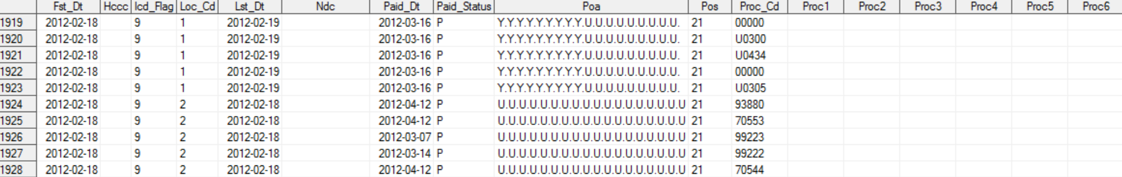
1. Procedure codes: Loc_Cd
CPT/HCPCS: Doctors/Professionals (Loc_Cd = 2) generally use it to indicate what services are performed on the patients.
ICD procedure codes: generally used by facilities (Loc_Cd=1) to indicate what services the patients received within their facility
Most claims with Loc_Cd = 1 have empty Proc1-25 in the medical tables. Why? Example: Med_dvt_2012

Slide 6
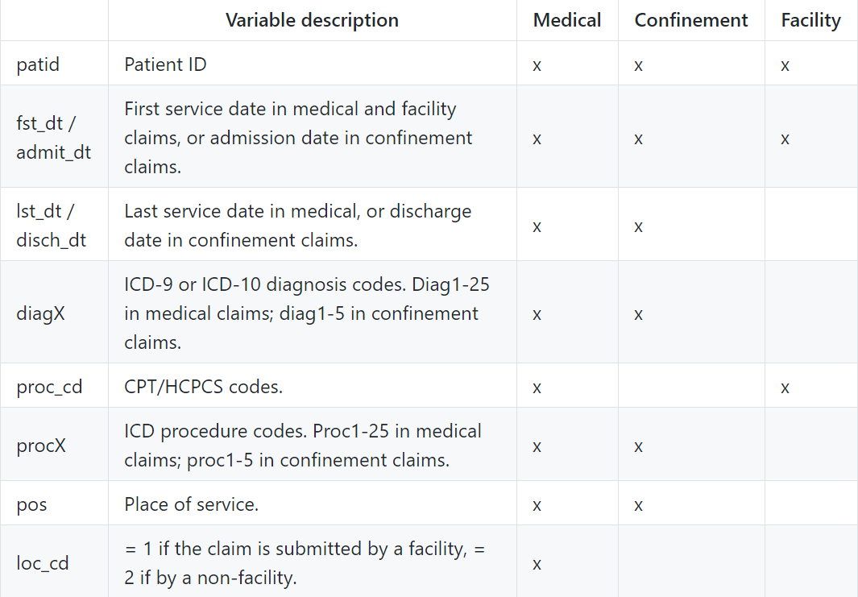
Variables available in different claims tables
Notes:
https://github.com/zhenkewu/OptumInsight/wiki/Variables-in-The-Data-Sets

Slide 7
2. Financial fields
Statistical goal: analyze the costs of different types of procedures used by individual patients using OptumInsight. We think it is likely that the costs correlate with patient and provider characteristics (e.g., different hospital settings, patient diagnoses, and medical procedures, etc.).
Data: Financial variables, including charge, copay, coinsurance, and deductible, are available in medical tables and confinement tables.
Today:
Use some specific examples of claims to understand how these variables are populated for each individual
Need your input in how useful/valid these variables are

Slide 8
2. Financial fields: example 1
Is there any way to see breakdown of charges in confinement claims?
Is the sum of the charges in medical claims equal to the confinement claim with matched patient ID, fst_dt (or admit_dt), lst_dt (or disch_dt), and confinement ID?
No. Example:
1) Confinement claims of patient 802666500107193, between 2015-01-22 and 2015-02-06.
2) The medical claims of this patient between 2015-01-22 and 2015-02-06

Slide 9
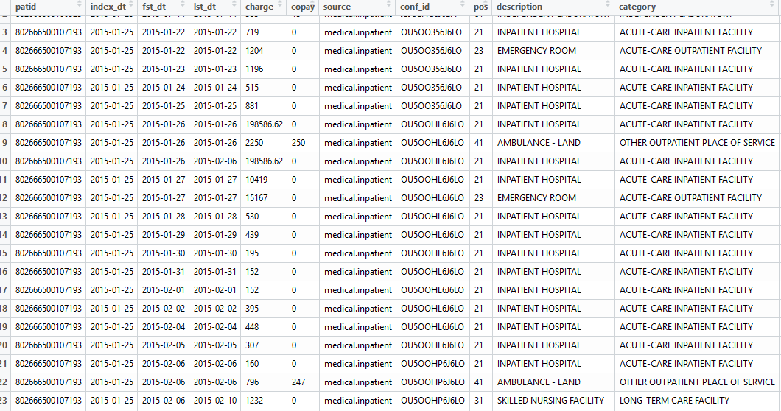
2. Financial fields: example 1
Notes:
For records between 2015-01-22 and 2015-01-26, the medical charges do not sum up to 155071.3, i.e. the confinement charge. In addition, for records between 2015-01-26 and 2015-02-06, the medical charges do not sum up to 394895.24 either. However, charges in rows 8 and 10 of the medical claims sum up to 394895.24 -- why is the confinement charge split into two halves with different lst_dt?

Slide 10
3. Diagnoses
Statistical Goal: understand the entire health trajectory in the population and for an individual by modeling the temporal, multiple diagnosis codes recorded in OptumInsight.
Caveats: Must take into account of the process, custom and rules of how these codes are entered into the OptumInsight database.
In general, what is the best way to obtain a complete picture of the diagnostic codes of a patient, in both inpatient and outpatient settings?

Slide 11
3. Diagnoses: Question 1
It seems that inpatient diagnoses cannot be uniquely identified from confinement claims and medical claims having the same patid, fst_dt, and conf_id. Consider the partition of confinement claims and medical claims:
1: claims in confinement tables, but not in medical tables. These claims might be declined, for example due to rare diseases, but stayed in the confinement tables for so long that people forgot to remove them.
2: claims in both confinement table and medical tables. These confinement claims are a summary of the medical table counterpart.
3: claims in medical tables, but not in confinement tables. What are these?
Confinement claims
Medical claims
1
2
3

Slide 12
3. Diagnoses: Question 1
Example: non-empty conf_id, but the place of service is an outpatient setting
Notes:
diagInpatient_long.csv

Slide 13
3. Diagnoses: Question 2
The ICD-9 codes have three levels: 3 digits, 4 digits, and 5 digits. Why did the doctor put ICD-9 codes at multiple levels corresponding to the same disease?
Example: 585 and 585.9 appear on the same day at place of service 21. 585 means Chronic kidney disease (ckd).

Slide 14
3. Diagnoses: Question 3
Since we count the number of occurrences of ICD-9 codes, under what circumstances should we consider multiple occurrences of an ICD-9 code on the same date as multiple contributions.
Example: 1889 appears twice in the picture, in the 1st and 3rd rows. Each row has a different charge amount or place of service.

