Slide 1
Process of Subsetting the Data Set

Slide 2
Overview of the process:
Exclude patients who never got any anti-coagulants
Obtain index cancer date and index cancer type
1) Implement the multiple cancer algorithm
Exclude patients whose cancer was not active
Definition of being active: having an HCPCS code for chemo procedure or an NDC code for chemo drug after index cancer diagnosis and before index VTE date
Remove duplicated records: rows that agree on: patid, fill_dt, category, brand_name, copay, index_dt, index_cancer_dt, cancer_type, days_sup, quantity, strength. (The reason is that some patients were on multiple plans (multiple planid), so records were duplicated.)
Exclude patients who did not get any anti-coagulants within 30 days after index VTE date
Implement the multiple cancer algorithm:
stomach + any other cancer --> stomach,
pancreas + any other cancer --> pancreas,
stomach + pancreas --> pancreas,
lung/lymphoma/gynecologic/bladder/testicular cancer + any other non-stomach or pancreas cancer --> the named cancer (either lung, lymphoma, gynecologic, bladder, testicular (essentially ignore the other non stomach/pancreas cancer),
any combination not listed above --> multiple cancers.

Slide 3
Sources of information:
Key variable to matching all patient information across data sets: patid
PHARMA data sets (2007-2016):
patid
clmid
copay
fill_dt (prescription date)
ndc (NDC codes for outpatient anti-coagulants and chemo drugs)
days_sup (# of days of supply for the prescribed drug)
quantity
strength
MEDICAL data sets (2007-2016):
patid
diag1 – diag25 (ICD9 codes for diagnoses)
fst_dt (first service date, viewed as diagnosis date)
ndc (NDC codes for inpatient and outpatient chemo drugs)
proc_cd (HCPC codes for chemo procedures)
CONFINEMENT data sets (2007-2016):
patid
Diag1-diag5 (ICD9 codes for diagnoses)
fst_dt (first service date, viewed as diagnosis date)
MEMBER data set:
patid
index_dt (index VTE date)
FACILITY data sets (2007-2016):
patid
proc_cd (HCPC codes for chemo procedures)
All_codes_ICD9_NDC_HCPCS.xlsx
ICD9 codes for cancers
NDC codes for AC
NDC codes for chemo drugs
HCPCS codes for chemo procedures

Slide 4
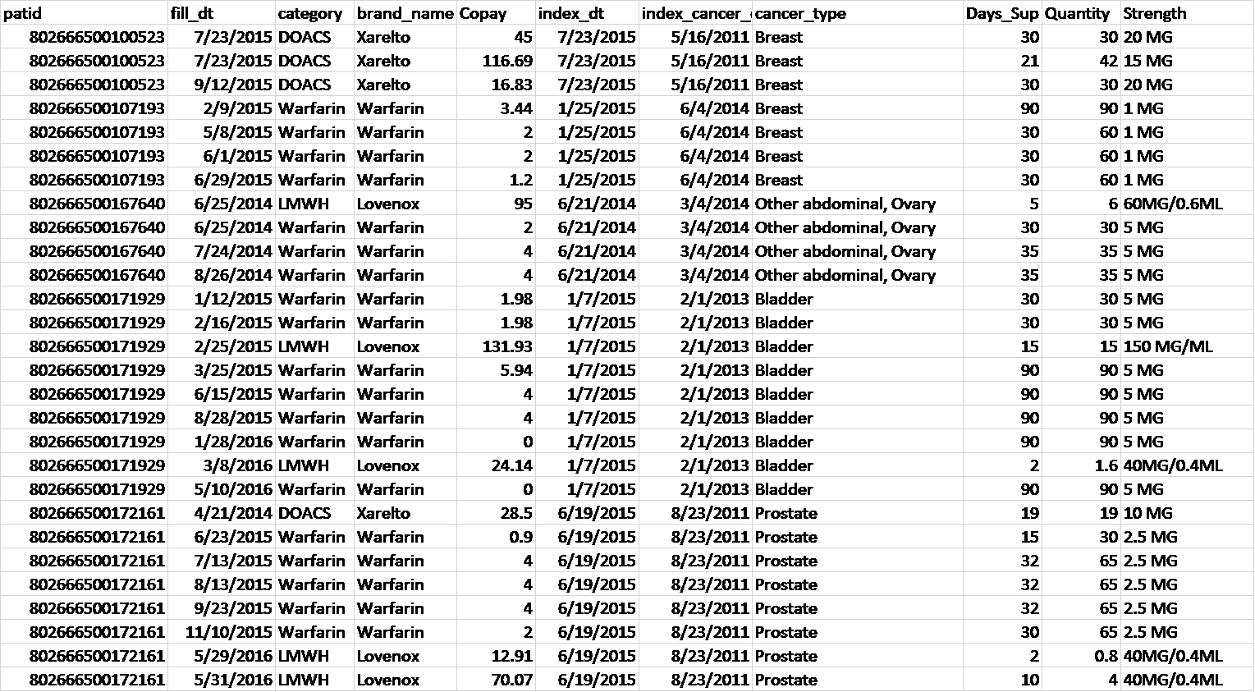
How does the final data set look like?
subset_ac_days_multi_cancers.xlsx

Slide 5
Procedures of subsetting
1. Exclude patients who never got outpatient anti-coagulants from pharma data
check2_proccd.xlsx contains all HCPCS/CPT codes (proc_cd) from medical and facility data sets
5. Remove patients who did not get an AC within 30 days after index VTE date
1) Merge outpatient prescription records from PHARMA, and index VTE date from MEMBER data sets
3. Select patients whose cancer was active
fill_dt <= index_dt+30 & fill_dt >= index_dt
1) Select patients who had a chemo drug or chemo procedure between index cancer date and index VTE date
where index_cancer_dt <= fst_dt <= index_dt and (ndc in (select ndc from chemo_codes));
Or
where procedure = "chemo“ (from proccd.xlsx)
# subjects: 14945
# rows: 171050
2) Keep rows having an NDC code for anti-coagulant:
where ndc in (select ndc_ac_code from ndc_ac)
6. Implement the multiple cancer algorithm
Resulting data set is named final1
# subjects: 184320
# rows: 2948379
See analysis_data_dictionary.xlsx for rules.
Resulting data set is named final2
# subjects: 21332
# subjects: 14945
# rows: 171050
2. Obtain index cancer date and index cancer type
4. Remove duplicated records
7. Merge repeated rows
1) Merge final1 and final2, keeping rows with patid appearing in both data sets
Multiple rows are merged into one row if they agree on all of the following variables: patid, clmid, fill_dt, brand_name, days_sup, quantity, and strength. In this case, copay is summed up, matching on these variables.
1) Read diagnosis information from MEDICAL data sets and CONFINEMENT data sets
# subjects: 21332
# rows: 244770
2) Keep rows with distinct values:
select distinct patid, climd, fill_dt, category, brand_name, copay, index_dt, index_cancer_dt, cancer_type, days_sup, quantity, strength
# subjects: 14945
# rows: 168355
2) Go through diag1-diag25 (MEDICAL) and diag1-diag5 (CONFINEMENT) in each row to look for cancer ICD9 codes
8. Keep rows with AC prescribed after index VTE date
3) Among patients with at least one cancer diagnosis, use the earliest cancer diagnosis date as the index cancer date:
group by patid having fst_dt = min(fst_dt);
and the corresponding cancer(s) as
index cancer(s)
filter(fill_dt >= index_dt)
# subjects: 21332
# rows: 238702
# subjects: 14945
# rows: 134340
Note:
Procedures 1 to 4 are implemented in subset_ac_active_nodup.sas.
Procedures 5 and 6 are implemented in subset_ac_days_multi_cancers.R.
Procedures 7 and 8 are implemented in prog100_create_analysis_data.R
4) Keep patients whose index cancer happened prior to index VTE:
index_dt >= index_cancer_dt
Resulting data set: final
Number of patients: 14,945
Number of rows: 134,340
# subjects: 44162
Included variables: patid, clmid (claim ID), fill_dt (AC prescription date), category (AC category), brand_name (AC brand name), copay, index_dt (index VTE date), index_cancer_dt, cancer_type, cancer_type_combined (after implementing the multiple algorithm), days_sup (days of supply), quantity (quantity of prescribed drug), strength (dose of prescribed drug)

Slide 6
After subsetting data, a data set used for modeling is prepared via prog100_create_analysis_data.R

