Slide 1
Running LDA on diagnostic codes

Slide 2
Data description
We consider both inpatient and outpatient diagnoses from medical claims data, obtained from rows in diagData_20181020_freeze.csv that have source %in% ("medical.inpatient", "medical.outpatient").
Diagnoses after index VTE date are included and range from 2007-01-01 to 2015-09-30.

Slide 3
LDA setup
Each patient is considered a document, and diagnostic codes are considered the terms.
The frequency of a term in a document is the number of times a diagnostic code on a patient appears after index VTE.

Slide 4
Select the number of topics
We first wanted to choose the number of topics. A preliminary selection was based on 3 different criteria in Griffiths2004, Arun2010, and Deveaud2014.
Griffiths2004 maximizes the posterior probability of the words given the number of topics T, i.e. P(w|T)
Arun2010 minimizes their proposed divergence measure based on KL divergence of two stochastic matrices output from LDA.
Deveaud2014 maximizes the KL divergence between all pairs of LDA’s topics.
However, I unfortunately ignored the counts of diagnostic codes when converting the data into a runnable format. The plot on the next page was generated when considering each diagnostic code only appeared once in a patient. I will update the result later as the process takes about 16 hours.

Slide 5
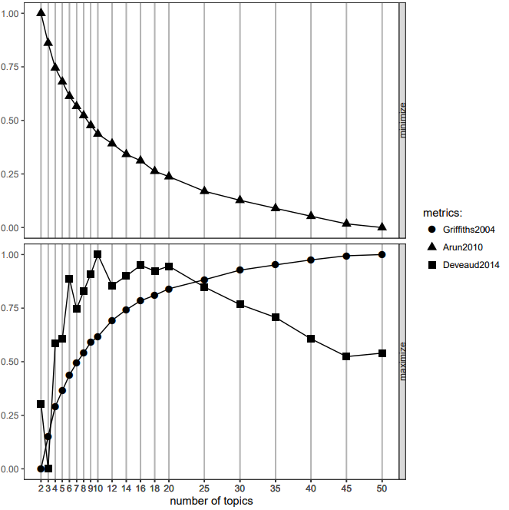

Slide 6
Running LDA
Neither Griffiths2004 nor Arun2010 suggest a good number of topics. Deveaud2014 suggests the number be between 6-20.
Model was run using the LDA function from R package topicmodels
The numbers of topics: c(2, 10, 20).
Results:
Word
1) The most common ICD-9 codes within each topic
2) Distribution of the most likely topics
3) Probability of assignment to the most likely topic
Topic distributions : Posterior topic distribution for individual patients

Slide 7
Future considerations
LDA does not account for the sequential nature of the diagnostic codes.
There may be correlation between diagnostic codes (words).

