Slide 1
Innovation Lab Relational Database
Owen Heaslip

Slide 2
Background
As graduate assistant in the Innovation Lab, I wanted to create a simple, yet effective relational database to store data on our equipment, workers, players, and most importantly visits to the lab.
When students arrive, they are met with a worker at the front desk. They are asked to sign in and indicate which equipment they are using for the day.
The ultimate goal for this project is to (1) create and implement a database to store data in all three previously mentioned categories, (2) create interactive data visualizations for our supervisor to see periodic usage of the lab, and (3) create a user interface for front desk workers to add daily visits into data tables while working the front desk.
A description of the lab, and some photos of the equipment we have is shown here:

Slide 3
Entity-Relationship Diagram

Slide 4
Location
Name
Quantity
EID
Description
Equipment
Sport
Grade
Name
Gender
Name
Sport
PID
Active
1
WID
Email
Player
Worker
M
1
1
M
M
Visits
VID
Time
Year
Day
Month
Notes:
Note that it would be possible to link worker and player, but would not find it necessary for analysis
Relationships:
Player to Visits ->
Each visit is associated with one player, but a player can have multiple visits.
Equipment to Visits ->
Each visit is associated with one piece of equipment, but one equipment can be used in many visits.
Worker to Visits->
Each visit is associated with one worker, but a worker can be associated with multiple visits.

Slide 5
Relational Model Diagram

Slide 6
Player
PID | Name | Sport | Gender | Active
FK
Worker
WID | Name | Grade | Sport | Email
FK
Equipment
EID | Name | Location | Quantity | Description
FK
Visits
VID | Year | Month | Day | Time | EID | WID | PID

Slide 7
Implementation

Slide 8
Player
Equipment
CREATE TABLE Player
(
PID INT,
Name TEXT NOT NULL,
Sport VARCHAR(10) NOT NULL,
Gender CHAR(1) NOT NULL,
Active BOOLEAN NOT NULL,
PRIMARY KEY (PID)
);
CREATE TABLE Equipment
(
EID INT,
Name TEXT NOT NULL,
Location TEXT NOT NULL,
Quantity INT NOT NULL,
Description TEXT,
PRIMARY KEY (EID)
);

Slide 9
Worker
Visits
CREATE TABLE Worker
(
WID INT,
Name TEXT NOT NULL,
Grade VARCHAR(10) NOT NULL,
Sport VARCHAR(10) NOT NULL,
Email TEXT NOT NULL,
PRIMARY KEY (WID)
);
CREATE TABLE Visits
(
VID INT,
Year INT NOT NULL,
Month VARCHAR(12) NOT NULL,
Day INT NOT NULL,
Time DECIMAL NOT NULL,
PID INT NOT NULL,
EID INT NOT NULL,
WID INT NOT NULL,
PRIMARY KEY (VID),
FOREIGN KEY (PID) REFERENCES Player(PID),
FOREIGN KEY (EID) REFERENCES Equipment(EID),
FOREIGN KEY (WID) REFERENCES Worker(WID)
);

Slide 10
Population

Slide 11
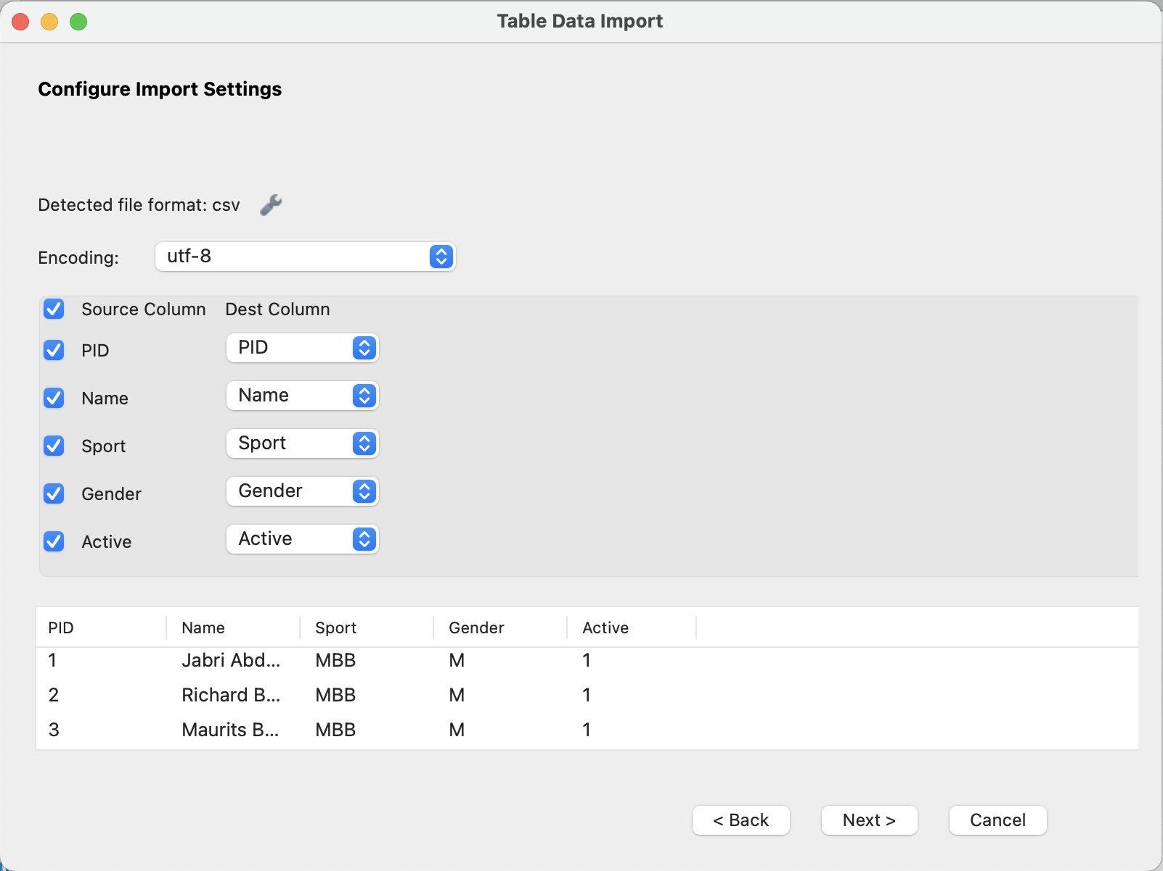
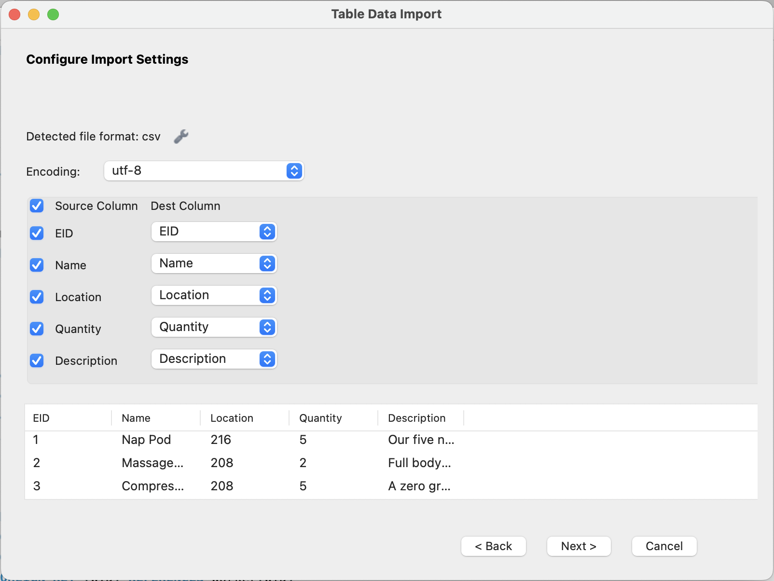
Player
Equipment

Slide 12
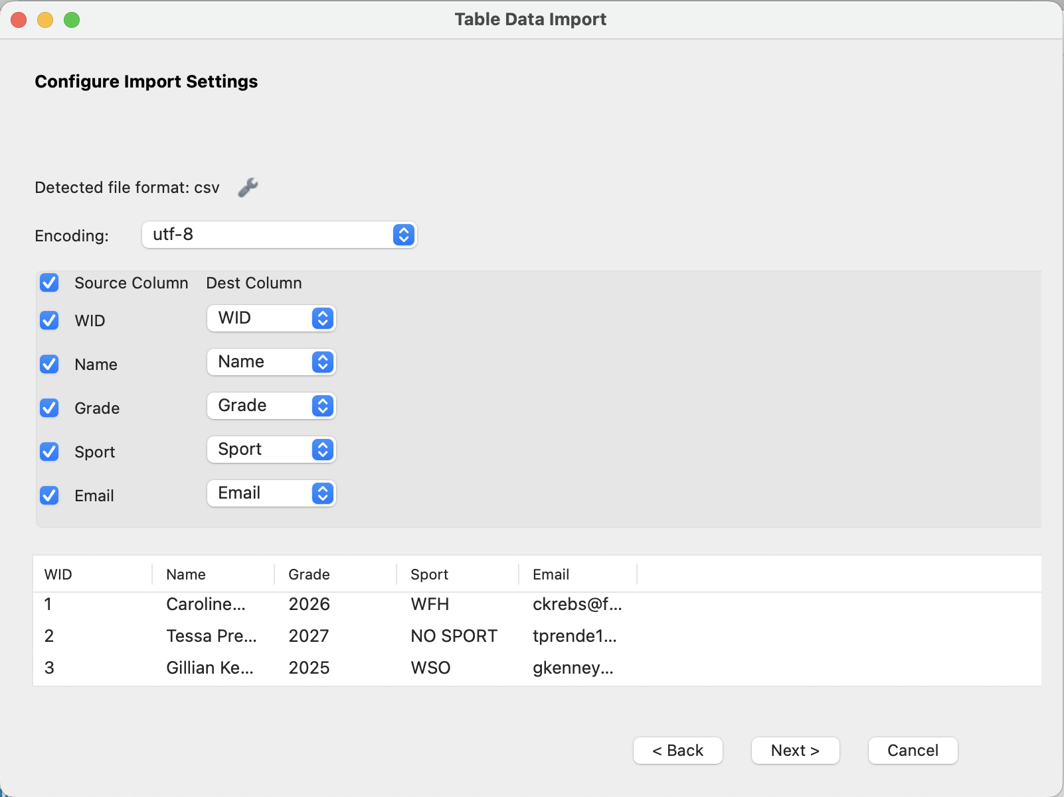
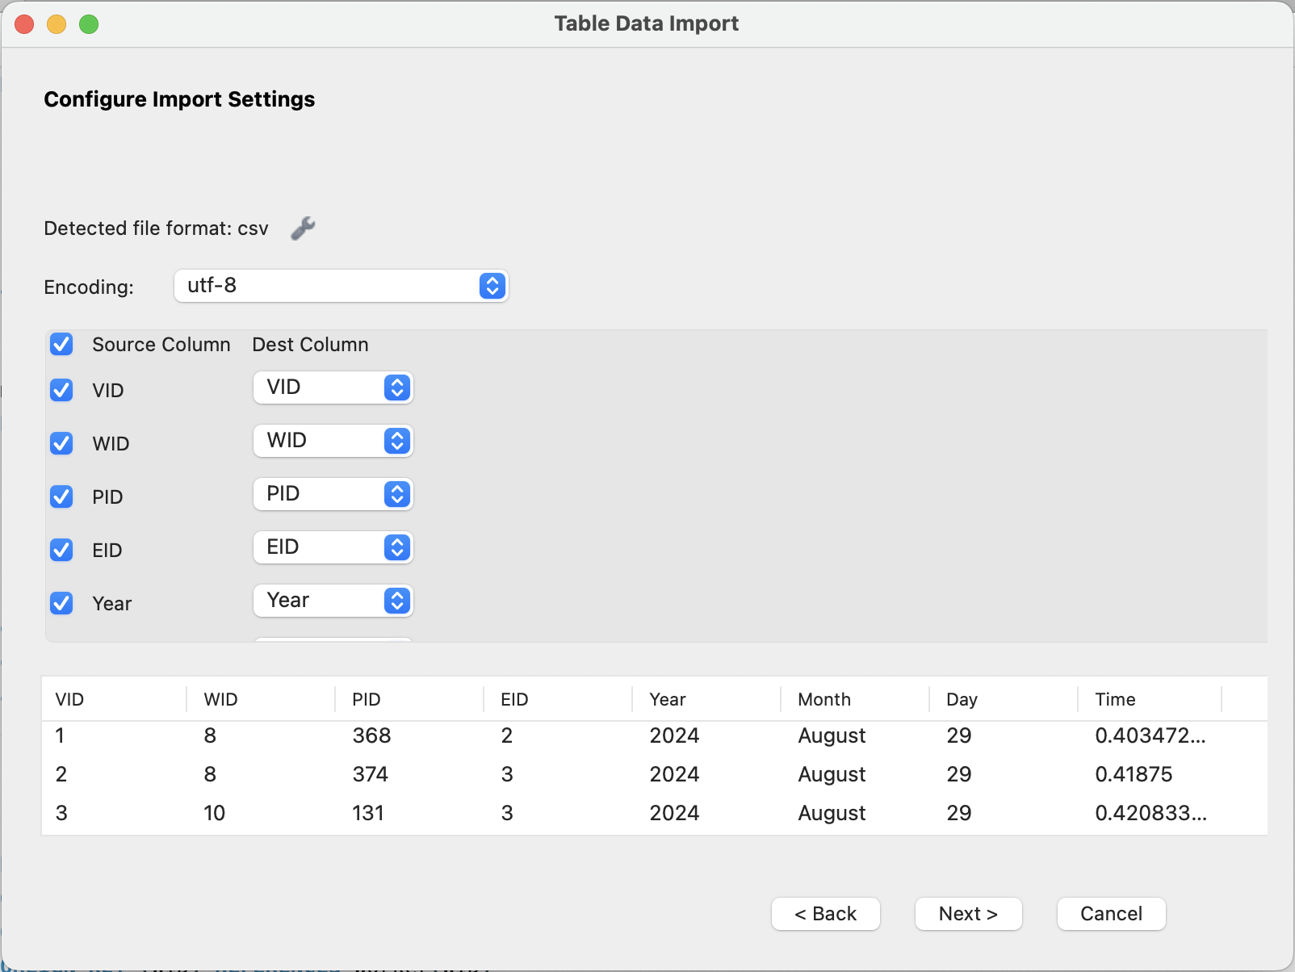
Worker
Visits

Slide 13
Retrieval Queries

Slide 14
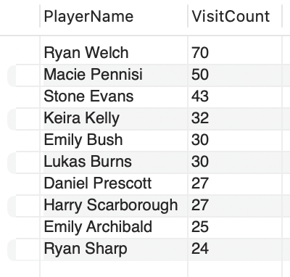
List the top ten most visited players and how many times they have visited.
SELECT P.Name AS PlayerName, COUNT(V.VID) AS VisitCount
FROM Visits V, Player P
WHERE V.PID = P.PID
GROUP BY P.Name
ORDER BY VisitCount DESC
LIMIT 10;
Basic Query 1

Slide 15
List the three most used equipment, how many times it has been used, and its description.
SELECT E.Name AS EquipmentName, COUNT(V.VID) AS UsageCount, E.Description
FROM Visits V, Equipment E
WHERE V.EID = E.EID
GROUP BY E.Name, E.Description
ORDER BY UsageCount DESC
LIMIT 3;
Basic Query 2

Slide 16
List the three least used equipment, how many times it has been used, and its description.
SELECT E.Name AS EquipmentName, COUNT(V.VID) AS UsageCount, E.Description
FROM Visits V, Equipment E
WHERE V.EID = E.EID
GROUP BY E.Name, E.Description
ORDER BY UsageCount ASC
LIMIT 3;
Basic Query 3

Slide 17
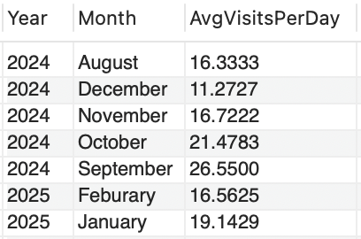
Find the average amount of visits per day for every month.
SELECT Year, Month, (COUNT(VID) / COUNT(DISTINCT Day)) AS AvgVisitsPerDay
FROM Visits
GROUP BY Year, Month;
Basic Query 4

Slide 18
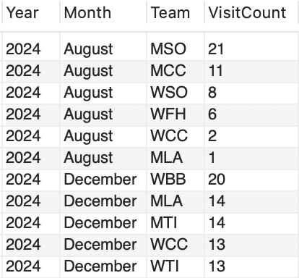
For every month, display each team and how many times they visited.
SELECT V.Year, V.Month, P.Sport AS Team, COUNT(V.VID) AS VisitCount
FROM Visits V, Player P
WHERE V.PID = P.PID
GROUP BY V.Year, V.Month, P.Sport
ORDER BY V.Year, V.Month, VisitCount DESC;
Basic Query 5

Slide 19
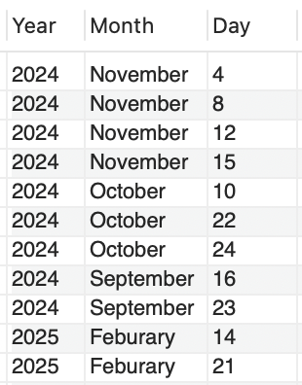
Select each day where Float Tank, Compression Pants, and Massage Chair were used in the same day.
SELECT Year, Month, Day
FROM Visits V, Equipment E
WHERE V.EID = E.EID AND ( E.Name = “Float Tank” OR E.Name = “Compression Boots” OR E.Name = “Massage Chair” )
GROUP BY Year, Month, Day
HAVING COUNT(DISTINCT E.Name) = 3;
Basic Query 6

Slide 20
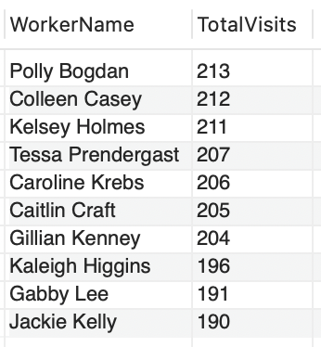
Find the workers who have signed in on the most visits.
SELECT W.Name AS WorkerName, COUNT(V.VID) AS TotalVisits
FROM Visits V, Worker W
WHERE V.WID = W.WID
GROUP BY W.Name
ORDER BY TotalVisits DESC;
Basic Query 7

Slide 21
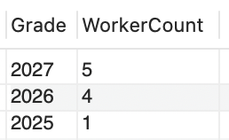
Show the number of workers in each grade and order by grade.
SELECT Grade, Count(WID) as WorkerCount
FROM Worker
GROUP BY Grade
ORDER BY Grade DESC;
Basic Query 8

Slide 22
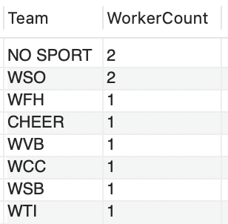
Select the teams that have the most workers.
SELECT Sport AS Team, COUNT(WID) AS WorkerCount
FROM Worker
GROUP BY Sport
ORDER BY WorkerCount DESC;
Basic Query 9

Slide 23
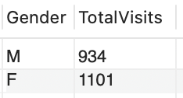
Find the total amount of male and female visits.
SELECT P.Gender, COUNT(V.VID) AS TotalVisits
FROM Player P, Visits V
WHERE V.PID = P.PID
GROUP BY P.Gender;
Basic Query 10

Slide 24
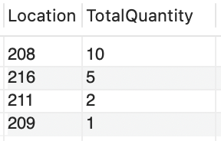
List each location and the total quantity of equipment in each room.
SELECT Location, SUM(Quantity) AS TotalQuantity
FROM Equipment
GROUP BY Location
ORDER BY TotalQuantity DESC;
Aggregation Query 1

Slide 25

What is the average amount of equipment per room?
SELECT AVG(Quantity) AS AverageQuantity
FROM Equipment;
Aggregation Query 2

Slide 26
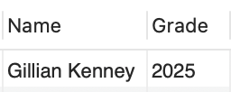
Who is the oldest worker according to their grade?
SELECT Name, Grade
FROM Worker
WHERE Grade = (SELECT MIN(Grade)
FROM Worker);
Aggregation Query 3

Slide 27
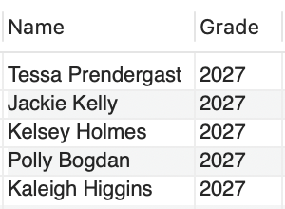
Who is the youngest worker according to their grade?
SELECT Name, Grade
FROM Worker
WHERE Grade = (SELECT MAX(Grade)
FROM Worker);
Aggregation Query 4

Slide 28

Who was the first person to use the Lab this year?
SELECT P.Name, V.Month, V.Day
FROM Visits V, Player P
WHERE V.PID = P.PID AND V.VID = (SELECT MIN(VID)
FROM Visits);
Aggregation Query 5

Slide 29
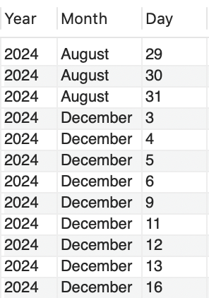
Find the days worked by workers who play no sport.
SELECT DISTINCT Year, Month, Day
FROM Visits V
WHERE V.WID IN (SELECT WID
FROM Worker
WHERE Sport = “NO SPORT” )
ORDER BY Year, Month, Day;
IN / Exists Query 1

Slide 30

Find the most used equipment given that the visits were by females.
SELECT E.Name, COUNT(*) AS UsageCount
FROM Equipment E JOIN Visits V ON E.EID = V.EID
WHERE EXISTS ( SELECT *
FROM Visits V2 JOIN Player P ON V2.PID = P.PID
WHERE V2.EID = E.EID AND P.Gender = “F”)
GROUP BY E.Name
ORDER BY UsageCount DESC
LIMIT 1;
Exists Query 2

Slide 31
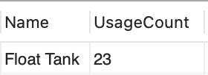
Find the least used equipment given that the visits were by males.
SELECT E.Name, COUNT(*) AS UsageCount
FROM Equipment E JOIN Visits V ON E.EID = V.EID
WHERE EXISTS ( SELECT *
FROM Visits V2 JOIN Player P ON V2.PID = P.PID
WHERE V2.EID = E.EID AND P.Gender = “M”)
GROUP BY E.Name
ORDER BY UsageCount ASC
LIMIT 1;
Exists Query 3

Slide 32
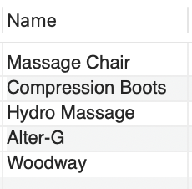
Select the name of all equipment given that it is located in 208.
SELECT Name
FROM Equipment E
WHERE EXISTS ( SELECT *
FROM Equipment E2
WHERE E2.EID = E.EID AND E2.Location = 208);
Exists Query 4

Slide 33
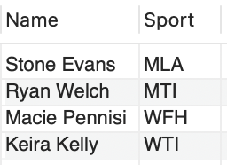
Find any players Name and Sport given that they have visited the lab at least 30 times.
SELECT Name, Sport
FROM Player P
WHERE EXISTS (SELECT *
FROM Visits V
WHERE V.PID = P.PID
GROUP BY V.PID
HAVING COUNT(*) > 30);
Exists Query 5

Slide 34
Data Visualization (Power BI)

Slide 35


