Slide 1
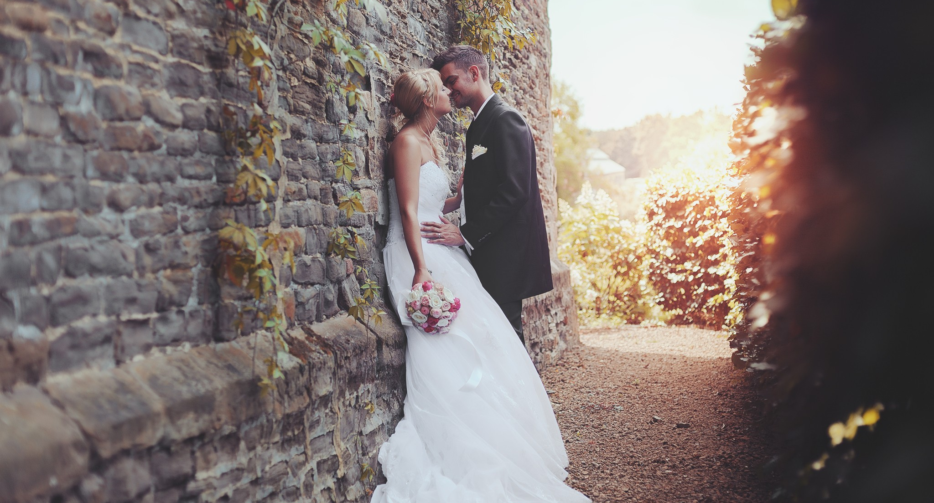
Wedding
Toast Master Table Topic
By Owen

Slide 2
Rules
Based on the story that has been told
At least two sentences
Try to create new scene

Slide 3
Start up
As almost everyone arrived, I started to feel more excited, my beautiful bride stood beside me and her smile was so charming. I could not move my eyes elsewhere from her. The sky was so blue, the air was so fresh, I felt like I was the happiest man in the world at that moment.
But all of a sudden, a voice just attracted everybody’s attention. Her ex-boyfriend just stood at the center of road…

Slide 4
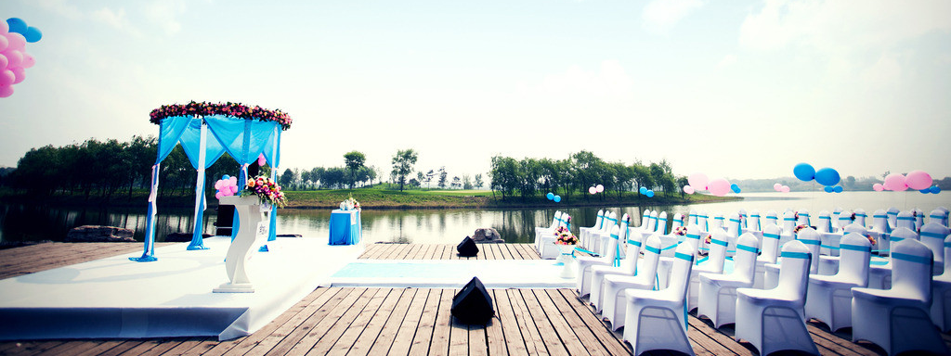
What’s your wedding story(experience) ?

Slide 5
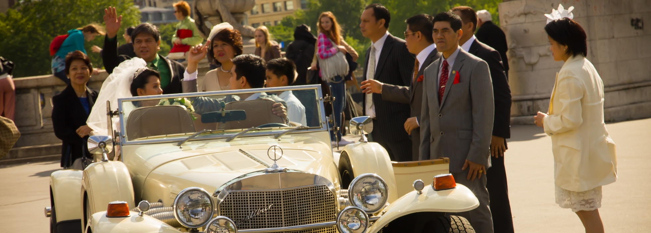
What do you care most on your wedding?

Slide 6
Thanks
Toast Master Table Topic
By Owen

