Slide 1

Parkinson's Dataset Exploration
By Owen Telis and Michael Farrelly

Slide 2

Why did we choose this dataset?
We chose to interpret this dataset because it is a common issue in the world that can be helped by understand what causes it.
Experts estimate there are 1 million persons in the US living with Parkinson’s disease.
It increases with age and affects 1% of the population above 60.
Although Parkinson’s is not a fatal disease, it does stop a person from having a normal life due to complications caused by the disease.
Some common symptoms are tremors, muscle stiffness (Contracted muscles that remain a long time), Slowness of movement, and Impaired balance/coordination that can lead to dangerous falls.

Slide 3
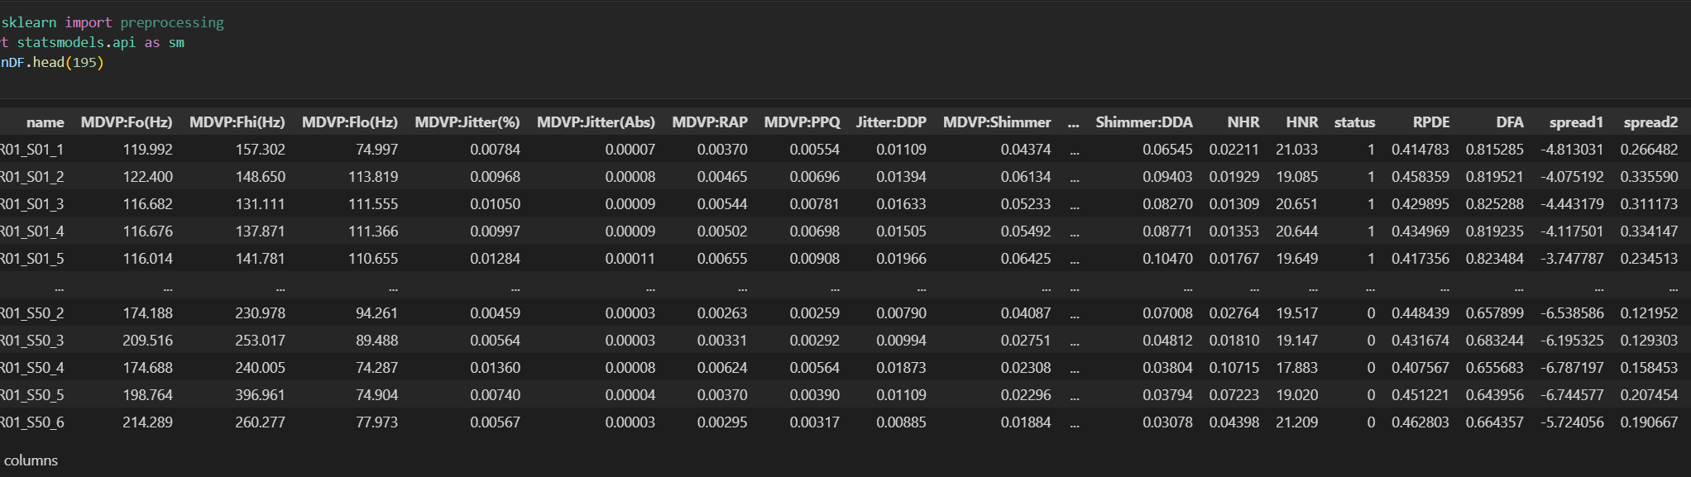
Visualizing the Data
To visualize the data, we used the head function to display the data. Our data set has 195 rows and 24 columns.

Slide 4
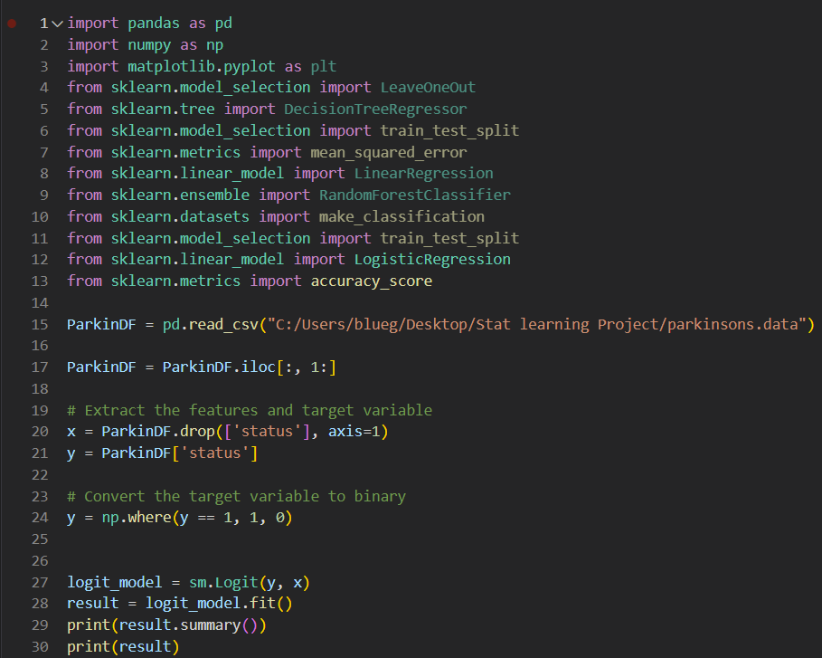
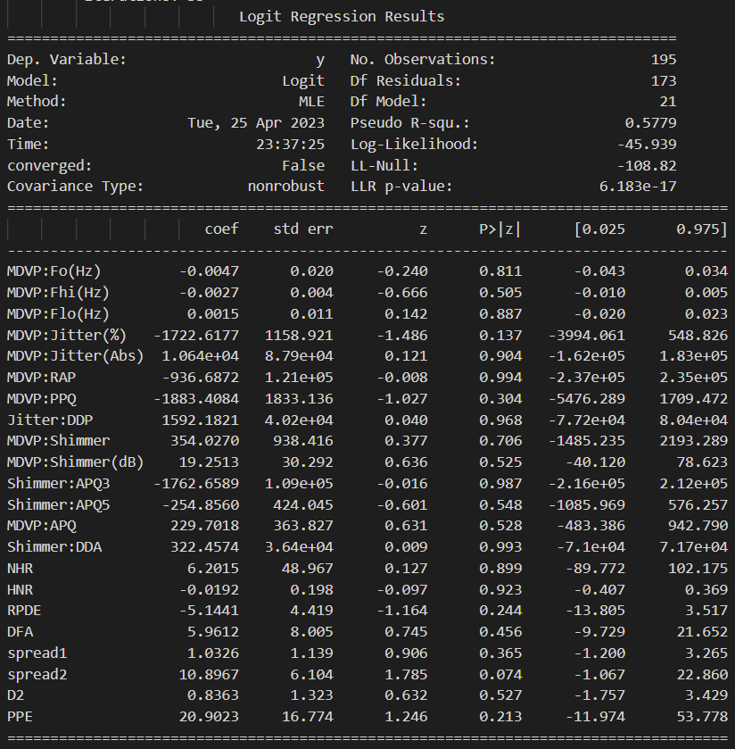
Summary of The Data & Attributes
We ran a logistic regression on the data set and found the following information:

Slide 5
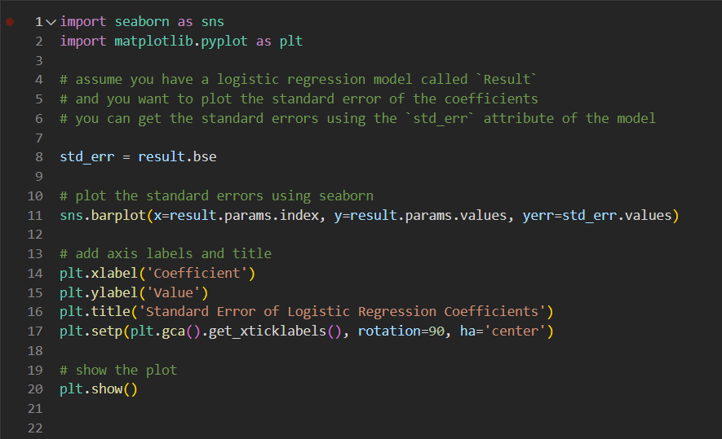
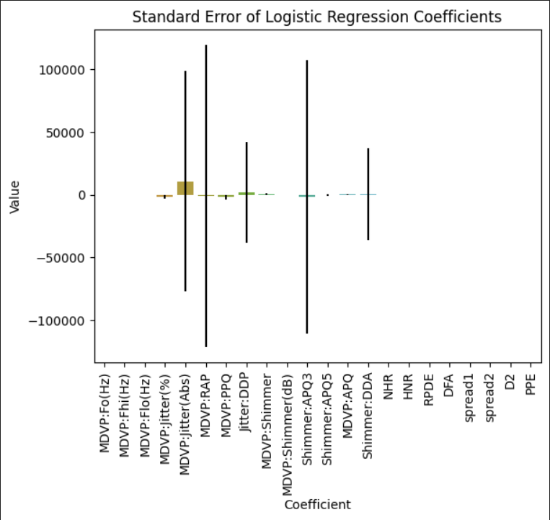
Graphing Standard Error

Slide 6
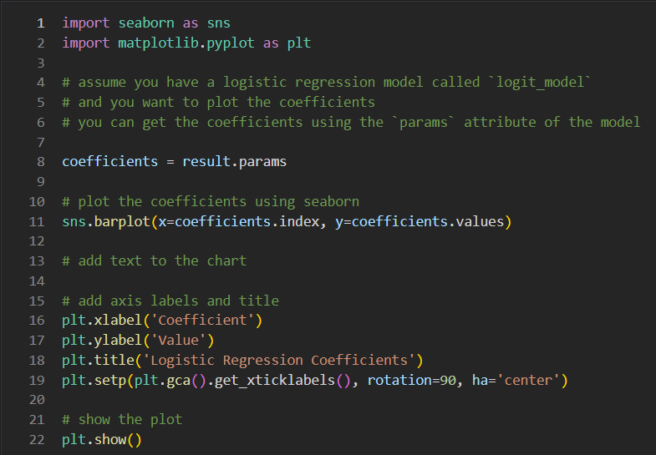
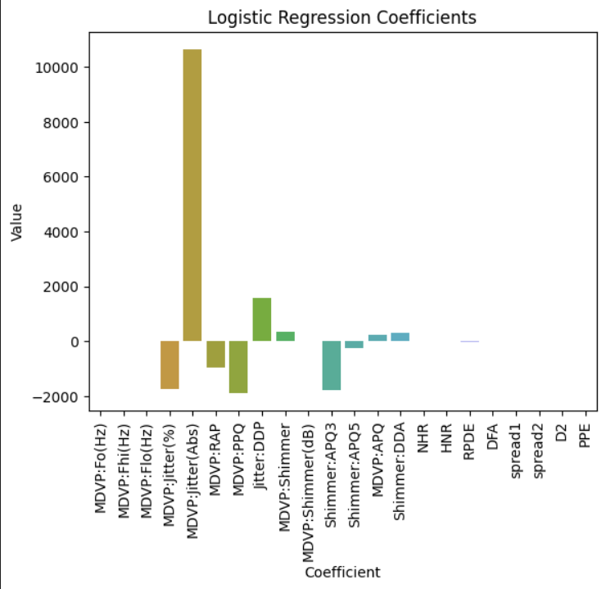
Visualizing Coefficient Values

Slide 7
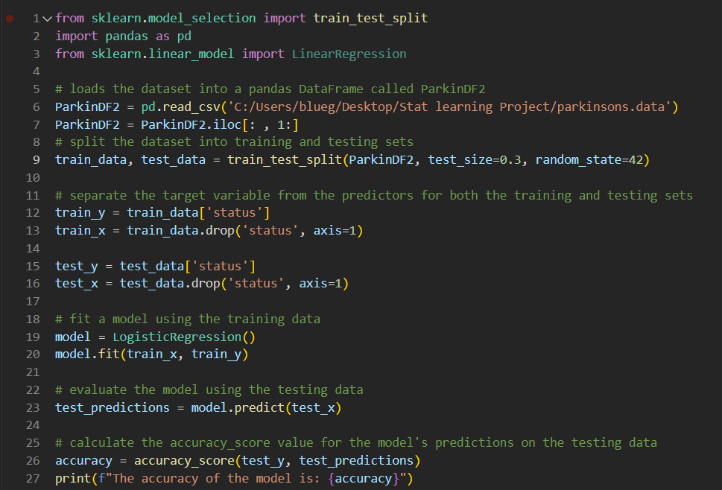
Running a Logistic Regression

Slide 8

LOOCV Technique with Selected Features

Slide 9
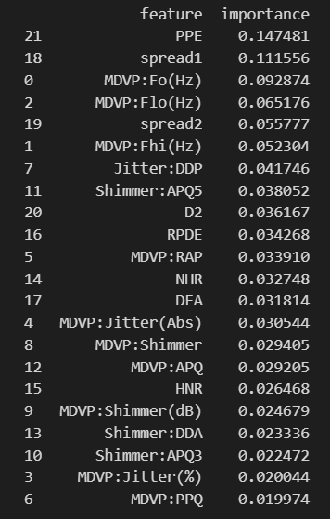
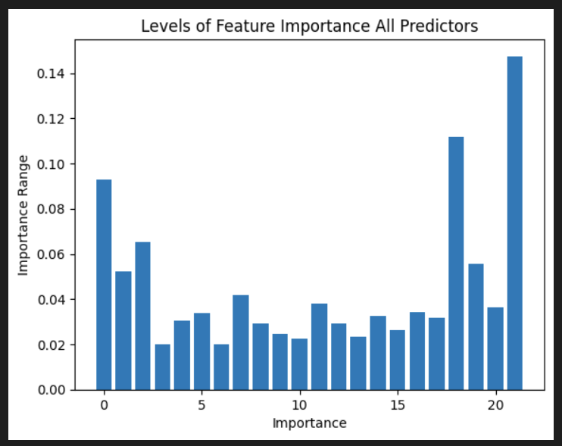
Levels of Feature Importance
We found that PPE. Spread1, MDVP:Fp(Hz)MDVP:Flo(Hz), and spread2 were the most important attributes for predicting Parkinson’s.

Slide 10
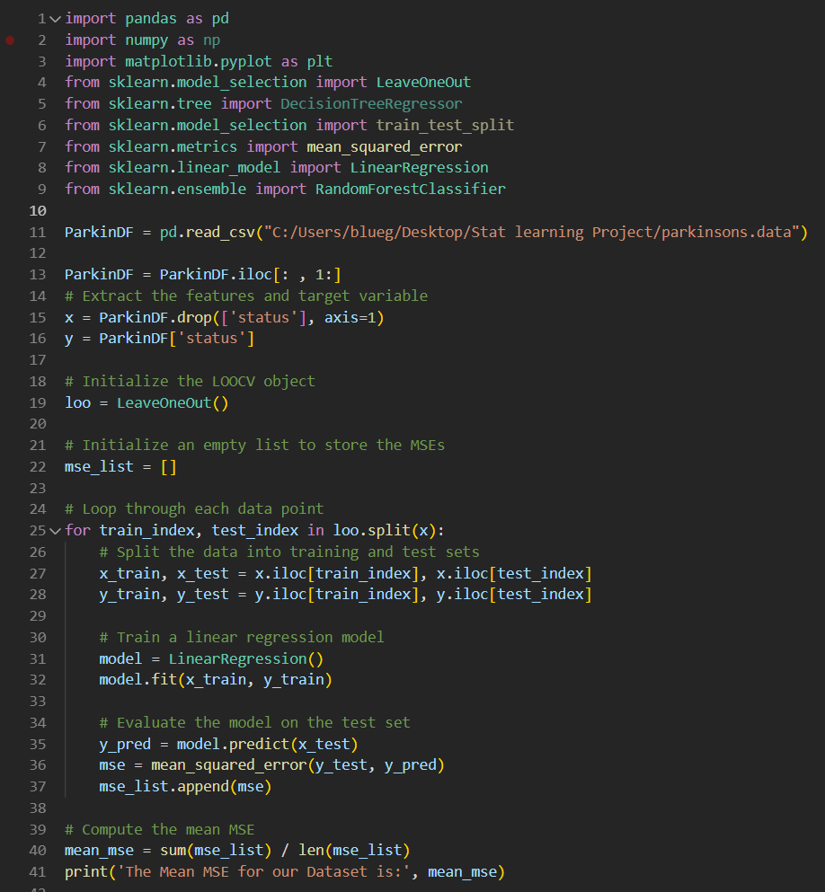
Finding the Mean MSE for our Dataset.
We found that our model has a mean MSE of 0.11461647597580019.
This means that our model when using LOOCV and random tree classification is better than using simple logistic regression.

Slide 11

Conclusion
We found that by using a random forest classification and LOOCV model we could predict if a patient has Parkinson’s by 85%.
While our test may not be perfect, It is a stride in the right direction that can lead to more opportunities that can combat diagnosing Parkinson’s.
Catching the diagnosis early is very important and we hope our dataset can shed some light on the process.

