Slide 1
Mimic NLP
AI in healthcare
Owen Mccormack

Slide 2
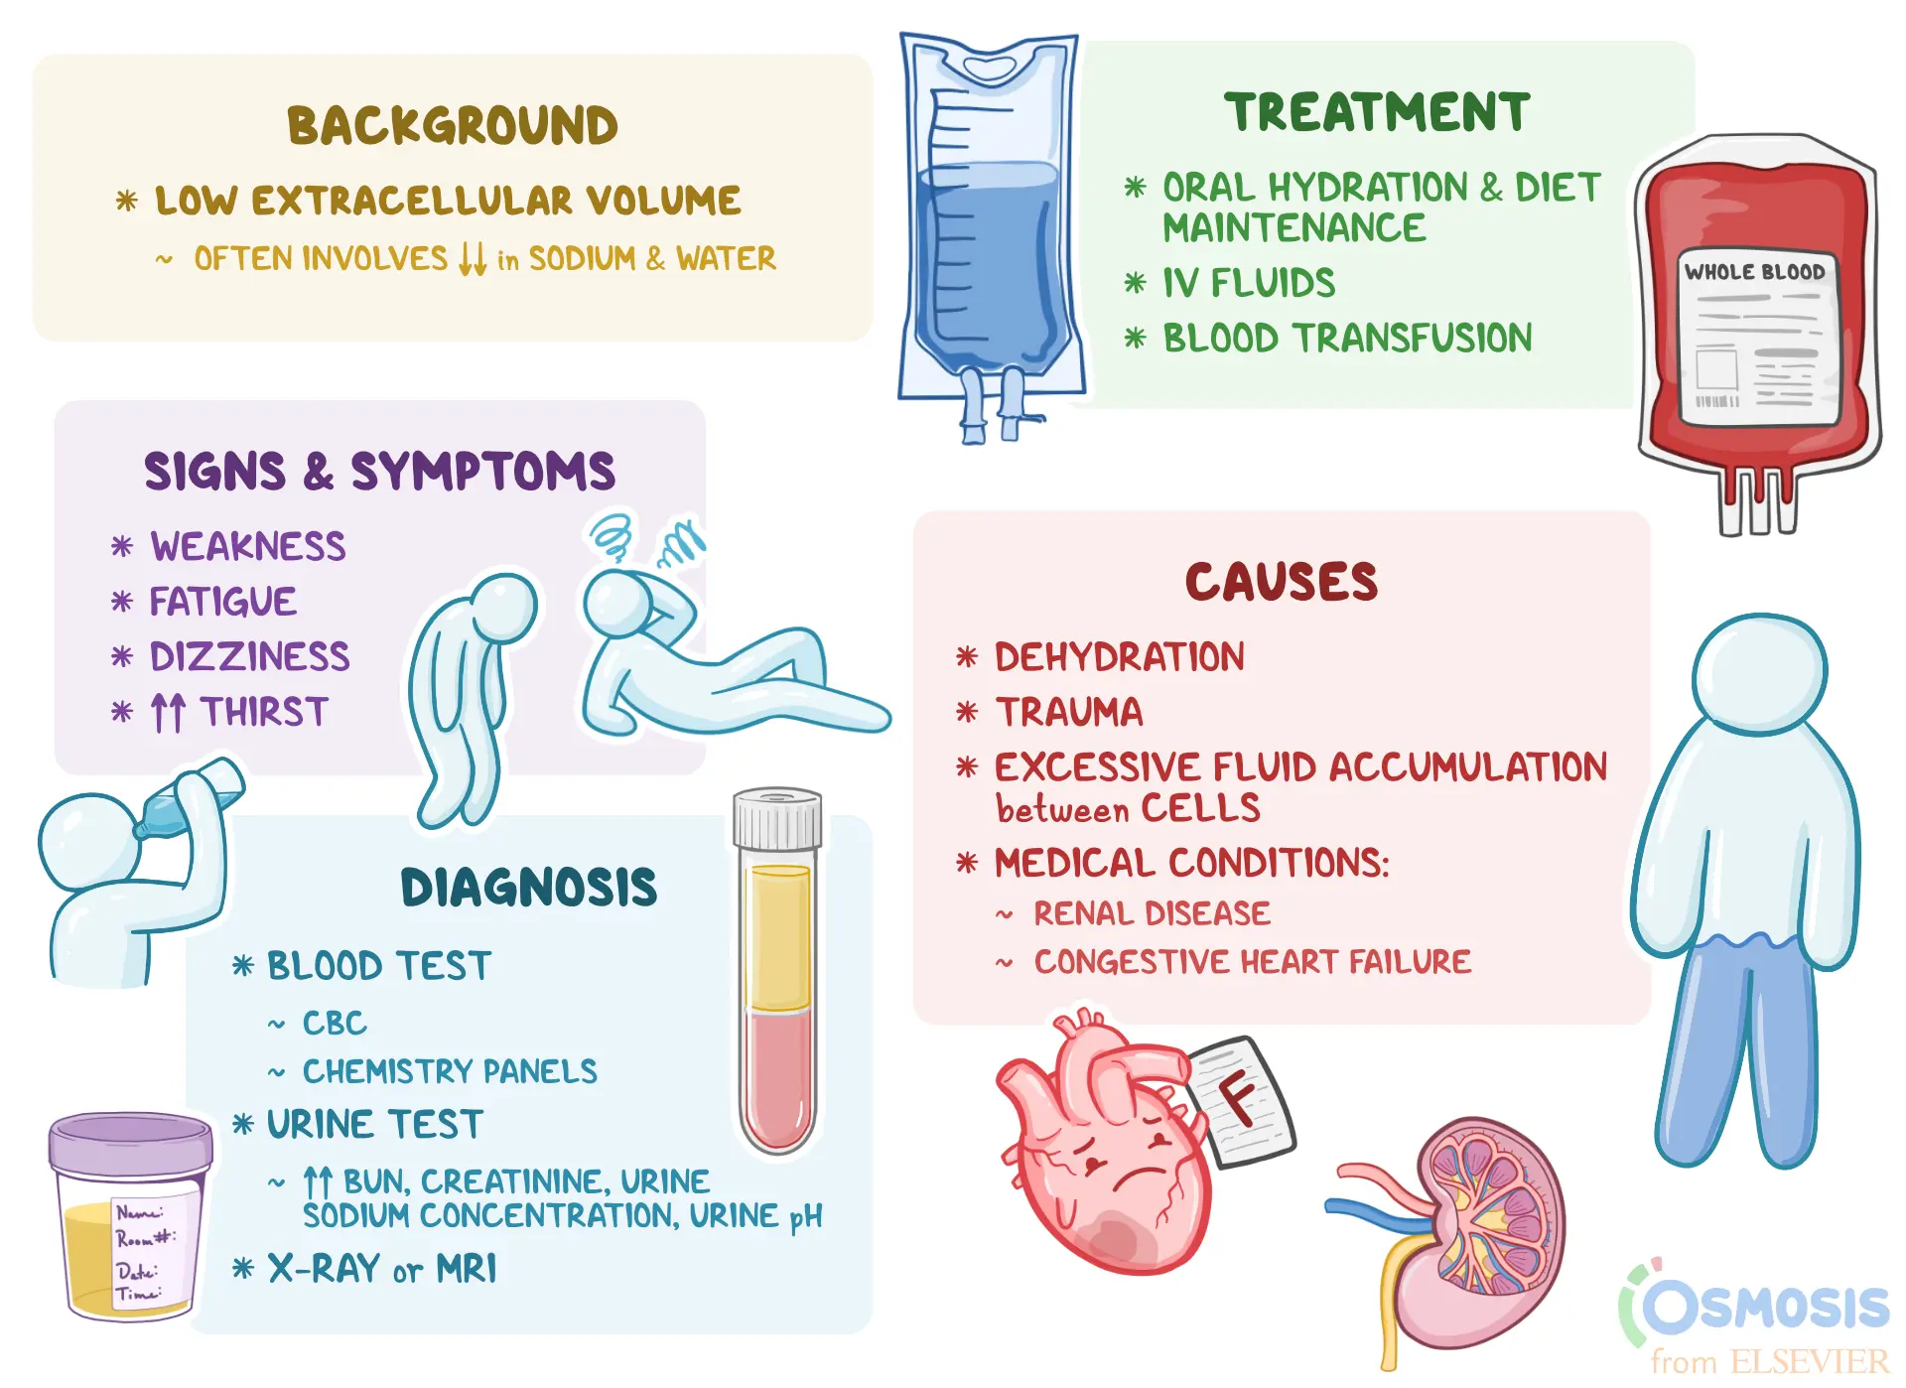
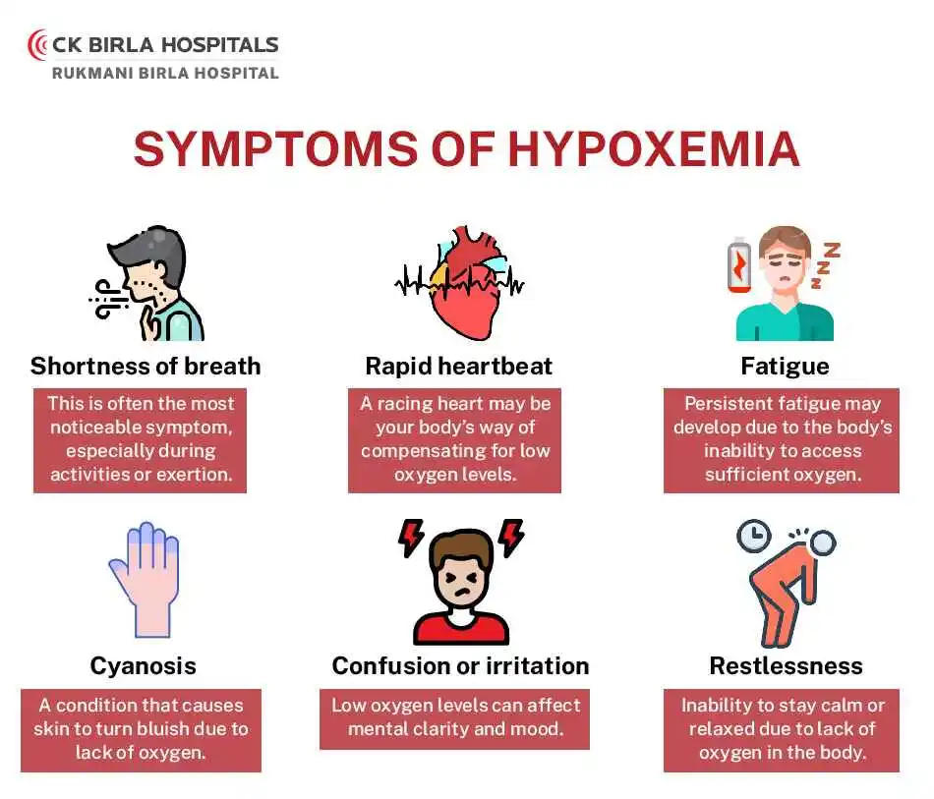
diagnoses of interest
Focus was on discharge notes related to hypoxemia and hypovolemia
Hypoxemia (icd9 79902) is a low level of oxygen in the blood, causes are are related to problems with blood or blood flow, such as Anemia, or breathing conditions, such as Asthma.
Hypovolemia (icd9 27652) is when a patient has a low volume of fluid (water, blood, lymphatic fluid) in their body. It can be caused by injuries, internal bleeding or other conditions.
https://www.osmosis.org/answers/hypovolemia
https://ckbirlahospitals.com/bmb/blog/hypoxemia-early-signs-and-treatments-for-low-blood-oxygen-levels

Slide 3
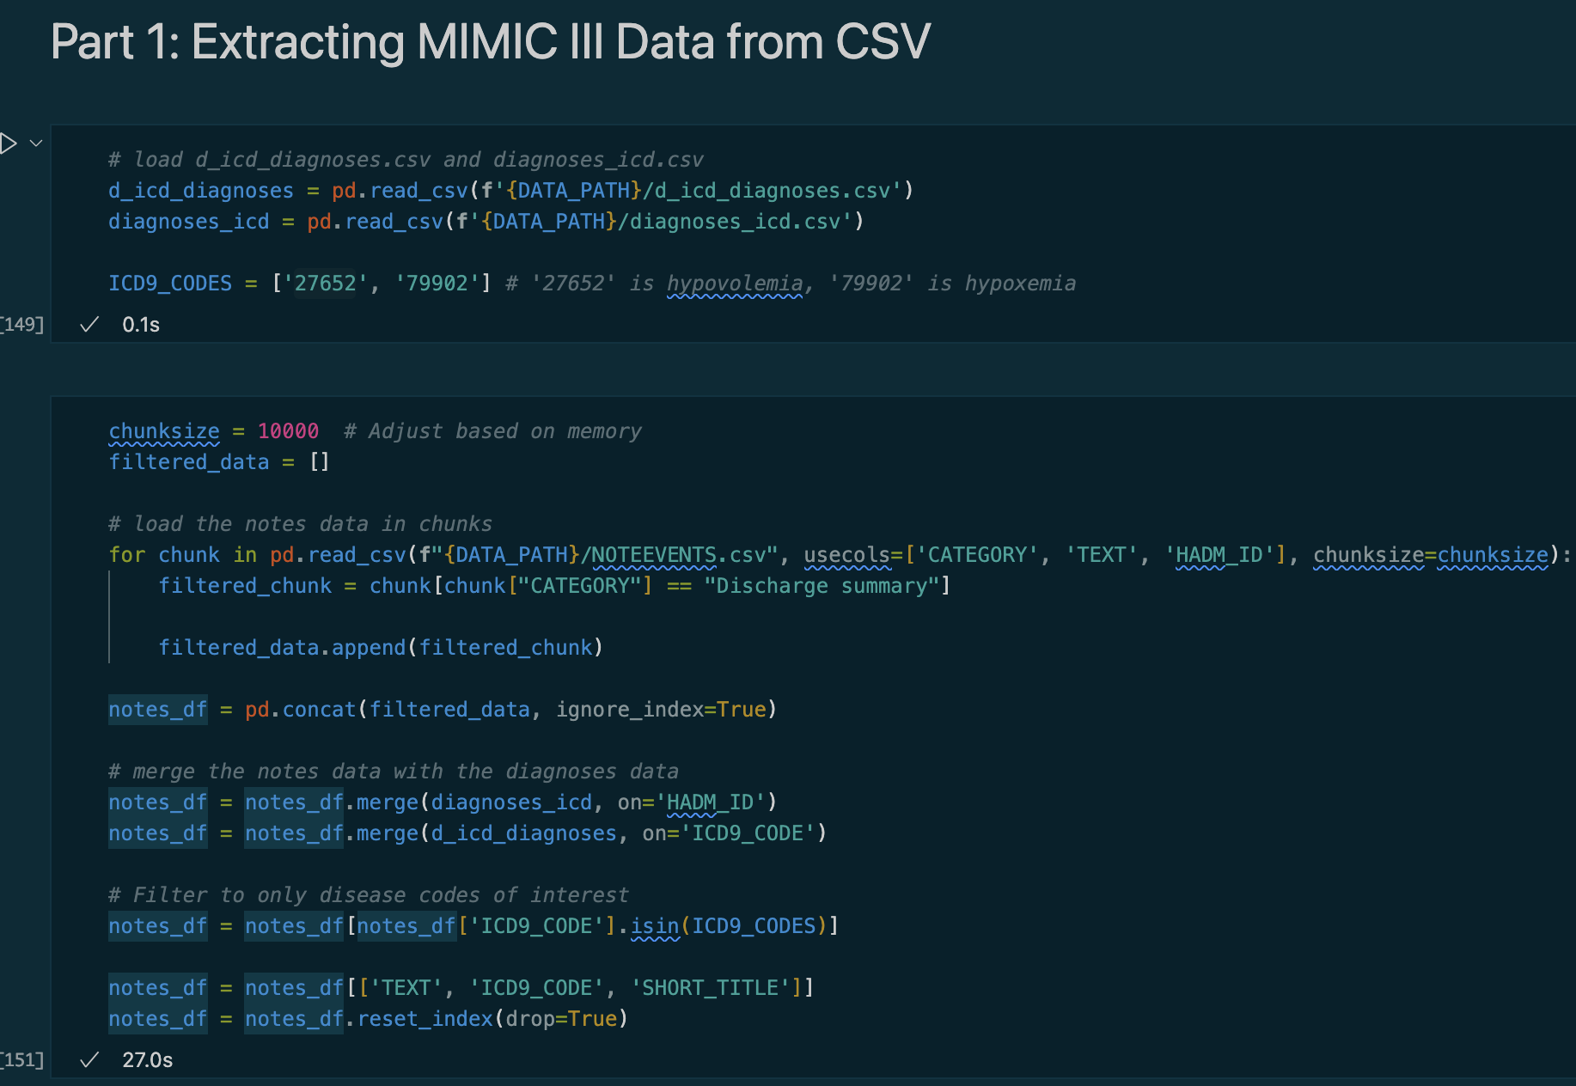
Part 1: Extracting Mimic iii Data
NOTEEVENTS, DIAGNOSES_ICD, and D_ICD_DIAGNOSES tables were used to extract data.
Both diagnoses tables were joined with NOTEEVENTS on hadm_id, then filtered by icd9_codes for hypoxemia (79902) and hypovolemia (27652)
Only notes with category discharge summary were selected, other columns were dropped to save memory.

Slide 4
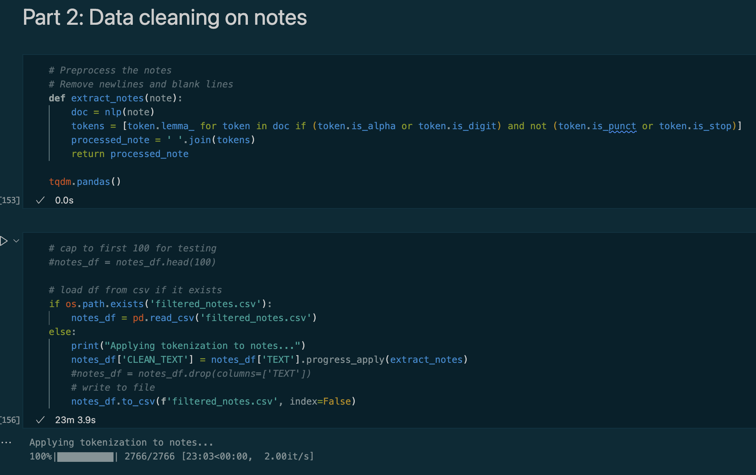
Part 2: Tokenization
With the filtered notes, spacy tokenization was applied to create a CLEAN_NOTES column
For each token, the lemmatized token was taken and punctuation and stopwords were filtered out
Applying this to each filtered notes (~2700) takes a while, so results are written to a csv for quicker loading on subsequent runs

Slide 5
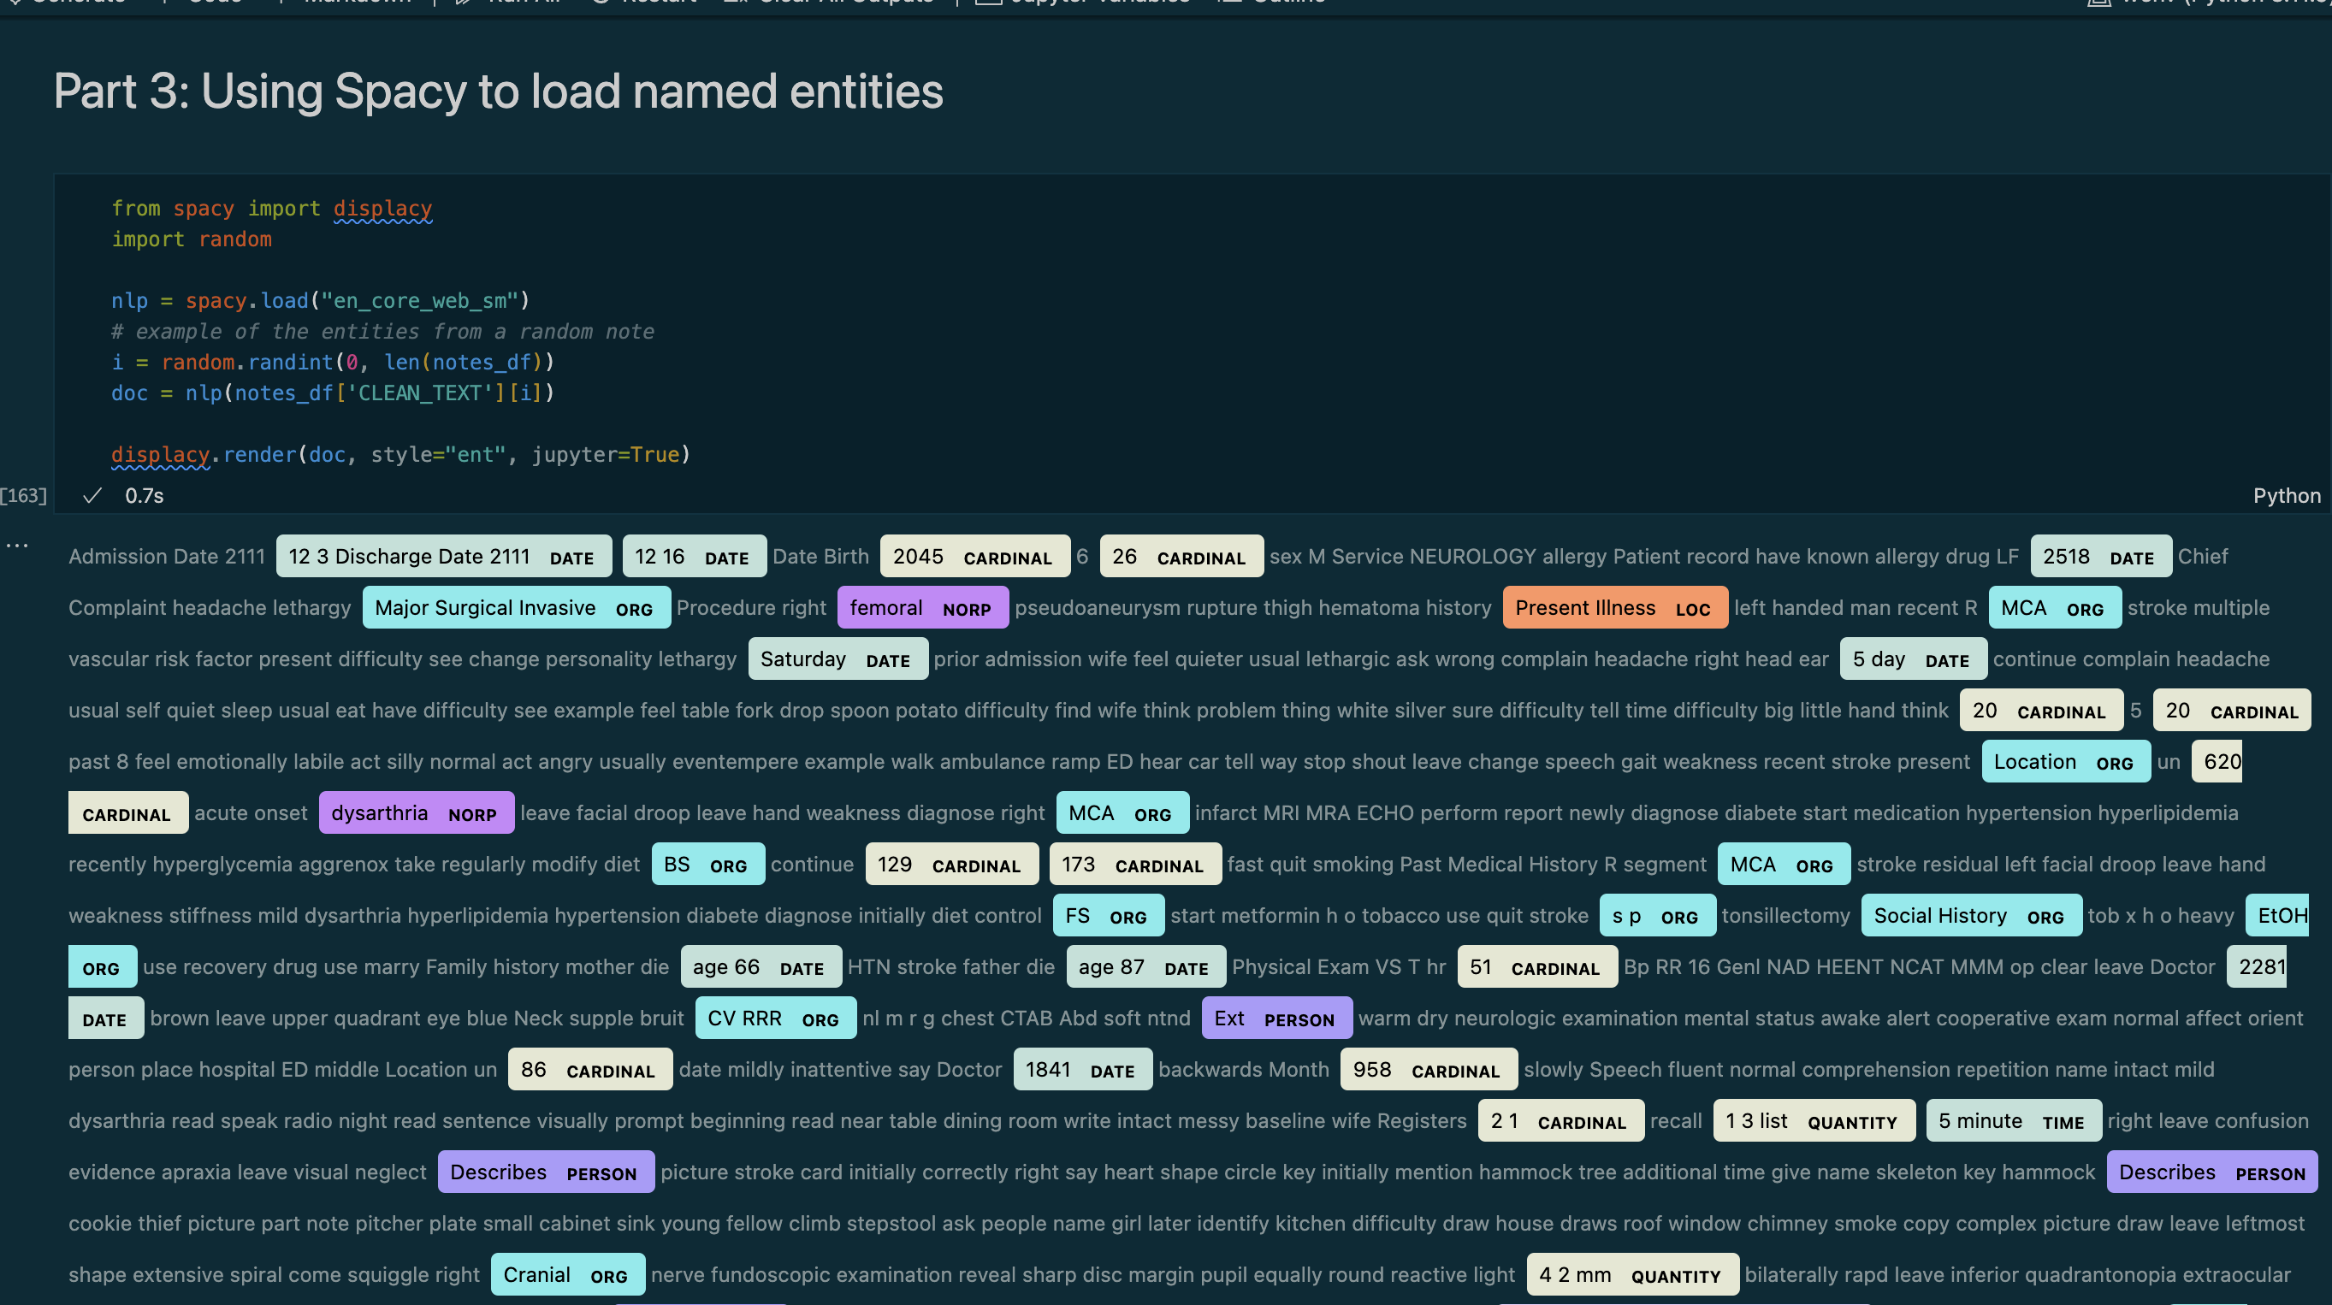
Part 3: Spacy Extracted Entities
When using Spacy to extract entities, many general terms are taken as seen in a random tokenized note
Many important entities related to diagnoses, drugs, and readings are missed.

Slide 6
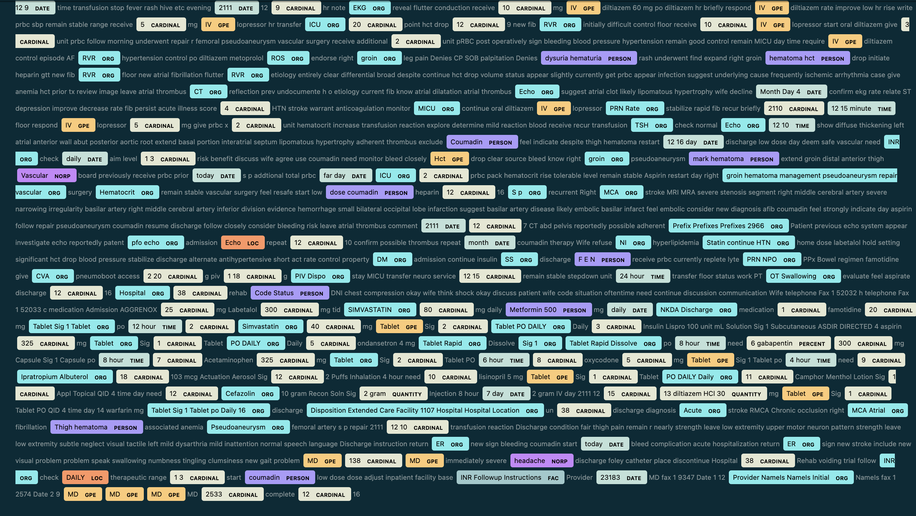
Part 3 (cont.) additional Spacy NER

Slide 7
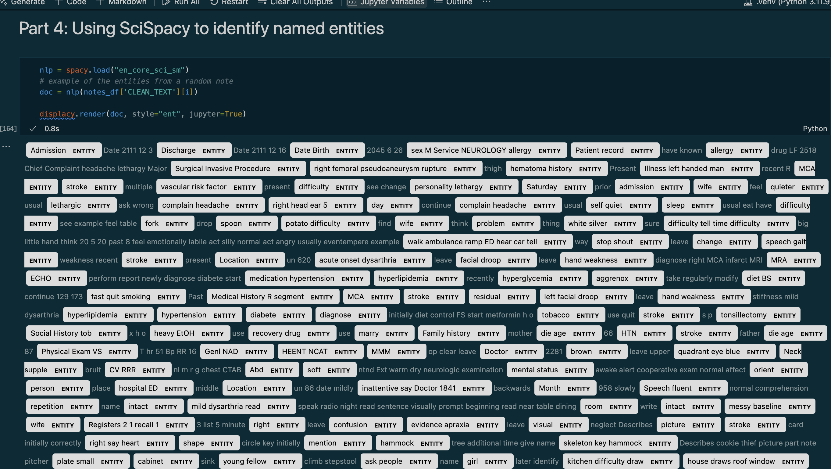
Part 4: Scispacy Named Entity Recognition
If we apply Scispacy to the same set of tokens, we see it can identify many more medically meaningful terms such as “facial droop”, “allergy” or “stroke”

Slide 8
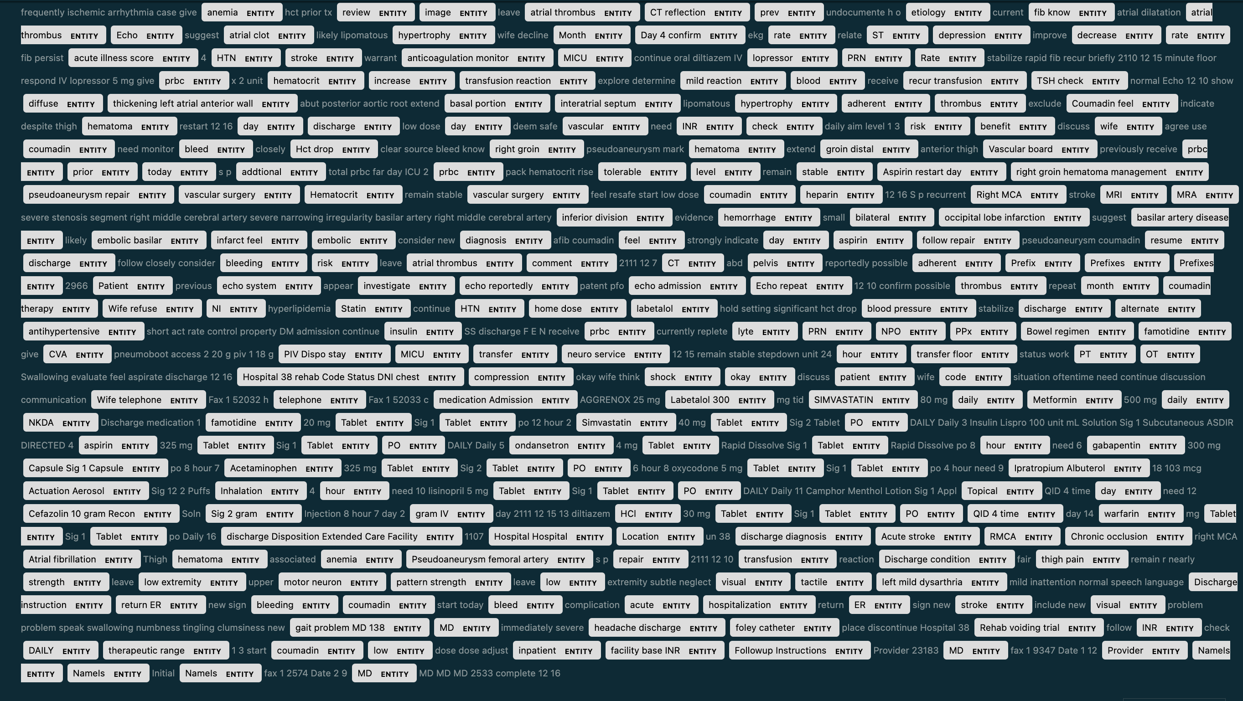
Part 4 (CONT.) Additional SciSpacy NER

Slide 9
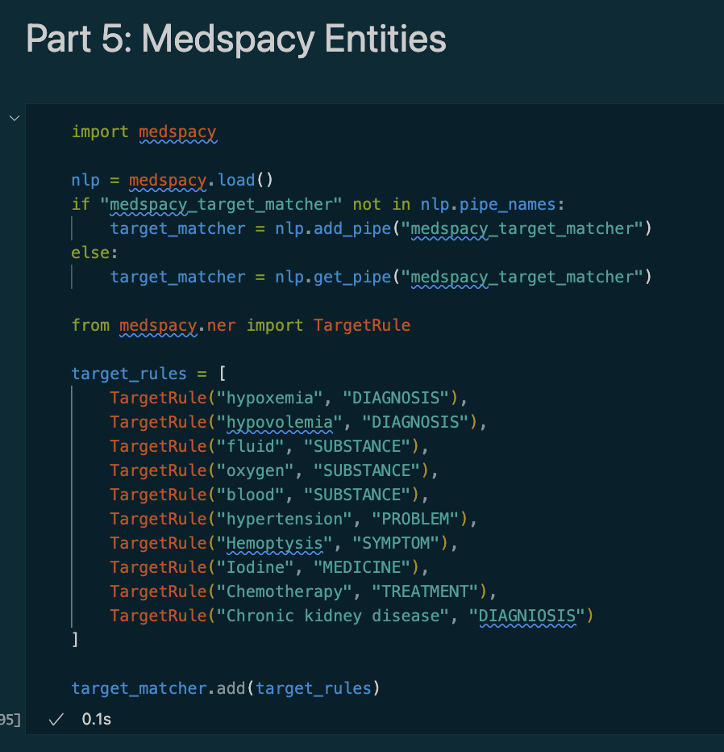
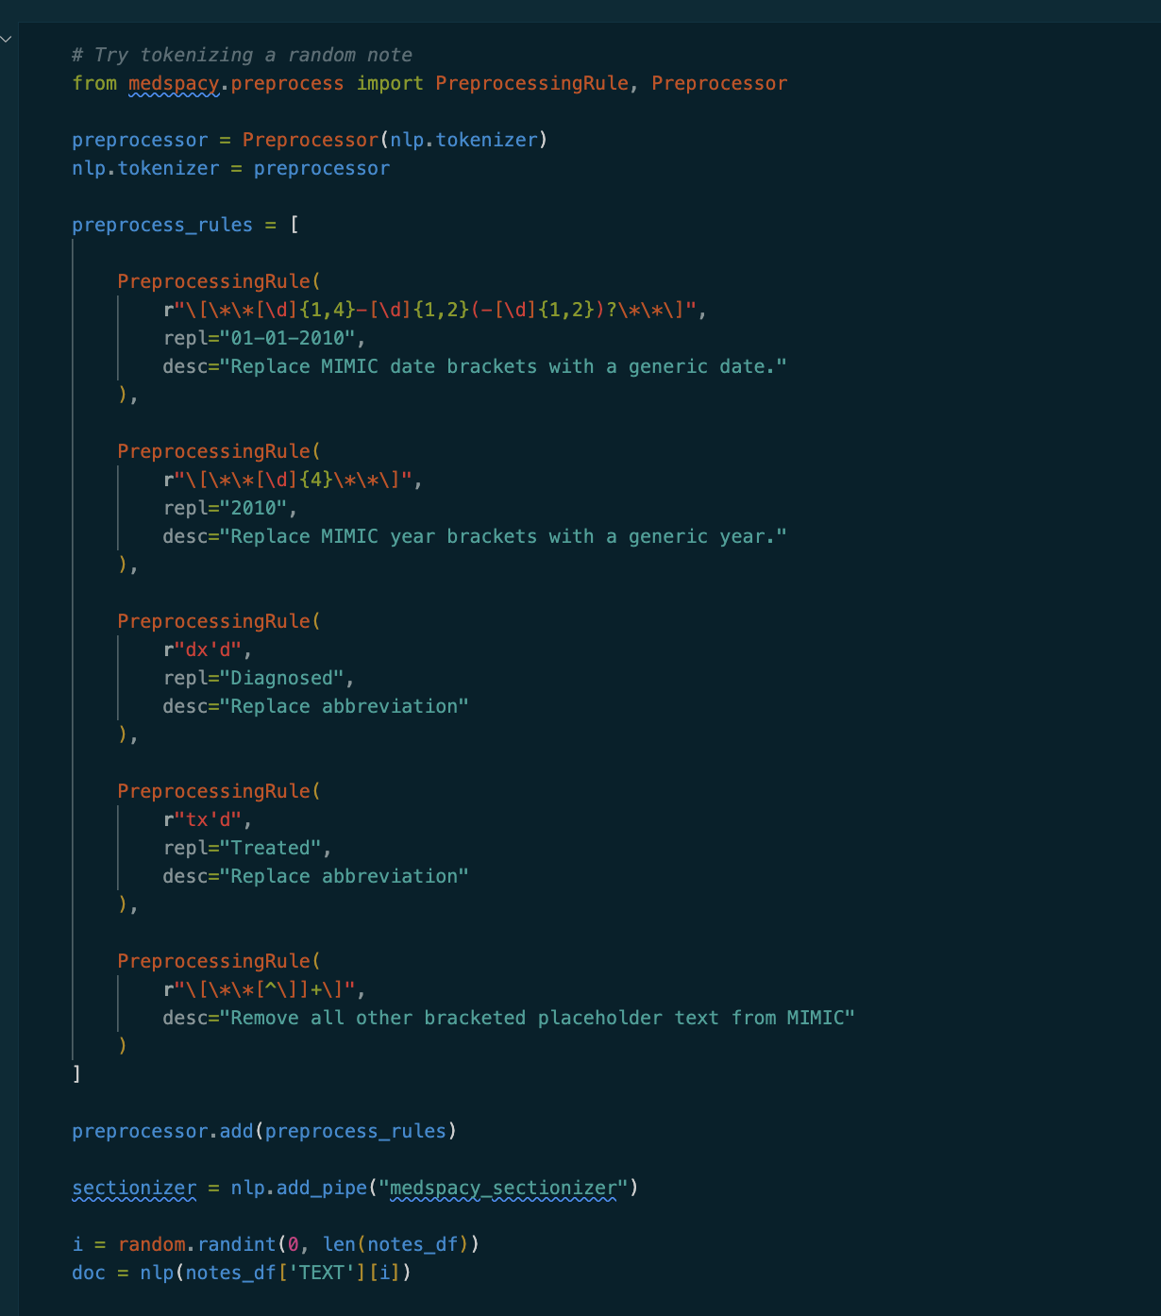
Part 5: Medspacy
Medspacy has many tools specific to medical notes that come in handy for text processing. I used the sectionizer and tokenizer to retokenize the filtered notes with some mimic specific rules (such as removing scrubbed date formatting)

Slide 10
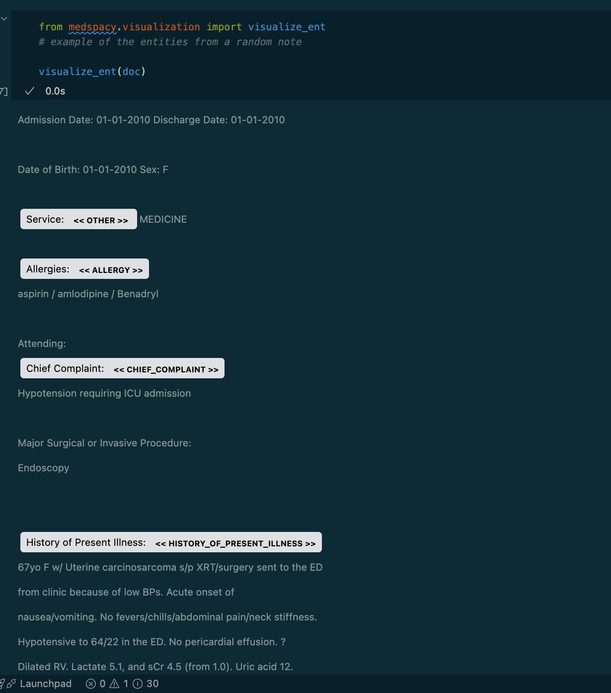
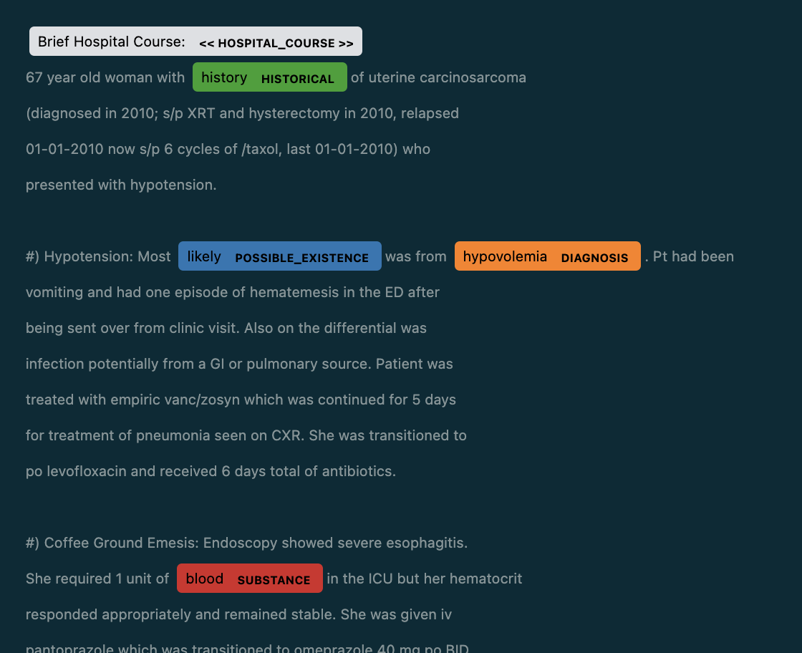
Part 5: Medspacy (Cont.)

Slide 11
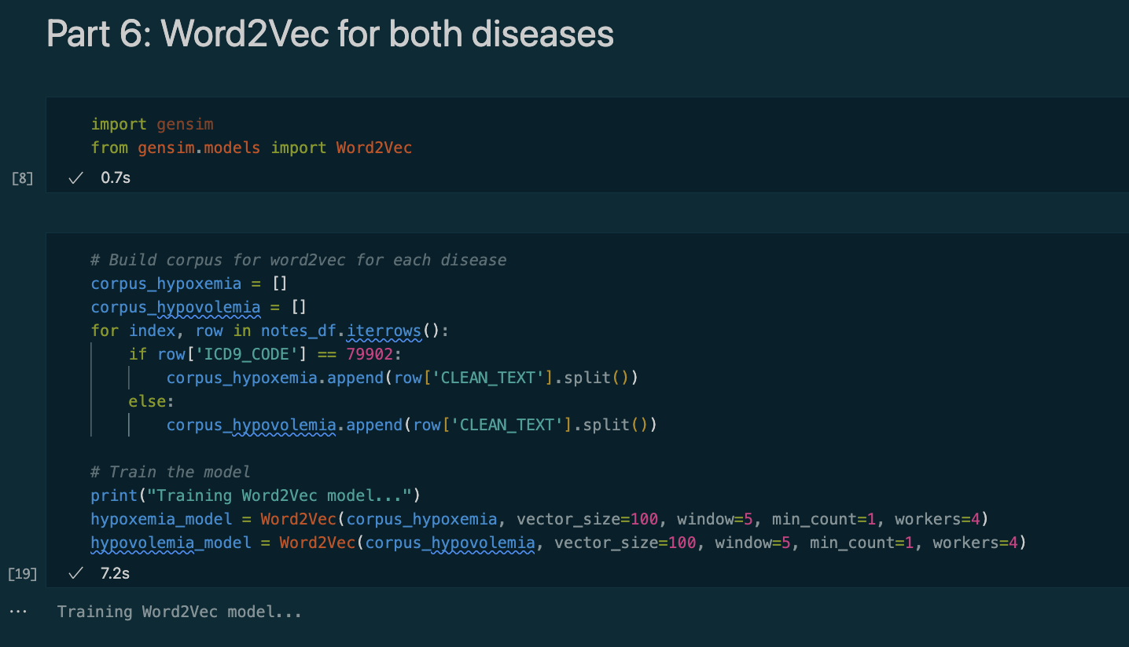
Part 6: Word2Vec
Both diagnoses were loaded into gensim Word2Vec to generate embeddings for the corpus of all of the notes.

Slide 12
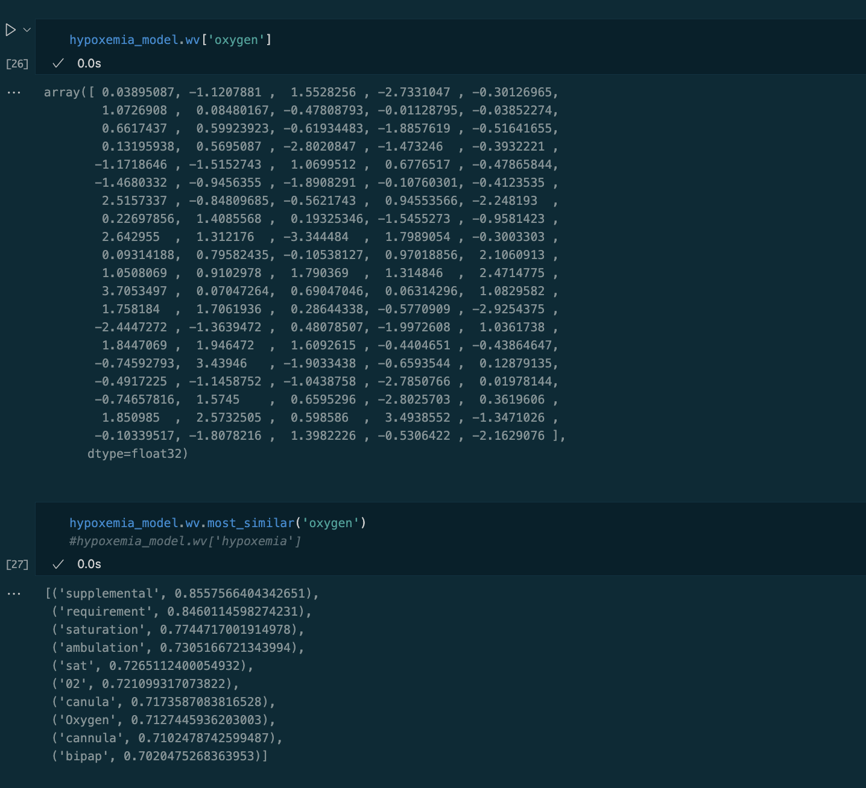
Part 6 (Cont.) : Word2vec Hypoxemia
Here we see the word vector for hypoxemia and notice that the similar words to Oxygen are related (ex. Saturation, o2, supplemental, bipap)

Slide 13
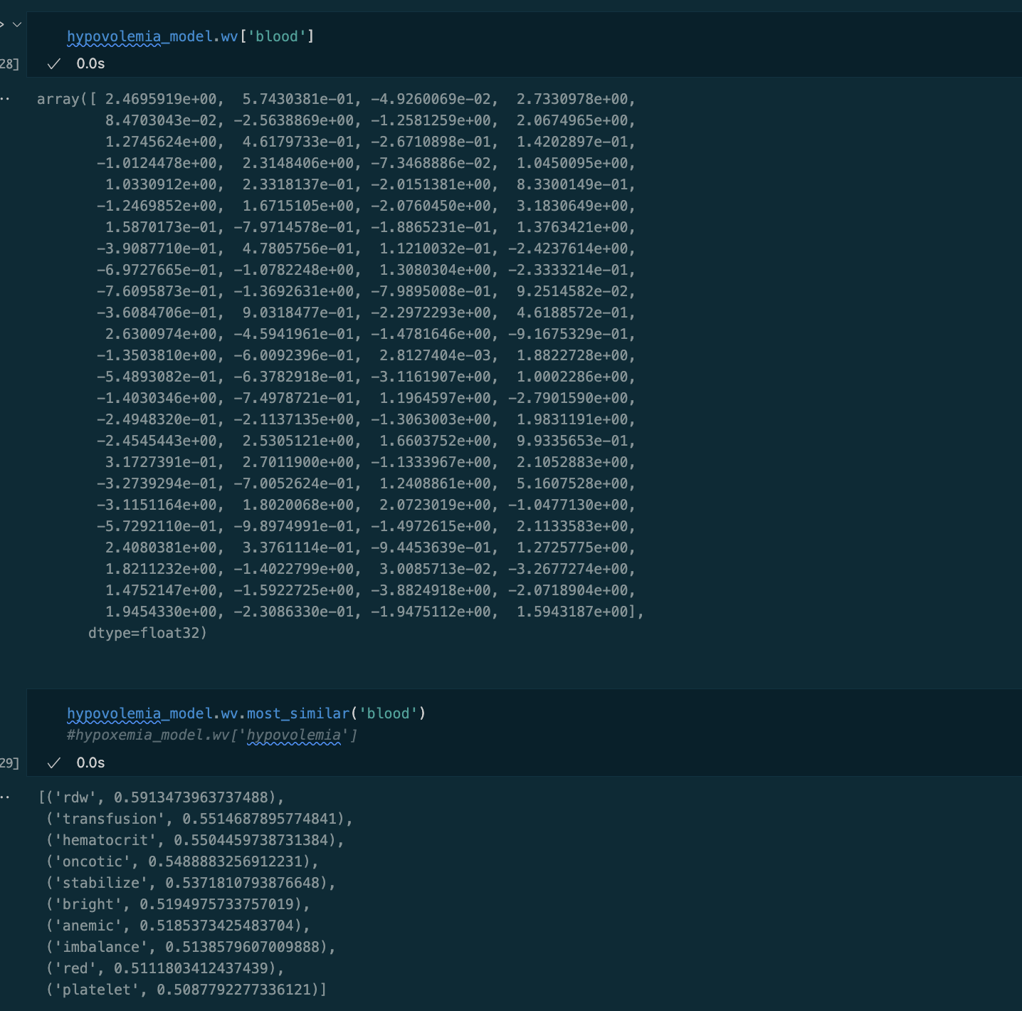
Part 6 (Cont.) : Word2vec Hypovolemia
In the same manner, the hypovolemia word embeddings and similar words are related topics to blood (ex. Rdw, anemic, platelet)

Slide 14
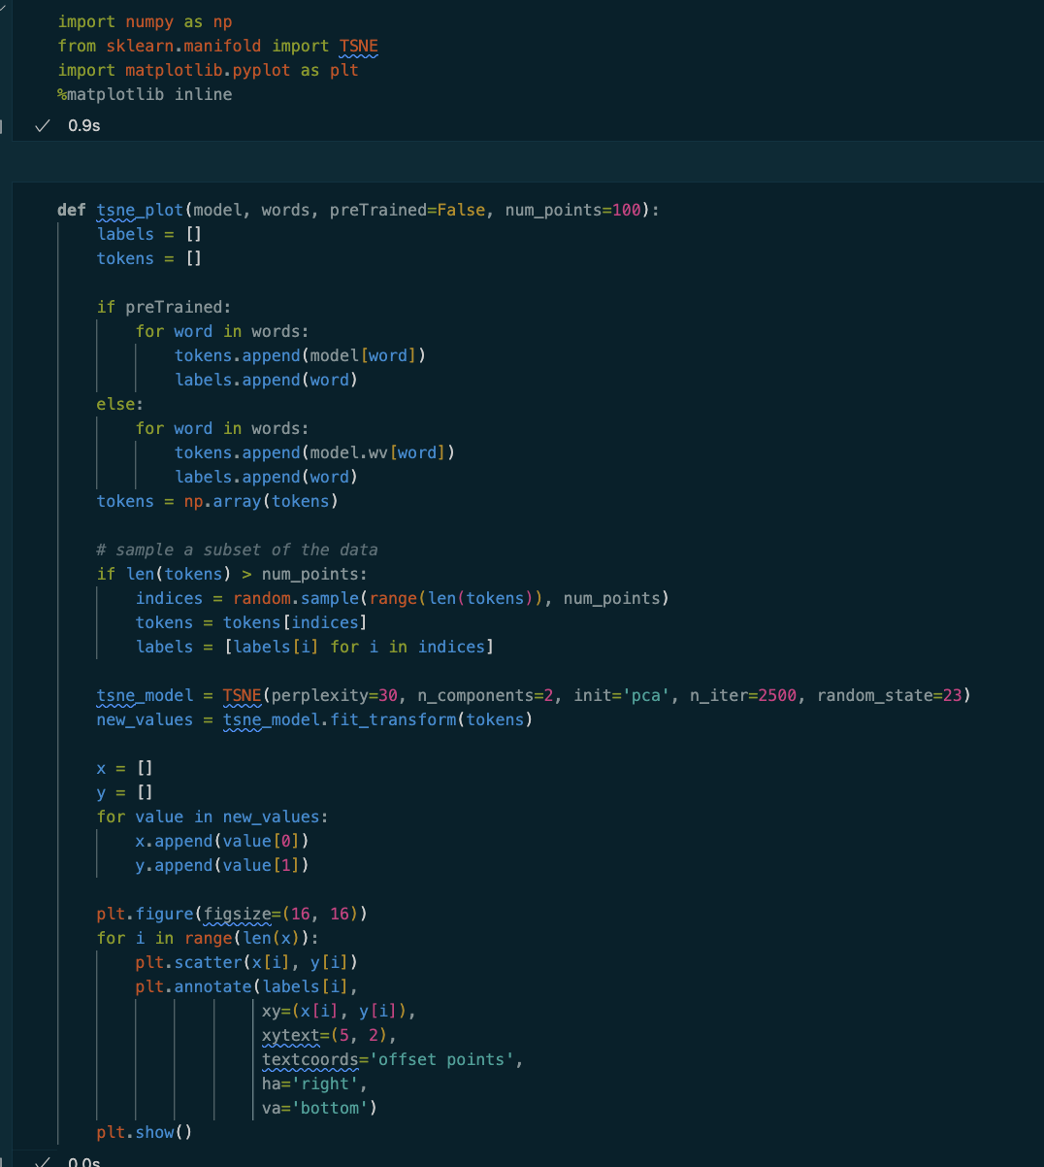
Part 7: TSNE Plots
TSNE plots were generated through the method described in the lecture, using sklearn and matplotlib libraries

Slide 15
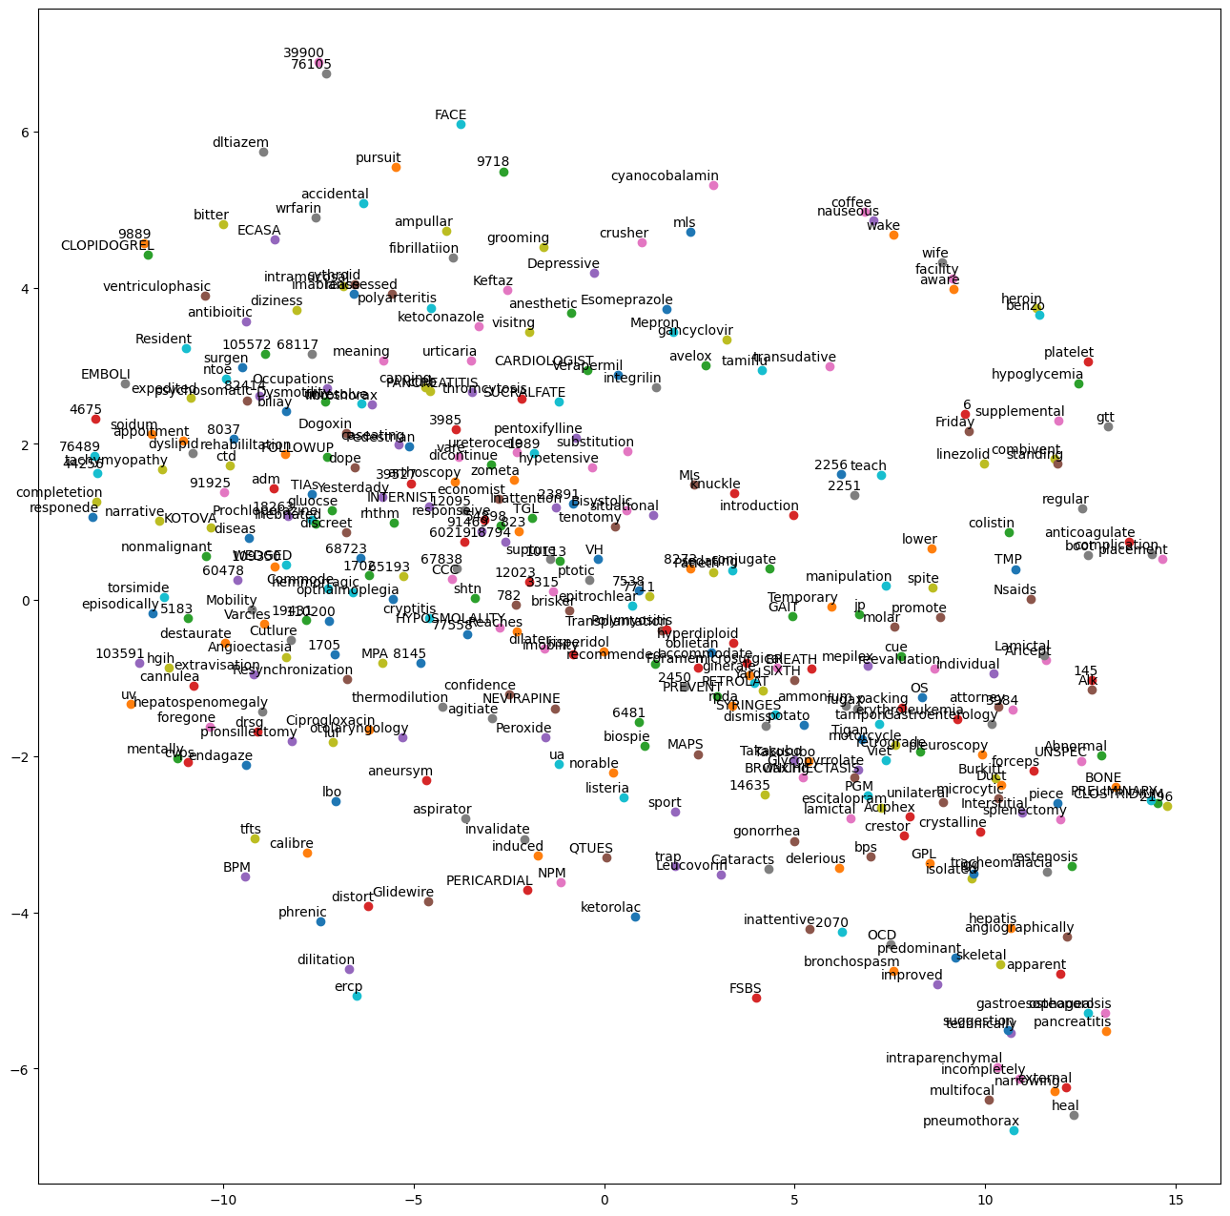
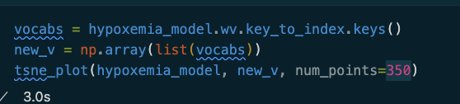
Part 7 (Cont.): Hypoxemia Plot
With a sample size of 350 words the hypoxemia plot does not have any large defined groupings but zooming in reveals some related clusters
Ex. Platelet, hypoglycemia, and gtt (Glucose Tolerance Test) in the top right

Slide 16
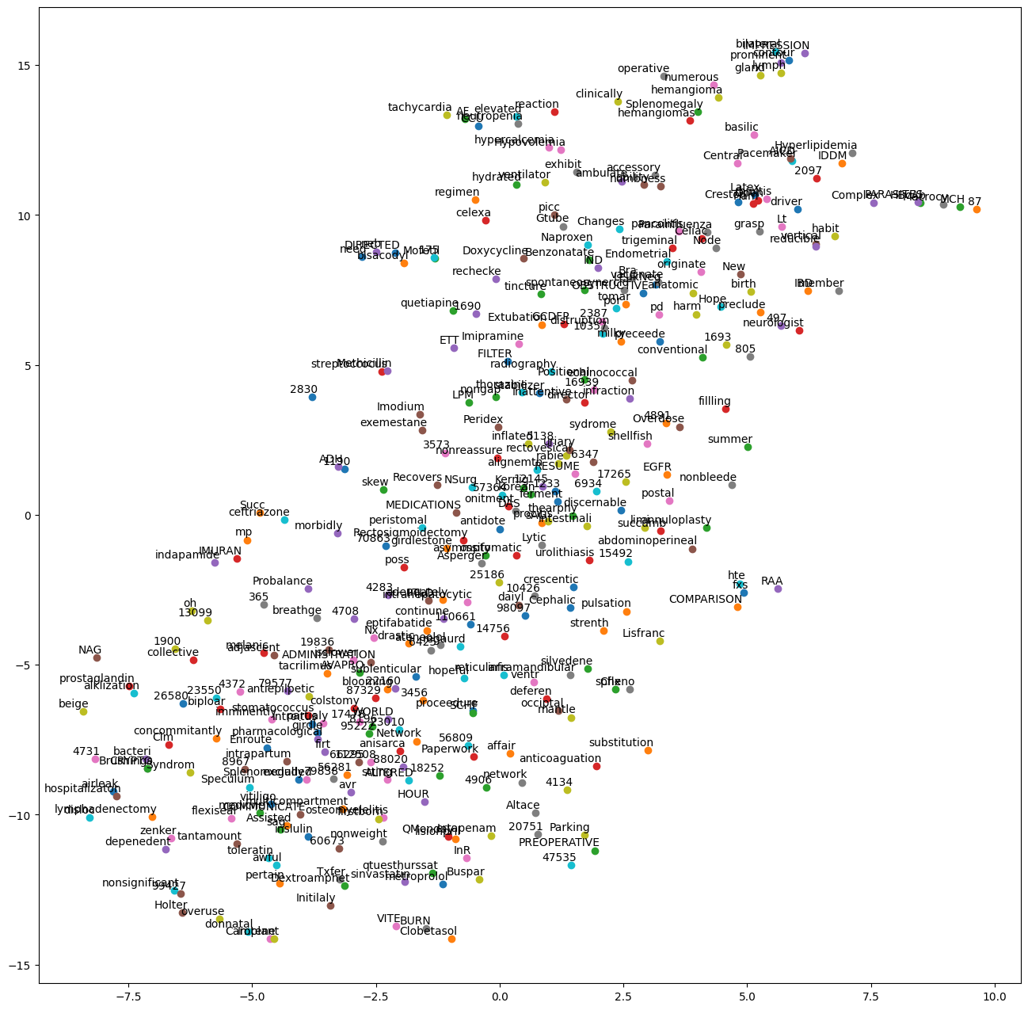
Part 7 (Cont.): hypovolemia Plot
The words for hypovolemia are also less defined groupings.
There are some connections such as prostaglandin and alkization in the bottom left

