Slide 1
Mimic SQL
Owen McCormack
Ai in Healthcare Assignment 3

Slide 2
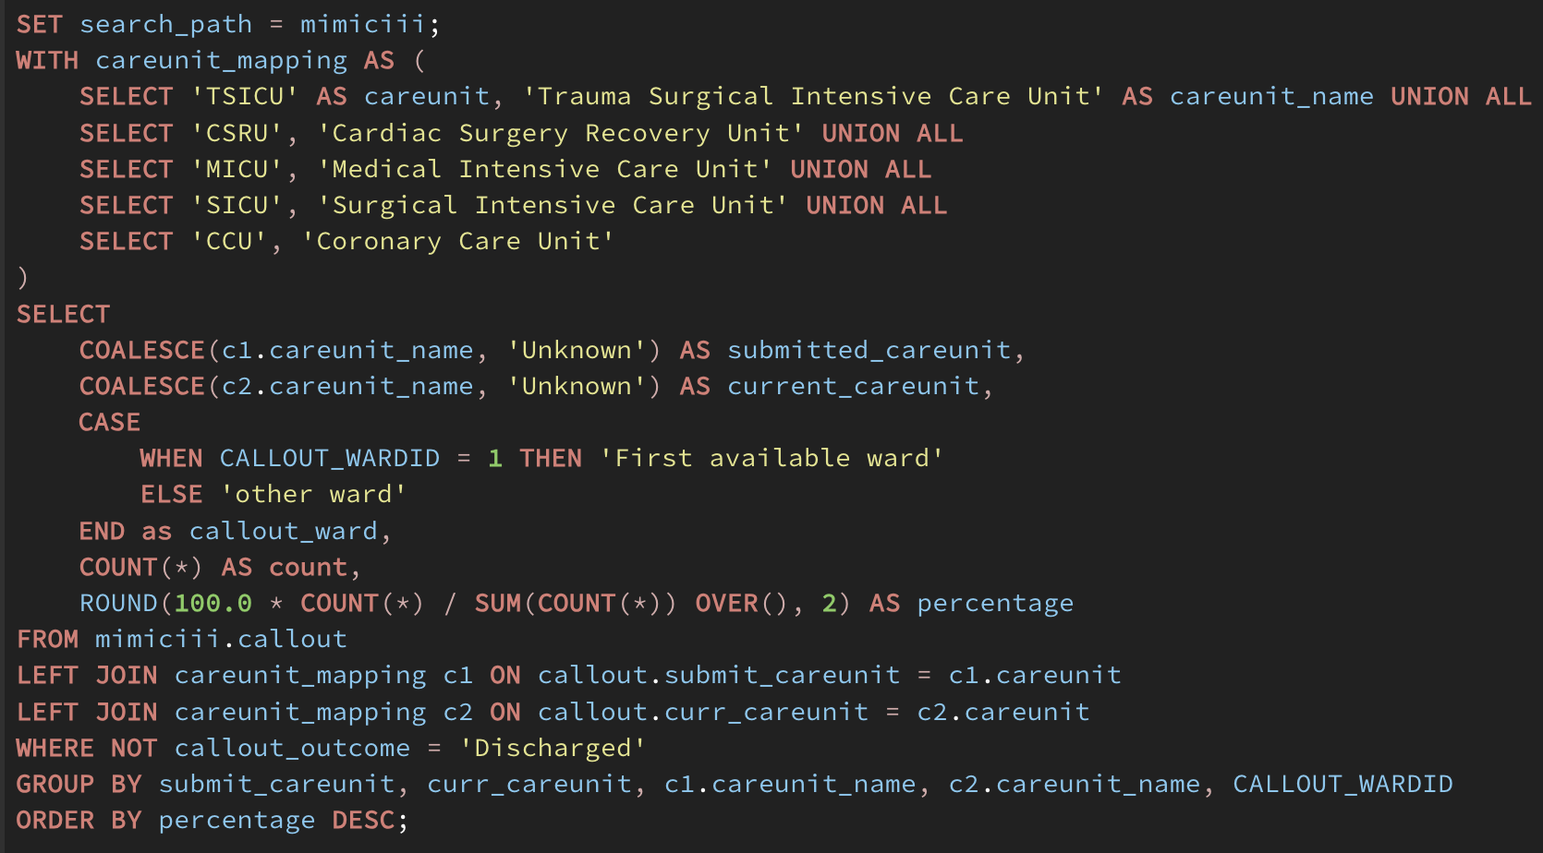
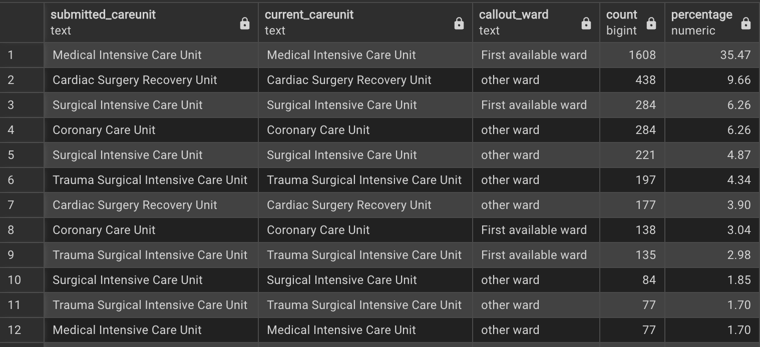
Query 1: Unsuccessful callouts
The callouts table “Provides information when a patient was READY for discharge from the ICU, and when the patient was actually discharged from the ICU.” MIMIC DOCS
Not every transfer initiated by a callout is successful, so the purpose of this query is to look at what ICU units are involved in failed callouts.
This could provide insight into which specific ICUs need more support. We can see from the results that the MICU has the vast majority (~35%) of failed callouts just trying to go to the first available ward
This query works by creating a mapping of care units found in the docs and then joining the mapping with the results where a patient was NOT discharged and forming groups to get the count and percentage.

Slide 3
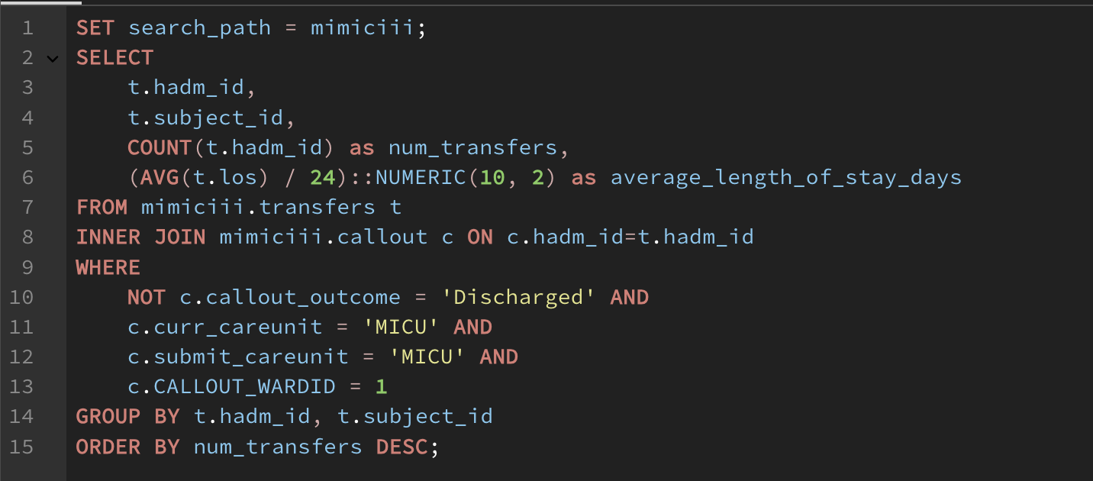
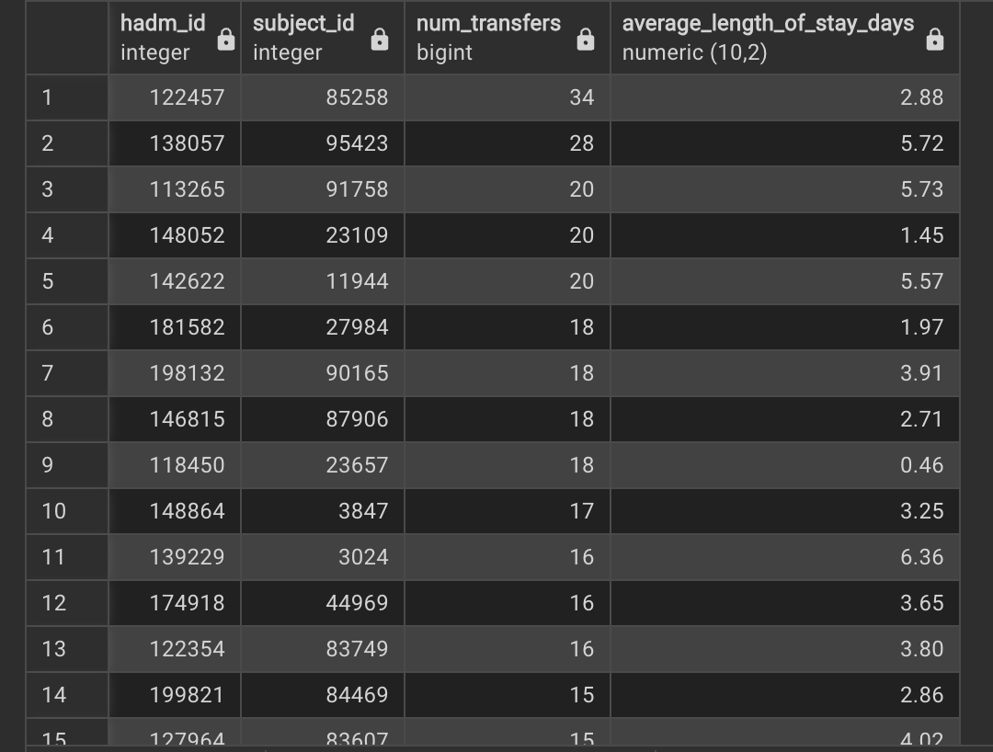
Query 2: Transfers for unsuccessful callouts
Following up on the last query, this one applies the top result of unsuccessful callouts, current care unit – MICU, submit care unit – MICU, and callout care unit – first available, to see what the transfers look like for patients in this group.
The results show the number of transfers and average length of stay for each admission-patient group, ordered by the number of transfers. One patient, 85258, shockingly had 34 transfers over the course of one hospital stay.
This query works by pulling directly from the transfers table and joining in the callout information before filtering with the care unit criteria specified in the first bullet point.

Slide 4
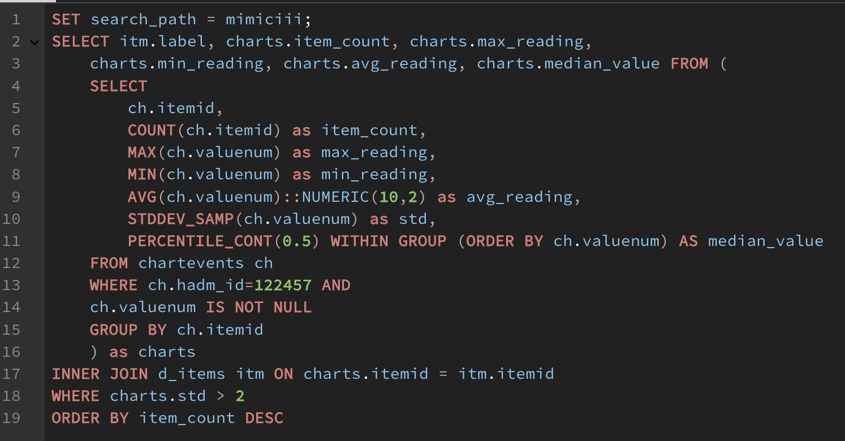
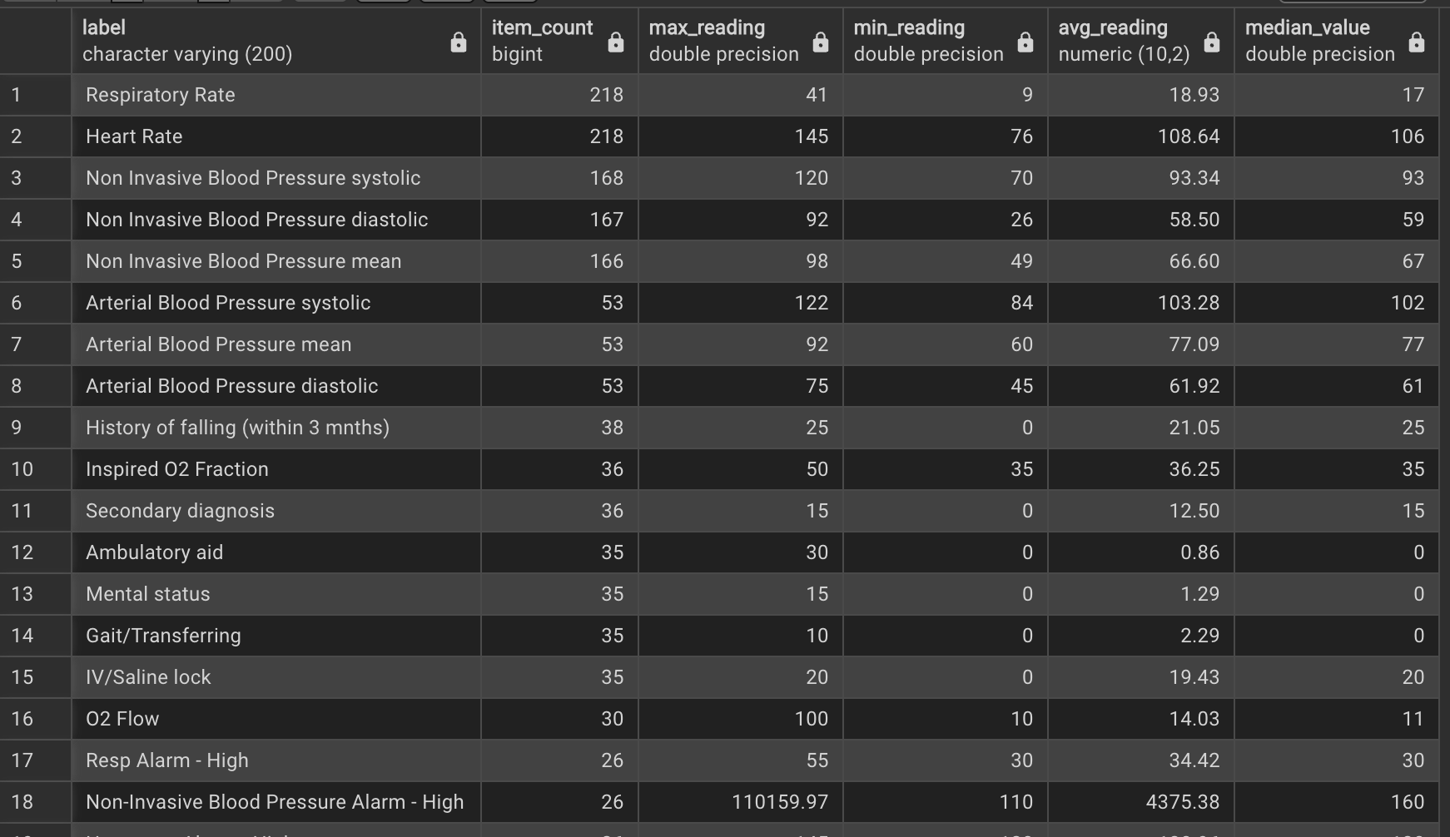
Query 3: Frequently Transferred Patient
This query takes a closer look at the patient (adm 122457) who was transferred 34 times, what is some information from their chart data that stands out?
When looking at chart readings with above a standard deviation threshold of 2, we see the respiratory rate, heart rate, and blood pressure readings rank as the top results that vary from their averages.
The max, min, average, and median are included in the results to get a better overall picture of each chart item. Notice that for charts with outliers, such as Non Invasive Blook Pressure Alarm, the median is not as influenced by a much higher max value as the average is.
This query works by filtering chartevent data specific to admission 122457, then uses built-in postgres avg and stddev_samp functions to calculate average and std respectively. Results are grouped by item and d_items is joined to get the item’s name. percentile_cont is then used to calculate the median of the group results.

Slide 5
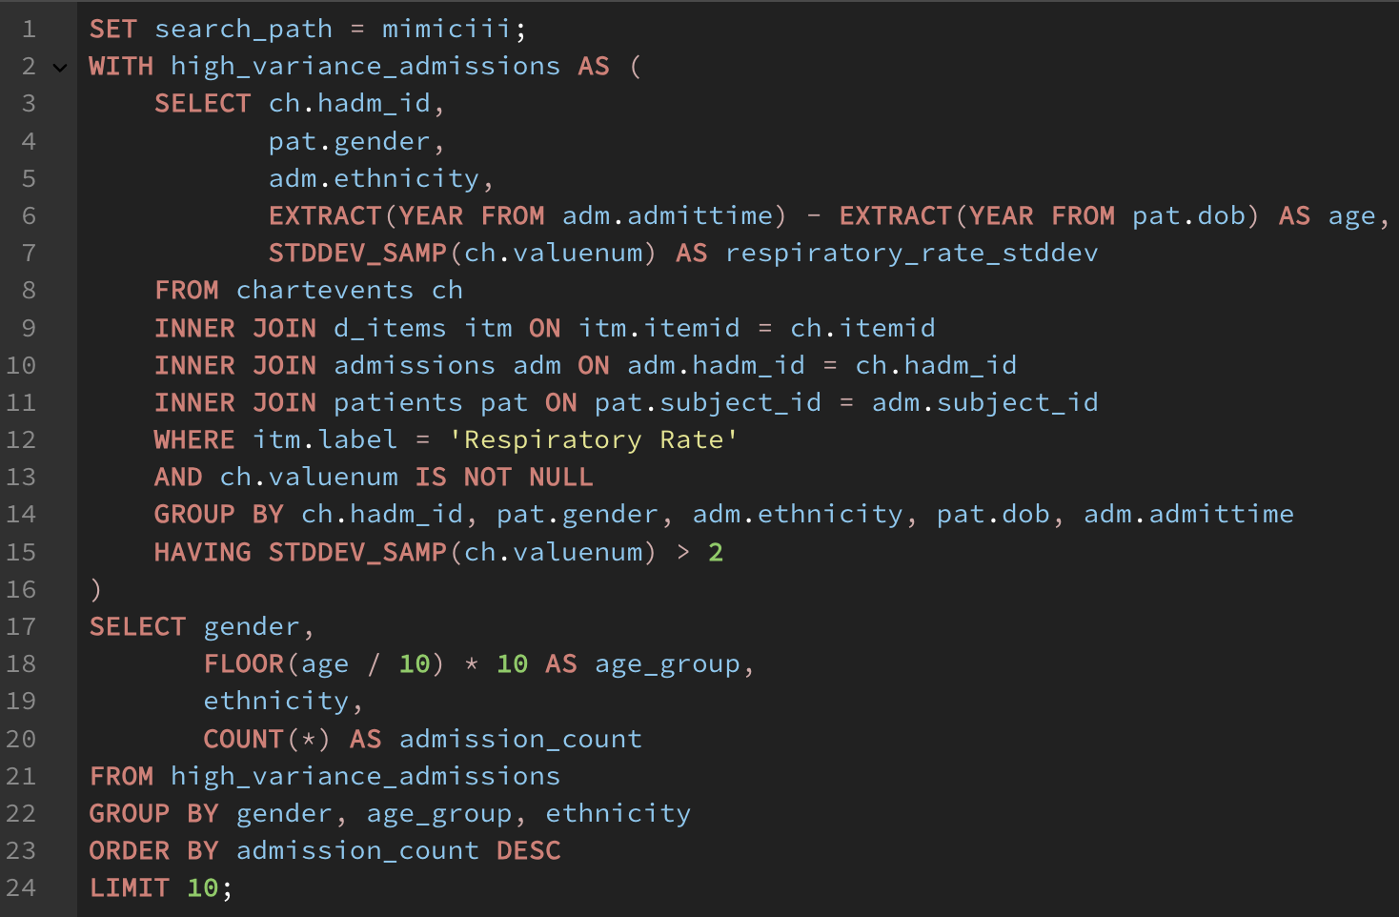
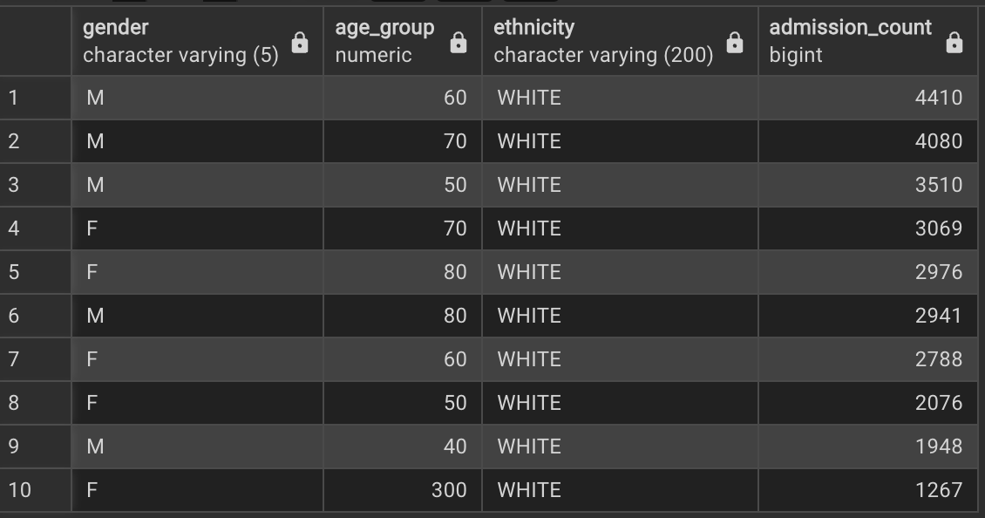
Query 4: Other Deviations in Respiratory Rate
Building on the previous query, this query seeks to identify what other gender, age, ethnicity groups had high deviation in their Respiratory Rate chart data. Each row represents a gender, 10 year age span, ethnicity group that is ordered by the admission count of each group.
The results show that white males in their 60s had the largest representation in admissions where the respiratory rate charts had a higher standard deviation. It would be interesting to see how these numbers were affected by the COVID19 pandemic.
This query works by using the WITH keyword to save subquery results from chartevents joined by d_items, admissions, and patients filtered by only items related to ‘Respiratory Rate’. Those charts are then grouped by admission, gender, ethnicity, dob and admittime (both to calculate age) and filtered by std > 2. Finally, these subquery results are regrouped into the 10 year age ranges, ordered by count and limited to the top 10.

Slide 6
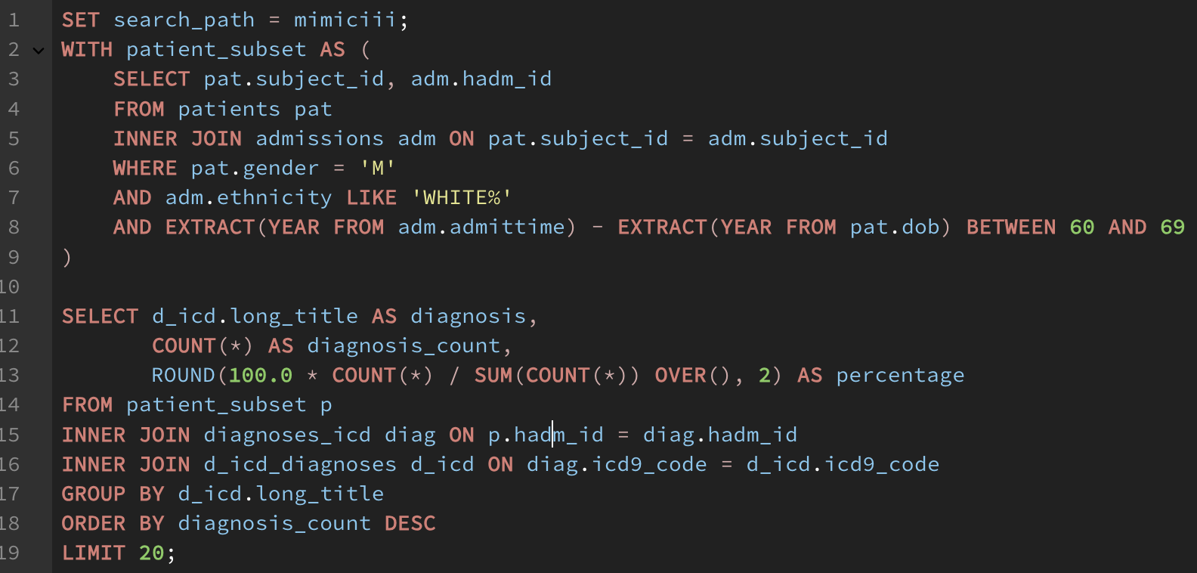
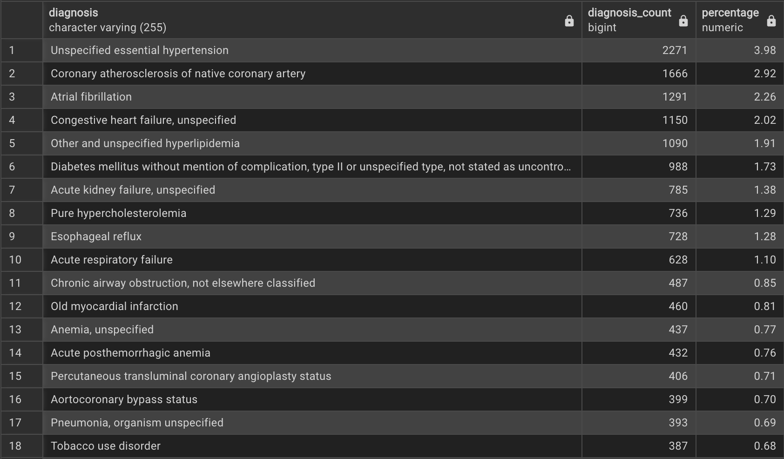
Query 5: Common Diagnosis of 60s white Males
Continuing with the top result from the previous query, these results show top diagnosis for the patient subset: White, 60s, Male.
The top results are relatively unrelated to respiratory issues (hypertension, atrial fibrillation, congestive heart failure, etc) but there are some in the list like Esophageal reflux, Acute respiratory failure, Chronic Airway obstruction, Pneumonia, or Tobacco use disorder.
This query again uses WITH to first retrieve the patient subgroup mentioned in the first bullet which is then queried and joined with diagnosis and d_diagnosis tables to get the top diagnoses and their names. Percentage is calculated with built in postgres aggregations like SUM and COUNT

Slide 7
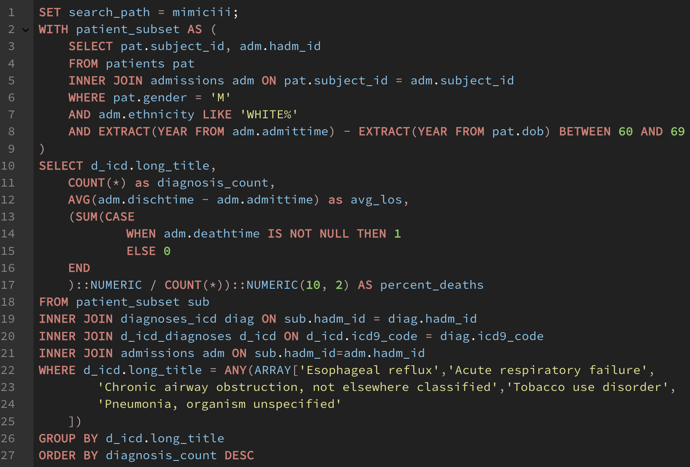
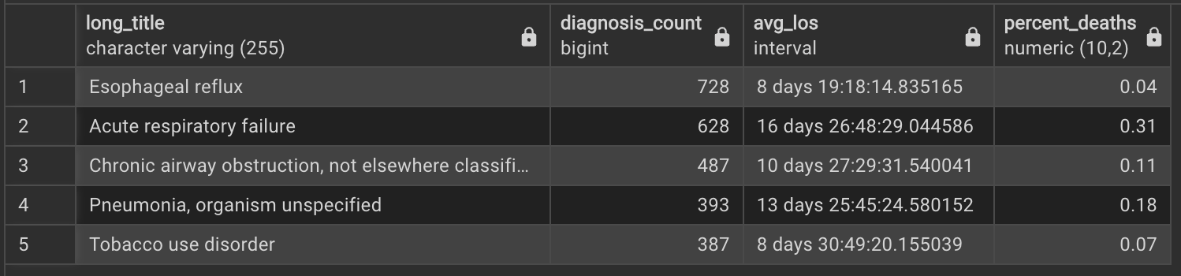
Query 6: admissions info for Patient Group
With the same patient subset, white 60s males with respiratory-related conditions, this query investigates the related stay information.
Results show the count, average length of stay, and percentage of stays that resulted in deaths for each respiratory diagnosis. We see that Acute Respiratory Failure has both the highest average length of stay, over 2 weeks, and a much higher mortality rate, ~31%, than other diagnoses. These results highlight the seriousness of such a diagnosis.
This query again uses the WITH keyword to extract the patient subset. With the subset results, diagnoses_icd, d_icd_diagnoses, and admissions are all joined for each visit. These results are then filtered to only respiratory-related icd titles. Postgres AVG with dischtime and admittime is used to get avg_los and percent deaths is calculated based on the deathtime.

Slide 8
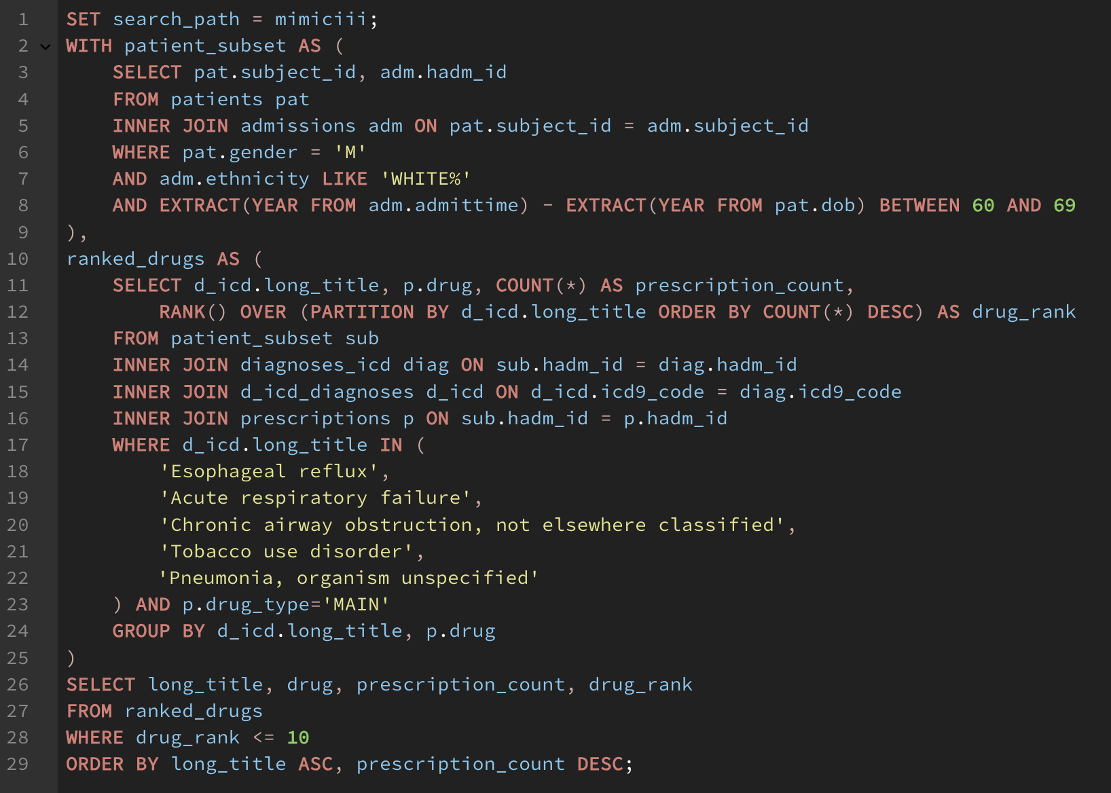
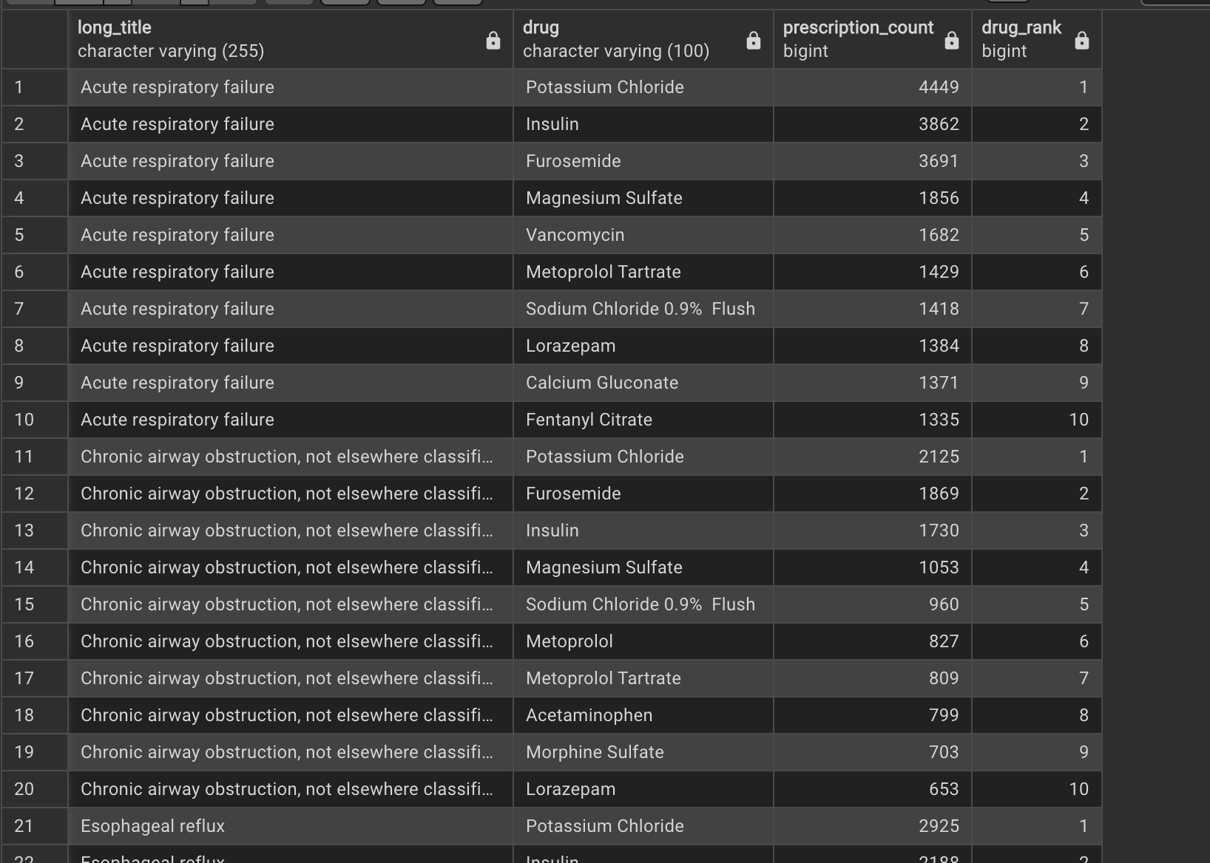
Query 7: Prescription info for patient group
Continuing with the same patient subgroup (white 60s M) , this query identifies what the top 10 prescriptions are for each respiratory-related diagnosis.
The results show common IV drugs as the top results such as Insulin, Potassium Chloride, and Furosemide. Because these drugs are so commonly given to many diagnoses, they may not actually be related to the respiratory-specific diagnosis.
This query first uses WITH to get the patient subgroup in the same way as previous queries. A second subquery is then used to get a list of drugs grouped by each respiratory-related icd9 long title. RANK and PARTITION BY are used to identify the top drugs within each group. Finally, the results are selected from the second subquery.

Slide 9
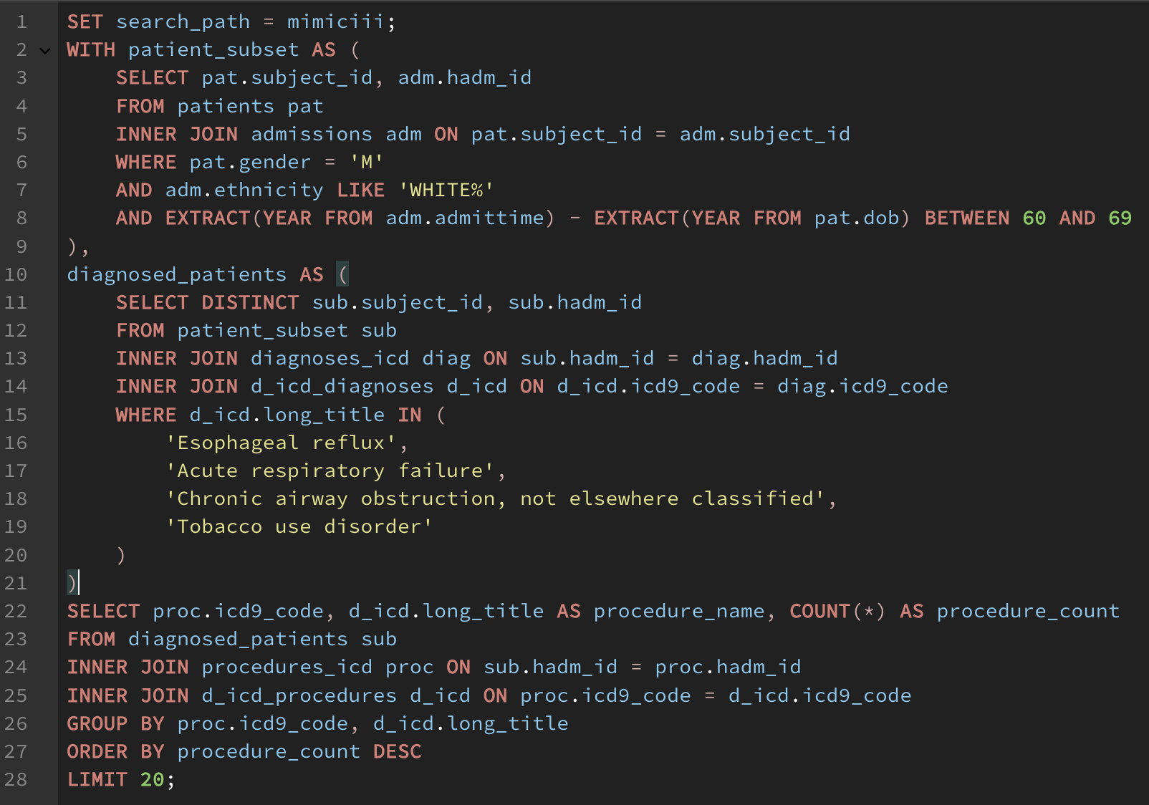
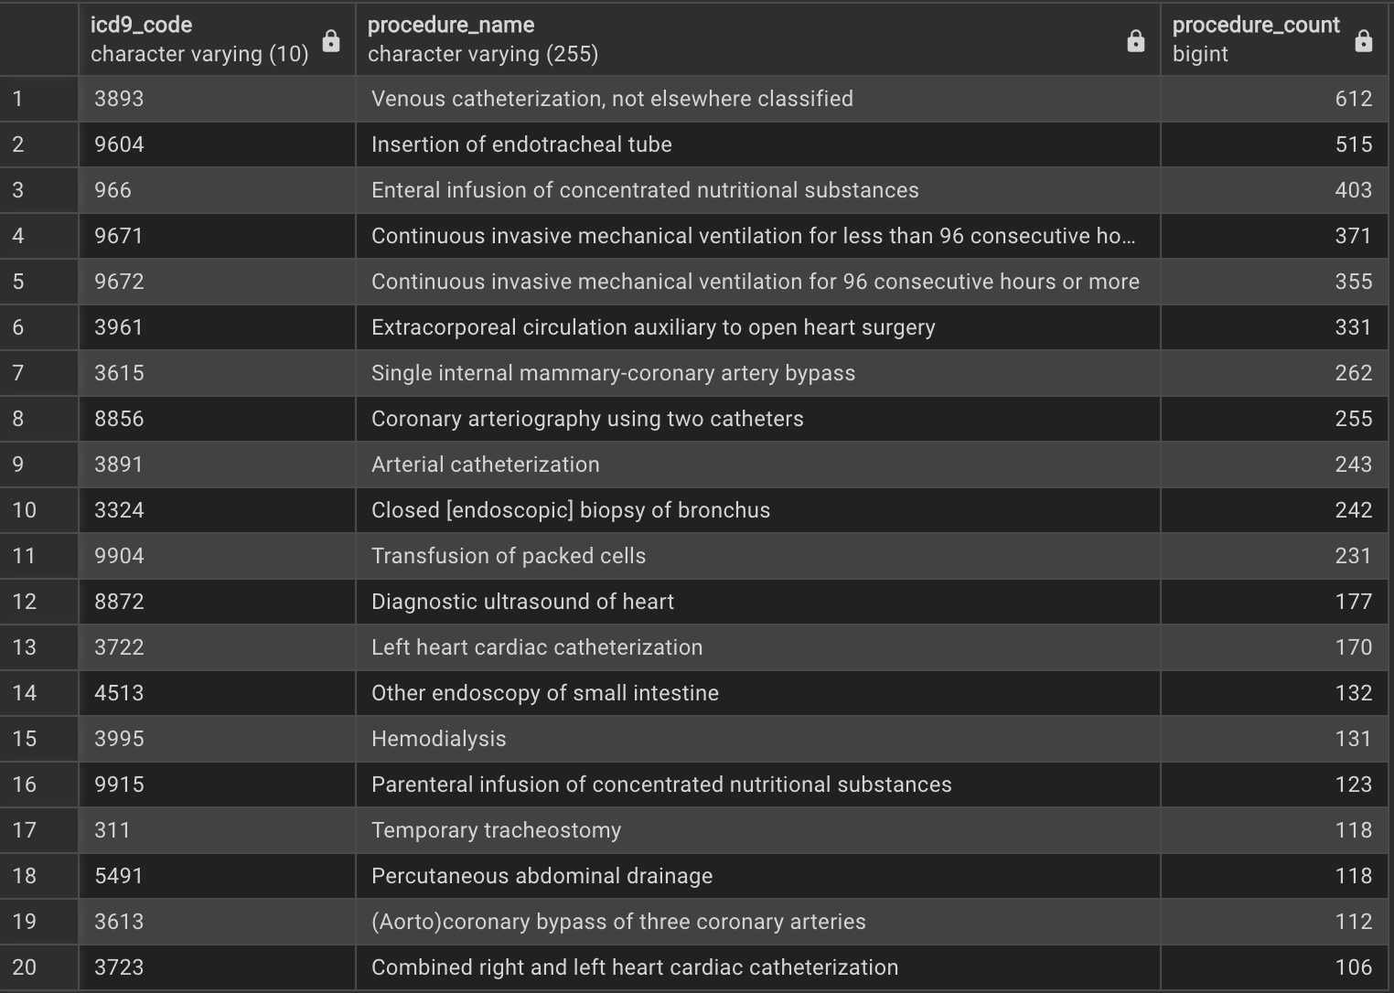
Query 8: Procedure info for patient subgroup
Continuing with the same patient subgroup (white 60s M), this query identifies what the top procedures are for all respiratory-related diagnoses.
The results show various respiratory related procedures such as Insertion of endotracheal tube, Continuous invasive mechanical ventilation (< and > 96 hours), and Closed [endoscopic] biopsy of bronchus.
There are also other general procedures such as venous catheterization, Enteral infusion of concentrated nutritional substances, and Extracorporeal circulation auxiliary to open heart surgery.
This query works by using WITH to capture the patient subset, then using those results for a new WITH capturing the patient diagnosis, then finally querying the diagnosis results by joining the procedures_icd and d_icd_procedures table and grouping by icd9 code and long title.

Slide 10
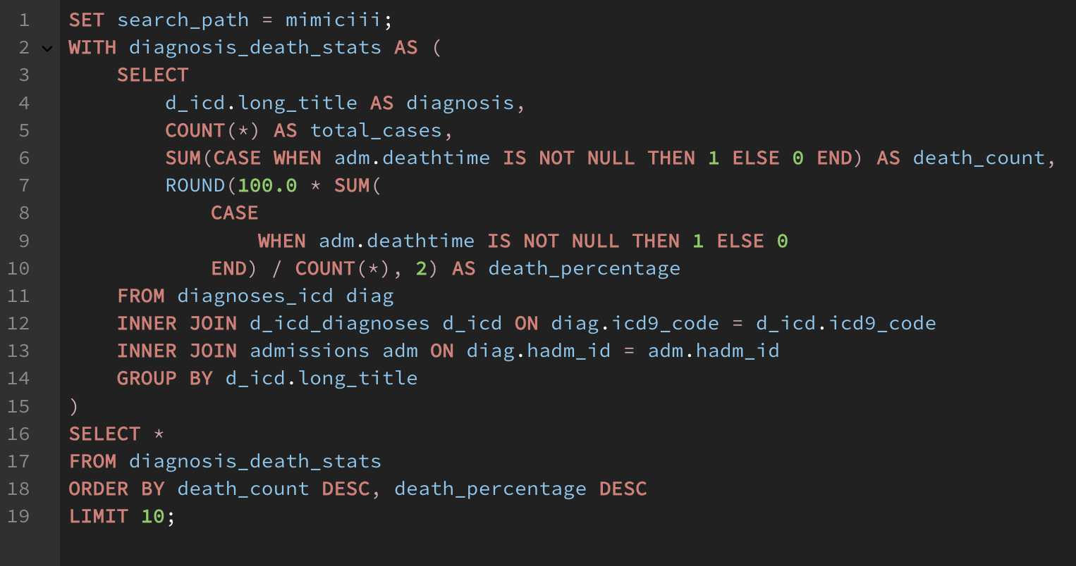
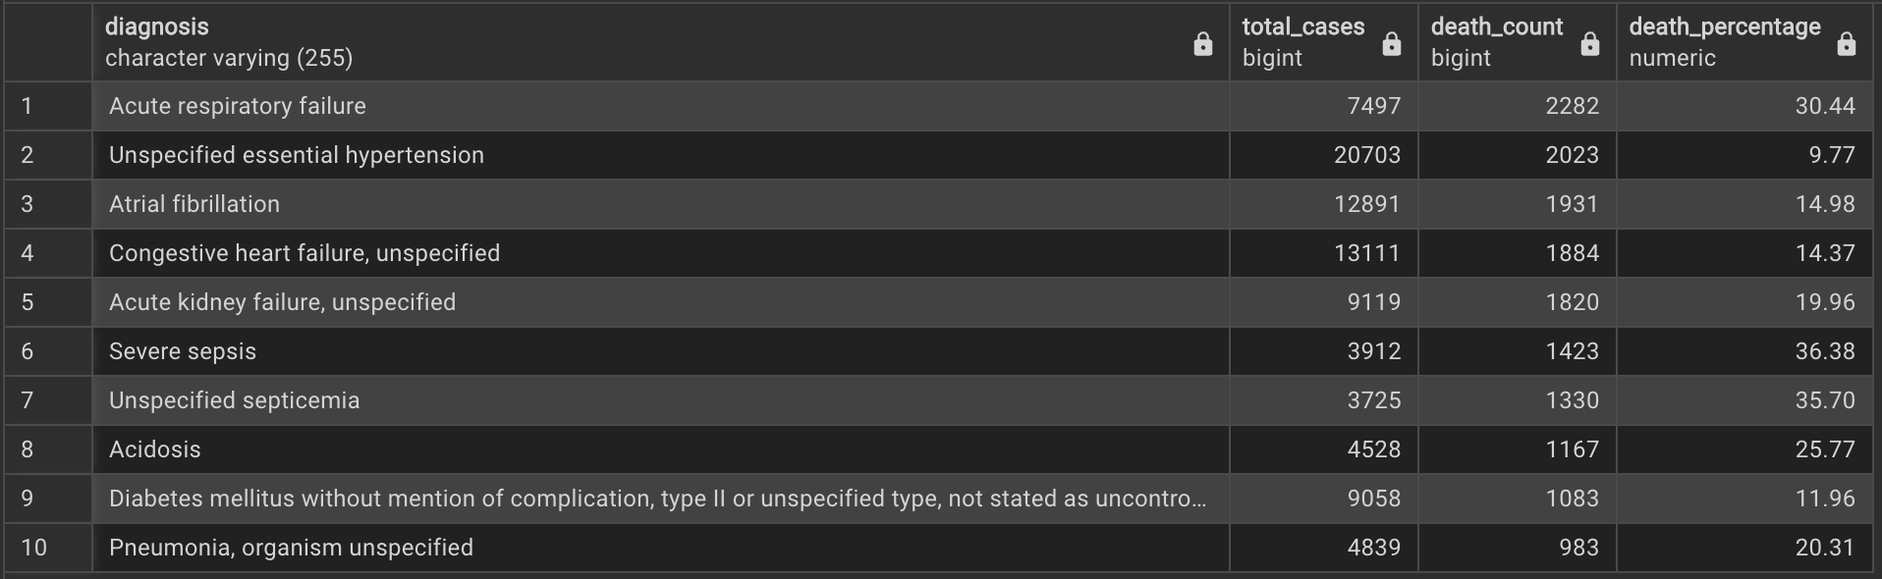
Query 9: Overall mortality of Diagnosis
This query identifies the diagnosis that has led to the most deaths in patients, in case there is any link to the previous respiratory-related diagnoses.
The results are sorted by highest percentage but are also weighted by the overall number of deaths so that diagnoses with a single case and a single death do not dominate the results. We see that Acute respiratory failure is the top ranked result and that Pneumonia also shows up farther down.
This query works by using a WITH subquery to get the death information from the admissions table with diagnoses_icd and d_icd_diagnoses also getting joined for icd title info. Results are then selected and orded by death_count and death_percentage.

Slide 11
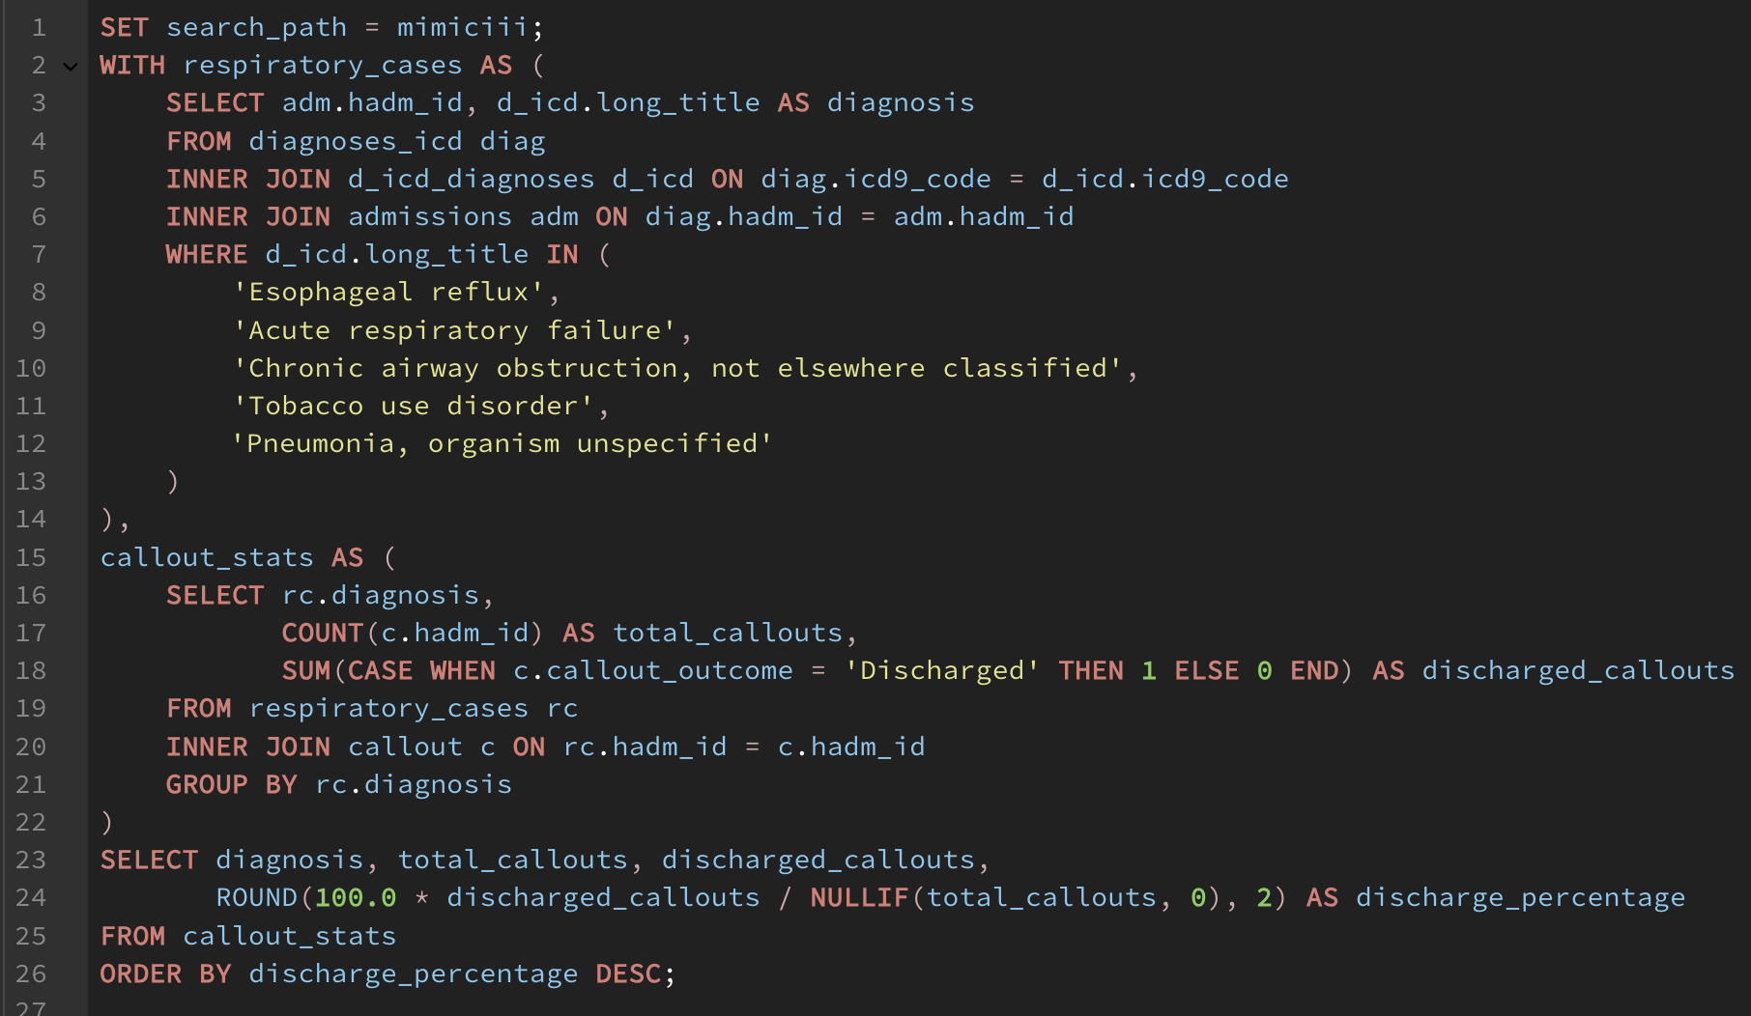
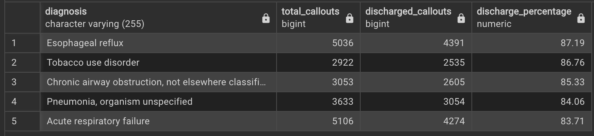
Query 10: Successful Callouts for Respiratory Diagnoses
This query takes us back the the original one in relation to callouts, what does the success of callouts look like for the respiratory conditions that have been explored in the previous queries.
From the results we see the reflux in the most successful in its callout transfers while Acute Respiratory Failure is the worst. This could be connected to the fact that Acute Respiratory Failure has a much higher mortality rate but further data analysis is needed.
This query works by first doing a query to get the long_title and admissions id of patients that came in with the repiratory-related diagnoses. Then the results of the first query are joined with the callout table and the callout_outcome is summed to determine the successful count. One final query is used to select the final results and the percentage of successful callouts is calculated.

