Slide 1
Assignment 2 MIMIC Visualization
AI in Healthcare
Owen McCormack

Slide 2
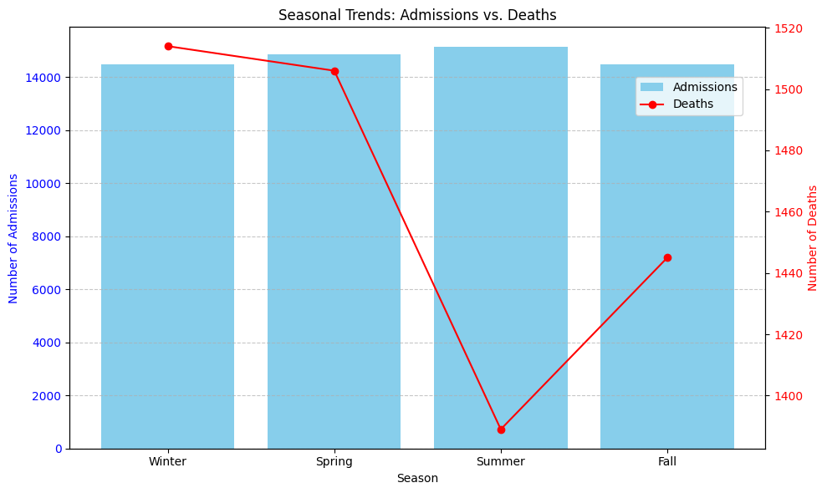
Visualization 1
Admissions vs Deaths seasonally
Although dates are shifted, seasons are preserved:
“Time of day, day of week, and approximate seasonality were conserved during date shifting.” (Johnson, 2016)
Admissions per season do not deviate much with the peak being the Summer months and the lowest in the Fall
Deaths are nearly opposite with a peak in the Winter and a large drop in summer months

Slide 3
Visualization 1 Explained
From the admissions csv, create a dataframe filtering to just ADMITTIME and DEATHTIME columns
Extract the month from ADMITTIME and DEATHTIME and apply a function to create 2 new columns in this dataframe: admitseason and deathseason
Create a new admissions_by_season data frame by grouping admissions by admitseason
Create a new deaths_by_season data frame by grouping admissions by deathseason
Using matplotlib, Plot admissions_by_season as a bar and deaths_by_season as a line graph and include both subplots together

Slide 4
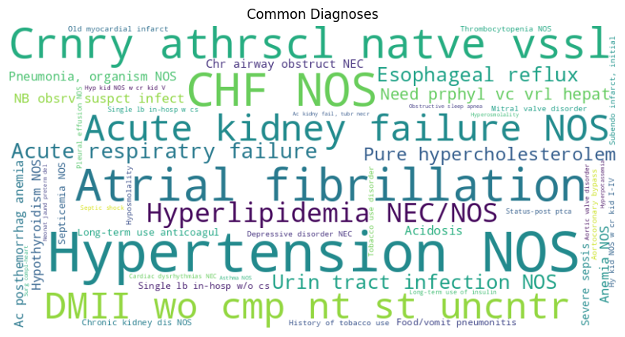
Visualization 2
Word Cloud of the 50 Most Common Diagnoses
Diagnosis Table icd9 codes were joined with d_icd to get the short name of each code
Popular diagnosis include Congestive Heart Failure (CHF NOS), Hypertension NOS, Atrial fibrillation, and Acute Kidney Failure NOS

Slide 5
Visualization 2 explained
From the D_ICD_DIAGNOSIS csv cast the ICD9_CODE column as a string and then join with the DIAGNOSIS table on its ICD_CODE column there to create a new dataframe
Group results by SHORT_TITLE to get a descriptor of each icd9 code
Wordcloud needs a dict so use size() and nlargest() on the group results and then to_dict() to convert to the correct data structure
Use the python wordcloud library to generate the visualization and tune the prefer_horizontal param as needed

Slide 6
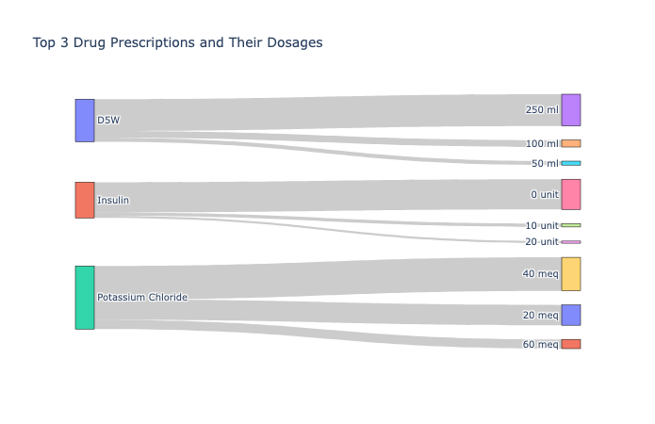
Visualization 3
Sankey Diagram showing Top 3 Drugs with the Top 3 Associated Doses
Most prescribed included D5W 250 mL at 86k, Insulin 0 units at 82.1k, and Potassium Chloride 40 mEq at 90.8k
D5W had separate categories for “250 ml” and “250 mL” so all measurements were lower cased to be combined
Note: These prescriptions have additional dosages but they were limited to 3 to allow readability

Slide 7
Visualization 3 Explained
From the PRESCRIPTIONS csv select DRUG, DOSE_VAL_RX and DRUG_UNIT_RX columns
Drop rows with empty or null values and make DOSE_VAL_RX numeric
Create new column DOSE by combining DOSE_VAL_RX and DRUG_UNIT_RX (lower cased)
Group the rows by DRUG and DOSE and save the size of each group in a Frequency column
Now group on DRUG and sum the Frequencies to get the n largest (my visualization used top 3)
With the top_drugs dataframe, sort by DRUG and Frequency then group by DRUG and use head to get the top n doses
For the Sankey diagram set nodes to the drugs + dose combinations, source to the DRUG column, target to the DOSE column, and value to the frequency and display with plotly

Slide 8
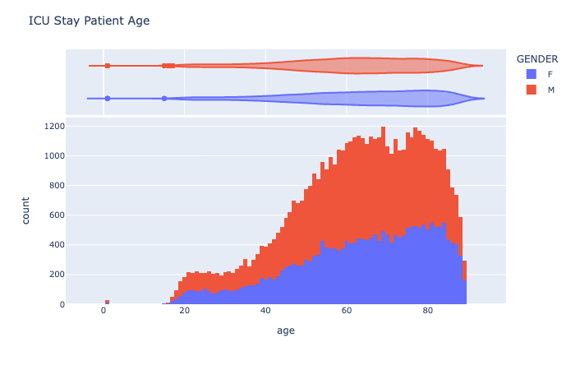
Visualization 4
Stacked Histogram of ICU Patient staytime vs Age combined with gender
Patients older than 89 and younger than 1 were excluded
ICU admissions start to rise in the late 30s, peak around the mid 70s and then begin to drop off
Male admissions rise faster than female and typically have higher ICU admission numbers

Slide 9
Visualization 4 Explained
From the ICU_STAYS csv make a dataframe with the LOS, SUBJECT_ID, and INTIME columns
From the PATIENTS csv make a dataframe with the SUBJECT_ID, GENDER, and DOB columns
Merge both dataframes together on SUBJECT_ID into a new dataframe
Add a new column “age” by subtracting the DOB year from the INTIME year
Filter out age > 89 and < 1 from the dataframe
Plug this dataframe into a plotly stacked histogram, where color is gender

Slide 10
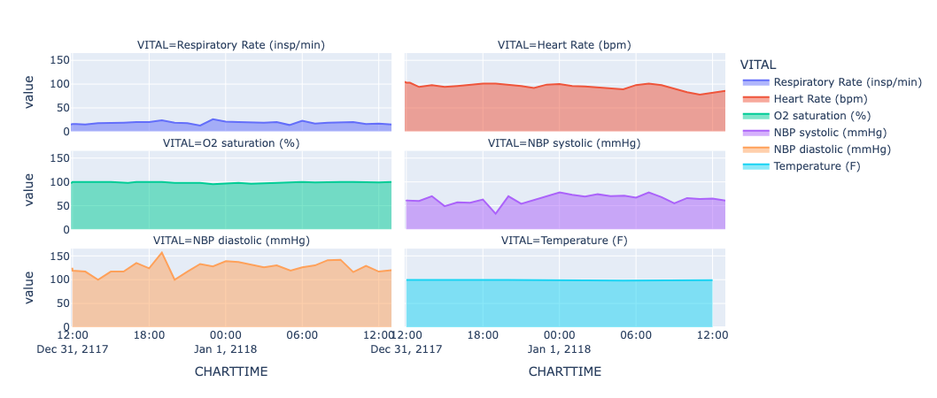
Visualization 5
Time-series subplots of an ICU stay for single patient with id 99999 admitted with a Spondylolisthesis diagnosis
Patient had an ICU stay of just under 27 hours
Temperature and O2 Saturation were stable unlike NBP diastolic & systolic, heart rate, and respiratory readings

Slide 11
Visualization 5 explained
Create a map of itemids to label for vitals of interest (In this case Respiratory Rate, Heart Rate, O2 saturation, NBP Systolic/Diastolic, and Temperature were selected.
Note: These itemids may vary by patient even with the same label. Ex. “Heart Rate” and “Heart Rate” could have different itemids even though they have the same label
Create a dataframe with CHARTEVENTS filtered by the selected SUBJECT_ID. Note: This operation should be chunked considering the size of the csv
From the filtered dataframe, narrow to CHARTTIME, VALUENUM, and ITEMID columns
Add column VITAL to the dataframe that uses the itemid -> label map from step one
Drop the ITEMID column and sort by CHARTTIME
Plug the dataframe into a plotly area chart with color set to VITAL

