Slide 1
Deep autism Trait Prediction
Ai in healthcare self learning tutorial
Notes:
Colab Link: https://colab.research.google.com/drive/1Xj0QP9NFRvc8w7S-Ni88V4EmyrJKU4HB?usp=sharing

Slide 2
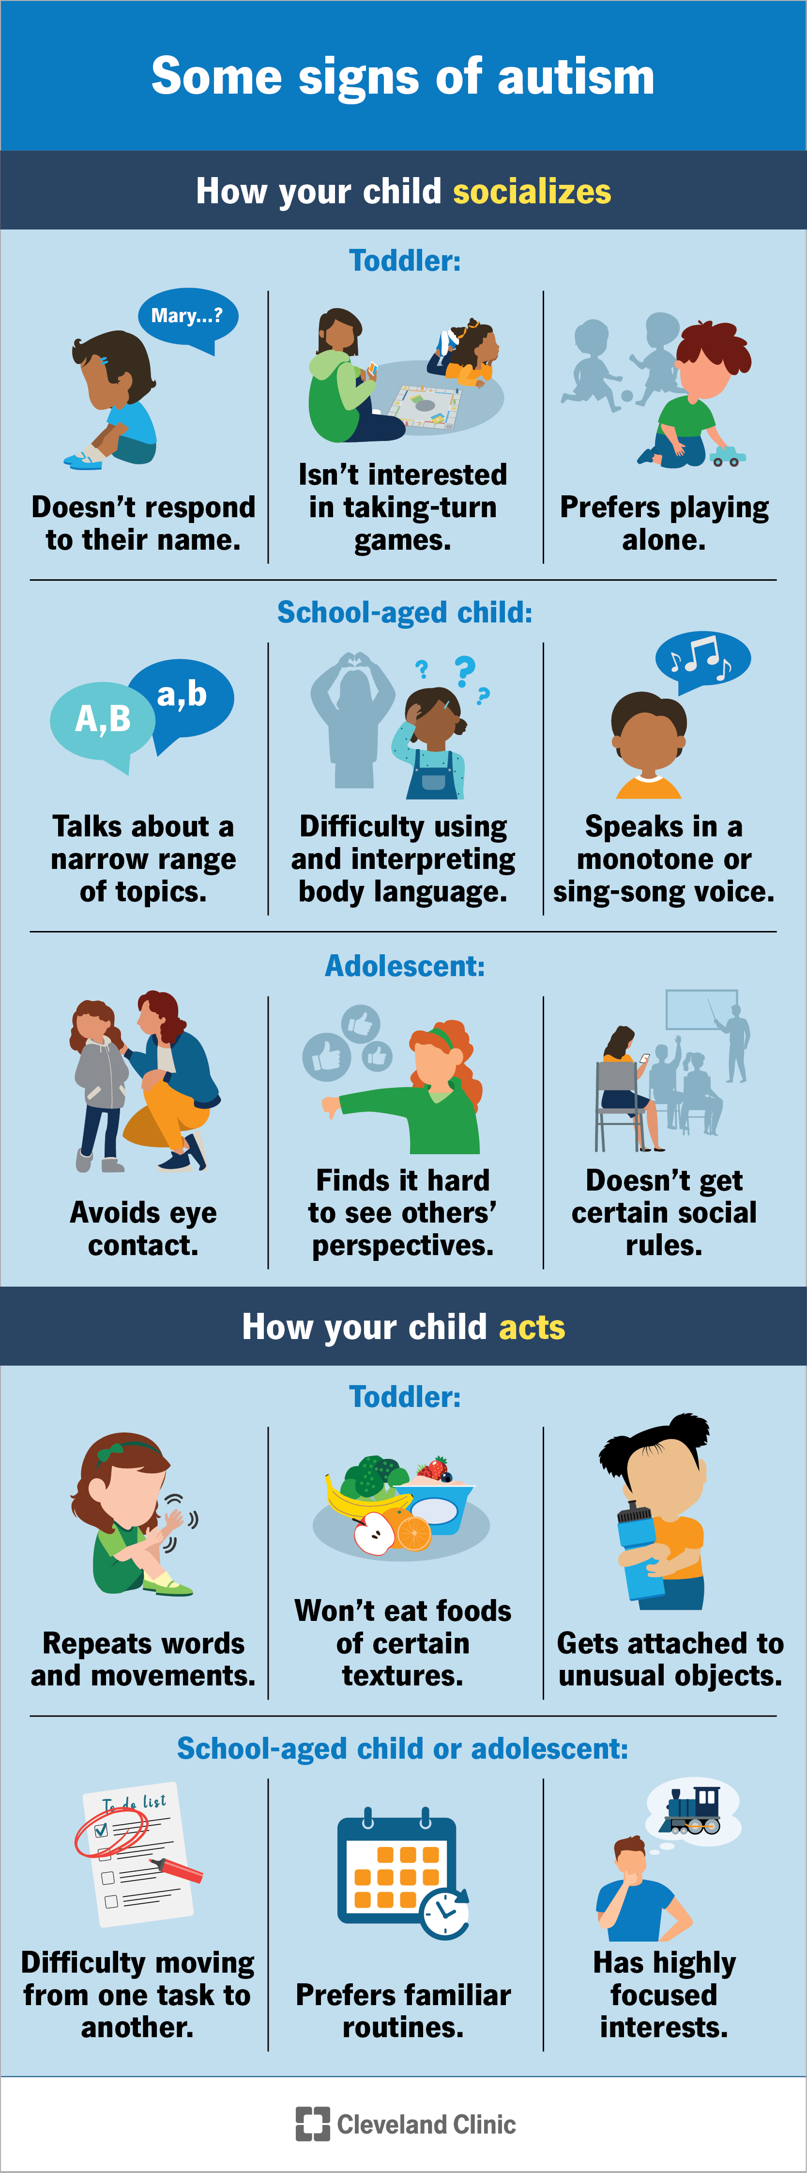
What is Autism?
Autism spectrum disorder (ASD), or simply autism, is a neurodevelopmental disorder "characterized by persistent deficits in social communication and social interaction across multiple contexts" and "restricted, repetitive patterns of behavior, interests, or activities” [1]
Diagnosis can difficult due to it resulting from both genetic and environmental factors, some do not get diagnosed until later as adults.
I have a sibling with various mental and physical disabilities, so I find modern health research/solutions relating to mental or physical disabilities very interesting!
[2]
Notes:
For my self learning project, I decided to focus on a problem relating to disabilities, in this case Autism Spectrum Disorder (ASD), commonly referred to as Autism. Autism is a well-known disorder affecting 1 in 100 worldwide according to a recent study (Zeidan et al, 2022). There are several behavioral signs that help to identify individuals that may have the disorder and multiple different screening assessments exist such as M-CHAT-R, SACS-R, SACS-PR, SCSQ, AQ to determine whether a child or adult is showing the traits of autism. I have a sibling with many different physical and mental disabilities and thinking about how ML/AI can be helpful to those with disabilities drew me to this problem.

Slide 3
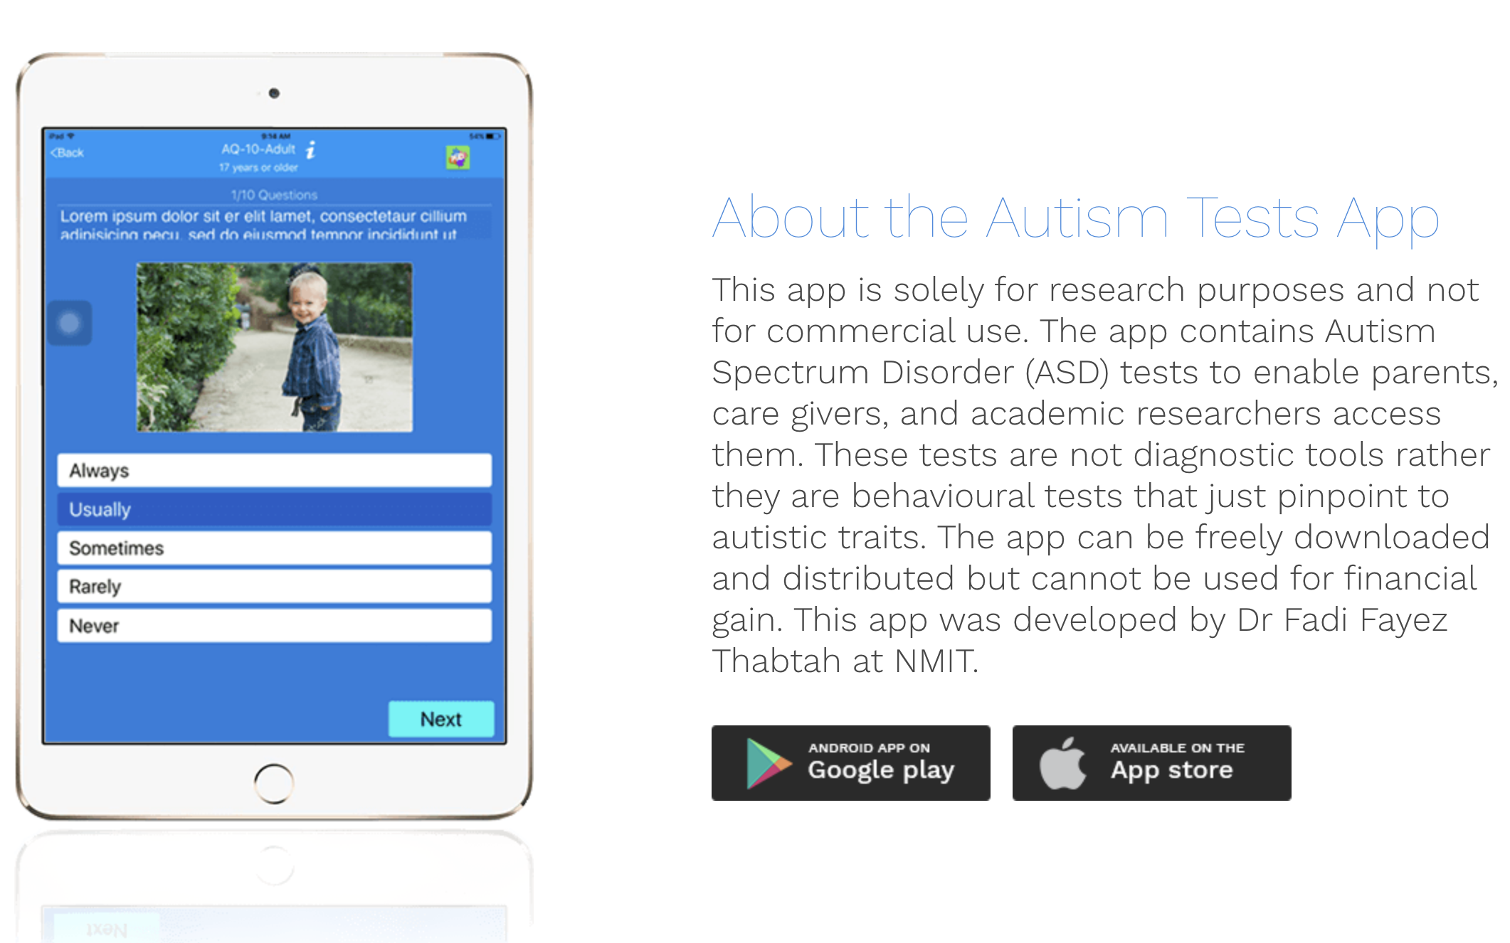
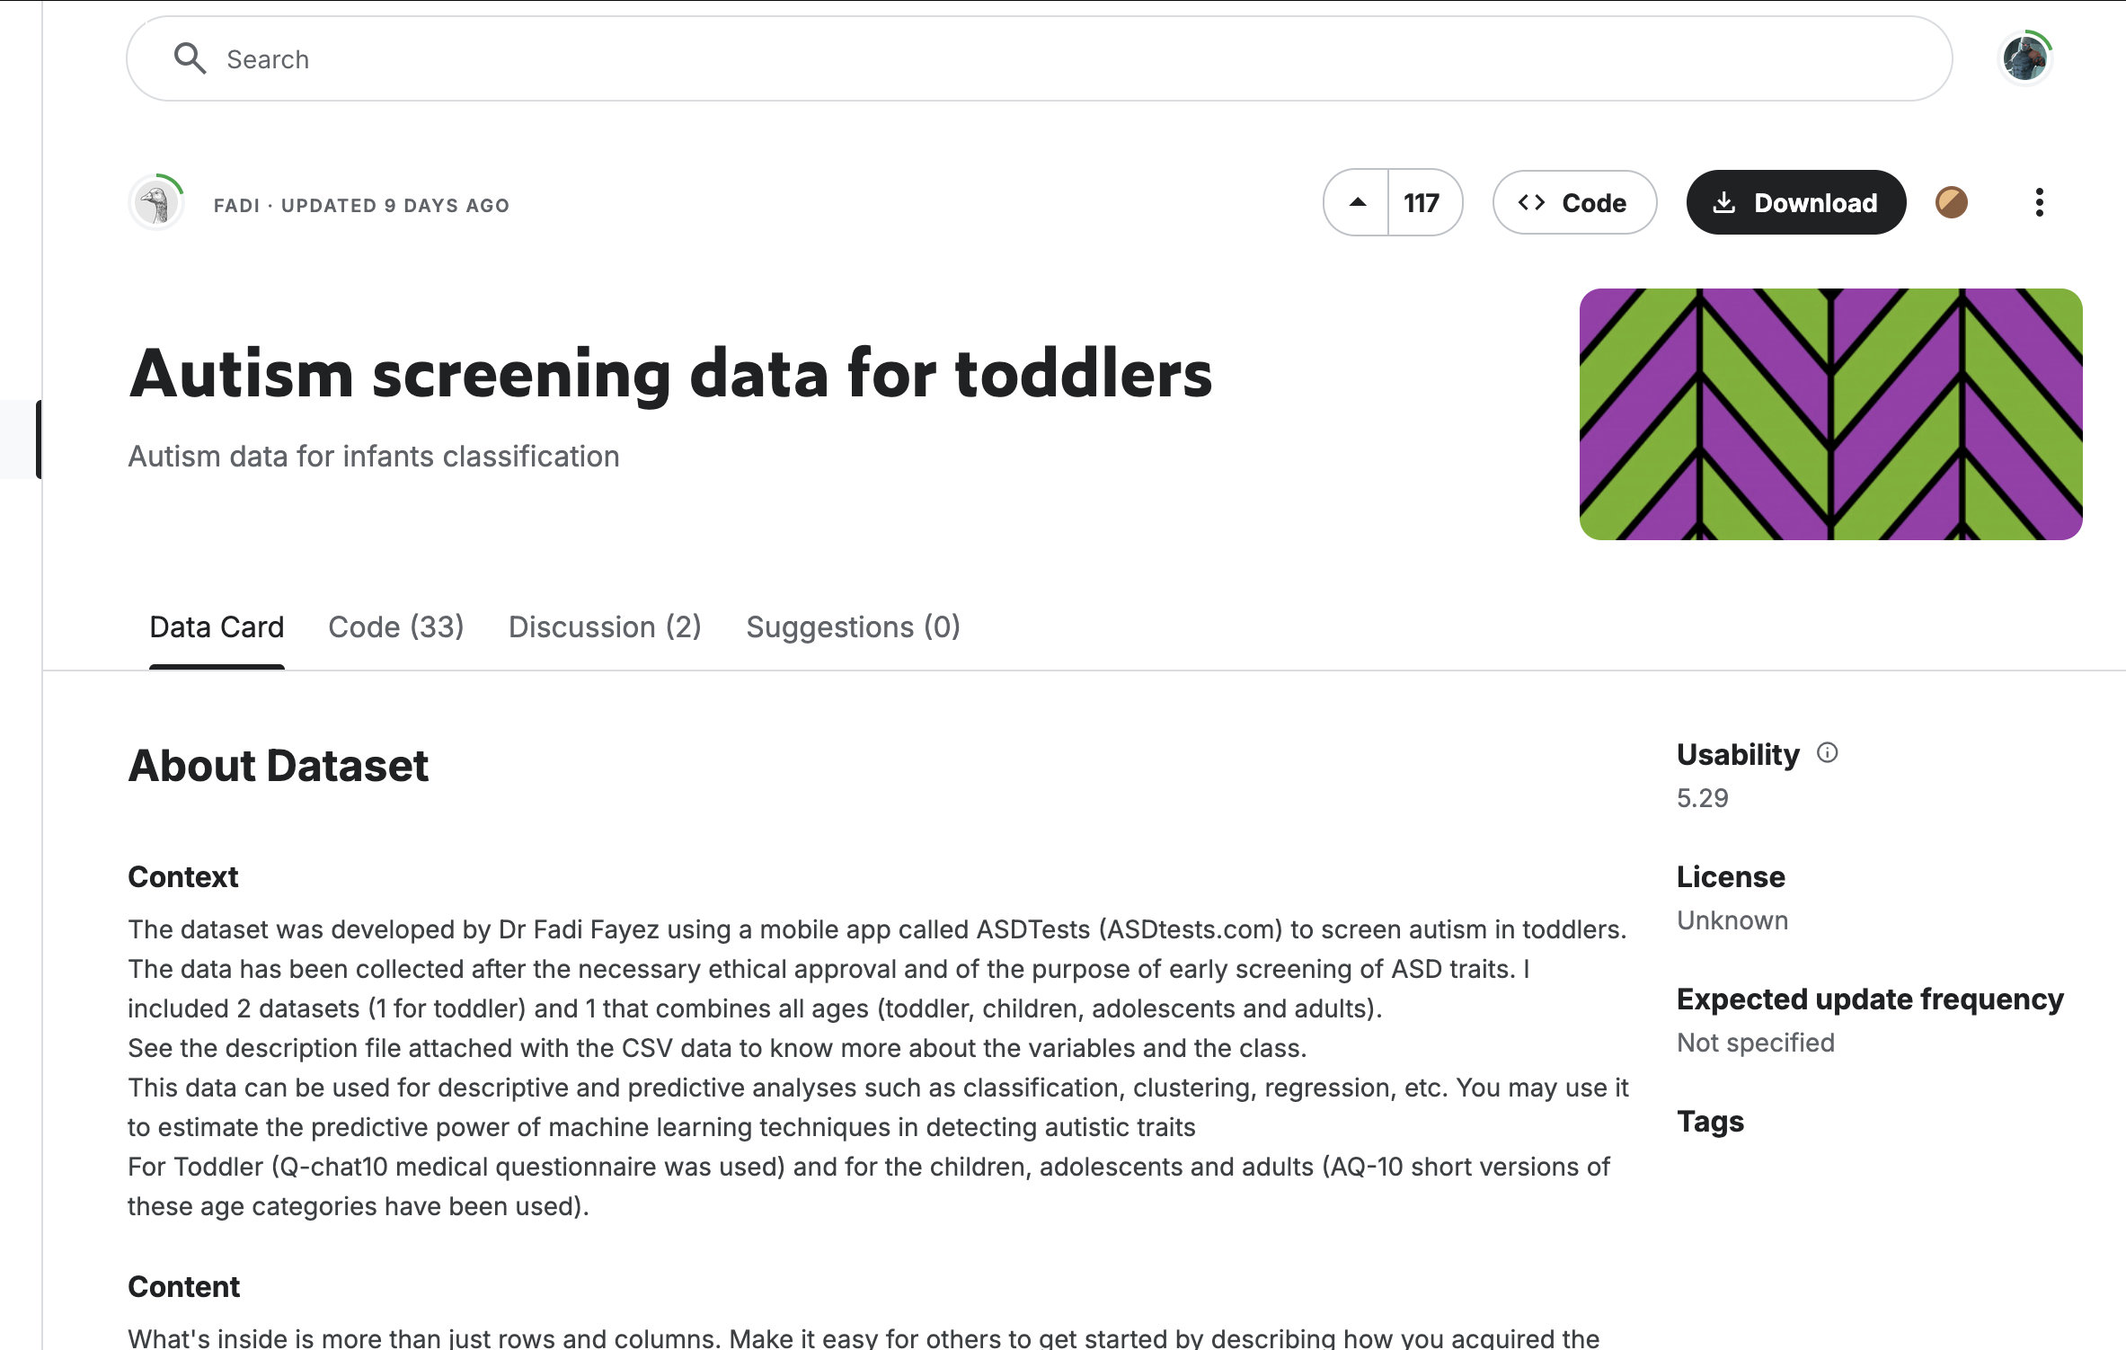
An Autism Related Problem
Kaggle dataset of autism screening information for toddlers including separate data for children and adults.
Dataset was developed by Dr Fadi Fayez using a mobile app developed for research called ASDTests.
Data includes answers to the AQ-10 questionnaire that classifies if the subject described in the survey has ASD-related answers.
With this data I can create a model to predict the ASD traits based on question answers and other subject information
Notes:
I searched through Kaggle and Physionet to find a comprehensive dataset related to Autism and landed on this screening data for toddlers. This data was collected in 2018 through a mobile application developed specifically for the study. A few years later, Dr. Fayez added the data to Kaggle and there are two main csv files, one containing the question results related only to toddlers, and another for all ages. My tutorial only focuses on the toddler dataset, a csv containing around 1000 samples including data like question answers, age in months, ethnicity, if family members have ASD, if subject has the jaundice condition, a yellowing of the eyes sometimes associated with Autism. The data are then loaded into memory from the provided CSV file with pandas for analysis.

Slide 4
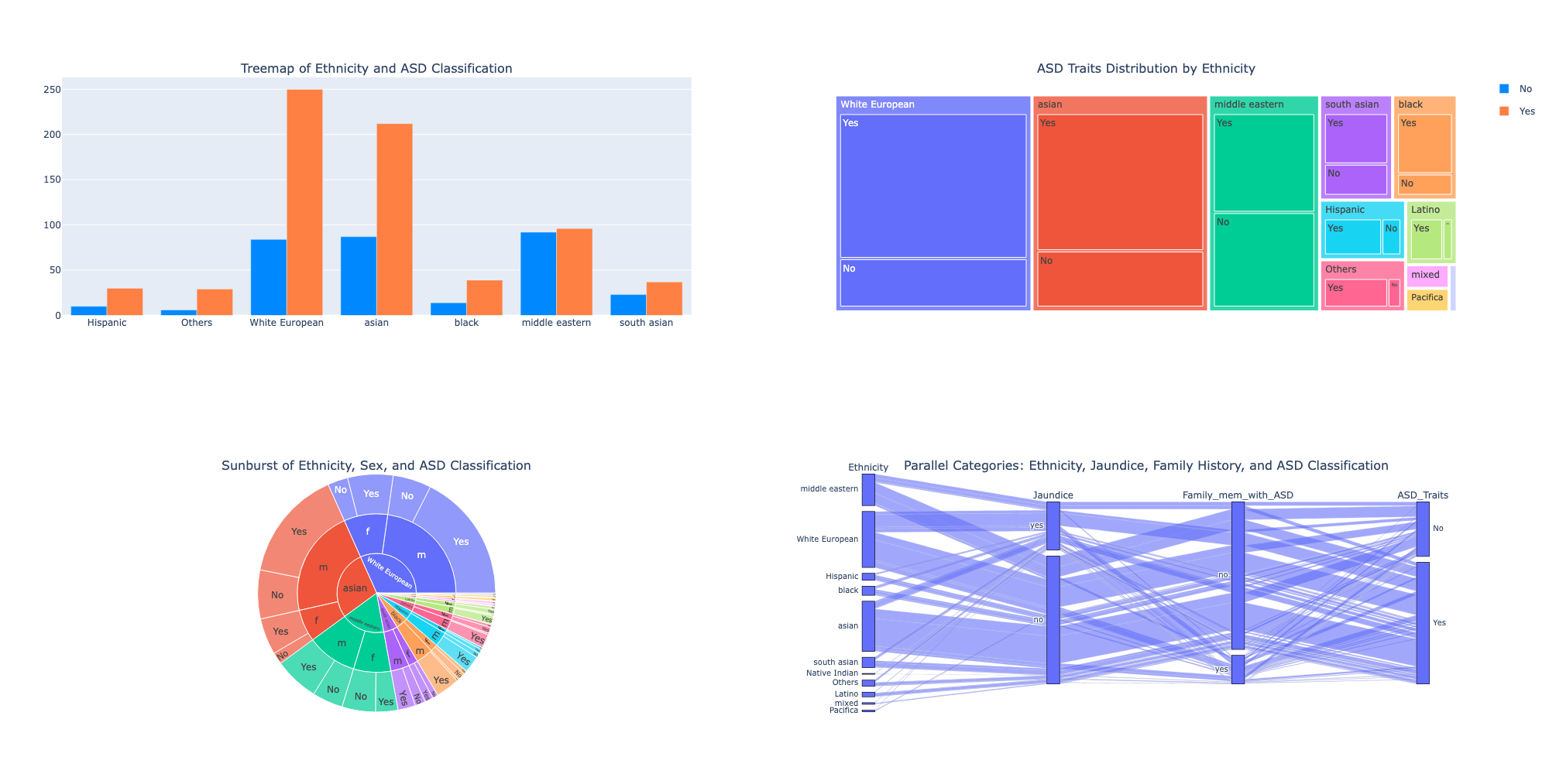
Data Analysis - ethnicity
Notes:
Before any ML/DL application, it’s useful to examine how the data is distributed in some of the features. This analysis will help understand the presence of any bias or imbalance in the dataset and give an overall picture of what the data look like, so the next few slides focus on visualizations made with the Python Plotly library. On this slide, we see the distribution of ethnicity in many different forms. Strating with the multiple bar plot and the tree map, we see that the data are predominantly weighted towards White and Asian male samples than any other group, and although there are several ethnicities, White, Asian, and Middle Eastern samples make up around 75% of data. On the bottom row we have a sunburst plot and a parallel categories which both start with ethnicity and show a finer grained breakdown considering other features like gender, family history, jaundice, and ASD traits.

Slide 5
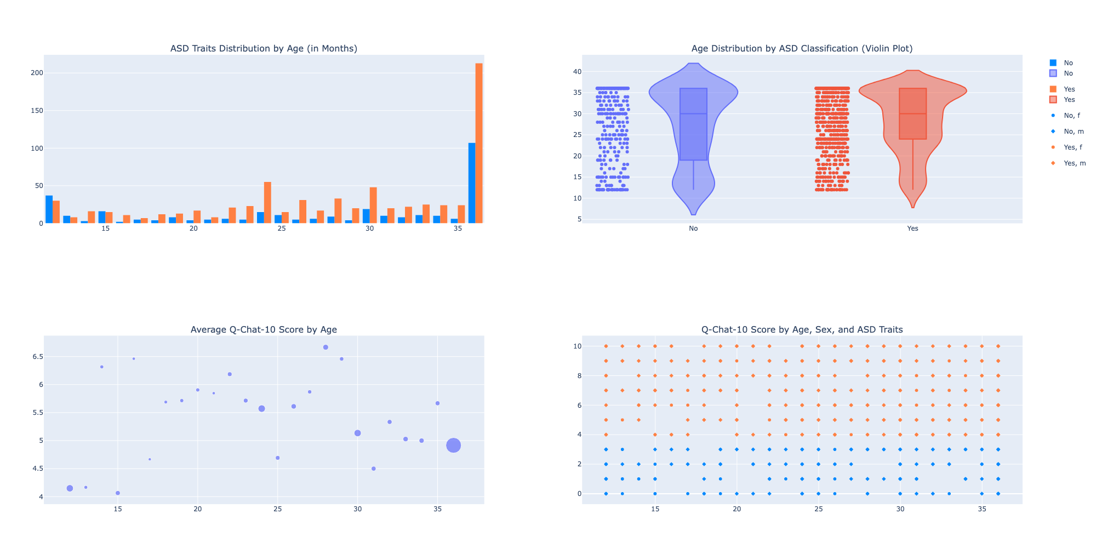
Data Analysis - age
Notes:
The visualizations in this slide focus more on distributions linked to age. From the multiple bar and violin plot on the top row, we can see that there are peaks for ASD trait samples at both ends of the range, 0-15 months, and 35-40 months have spikes for yes and no ASD trait classifications. The bottom scatter plots represent this same age/score distribution.

Slide 6
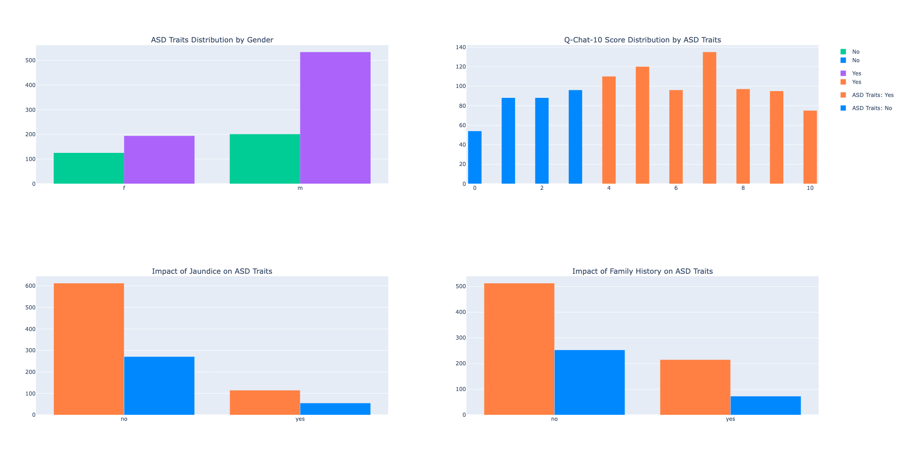
Data analysis – Other features
Notes:
Plotting some of the remaining features reveals a few more insights. From the top row of plots we can see that in data ASD traits show up much more in males than in females, and that scores past 3 are considered the threshold for ASD traits, with scores of 5 and 7 being the most common. On the bottom row we see the jaundice and family history may not have as much as a significant impact on ASD traits considering the bulk of the ASD trait positive samples do not have jaundice or family history.

Slide 7
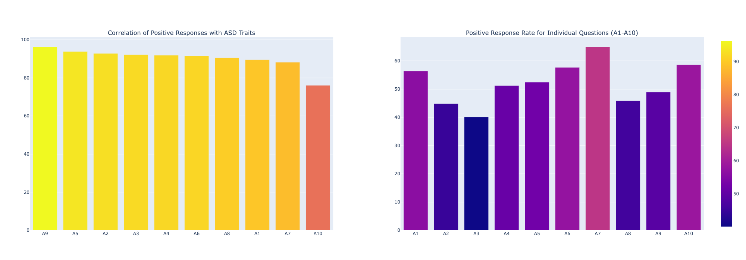
Data analysis - Questions
Notes:
In these last two plots we can see how the questions answers are distributed. The first plot shows questions 9 and 5 being the most correlated with ASD traits while the second plot shows that questions A10 and A7 had the highest number of samples with positive results, meaning the person answering the question answered other than “Rarely” or “Never” for the behavior.

Slide 8
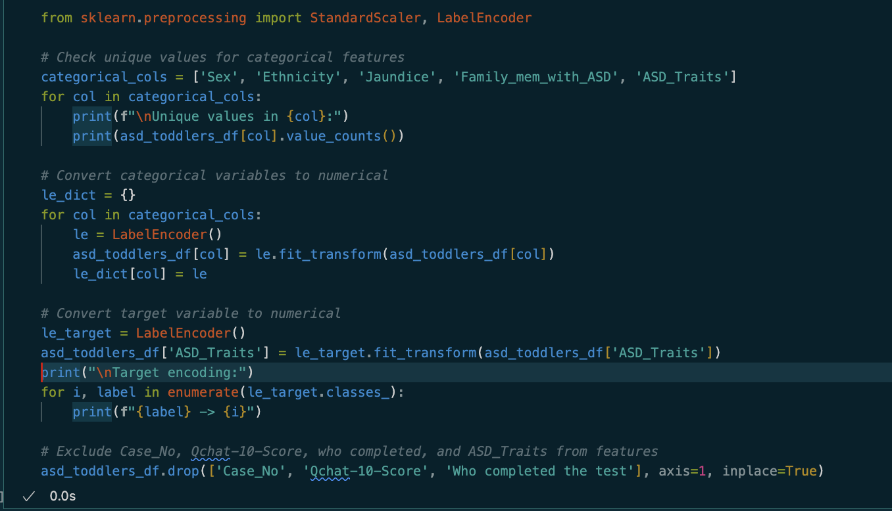
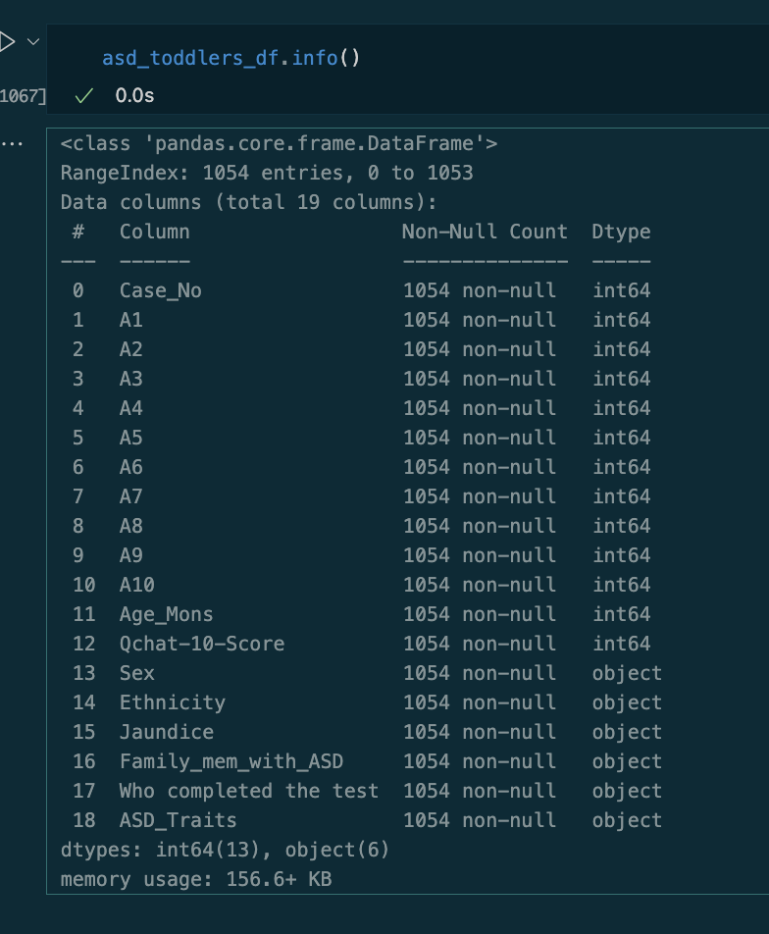
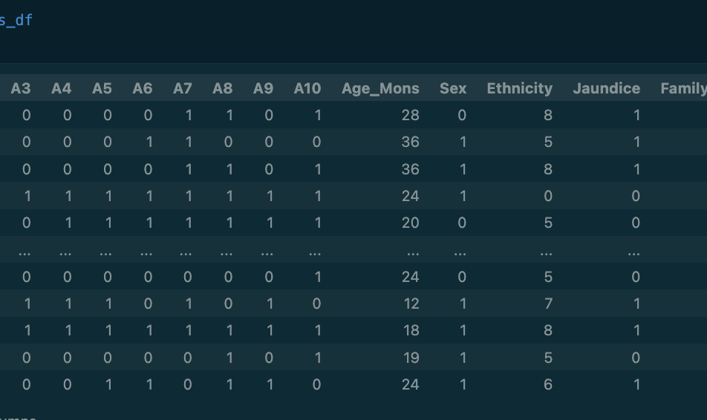
Data cleaning
Are there any features to remove?
Are there any categorical features?
Should any features be transformed?
Notes:
Now that we have a good idea of our data, we can begin cleaning and transforming features so that we can learn from them. This involves identifying if there are any columns we do not want to include in training or if there are categorical columns, such as ethnicity, that have a limited number of categories, or if there are features that should be remapped for easier processing like transforming “Yes” or “yes” to true/false or 1/0 in the A columns. For this data I removed the Q-10 chat score so we can learn from the individual question answers independently, the who completed since for toddlers, this is always a family member and likely has no bearing on the result, and the Case_no, since it is an index column that does not provide any information relevant to ASD. Yes/yes/No/no were converted to 1s and 0s, and categorical columns were transformed using Sklearn’s LabelEncoder.

Slide 9
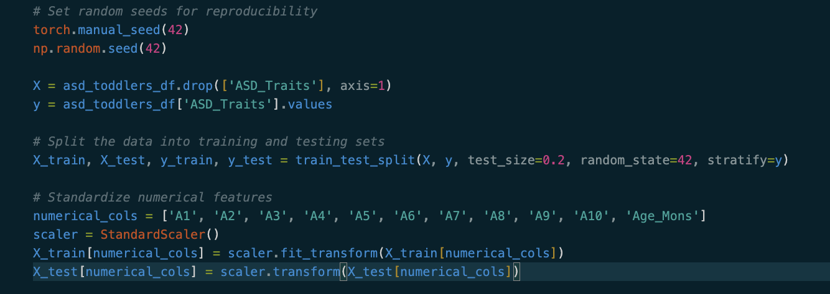
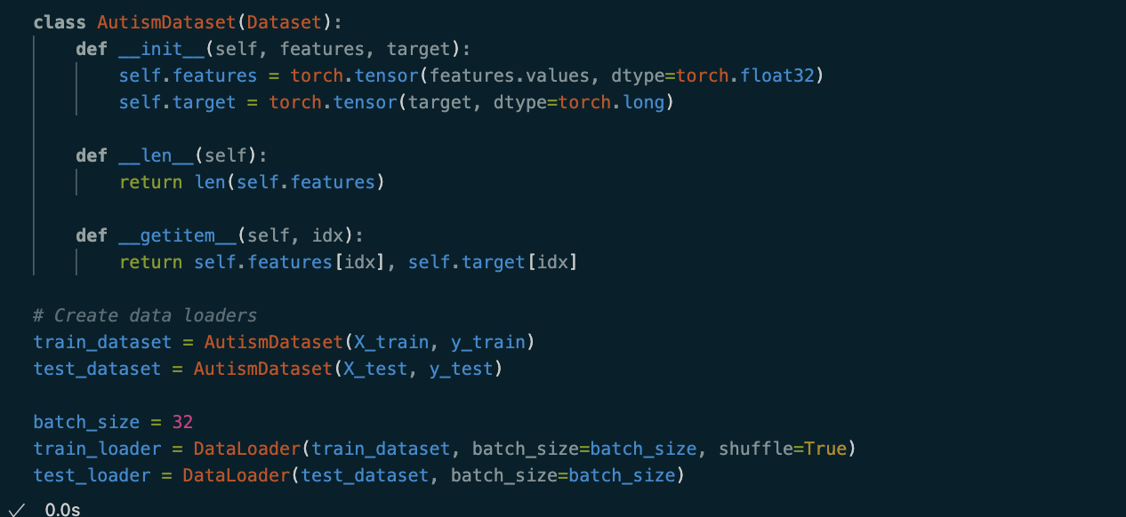
Building a model in Pytorch – loading data
Split the data into train and test
Scale the numerical columns for better convergence and numerical stability
Use PyTorch Dataset and Dataloader to easily load the features and target into tensors then be able to batch the data into the model
Notes:
With the data cleaned, we can now move on to splitting, scaling and loading. For this problem I created a train test split of 80/20. If there were much more data, I would probably have done a train/validation/test set, but with the dataset being so small it did not seem beneficial. All numerical columns in the training set were scaled with scikit learn’s StandardScaler, provider better numerical stability and results. To feed the data into the training loop I used PyTorch’s built in DataLoader and DataSet classes which are great utilities for batching up large datasets for training. You must choose a batch size for the DataLoader, so I went with 32 since each row is small in space.

Slide 10
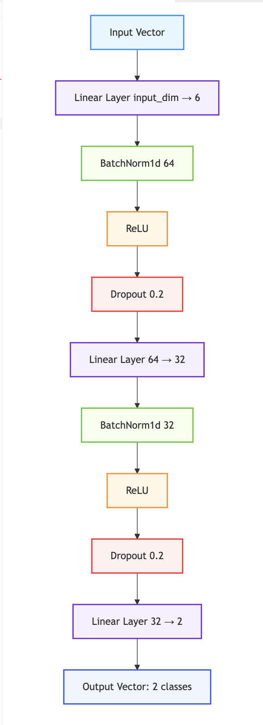
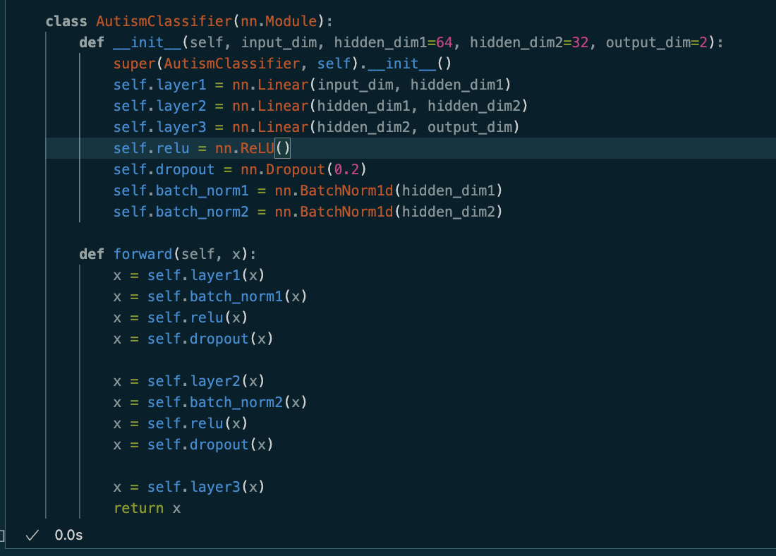
Building a model in Pytorch - Architecture
Notes:
For my model’s architecture I went with a straightforward deep neural network with only one hidden layer. I have a fully connected layer followed by a batch normalization, ReLU activation, then dropout as shown then the same set of layers again before the final fully connected layer. Additional layers would likely not add much since the gradient signal would be reduced and the data is so simple. This is not a transformer or CNN so there is no need for other special layers or operations. With PyTorch, the layers are defined in the Module class init function and then ordered in the forward function as seen in the screenshot.

Slide 11
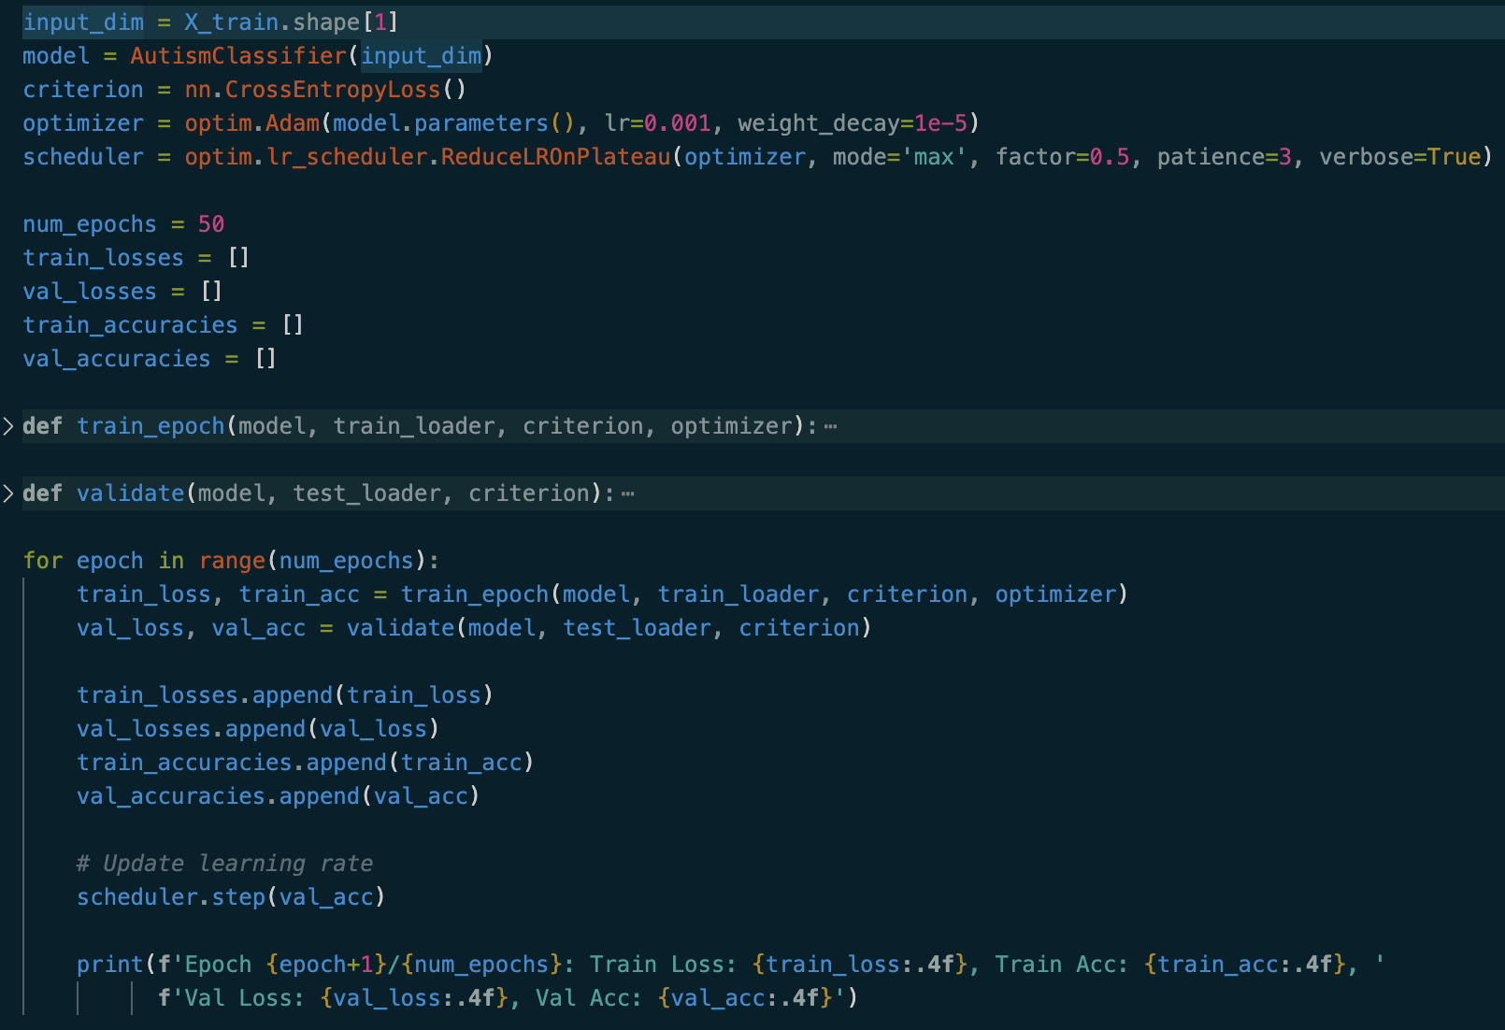
Building a model in Pytorch – train/validate loop
Typical PyTorch train/validate loop
Cross Entropy loss function
ReduceLROnPlateau scheduling
ADAM Optimizer
Runs for 50 Epochs with a scheduler to reduce the LR as the error drops
Notes:
With the architecture in place, the model can now be trained. Both functions will be shown in the next slide, but here we can see the configuration and main training loop: Cross Entropy loss (this is a binary classifier), ADAM optimization, and a ReduceLROnPlateau scheduler. On each epoch we loop through every batch of the data for training and adjust the weights based on the prediction, then validate the current weights against the test set without updating them. The loss and accuracy is collected for every epoch (for graphing) and our scheduler dynamically adjusts the LR based on how well the model performed on the test set. This loop runs for 50 epochs and prints information after each one.

Slide 12
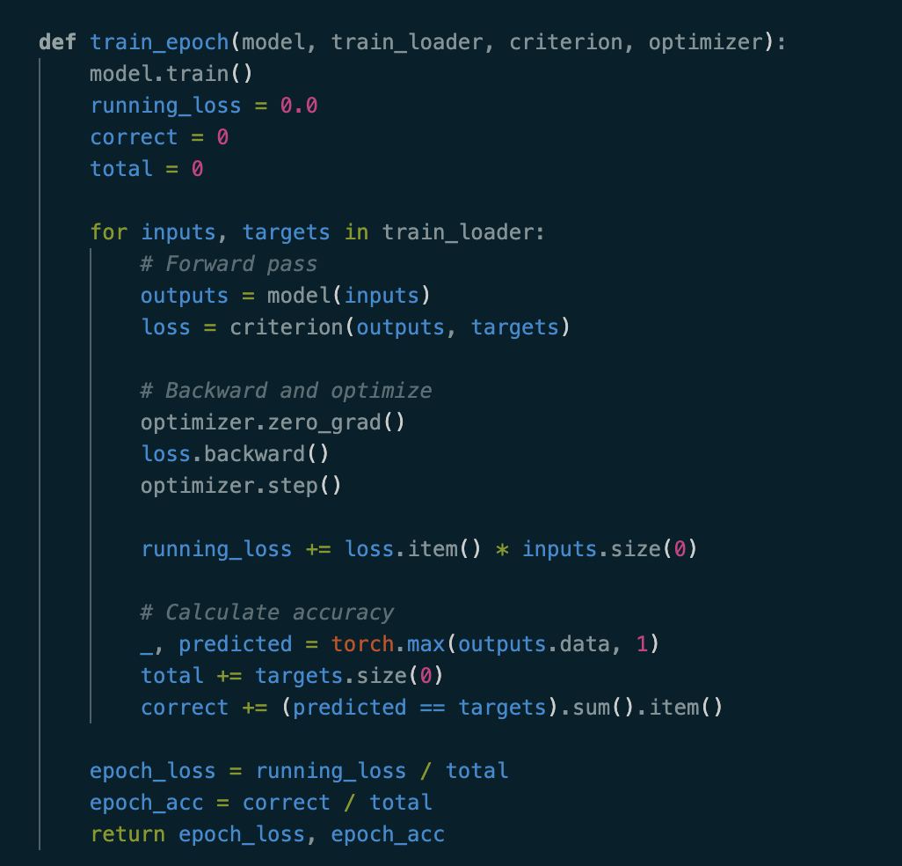
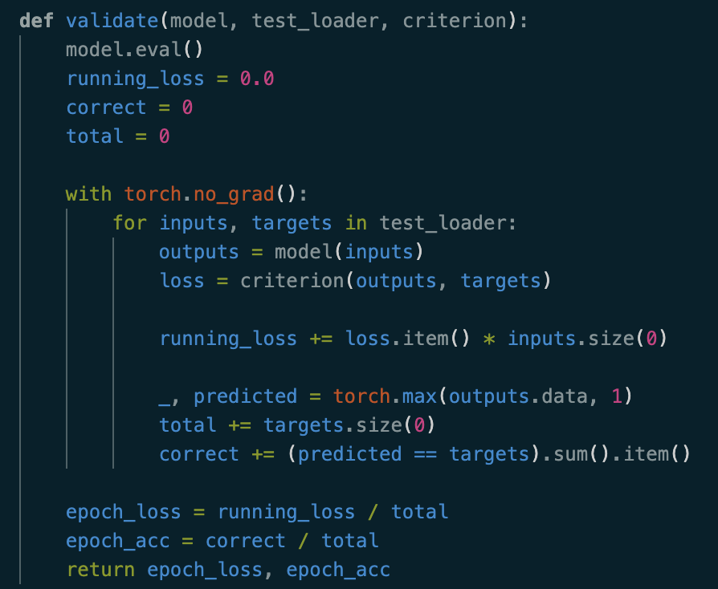
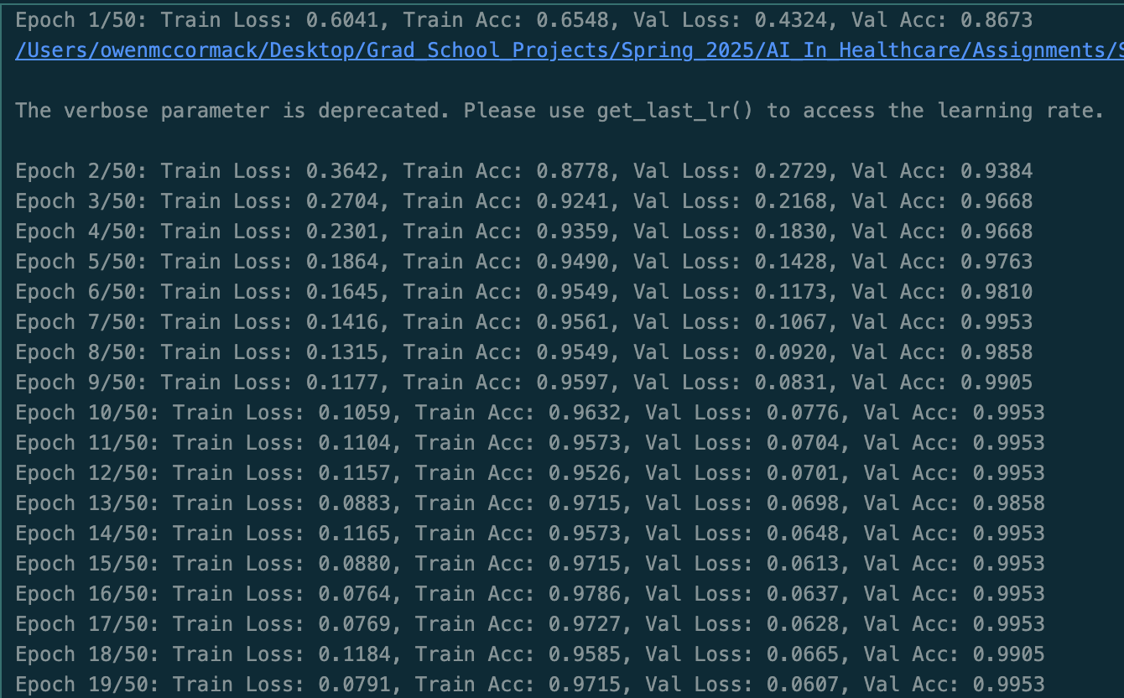
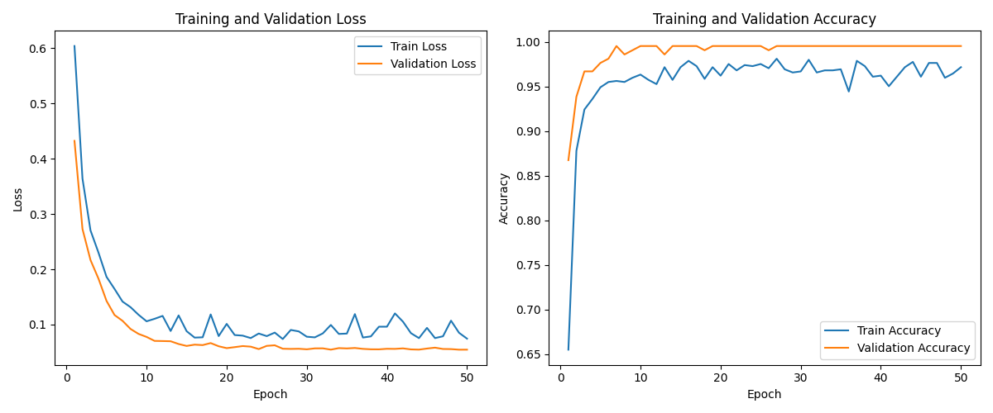
Building a model in Pytorch – train/validate loop
Notes:
Within each epoch the data from the current batch is loaded, loss is calculated, the gradients reset to 0 with zero_grad and then we use PyTorch’s backward function to compute new gradients and step to update the model parameters. With all this information we can return the loss and accuracy to log the progress of training. For validation, we keep the gradients at 0 and do not use the optimizer or backward, we only run the current parameters against the test set and record the loss and accuracy of the results. We see in the plot a nice drop in loss that levels off around 15-20 epochs meaning we probably do not need all 50 and may be overfitting the data.

Slide 13
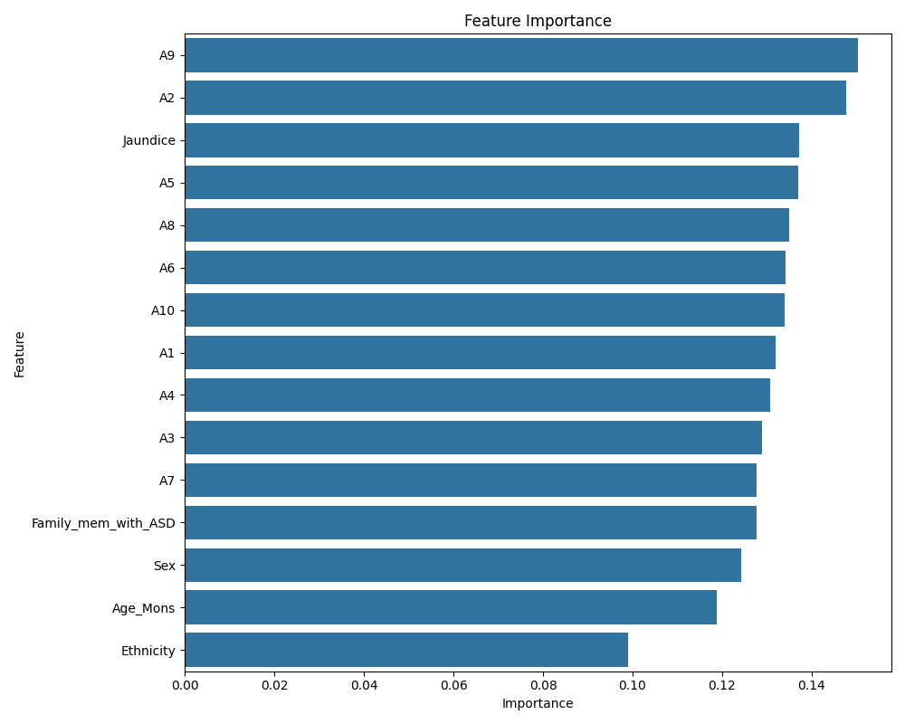
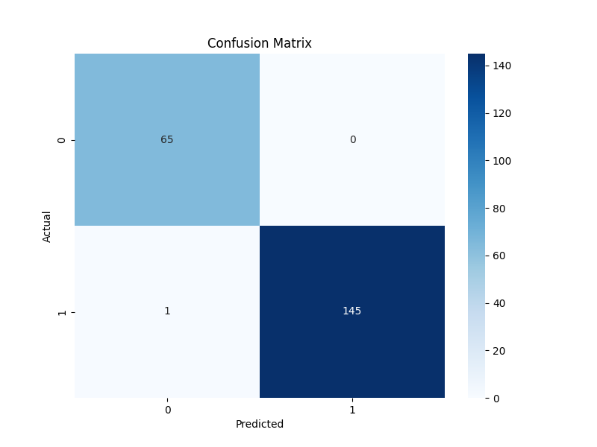
Building a model in Pytorch – Evaluation
Notes:
Now to evaluate the results we use two diagrams: A confusion matrix and feature importance weighting. In our confusion matrix only one example was classified as negative for ASD traits when it should have been positive. While these results may seem strong, they are likely indicative of overfitting and may not represent the true distribution of the data. On the right we have feature importance rankings showing that Question 9 and Question 2 have a big impact on ASD traits while Ethnicity, Age, and Sex have much less.

Slide 14
Conclusions
A9 and A2 are important questions whose answers could be indicative of autism traits while question 3 and 7 may need to be reviewed.
The high accuracy indicates that there is probably overfitting on the data.
The dataset is made up of mainly White and Asian samples, but a larger, more diverse dataset could provide better insight into disparities across ethnicity and gender.
It would be interesting to introduce multi-modal data, such as audio/video interviews of diagnosed and non-diagnosed individuals and incorporate that into an embedding in a more complex network.
PyTorch makes creating Deep Neural Networks simple for toy problems or initial data exploration
Notes:
Some takeaways from this process: As mentioned before A2 and A9 should continue to be examined for their impact in determining ASD Traits. Further analysis could be helpful in building new screening tests with questions that have more value. We should also acknowledge the distribution of the data indicates potential racial and ethnic biases that need to be accounted for, limiting the overall usefulness of the model. Some interesting follow up work could be to introduce multimodal input data like video/audio interviews, additional health information, or any other behavioral data to develop a more complex and reliable way to identify Autism. And lastly, PyTorch (along with Scikit and Pandas) is a fantastic tool to set up deep learning models quickly considering you understand the underlying ML/DL concepts. Utilities like Datasets and DataLoaders, backward, and zero_grad, make the process defining and training networks fast and reproducible.

Slide 15
references
[1] Diagnostic and Statistical Manual of Mental Disorders (5th ed.). American Psychiatric Association. 2013. p. 31.
[2] https://my.clevelandclinic.org/health/articles/autism

