Slide 1
ML/DL Tutorial
AI in HealthCare

Slide 2
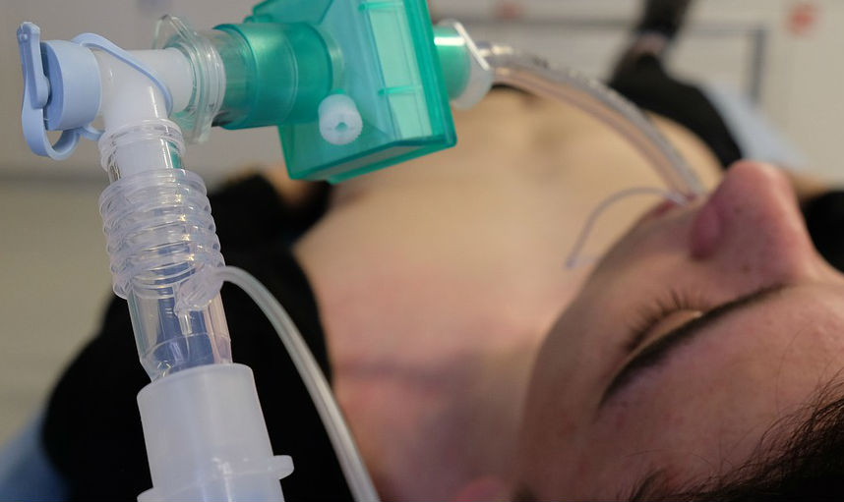
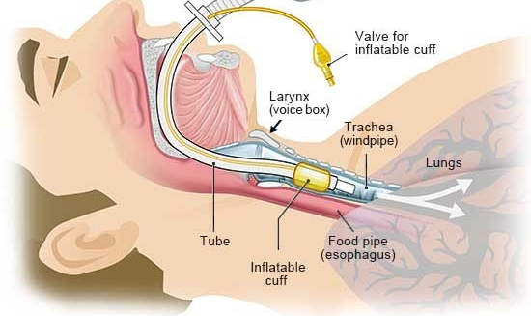
Breathing tubes
ICD9 code 96.04 refers to the Insertion of endotracheal tube
In emergency situations such as respiratory failure, a patient might not be able to breath on their own and requires this procedure.
Breathing tubes are used in surgeries when a patient is under Anesthesia and cannot breathe on their own.
Can we use MIMIC data to predict a patient's need for the procedure? There are 10,000+ procedure codes for 96.04 in MIMIC III

Slide 3
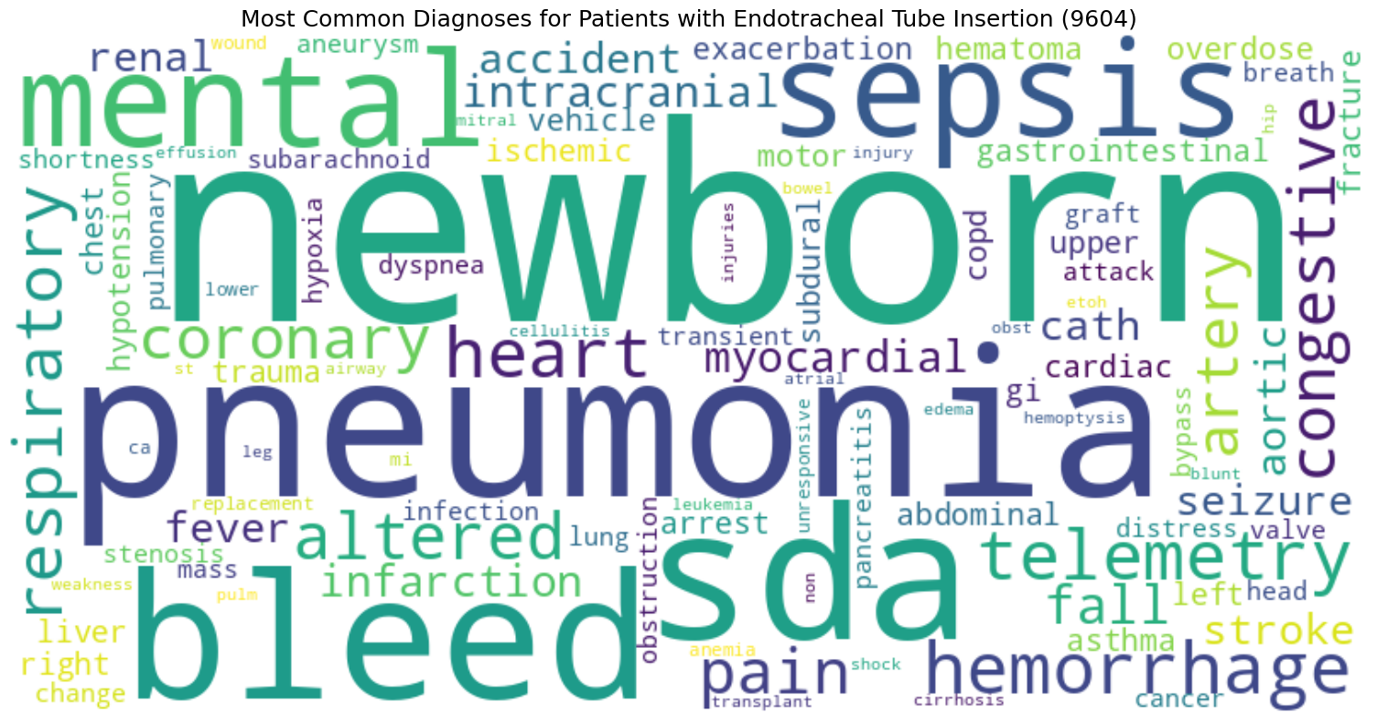
Features from Mimic Tables
ADMISSIONS provides features specific to the patient’s diagnosis, insurance, ethnicity, admission type and admission location.
With PATIENTS columns we can determine the patient’s age and gender
PROCEDURES provides the target column, breathing_tube_inserted, which is determined by seeing if the patient had a 96.04 procedure.

Slide 4
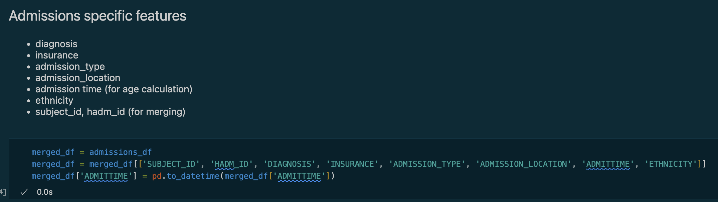
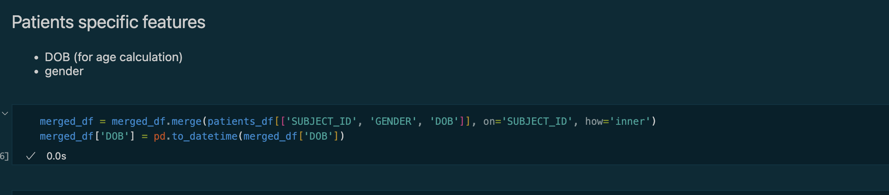
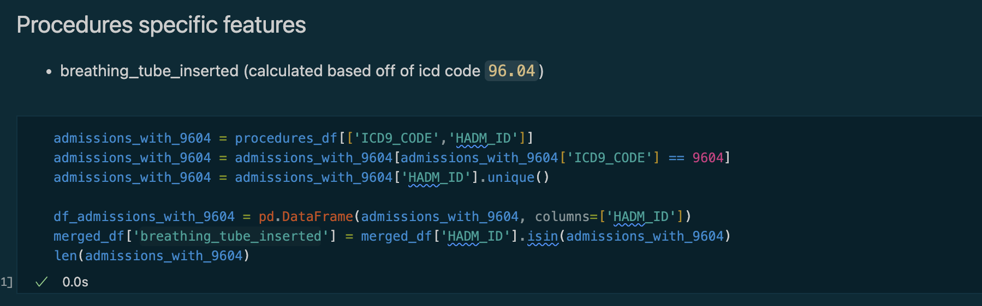
Features from Mimic Tables (code)

Slide 5
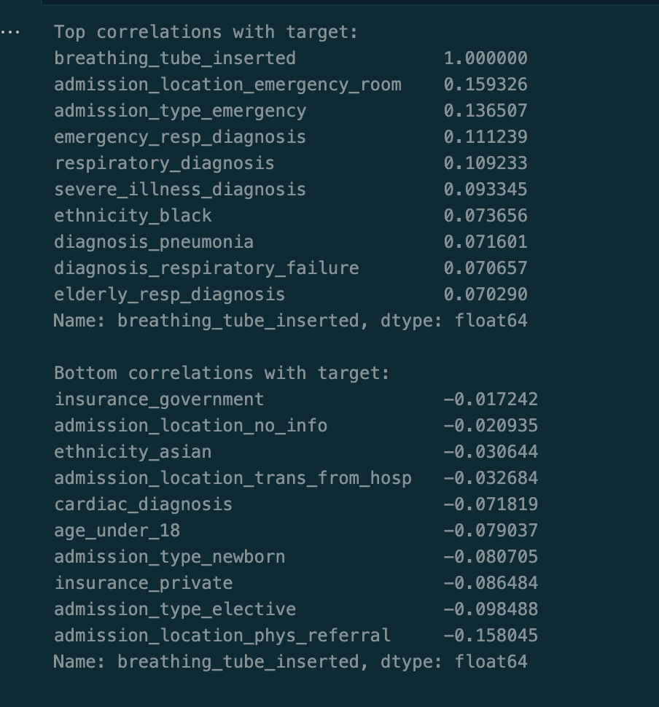
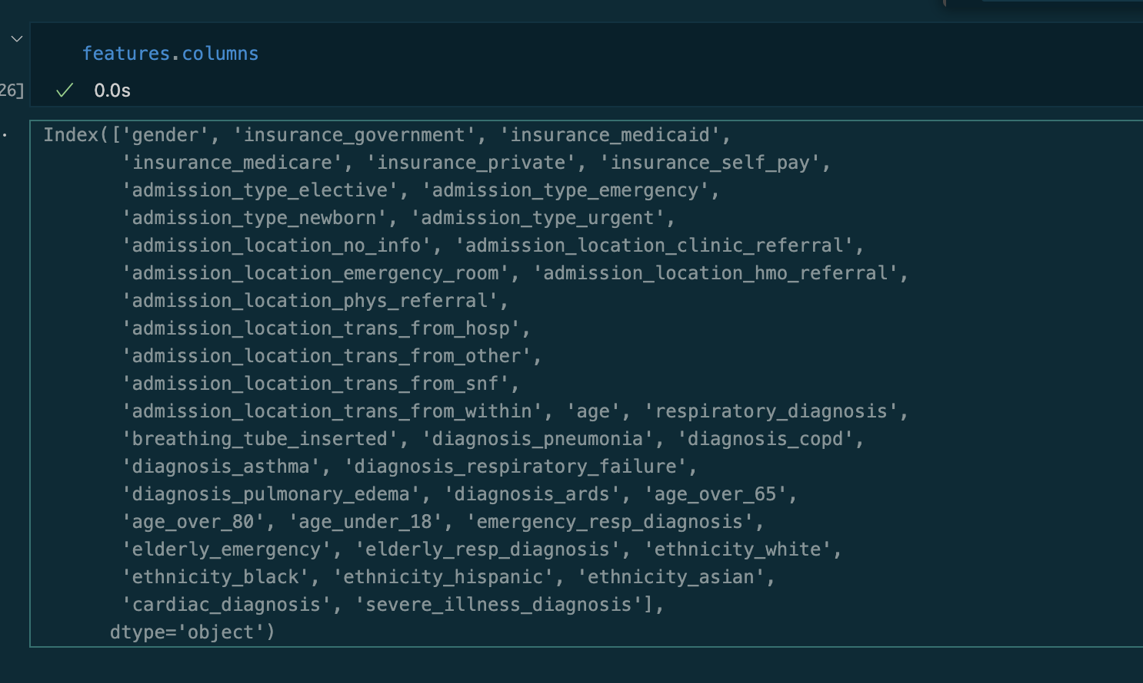
Feature Engineering
Beyond raw feature data, other combined and calculated columns could be relevant:
Age thresholds, ex. age_over_65
Diagnosis for specific conditions, ex. diagnosis_pneumonia
Age + Diagnosis features, ex. elderly_emergency
Broader ethnic groups, ex. ethinicity_asian
Combinations of diagnosis, ex severe_illness_diagnosis, respiratory_diagnosis

Slide 6
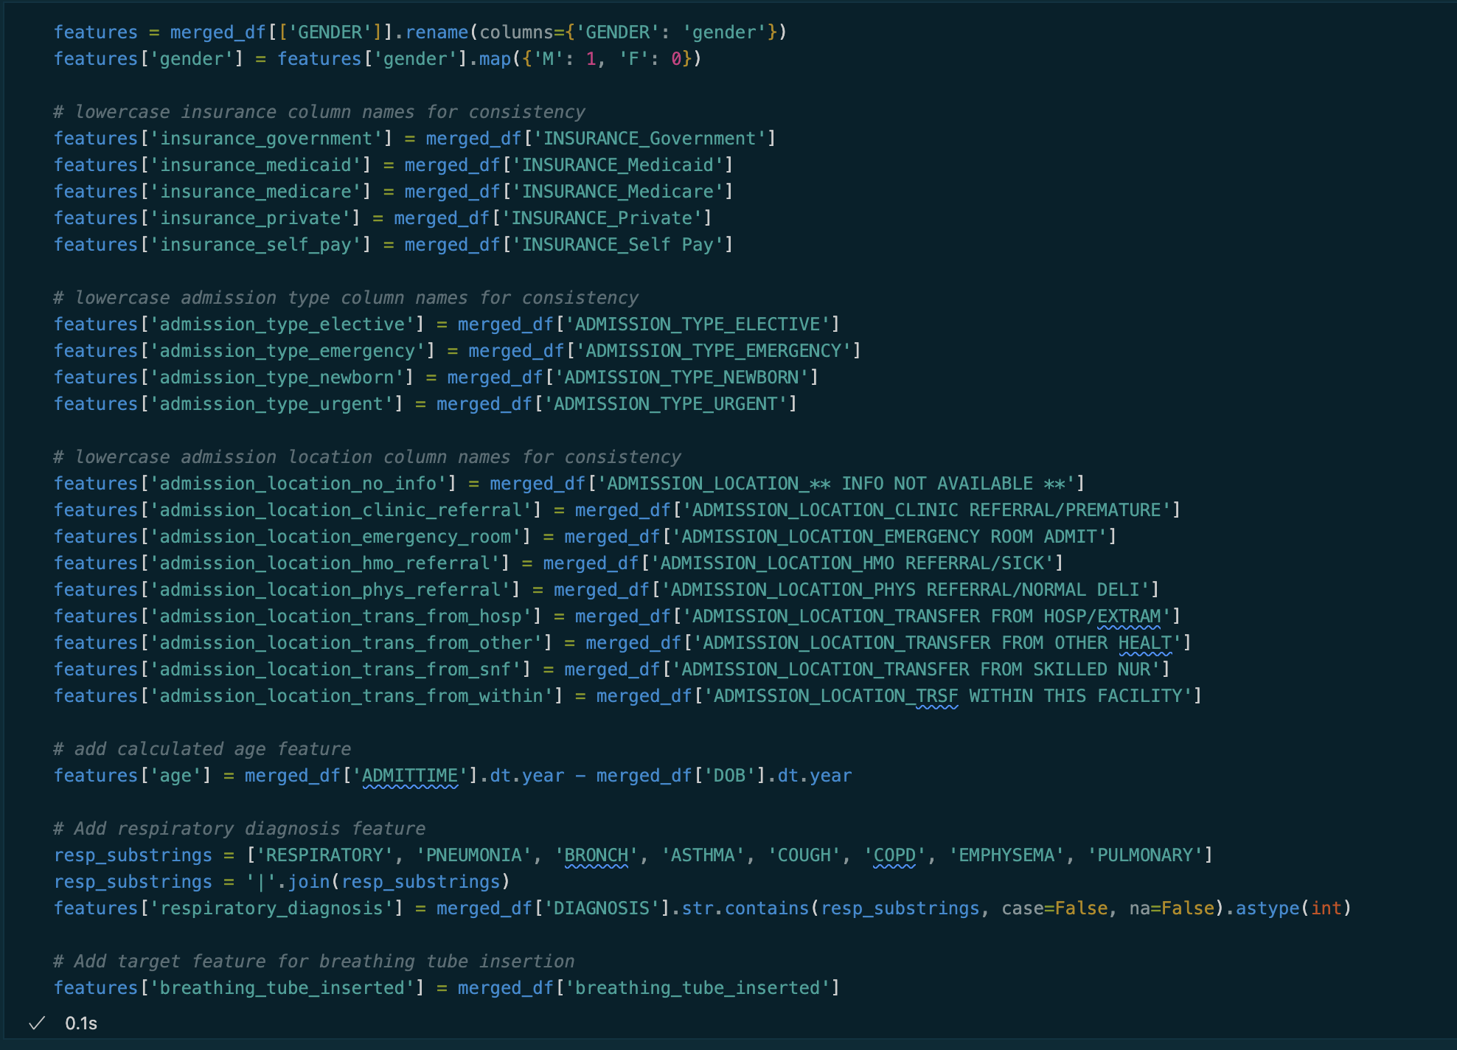
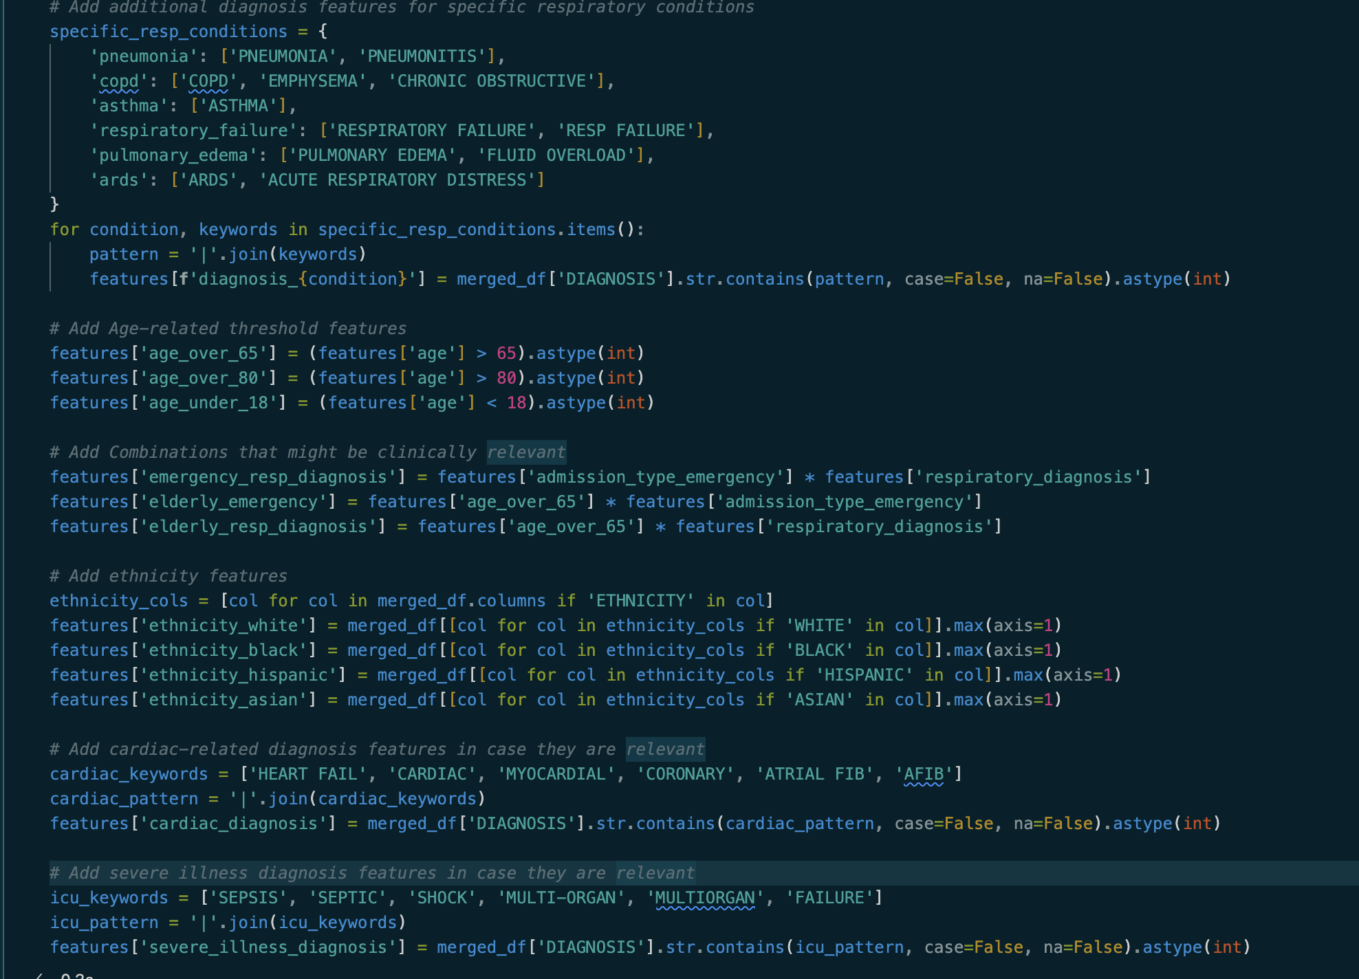
Feature engineering (code)

Slide 7
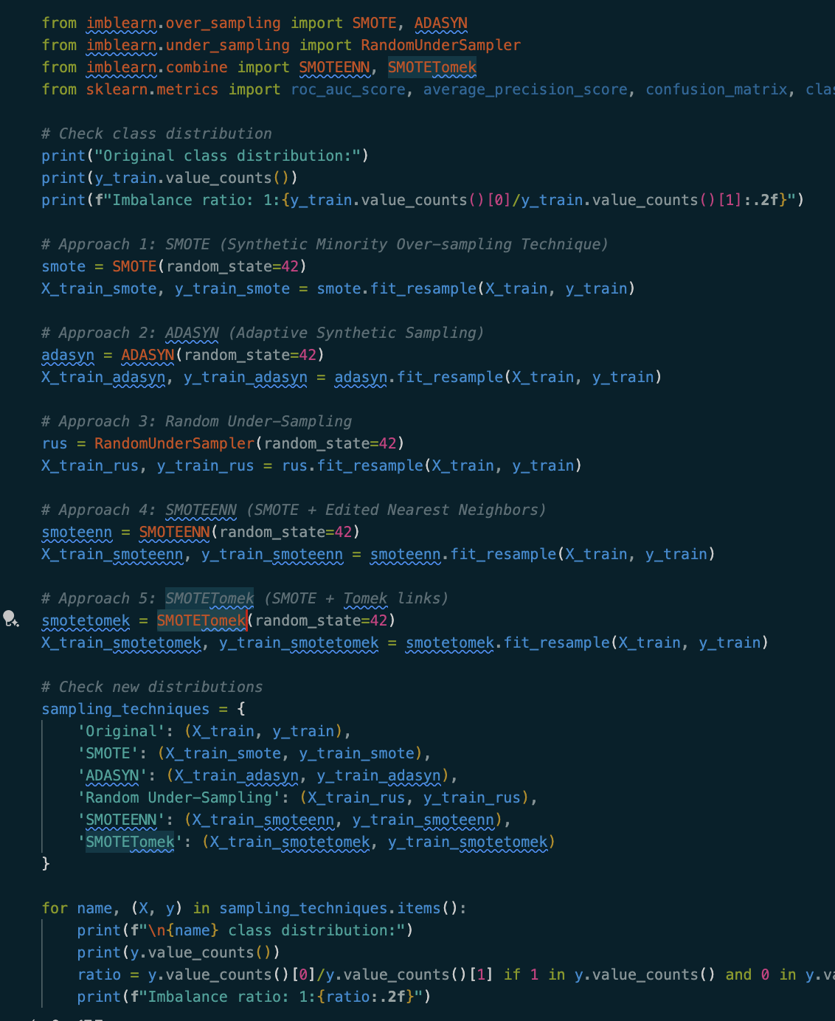
Addressing the Class Imbalance
MIMIC III contains 9,882 admissions that involved a breathing tube insertion procedure
The remaining 49,094 admissions did not involve breathing tube insertion
A nearly 1:5 ratio, something that must be addressed in the data
Different sampling techniques can be applied to address this imbalance such as: SMOTE, ADASYN, Random Undersampling, SMOTEENN, or SMOTETomek
Imblearn provides various utilities to make these techniques simple to apply as seen in the code.

Slide 8
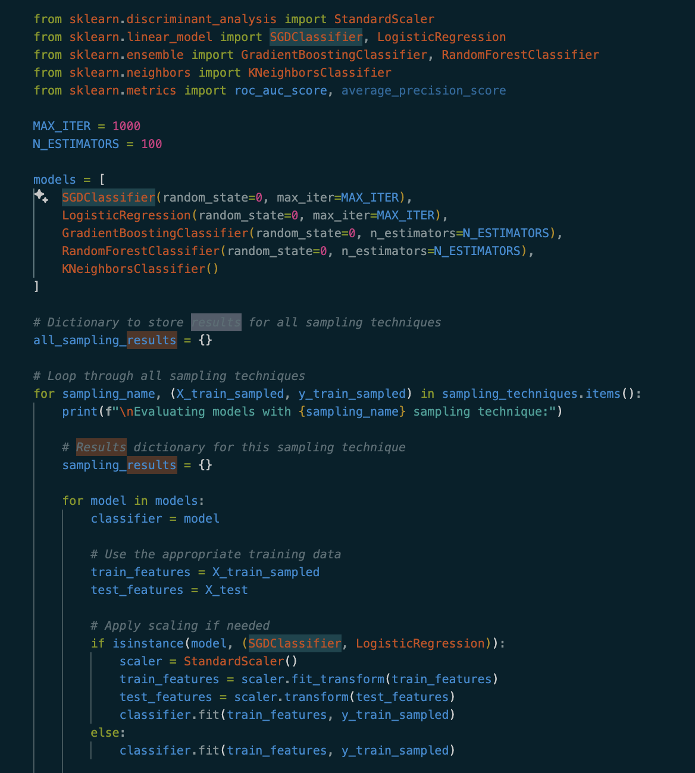
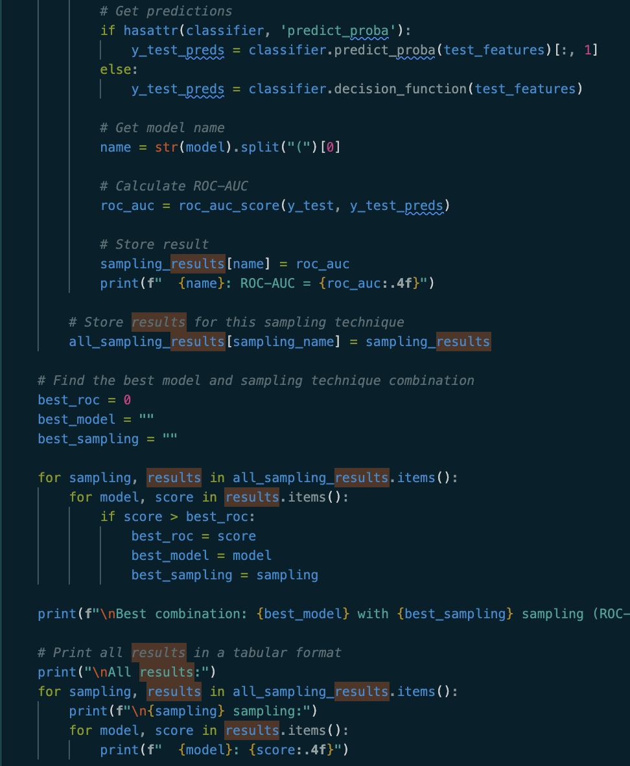
Model Training
With train/test splits for each sampling approach, we can compare the results of the sampling + ML model combinations
From Scikit Learn SGDClassifier, LogisticRegression, GradientBoostingClassifier, RandomForestClassifier, and KNeighborsClassifier were used in training

Slide 9
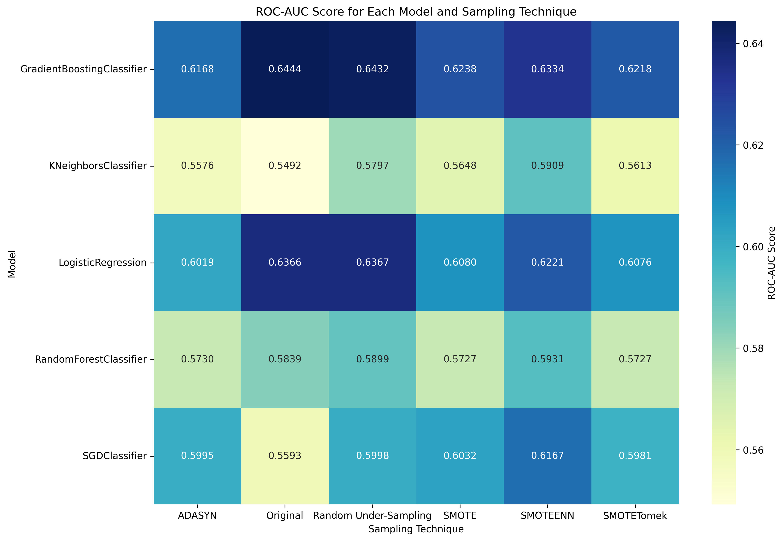
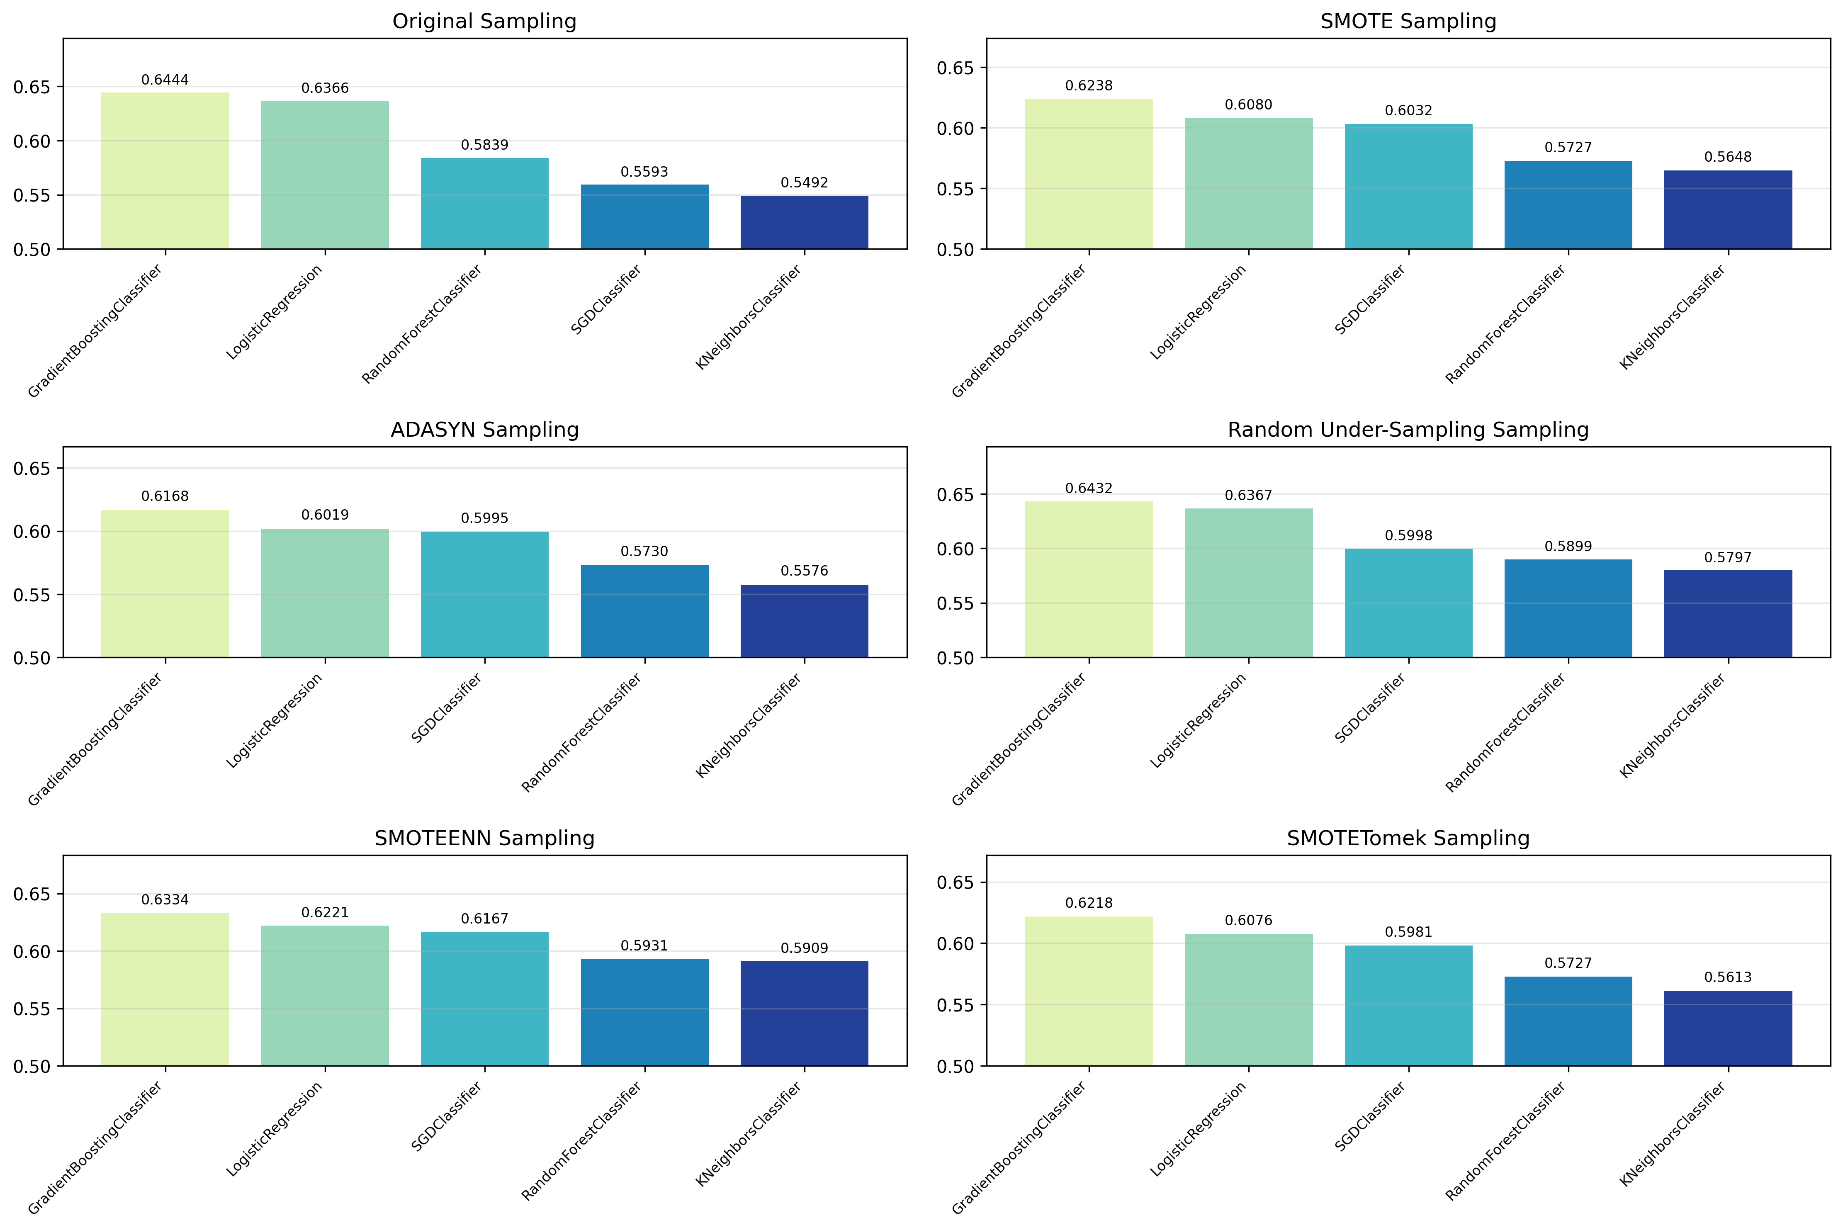
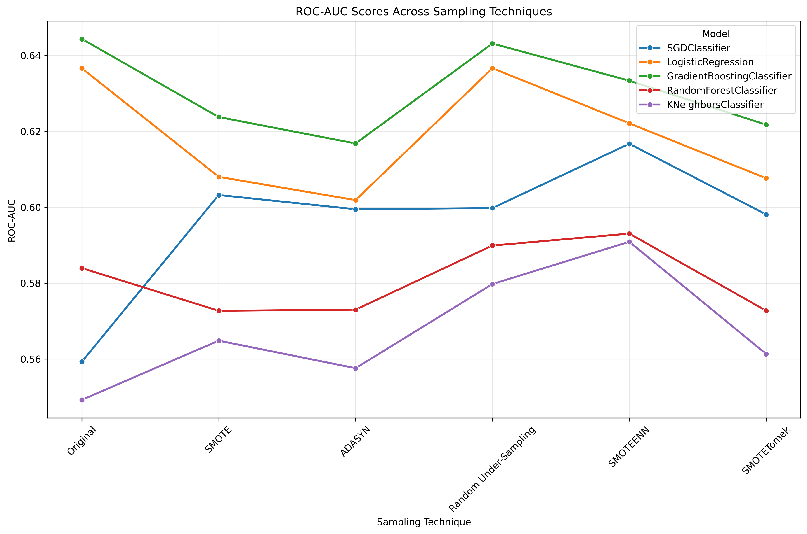
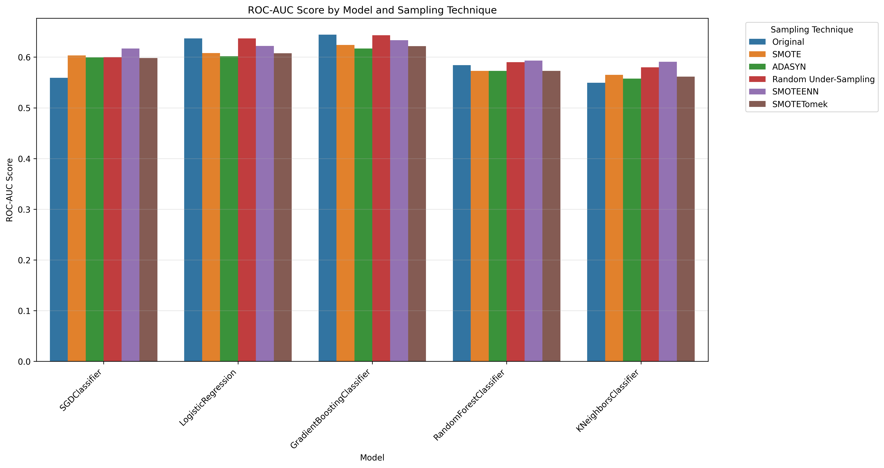
Model Evaluation (Plots)
The plots on the right show the sampling + model test set results
Gradient boost with the original sampling had the best results at 0.6444 ROC-AUC
AUC is the area under the ROC curve, which summarizes the model’s ability to distinguish between positive and negative classes.
Ideally, we want an AUC close to 1 but results from 80-90 are considered strong

Slide 10
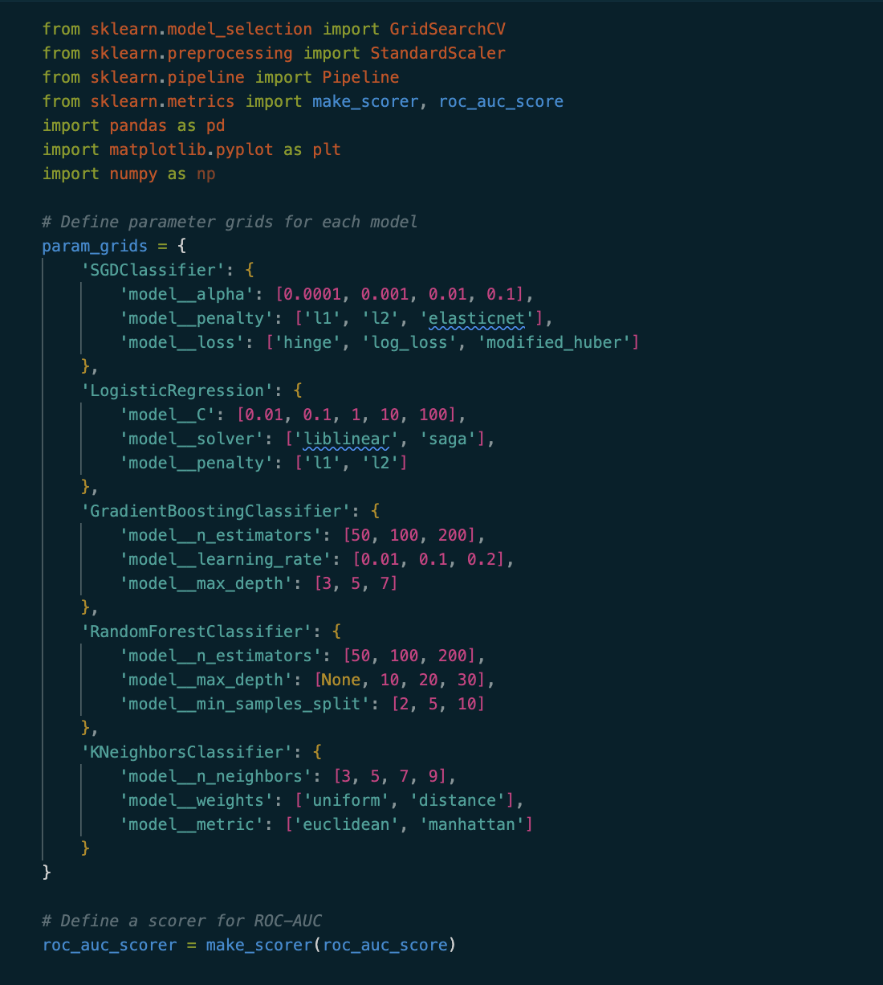
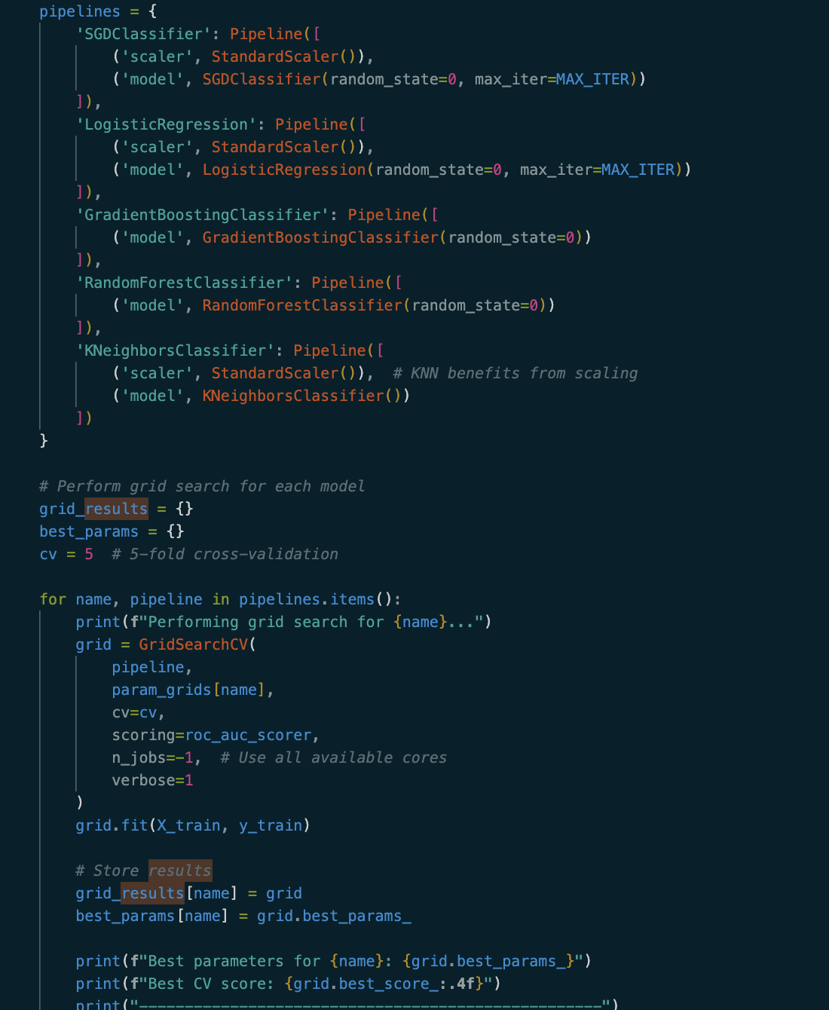
HyperParam tuning
Using scikit GridSearchCV a variety of hyperparams were tried with different models
The models all used the original sampling method since it had the highest roc-auc
Overall results did not show much improvement over default hyperparams for the models.

Slide 11
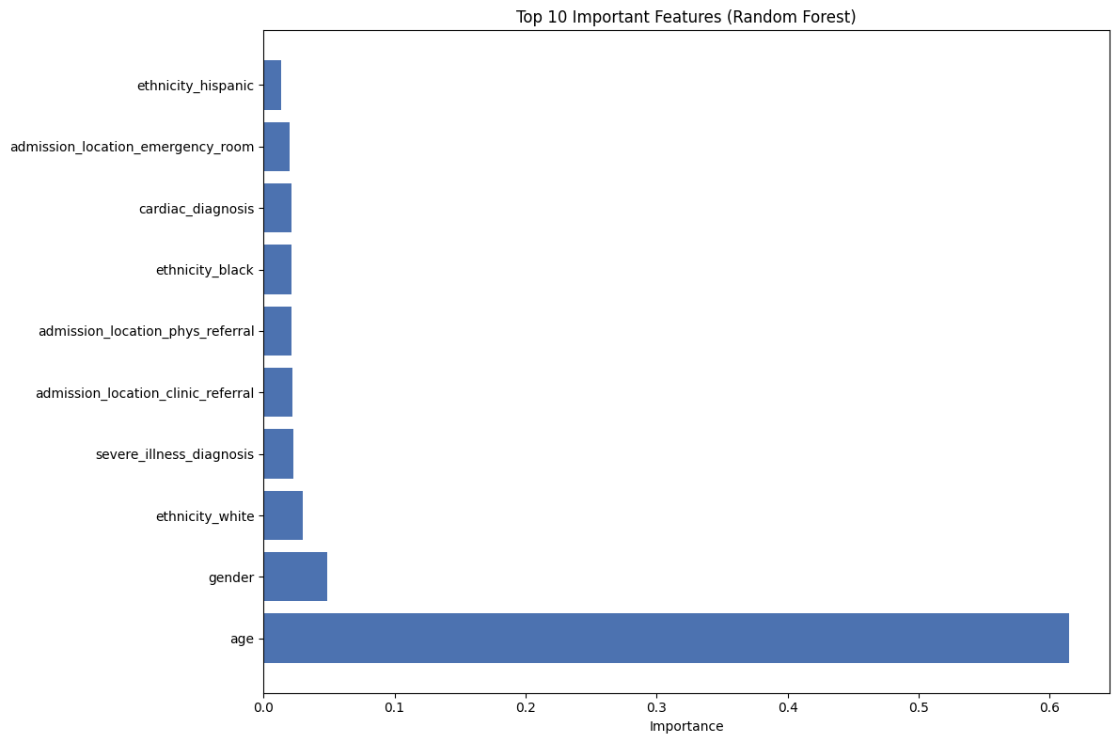
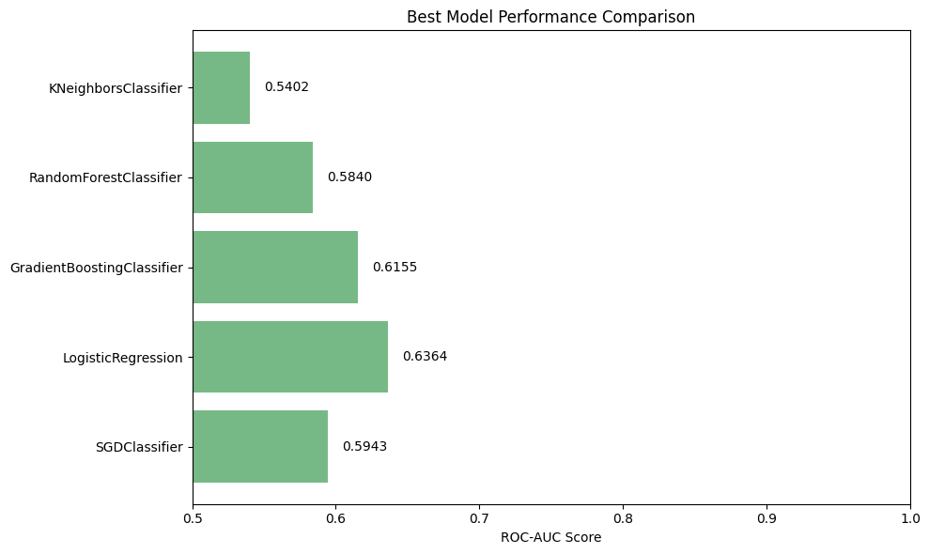
Hyperparam tuning (plots)

Slide 12
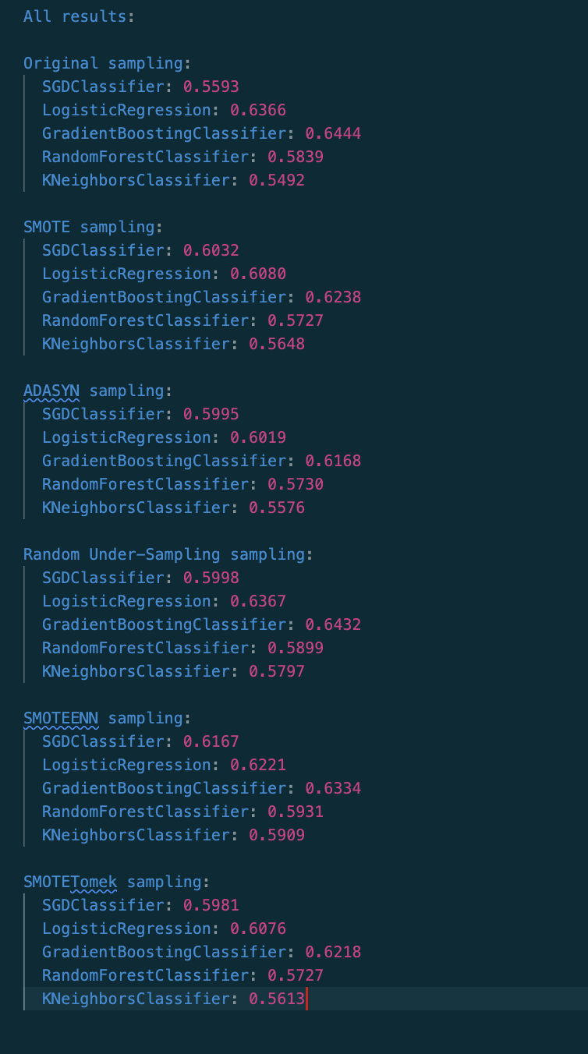
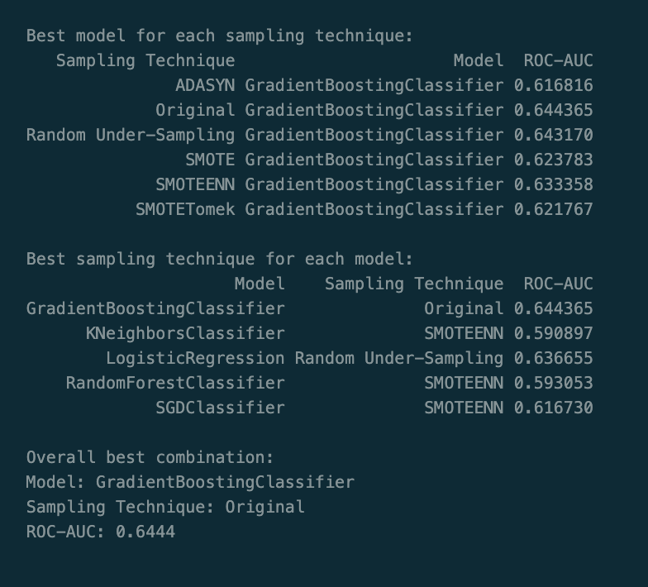
Conclusions
ROC-AUC results are only slightly better than random chance (0.5)
Additional features could be engineered to possibly enhance results using aggregated charts data or even named entities from notes
With an accurate model a hospital could more efficiently allocate staff or item resources to prepare ahead for patients that might need such a serious procedure or even transfer them.

