Slide 1

ED Fast-Track Prediction
AI in Healthcare - High Risk Project
Notes:
I chose to cover ED fast-track predicition for high risk project

Slide 2
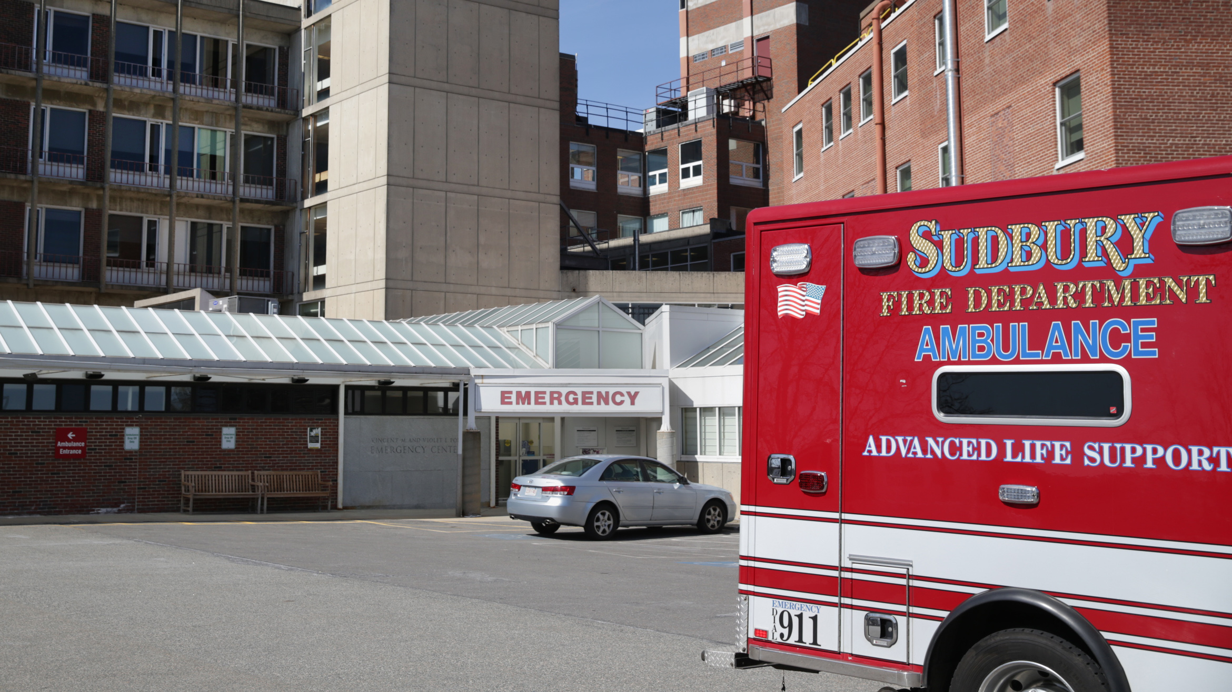
Hospital Emergency Department (ED)
Patients can arrive without appointments for 24/7 care
Conditions can range from non-urgent to critical
Wait times depend on factors like occupancy, staff, and resources available
Notes:
- dept of hospital staffed by doctors, nurses, techs
- Ambulances bring in new patients

Slide 3
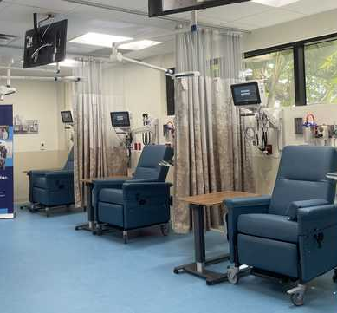
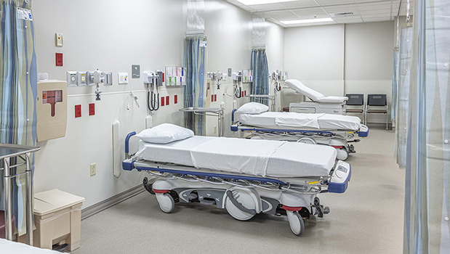
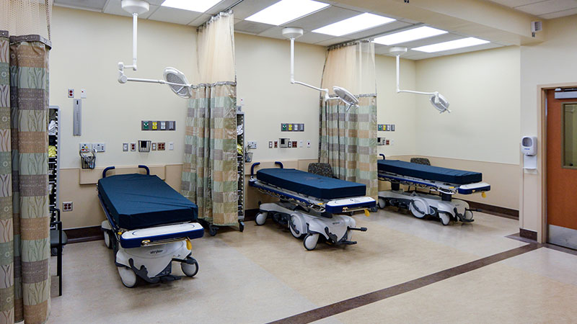
Fast-Track Area (FT)
Specific to low-acuity patients to get them in and out of the ED quickly
Beneficial for waiting room occupancy, patient satisfaction, and length of stay for all patients
Notes:
- Subsection of ED dedicated to lower acuity patients, ex sprains/fractures, lacerations, sore throats, rashes, insect bites
- The patients come in with minor issues increase occupancy and leads to longer LOS for all patients, lower satisfaction, higher wait times
- want to maximize patient flow!

Slide 4
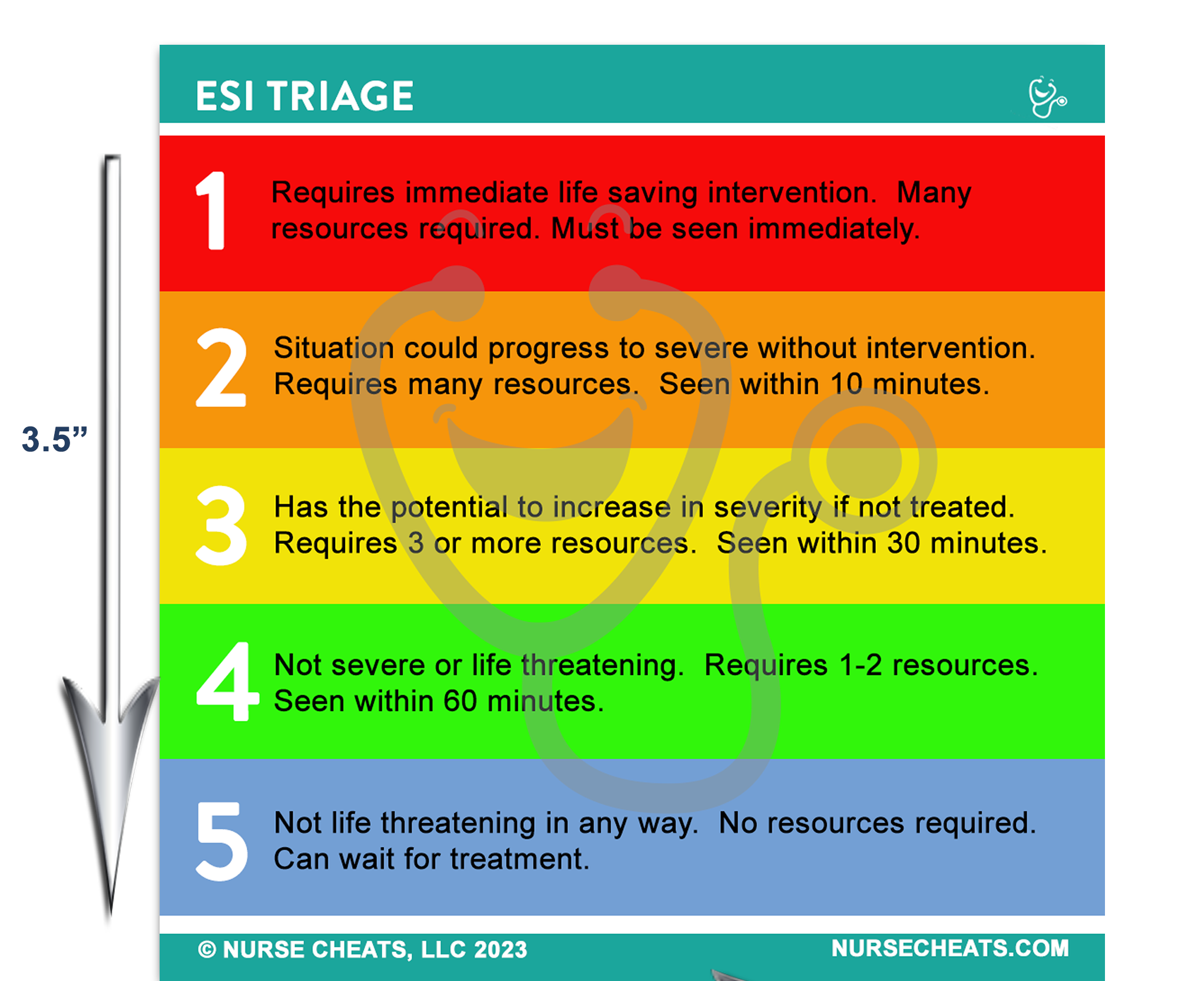

How can ML and ED Multi-Modal Data Aid Triage staff in making fast-track decisions?
Notes:
- my research question
- My fast-track criteria (based on FT papers) was 4 or 5 ESI score or 3 with a LOS less than 1 hour

Slide 5


MC-MED Dataset
Published on PhysioNet March 3, 2025
Multi-modal ED data from Stanford Adult ED from 2020-2022
Pre-defined train, validation, and test splits that keep patients consistent
Notes:
- Real de-identified Multi-modal ED data from Stanford Adult Ed from 2020-2022
- During height of covid
- covers information like demographics, triage vitals, acuity, pmh, home meds, labs, time series vitals, and waveform data
- What did I use?

Slide 6
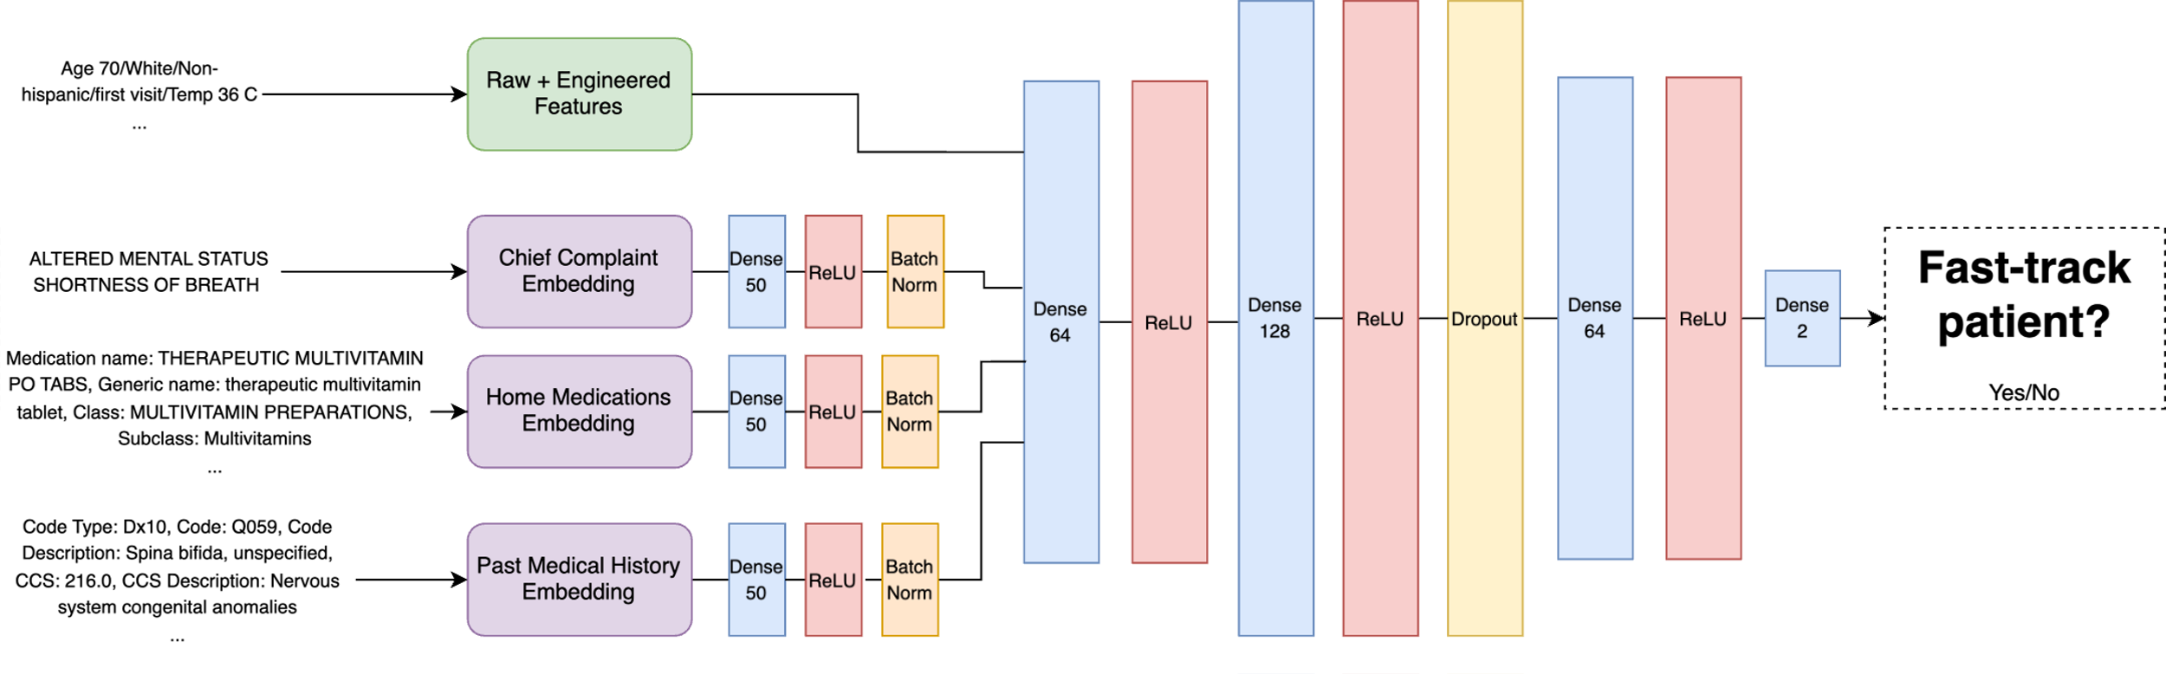
Fast-Track Eligibility Prediction
Notes:
- Binary classifier model combining unstructured text and tabular numerical data from MC-MED
-BioClinicalBERT, PubMedBERT, BlueBERT, and a standard BERT base used for embeddings.

Slide 7
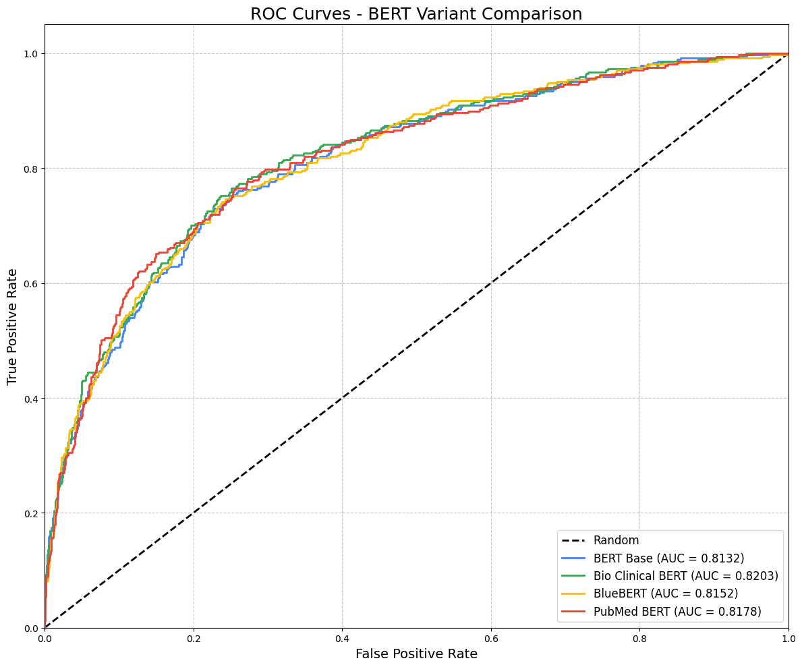
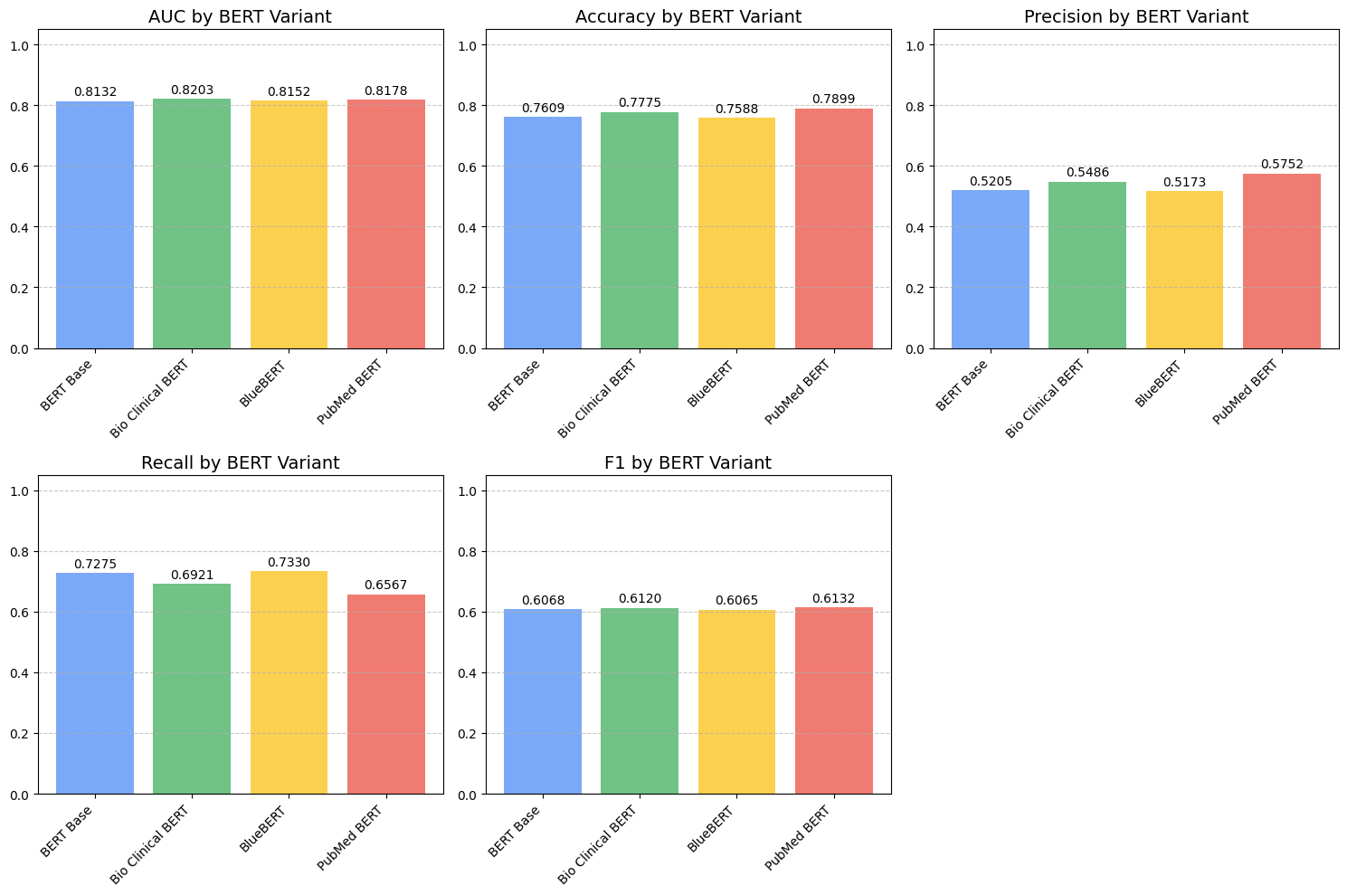
Results – ROC-AUC
Notes:
- 0.82 ROC-AUC for the highest performing BERT (BioClinical BERT)
- PubMed BERT also led in Accuracy, Precision, and F1

Slide 8
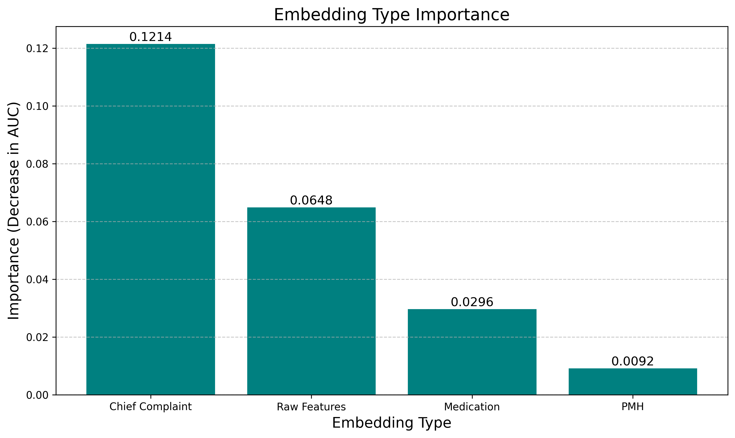
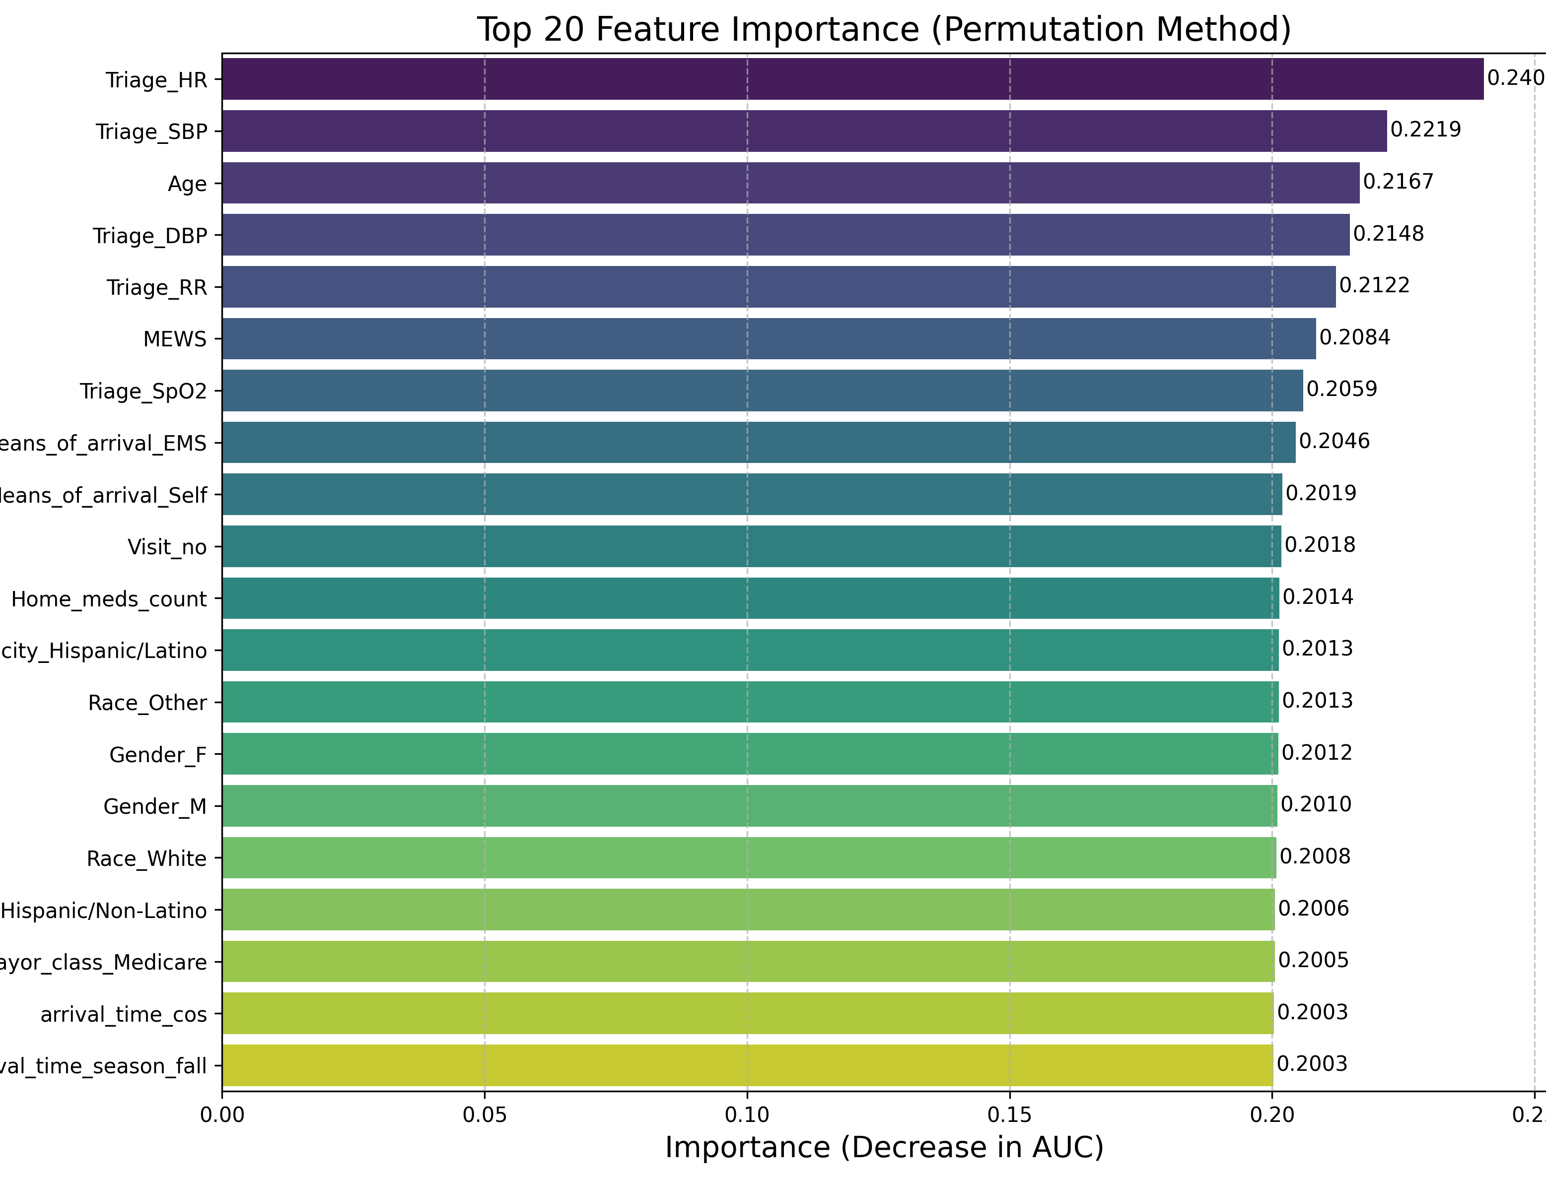
Results – Feature Importance
Notes:
- Chief Complaint was the most important feature across modalities
- Triage Vitals, age, and MEWs Score were the most important tabular features

Slide 9
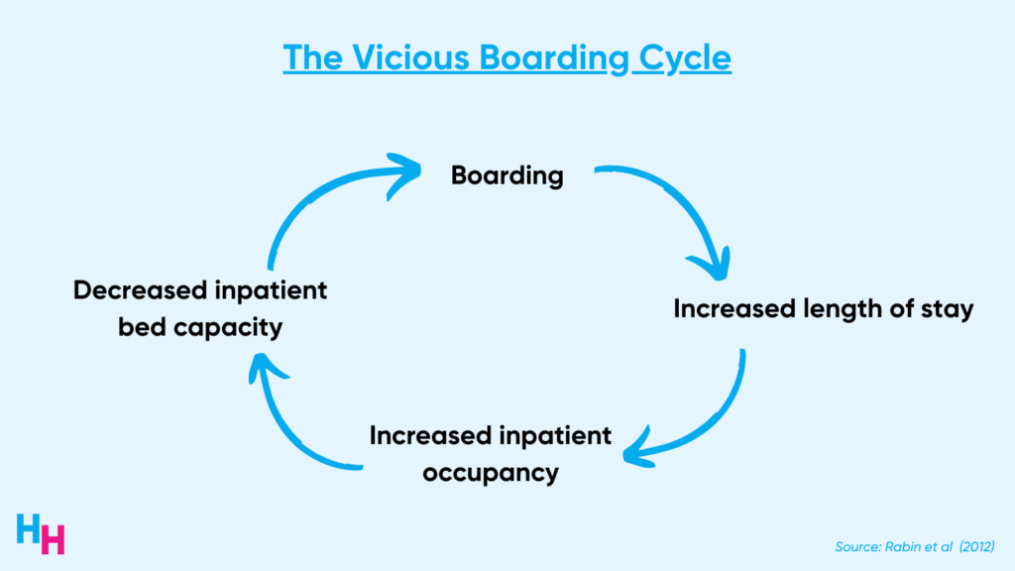
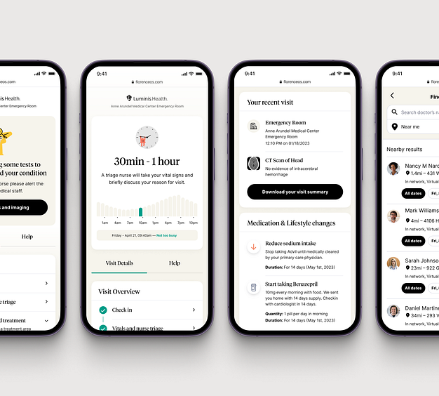
Future Directions
Train a model with additional modalities (ex. audio or images)
More research into different fast-track criteria
Larger max token limit for BERT embeddings
Notes:
- Would be interesting to build FE where the vitals and text could be collected
- Add additional modalities like audio or video to increase the context of the patients condition
- Run with a higher token limit for BERT since some pmh and home meds had to be excluded
- Look at hospital FT criteria for ground truth, not part of MC-MED and hard to find!

