Slide 1
LLM Tutorial
AI in Healthcare

Slide 2
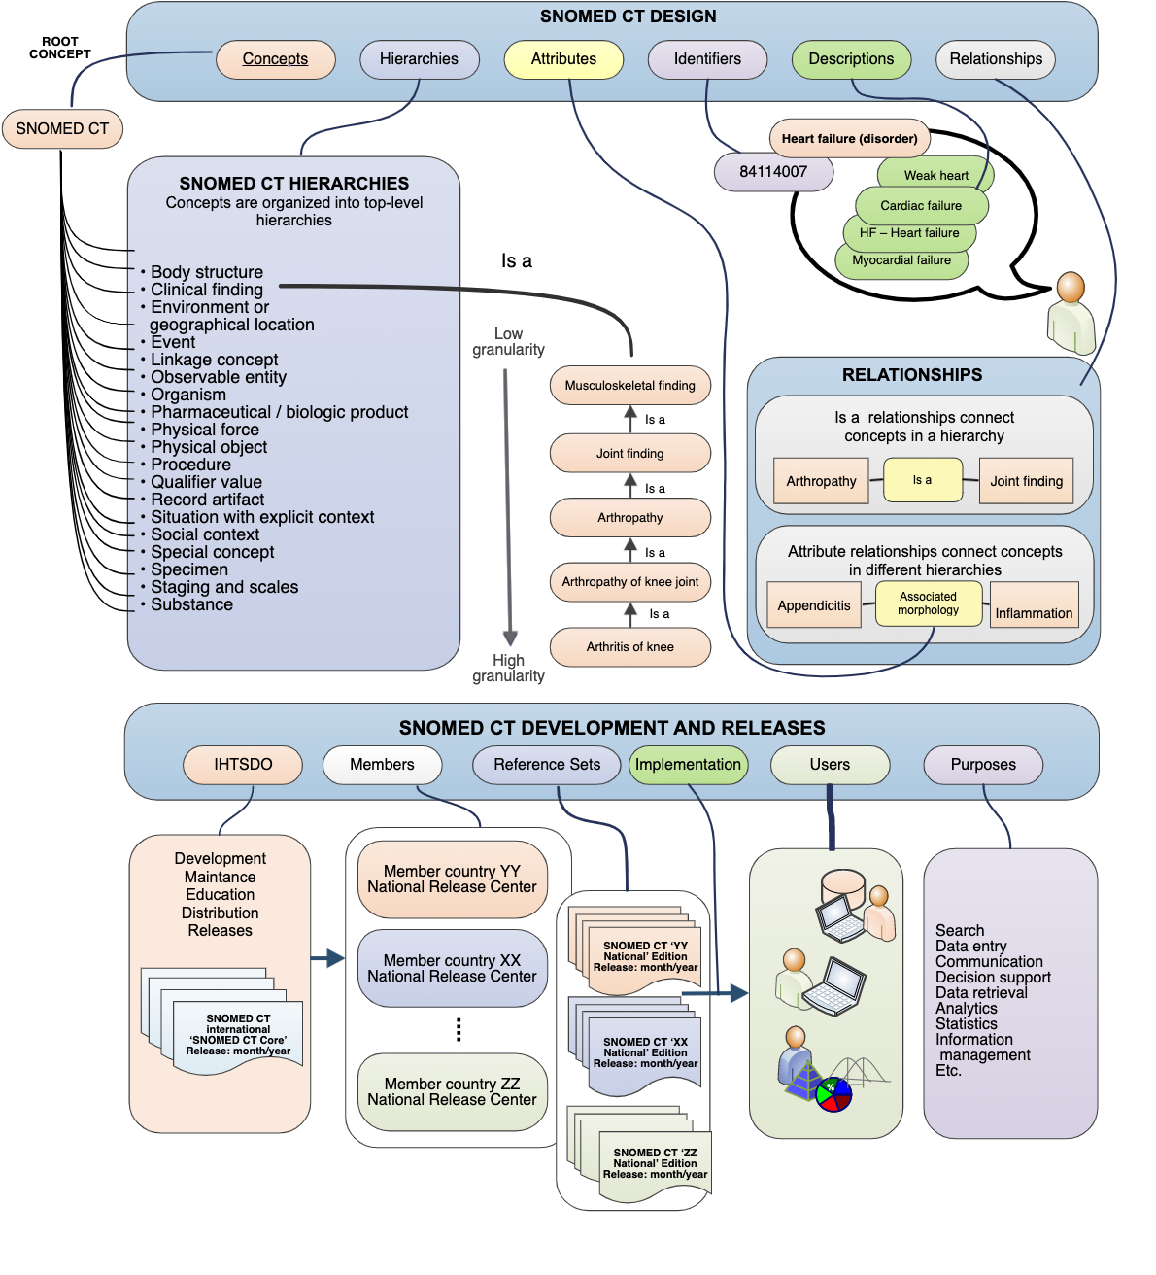
Problem: Inferring SNOMED Procedure codes
SNOMED offers a way for medical staff to code several medical concepts in a precise way, including diseases, symptoms, procedures, etc.
What if we could figure out the SNOMED procedure coding based on conditions or diagnoses associated with a patient?
An LLM could be take in various patient data and infer potential procedures that could be useful for physicians to consider, or the patient to expect.

Slide 3


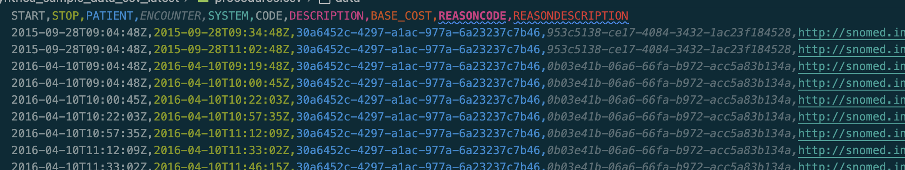
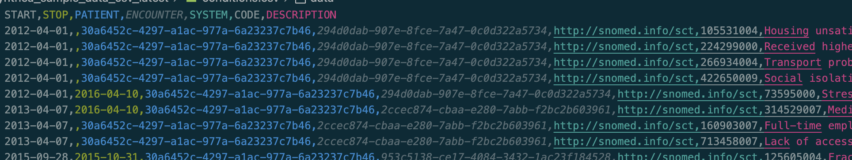
Dataset
The MIMIC III notesevents table provides several free text discharge summaries great for this task but data cannot be shared.
Synthea by MITRE instead provides some synthetic patient data such as conditions, and procedures that we can use for similar in-context learning as we would with MIMIC notes
I used the Synthea conditions and procedures csv files to prompt a model to infer the top 5-10 potential SNOMED procedures for a visit given the conditions.

Slide 4
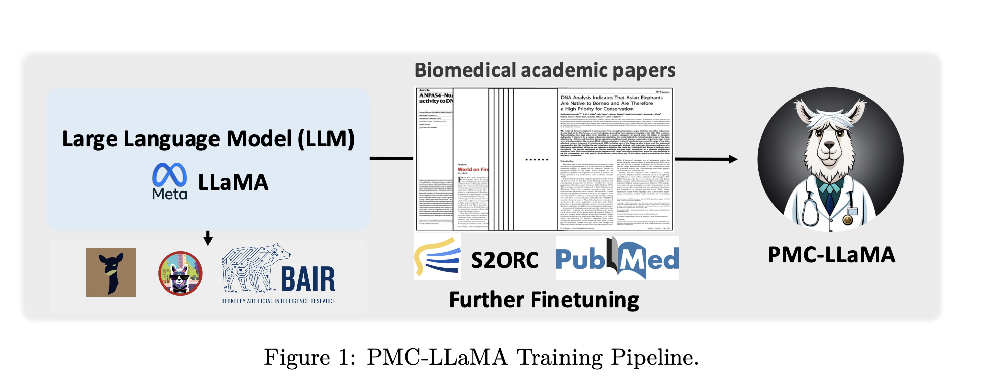
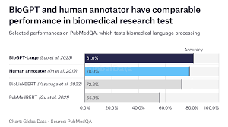

llm approach
Initially I used PMC Llama 13B, but the model size and inference times were too much for Colab
Smaller 1B parameter models such as BioGPT were faster but did not have nearly as much knowledge leading to weaker output
OpenAI’s 4o-mini had much faster inference, lower cost, and provided strong answers for my prompts, so this model was used

Slide 5
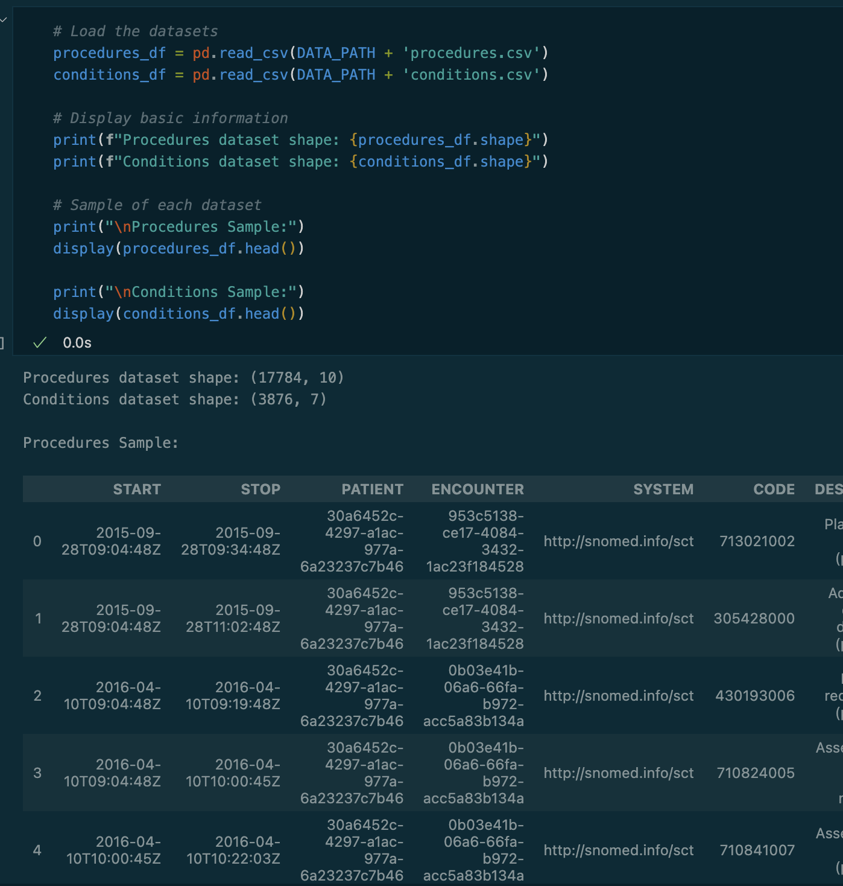
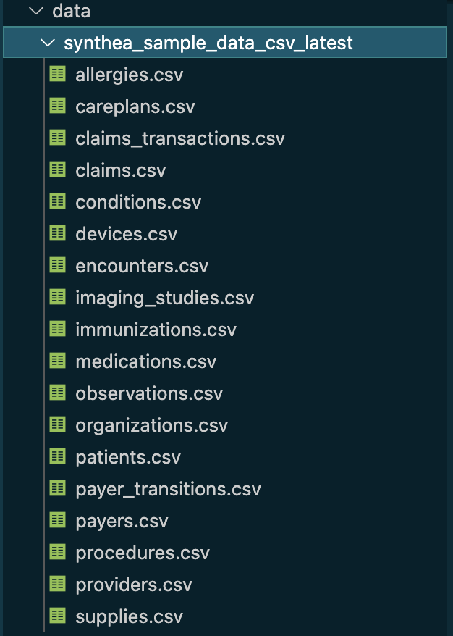
Synthea Data analysis
Synthea data is provided as multiple csv files, however only conditions and procedures are relevant for this problem
We can see there are 17,000+ procedures and nearly 4,000 conditions but there could be multiple rows per encounter
Procedures gives us the SNOMED code as well as the description which will be important for the model

Slide 6
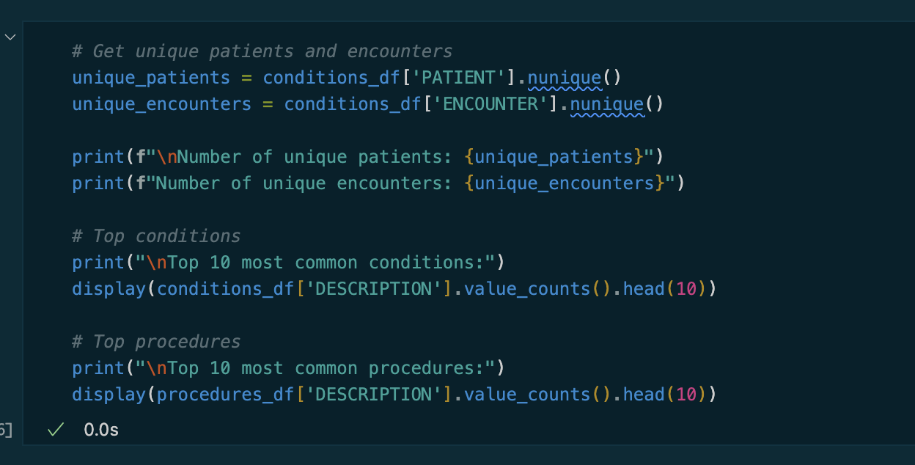
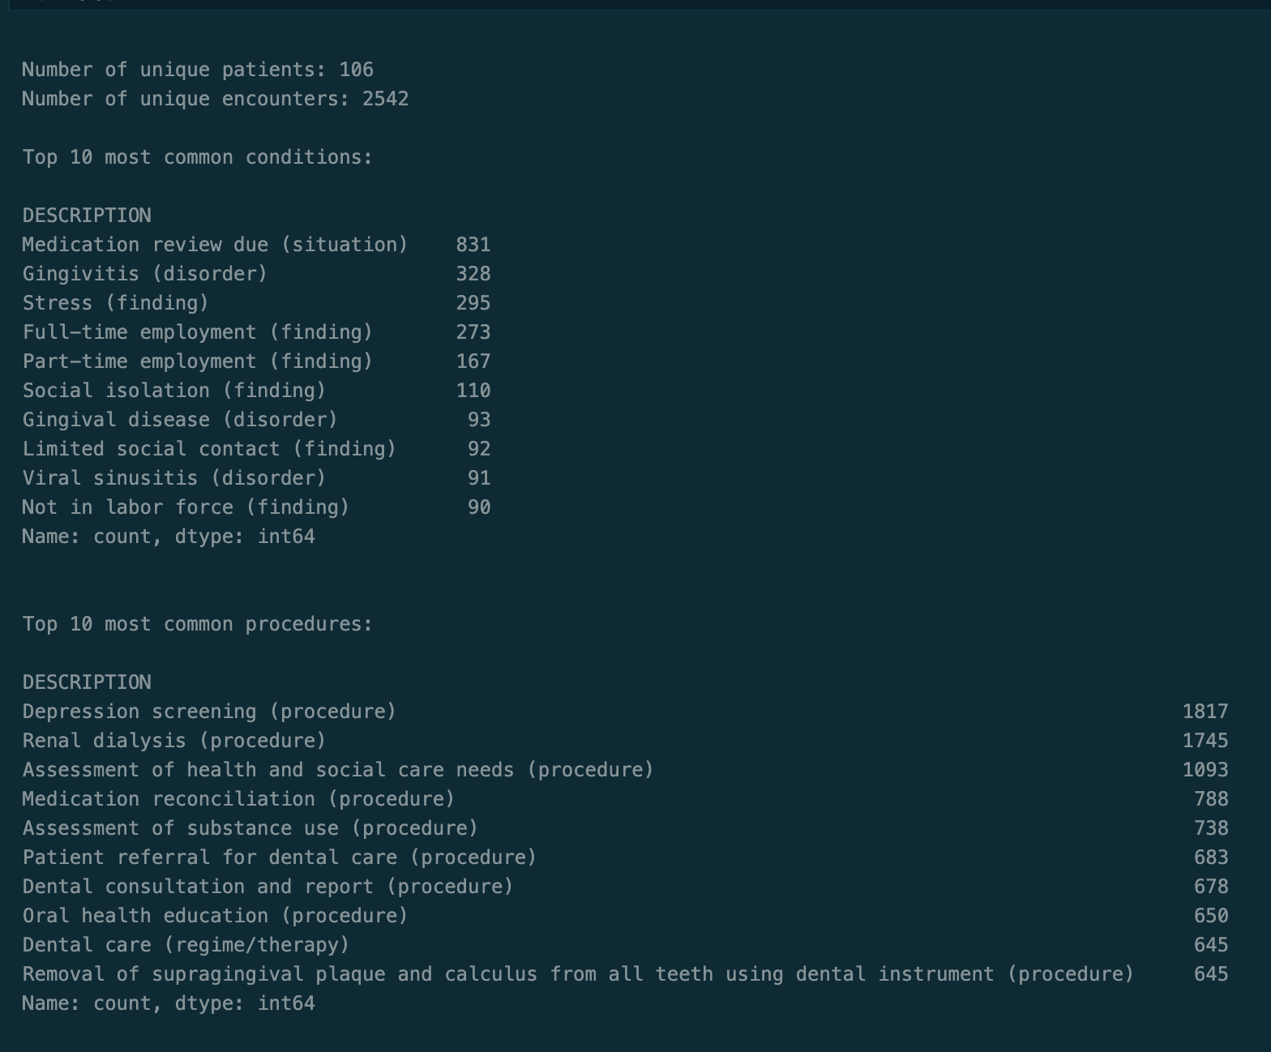
Synthea data analysis (cont.)
If we group the conditions by patients and encounters we see that there only around 100 unique patients and 2.5k encounters
Ordering conditions shows that the data contain many Medication review due, Gingivitis, and Stress
Ordering procedures shows frequent Depression Screening, Renal Dialysis, and Assessment of health and social care needs

Slide 7
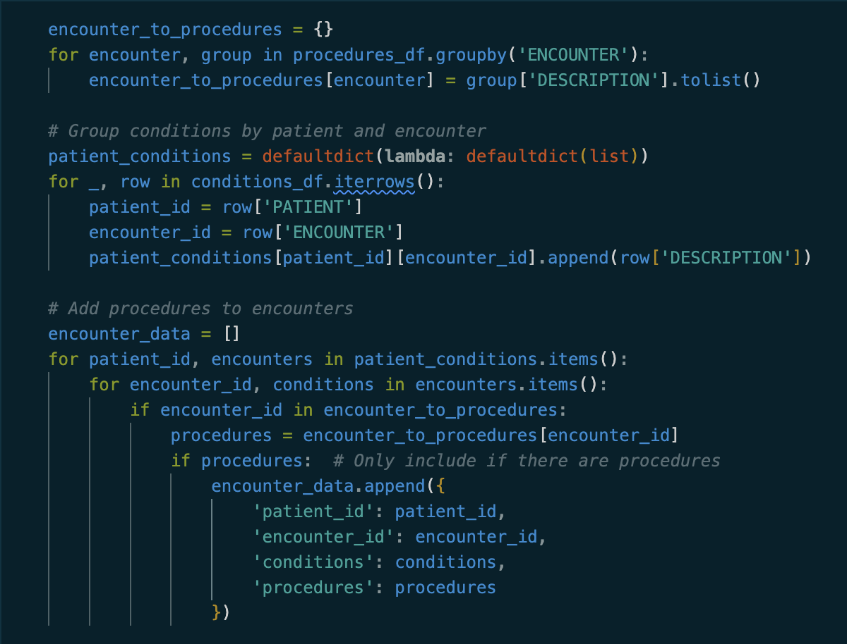
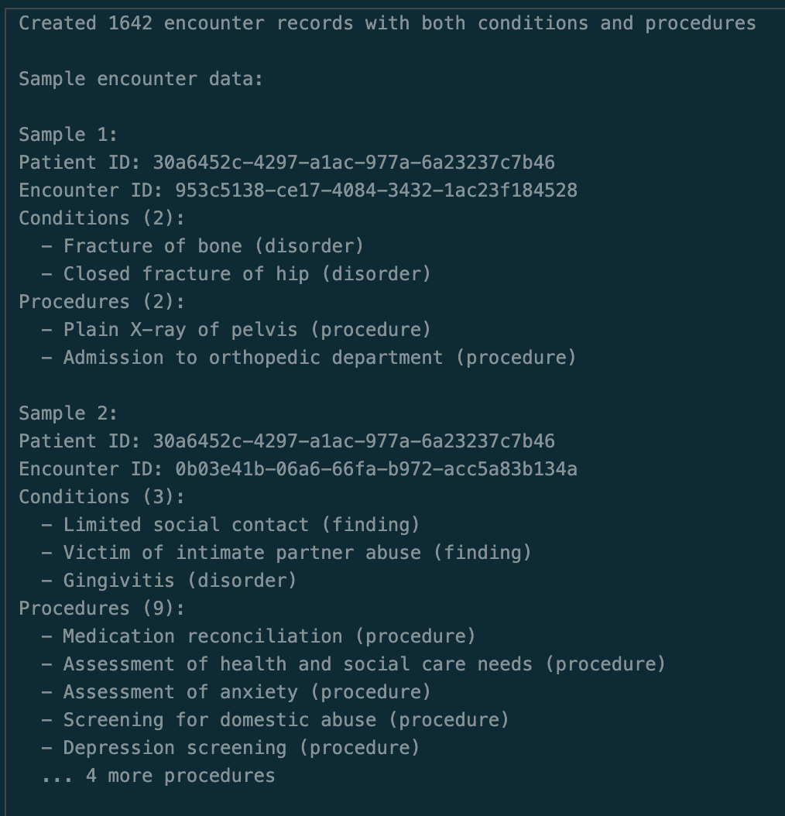
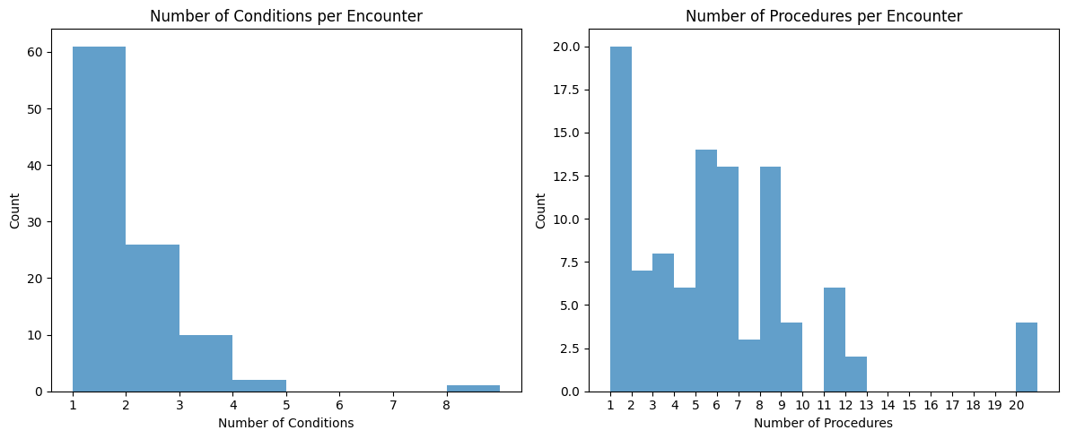
Data transformation
For prompting and evaluation, unique encounters must be mapped to their associated conditions and procedures
Ex. One encounter can have many conditions and many procedures, all of which provide context for the LLM prediction
Based on the plot, there are typically 1-2 conditions per encounter whereas the number procedures varies quite a bit.

Slide 8
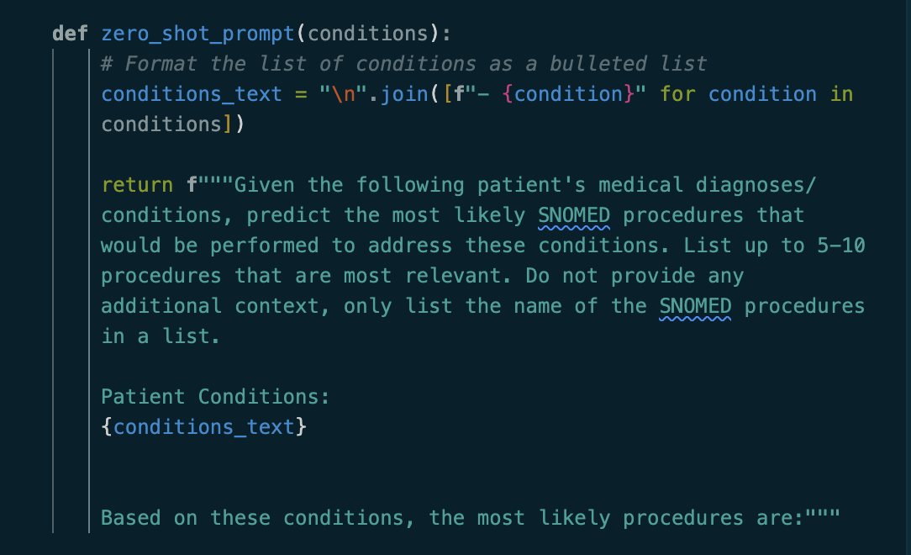
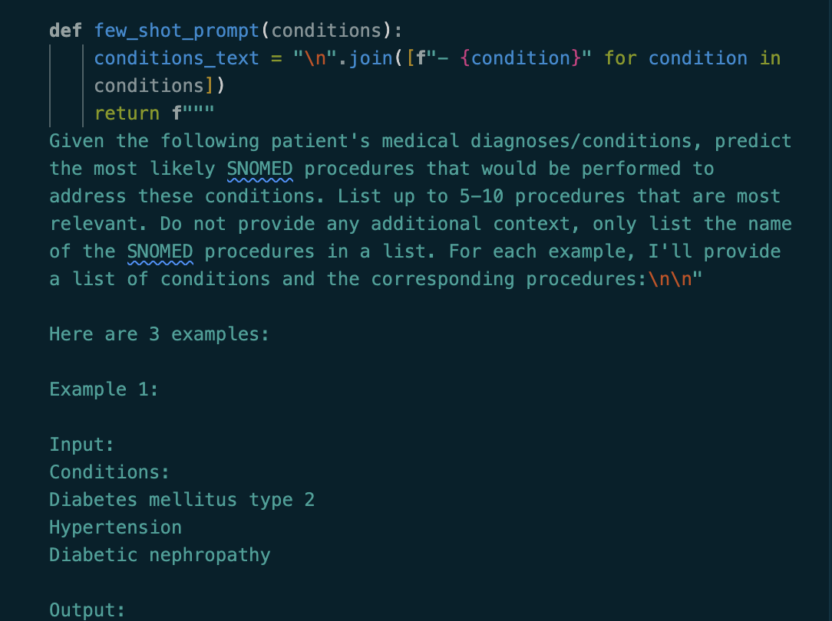
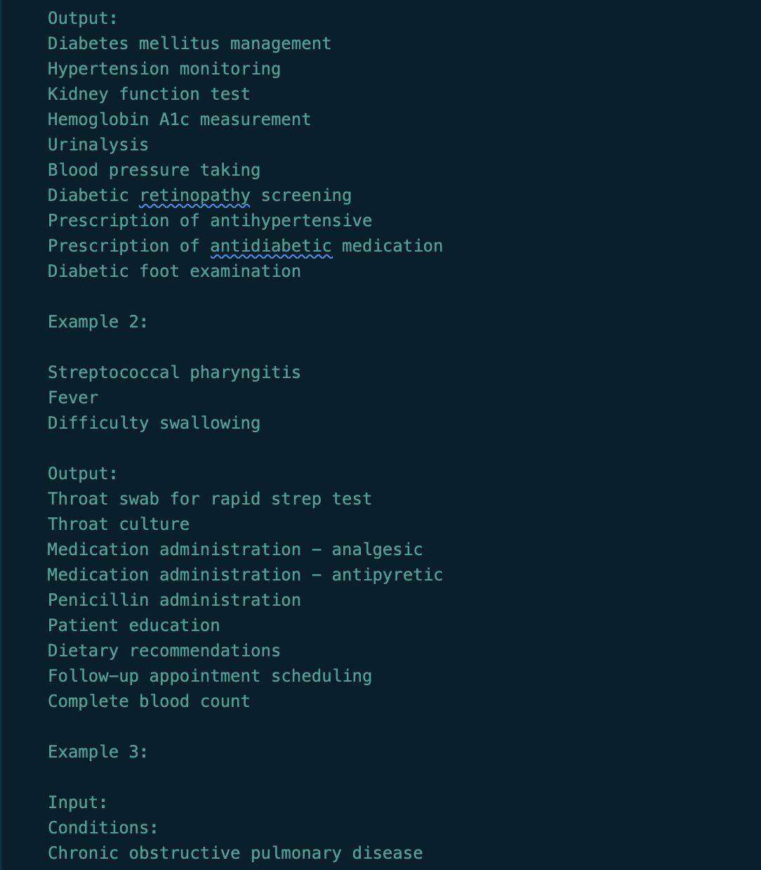
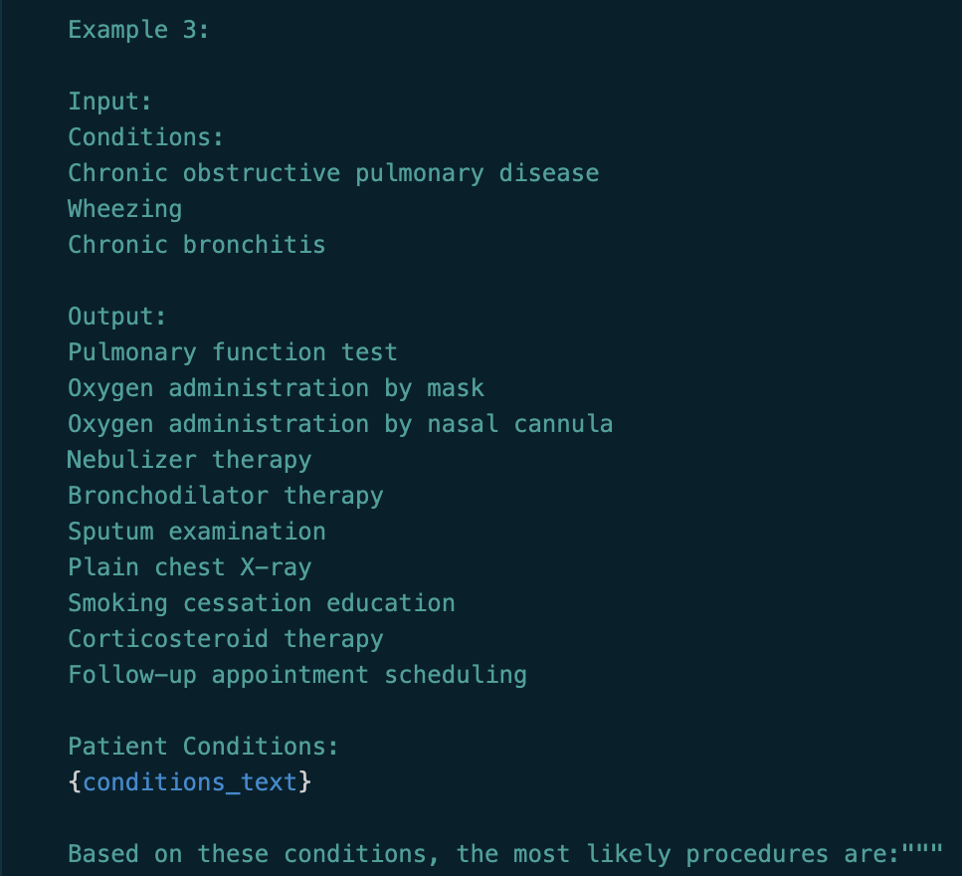
Prompting (Zero/few shot)
4 prompts were tried against 4o-mini: zero-shot, few shot, Chain of Thought, and Tree of Thought
For zero-shot, no examples were provided to the model, only a detailed prompt about what the model should produce.
The few-shot prompt was identical except that it included 3 hard coded examples.

Slide 9
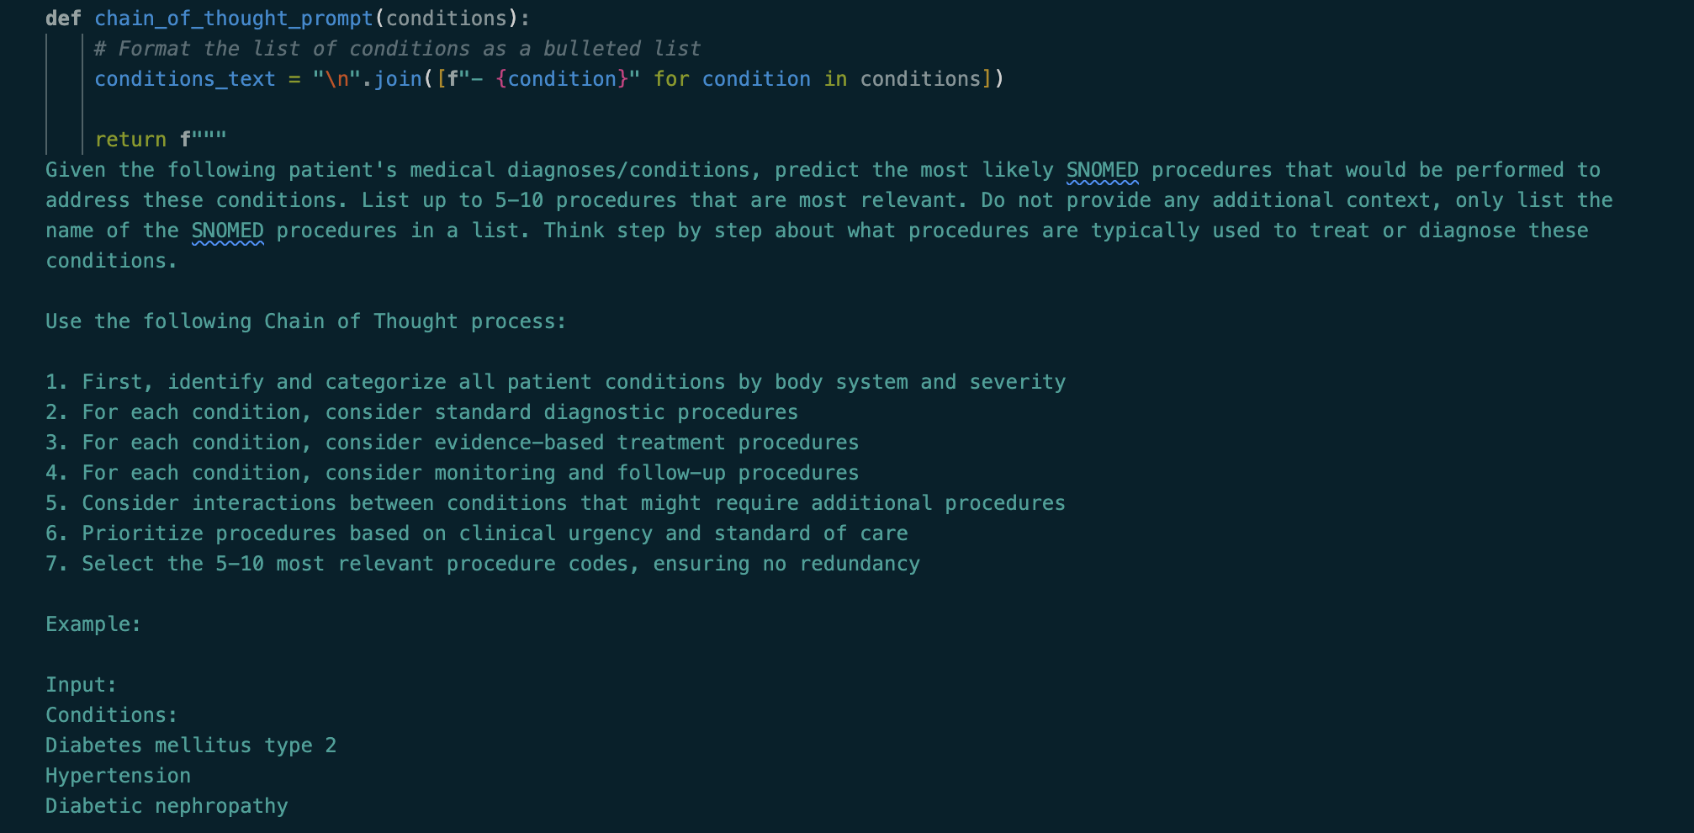
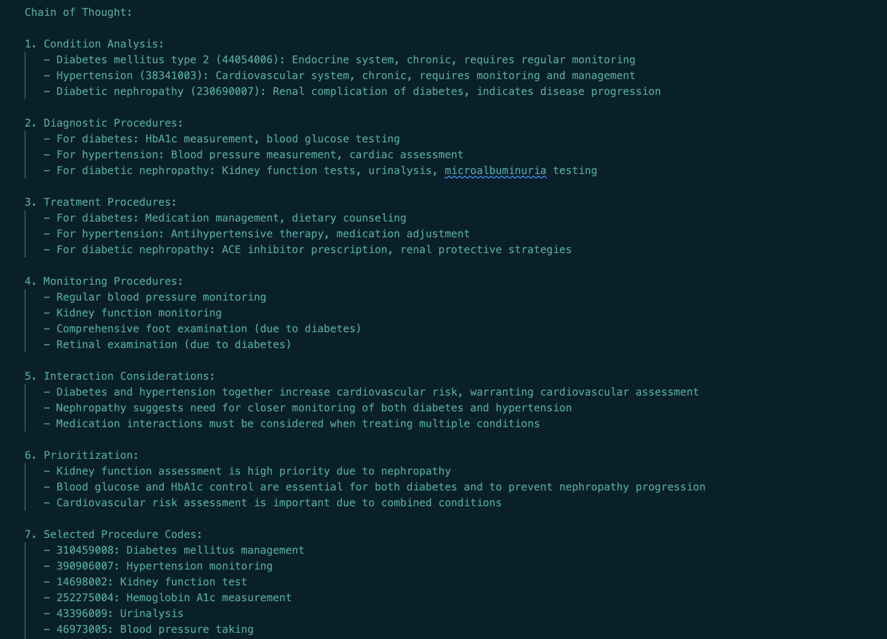
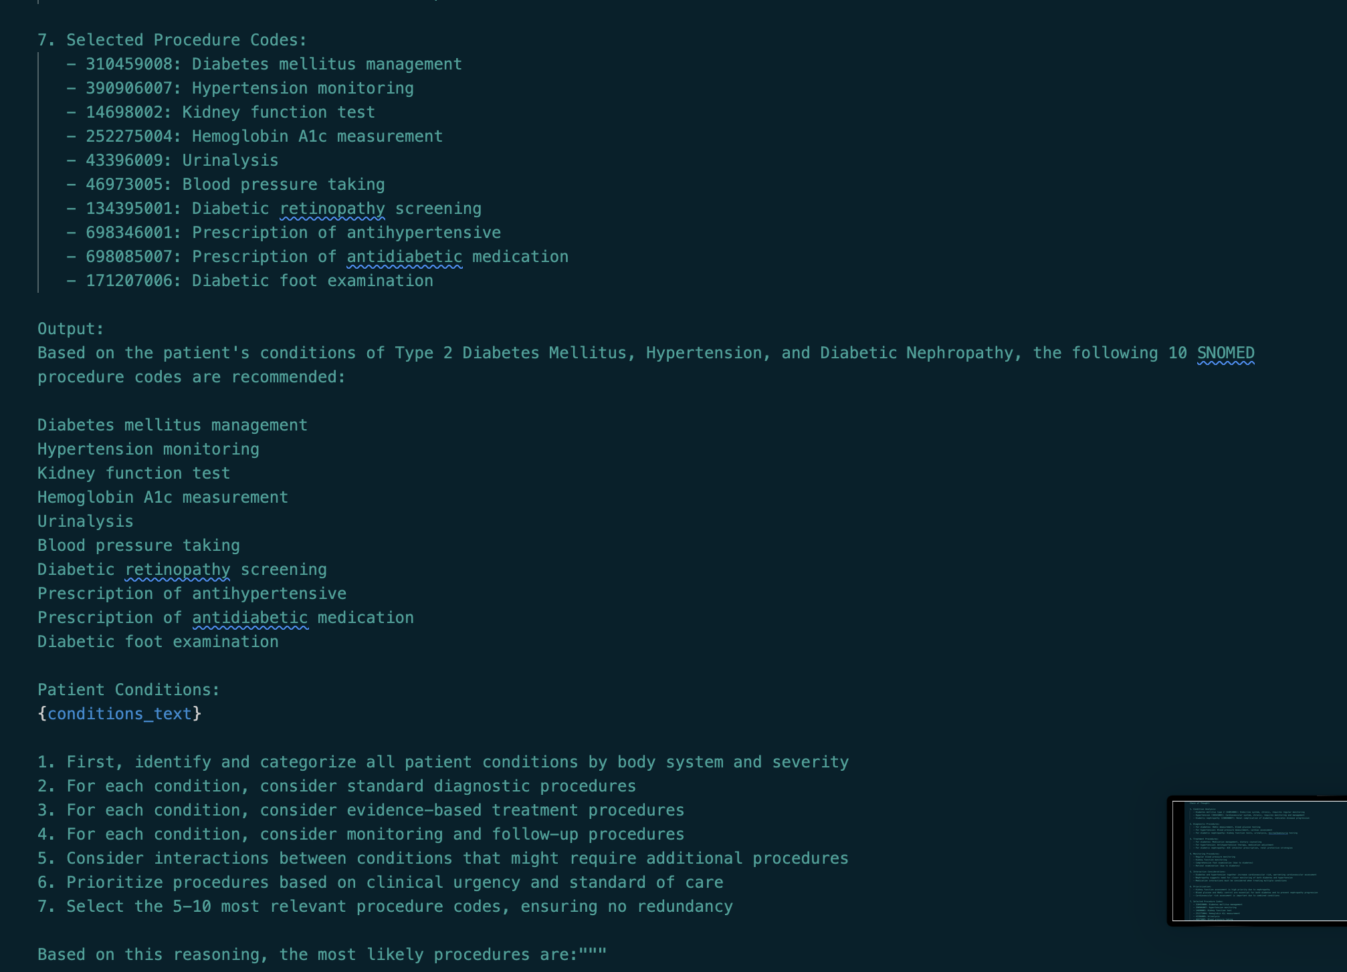
Prompting (Chain of thought)
The chain of thought prompt included reasoning steps for deducing the SNOMED code

Slide 10
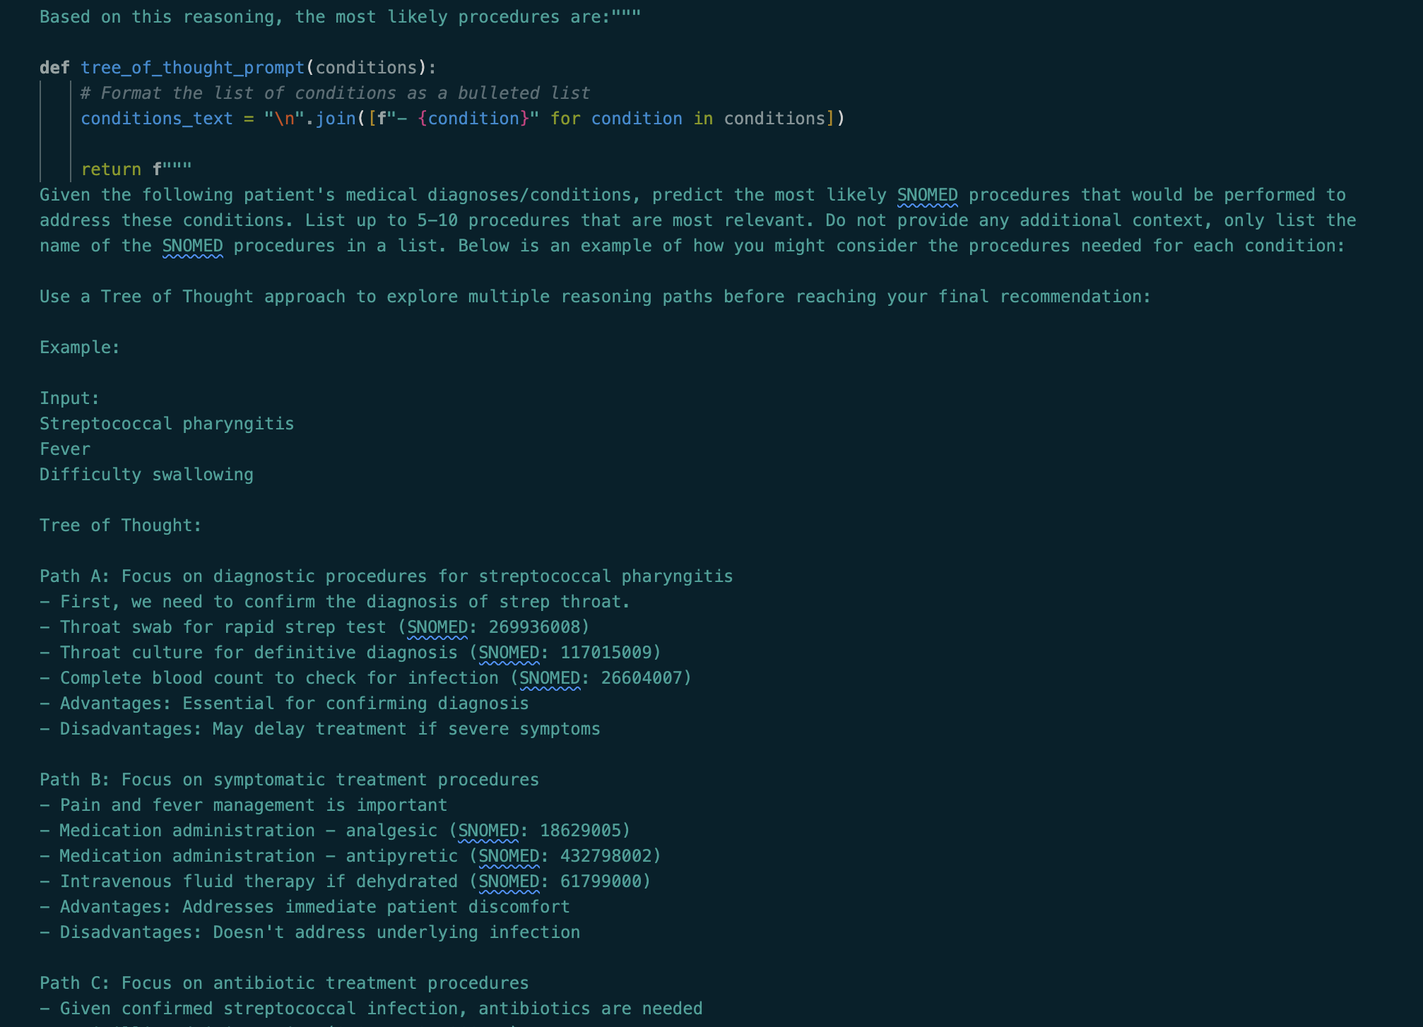
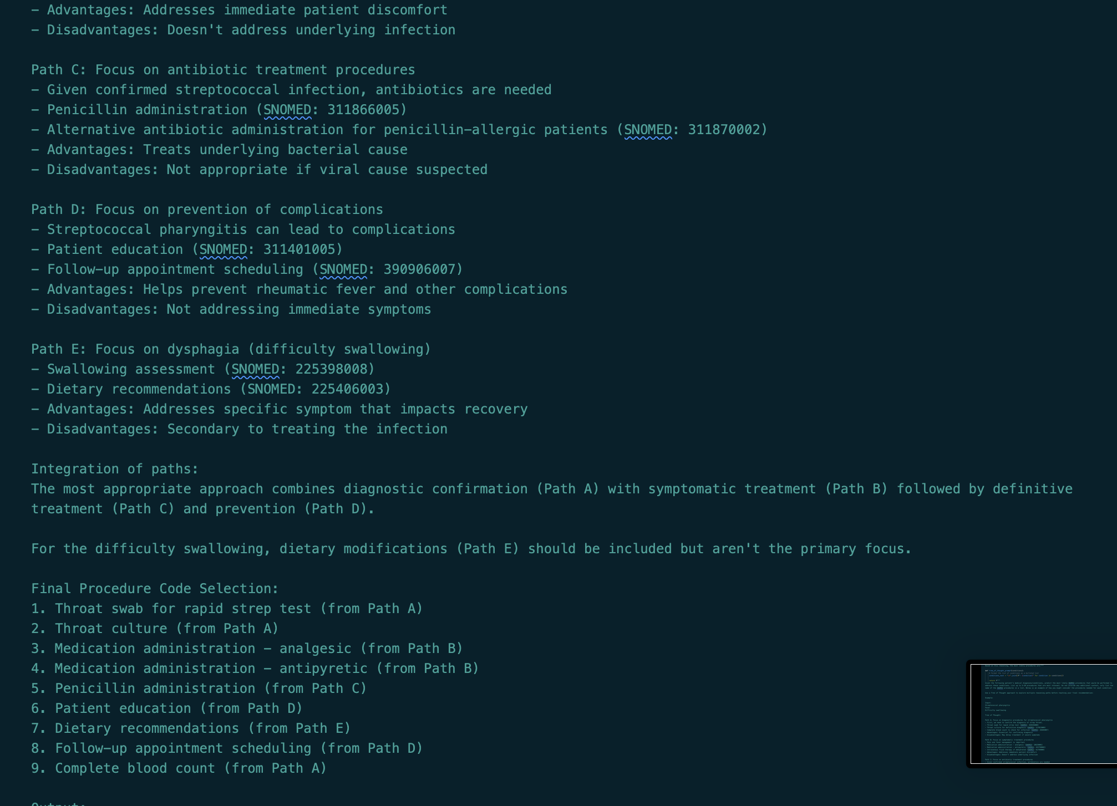
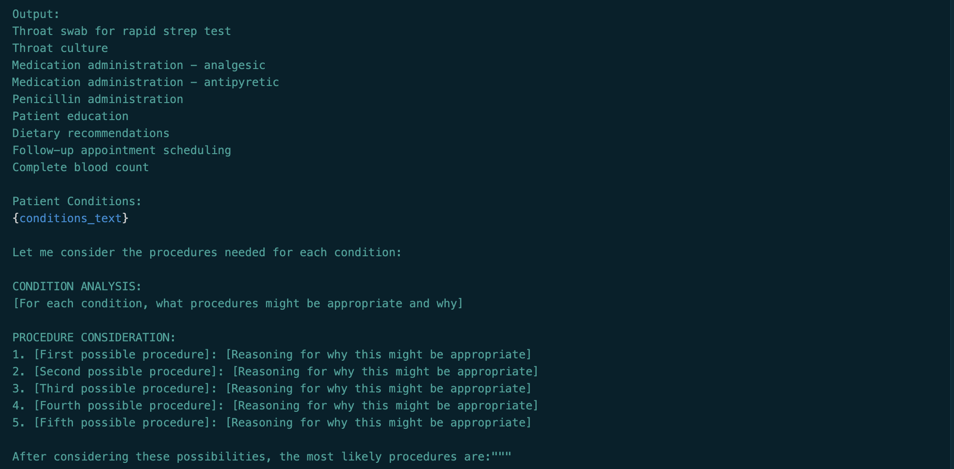
Prompting (Tree of thought)
The tree of thought prompt was like CoT, but included different reasoning paths.

Slide 11
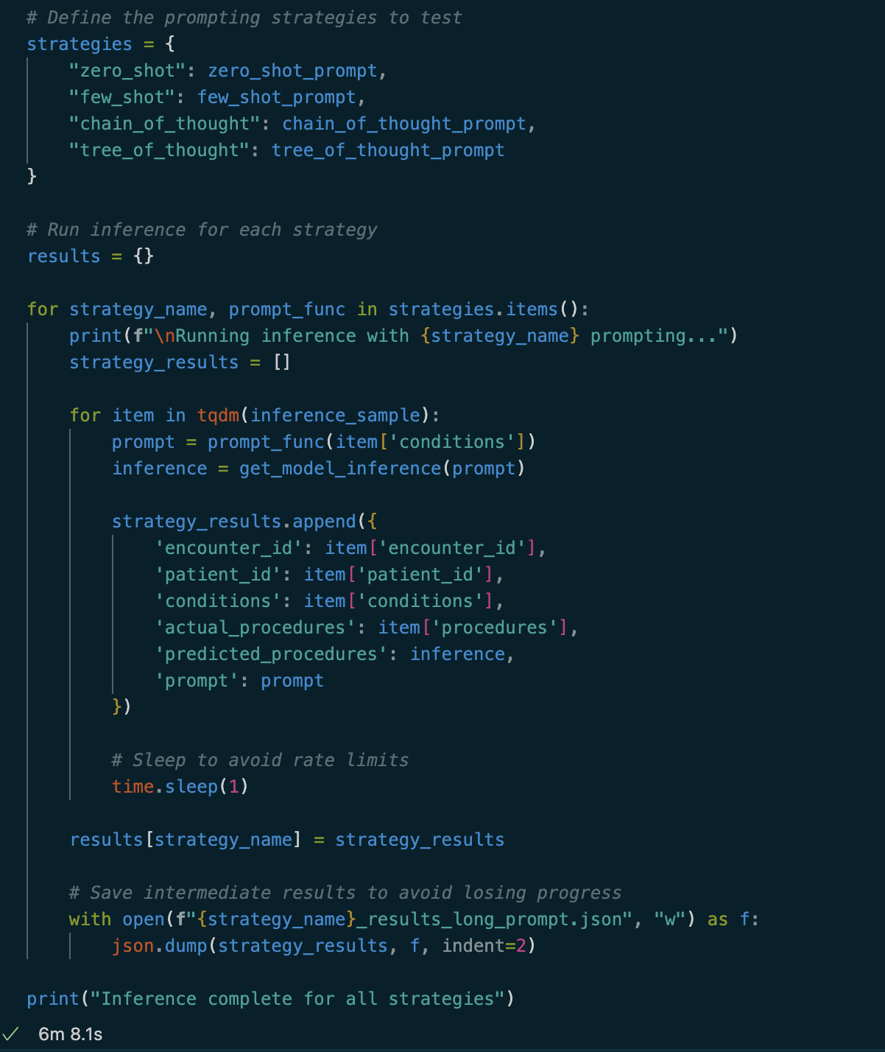
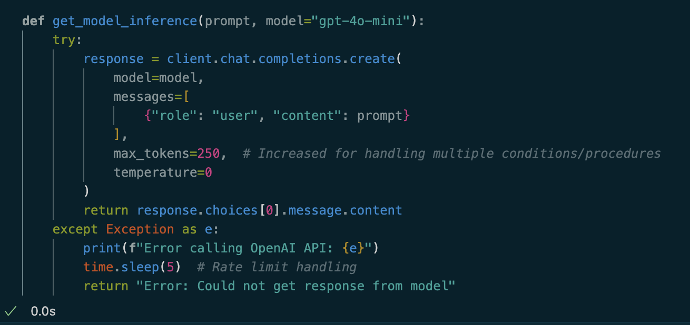
Inference through OpenAI API
A sample of a random sampling of 100 unique encounter ids are selected and sent with each prompt type in a loop to OpenAI’s 4o-mini model over their public API.
Because OpenAI’s inference costs are so low, multiple runs on the sample with all prompts only totals out to around $0.30

Slide 12
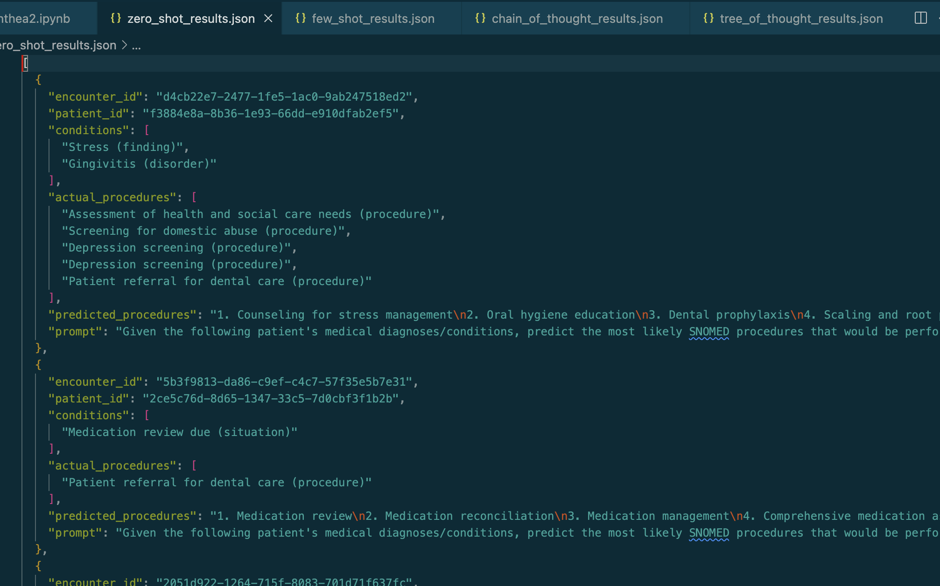
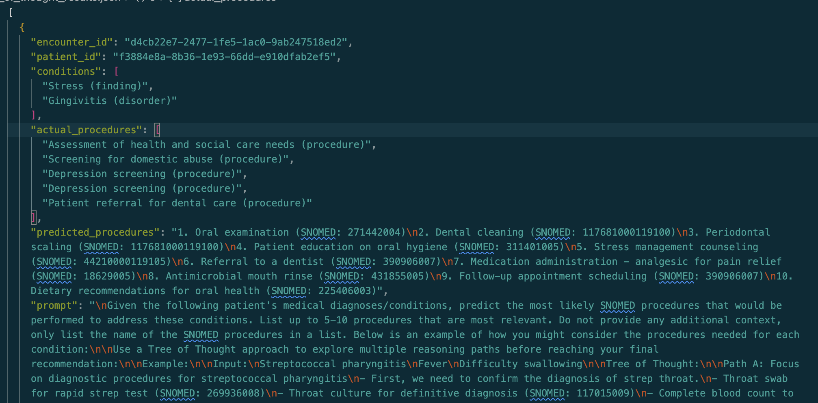
Results
Inference results were written in JSON format with useful context and saved to individual files for each prompt style
In JSON format results are easy to manually review, and share, plus there was much less of a risk losing the output if memory was reset by mistake

Slide 13
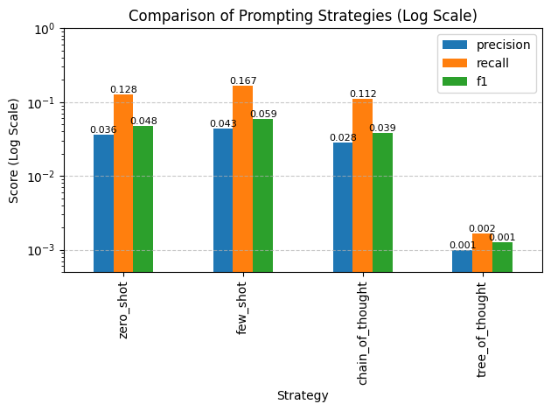
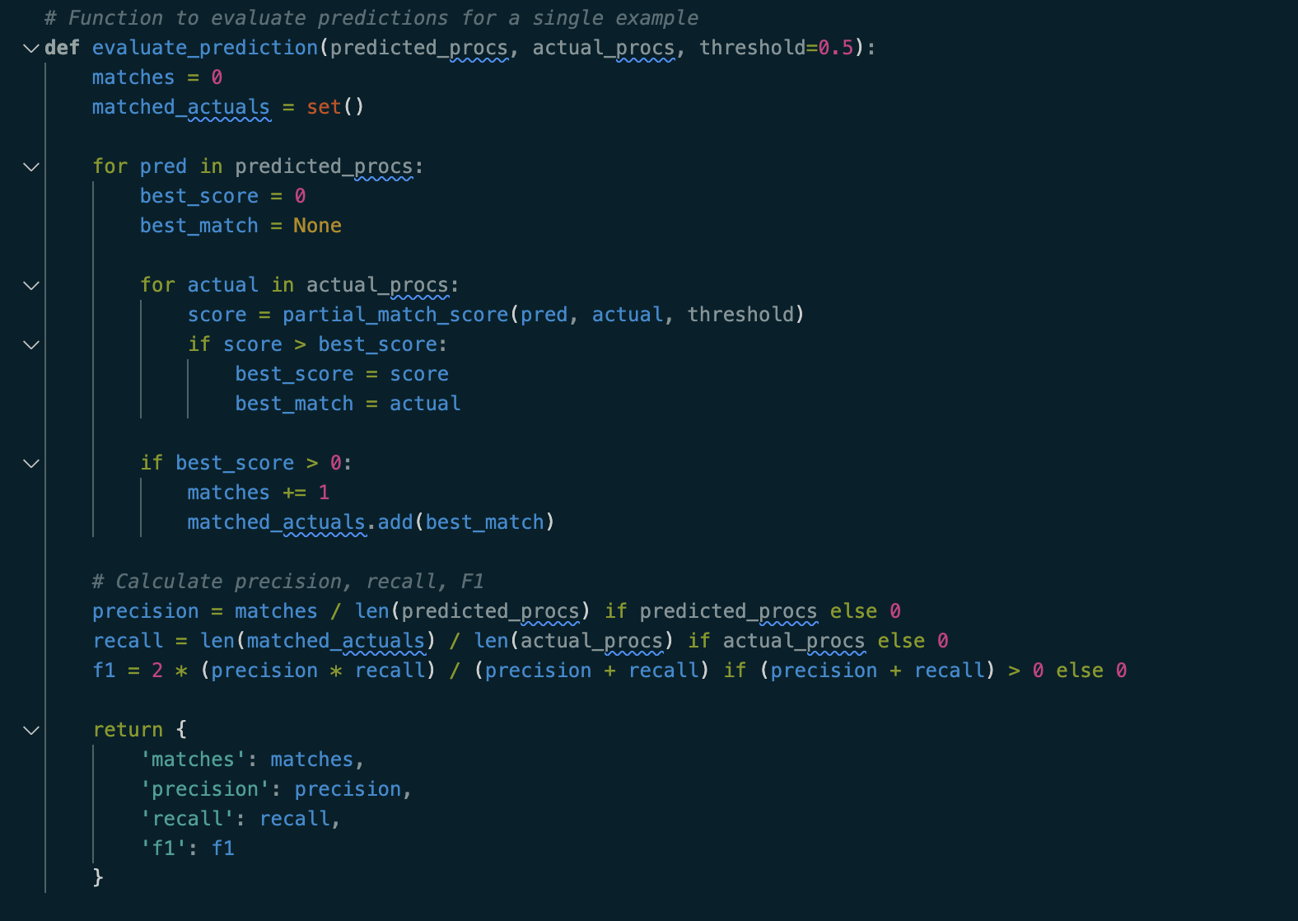
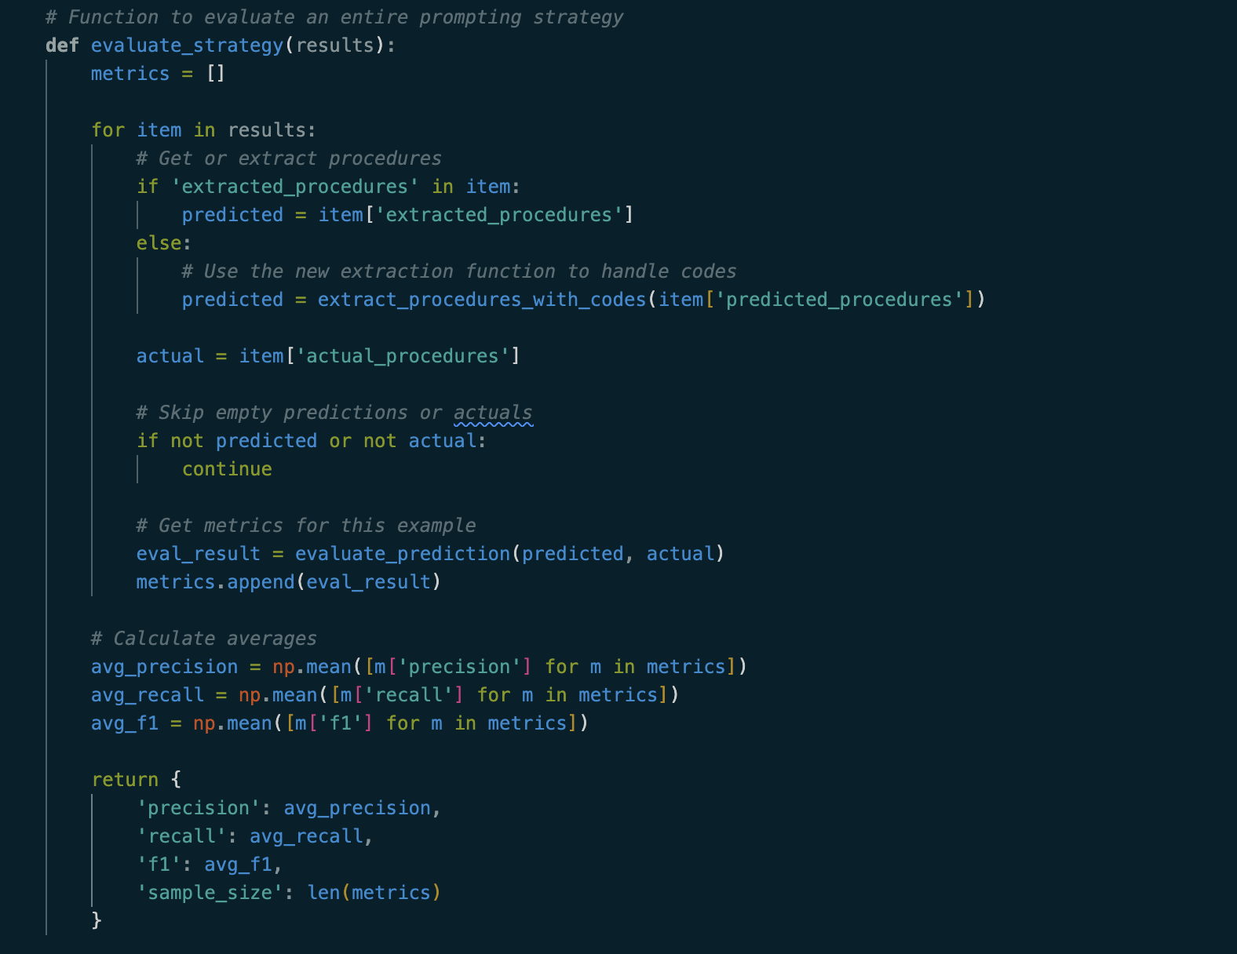
Evaluation
For each prompting strategy average precision, recall, and f1 score were calculated based on jaccard similarity of the predicted procedure words vs the actual procedure words.
Overall scores were very low, the model gave relevant and meaningful recommendations, but they typically did not match Synthea’s
With more detailed and realistic patient data (like that in MIMIC) predictions could have much higher accuracy
few shot performed the best with the evaluation metrics

Slide 14
Takeaways/improvement
LLMs are extremely powerful but come at the cost of expensive inference and demanding compute requirements
Large AI/Tech companies expose these LLMs at both low latency and cost, which can be an accelerator for research
Synthetic data is helpful but ultimately limiting as it does not reflect the diversity and richness of real data
With more funding or compute it would be interesting to try using MIMIC based prompts into a larger 7B or 15B healthcare-specific model such as PMC-Llama
One other idea I had is to give MIMIC noteevents data (and possible other tables) as input and use prompting to predict ICD9 procedure codes, but restrictions on data and lack of compute for more powerful models on Colab forced me to descope

