Slide 1

Universidad Nacional de San Agustín de Arequipa
School of Systems Engineering · Software Quality · Partial Work 6
Evaluating the quality of a malaria surveillance dashboard with ISO/IEC 25010
Quality model · GQM metrics · evaluation process & data-collection format · control board
Juan Manuel Cari Quispe · Daniel Wilston Chura Monroy · Ower Frank Lopez Arela
Alejandro Josue Phocco Tapia · Mauricio Eduardo Zegarra Puma
Lecturer: Mg. Jesús Martín Silva Fernández · Arequipa, Peru · October 2026
Notes:
Presenter: Juan Cari
Good morning. We are the team behind VigiSalud Malaria. In this partial work we applied the ISO/IEC 25010 product quality model to our own public-health software: a dashboard built on Peru's official malaria surveillance open data. We will show the product, the four points of the assignment and the measured results.

Slide 2
Agenda and team responsibilities
# | Topic | Presenter
1 | Context, official data and the product (web dashboard + quality board); Point 1 — characteristics | Juan Manuel Cari Quispe
2 | Point 2 — GQM and metrics: functional suitability, performance, compatibility, flexibility, maintainability | Daniel Wilston Chura Monroy
3 | Point 2 — Metrics: interaction capability, reliability, security, safety | Ower Frank Lopez Arela
4 | Point 3 — Evaluation process, data-collection format, failure classification | Alejandro Josue Phocco Tapia
5 | Point 4 — Control board and evolution of the runs | Mauricio Eduardo Zegarra Puma
6 | Results across the runs | Daniel Wilston Chura Monroy
7 | Incident log | Ower Frank Lopez Arela
8 | Lessons learned | Alejandro Josue Phocco Tapia
9 | Conclusions | Mauricio Eduardo Zegarra Puma
VigiSalud Malaria · ISO/IEC 25010 evaluation · Presenter: Juan Cari
2
Notes:
Presenter: Juan Cari
The presentation follows the four points of the assignment. Each member presents the part they owned.

Slide 3
Context: malaria in Peru and the official data
Source: MINSA – CDC Peru, National Open Data Platform (downloaded 2026-10-26)
1,243,299
33,516
15.4 %
99 %
notified cases 2000–2025
cases in 2025
P. falciparum share in 2025
of 2025 cases in Loreto
Official file | Period | Granularity | Rows | Invalid
datos_abiertos_vigilancia_malaria_2000_2008.csv | 2000-2008 | week × district aggregate | 106,355 | 0
datos_abiertos_vigilancia_malaria_2009_2025.csv | 2009-2025 | nominal (one case per row) | 630,657 | 40
▪ Validation: year, epidemiological week, age, sex and ICD-10 code (B50 P. falciparum, B51 P. vivax) are checked on every row.
▪ Recovery, not invention: 5,712 cases without a department name were recovered from the INEI ubigeo code; the letter Ñ, delivered as U+FFFD in the official files, was restored in 14 names (figures unchanged).
▪ Privacy by design: only aggregates are published, each source file is fingerprinted with SHA-256.
VigiSalud Malaria · ISO/IEC 25010 evaluation · Presenter: Juan Cari
3
Notes:
Presenter: Juan Cari
Malaria is endemic in the Peruvian Amazon. Between 2000 and 2025 the surveillance system notified 1,243,299 cases. In 2025 there were 33,516 cases, 15.4 percent due to P. falciparum, and Loreto concentrated most of them. We use only the official open data; nothing is typed by hand. The pipeline validates every row and publishes only aggregates, so no individual record reaches the browser.

Slide 4
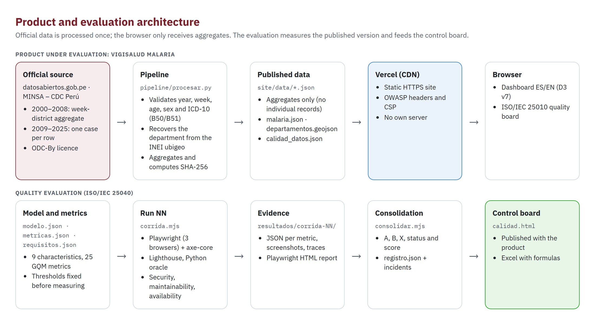
The product we evaluate: VigiSalud Malaria
Public web dashboard + ISO/IEC 25010 quality board · https://vigisalud-malaria.vercel.app
VigiSalud Malaria · ISO/IEC 25010 evaluation · Presenter: Juan Cari
4
Notes:
Presenter: Juan Cari
This is what we built and what we evaluate. On top: the product. Official CSV files go through a Python pipeline, the aggregated JSON is served as a static site on Vercel with OWASP security headers, and the browser renders the dashboard. Below: the evaluation. Each run measures the published version with Playwright, axe, Lighthouse, an independent oracle and probes; the evidence is consolidated into the quality board that is published next to the product.

Slide 5
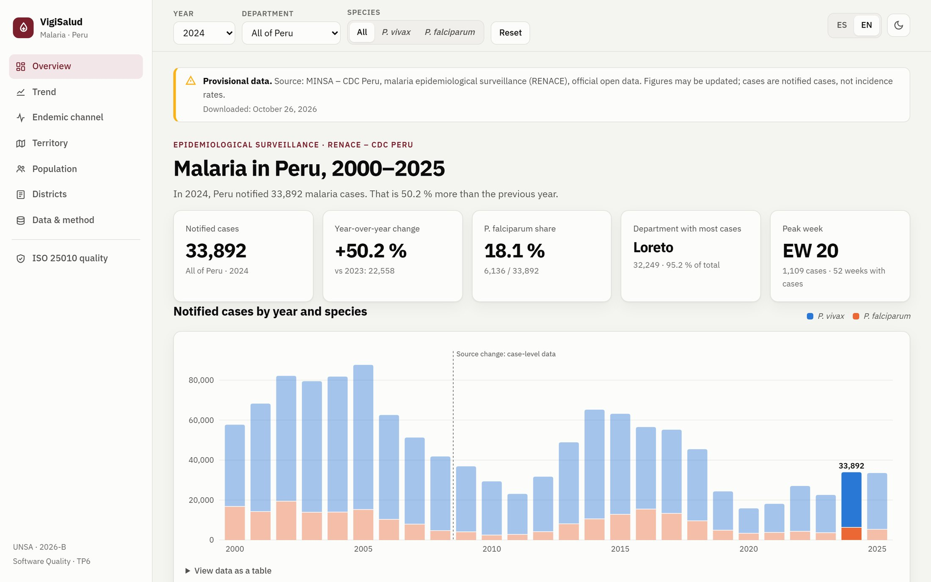
The web dashboard (1/2): what the user sees
Three global filters — year, department, species — drive every view and are shared in the URL
▪ Navigation: seven sections plus the ISO 25010 quality board.
▪ Filters: year, department and species; shared in the URL.
▪ Provisional-data notice: source, limits and download date.
▪ Overview: 5 KPIs and a one-sentence trend summary.
▪ Trend: annual cases by species; dashed line marks the 2009 change of source.
▪ ES / EN and light / dark: remembered per user.
VigiSalud Malaria · ISO/IEC 25010 evaluation · Presenter: Juan Cari
5
Notes:
Presenter: Juan Cari
The dashboard opens with a provisional-data notice and five key indicators: notified cases, change versus the previous year, P. falciparum share, the department with most cases and the peak epidemiological week. Below, the annual series by species from 2000; the dashed line in 2009 marks the change of source so nobody reads it as an epidemiological jump. Everything is bilingual and has a table view for accessibility.

Slide 6
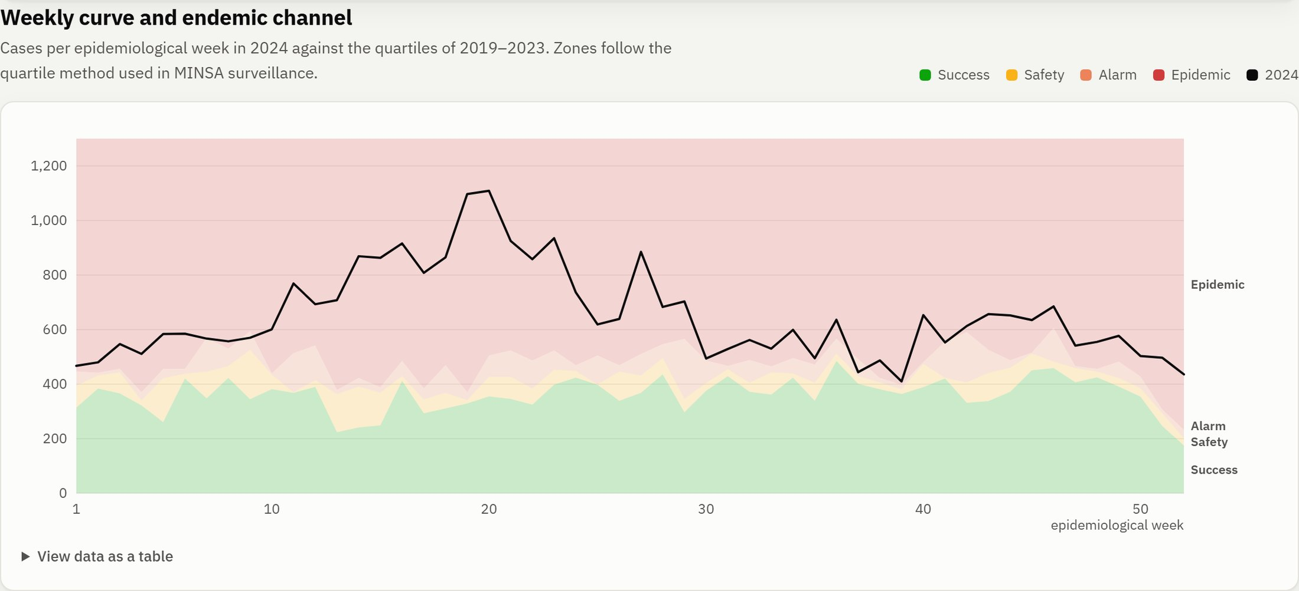
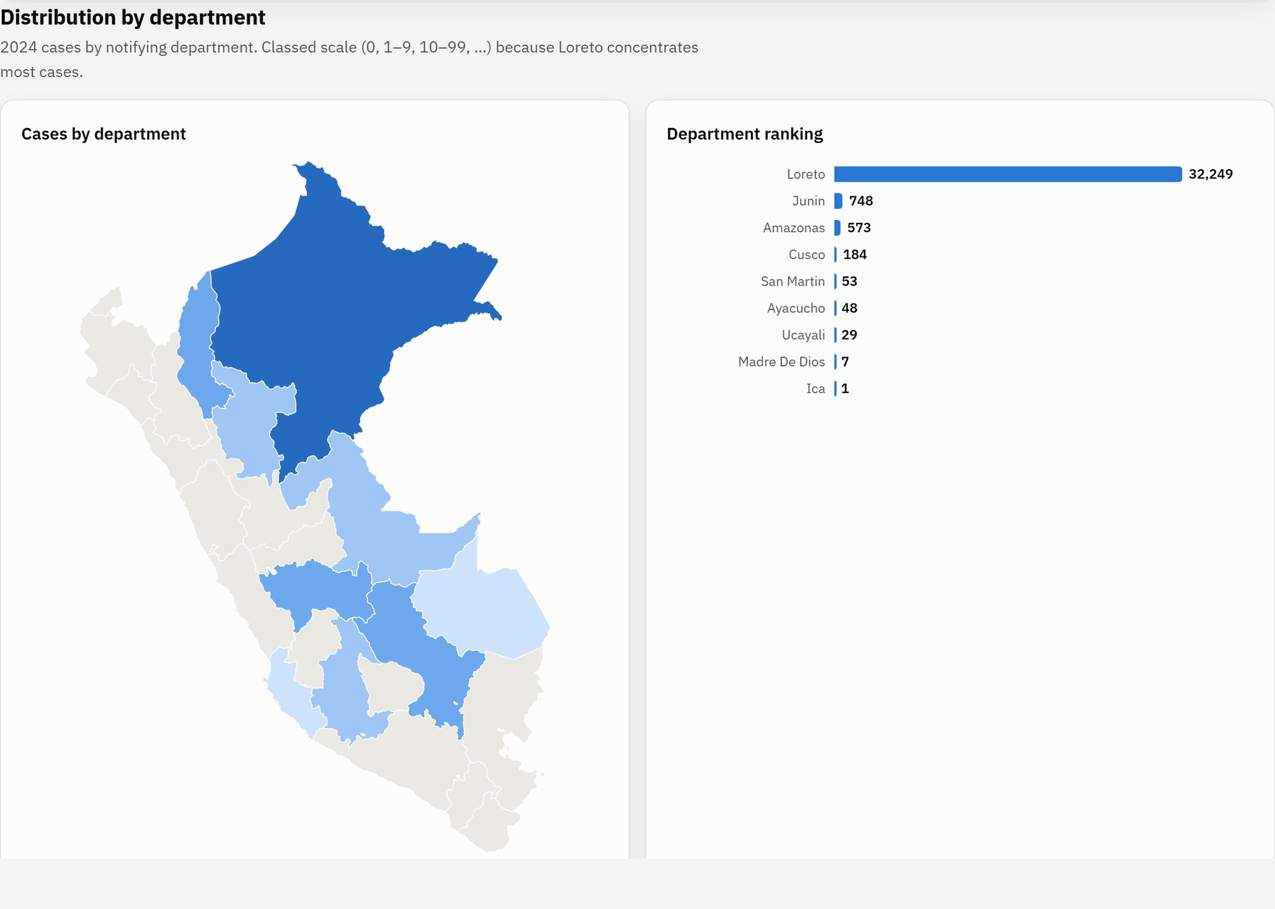
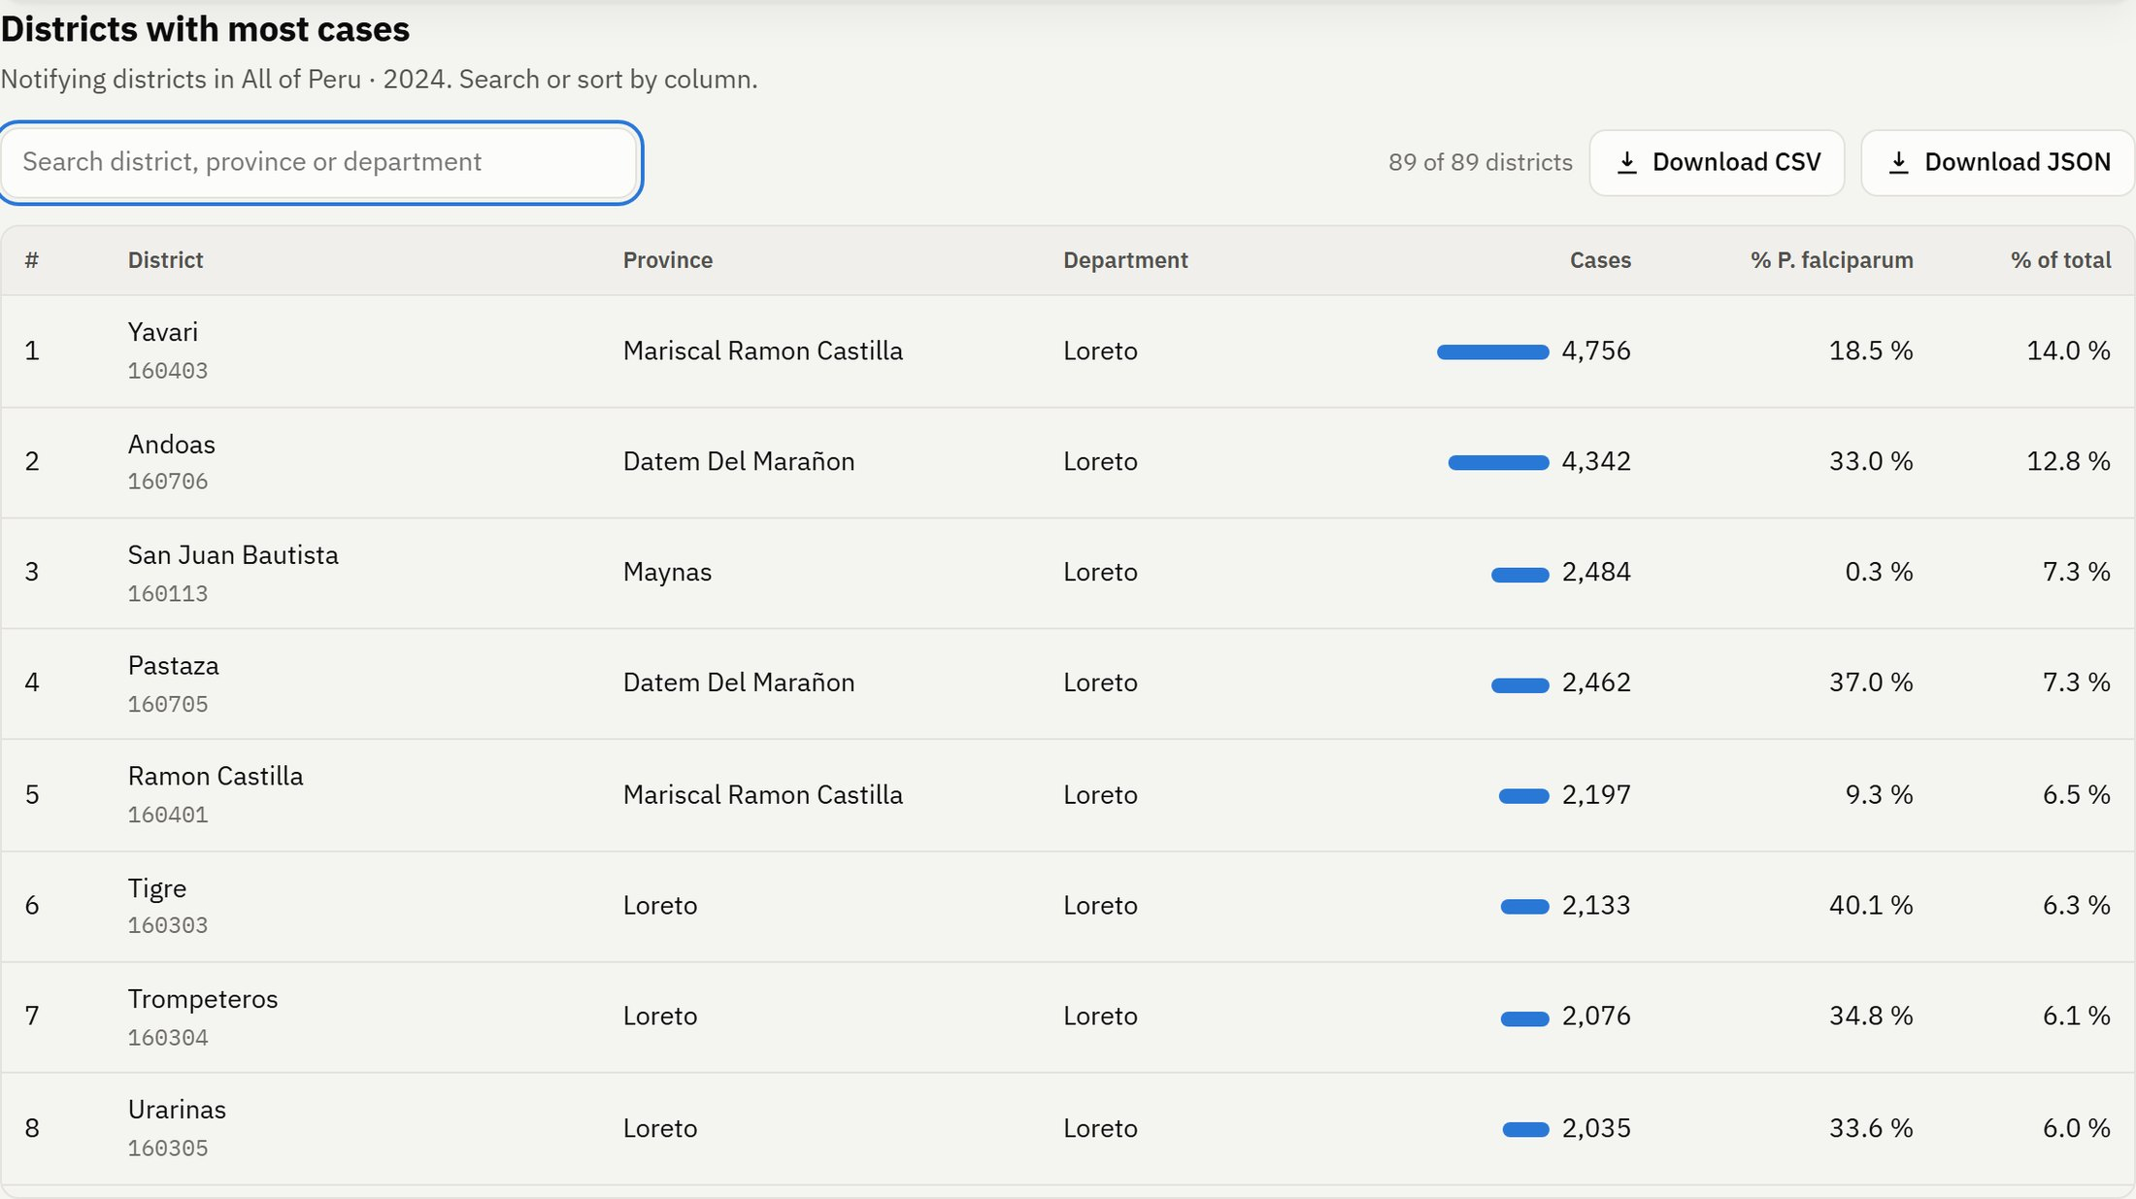
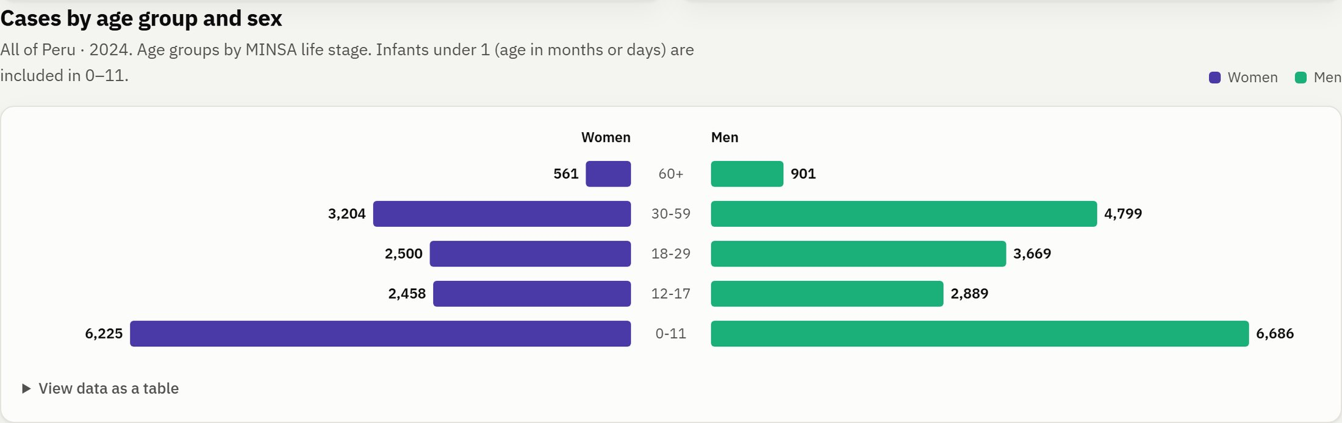
The web dashboard (2/2): surveillance views
Endemic channel · territory · population · districts with export
VigiSalud Malaria · ISO/IEC 25010 evaluation · Presenter: Juan Cari
6
Notes:
Presenter: Juan Cari
The endemic channel compares the weekly curve with the quartiles of the previous five years: success, safety, alarm and epidemic zones. The choropleth map uses threshold classes and clicking a department filters the whole dashboard. The district table supports search, sorting and CSV or JSON export of the current cut. The 'Data and method' section shows source, licence, validation rules and hashes so any figure can be checked against the original.

Slide 7
Point 1 — Adopted characteristics and priorities
All 9 ISO/IEC 25010:2023 characteristics adopted · 24 sub-characteristics selected · 14 justified as N/A or not evaluated
Characteristic | Priority | Selected sub-characteristics | Metrics
Functional suitability | High | Functional completeness, Functional correctness, Functional appropriateness | IF-01, IF-02, IF-03
Performance efficiency | Medium | Time behaviour, Resource utilization | ED-01, ED-02, ED-03
Compatibility | Low | Interoperability | CO-01
Interaction capability | High | Operability, User error protection, Inclusivity, Self-descriptiveness | CI-01, CI-02, CI-03, CI-04
Reliability | High | Faultlessness, Availability, Fault tolerance, Recoverability | FI-01, FI-02, FI-03, FI-04
Security | High | Confidentiality, Integrity, Resistance | SE-01, SE-02, SE-03
Maintainability | Medium | Analysability, Modifiability, Testability | MA-01, MA-02, MA-03
Flexibility | Medium | Adaptability | FL-01
Safety | High | Hazard warning, Fail safe, Risk identification | SO-01, SO-02, SO-03
VigiSalud Malaria · ISO/IEC 25010 evaluation · Presenter: Juan Cari
7
Notes:
Presenter: Juan Cari
We reviewed the nine characteristics against the nature of the product: a read-only system that informs official figures for health decisions, with no user accounts and no transactions. Priority reflects the impact of a defect: a wrong figure or an unavailable site directly affects decisions, so functional suitability, interaction capability, reliability, security and safety are high. Coexistence, for example, does not apply.

Slide 8
Point 1 — What we did not evaluate, and why
Exclusions are explicit: not applicable (the property does not exist) vs. not evaluated (needs resources out of scope)
Characteristic | Sub-characteristic | Status | Justification
Performance efficiency | Capacity | Not applicable | Static site served by Vercel's CDN; no own server or concurrent users to limit.
Compatibility | Co-existence | Not applicable | Runs in the browser without sharing resources with other installed products.
Interaction capability | Appropriateness recognizability | Not evaluated | Requires tests with real CDC users; left for a user-testing iteration.
Interaction capability | Learnability | Not evaluated | Requires user testing; outside the scope of this automated evaluation.
Security | Non-repudiation | Not applicable | Read-only system: there are no transactions or user actions to attribute.
Security | Accountability | Not applicable | There are no user accounts or operations to log.
Security | Authenticity | Not applicable | Public information without sign-in.
Maintainability | Modularity | Not evaluated | Observed indirectly through MA-01 and MA-02; it has no metric of its own.
Maintainability | Reusability | Not evaluated | Not a project goal at this stage.
Flexibility | Scalability | Not applicable | Published data volume is fixed per version and hosting scales automatically.
Flexibility | Installability | Not applicable | Web application: nothing is installed.
Flexibility | Replaceability | Not applicable | Does not replace another product at this stage.
Safety | Operational constraint | Not applicable | The system does not control equipment or physical processes.
Safety | Safe integration | Not applicable | It is not integrated with other systems in this version.
VigiSalud Malaria · ISO/IEC 25010 evaluation · Presenter: Juan Cari
8
Notes:
Presenter: Juan Cari
We did not drop sub-characteristics silently. Non-repudiation, accountability and authenticity do not apply because there are no accounts or transactions. Learnability and appropriateness recognisability do apply, but they need tests with real CDC users, so we declare them not evaluated and propose them as future work.

Slide 9
Point 2 — Metrics defined with GQM
25 metrics · X = A/B × 100 or measured value · thresholds fixed BEFORE run 01
Goal → Question → Metric (example IF-02)
Independent oracle
G: Ensure every figure shown matches the official CSV files.
Q: What share of the figures shown equals the value recomputed from the raw data?
M: X = A/B × 100 · A = matching values · B = compared values · threshold ≥ 100 %
evaluacion/oraculo.py recomputes 8 scenarios (year × department × species) straight from the CSV files with its own INEI map.
Last run: 84 of 84 values identical.
Score range | Category (Calabrese et al., CACIC 2017)
0 – 40 | Not acceptable
40 – 60 | Minimally acceptable
60 – 90 | Target range
90 – 100 | Exceeds requirements
▪ Proportion metrics: score = X.
▪ Lower-is-better values: score = min(100, 100 × threshold / value).
▪ Status: Approved / Rejected against the threshold; Pending if not measured.
▪ Owners: every metric has a named team member.
VigiSalud Malaria · ISO/IEC 25010 evaluation · Presenter: Daniel Chura
9
Notes:
Presenter: Daniel Chura
Every selected sub-characteristic has at least one metric derived with Goal, Question, Metric. Each metric records A, B, formula, unit, direction, threshold, requirement, procedure, tool and owner. We adopted the scoring scale of Calabrese et al.: 0 to 40 not acceptable, 40 to 60 minimally acceptable, 60 to 90 target range, 90 to 100 exceeds requirements. The key example is functional correctness: an independent Python oracle recomputes the expected figures from the raw CSV files, so the product is never checked against its own code.

Slide 10
Point 2 — Metrics owned by Daniel Wilston Chura Monroy
ID | Sub-characteristic | Metric | A / B (or value) | Threshold | Tool
IF-01 | Functional completeness | Functional requirement coverage | A/B × 100 | ≥ 95 % | Playwright 1.64 (Chromium)
IF-02 | Functional correctness | Accuracy against the official oracle | A/B × 100 | ≥ 100 % | Python 3.12 + Playwright
IF-03 | Functional appropriateness | Coverage of surveillance dimensions | A/B × 100 | ≥ 90 % | Playwright
ED-01 | Time behaviour | Largest Contentful Paint (mobile) | measured value | ≤ 2.5 s | Lighthouse 12.8
ED-02 | Time behaviour | Filter response time | measured value | ≤ 200 ms | Playwright + Performance API
ED-03 | Resource utilization | Initial page weight | measured value | ≤ 1,000 KB | Lighthouse 12.8
CO-01 | Interoperability | Valid and consistent exports | A/B × 100 | ≥ 100 % | Playwright
MA-01 | Analysability | Functions with acceptable complexity | A/B × 100 | ≥ 90 % | ESLint 9 (regla complexity) + Radon 6
MA-02 | Modifiability | Static-analysis issue density | measured value | ≤ 2 issues/KLOC | ESLint 9
MA-03 | Testability | Requirements with automated tests | A/B × 100 | ≥ 90 % | Script de consolidación
FL-01 | Adaptability | Correct browser × viewport combinations | A/B × 100 | ≥ 100 % | Playwright
VigiSalud Malaria · ISO/IEC 25010 evaluation · Presenter: Daniel Chura
10
Notes:
Presenter: Daniel Chura
These are the metrics I owned. Functional completeness: share of the fifteen functional requirements whose end-to-end test passes. Correctness with the oracle. Performance: mobile LCP from Lighthouse, interaction response time and page weight. Interoperability: exported CSV and JSON add up to what the interface shows. Adaptability across three browsers and three screen sizes. Maintainability: cyclomatic complexity, lint density per thousand lines and test coverage of requirements.

Slide 11
Point 2 — Metrics owned by Ower Frank Lopez Arela
ID | Sub-characteristic | Metric | A / B (or value) | Threshold | Tool
CI-01 | Operability | Keyboard-operable controls | A/B × 100 | ≥ 95 % | Playwright
CI-02 | User error protection | Invalid inputs handled | A/B × 100 | ≥ 100 % | Playwright
CI-03 | Inclusivity | Serious WCAG violations | A/B × 100 | ≥ 100 % | axe-core 4 + Playwright
CI-04 | Self-descriptiveness | Charts with a text alternative | A/B × 100 | ≥ 100 % | Playwright
FI-01 | Faultlessness | Runs without JavaScript errors | A/B × 100 | ≥ 100 % | Playwright (Chromium, Firefox, WebKit)
FI-02 | Availability | Measured availability | A/B × 100 | ≥ 99 % | Node.js fetch
FI-03 | Fault tolerance | Data failures handled | A/B × 100 | ≥ 100 % | Playwright (page.route)
FI-04 | Recoverability | Recovery after failure | A/B × 100 | ≥ 100 % | Playwright
SE-01 | Confidentiality | No published microdata | A/B × 100 | ≥ 100 % | Node.js
SE-02 | Integrity | Source data integrity | A/B × 100 | ≥ 100 % | Node.js crypto
SE-03 | Resistance | OWASP security headers | A/B × 100 | ≥ 85 % | Node.js fetch
SO-01 | Hazard warning | Views with a provisional-data warning | A/B × 100 | ≥ 100 % | Playwright
SO-02 | Fail safe | No partial figures on failure | A/B × 100 | ≥ 100 % | Playwright
SO-03 | Risk identification | Source limitations disclosed | A/B × 100 | ≥ 100 % | Playwright
VigiSalud Malaria · ISO/IEC 25010 evaluation · Presenter: Ower Lopez
11
Notes:
Presenter: Ower Lopez
My metrics cover interaction, reliability, security and safety. Operability: every control reachable by keyboard. User-error protection: invalid URL parameters are ignored with a visible notice. Inclusivity: zero serious or critical axe-core violations under WCAG 2.2 A/AA. Reliability: no console errors, availability probes, four injected faults that must be handled and recovered. Security: no individual records published, SHA-256 integrity, HTTPS, and seven OWASP headers. Safety: provisional-data warnings and that no figure is ever shown while data failed to load.

Slide 12
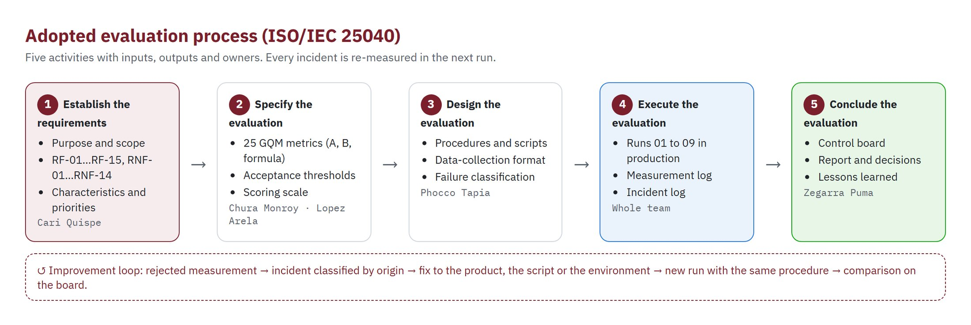
Point 3 — Evaluation process (ISO/IEC 25040)
Five activities with inputs, outputs and owners; every rejected metric loops back through an incident
VigiSalud Malaria · ISO/IEC 25010 evaluation · Presenter: Alejandro Phocco
12
Notes:
Presenter: Alejandro Phocco
We adopted the five activities of ISO/IEC 25040: establish the requirements, specify, design, execute and conclude the evaluation. The important part is the loop at the bottom: a rejected measurement becomes an incident, the incident is classified by origin, fixed, and re-measured in the next run with exactly the same procedure. A run is a single command that records the conditions, runs every tool against production and consolidates the results.

Slide 13
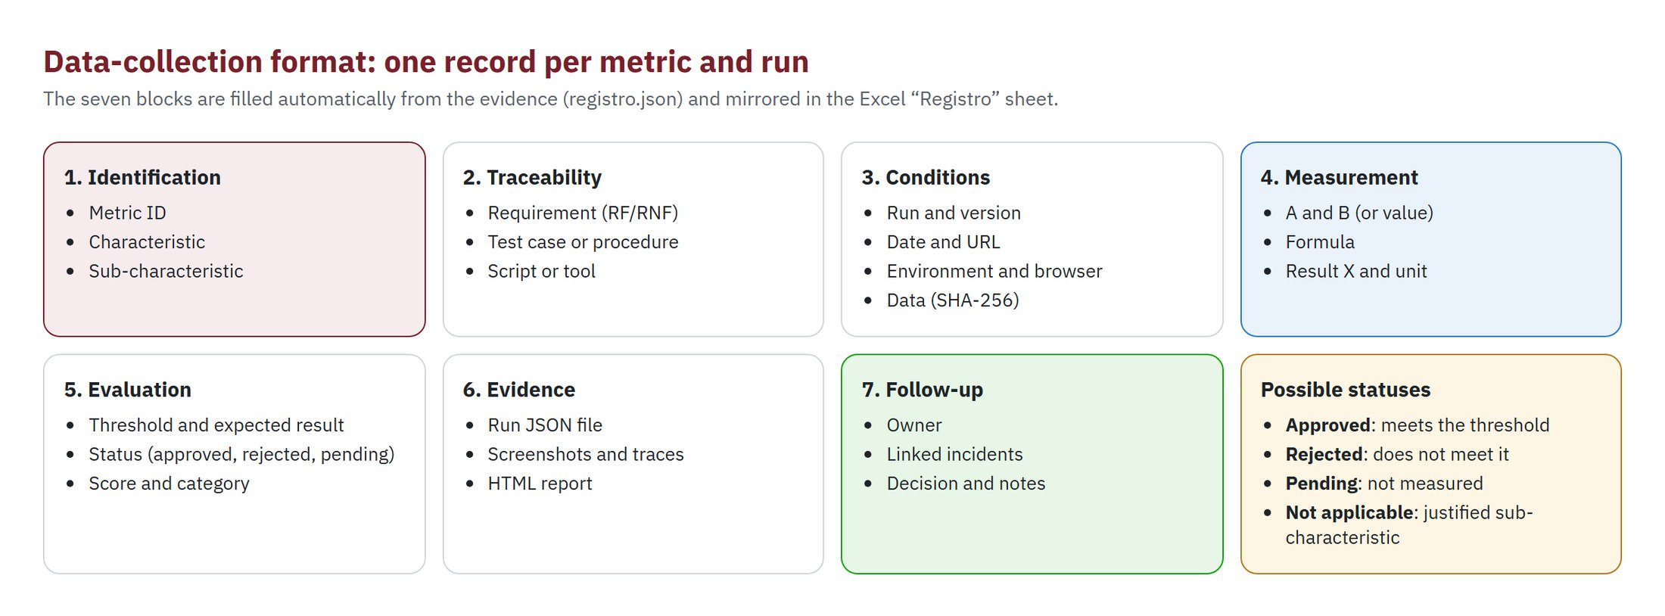
Point 3 — Data-collection format
One record per metric and run, seven blocks, generated from the evidence and mirrored in Excel
VigiSalud Malaria · ISO/IEC 25010 evaluation · Presenter: Alejandro Phocco
13
Notes:
Presenter: Alejandro Phocco
This is the collection format required by the assignment: identification, traceability, conditions, measurement, evaluation, evidence and follow-up. Records are not typed by hand: the consolidation script fills them from the JSON evidence of each run, and the Excel workbook recomputes result, status, score and category with formulas, so a reviewer can change A, B or the threshold and see the effect.

Slide 14
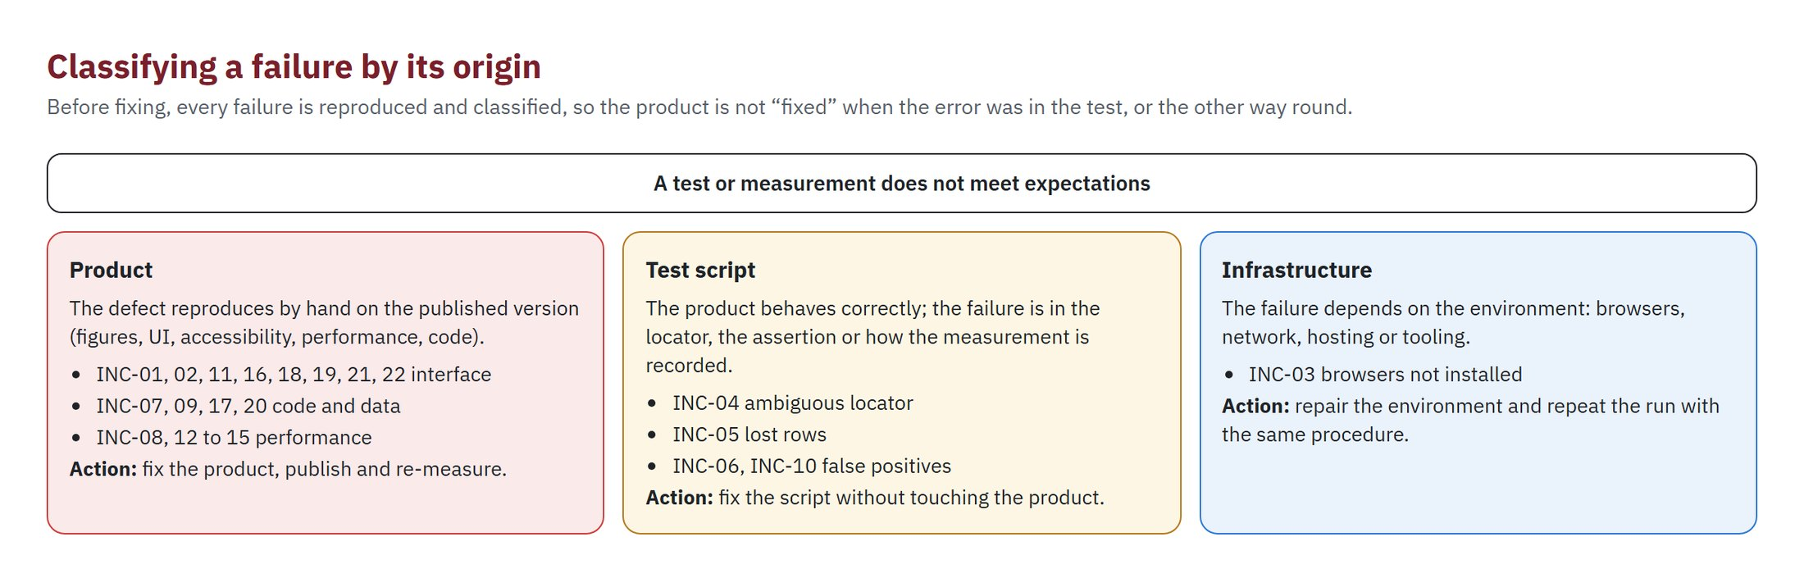
Point 3 — Classifying every failure by its origin
22 incidents: 17 product · 4 test script · 1 infrastructure
VigiSalud Malaria · ISO/IEC 25010 evaluation · Presenter: Alejandro Phocco
14
Notes:
Presenter: Alejandro Phocco
Before fixing anything we reproduce the failure and classify it. Product: the defect shows on the published version. Script: the product is right and the test or the way we record the measurement is wrong. Infrastructure: the environment. In run 01 Firefox and WebKit failed in all six combinations; the cause was simply that the browsers were not installed. Fixing the product for that would have been a mistake.

Slide 15
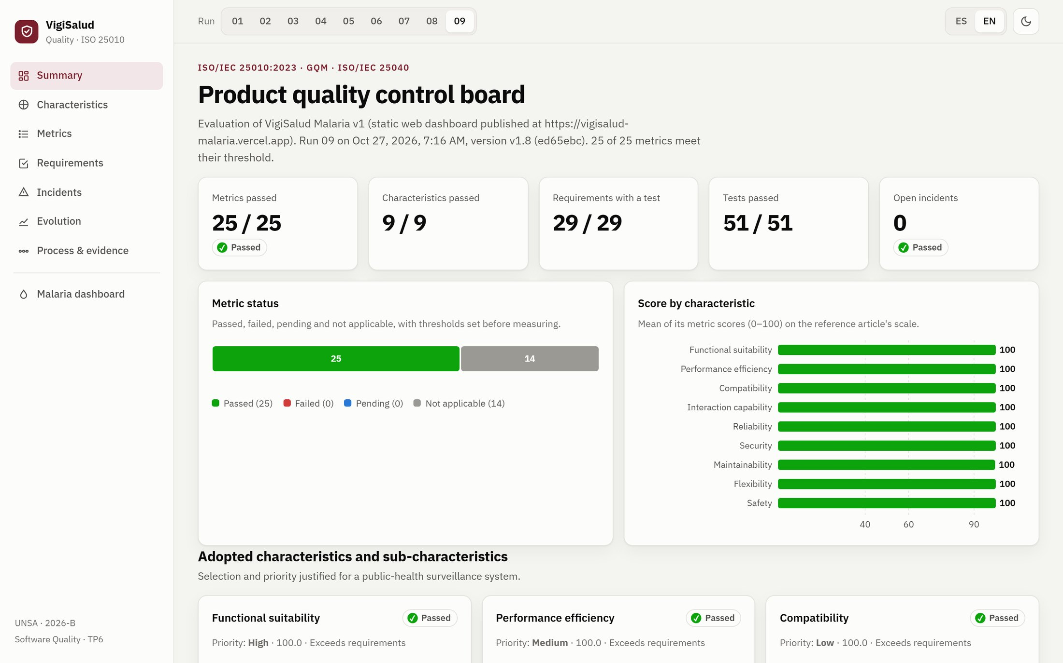
Point 4 — The control board (what it shows and how to read it)
https://vigisalud-malaria.vercel.app/calidad.html · bilingual · regenerated from the evidence after every run
▪ Status: approved / rejected / pending / N/A
▪ Score per characteristic: Calabrese scale
▪ Metric detail: A, B, X, threshold, evidence link
▪ Requirement coverage: 15 RF + 14 RNF
▪ Incidents: by origin and state
▪ Evolution: runs 01 → 09
▪ Evidence: screenshots of the last run
VigiSalud Malaria · ISO/IEC 25010 evaluation · Presenter: Mauricio Zegarra
15
Notes:
Presenter: Mauricio Zegarra
The control board is a web page published next to the product. A selector chooses the run. It shows the count of approved, rejected, pending and not-applicable metrics; the score per characteristic with guide lines at 40, 60 and 90; every metric with A, B, X, threshold, category, status and a link to its evidence; the coverage of the twenty-nine requirements; incidents by origin and state; the evolution across runs; the ISO 25040 process; and a gallery of evidence screenshots. Nothing on it is typed by hand.

Slide 16
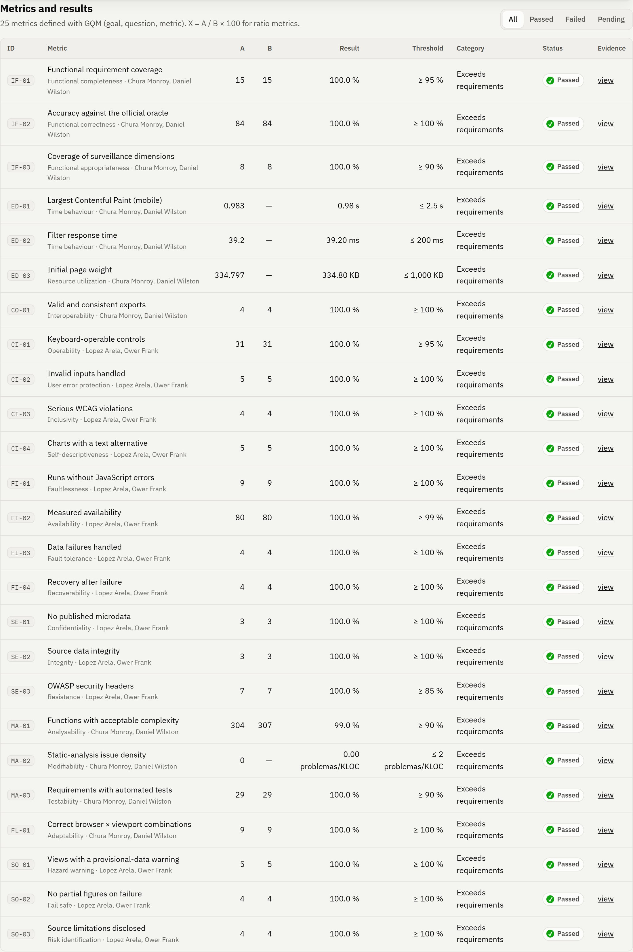
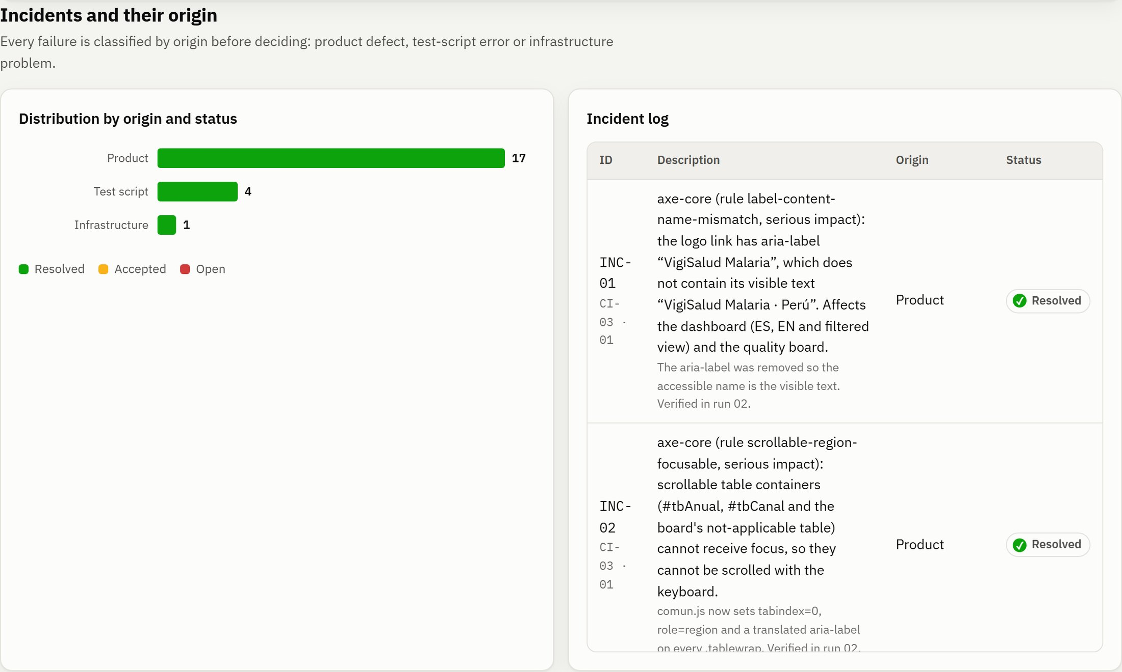
Point 4 — Board detail: metrics and incidents
VigiSalud Malaria · ISO/IEC 25010 evaluation · Presenter: Mauricio Zegarra
16
Notes:
Presenter: Mauricio Zegarra
Here is the metric table with its filter by status and links to the evidence on GitHub, and the incident distribution by origin and state. Every incident links to the metric and run where it appeared.

Slide 17
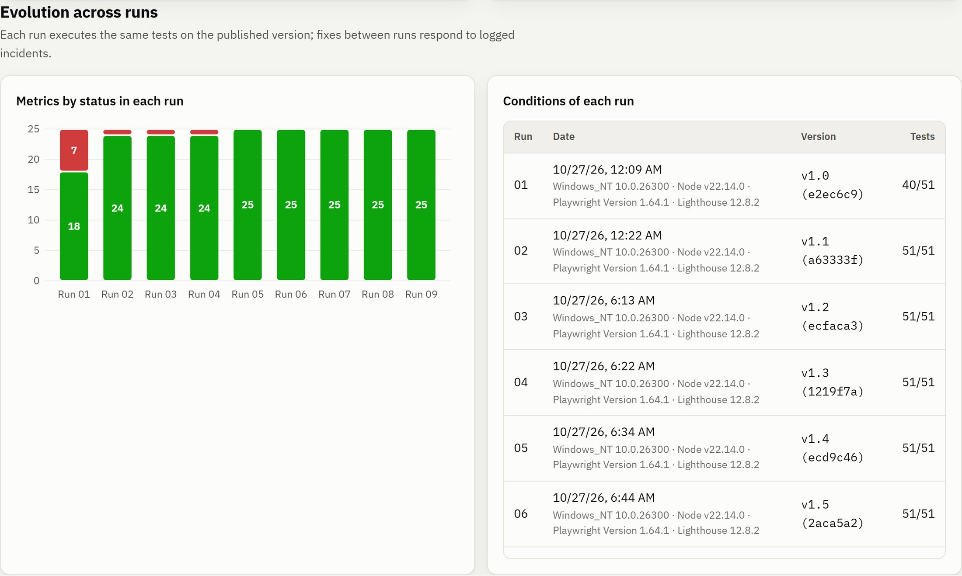
Evolution on the control board
The board keeps every run: status per metric, conditions and the version evaluated
VigiSalud Malaria · ISO/IEC 25010 evaluation · Presenter: Mauricio Zegarra
17
Notes:
Presenter: Mauricio Zegarra
This is the evolution view of the board. Each bar is one run; red is rejected metrics. On the right, the conditions of each run: date, environment, version and tests passed. A reviewer can select any run at the top of the board and see exactly what was measured then.

Slide 18
Results across the runs
Approved metrics per run: 18 → 24 → 24 → 24 → 25 → 25 → 25 → 25 → 25 (of 25) · automated tests: 40/51 → 51/51
ID | Metric | Threshold | 01 | 02 | 03 | 04 | 05 | 06 | 07 | 08 | 09
IF-01 | Functional requirement coverage | ≥ 95 % | 93.3 ✗ | 100.0 | 100.0 | 100.0 | 100.0 | 100.0 | 100.0 | 100.0 | 100.0
IF-02 | Accuracy against the official oracle | ≥ 100 % | 100.0 | 100.0 | 100.0 | 100.0 | 100.0 | 100.0 | 100.0 | 100.0 | 100.0
ED-01 | Largest Contentful Paint (mobile) | ≤ 2.5 s | 3.29 ✗ | 2.48 | 2.56 ✗ | 2.55 ✗ | 0.98 | 0.98 | 0.98 | 0.98 | 0.98
ED-02 | Filter response time | ≤ 200 ms | 42.80 | 42.40 | 38.50 | 38.50 | 36.90 | 36.60 | 37.10 | 38.80 | 39.20
CI-03 | Serious WCAG violations | ≥ 100 % | 0.0 ✗ | 100.0 | 100.0 | 100.0 | 100.0 | 100.0 | 100.0 | 100.0 | 100.0
FI-01 | Runs without JavaScript errors | ≥ 100 % | 33.3 ✗ | 100.0 | 100.0 | 100.0 | 100.0 | 100.0 | 100.0 | 100.0 | 100.0
FI-02 | Measured availability | ≥ 99 % | 100.0 | 100.0 | 100.0 | 100.0 | 100.0 | 100.0 | 100.0 | 100.0 | 100.0
SE-01 | No published microdata | ≥ 100 % | 66.7 ✗ | 66.7 ✗ | 100.0 | 100.0 | 100.0 | 100.0 | 100.0 | 100.0 | 100.0
MA-02 | Static-analysis issue density | ≤ 2 issues/KLOC | 3.01 ✗ | 0.00 | 0.00 | 0.00 | 0.00 | 0.00 | 0.00 | 0.00 | 0.00
FL-01 | Correct browser × viewport combinations | ≥ 100 % | 33.3 ✗ | 100.0 | 100.0 | 100.0 | 100.0 | 100.0 | 100.0 | 100.0 | 100.0
Columns 01–09: result X per run (units as in the threshold). Rows: metrics rejected in at least one run, plus three reference metrics. ✗ = threshold not met.
VigiSalud Malaria · ISO/IEC 25010 evaluation · Presenter: Daniel Chura
18
Notes:
Presenter: Daniel Chura
Run 01 was the baseline with 18 of 25 metrics approved. Rejections came from accessibility and performance defects of the product, lint problems, a test-script locator, a false positive in the confidentiality check and the missing browsers. Run 02 approved 24 metrics but also revealed two regressions caused by our own fixes, the logo name on mobile and layout shift from fonts, plus a residual false positive. Run 03 proved that one of our fixes had been misdiagnosed: layout shift was still 0.11 and mobile LCP went just above 2.5 seconds. Measuring the shifts directly in the browser showed a mobile grid that stretched the top bar while data was loading. Run 04 fixed the layout shift, but LCP stayed at 2.55 seconds: Lighthouse's simulated network counts every request started before first paint, and our own data and font preloads were now competing with it. After loading data and D3 after first paint, run 05 approved every metric; a manual review of its screenshots still found a clipped chart legend, fixed in run 06. Reviewing run 06 we found names whose letter Ñ arrives damaged in the official files, overlapping labels in the endemic channel and a cramped data card; reviewing run 07 in English we found Spanish text left in the English interface, and run 08 still showed the priority in Spanish. All were fixed and verified in run 09: 25 of 25. Correctness against the oracle was perfect in every run.

Slide 19
Incident log (1/2)
22 incidents: 17 product · 4 test script · 1 infrastructure — all reproduced, classified, fixed and re-measured
ID | Run | Metric | Origin | What happened
INC-01 | 01 | CI-03 | Product | axe-core (rule label-content-name-mismatch, serious impact): the logo link has aria-label “VigiSalud Malaria”, which does not contain its…
INC-02 | 01 | CI-03 | Product | axe-core (rule scrollable-region-focusable, serious impact): scrollable table containers (#tbAnual, #tbCanal and the board's not-applicable…
INC-03 | 01 | FL-01 | Infrastructure | The 6 Firefox and WebKit combinations (mobile, tablet and desktop) did not run: “browserType.launch: Executable doesn't exist” on the test…
INC-04 | 01 | IF-01 | Script | Test RF-04 failed with a “strict mode violation”: the locator getByRole('button', {name: 'P. falciparum'}) matched both the species filter…
INC-05 | 01 | CI-03 | Script | ci03-axe.json kept only the last of the 4 audited views. When a test fails Playwright restarts the worker, and rows held in memory were…
INC-06 | 01 | SE-01 | Script | SE-01 flagged calidad_datos.json as individual data because it contains the key “tipo_edad”. On review, that key holds an aggregate count…
INC-07 | 01 | MA-02 | Product | ESLint reported 3 no-unused-vars problems (unused “e” in catch blocks of comun.js and calidad.js): 3.01 per KLOC, above the threshold of 2.
INC-08 | 01 | ED-01 | Product | Mobile LCP of 3.29 s (median of 3 Lighthouse runs), above 2.5 s. The LCP element is the provisional-data notice; 79 % of the time is render…
INC-09 | 01 | MA-01 | Product | Function kpis() in app.js had cyclomatic complexity 25, more than twice the limit of 10, although MA-01 overall (98.2 %) met the threshold.
INC-10 | 02 | SE-01 | Script | SE-01 flagged calidad_datos.json again, this time for “localidad” and “localcod” inside “nulos” ({localidad: 5412, localcod: 5634}), which…
INC-11 | 02 | CI-03 | Product | Lighthouse's mobile accessibility audit dropped from 100 to 96 (rule link-name): below 960 px the logo link had no accessible name. This is…
VigiSalud Malaria · ISO/IEC 25010 evaluation · Presenter: Ower Lopez
19
Notes:
Presenter: Ower Lopez
Each incident records run, metric, requirement, description, cause, origin, severity, state, decision, owner and evidence. Here is the short version; the full record is on the board and in evaluacion/incidentes.json.

Slide 20
Incident log (2/2)
22 incidents: 17 product · 4 test script · 1 infrastructure — all reproduced, classified, fixed and re-measured
ID | Run | Metric | Origin | What happened
INC-12 | 02 | ED-01 | Product | Cumulative layout shift (CLS) rose from 0 to 0.11 on mobile, above the Core Web Vitals “good” value (0.1). Lighthouse attributes it to the…
INC-13 | 03 | ED-01 | Product | Mobile CLS stayed at 0.109 after INC-12. PerformanceObserver (layout-shift) at 412×823 showed the real cause: when the data is painted, the…
INC-14 | 03 | ED-01 | Product | Mobile LCP of 2.56 s (median of 3 runs), above the 2.5 s threshold; it was 2.48 s in run 02. The LCP element (the provisional-data notice)…
INC-15 | 04 | ED-01 | Product | CLS was fixed (0.0013), but mobile LCP stayed at 2.55 s even though the notice no longer waited for the data. Lighthouse uses simulated…
INC-16 | 05 | CI-04 | Product | A manual review of the run 05 screenshots showed the annual chart legend displaying “P.” and “…lcipar” instead of the species names. The…
INC-17 | 06 | IF-03 | Product | A manual review of the run 06 screenshots showed “Datem Del Mara�on” in the districts table. The official CSV files have the letter Ñ…
INC-18 | 06 | CI-04 | Product | In the endemic channel, the “Alarm” and “Safety” labels overlapped at the end of the chart when those bands are thin (e.g. 2024).
INC-19 | 06 | IF-03 | Product | In the “Data validation” card, the long label “Department recovered from INEI ubigeo” widened the first column and left values in a very…
INC-20 | 06 | SE-02 | Product | Re-running the pipeline for INC-17 revealed it took the download date from the system date (date.today()): each run would have changed the…
INC-21 | 07 | IF-01 | Product | Reviewing the English screenshots of run 07 showed Spanish text in the English interface. An automated sweep of the visible text confirmed…
INC-22 | 08 | IF-01 | Product | Visual inspection of the English screenshots of run 08 showed “Priority: Alta / Media / Baja” in the board's characteristic cards. The…
VigiSalud Malaria · ISO/IEC 25010 evaluation · Presenter: Ower Lopez
20
Notes:
Presenter: Ower Lopez
Each incident records run, metric, requirement, description, cause, origin, severity, state, decision, owner and evidence. Here is the short version; the full record is on the board and in evaluacion/incidentes.json.

Slide 21
Lessons learned
▪ Classify before fixing: 5 of 22 incidents were in our scripts or environment, not in the product.
▪ Re-measure after every fix: two fixes caused regressions (INC-11, INC-12) and one exposed a latent layout defect (INC-13).
▪ Close incidents with evidence: INC-12 looked fixed from the tool's explanation; run 03 proved it was not.
▪ One optimisation can hurt another: preloads that helped LCP in run 02 hurt it once the LCP element no longer needed the data (INC-15).
▪ Green is not the end: visual review found a clipped legend, overlapping labels, Ñ damaged in the official files and Spanish text in the English UI (INC-16 to INC-22); visual and automated checks complement each other.
▪ Respect the source: restored characters are listed and every figure was checked to be unchanged.
VigiSalud Malaria · ISO/IEC 25010 evaluation · Presenter: Alejandro Phocco
21
Notes:
Presenter: Alejandro Phocco
Our main lesson: many incidents were not product defects. Without the origin rule we would have changed the product for problems in our tests or our machine, and reported lower quality than the real one. Second: fixes can introduce regressions, which only appear when the complete measurement is repeated; that is why every fix requires a new run. Third: an incident is closed by the next measurement, not by the tool's explanation; INC-12 looked fixed and run 03 proved it was not. Fourth: green metrics are not the end; reviewing screenshots by eye we found defects that no metric caught, including names damaged in the official files. Fifth: our accessibility audit only ran on desktop; the logo regression appeared on mobile, so we recommend adding a mobile view to CI-03.

Slide 22
Conclusions
9 / 9
25
18 → 25
22
characteristics adopted
GQM metrics, automated
approved metrics (of 25)
incidents classified & closed
▪ Point 1: explicit priorities and justified exclusions for a read-only public-health system.
▪ Point 2: every selected sub-characteristic has a metric with formula, source, owner and a threshold fixed before measuring.
▪ Point 3: ISO/IEC 25040 process, seven-block collection format, failures classified by origin before fixing.
▪ Point 4: public bilingual control board regenerated from the evidence of every run.
▪ Next steps: run the evaluation in CI with deployment gates; add mobile axe audit; user testing for learnability.
Dashboard: https://vigisalud-malaria.vercel.app
Quality board: https://vigisalud-malaria.vercel.app/calidad.html · Repository: https://github.com/OwerLopez/vigisalud-malaria-iso25010
VigiSalud Malaria · ISO/IEC 25010 evaluation · Presenter: Mauricio Zegarra
22
Notes:
Presenter: Mauricio Zegarra
To conclude: we covered the four points with real measurements on the published product. Everything is reproducible from the repository, and the board and the dashboard are public. Thank you; we are happy to take questions.

