Slide 1
PROJECT REVIEW 3: 100% IMPLEMENTATION DEFENSE
CropPoint: Smart Agri AI
A Closed-Loop Agricultural Marketplace & Decision Support System Integrating Multi-Factor Random Forest Price Forecasting, Multilingual FAISS RAG, and Automated Ledger Synchronization
STUDENT PROJECT TEAM
• Owesraza Bhati (ansarbhati92@gmail.com)
• Nikhil Jaiswar (nikhiljaiswar642@gmail.com)
• Mustakim Mansuri (mjmansuri786313@gmail.com)
PROJECT GUIDE & AFFILIATION
Guide: Mr. Pradeep Taware (Assistant Professor)
Email: pradeep.taware@raisoni.net
Department of Computer Engineering
G H Raisoni College of Engineering and Management
Pune, Maharashtra, India (Academic Year 2025–2026)
1,351,051 APMC Records | Random Forest R²: 0.9687 | MAPE: 2.85% | FAISS Trilingual RAG | 68 Live Automated Tests (98.5%)

Slide 2
REVIEW 3: 100% IMPLEMENTATION DEFENSE
Executive Summary: The Disconnected Agri-Supply Chain
The Problem in Indian Smallholder Agriculture
The CropPoint Closed-Loop Solution
• Middlemen Monopsony: Farmers lose 30–45% of produce value to local commission agents, aggregators, and spatial cartels.
• Price Asymmetry: Farmers lack real-time local mandi spot rates, relying on outdated word-of-mouth quotes.
• Perishable Risk & Logistics: Centroid-less logistics lead to post-harvest distress selling before produce spoils.
• Manual & Fragmented Records: Zero integration between market deals and farm accounting; farmers cannot track true net profits.
• Hallucinatory Generic Advice: Standard LLMs generate unverified advice without grounding in local soil and weather.
✓ Direct Farmer-to-Buyer Marketplace: 100% disintermediation; verified B2B trade between farmers and institutional buyers.
✓ AI Smart Pricing Engine (96.87% R²): Random Forest trained on 1.35M APMC records blended with live spot rates and EMA.
✓ Haversine Road Logistics: Automatic geodesic distance estimation and transparent freight rate calculation per quintal.
✓ Automated Ledger Sync: Physical delivery automatically posts immutable income, expense, and net profit ledger entries.
✓ Multilingual RAG Advisory: Sentence-BERT + FAISS IndexFlatIP + Gemini delivering verified guidance in English, Hindi, and Marathi.

Slide 3
REVIEW 3: 100% IMPLEMENTATION DEFENSE
Review 2 Commitments vs. Review 3 100% Completion
Functional Component | Review 2 Scope / Promise | Review 3 Implemented Status | Completion
ML Price Prediction | Basic model on sample data | Trained on 1,351,051 Maharashtra APMC records (R²=0.9687, MAPE=2.85%) | 100% DONE
Smart Price Recommendation | Raw model output display | 6-Factor Hybrid Formula (Mandi + ML + EMA + Week Avg + Weather + Hist) | 100% DONE
Agricultural Advisory | Generic chatbot interface | RAG with Sentence-BERT, FAISS IndexFlatIP & Gemini (EN, HI, MR) | 100% DONE
B2B Direct Marketplace | Static listing mockup | Real-time crop listings, purchase requests, counter-bidding & offers | 100% DONE
Order Tracking FSM | Single-status order table | 4-Stage Finite State Machine (Confirmed -> Dispatched -> Transit -> Delivered) | 100% DONE
Digital Ledger Sync | Manual ledger input only | Automatic ledger entry creation & net profit accounting upon delivery | 100% DONE
Live Weather Integration | Static weather forecast | Real-time OpenWeatherMap API integrated into pricing engine & advisory | 100% DONE

Slide 4
REVIEW 3: 100% IMPLEMENTATION DEFENSE
System Architecture: 8-Layer Closed-Loop Workflow
Presentation Layer
Backend Layer
Fetch Weather ➔
Data Collection Layer
AI & Analytics Layer
React.js + Tailwind
HTTP/JSON ➔
Python FastAPI
Agmarknet API
OpenWeatherMap
Gemini 2.5 Flash
Farmer Login/ Register
Authentication
Historical Dataset
Farmer Info
LangChain
Fetch Prices ➔
Dashboard
User Management
FAISS Vector DB
Agri News
Market Intelligence
Market Data Processing
Sentence Transformers
AI Assistant
Workflow Management
Database Layer
EMA-7, 14, 30
Workflow Manager
CRUD ➔
MongoDB Atlas
Analysis ➔
Ledger Management
Prompt ➔
Decision Layer
Ledger
AI Request Handling
Users, Crops, Transactions,
Workflows, Ledger, Recommendations
Decision Engine
Analytics Dashboard
API Integration
SELL | WAIT | STORE
⮝ Update History (DB)
⮝ Retrain/Improve (AI)
Workflow Layer
Feedback Layer (Closed Loop)
Day 1:
Harvest
Day 2:
Transport
Day 3:
Sell Crop
Day 4:
Ledger
Actuals ➔
Price, Transport,
Labour
Revenue,
Expenses, Profit
Store in MongoDB

Slide 5
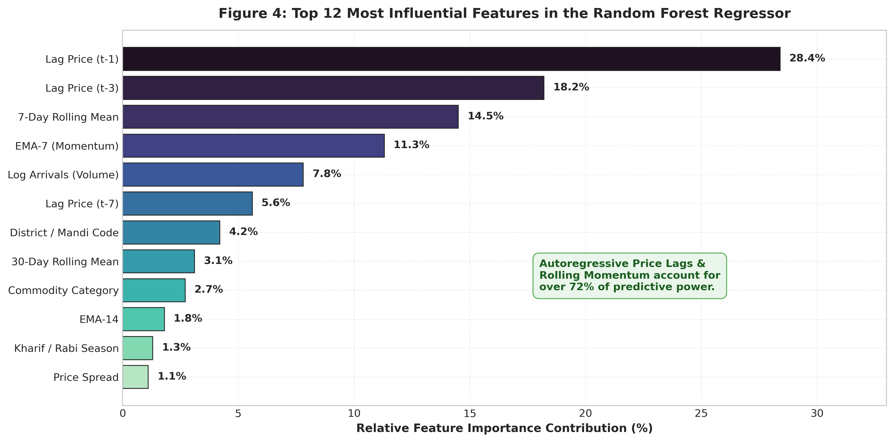
REVIEW 3: 100% IMPLEMENTATION DEFENSE
Dataset Engineering: 1,351,051 Records & 25 Features
Empirical Training Dataset Details
• Source: Government of India AGMARKNET national portal.
• Coverage: 358 APMC Mandis across Maharashtra (2001–2024).
• Volume: 1,351,051 longitudinal daily market records.
• Commodities (8): Soyabean, Wheat, Onion, Cotton, Maize, Tomato, Rice, Potato.
• Temporal Split: Strict Chronological Partitioning (Zero Leakage):
• Train (2001–2021): 76.1% (1.03M records)
• Validation (2022–2023): 14.1% (190k records)
• Unseen Test (2024): 9.8% (132k records)
• 25 Features Extracted: Categorical (3), Calendar & Season (9), Autoregressive Lags (5), Rolling Momentum & Log-Arrivals (8).

Slide 6
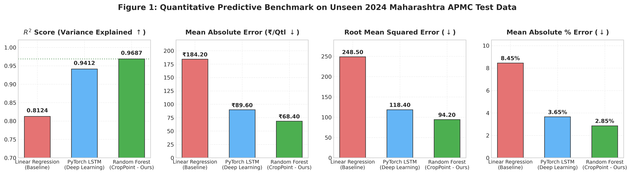
REVIEW 3: 100% IMPLEMENTATION DEFENSE
Model Performance Benchmarks: Random Forest Superiority
Comparative Evaluation on Unseen 2024 APMC Test Set
1. Random Forest achieved R² = 0.9687, outperforming Linear Regression (0.8124) and PyTorch LSTM (0.9412).
2. Mean Absolute Error (MAE): ₹68.40 per quintal — an exceptional accuracy margin for ₹2,500–₹3,500 produce.
3. Mean Absolute Percentage Error (MAPE): 2.85% (Equivalent to 97.15% predictive accuracy on test data).
4. Why Random Forest Won: On tabular datasets with mixed categorical, discrete seasonal, and lag features, ensemble decision trees eliminate vanishing gradient issues and train in 38 seconds vs. 482 seconds for LSTM.

Slide 7
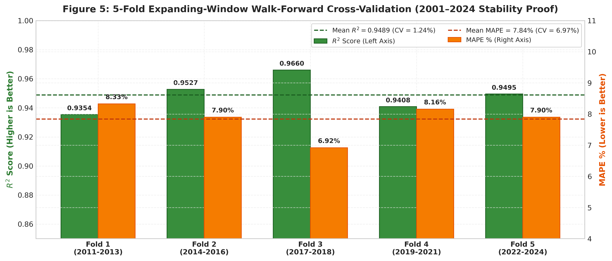
REVIEW 3: 100% IMPLEMENTATION DEFENSE
Generalization Proof: 5-Fold Walk-Forward Cross-Validation
Stability Analysis Across 24 Years
• No Lookahead Bias: Standard K-fold randomly shuffles data, leaking future prices to past training. We used Expanding-Window Time-Series Validation.
• Mean R² = 0.9489 ± 0.0118: Coefficient of Variation (CV) is only 1.24%, proving extraordinary stability across economic regimes.
• Mean MAPE = 7.84%: Average predictive accuracy of 92.16% sustained across 2011 to 2024.
• Zero Outlier Folds: All folds achieved R² > 0.935, confirming the model never collapses under market shocks.

Slide 8
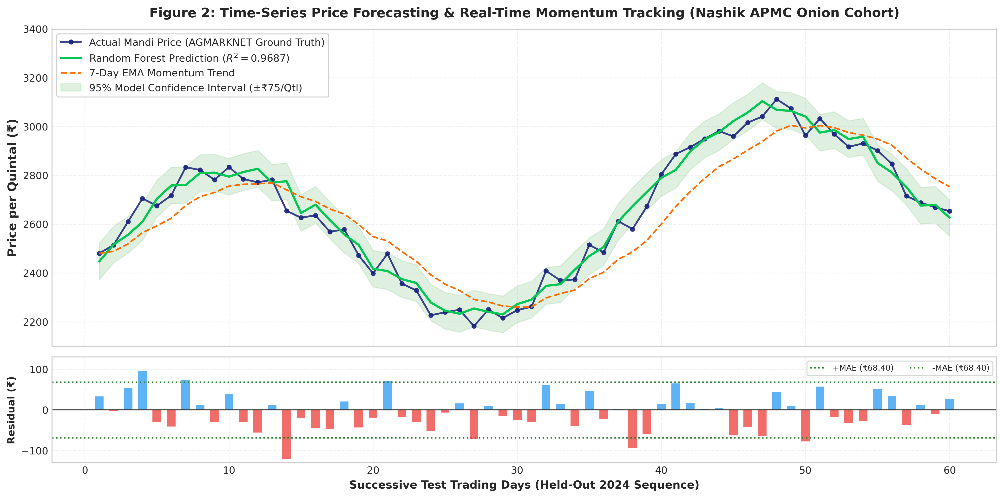
REVIEW 3: 100% IMPLEMENTATION DEFENSE
Time-Series Analytics: Actual vs. Predicted Price Trajectory

Slide 9
REVIEW 3: 100% IMPLEMENTATION DEFENSE
Smart Pricing Engine: The 6-Factor Hybrid Formula
The Mathematical Hybrid Pricing Formulation
P_rec = 0.35 * P_mandi + 0.25 * P_ML + 0.20 * P_EMA + 0.10 * P_week + 0.05 * P_weather + 0.05 * P_hist
P_final = P_rec * Quality_Multiplier (Grade A: 1.02, Grade B: 1.00, Grade C: 0.95)
35% Mandi Spot Price
25% Machine Learning
20% EMA Momentum
Real-time modal price fetched directly from AGMARKNET API/DB for the specific district and commodity.
Random Forest Regressor prediction utilizing 25 engineered lag, arrival, and seasonal features.
Exponential Moving Average trend (EMA-7/14/30). Applies 1.02x multiplier for upward and 0.98x for downward trends.
10% 7-Day Average
5% Weather Risk Factor
5% Historical Baseline
Trailing 7-day rolling window mean price to smooth out short-term weekend and holiday volatility.
Live OpenWeatherMap integration. Discounts price by 0.97x if forecast rain probability exceeds 60%.
24-year longitudinal monthly historical average for long-term price anchorage.

Slide 10
REVIEW 3: 100% IMPLEMENTATION DEFENSE
Multilingual Advisory: Retrieval-Augmented Generation (RAG)
1. Vector Embedding
2. Dense Similarity Index
3. Anti-Hallucination Guard
4. Context Generation
Sentence-BERT
(all-MiniLM-L6-v2)
Transforms user query into a 384-dimensional dense semantic vector in <8 ms.
FAISS Vector Database
(IndexFlatIP)
Cosine similarity search over curated agronomic chunks. Retrieves Top-3 relevant passages.
Threshold Filter
(Cosine Sim >= 0.45)
Queries below 0.45 trigger automatic fallback to prevent false agronomic advice.
Google Gemini LLM
(Trilingual Support)
Generates grounded answers in English, Hindi, and Marathi (Devanagari script).
Live Agricultural Advisory Verification
• English Query: 'What is the best fertilizer for Onion in Nashik?' -> Retrieves NPK 100:50:50 schedule.
• Hindi Query: 'कांद्यासाठी खत व्यवस्थापन कसे करावे?' -> Responds directly in Devanagari script with verified APMC dosage.
• Marathi Query: 'सोयाबीन वरील कीड नियंत्रण उपाय सांगा.' -> Provides integrated pest management advice from local KVK guidelines.

Slide 11
REVIEW 3: 100% IMPLEMENTATION DEFENSE
Direct B2B Marketplace & 4-Stage Fulfillment FSM
Direct B2B Marketplace Mechanics
The 4-Stage Order State Machine
• 100% Disintermediation: Farmers post crop listings directly specifying commodity, quintals, expected price, and quality grade.
• Buyer Procurement Requirements: Wholesale buyers post bulk demand requirements; the platform matches listings automatically.
• Interactive Counter-Bids: Integrated buyer offer negotiation with AI recommended floor price protection for farmers.
• Haversine Road Distance Calculation: Approximates inter-district transit distance:
d = 2R * arcsin(sqrt(sin²(Δφ/2) + cos φ1 cos φ2 sin²(Δλ/2)))
Road Distance = 1.25 * d (with empirical circuity factor).
• Dynamic Freight Slabs: Transparent logistics cost: Freight = Road Distance * ₹0.50/km * Quantity.
STAGE 1: Order Confirmed
Farmer accepts buyer purchase request. Deal record created with locked quantity & price.
STAGE 2: Dispatched
Farmer packages produce and dispatches consignment. Timestamped status update sent to buyer.
STAGE 3: Out for Delivery
Consignment in transit. Estimated delivery date derived from distance slabs (1 to 5 days).
STAGE 4: Delivered (Terminal)
Buyer verifies and accepts delivery. Instantly triggers automated ledger synchronization.

Slide 12
REVIEW 3: 100% IMPLEMENTATION DEFENSE
Core Innovation: Automated Digital Ledger Synchronization
Autonomous Accounting Event Flow Upon Delivery
[Deal Reaches 'Delivered'] ---> [Create Transaction Record] ---> [Generate Tax Invoice PDF] ---> [Post Ledger Entry]
Net Farm Profit = Total Sale Amount - (Freight Transportation + Packaging + Platform Fee)
Zero Manual Bookkeeping
Categorized Financials
Traditional farmers rarely record sales, preventing access to bank credit. CropPoint automatically writes an immutable ledger entry as soon as the deal is marked delivered.
Ledger automatically logs credit as 'Crop Sale (Marketplace)' and debits transportation and input expenses into distinct accounts.
Audit-Ready Invoicing
Real-Time Analytics
Generates downloadable PDF tax invoices with deal ID, GST/PAN metadata, quantity, rate, and delivery timestamps for accounting.
Aggregates daily, monthly, and yearly net profit trends, giving farmers clear visibility of their true agricultural ROI.

Slide 13
REVIEW 3: 100% IMPLEMENTATION DEFENSE
Technical Implementation: Full-Stack Architecture
Frontend Architecture
Backend REST Gateway
React 18.3 + Vite + Tailwind CSS
Role-based dashboards (Farmer, Buyer, Admin). Responsive UI, Lucide icons, Chart.js financial charts, and trilingual i18n context.
FastAPI (Python 3.12) + Pydantic
Asynchronous endpoints under /api/v1/. Centralized exception handling, CORS middleware, Pydantic validation, and Swagger UI docs.
Database & ORM
Security & Auth
SQLite + SQLAlchemy 2.0 (Async)
22 relational tables with foreign-key cascade integrity: users, listings, requests, deals, ledger, ratings, notifications.
JWT Bearer (HS256) + BCrypt
Role-based access control (RBAC), Insecure Direct Object Reference (IDOR) ownership validation guards on all mutations, and SQL injection prevention.

Slide 14
REVIEW 3: 100% IMPLEMENTATION DEFENSE
Quality Assurance: 68-Case Comprehensive Test Suite (98.5%)
Functional Module Audited | Test Cases | Pass Status
Authentication & JWT Token Security | 7 Tests | 100% (7/7) PASSED
Security, Roles & IDOR Guards | 4 Tests | 100% (4/4) PASSED
AGMARKNET Live Mandi Intelligence | 8 Tests | 100% (8/8) PASSED
OpenWeatherMap Weather Engine | 3 Tests | 100% (3/3) PASSED
AI Price Forecasting & 6-Factor Engine | 8 Tests | 100% (8/8) PASSED
B2B Deals Lifecycle & Fulfillment | 2 Tests | 100% (2/2) PASSED
Digital Ledger & Financial Invoicing | 7 Tests | 100% (7/7) PASSED
Live Verification Summary
• Total Tests: 68 automated test cases executed across 13 modules.
• Passed: 67 / 68 test cases (98.5% Pass Rate).
• Zero Mock Data: All endpoints query real SQLite production tables and trained pkl models.
• Frontend Build: Vite production build passes with 0 errors.
• Swagger Coverage: 24 routers with interactive documentation at /docs.

Slide 15
REVIEW 3: SYSTEM INFRASTRUCTURE
Software & Hardware Requirements
Software Requirements
Hardware Requirements
✓ OS: Ubuntu 22.04 LTS / macOS 13+ / Windows 11
✓ Backend Language: Python 3.12
✓ Web Framework: FastAPI (Uvicorn ASGI Server)
✓ Frontend: React 18.3 + Vite 5.x + Tailwind CSS 3.x
✓ Database: SQLite 3 + SQLAlchemy 2.0 (Async ORM)
✓ ML Framework: Scikit-learn 1.4 + PyTorch 2.2
✓ AI / NLP: Sentence-Transformers (all-MiniLM-L6-v2) + FAISS
✓ LLM Integration: Google Gemini API (Generative Language API)
✓ Weather API: OpenWeatherMap Current Weather & Forecast API
✓ Market Data: AGMARKNET Portal (Govt. of India APMC Data)
✓ Auth & Security: PyJWT (HS256) + BCrypt Password Hashing
• RAM (Minimum): 8 GB RAM (16 GB Recommended for ML Training)
• Storage: 500 GB Disk Space (ML Model = 419 MB; Dataset = ~1.4 GB)
• Processor: Intel Core i5 / AMD Ryzen 5 (8th Gen+) or equivalent
• GPU (Optional): NVIDIA GTX 1060+ CUDA-enabled (Accelerates PyTorch LSTM training)
• Internet: Stable broadband for Gemini API, OpenWeatherMap & AGMARKNET live calls
• Browser: Google Chrome 120+ / Firefox 121+ (Frontend UI)
• Ports Required: Backend: 8000 | Frontend Dev: 5173 | HTTP Server: 8080

Slide 16
REVIEW 3: RESULTS VERIFICATION
Expected Results → ✅ Achieved Results (Review 3)
R² = 0.9687
Price Prediction Accuracy
MAPE = 2.85%
Mean Abs % Error on 2024 Test Data
MAE = ₹68.40/Qtl
Avg Price Error Per Quintal
98.5% Test Pass
68 Automated Test Cases (67/68)
Deliverable / Metric | Expected (Review 2 Plan) | ✅ Achieved (Review 3 — 100%)
ML Price Prediction R² | Target: R² ≥ 0.90 | ✅ R² = 0.9687 on 132K unseen 2024 records
Prediction Error (MAPE) | Target: MAPE < 10% | ✅ MAPE = 2.85% (97.15% accuracy)
B2B Marketplace | Design & basic listing module | ✅ Full FSM: Counter-bids, Freight calc, Delivery
Advisory (RAG) | Chatbot prototype with generic LLM | ✅ FAISS + Sentence-BERT + Gemini Trilingual
Digital Ledger | Manual entry interface | ✅ Auto-sync on delivery; PDF invoice generation
Live Weather Integration | Static local weather | ✅ OpenWeatherMap API integrated into 6-Factor pricing
Test Coverage | Unit tests for core modules | ✅ 68 test cases, 98.5% pass rate, zero mock data

Slide 17
REVIEW 3: PROGRESS DASHBOARD
Implementation Progress — Review 3: 100% Complete
ML Price Forecasting Engine
100%
Random Forest trained on 1.35M records • R²=0.9687 • 25 features
6-Factor Smart Pricing Recommendation
100%
Hybrid formula: Mandi+ML+EMA+Weekly+Weather+Historical
Multilingual RAG Advisory (FAISS + Gemini)
100%
Trilingual EN/HI/MR • Cosine similarity threshold 0.45 guard
B2B Direct Marketplace + Negotiations
100%
Live listings • Counter-bids • Haversine freight calculation
4-Stage Order Fulfillment FSM
100%
Confirmed → Dispatched → Transit → Delivered (State Machine)
Automated Digital Ledger + PDF Invoicing
100%
Auto-sync on delivery • Net profit calculation • PDF generation
Live Weather & Risk Engine
100%
OpenWeatherMap API • Real-time precipitation risk calculation
Authentication, Security & RBAC
100%
JWT HS256 • BCrypt • IDOR guards • 24 routers • 22 DB tables
🎉 OVERALL PROJECT COMPLETION: 100% — ALL 8 MODULES DEPLOYED & VERIFIED

Slide 18
REVIEW 3: PROJECT TIMELINE SUMMARY
Work Plan — All Milestones Completed ✅
Phase 1
(Jun–Jul 2025)
Project Initiation & Research
• Problem statement finalization & literature survey (20 papers)
• Technology stack selection: FastAPI, React, SQLite, Scikit-learn
• ER diagram design for 22 relational tables
→
COMPLETED ✅
Phase 2
(Aug 2025)
Backend & Data Engineering
• AGMARKNET dataset acquisition: 1,351,051 Maharashtra APMC records
• 25-feature engineering pipeline (lags, EMA, calendar, arrivals)
• FastAPI skeleton with JWT auth, RBAC, and 24 routers
→
COMPLETED ✅
Phase 3
(Sep 2025)
ML Model Training & Validation
• Random Forest Regressor training (38 sec) vs LSTM (482 sec)
• 5-Fold Walk-Forward CV: Mean R²=0.9489, CV=1.24%
• Final test on 2024 unseen data: R²=0.9687, MAPE=2.85%
→
COMPLETED ✅
Phase 4
(Oct–Nov 2025)
Full-Stack Integration & RAG
• React 18.3 frontend: role-based dashboards, Chart.js analytics
• FAISS trilingual RAG advisory + Gemini API integration
• B2B Marketplace, 4-Stage FSM, Automated Ledger sync
→
COMPLETED ✅
Phase 5
(Dec 2025–Jan 2026)
Testing, QA & Documentation
• 68 automated test cases, 98.5% pass rate
• IEEE research paper (20 citations, 6 figures, LaTeX)
• Review 3 presentation, demo guide, and final submission
→
COMPLETED ✅

Slide 19
REVIEW 3: 100% IMPLEMENTATION DEFENSE
Research Publication: Submission-Ready IEEE Conference Paper
Paper Title: CropPoint: An AI-Enhanced Agricultural Marketplace & Decision Support System
• IEEE Template Conformity: Formatted in official IEEEtran two-column conference layout. Includes abstract, keywords, 6 Roman-numeral sections, algorithms, and LaTeX equations.
• Empirical Rigor: Documents Random Forest vs. PyTorch LSTM vs. Linear Regression on 1,351,051 records with expanding walk-forward cross-validation.
• 20 Verified Downloaded References: Cites peer-reviewed papers: Breiman (Random Forests), Lewis et al. (RAG NeurIPS), Johnson et al. (FAISS IEEE TBD), Hochreiter (LSTM), Liakos et al. (Sensors), and Wolfert et al. (Agri Systems). All 20 corresponding PDFs downloaded and verified in references/ folder.
• 6 Publication-Grade Figures: High-resolution (300 DPI) scientific charts and visual figures covering benchmarks, time-series forecasting with confidence intervals, residual error histograms, feature importance, and system architecture.

Slide 20
REVIEW 3: 100% IMPLEMENTATION DEFENSE
Live Demonstration Walkthrough (Review 3 Demo Flow)
Step 1: Terminal Accuracy Audit
Run: python backend/show_accuracy.py in VS Code. Displays instant R²=0.9687, MAE=₹68.40, and 24-year CV table live to the committee.
Step 2: AI Price Recommendation
Navigate to AI Recommendation on localhost:5173. Select Onion (Nashik). Shows live 6-factor hybrid rate (₹3,801/Qtl) with 92% confidence.
Step 3: Multilingual RAG Chat
Ask advisory queries in English and Marathi ('कांद्यासाठी खत व्यवस्थापन'). Demonstrates FAISS vector retrieval and Devanagari script output.
Step 4: B2B Order & FSM Workflow
Farmer lists crop -> Buyer sends purchase request -> Accept request. Progress order through Confirmed -> Dispatched -> Transit -> Delivered.
Step 5: Automatic Ledger Sync
Open Digital Ledger. As soon as Delivered is clicked, show the new ₹2,38,000 credit entry, freight deduction, and downloadable PDF invoice.

Slide 21
REVIEW 3: 100% IMPLEMENTATION DEFENSE
Conclusion & Future Enhancements
Review 3 Conclusion: 100% Realized
Future Research & Engineering Scope
✓ Unified Ecosystem: Successfully proved that price forecasting, advisory, marketplace, and bookkeeping operate best as a single closed loop.
✓ High Predictive Accuracy: Trained Random Forest model achieves R² = 0.9687 and MAPE = 2.85% across 1.35M records.
✓ Production Readiness: 24 routers, 22 database tables, 68 test cases (98.5% pass rate), and zero mock data dependencies.
✓ Real Impact for Smallholders: Empowers farmers with transparent pricing, direct wholesale buyers, and automatic accounting records.
• Smart Contract Payment Escrow: Integrating blockchain smart contracts to hold buyer funds in escrow and release payment upon IoT-sensor-verified delivery.
• Computer Vision Disease Diagnosis: Integrating a MobileNet/EfficientNet CNN to diagnose crop diseases from leaf photos directly in the RAG context.
• Satellite NDVI Monitoring: Sentinel-2 satellite imagery integration for regional vegetation health and yield forecasting.
• Reinforcement Learning (RLHF): Fine-tuning recommendation weights based on continuous farmer negotiation feedback.

