Slide 1
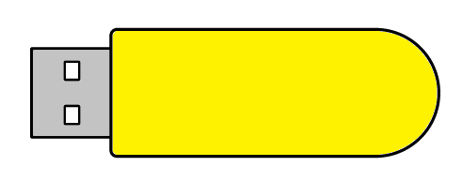
MM
<' \___/|
\_ _/
][
Pecky
A BadUSB Using Arduino
Presented by: Krishna S Nandana Ajilal Sangeeth Satheesh Soorya Kiran B | Guided by: Divya TL Asst. Professor CSE Dept

Slide 2
Abstract
This mini-project involves creating a USB stick that emulates a keyboard using an Arduino Pro Micro to execute preset commands upon connection to a computer. The Arduino, with its ATmega32U4 microcontroller, is programmed to send keystrokes that automate tasks or, in a malicious context, exploit system vulnerabilities. The hardware mainly includes an Arduino Pro Micro and a USB stick case, while the software part uses the Arduino IDE and the Arduino Keyboard library to simulate keyboard input. This project demonstrates both the versatility of Arduino in emulating USB devices and the security risks posed by USB peripherals, often exploited in a BadUSB attack.

Slide 3
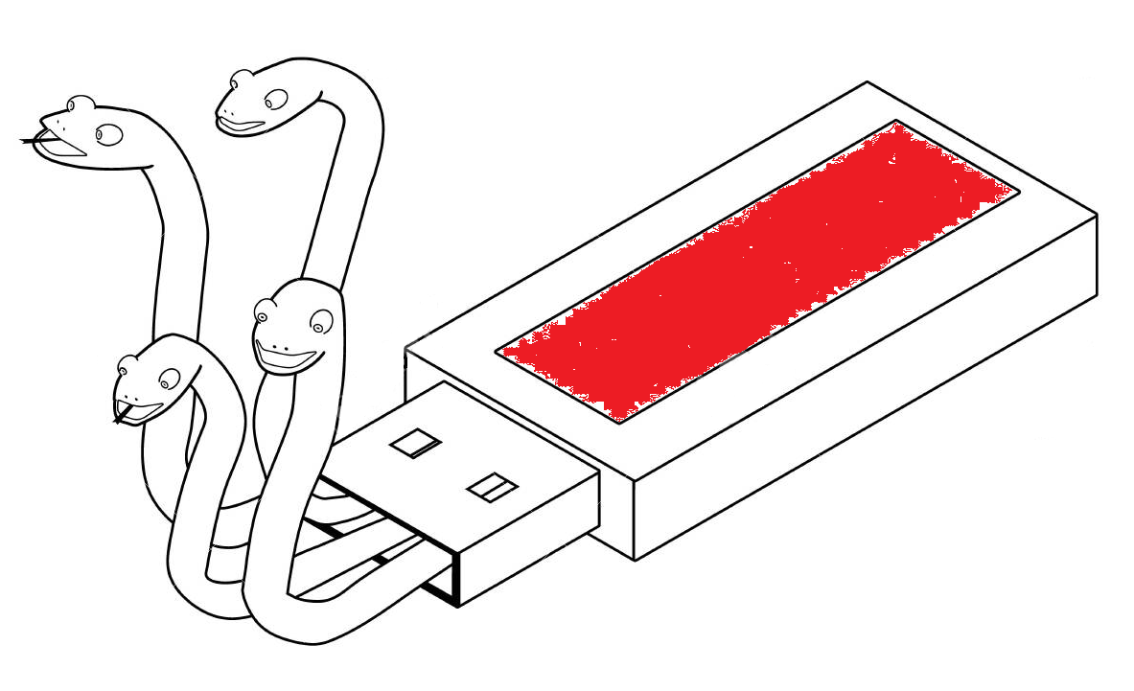
Introduction
What is BadUSB?
A USB based computer security attack
Special USB devices that are programmed to act maliciously
BadUSBs commonly emulate a keyboard
Types malicious commands upon plugging into a device

Slide 4

Introduction
Why is it possible?
USB is designed for an easy, plug-and-play interface
Computers trust HID devices
Attacks have same privilege as the logged in user
Able to bypass most security measures

Slide 5
Literature Survey
1. Spyduino: Arduino as a HID exploiting the BadUSB vulnerability
Evangelos Karystinos, Antonios Andreatos, Christos Douligeris
May 2019, 10.1109/DCOSS.2019.00066
Methodology Used | Merits | Demerits | Proposed System Benefits
An Arduino UNO board embedded within a keyboard acting an HID device to do BadUSB attacks. | Difficult to detect due to being physically hidden. | Not easy to setup or reprogram for future uses. | Ease of reprogramming and improved adaptability.

Slide 6
Literature Survey
2. Exploit remote attack test in operating system using Arduino Micro
HE Wahanani et al 2020 J. Phys.: Conf. Ser. 1569 022038
Methodology Used | Merits | Demerits | Proposed System Benefits
Injecting remote exploits made using Metasploit using an Arduino Micro based BadUSB. | Potential to take full control of the target system using unpatched exploits. | Over reliant on stable network connections for proper working. | Supports both network based as well as offline attack payloads.

Slide 7
Literature Survey
3. Enhancement And Implementation Of BadUSB Attacks Using
Microcontrollers
B S Vishnu Charan, Lalit Kulkarni | 2022, Vol. 6, No. 9, 563-573
Methodology Used | Merits | Demerits | Proposed System Benefits
A Raspberry Pi Pico and Node MCU joined to create a wirelessly controlled BadUSB device. | Potential for live, offline control of the victim’s system. | Use of two development boards leads to high cost and large size. | Compact, cheap and extendable design.

Slide 8
Literature Survey
4. Hacking Experiment by Using USB Rubber Ducky Scripting
Benjamin Cannols, Ahmad Ghafarian | 2017 Vol. 5, No. 2, 1690-4524
Methodology Used | Merits | Demerits | Proposed System Benefits
Mimikatz based attack on a Windows machine using USB Rubber Ducky. | Ability to quickly steal log in credentials. | Attack device used is expensive and not easily available. | Uses cheap and commonly available hardware to do similar attacks.

Slide 9
Literature Survey
5. Bypassing Multiple Security Layers Using Malicious USB Human
Interface Device
Mathew Nicho, Ibrahim Sabry | 2023, 978-989-758-624-8
Methodology Used | Merits | Demerits | Proposed System Benefits
Analysis and demonstration of BadUSB attacks bypassing different layers of security. | Details various possible methods to do attacks using the USB protocol. | Focuses on theoretical and simulated attacks. | Practical and easy to use real-world tool for doing BadUSB attacks.

Slide 10
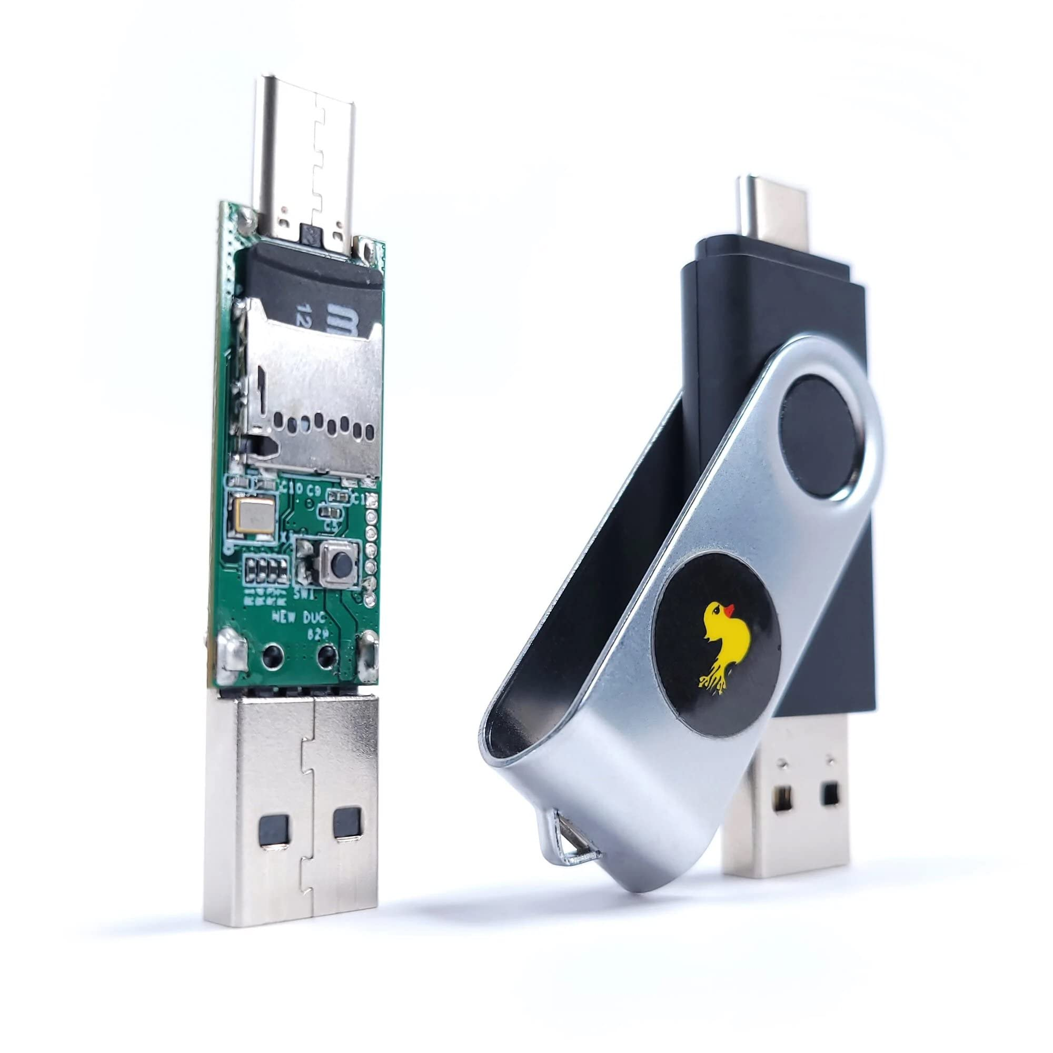
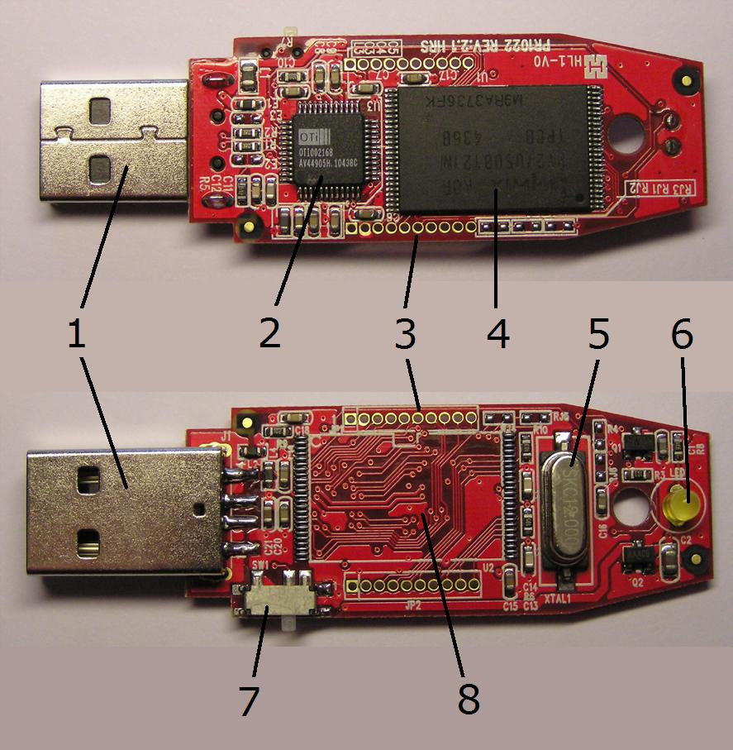
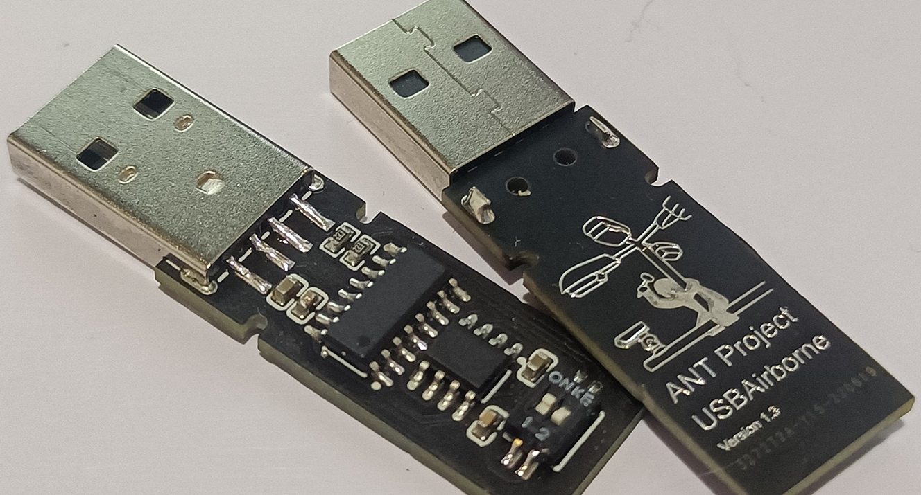
Existing System
Reprogrammable USB flash drive
USBAirborne
Push3AX
USB Rubber Ducky
Hak5

Slide 11

Existing System
Some disadvantages of existing BadUSB devices:
High cost
Low availability
Difficult to build
Reduced customization options
Proprietary designs
Documentation may not be free
₹6,500

Slide 12
Problem Statement
Existing devices performing BadUSB attacks are expensive and are not easily available.
By using an Arduino based system, known for its flexibility and ease of use, the device can be developed very easily and at a much lower cost.

Slide 13
Proposed System
A device that looks like a USB flash drive
Contains a programmable Arduino board
Able to store different attack “payloads”
Acts as a keyboard upon insertion
Types commands at very high speed

Slide 14
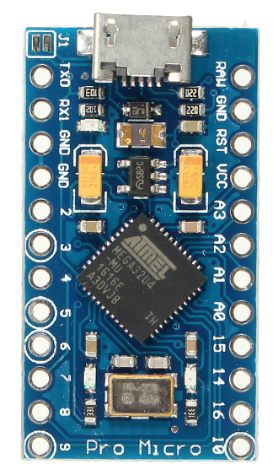
System Requirements
Hardware
Full USB 2.0 support
USB capable Arduino board with a small form-factor
ATmega32U4
Clock: 16 MHz
SRAM: 2.5KB
Flash: 32KB
EEPROM: 1KB
Arduino Pro Micro

Slide 15
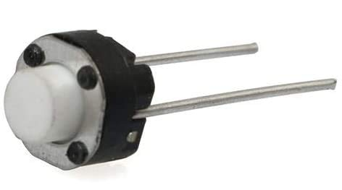
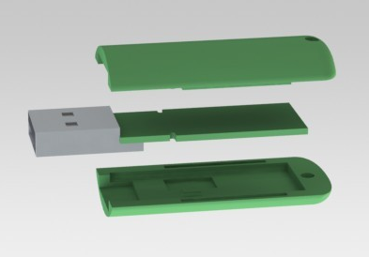

System Requirements
Hardware
Push button
Indicator LED
Plastic USB case

Slide 16
System Requirements
Software
For programming:
Arduino IDE (Windows, macOS, Linux)
Arduino Keyboard library

Slide 17
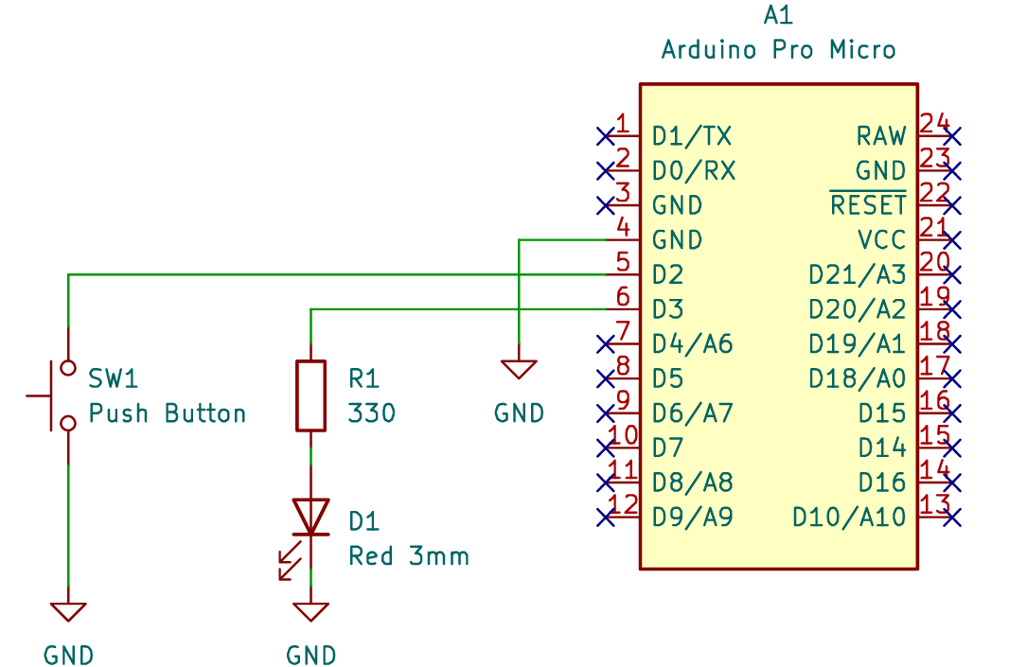
Design
Schematic Diagram

Slide 18
Start
Attack mode
Pecky is plugged in
Programming mode
Is button pressed?
Programming
started
New attack code
Yes
Wait for programming
or button presses
No
Button pressed
Perform selected attack
Read button presses
and change selected attack
Install new attack code
Pecky is unplugged
Usage Diagram
End

Slide 19
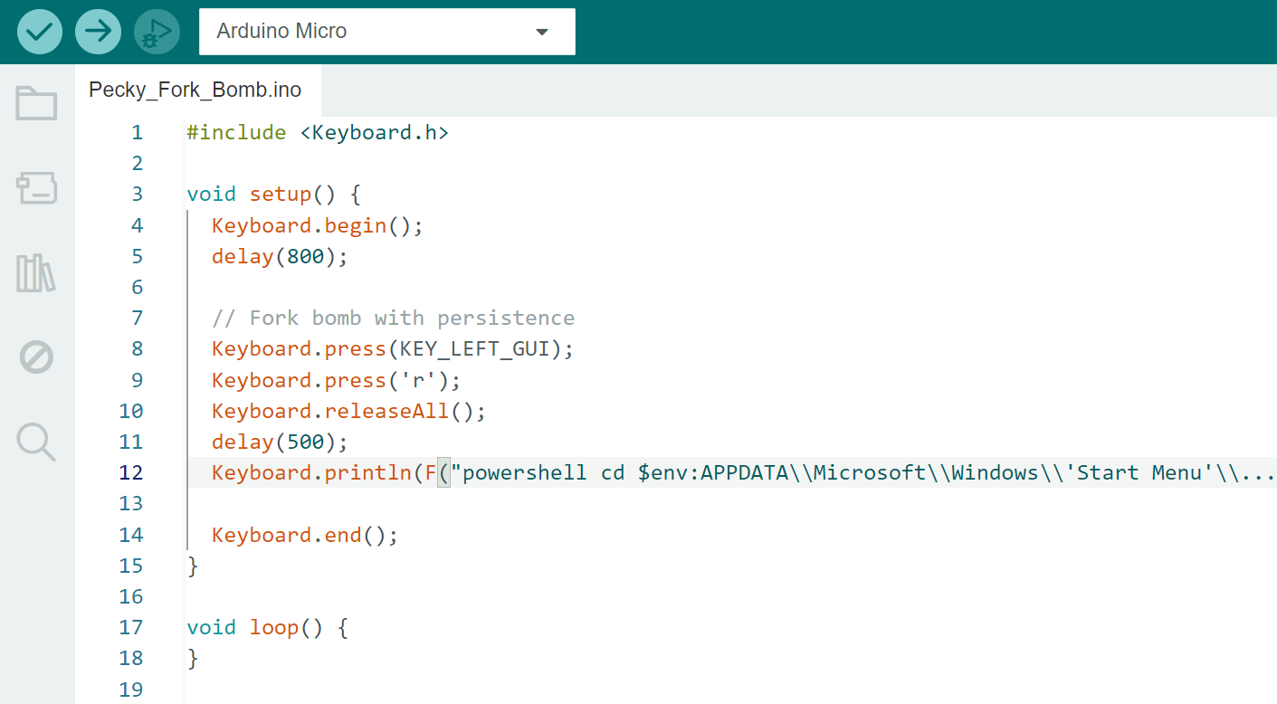

Slide 20
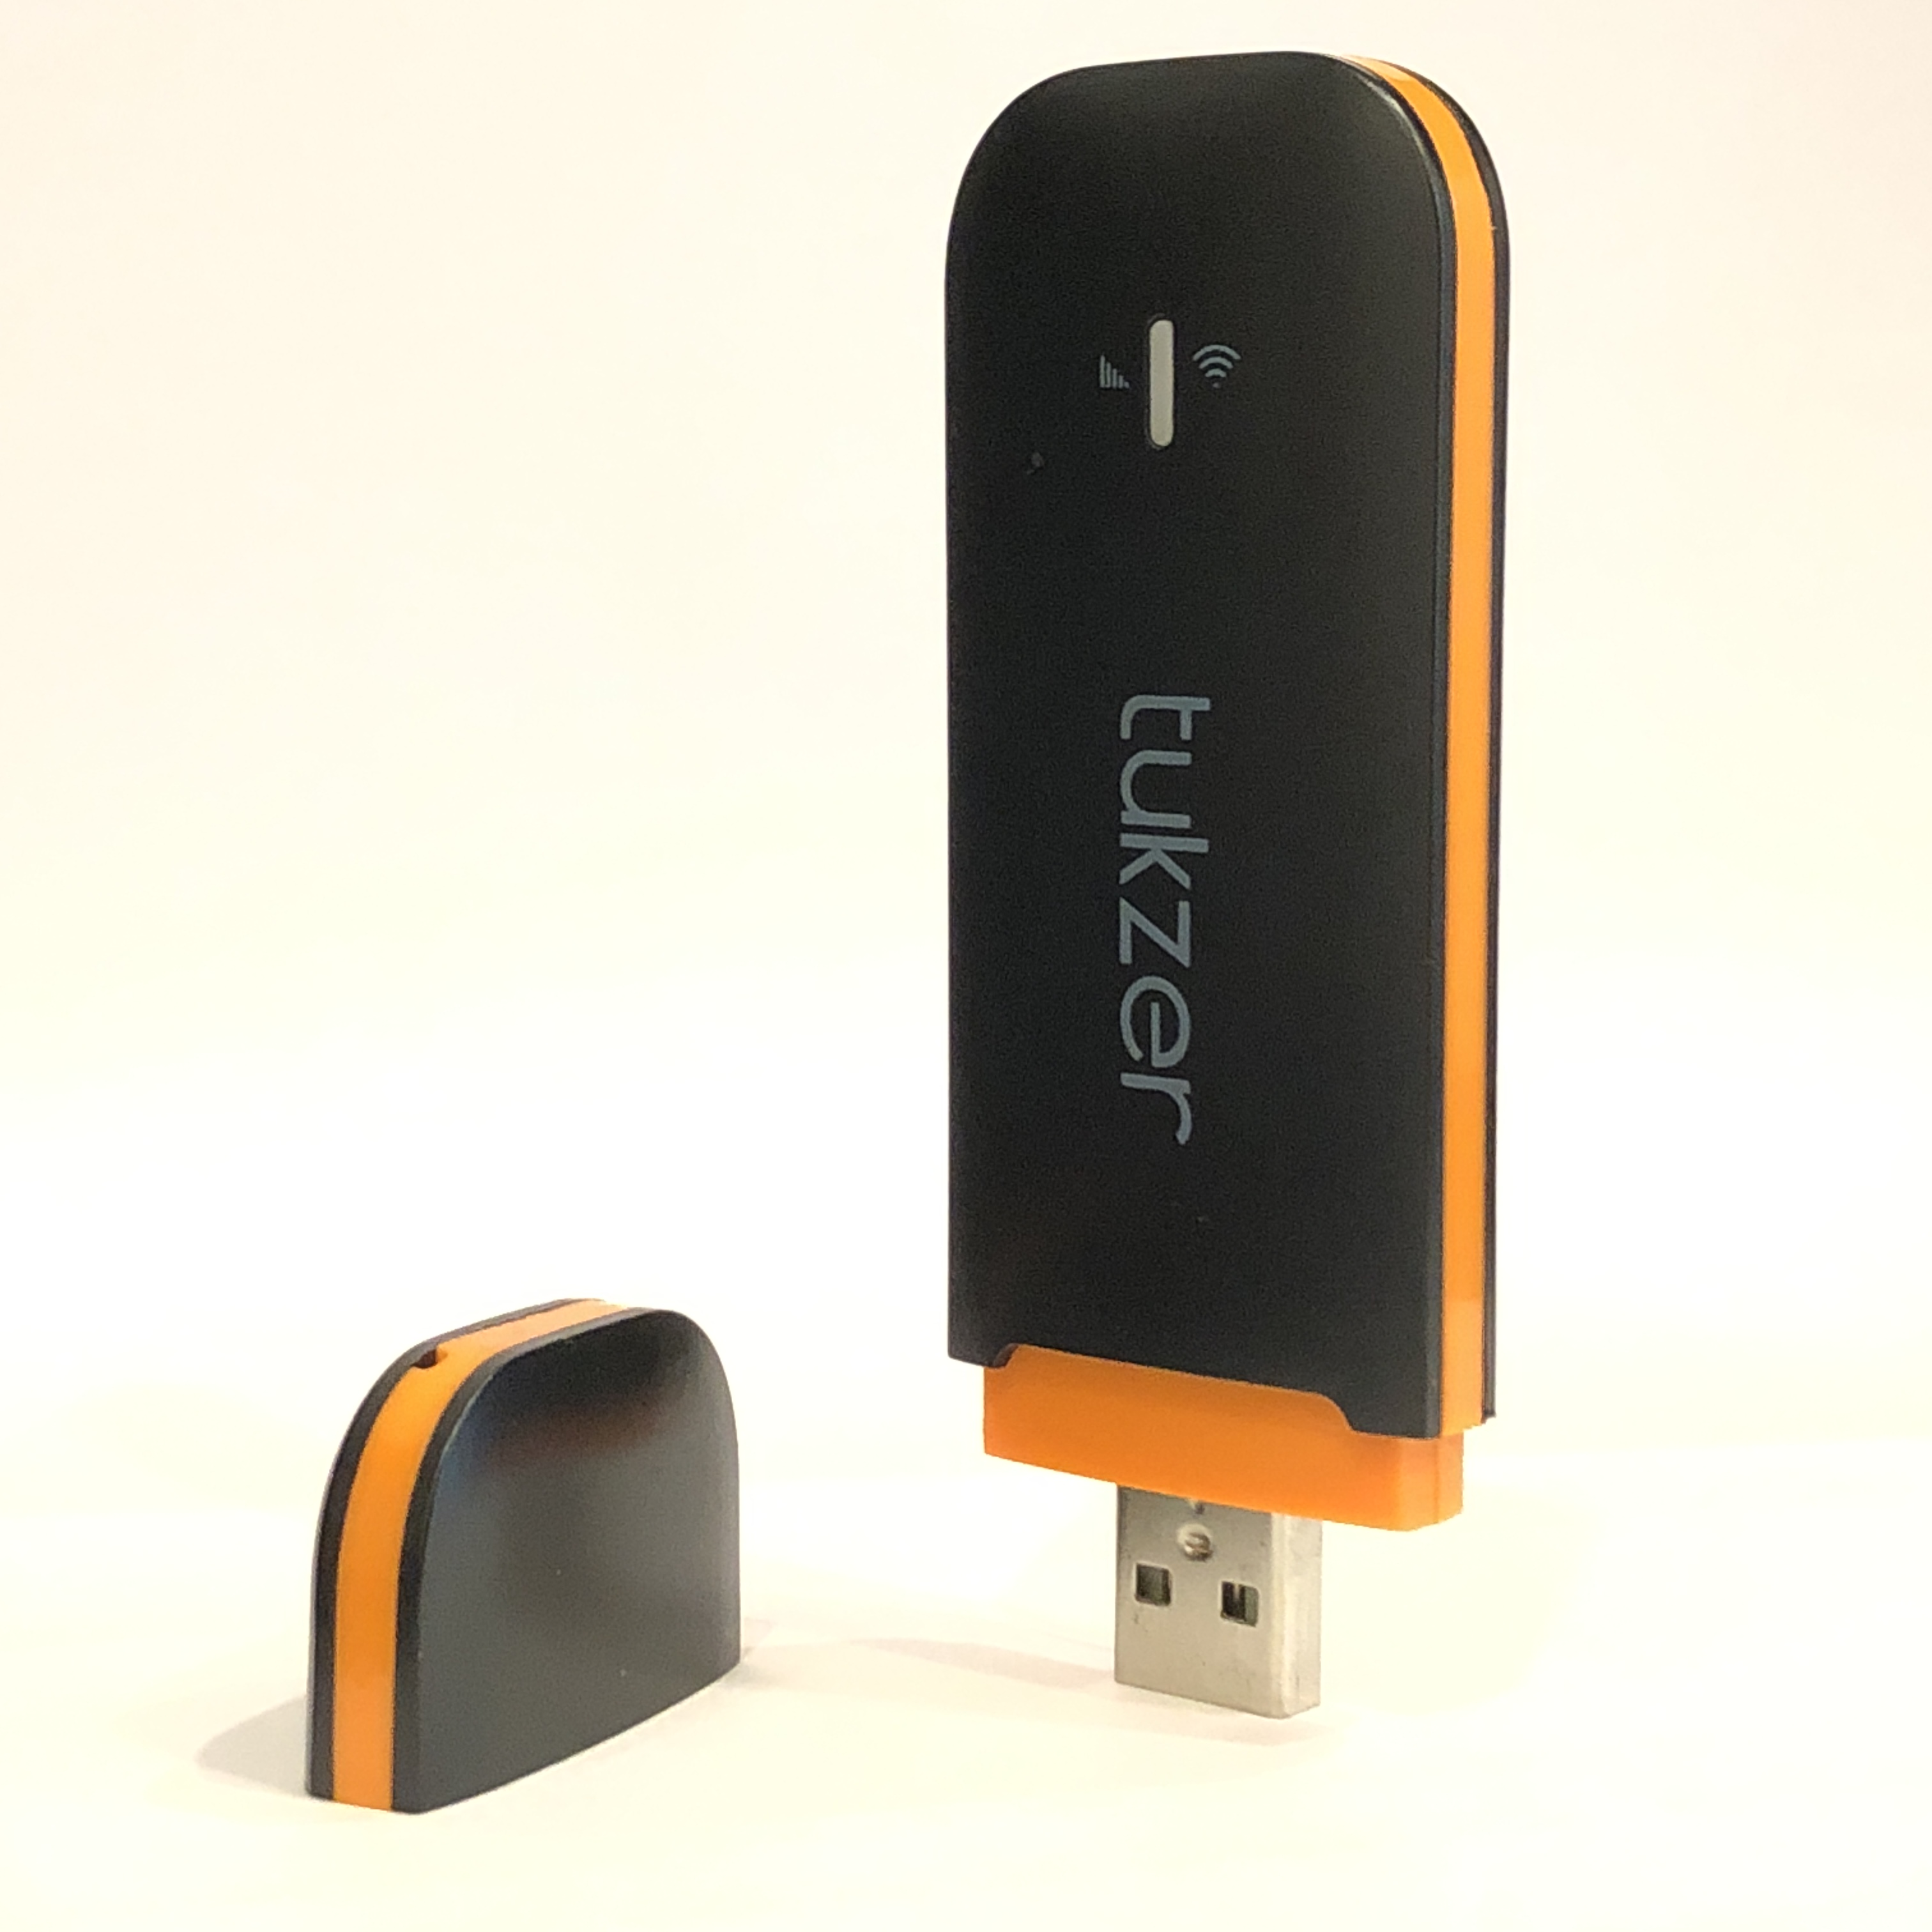
Results

Slide 21
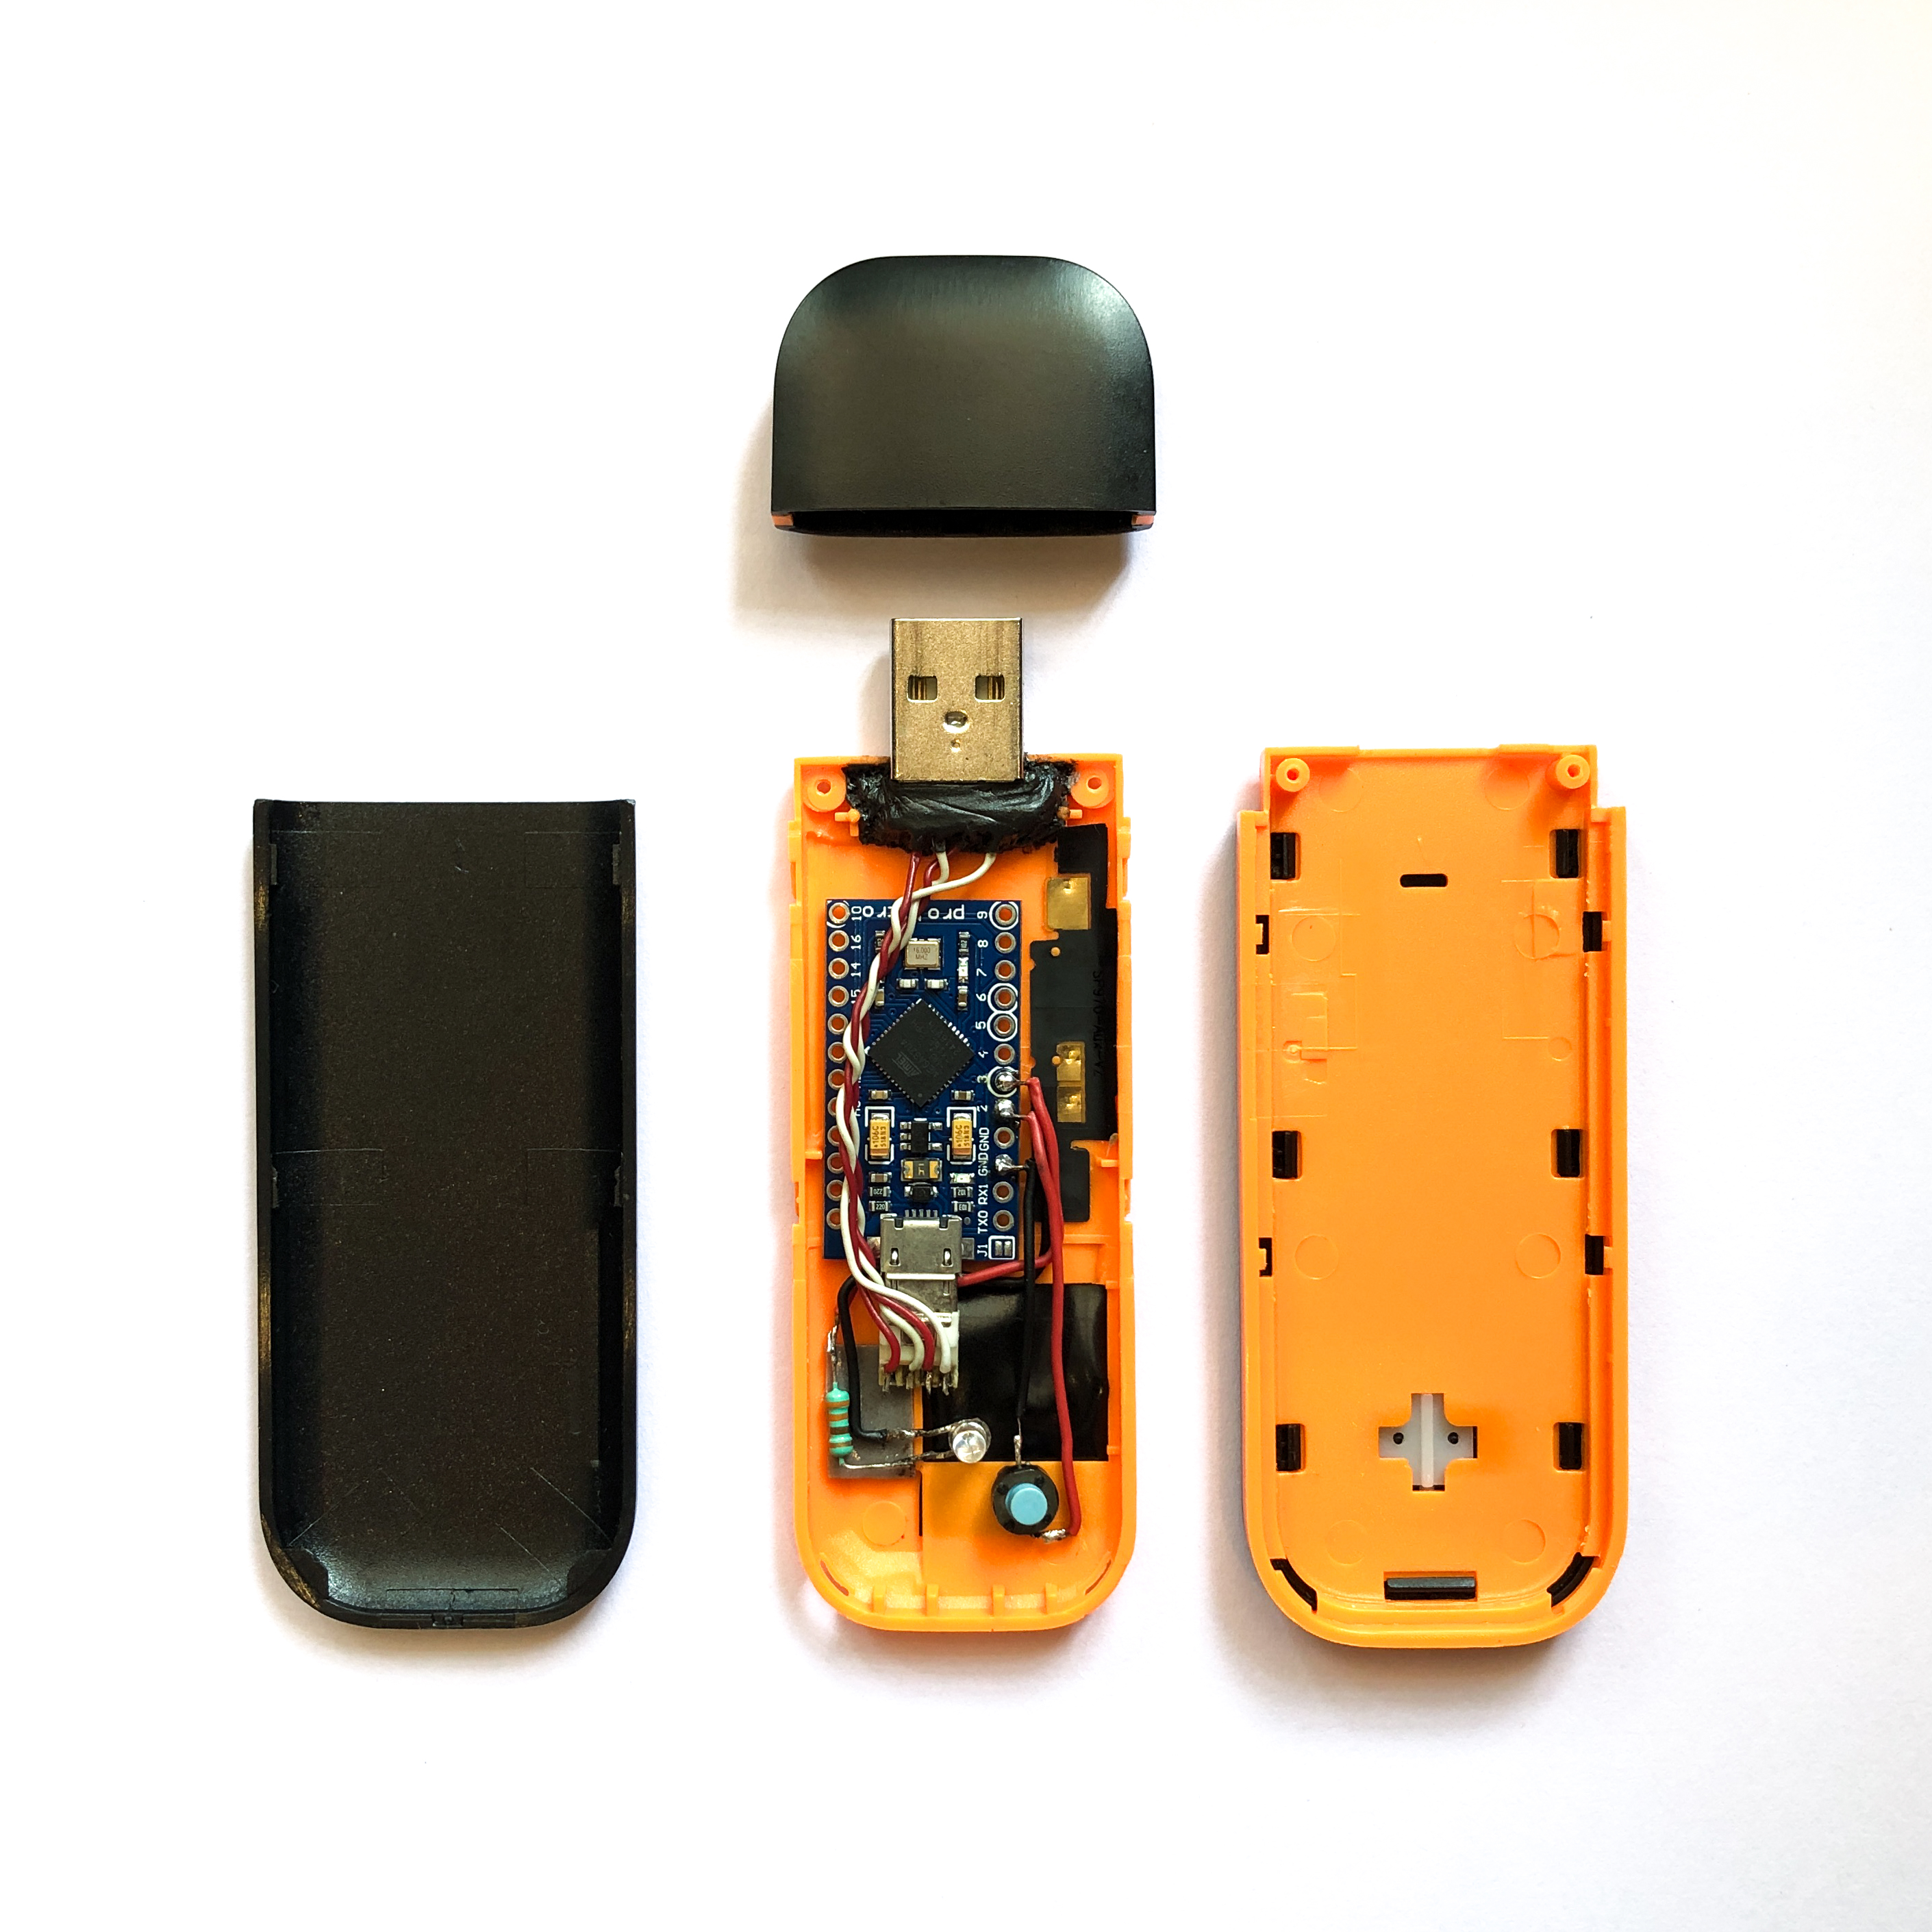
Results

Slide 22
What can you do with it?
Keystroke injection – that is what Pecky is good at.
In short, if you can do something using your keyboard, Pecky can do it as well at much faster speeds.
All you need is a few seconds of physical access to an unattended system.
This makes Pecky a great tool for pentesting, ethical hacking and automating repetitive IT tasks.

Slide 23
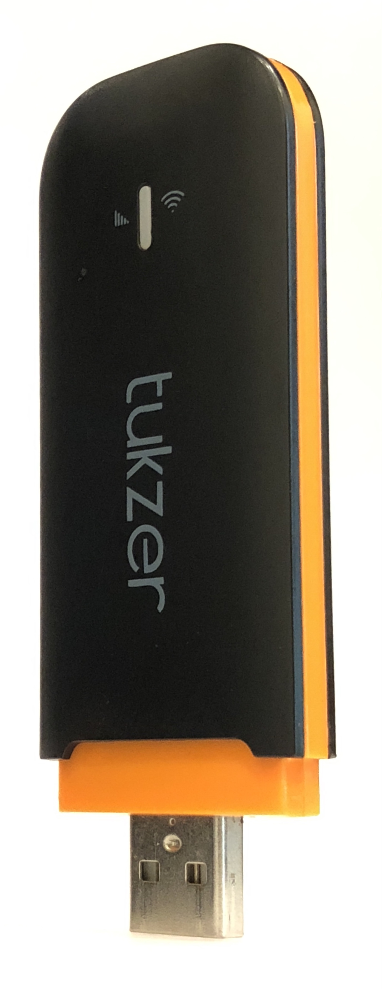
Advantages
Some of the key advantages of our project are:
Low cost
Easy to build
High customizability
Highly available parts
Based on Open Source hardware and software

Slide 24
Future Enhancements
Additional features that would enhance the project:
Ultra compact design
Wireless control option
Additional port options
External storage support
Keyboard light based exfiltration technique

Slide 25
Conclusion
We have successfully made a device capable of performing customizable BadUSB attacks capable of exploiting the well known yet mostly unpatchable vulnerability with USB HID devices.
We were able to do it at a very low cost, using parts that are easily available and with a well supported platform for hardware development. Our device is easily customizable to suit all kinds of pentesting needs.

Slide 26
References
Arduino Pro Micro. (2019). Arduino Pro Micro Specifications and Documentation. Retrieved from
https://www.arduino.cc/en/Guide/ArduinoProMicro
Arduino Reference: Keyboard Library. (2021). Retrieved from
https://www.arduino.cc/reference/en/language/functions/usb/keyboard/
Wahanani, H., Idhom, M., & Kurniawan, D. R. (2020). Exploit Remote Attack Test in Operating
System Using Arduino Micro. Journal of Physics: Conference Series, 1569, 022038.
https://doi.org/10.1088/1742-6596/1569/2/022038

Slide 27
References
Wahab H and Zain J M 2018 Windows Privilege Escalation Through Network Backdoor And Information Mining Using USB Hacktool. Malaysian Journal of Computing.
Bang and J E A 2010 Secure USB bypassing tool Digital Investigation 7, S114 – S120.
Cannols B and Ghafarian A 2017 Hacking Experiment by Using USB Rubber Ducky Scripting vol
15 (Systemics, Cybernetics and Informatics) pp 66-71
Sparkfun - Pro Micro & Fio V3 Hookup Guide
https://learn.sparkfun.com/tutorials/pro-micro--fio-v3-hookup-guide/all

Slide 28
Questions, anyone?

Slide 29
Thank you
and happy hacking!

