Slide 1
AICOE · ITSV
One front door for AI models
Models-as-a-Service on OpenShift AI 3.4.3 – our path, architecture and roadmap
Alexander Zeiss · Head of AI Center of Excellence, ITSV
Notes:
0:30 · OPENING
STORY: How every application gets one governed way to our models.
WORDS: regulated environment · social insurance · on-prem · nothing leaves the house · Models-as-a-Service
BRIDGE → "First: how we got here."

Slide 2
PLATFORM · DECISION
Our path to MaaS
From tool evaluation to OpenShift AI only
1
Evaluate
2
Plan
3
Rethink
4
Decide
LiteLLM, Bifrost, Portkey, Envoy AI Gateway, OpenShift AI MaaS
criteria: cost per customer / app, audit logging, SSO/RBAC, on-prem
phase 1 with LiteLLM as entry point
fast start: keys, budgets, routing
MaaS to follow later
a bridge costs an enterprise license
later migration of every consumer – new base URL, new keys
double governance while both run in parallel
gain: only a few weeks
OpenShift AI only – MaaS from day one
fully supported by Red Hat, configured via GitOps
one path, one set of rules for every consumer
We skipped the bridge: no migration, no double governance, no license.
Our path
2 / 6
Notes:
1:30 · OUR PATH · 4 clicks
STORY: We planned a bridge – and then decided we don't need one.
START (title only): "How did we get here?"
CLICK 1 – evaluate:
- LiteLLM · Bifrost · Portkey · Envoy AI Gateway · OpenShift AI MaaS
- criteria: cost allocation per customer and application · audit logging · SSO/RBAC · on-prem
CLICK 2 – plan:
- LiteLLM as entry point in phase 1 – fast start · MaaS later
CLICK 3 – rethink: what does the bridge cost?
- enterprise license for a temporary solution
- migrate every consumer later – new base URL, new keys
- double governance while both run in parallel
- gain: only a few weeks
CLICK 4 – decide (+ punchline):
- OpenShift AI only, MaaS from day one · fully supported · GitOps
- if asked (not on slide) – trade-off: no model-to-model fallback, no alias layer → served-model-name convention, retry in the app
BRIDGE → "So what does that look like?"

Slide 3
PLATFORM · MAAS
Phase 1 architecture: one gateway, all internal
OpenShift AI 3.4.3 · solid: model calls · dashed: MCP tool calls · dotted: OTel spans
Consumers
MaaS gateway
Serving
Traceability ← OTel spans
Business apps
ServiceAccount
Istio gateway + Kuadrant
authN, authZ, rate limits
llm-d scheduler
KV-cache-aware routing
OTel Collector
redaction · retention
Chat UI
groups from the IdP
Subscriptions per customer / app
token limits · API keys
MLflow
prompt/response traces
vLLM models
multiple replicas
Developer tools
own subscription
NeMo Guardrails
harmful content · jailbreak · PII
models only via gateway
Prometheus
usage per customer / app
Agents
MCP clients
MCP sandbox · TP · isolated namespace, no production data
MCP gateway (TP)
federation · tool filter by identity · token exchange
MCP test servers
no production data
MCP Lifecycle Operator
catalog · deploys servers
One entry point for all internal models: identity, quotas, guardrails – MCP tested in a sandbox first.
MaaS architecture
3 / 6
Notes:
2:00 · ARCHITECTURE · 5 clicks
STORY: One front door for every model call.
START (consumers only): who calls models? business apps · chat UI · developer tools · agents
CLICK 1 – gateway:
- single entry point · front door
- identity, not shared keys · service account · IdP groups
- subscription per customer or application · token quota · rate limit
CLICK 2 – serving:
- llm-d: KV-cache-aware routing, in front of vLLM
- network policy: models only reachable via the gateway – no way around it
CLICK 3 – guardrails:
- NeMo Guardrails · harmful content · jailbreak · PII
- FMS orchestrator is being deprecated → NeMo from day one
CLICK 4 – MCP:
- dashed = tool calls · MCP gateway: federation · tool filtering by identity · token exchange
- still Tech Preview → isolated namespace, test data
CLICK 5 – traceability:
- dotted = OTel spans · app-side logging for now, via OTel Collector → MLflow
- later only the source changes · Prometheus: usage per customer / app
BRIDGE → "Sounds simple. The catch is maturity."

Slide 4
PLATFORM · MATURITY
Maturity decides what goes into production
GA vs. Technology Preview in OpenShift AI 3.4.3
Capability · OpenShift / OpenShift AI | Status | How we handle it
MaaS: subscriptions, token limits, API keys | GA | phase 1, production
LLMInferenceService with llm-d | GA | default path (vLLM-only is TP)
vLLM serving runtime | GA | runtime for all internal models
NeMo Guardrails | GA | content safety from day one
Cluster IdP and groups | GA | identity for subscriptions
Prometheus user workload monitoring | GA | usage per customer / app
OpenShift GitOps | GA | all config as custom resources
External OIDC at the gateway | TP | until GA: cluster IdP and groups
MCP gateway | TP | sandbox only, no production data
Seven of nine are GA – the production path uses only those.
Production runs on GA – Tech Preview stays the documented exception.
Maturity
4 / 6
Notes:
1:30 · MATURITY
STORY: Production runs on GA – Tech Preview stays the exception, with a plan.
WORDS:
- seven of nine building blocks are GA – that's the production path
- MaaS · llm-d · vLLM · NeMo · cluster IdP · Prometheus · GitOps – all supported
- vLLM itself: GA · vLLM in MaaS without llm-d: Tech Preview → llm-d is our default path
- two TP examples, two patterns:
· external OIDC → workaround: cluster IdP and groups, until GA
· MCP gateway → sandbox only, no production data
- workaround · expiry date · GA date drives the roadmap, not the calendar
BRIDGE → "And what comes after phase 1?"

Slide 5
PLATFORM · ROADMAP
Two phases, paced by GA dates
Phase 1 is deliberately narrow – phase 2 follows Red Hat GA dates
Phase 1 · Foundation
Phase 2 · Opening up and agents
MaaS in production, configuration via GitOps
identity via cluster IdP and groups
NeMo Guardrails, OTel logging to MLflow
NetworkPolicy, admission policy for signed images
MCP sandbox in an isolated namespace
external providers with egress proxy and PII masking
MCP gateway: tool filtering by identity, token exchange
external OIDC and showback once GA
classical ML models (e.g. LAYA) via KServe / OIP v2
logging source moves from client to gateway
Phase 1 exit criteria
two apps in production · usage per customer / app · no TP in production
Phase 2 trigger
committed Red Hat GA dates for OIDC, showback, providers, MCP
GA dates set the pace – not the calendar.
Roadmap
5 / 6
Notes:
1:30 · ROADMAP
STORY: Phase 1 is deliberately narrow – phase 2 starts when Red Hat commits GA dates.
WORDS:
- phase 1: internal models only · GA only · GitOps · guardrails · OTel logging · MCP sandbox
- exit criteria: two apps live · usage per customer / app · no TP in production
- phase 2 trigger: committed Red Hat GA dates
- phase 2: external providers with PII masking · MCP gateway in production · external OIDC + showback · classical ML (e.g. LAYA) via KServe / Open Inference Protocol v2 · logging moves to the gateway
BRIDGE → "Let me pull this together."

Slide 6
SUMMARY
Three takeaways
Skip the bridge
A temporary gateway costs a migration, double governance and a license – MaaS from day one, one path, fully supported.
1
One front door
Identity, quotas and guardrails in one place · MCP tested in a sandbox first · traceability via OTel, independent of the source.
2
GA first
Production runs on GA. Tech Preview gets a workaround with an expiry date – GA dates drive the roadmap.
3
Questions?
Summary
6 / 6
Notes:
0:30 · TAKEAWAYS
WORDS: skip the bridge · one front door · GA first
→ questions

Slide 7
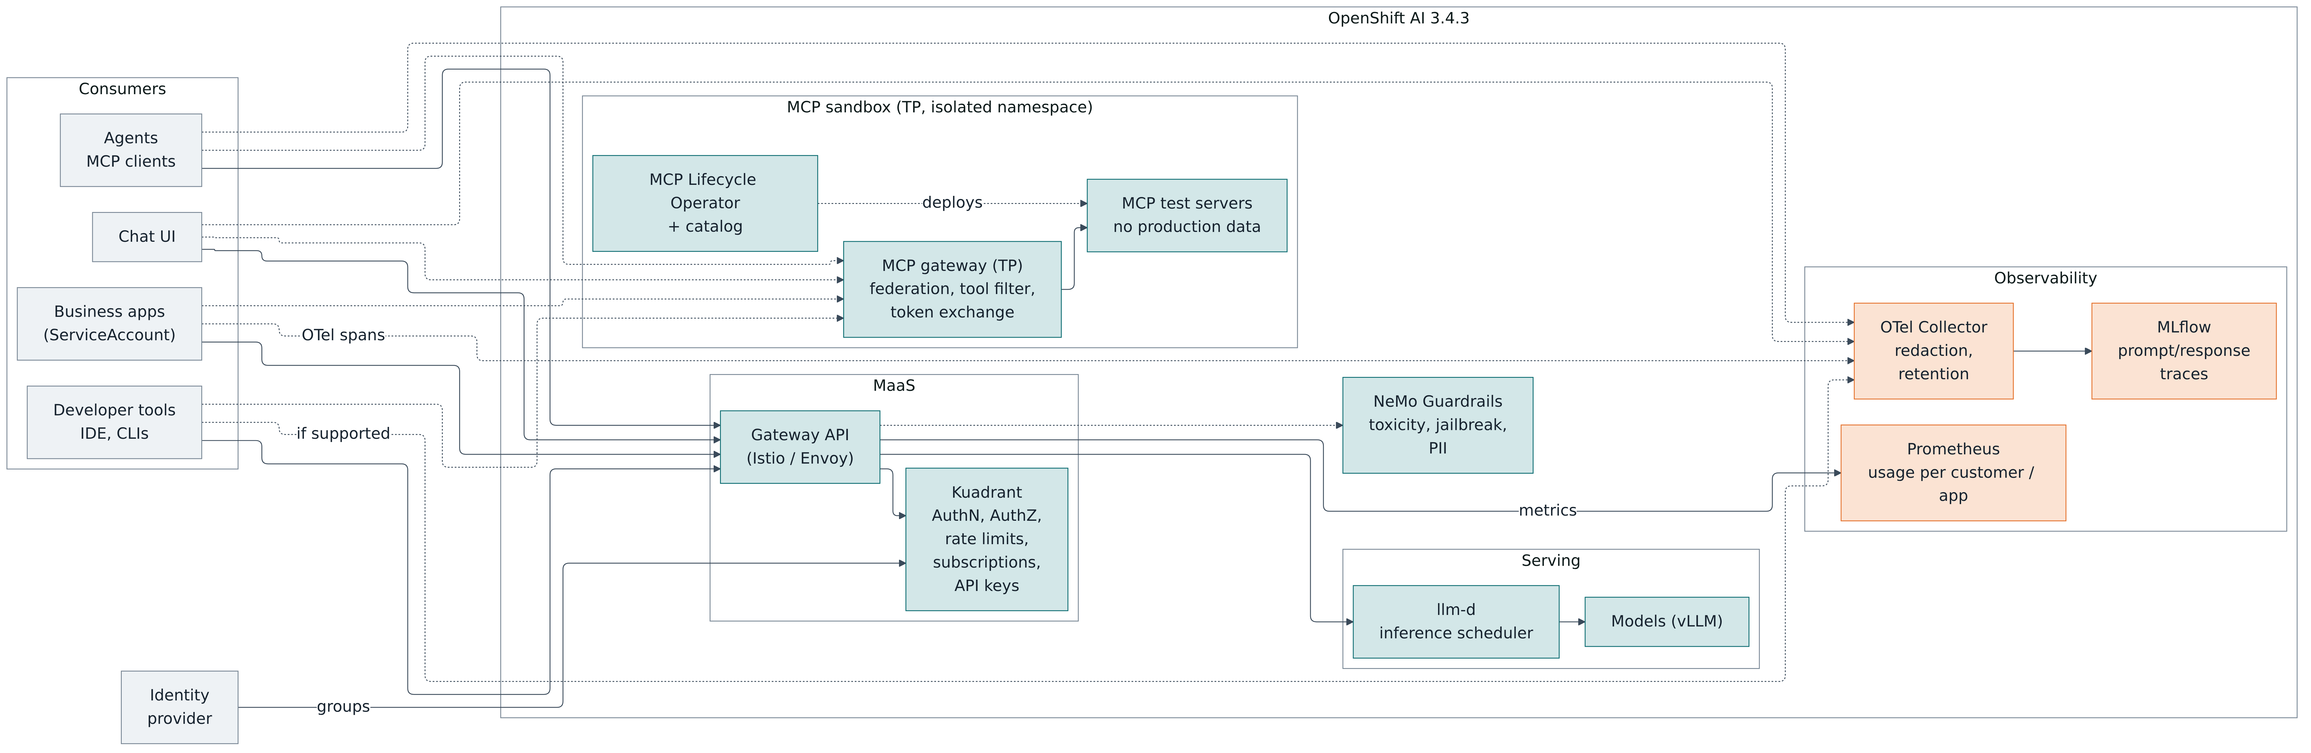
BACKUP · ARCHITECTURE
Phase 1 architecture in detail
Mermaid view from the design documentation
Solid: request path · dotted: telemetry and guardrail calls · orange: observability
Backup
Backup
Notes:
BACKUP · MERMAID VIEW
WORDS: same picture, more detail · point at the three line types · IdP groups → Kuadrant · metrics → Prometheus

