Slide 1

6 (or so) New Features of .NET 6
Joe Guadagno
Director, Technology @ Rocket Mortgage

Slide 2
About Joe Guadagno
@jguadagno
JosephGuadagnoNet
JosephGuadagno
jjg.me/aboutJJG
jjg.me/streaM

Slide 3
Agenda
C# 10
ASP.NET Changes
Maui
Windows Forms Improvements
Performance Improvements
New APIs
Others

Slide 4
Unified Platform

Slide 5
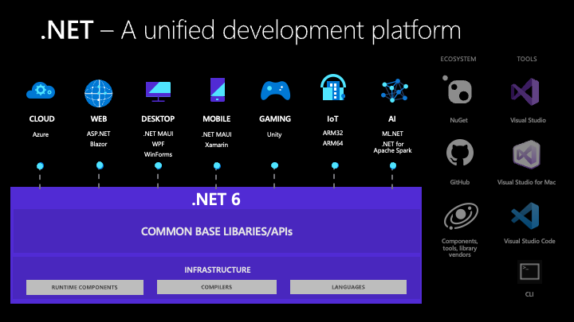
Unified Platform
Notes:
.NET 6 delivers a unified platform, for browser, cloud, desktop, IoT, and mobile apps. The underlying platform has been updated to serve the needs of all app types and to make it easy to re-use code across all your apps. New capabilities and improvements are available to all apps at the same time, so that your code running in the cloud or on a mobile device behaves the same way and has the same benefits.

Slide 6
Targeting .NET 6
<TargetFramework>net6.0</TargetFramework>
Notes:
When you target a framework in an app or library, you're specifying the set of APIs that you'd like to make available to the app or library. You specify the target framework in your project file using a target framework moniker (TFM).
An app or library can also target a specific .NET implementation to gain access to implementation-specific APIs. For example, an app that targets Xamarin.iOS (for example, Xamarin.iOS10) has access to Xamarin-provided iOS API wrappers for iOS 10, or an app that targets Universal Windows Platform (UWP, uap10.0) has access to APIs that compile for devices that run Windows 10.

Slide 7
Other Monikers
net6.0-android
net6.0-ios
net6.0-maccatalyst
net6.0-tvos
net6.0-windows
Notes:
The version-less TFMs are each equivalent to targeting the lowest supported operating system version by .NET 6. You can specify an operating system version if you want to be specific or to get access to newer APIs.
The net6.0 and net6.0-windows TFMs are supported (same as .NET 5). The Android and Apple TFMs are new with .NET 6 and currently in preview. They will be supported with a later .NET 6 update.
There are no compatibility relationships between the OS-specific TFMs. For example, net6.0-ios is not compatible with net6.0-tvos. If you want to share code, you need to do that with source with #if statements or binaries with net6.0 targeted code.

Slide 8
C# 10
Language Improvements

Slide 9

Global Usings in Code
Notes:
using directives simplify how you work with namespaces. C# 10 includes a new global using directive and implicit usings to reduce the number of usings you need to specify at the top of each file.
If the keyword global appears prior to a using directive, that using applies to the entire project:
There is no standard or requirement for where these global statements reside. Most are using globalusings.cs or global.cs

Slide 10
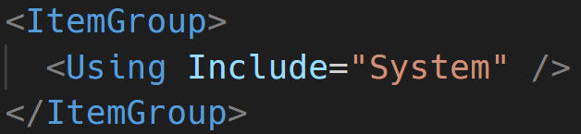
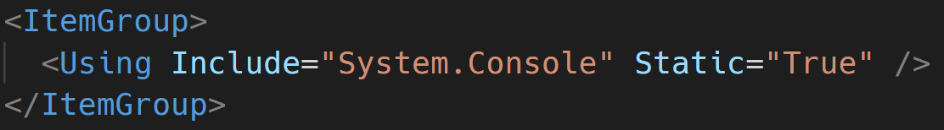
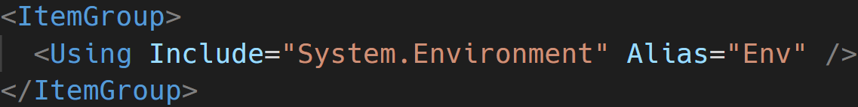
Global Usings in csproj

Slide 11
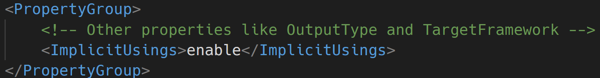
Implicit Usings
Notes:
The Implicit usings feature automatically adds common global using directives for the type of project you are building. To enable implicit usings set the ImplicitUsings property in your .csproj file:
Implicit usings are enabled in the new .NET 6 templates. Read more about the changes to the .NET 6 templates at this blog post.
The specific set of global using directives included depend on the type of application you are building. For example, implicit usings for a console application or a class library are different than those for an ASP.NET application.

Slide 12
Implicit Usings – Project Types
Microsoft.NET.Sdk
Microsoft.NET.Sdk.Web
Microsoft.NET.Sdk.Worker
Microsoft.NET.Sdk.WindowsDesktop (Windows Forms)
Microsoft.NET.Sdk.WindowsDesktop (WPF)
Notes:
Look in obj folder

Slide 13
Implicit Usings – Microsoft.NET.Sdk
System System.Collections.Generic System.IO System.Linq System.Net.Http System.Threading System.Threading.Tasks
http://jjg.me/6_implicit

Slide 14
Implicit Usings – Microsoft.NET.Sdk.Web
System.Net.Http.Json Microsoft.AspNetCore.Builder Microsoft.AspNetCore.Hosting Microsoft.AspNetCore.Http Microsoft.AspNetCore.Routing Microsoft.Extensions.Configuration Microsoft.Extensions.DependencyInjection Microsoft.Extensions.Hosting Microsoft.Extensions.Logging
http://jjg.me/6_implicit

Slide 15
Implicit Usings – Microsoft.NET.Worker
Microsoft.Extensions.Configuration Microsoft.Extensions.DependencyInjection Microsoft.Extensions.Hosting Microsoft.Extensions.Logging
http://jjg.me/6_implicit

Slide 16
Implicit Usings – Microsoft.NET.WindowsDesktop
Windows Forms
Microsoft.NET.Sdk namespaces System.Drawing System.Windows.Forms
WPF
Microsoft.NET.Sdk namespaces Removed System.IO Removed System.Net.Http
http://jjg.me/6_implicit

Slide 17
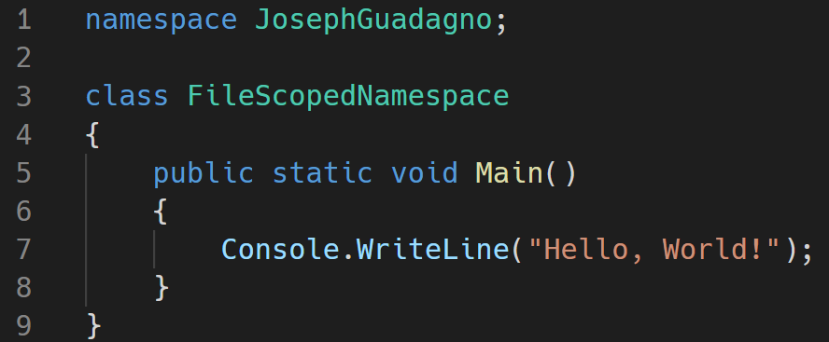
File Scoped Namespaces
Notes:
With this approach, everything you define in the current file belongs to the declared namespace. By removing a nesting level, you make the code a bit cleaner. However, you can't create nested namespaces with this new syntax.

Slide 18
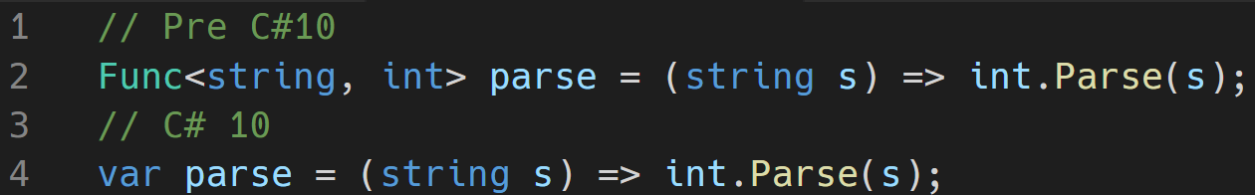
Lambda Improvements
Notes:
Microsoft made several improvements to both the types and the syntax around Lambda’s.
Lambda expressions now sometimes have a “natural” type. This means that the compiler can often infer the type of the lambda expression.
Up until now a lambda expression had to be converted to a delegate or an expression type. For most purposes you’d use one of the overloaded Func<...> or Action<...> delegate types in the BCL:
Natural Return Types
Pre C#10 (Line 2)
Lambda expressions now sometimes have a “natural” type. This means that the compiler can often infer the type of the lambda expression.
Up until now a lambda expression had to be converted to a delegate or an expression type. For most purposes you’d use one of the overloaded Func<...> or Action<...> delegate types in the BCL: Line 2
Starting with C# 10, however, if a lambda does not have such a “target type” we will try to compute one for you:
C#10 (Line 4)
You can hover over var parse in your favorite editor and see that the type is still Func<string, int>. In general, the compiler will use an available Func or Action delegate, if a suitable one exists. Otherwise, it will synthesize a delegate type (for example, when you have ref parameters or have a large number of parameters).

Slide 19
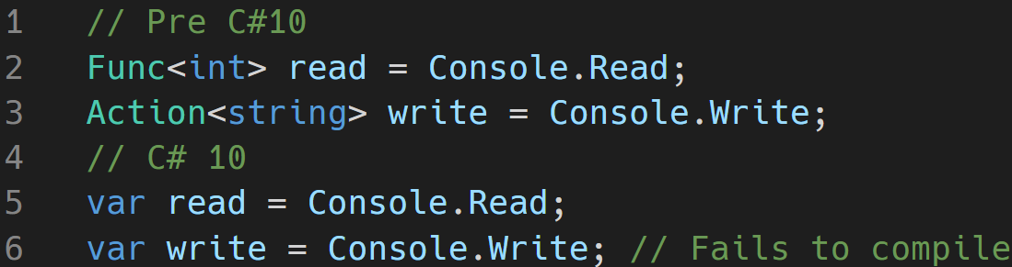
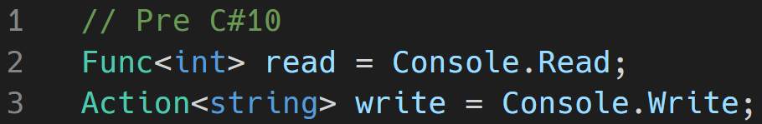
Lambda Improvements
Notes:
Natural Types for Methods
Method groups (that is, method names without argument lists) now also sometimes have a natural type. You have always been able to convert a method group to a compatible delegate type:
<CLICK>
Now, if the method group has just one overload it will have a natural type:

Slide 20
Other Improvements
Improvements to struct
Interpolated string improvements
More at:
https://jjg.me/6_c10
Notes:
Structs
Starting in C# 10, you can include your own parameterless struct constructors. If you don’t supply one, the implicit parameterless constructor will be supplied to set all fields to their default. Parameterless constructors you create in structs must be public and cannot be partial:
record structs similar to that of the record class
Interpolated String Improvements
Memory is handled better by not using String.Format for each item.
Const interpolated strings
String handlers to Overwrite how string processing is done

Slide 21
ASP.NET
What’s New!

Slide 22
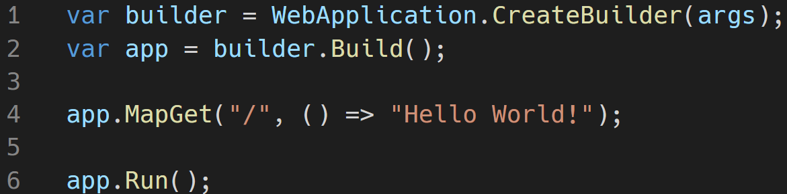
Minimal APIs
http://jjg.me/6_minapi
Notes:
Can remove line #2
Still have access to configuration, ports, environment, DI, and more
Intended for experience developers. Example use cases: file server, reading status updates
Can me mixed and matched with MVC

Slide 23
Other Improvements
SignalR Improvements
Razor Page Improvements
Hot Reload
HTTP/3 Support
Improved SPA
Web App Template Improvements
https://jjg.me/6_aspnetcore
Notes:
SignalR
SignalR uses the new Microsoft.AspNetCore.Http.Features.IHttpActivityFeature.Activity to add an http.long_running tag to the request activity. IHttpActivityFeature.Activity is used by APM services like Azure Monitor Application Insights to filter SignalR requests from creating long running request alerts.
Perf Improvements
Allocate HubCallerClients once per connection instead of every hub method call.
Avoid closure allocation in SignalR DefaultHubDispatcher.Invoke. State is passed to a local static function via parameters to avoid a closure allocation. For more information, see this GitHub pull request.
Allocate a single StreamItemMessage per stream instead of per stream item in server-to-client streaming. For more information, see this GitHub pull request.
Razor
Razor compiler uses source generators, no longer produces a separate views assembly
Hot Reload enables you to skip rebuilding and restarting your app to view a new change — while your app is running — supported in Visual Studio 2022 and from the .NET CLI, for C# and Visual Basic.
HTTP/3 has been added so that ASP.NET Core, HttpClient, and gRPC can all interact with HTTP/3 clients and servers.
Single-page apps built with ASP.NET Core now use a more flexible pattern that can be used with Angular, React, and other popular frontend JavaScript frameworks.
Web Templates Angular updated to v12

Slide 24
Windows Forms
Improvements

Slide 25
Accessibility Improvements
CheckedListBox
LinkedLabel
Panel
ScrollBar
TabControl
TrackBar
Notes:
In this release, Microsoft added UI Automation Provider (UIA providers) for CheckedListBox, LinkLabel, Panel, ScrollBar, TabControl and TrackBar that enable tools like Narrator, and test automation to interact with the elements of an application.
A Microsoft UI Automation provider is a software object that exposes an element of an application's UI so that accessibility client applications can retrieve information about the element and invoke its functionality. In general, each control or other distinct element in a UI has a provider.

Slide 26
Default Font

Slide 27
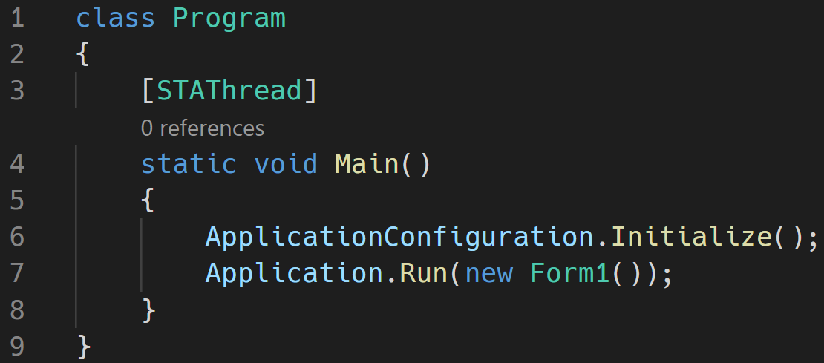
Minimal App
Notes:
As part of the .NET 6 release, most of the templates have been updated to make them more modern and minimal, including with Windows Forms. We decided to keep the Windows Forms template a bit more traditional, in part because of the need for the [STAThread] attribute to apply to the application entrypoint. However, there is more a play than immediately meets the eye.
ApplicationConfiguration.Initialize() is a source generated API that behind the scenes emits the following calls:
Application.EnableVisualStyles();
Application.SetCompatibleTextRenderingDefault(false);
Application.SetDefaultFont(new Font(...));
Application.SetHighDpiMode(HighDpiMode.SystemAware);

Slide 28
Other Window Forms Updates
Template Updates
More Runtime Designers
Single-File Apps
https://jjg.me/6_winforms
Notes:
Template updates
Windows Forms templates for C# have been updated to support the new application bootstrap, global using directives, file-scoped namespaces, and nullable reference types.
More runtime designers
Now you can build a general-purpose designer (for example, a report designer) since .NET 6 has all the missing pieces for designers and designer-related infrastructure. For more information, see this blog post.
Single-file Apps
In .NET 6, in-memory single file apps have been enabled for Windows and macOS. In .NET 5, this deployment type was limited to Linux. You can now publish a single-file binary that is both deployed and launched as a single file, for all supported OSes. Single files apps no longer extract any core runtime assemblies to temporary directories.

Slide 29
Performance Improvements

Slide 30
File IO Improvements
Method | Runtime | Mean | Ratio | Allocated
Write100MBAsync | .NET 5.0 | 1,308.2 ms | 1.00 | 3,809 KB
Write100MBAsync | .NET 6.0 | 306.8 ms | 0.24 | 3 KB
https://jjg.me/6_FileIO
Notes:
Changes made to File.IO include FileStream
On Windows, changes were made to FileStream.Seek and FileStream.Position which increased perf from 10-100%
On Unix,changes were made to SeekForward to now use lseek, which increased perf 25%
Reading jumped 3%
<CLICK>
Table
Writing out to 100mb file
On Windows with an SSD drive, they observed a 4x speedup and more than a 1200x allocation drop:

Slide 31
System.Text.Json Source Generators
Method | Mean | StdDev | Ratio
Serializer | 243.1 ns | 9.54 ns | 1.00
SrcGenSerializer | 149.3 ns | 1.91 ns | 0.62
Notes:
Microsoft added a source generator for System.Text.Json that avoids the need for reflection and code generation at runtime, and that enables generating optimal serialization code at build time. Serializers are typically written with very conservative techniques because they have to be. However, if you read your own serialization source code (that uses a serializer), you can see what the obvious choices should be that can make a serializer a lot more optimal in your specific case. That’s exactly what this new source generator does.
In addition to increasing performance and reducing memory, the source generator produces code that is optimal for assembly trimming. That can help with producing smaller apps.
<CLICK>
Serializing POCOs is a very common scenario. Using the new source generator, we observe that serialization is ~1.6x faster with our benchmark.

Slide 32
New APIs
Some JSON and Library APIs

Slide 33
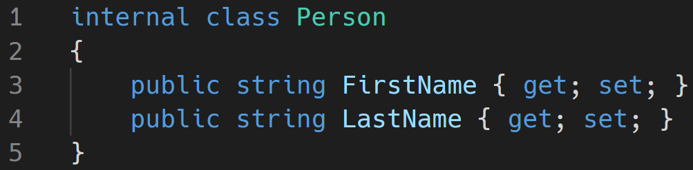
JSON APIs - Serialization
Notes:
In .NET 6.0, we are shipping a new C# source generator to help improve the performance of applications that use System.Text.Json.
With the introduction of the System.Text.Json source generator, we now have a few models for JSON serialization in .NET to choose from, using JsonSerializer. There is the existing model which is backed by runtime reflection, and two new compile-time source generation modes; where the generator generates optimized serialization logic, a static data access model, or both. In both source-generation scenarios, the generated artifacts are passed directly to JsonSerializer as a performance optimization.

Slide 34
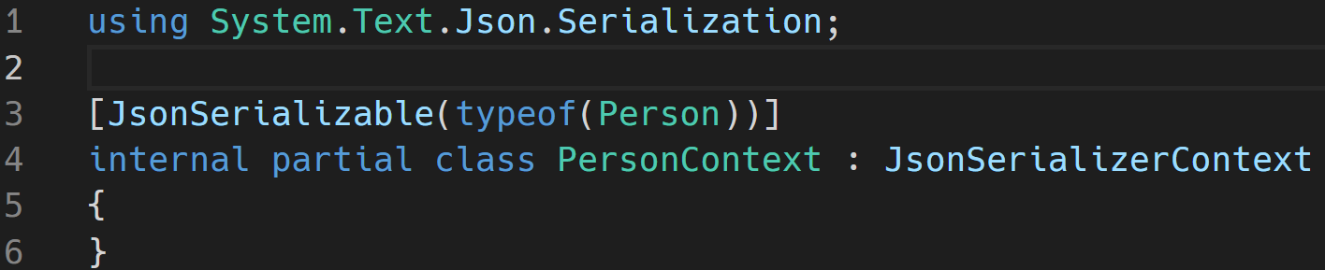
JSON APIs - Serialization
Notes:
We specify the source generator as follows

Slide 35
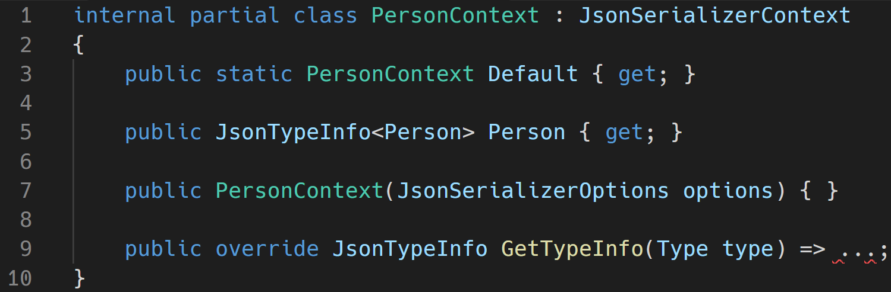
JSON APIs - Serialization
Notes:
As part of the build, the source generator will augment the MyJsonContext partial class with the following shape

Slide 36
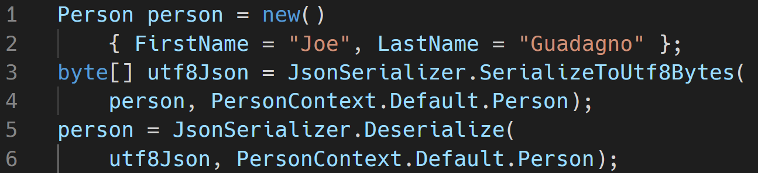
JSON APIs - Serialization
https://jjg.me/6_json
Notes:
The generated source code can be integrated into the compiling application by passing it directly to new overloads on JsonSerializer:
JsonSerializer is a tool that serializes .NET objects into JSON strings, and deserializes .NET objects from JSON strings. To process a type, the serializer needs information about how to access its members. When serializing, the serializer needs access to the object’s property and field getters. Similarly, when deserializing, the serializer needs access to a constructor to instantiate the type, and also to setters for the object’s properties and fields.
This is all done at compile time so not reflection is need which
Increased serialization throughput
Reduced start-up time
Reduced private memory usage
Removed runtime use of System.Reflection and System.Reflection.Emit
Trim-compatible serialization which reduces application size
While serializing this Person class with a Source Generator, there was around 1.6x performance increase

Slide 37
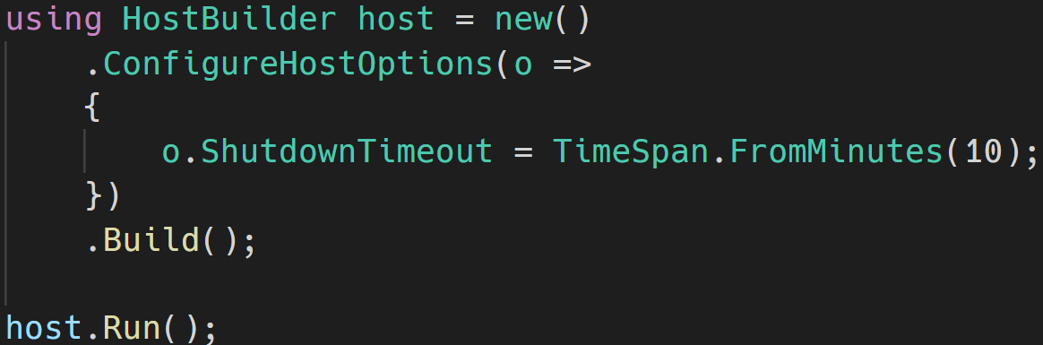
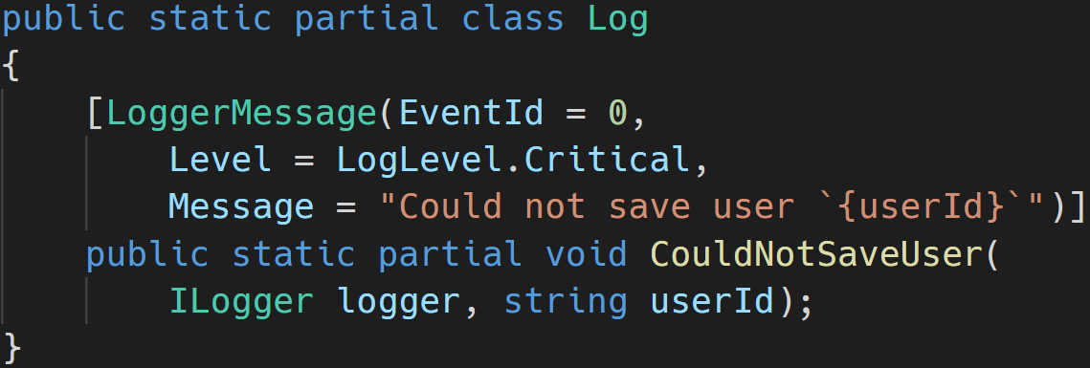
New APIs for the Web
WebSocket Compression (Community Contribution)
Socks Proxy Support (Community Contribution)
Microsoft.Extensions.Hosting - ConfigureHostOptions API
Microsoft.Extensions.Logging - compile time source generator
Notes:
Microsoft.Extensions.Hosting — ConfigureHostOptions API
We added a new ConfigureHostOptions API on IHostBuilder to make application setup simpler (for example, configuring the shutdown timeout):
.NET 6 introduces the LoggerMessageAttribute type. This attribute is part of the Microsoft.Extensions.Logging namespace, and when used, it source-generates performant logging APIs. The source-generation logging support is designed to deliver a highly usable and highly performant logging solution for modern .NET applications. The auto-generated source code relies on the ILogger interface in conjunction with LoggerMessage.Define functionality.
The source generator is triggered when the LoggerMessageAttribute is used on partial logging methods. When triggered, it is either able to autogenerate the implementation of the partial methods it’s decorating or produce compile-time diagnostics with hints about proper usage. The compile-time logging solution is typically considerably faster at runtime than existing logging approaches. It achieves this by eliminating boxing, temporary allocations, and copies to the maximum extent possible.

Slide 38
System.Linq
Enumerable support for Index and Range parameters
TryGetNonEnumeratedCount
DistinctBy/UnionBy/IntersectBy/ExceptBy
MaxBy/MinBy
Chunk (Community Contribution)
FirstOrDefault/LastOrDefault/SingleOrDefault (Community Contribution) overloads taking default parameters
Zip (Community Contribution)
PriorityQueue (Community Contribution)
Notes:
The Enumerable.ElementAt method now accepts indices from the end of the enumerable, as you can see in the following example.
The TryGetNonEnumeratedCount method attempts to obtain the count of the source enumerable without forcing an enumeration. This approach can be useful in scenarios where it is useful to preallocate buffers ahead of enumeration, as you can see in the following example.
DistinctBy.. MinBy New variants have been added to the set operations that allow specifying equality using key selector functions, as you can see in the following example.
Chunk can be used to chunk a source enumerable into slices of a fixed size
The Zip method now supports combining three enumerables
PriorityQueue<TElement, TPriority> (System.Collections.Generic) is a new collection that enables adding new items with a value and a priority. On dequeue the PriorityQueue returns the element with the lowest priority value. You can think of this new collection as similar to Queue<T> but that each enqueued element has a priority value that affects the behavior of dequeue.

Slide 39
Other Enhancements
CLI changes, and Roslyn Analyzers

Slide 40
CLI Changes – Optional Workloads
dotnet workload restore
dotnet workload install
dotnet workload list
dotnet workload update
Notes:
dotnet workload restore — installs the workloads required by a given project.
dotnet workload install — installs a named workload.
dotnet workload list — lists the workloads you have installed.
dotnet workload update — updates all installed workloads to the newest available version.

Slide 41
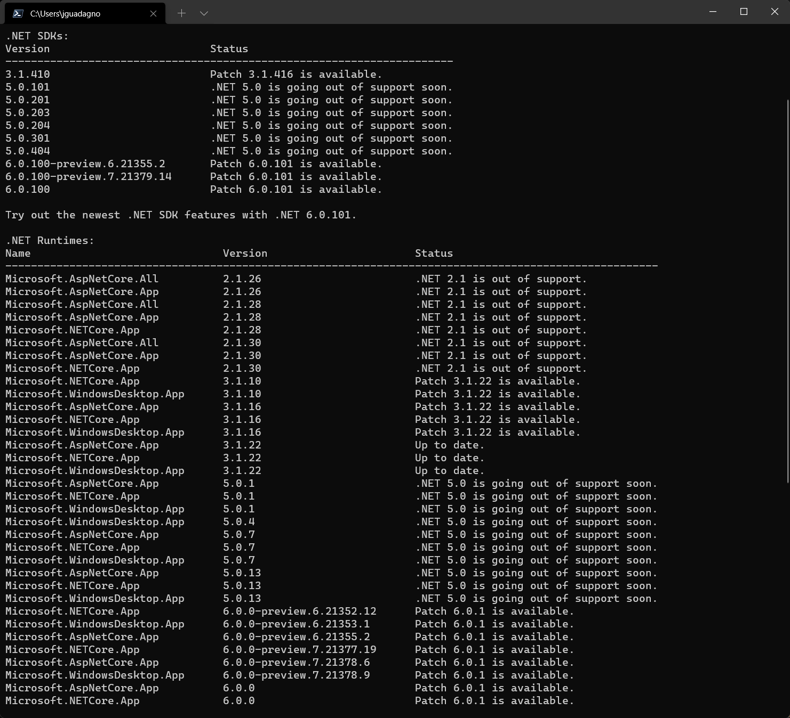
SDK Version Checking
dotnet sdk check
Notes:
dotnet new
You can now search NuGet.org for new templates with dotnet new --search.
Other improvements to template installation include support for the --interactive switch to support authorization credentials for private NuGet feeds.
Once CLI templates are installed, you can check if updates are available via --update-check and --update-apply.

Slide 42
Other CLI Changes
dotnet new
--search
--interactive
--update-check
--update-apply
Notes:
You can now search NuGet.org for new templates with dotnet new --search.
Other improvements to template installation include support for the --interactive switch to support authorization credentials for private NuGet feeds.
Once CLI templates are installed, you can check if updates are available via --update-check and --update-apply.

Slide 43
Roslyn Analyzers
16 Analyzers were added
6 were from the community
https://jjg.me/6_roslyn

Slide 44
.NET Support Policy
Release Lifecycle and Cadence

Slide 45
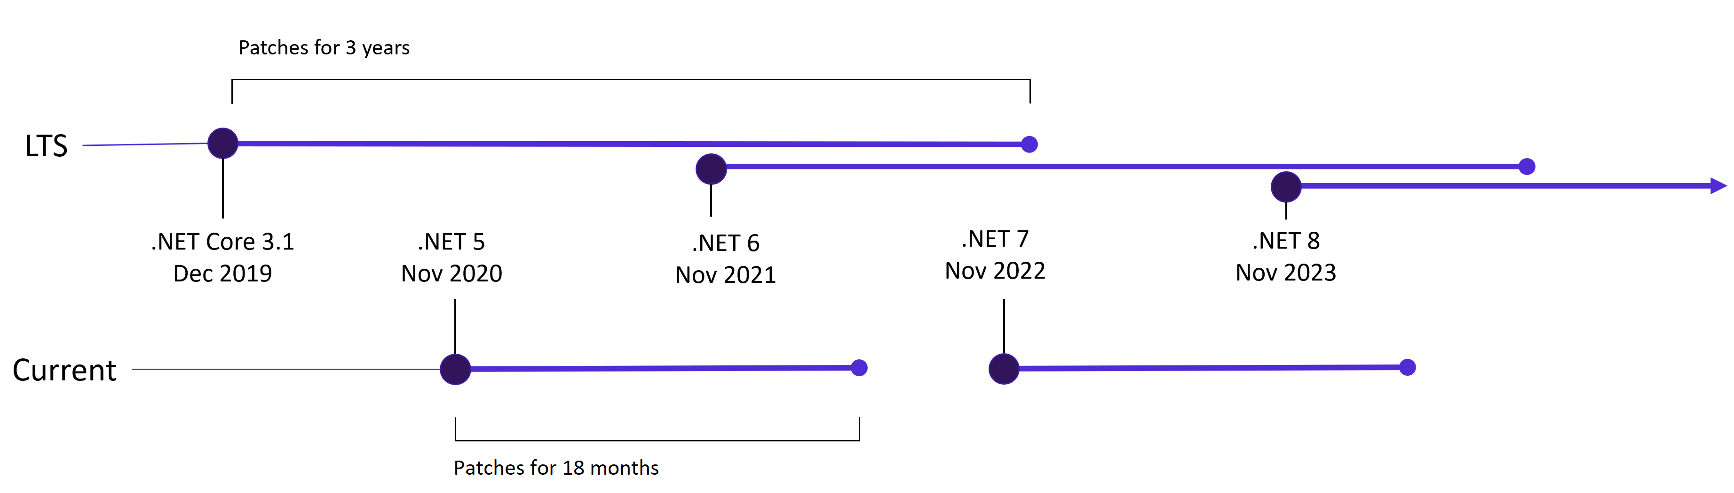
.NET Release Cadence
https://jjg.me/6_support

Slide 46
.NET and .NET Core Release Lifecycle
Version | Original Release Date | Latest Patch | Patch Release Date | Support Level | End of Support
.NET 6 | November 8, 2021 | 6.0.1 | December 14, 2021 | LTS | November 8, 2024
.NET 5 | November 10, 2020 | 5.0.13 | December 14, 2021 | Current | May 8, 2022
.NET Core 3.1 | December 3, 2019 | 3.1.22 | December 14, 2021 | LTS | December 3, 2022
https://jjg.me/6_support
Notes:
This means .NET Core 3.0 and earlier is out of support.

Slide 47

Q & A

Slide 48
About Joe Guadagno
@jguadagno
JosephGuadagnoNet
JosephGuadagno
jjg.me/aboutJJG
jjg.me/streaM

